Slide 1
University of Asia and the Pacific · BS Data Science · June 2026
Predicting Open-Market Residential Property Values in Metro Cebu
Using Machine Learning and Geospatial Features
Chris Dominic Estreba
BS Data Science Capstone

Slide 2
OUTLINE
2 / 78
Outline
The study follows the CRISP-DM arc, mapped to the thesis chapters.
▪ 1 · Introduction — the valuation problem in Metro Cebu
▪ 2 · Review of Related Literature — what is known, and the gap
▪ 3 · Methodology — data, geospatial features, modeling design
▪ 4 · Data Understanding — collection and exploratory analysis
▪ 5 · Data Preparation — cleaning, and preparing data for models
▪ 6 · Modeling — stratified models, selection, tuning
▪ 7 · Evaluation — accuracy, model comparison, ablation
▪ 8 · Results & Discussion — drivers and spatial structure
▪ 9 · Conclusions — answers, contributions, limits
▪ 10 · Recommendations — practice, policy, future work

Slide 3
01
Introduction
The valuation problem in Metro Cebu

Slide 4
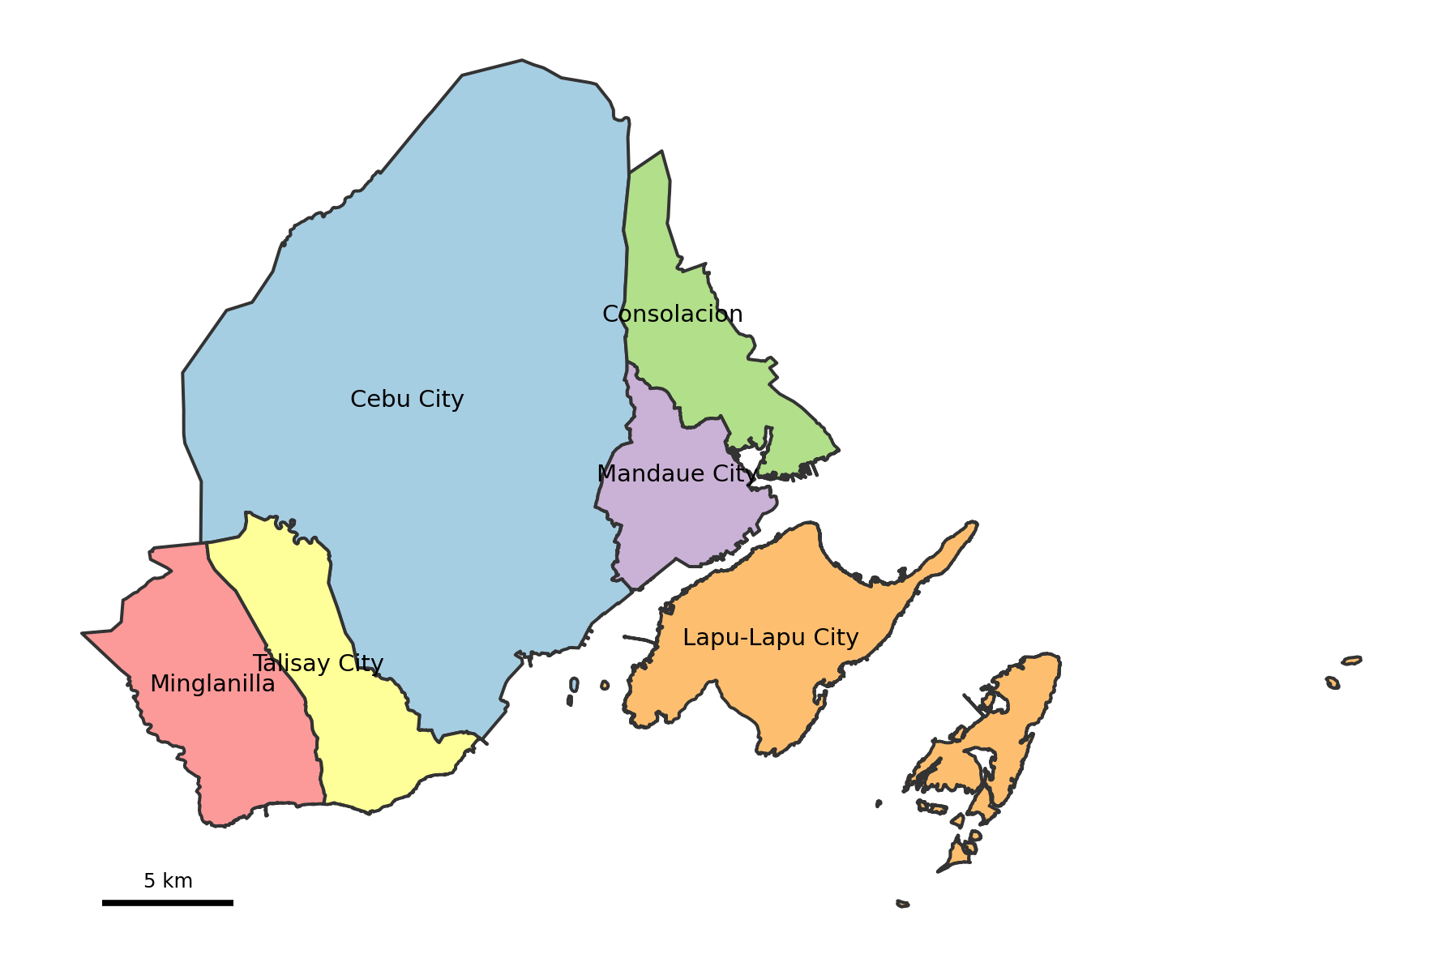
1 · INTRODUCTION
4 / 78
Where this study is set
▪ Metro Cebu is the country's second-largest urban region.
▪ This study focuses on its central core: six local government units — Cebu City, Mandaue, Lapu-Lapu, Talisay, Minglanilla, and Consolacion.
▪ Together they hold the most active transactions and the densest infrastructure.

Slide 5
1 · INTRODUCTION
5 / 78
A fast-growing economy
7.3%
Cebu economic growth in 2024 — among the fastest outside Metro Manila. (PSA Cebu, 2025)
▪ Growth is led by the IT-BPM sector and call-center expansion.
▪ Tourism has rebounded strongly since the pandemic.
▪ More jobs and higher incomes mean more demand for housing.

Slide 6
1 · INTRODUCTION
6 / 78
And a fast-rising housing market
11.5%
Metro Cebu residential price growth in 2025 — the highest rate outside the National Capital Region. (BSP, 2025)
▪ Major infrastructure (CBRT, Cebu–Cordova Expressway, SRP) is redrawing which barangays count as accessible.
▪ Two similar houses can now sit in very different market positions depending on access.
TAKEAWAY Prices are moving faster than the references people use to interpret them.

Slide 7
1 · INTRODUCTION
7 / 78
So how is a price decided in Cebu?
Imagine a family that finds a home, or an owner who wants to sell. Both ask the same question: what is this property actually worth?
▪ There is no single public source that answers it.
▪ Instead, price is pieced together from several partial references.
▪ Each reference is useful — but each was built to answer a different question.

Slide 8
1 · INTRODUCTION
8 / 78
Four partial references
Reference | Built for | What it misses
Broker & agent opinion | Local market knowledge | Not standardized or reproducible across people
Bank appraisals | Lending & collateral risk | Conservative; not the seller's market question
BIR zonal values | Taxation & assessment | Not live prices; often not updated (BIR, n.d.; Otsuka et al., 2023)
Online listings | Current, property-level | Asking prices — full of seller strategy and noise

Slide 9
1 · INTRODUCTION
9 / 78
Useful, but they don't line up
The references are not useless. The real problem is that they cannot be compared.
▪ They serve different purposes, follow different assumptions, and update at different speeds.
▪ A buyer cannot tell if an asking price is fair; a seller has no anchor; banks and LGUs work from drifting benchmarks.
▪ Metro Cebu has plenty of valuation activity — but no shared, spatially detailed reference layer.

Slide 10
1 · INTRODUCTION
10 / 78
The problem
Metro Cebu lacks a transparent, property-level, spatially detailed reference for interpreting residential price evidence.
TAKEAWAY This study builds that missing reference layer — a decision-support tool, not a replacement for professional appraisal .

Slide 11
1 · INTRODUCTION
11 / 78
Research questions
▪ RQ1 — What value drivers significantly influence residential prices in Metro Cebu?
▪ RQ2 — Among Hedonic Regression, Random Forest, and XGBoost, which is most suitable for deployment — balancing accuracy, small-sample robustness, and interpretability?
▪ RQ3 — Do geospatial features improve accuracy over a structural-only model, and how does that differ across property types?
▪ RQ4 — How large is the valuation gap between model estimates and BIR zonal values across Metro Cebu?

Slide 12
1 · INTRODUCTION
12 / 78
Significance and scope
Who benefits
Scope
▪ Brokers & appraisers — an inspectable extra evidence layer.
▪ Buyers, sellers, investors — a transparent reference for an asking price.
▪ Banks — market-facing spatial evidence.
▪ LGUs — where benchmarks drift from the market.
▪ Six LGUs; eight polycentric CBD nodes.
▪ Open-market segment only for the deployed model.
▪ A prototype web application for triangulation.
▪ Cross-sectional snapshot, late 2025.

Slide 13
02
Review of Related Literature
What is known, and the gap

Slide 14
2 · REVIEW OF RELATED LITERATURE
14 / 78
The core obstacle: data scarcity
International work consistently finds that data scarcity — not valuer misconduct — is the primary obstacle to accurate valuation in developing markets.
▪ Kenya — a census of 427 Nairobi valuers ranked “limited information” as the top valuation problem (Cheloti, 2021).
▪ Nigeria (Lagos) — of 300 valuers surveyed, 92.7% cited insufficient market evidence as the main challenge (Ajibola, 2010).
▪ This reframes the Metro Cebu problem: the fix is not better judgment but a better, shared evidence base.

Slide 15
2 · REVIEW OF RELATED LITERATURE
15 / 78
Two modeling traditions
Hedonic regression
Machine learning
▪ Interpretable; one explicit coefficient per attribute.
▪ The classic basis of property valuation (Rosen, 1974).
▪ Struggles with non-linear effects and correlated features.
▪ Captures non-linear, interacting effects (Breiman, 2001).
▪ Tree ensembles tend to win on tabular data (Grinsztajn et al., 2022).
▪ Regional precedent in Surabaya (Tanamal et al., 2023), with small-sample caution.

Slide 16
2 · REVIEW OF RELATED LITERATURE
16 / 78
Location is the dominant driver
▪ Four feature families recur: structural, economic / benchmark, geospatial / accessibility, amenity / point-of-interest.
▪ Agosto (2020) is the only Cebu-specific study — it finds transport accessibility the primary driver of land value, followed by neighborhood quality.
▪ Accessibility is formalized through gravity indexing (Hansen, 1959); raw distances alone are too fragmented to stand on their own (Rey-Blanco, 2024).
▪ Philippine ML work is mostly Manila- or Pangasinan-centric (Viray, 2023; Ramolete et al., 2023).

Slide 17
2 · REVIEW OF RELATED LITERATURE
17 / 78
Why model property types separately?
The decision to build separate models per property type is grounded in direct empirical evidence:
▪ Dröes, Hoesli & Bourassa (2019) — modeling housing submarkets separately rather than pooling them lifted explanatory power substantially (R² from 0.637 to 0.782).
▪ Usman, Lizam & Adekunle (2020), Malaysia — segmenting the market before fitting improved model fit by about 7% and cut prediction error by over 10%.
▪ The intuition: different property types are priced by different logic, so one pooled equation averages those logics into a worse fit for all of them.

Slide 18
2 · REVIEW OF RELATED LITERATURE
18 / 78
The research gap — and the bridge
The gap
This study
No published, reproducible, property-level valuation model for Metro Cebu integrates open-market listings, geospatial accessibility, and explainable ML.
▪ Property-level — every listing geocoded across six LGUs.
▪ Open-market — aligned to the IVS Market Value basis.
▪ Geospatial — the location signal is engineered, not ingested.
▪ Explainable — SHAP behind every prediction.

Slide 19
03
Methodology
Data, geospatial features, modeling design

Slide 20
3 · METHODOLOGY
20 / 78
Research design and data sources
A quantitative, non-experimental design — predictive (estimate price) and prescriptive (surface the benchmark gap).
Source | Role in the study
Lamudi, FilipinoHomes, DotProperty | Open-market listings — the training data
BIR zonal values | Administrative benchmark — the valuation-gap diagnostic
Google Maps & OpenStreetMap | Points of interest and geocoding for MCRAI
Road network via osmnx | Network distances to economic nodes
Target variable: price per square meter. A licensed-broker check validated plausibility.

Slide 21
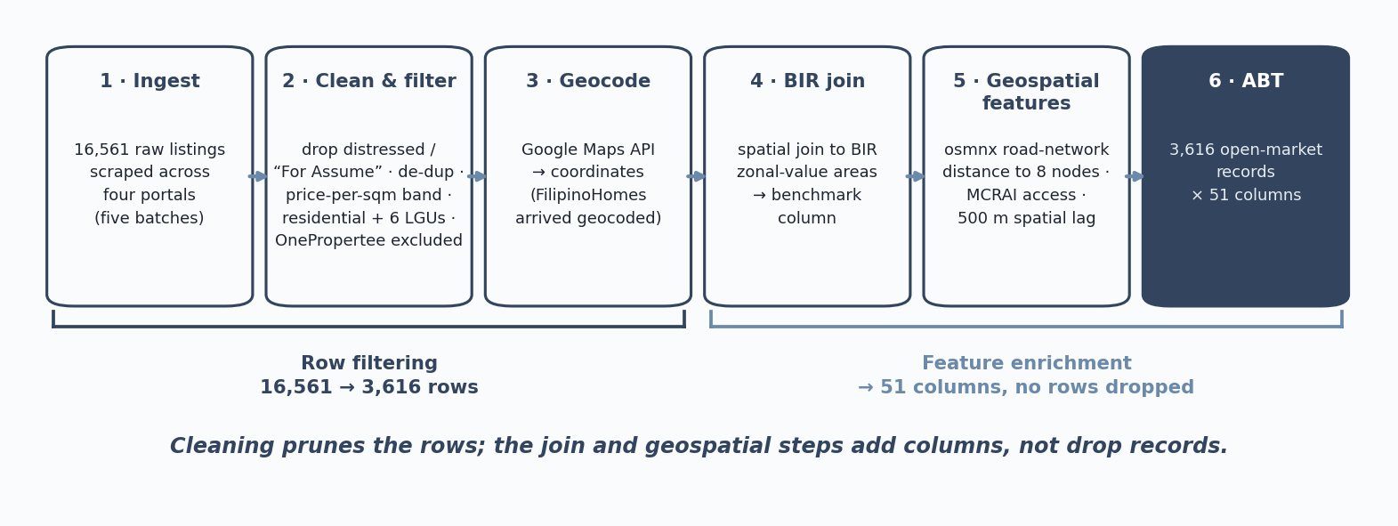
3 · METHODOLOGY
21 / 78
The data pipeline

Slide 22
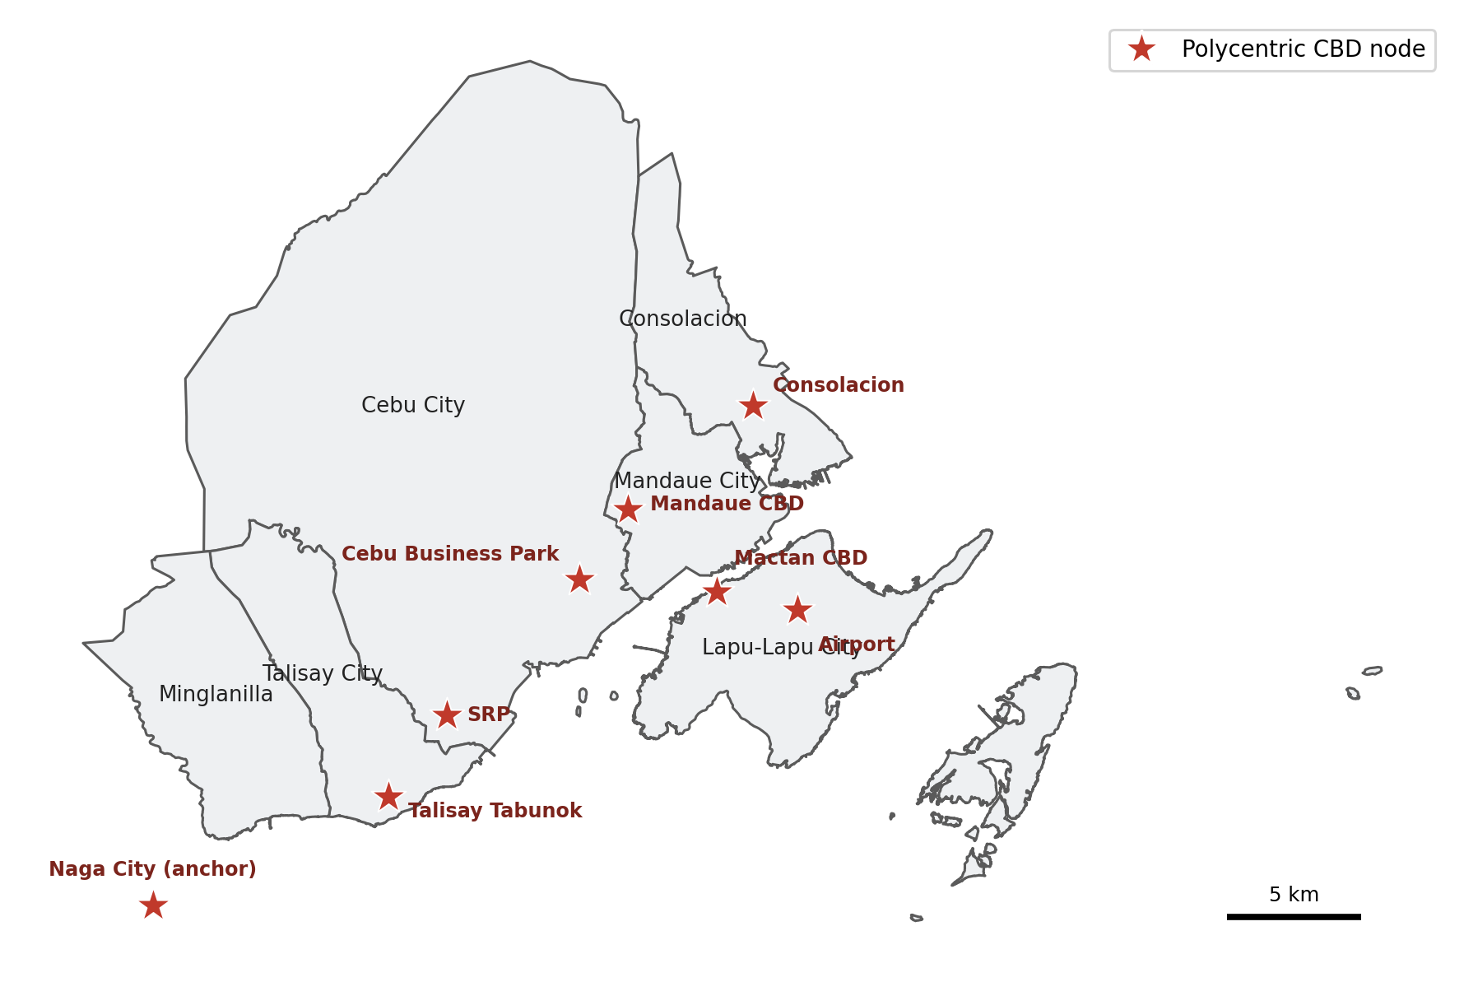
3 · METHODOLOGY
22 / 78
Geospatial features — distance to economic centers
▪ Shortest-path road-network distance (not straight-line) to eight economic nodes.
▪ Nodes: Cebu Business Park, Mandaue CBD, Mactan CBD, SRP, Talisay Tabunok, Consolacion, Naga City (anchor), and the airport.
▪ Grounded in polycentric urban economics (Giuliano & Small, 1991; McMillen, 2003; JICA, 2015).
▪ Road distance captures real travel cost — including the Mactan bridge crossing.

Slide 23
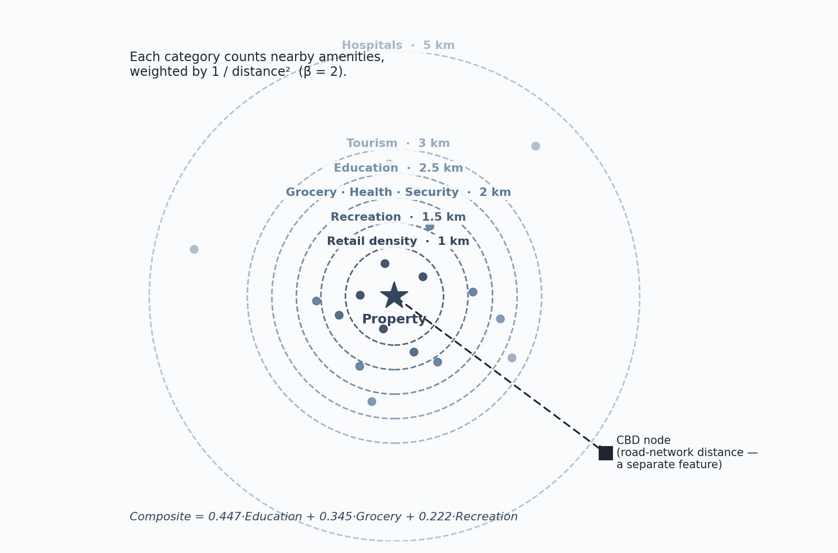
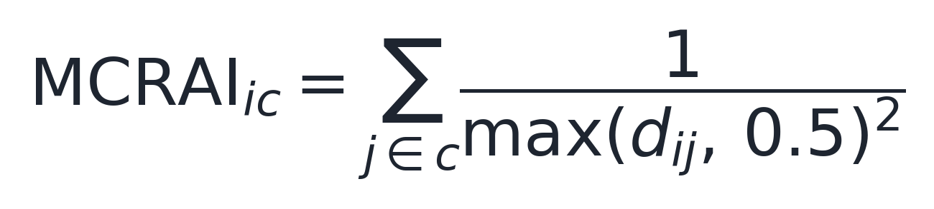
3 · METHODOLOGY
23 / 78
MCRAI — measuring access to amenities
The idea, in plain terms
▪ For each property, count the nearby amenities in a category (schools, groceries, hospitals, …).
▪ Closer amenities count more than far ones — the score fades with the square of road distance.
▪ Each category has its own reach (radius), because a hospital serves a wider area than a corner store.
Distances in km, floored at 0.5 km. (Hansen, 1959)

Slide 24
3 · METHODOLOGY
24 / 78
MCRAI — categories and reach
Category | Reach (km)
Education | 2.5
Grocery | 2.0
Health | 2.0
Hospitals | 5.0
Recreation | 1.5
Security | 2.0
Tourism | 3.0
Retail density | 1.0
▪ Eight categories, each at its typical catchment scale.
▪ Each reach is set to the category's catchment and refined for Metro Cebu — wider for hospitals and schools, tighter for everyday retail.
▪ Transport access is measured separately, as road distance to the eight nodes.
▪ Banking proximity was not kept — none of the residential studies reviewed treat it as a distinct amenity, and it overlaps with the commercial access the CBD distances already carry.

Slide 25
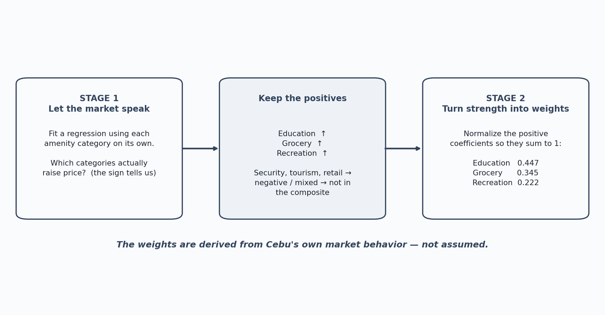
3 · METHODOLOGY
25 / 78
MCRAI — how the weights were chosen
▪ We did not assume the weights — we let the market reveal them, in two stages.
▪ Stage 1: fit a regression and check which categories actually raise price (the sign).
▪ Stage 2: for the positive ones, turn their strength into weights that sum to one.
▪ Result: education 0.447, grocery 0.345, recreation 0.222.

Slide 26
3 · METHODOLOGY
26 / 78
The two stages, in depth
Stage 1 — find the implicit prices
Stage 2 — turn prices into weights
▪ Fit a hedonic regression: price per square meter against the amenity categories together, alongside the structural and location controls.
▪ Each category's coefficient is its implicit price — how much buyers actually pay for that kind of access, holding everything else fixed (Rosen, 1974).
▪ The sign tells us premium or penalty; significance tells us whether the signal is reliable.
▪ Three categories come through as clear positive premiums: education, grocery, recreation.
▪ Keep only the positive, significant categories — the ones the market rewards.
▪ Normalize their coefficients so they sum to one: education 0.447, grocery 0.345, recreation 0.222.
▪ Negative or noisy categories (security, tourism, retail) are not forced into the composite; they stay as their own model features.
▪ The composite then reflects what Cebu buyers pay for, not an assumed weighting.
TAKEAWAY The regression discovers the weights — we do not impose them. A two-stage hedonic approach grounded in implicit-price theory and prior accessibility work.

Slide 27
3 · METHODOLOGY
27 / 78
Two more design choices
Neighborhood price (spatial lag)
Target variable
▪ The average price of nearby same-type listings within 500 m.
▪ Captures Tobler's First Law — near things tend to be alike (Tobler, 1970).
▪ The model predicts the log of price per square meter.
▪ Logging tames the skew; predictions are converted back for the price surface.

Slide 28
3 · METHODOLOGY
28 / 78
Evaluation protocol
The headline numbers are estimated under a deliberately strict protocol.
▪ GroupKFold(5), with groups defined by coordinate cluster.
▪ The same location can never appear in both training and test folds.
▪ This is stricter than a random 80/20 split — it prevents the model from memorizing a neighborhood and overstating its accuracy.
▪ Every reported accuracy figure is out-of-fold.

Slide 29
04
Data Understanding
Collection and exploratory analysis

Slide 30
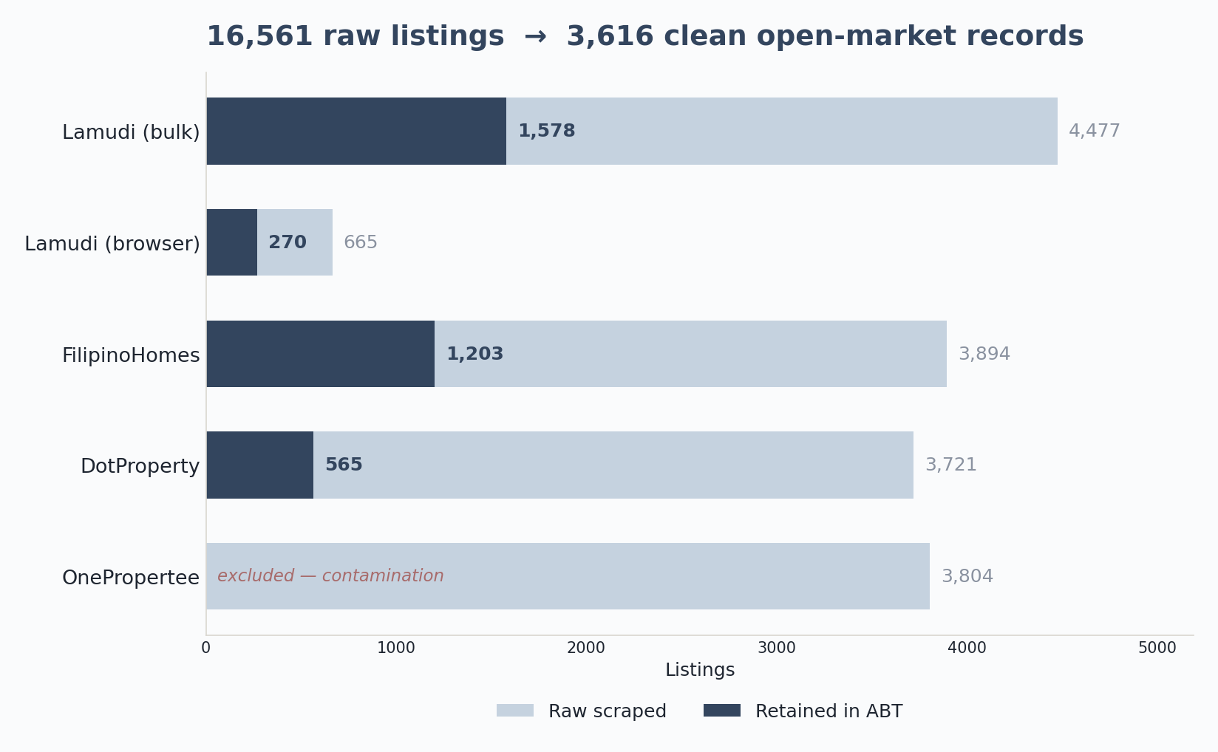
4 · DATA UNDERSTANDING
30 / 78
From collection to a clean ABT
▪ 16,561 listings scraped across three portals; 3,616 survived to the ABT.
▪ Filters: geocoding, the six-LGU and residential constraints, a price-per-sqm sanity band, distressed-listing removal, and de-duplication.
▪ OnePropertee was excluded entirely — bad geocoding and mis-extracted prices would have contaminated the model.
TAKEAWAY A conservative funnel: roughly one in five raw listings is kept.

Slide 31
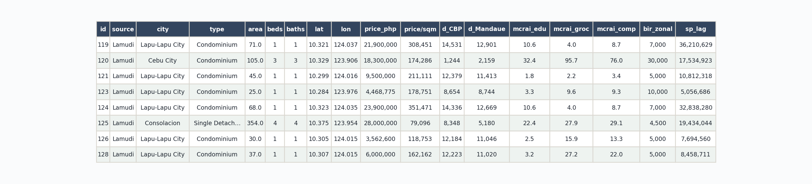
4 · DATA UNDERSTANDING
31 / 78
What one record looks like
A slice of the assembled ABT — 18 of 51 columns: structural attributes, coordinates, node distances, MCRAI scores, BIR benchmark, and spatial lag.

Slide 32
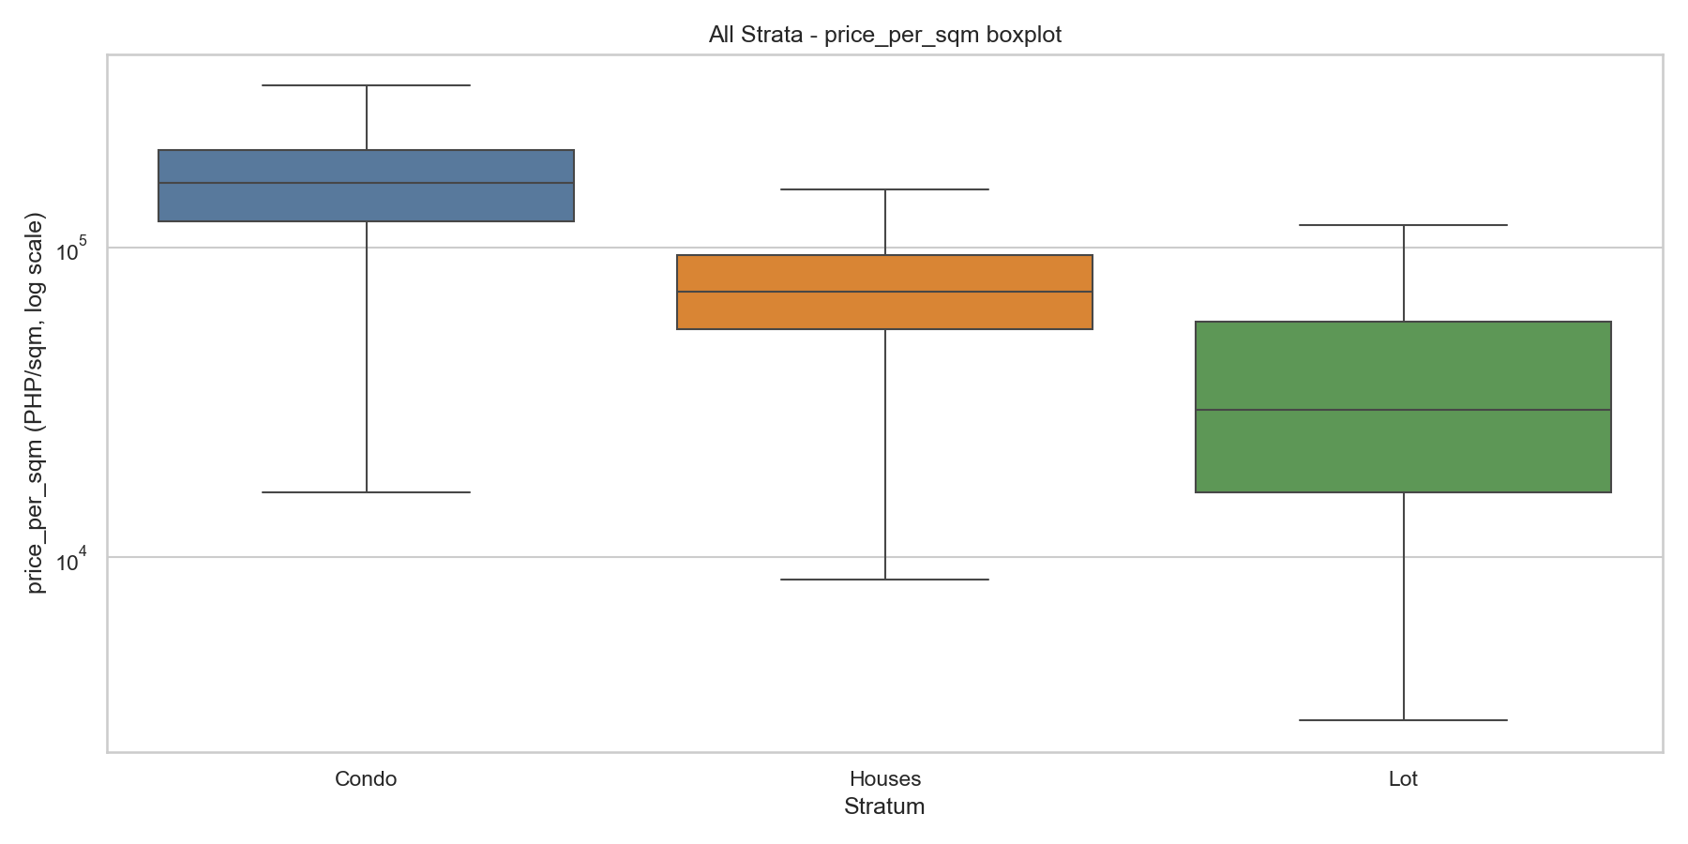
4 · DATA UNDERSTANDING
32 / 78
Exploratory analysis — the target
▪ Price per square meter is right-skewed — a few premium units stretch the upper tail.
▪ Condominiums command the highest unit prices; vacant lots the lowest (land only, no built area).
▪ This is why the target is modeled in log and converted back for the surface.

Slide 33
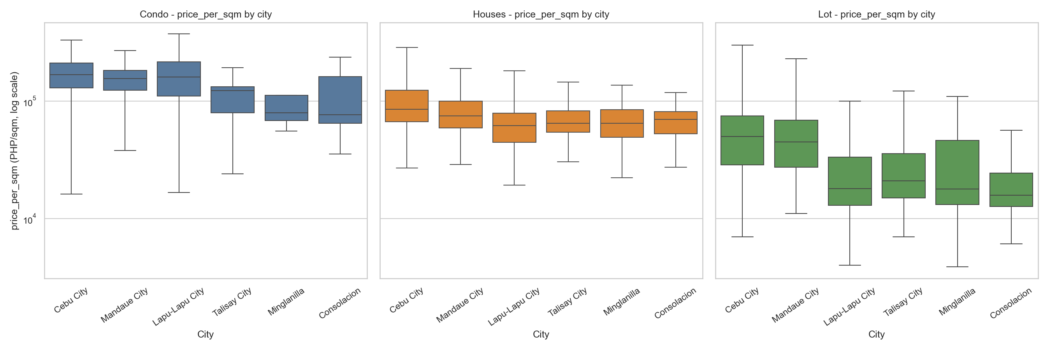
4 · DATA UNDERSTANDING
33 / 78
Price varies sharply across the map
▪ The premium signal sits in the core and island: Cebu City ~₱113,600/sqm, Mandaue ~₱96,100, Lapu-Lapu ~₱92,100.
▪ Talisay, Minglanilla, and Consolacion form a lower band (~₱47,100–56,800).
▪ Location cannot be treated as uniform — it has to be modeled explicitly.

Slide 34
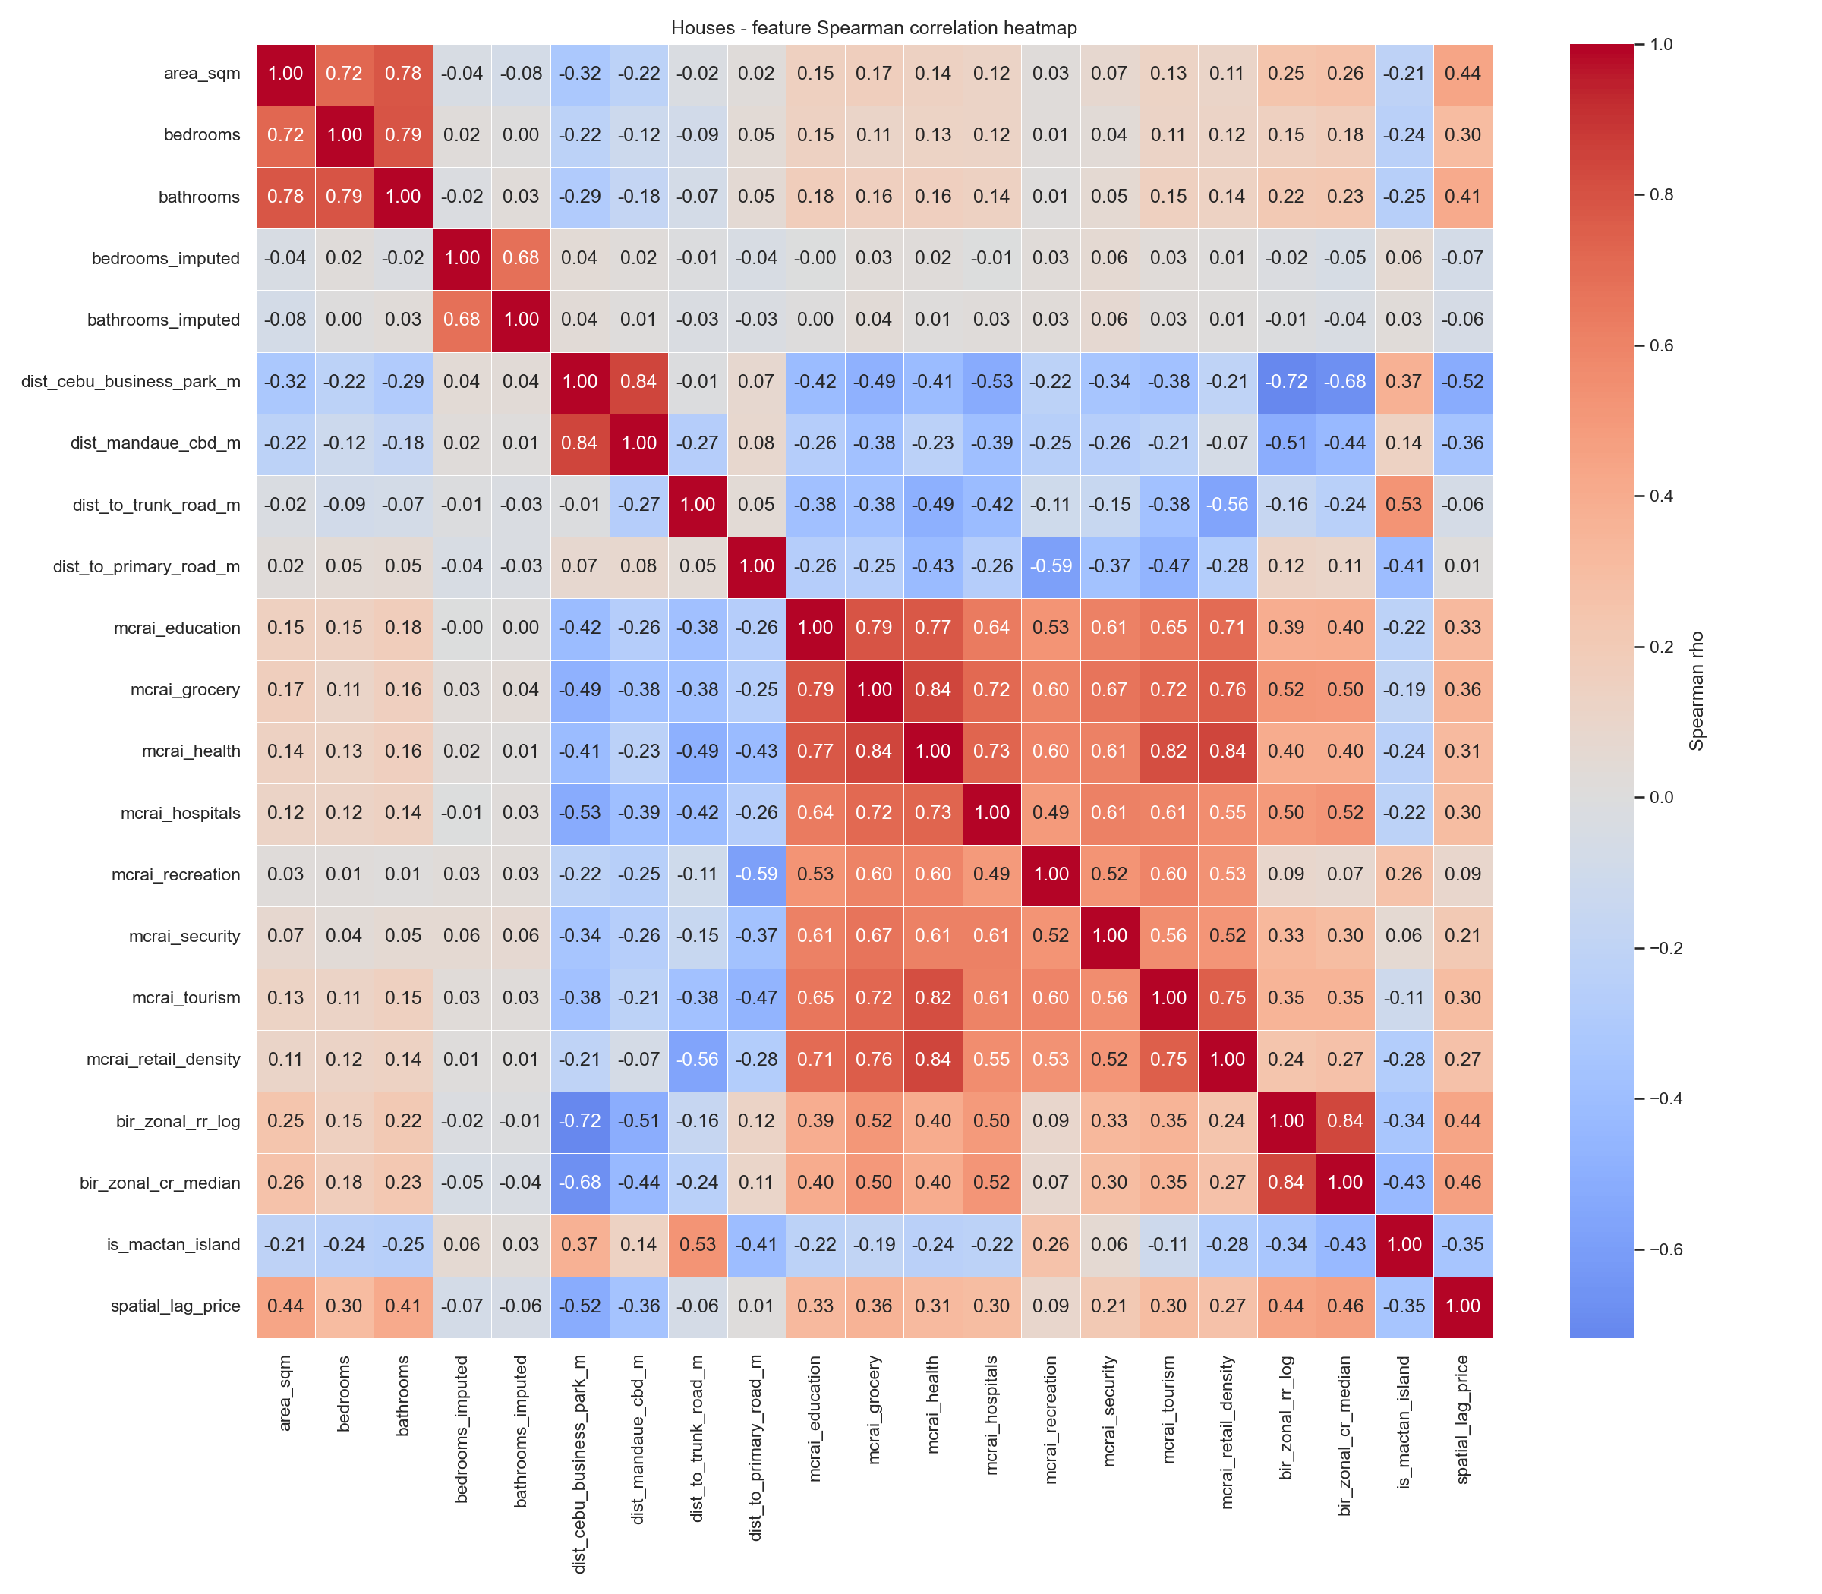
4 · DATA UNDERSTANDING
34 / 78
Can we trust the features?
▪ Several southern-corridor CBD distances move together — an early collinearity warning.
▪ This matters for the linear baseline, not the trees: OLS dropped the redundant terms (confirmed with VIF).
▪ Random Forest tolerates correlated predictors, so the substantively meaningful nodes were kept.

Slide 35
4 · DATA UNDERSTANDING
35 / 78
MCRAI coverage is real, not assumed
MCRAI category | Zero rate
Security | 26.6%
Retail density | 15.8%
Recreation | 12.0%
Health | 10.0%
Grocery | 4.3%
Education | 0.3%
▪ Zero rates were checked before modeling to separate true absence from data gaps.
▪ Education and grocery access are effectively complete; security is the sparsest.
▪ High zero rates flag genuinely thin amenity catchments — not a data failure.

Slide 36
05
Data Preparation
Cleaning, and preparing data for the models

Slide 37
5 · DATA PREPARATION
37 / 78
Cleaning kept every decision visible
▪ Imputed values were flagged, never silently filled — imputation stays auditable.
▪ Structurally-absent fields (bedrooms/bathrooms for vacant lots) were left unimputed, not faked.
▪ Hard duplicates were dropped and a price-per-square-meter sanity band applied.
▪ The modeling subset is 3,372 of the 3,616 assembled rows, after model-requirement filters.
TAKEAWAY The aim was a clean, defensible table — usable rows without inventing evidence.

Slide 38
5 · DATA PREPARATION
38 / 78
A data-integrity story
One finding shaped how much the rest of the results can be trusted.
▪ Early models were dominated by a single suspicious feature in the SHAP rankings.
▪ The cause: the target had quietly come to mean two different things across scrape batches — the feature was acting as a scale-selector.
▪ Tracing and fixing it (redefining the target to log price per square meter) is exactly why the final metrics are dependable.

Slide 39
5 · DATA PREPARATION
39 / 78
Preparing the data for modeling
Three steps turn the clean ABT into model-ready inputs.
▪ Split by property type — condominiums, houses, and vacant lots become three separate datasets.
▪ Encode and assemble — cities become indicator columns; structural, distance, MCRAI, benchmark, and spatial-lag features are joined per row.
▪ Select features per stratum — each dataset keeps only the features that earn their place (next slide).

Slide 40
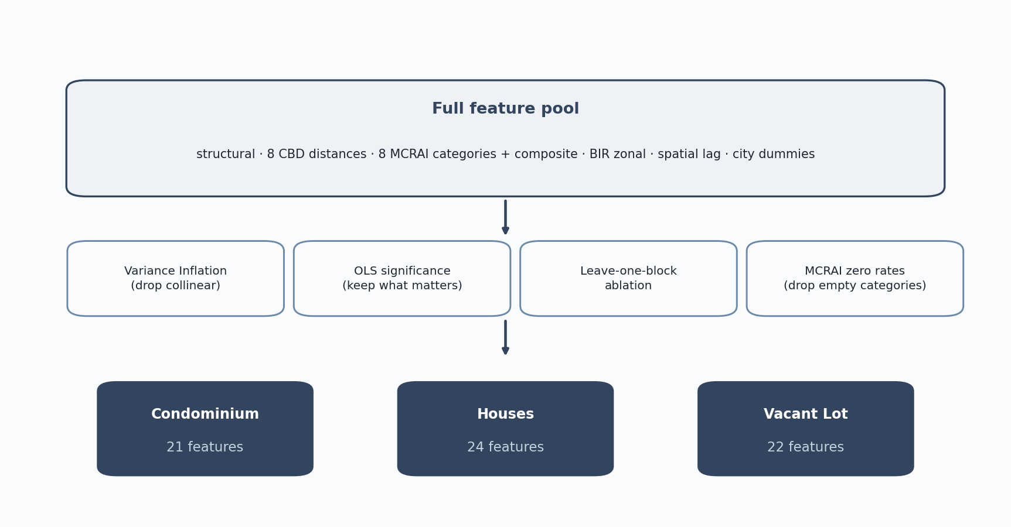
5 · DATA PREPARATION
40 / 78
How the three feature sets were chosen
▪ Every candidate feature passed through four screens:
▪ Variance inflation — drop features that duplicate others.
▪ OLS significance — keep features that actually move price.
▪ Leave-one-block ablation + MCRAI zero rates — drop blocks that add nothing and empty categories.
▪ The result is three tailored feature sets: 21 / 24 / 22.

Slide 41
06
Modeling
Stratified models, selection, tuning

Slide 42
6 · MODELING
42 / 78
One model cannot price three markets
The price distributions shown earlier settle the modeling design.
5.8×
The condominium median price per square meter runs about 5.8 times the vacant-lot median.
▪ Built area and land-only follow fundamentally different price logic.
▪ A single pooled model averages these into one blurred equation that fits none of them well.
▪ So the study fits three separate models, one per property type — backed by Dröes et al. (2019) and Usman et al. (2020).
TAKEAWAY Stratifying is itself an evidence-based finding, not a convenience.

Slide 43
6 · MODELING
43 / 78
Features used — Condominium (21)
Structural
CBD distances (8)
Accessibility & benchmark
City indicators (5)
area_sqm
bedrooms
bathrooms
bedrooms_imputed
bathrooms_imputed
Cebu Business Park
Mandaue CBD
Mactan CBD
SRP
Talisay Tabunok
Consolacion
Naga City
Airport
mcrai_composite
bir_zonal_rr_median
spatial_lag_price
Consolacion
Lapu-Lapu City
Mandaue City
Minglanilla
Talisay City

Slide 44
6 · MODELING
44 / 78
Features used — Houses (24)
Structural
CBD distances (8)
Accessibility & benchmark
City indicators (5)
Property-type (3)
area_sqm
bedrooms
bathrooms
bedrooms_imputed
bathrooms_imputed
Cebu Business Park
Mandaue CBD
Mactan CBD
SRP
Talisay Tabunok
Consolacion
Naga City
Airport
mcrai_composite
bir_zonal_rr_median
spatial_lag_price
Consolacion
Lapu-Lapu City
Mandaue City
Minglanilla
Talisay City
House and Lot
Single Detached
Townhouse

Slide 45
6 · MODELING
45 / 78
Features used — Vacant Lot (22)
Structural
CBD distances (8)
MCRAI individual (6)
Benchmark
City indicators (5)
area_sqm
Cebu Business Park
Mandaue CBD
Mactan CBD
SRP
Talisay Tabunok
Consolacion
Naga City
Airport
education
grocery
health
hospitals
recreation
tourism
bir_zonal_rr_median
spatial_lag_price
Consolacion
Lapu-Lapu City
Mandaue City
Minglanilla
Talisay City

Slide 46
6 · MODELING
46 / 78
Why the three feature sets differ
Statistical check | What was done
CBD nodes cluster, so their distances correlate (VIF > 5) | Kept in the trees — splits handle correlation; the OLS baseline trimmed the redundant terms per stratum
MCRAI composite is a fixed blend of its own parts | Dropped from the OLS baseline (unstable); kept for the trees and for SHAP
Zonal value carried both raw and logged | One form dropped in the OLS baseline (double-counting)
Residual spread grows with price (heteroscedasticity) | OLS reported with HC3 robust errors; the trees are unaffected
▪ Vacant lots carry land only — no bedrooms or bathrooms to model — and lean on individual MCRAI access categories, since bare land responds to specific nearby amenities.
▪ Houses span sub-types (single-detached, house-and-lot, townhouse), so property-type indicators stay in.
▪ Condominiums keep the structural attributes and the single MCRAI composite.
▪ Correlated spatial features were kept in the deployed trees on purpose — dropping them would throw away real location signal.
TAKEAWAY Collinearity was a problem for the interpretable OLS baseline, not for the deployed trees — so the diagnostics shaped the baseline, while the strata themselves differ mainly by what each property type actually has.

Slide 47
6 · MODELING
47 / 78
The model lineup
▪ OLS hedonic — interpretable baseline (HC3 robust errors) (Rosen, 1974).
▪ Random Forest — non-linear, robust on small samples (Breiman, 2001).
▪ XGBoost — gradient boosting on tabular data (Chen & Guestrin, 2016).
▪ SHAP explains every prediction, feature by feature (Lundberg & Lee, 2017).
▪ OLS doubles as the diagnostic that screens MCRAI category signs.
▪ All three fit per stratum on the log price-per-sqm target.

Slide 48
6 · MODELING
48 / 78
Why these three models?
The shortlist spans the interpretability–accuracy spectrum. Other families were considered and set aside for clear reasons.
Model considered | Why it was not retained
Support Vector Regression | Expensive to tune; weak native interpretability; usually trails boosting on tabular data
LASSO / Ridge | Constrained by linearity; effectively subsumed by the OLS baseline
Deep Neural Networks | Need >10,000 labeled samples; the dataset is far smaller, and global interpretability is lost
The three retained models (OLS, Random Forest, XGBoost) fit the sample size, the tabular structure, and the need for explainability.

Slide 49
6 · MODELING
49 / 78
Hyperparameters and tuning
The deployed Random Forest was tuned per stratum; the two comparators ran at standard settings, so the head-to-head stayed fair.
Random Forest — deployed, tuned per stratum
Stratum | Trees | Max features | Min leaf | Max depth
Condominium | 300 | 0.7 | 1 | none
Houses | 300 | 1.0 | 2 | none
Vacant Lot | 300 | 1.0 | 1 | none
Winner chosen by lowest GroupKFold MdAPE among the random-forest grid (random_state = 42).
Comparators — standard settings
Model | Configuration
XGBoost | 300 trees, learning rate 0.05, max depth 6 — held constant across the three strata
OLS hedonic | Log-log specification with HC3 robust standard errors — a fixed functional form, no tuning grid
The comparators were run at common, defensible defaults; only the chosen family (Random Forest) was tuned for deployment.

Slide 50
07
Evaluation
Accuracy, model comparison, ablation

Slide 51
7 · EVALUATION
51 / 78
Headline accuracy — all three models
MdAPE — typical error (lower is better)
Property type | OLS | Random Forest † | XGBoost
Condominium | 24.5% | 19.3% | 19.8%
Houses | 25.1% | 22.7% | 23.6%
Vacant Lot | 44.8% | 38.4% | 40.2%
PE20 — share within 20% (higher is better)
Property type | OLS | Random Forest † | XGBoost
Condominium | 40% | 51% | 50%
Houses | 41% | 44% | 43%
Vacant Lot | 22% | 26% | 27%
† Deployed. All three scored under identical leak-free GroupKFold(5) by coordinate cluster; Random Forest matches the deployment manifest. Supporting diagnostics: MAPE, COD, PRD. The study does not claim IAAO assessment-grade compliance.
TAKEAWAY Both tree models beat OLS in every stratum; Random Forest is best-or-tied and was deployed. Condominiums and houses estimate well; vacant lots remain the weakest.

Slide 52
7 · EVALUATION
52 / 78
Reading the metrics
▪ MdAPE — the median absolute percentage error; half of estimates fall within this band. Robust to a few extreme listings.
▪ PE20 — the share of estimates within 20% of the listing; the practical hit-rate.
▪ MAPE, COD, PRD — supporting diagnostics, reported for comparability.
▪ Peer benchmark: comparable small-sample studies report MAPE near 48–53% (Nyanda, 2024) — the present errors are competitive.

Slide 53
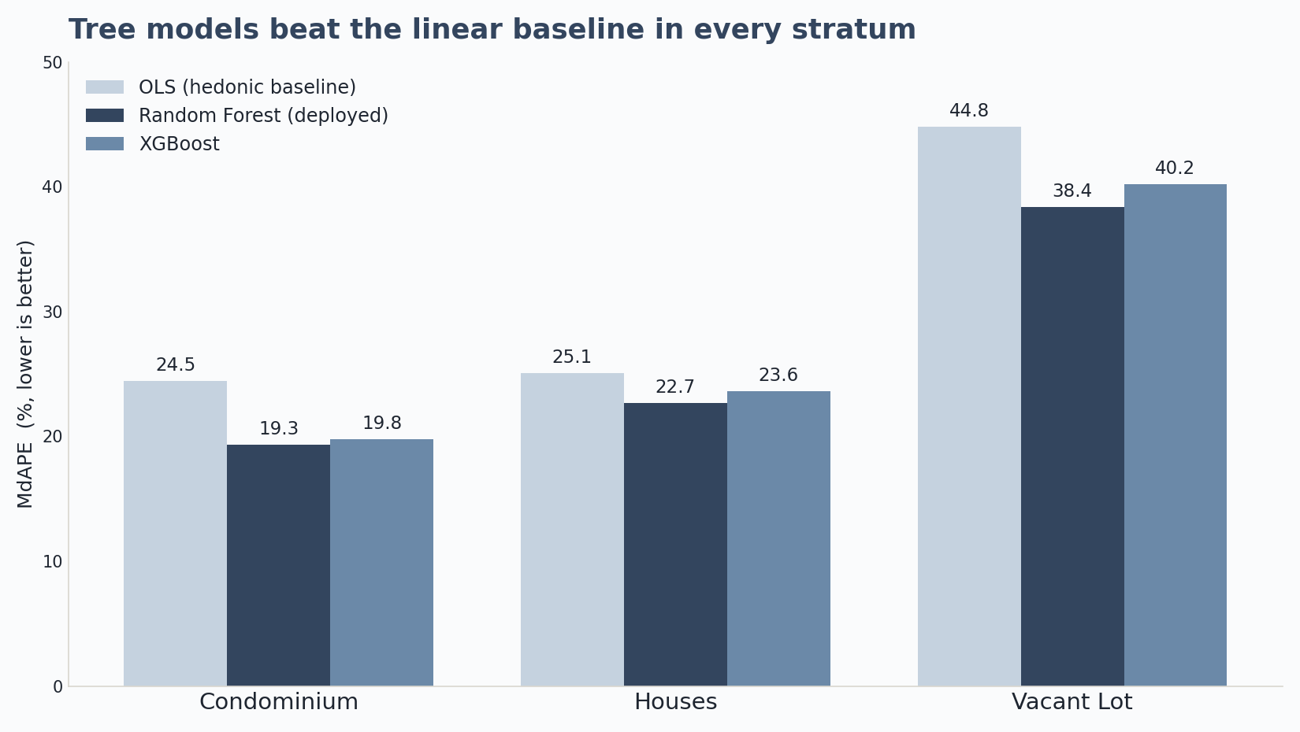
7 · EVALUATION
53 / 78
Which model performed best? (RQ2)
▪ Under identical leak-free folds, both tree models beat the OLS baseline in every stratum.
▪ Random Forest and XGBoost are close; RF edges it on the deployed grouped-CV (19.3 vs 19.8 / 22.7 vs 23.6 / 38.4 vs 40.2).
▪ Because the tree models are so close, the fair reading is “RF best-or-tied.”
▪ Random Forest was deployed — robust on small samples, and simpler to maintain.

Slide 54
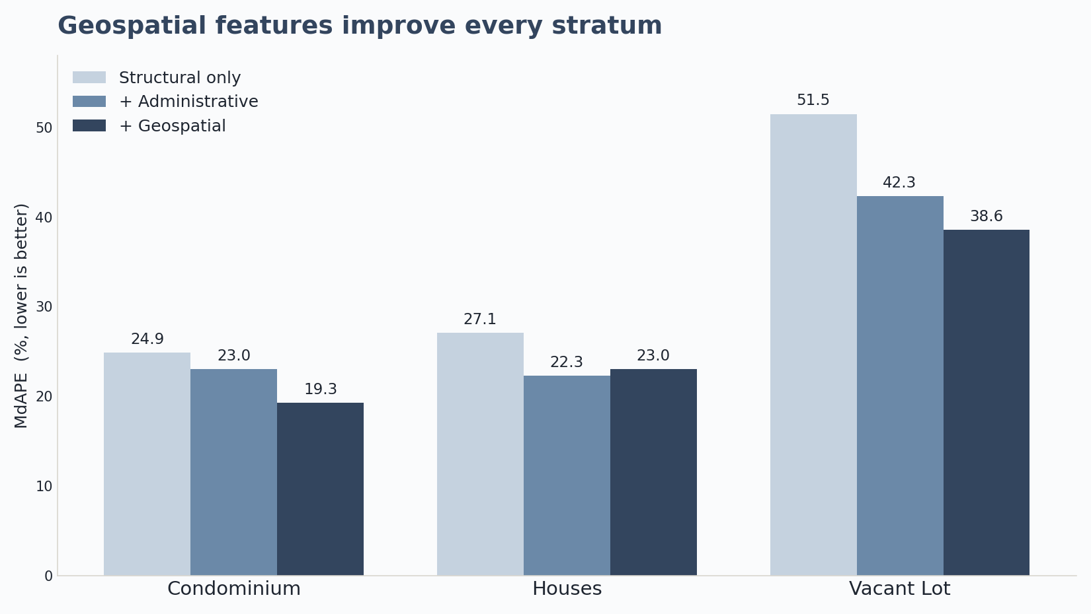
7 · EVALUATION
54 / 78
Do geospatial features earn their place? (RQ3)
▪ A three-tier ablation under identical folds: Structural → + Administrative → + Geospatial.
▪ Geospatial features improve every stratum vs structural-only: condo +5.7, houses +4.2, lot +13.0 points.
▪ On top of administrative location (city + BIR zonal): condo +3.7, lot +3.8, but houses ≈ −0.7.
▪ They add the most where benchmarks are weakest — vertical condos and bare land.

Slide 55
7 · EVALUATION
55 / 78
Where the model errs (residual analysis)
The error pattern is consistent and informative across all three strata.
▪ At the center of the distribution the models are close to unbiased — median signed error within a few percent of zero.
▪ The damage is concentrated in the tails: a few extreme misses, not broad bias.
▪ Those misses are atypically cheap listings — their low price reflects what the listing does not record: condition, title issues, distressed or pre-selling pricing, or (for lots) terrain.
▪ The model cannot see these factors, so it over-predicts them — the data ceiling, made concrete.
TAKEAWAY The model is reliable for typical properties; it cannot price what the data never captured.

Slide 56
08
Results and Discussion
Drivers and spatial structure

Slide 57
8 · RESULTS & DISCUSSION
57 / 78
Three findings stand out
▪ Location dominates value formation in every stratum — the geospatial block carries most of the SHAP attribution.
▪ Drivers differ by property type — which is exactly why the three strata are modeled separately.
▪ MCRAI is selective — education, grocery, and recreation carry positive weight; security, tourism, and retail behave as diagnostic categories, not premiums.

Slide 58
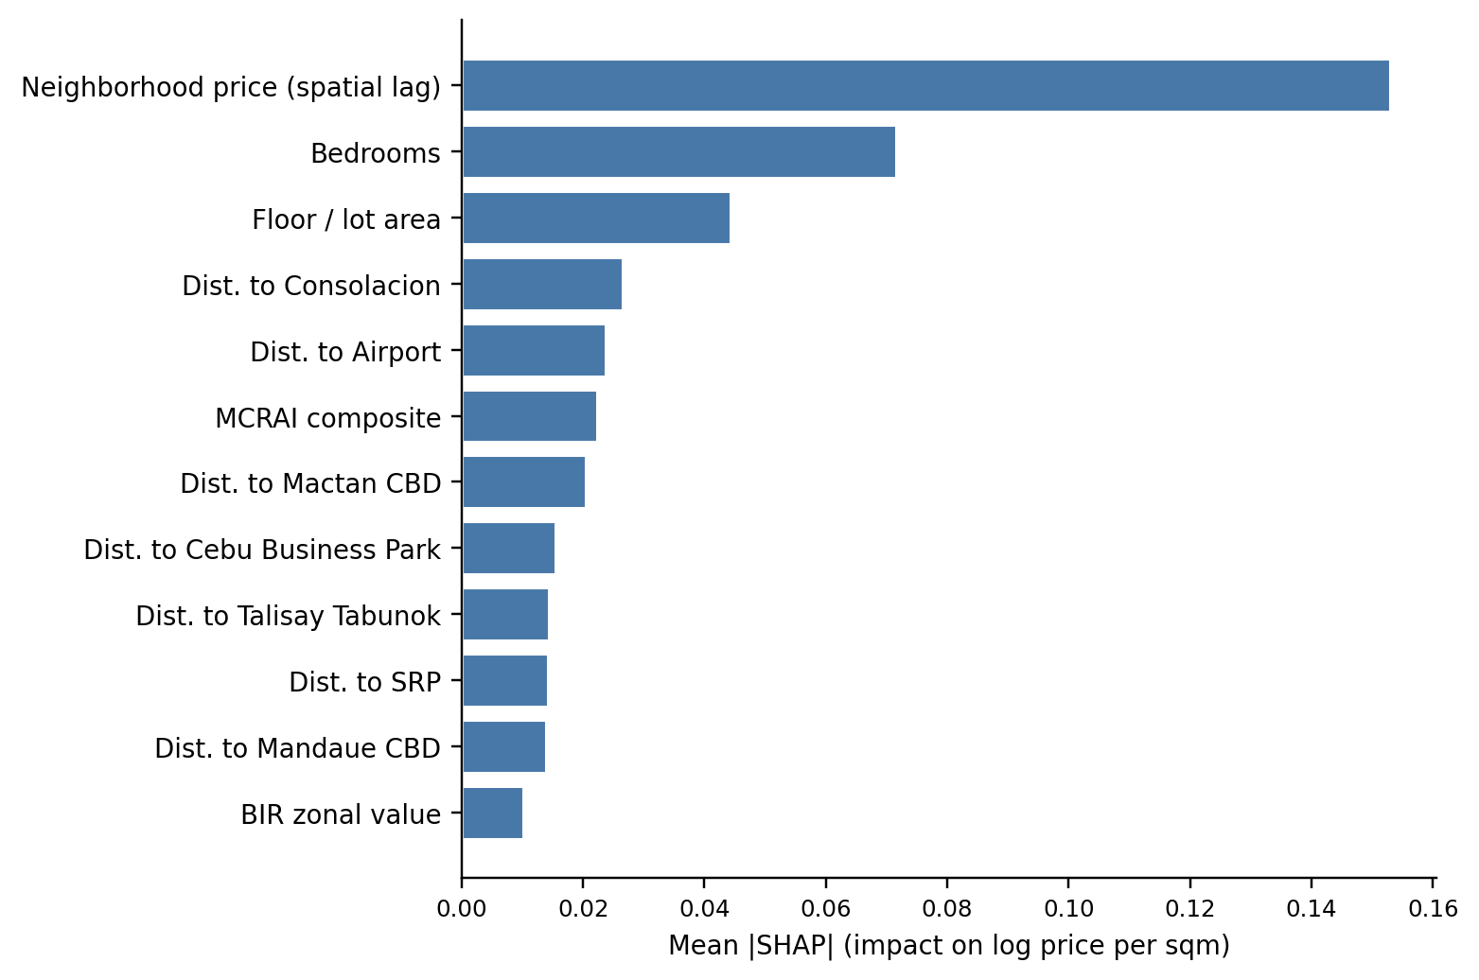
8 · RESULTS & DISCUSSION
58 / 78
Drivers — condominiums
▪ Neighborhood price level (spatial lag) leads — condos track their immediate block.
▪ Locational weight then spreads across several nodes: Consolacion, the airport, Mactan CBD, and CBP.
▪ The signature of a market responding to several active centers at once.

Slide 59
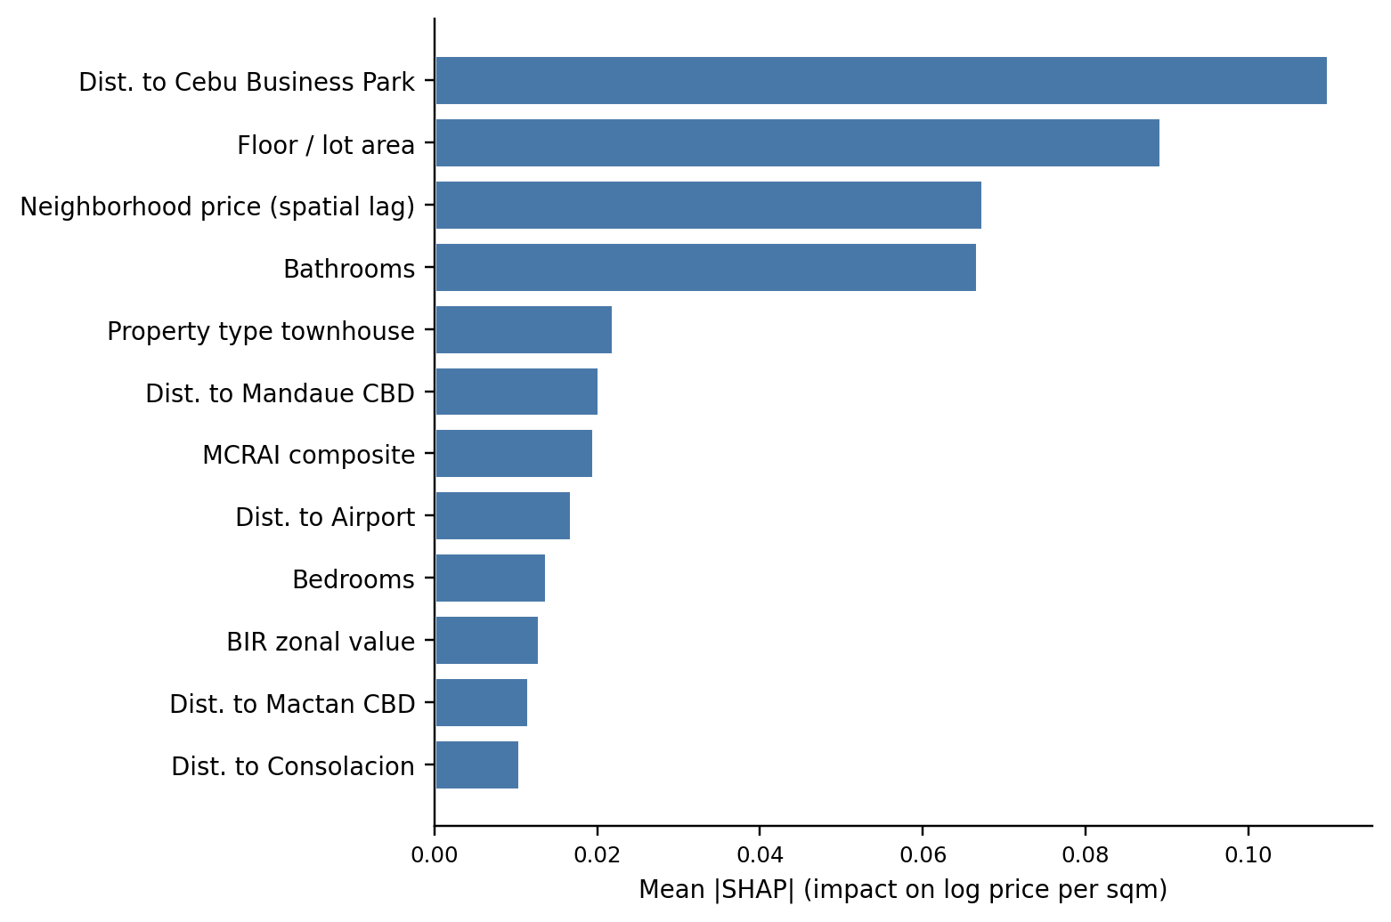
8 · RESULTS & DISCUSSION
59 / 78
Drivers — houses
▪ Distance to Cebu Business Park is the single strongest driver.
▪ Classic bid-rent: detached-house value falls with distance from the principal center.
▪ Amenities enter only as the bundled MCRAI composite.

Slide 60
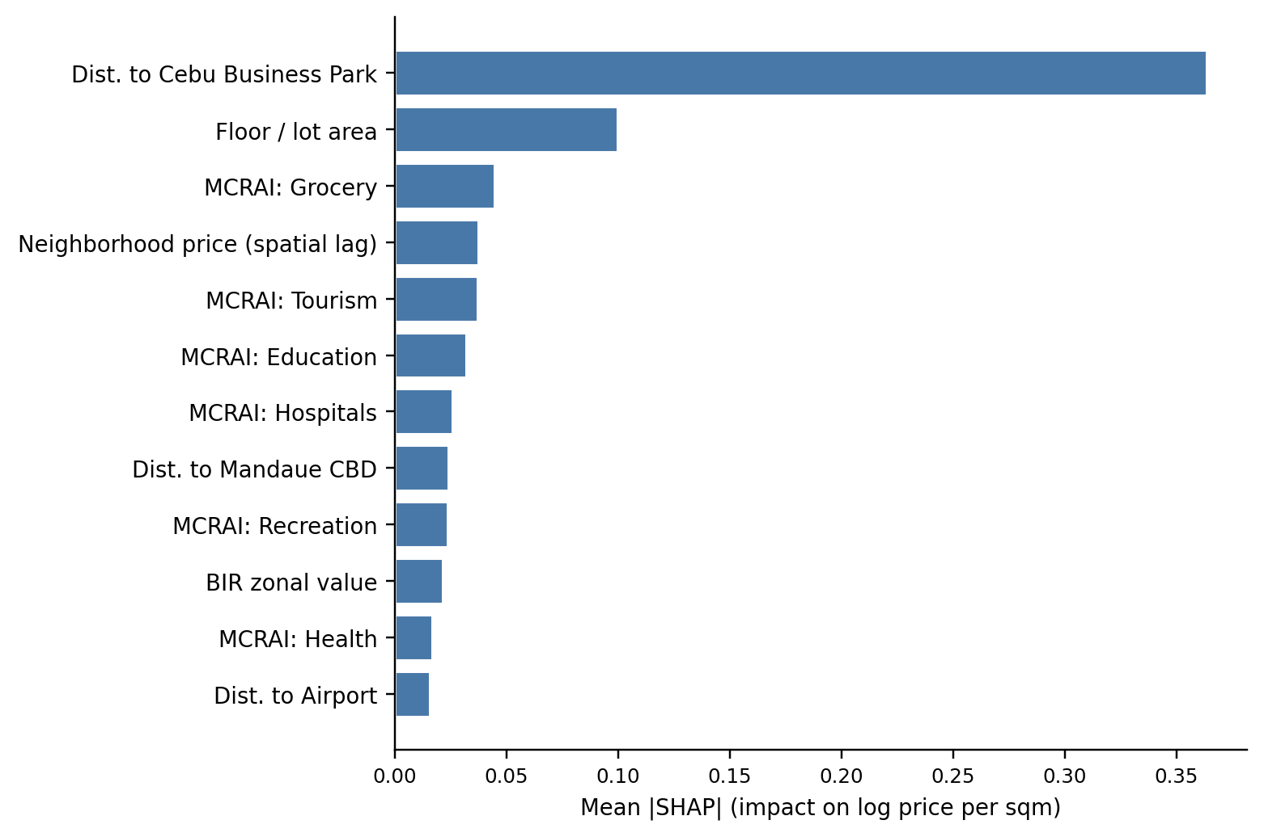
8 · RESULTS & DISCUSSION
60 / 78
Drivers — vacant lots
▪ Distance to CBP leads — the steepest bid-rent gradient of the three strata.
▪ Individual amenity categories are the second-largest driver: bare land responds to specific nearby access.
▪ Still the weakest stratum — unrecorded parcel attributes (frontage, zoning, slope, titling) cap accuracy.
TAKEAWAY A data ceiling, reported transparently — not a modeling failure.

Slide 61
8 · RESULTS & DISCUSSION
61 / 78
A polycentric price surface
The SHAP results are the clearest evidence that the model learned a polycentric, not monocentric, structure.
▪ CBP still anchors land and detached housing — the historic core matters most there.
▪ But it does not stand alone: condominium weight spreads across the Mactan/airport corridor and the northern Mandaue–Consolacion nodes.
▪ The reading is a corridor of linked centers, consistent with the JICA roadmap and polycentric theory (Giuliano & Small, 1991; McMillen, 2003; JICA, 2015).

Slide 62
8 · RESULTS & DISCUSSION
62 / 78
The Mactan submarket, and spatial sorting
Mactan
MCRAI negative signs
▪ The Mactan signal comes through the condominium stratum, via airport and Mactan-CBD distance.
▪ Better read as a submarket bundle (airport access, bridge connectivity, tourism-adjacent demand) than a raw island premium.
▪ Negative coefficients on security, tourism, and retail density are not proof of harm.
▪ They reflect spatial sorting — these uses cluster where congestion or commercial intensity deters some buyers (Tiebout, 1956; Bayer & McMillan, 2012; Yang et al., 2016).

Slide 63
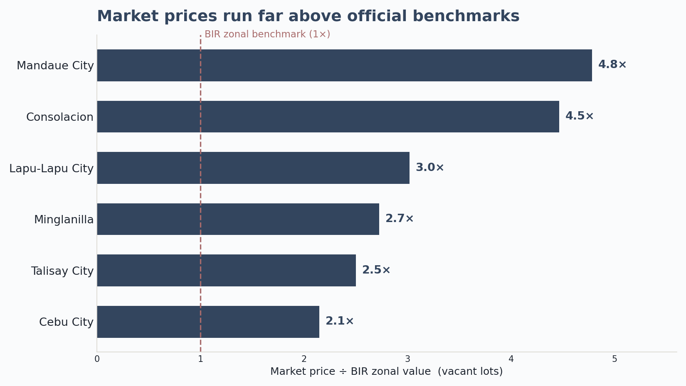
8 · RESULTS & DISCUSSION
63 / 78
The valuation gap (RQ4)
▪ On the clean land-to-land comparison, vacant-lot market price runs ~3× the BIR benchmark overall.
▪ From ~2.2× in Cebu City to ~4.8× in Mandaue; listings exceed the benchmark in nearly every LGU.
▪ The gap is large, positive, and systematic — BIR zonal values sit well below the open market.
▪ Read it as a research signal that benchmarks are stale — not a correction factor to apply.

Slide 64
8 · RESULTS & DISCUSSION
64 / 78
Is the model good enough?
Yes — as a reference for triangulating price, and within clear limits.
▪ The typical error stays substantial even in the best strata, so it informs a valuation judgment rather than settling it.
▪ Strongest for condominiums and houses; only indicative for vacant lots and thin LGU×type cells.
▪ It complements professional appraisal judgment; it does not replace it.

Slide 65
▸
The Decision-Support Tool
The applied deliverable

Slide 66
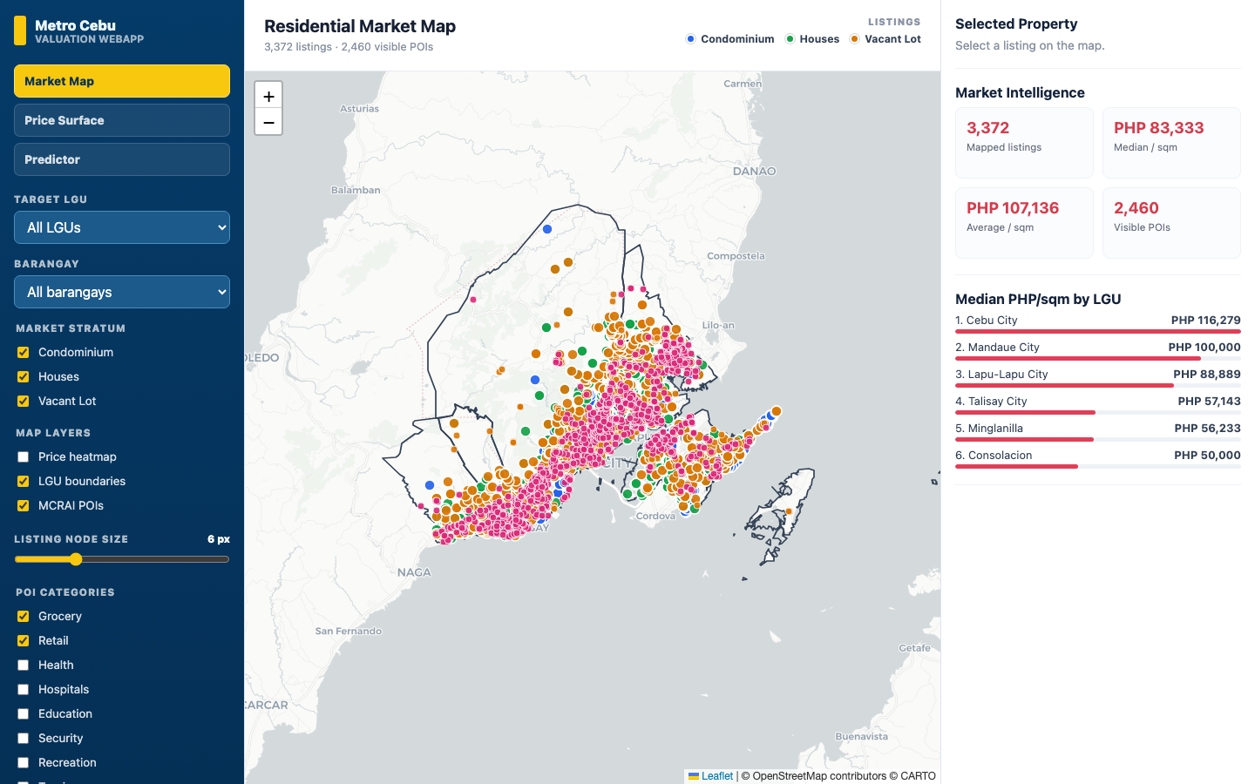
THE DECISION-SUPPORT TOOL
66 / 78
Market Map
Open-market listings with filters and market-intelligence summaries. The backend runs the exact deployed models.

Slide 67
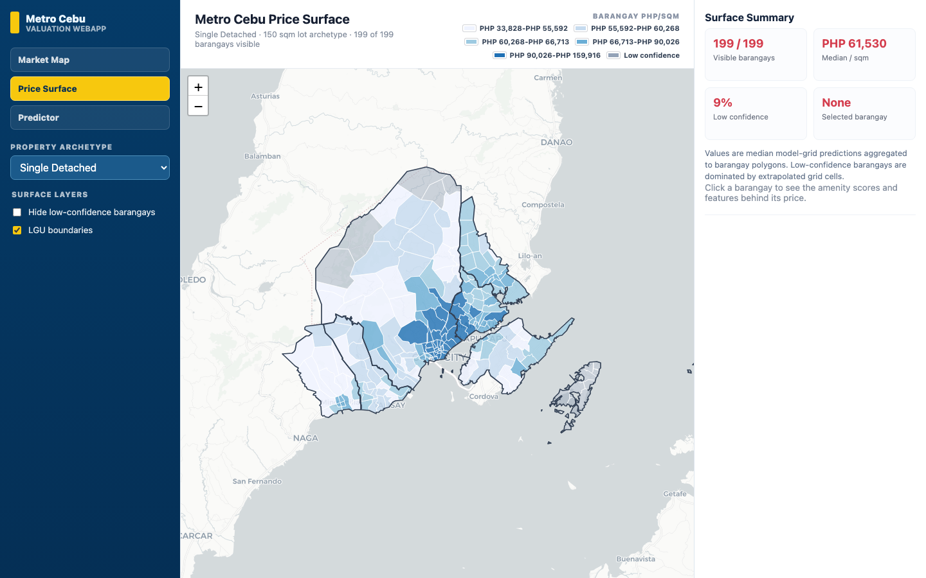
THE DECISION-SUPPORT TOOL
67 / 78
Price Surface
The predicted price-per-square-meter surface, aggregated by barangay.

Slide 68
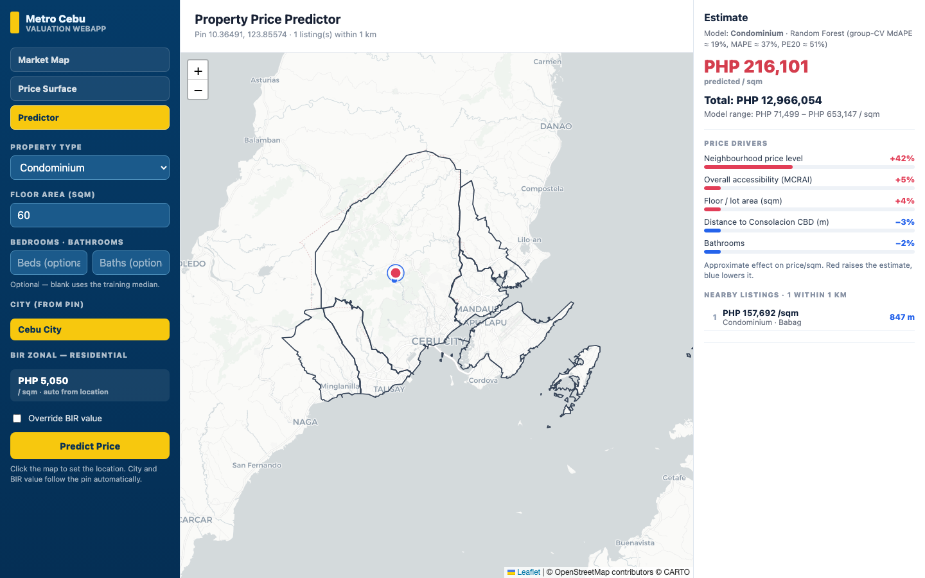
THE DECISION-SUPPORT TOOL
68 / 78
Property Predictor
A property-level prediction with its SHAP contribution breakdown — the tool always shows its reasoning.

Slide 69
09
Conclusions
Answers, contributions, limits

Slide 70
9 · CONCLUSIONS
70 / 78
Answers to the research questions
▪ RQ1 — Location dominates; drivers differ by type (spatial lag for condos; CBP distance for houses and lots; amenities for bare land).
▪ RQ2 — Tree models beat OLS everywhere; Random Forest best-or-tied with XGBoost, deployed for robustness and simplicity.
▪ RQ3 — Geospatial features materially help, most where administrative benchmarks are weakest.
▪ RQ4 — The BIR gap is large, positive, and systematic (~3× on the clean lot comparison).

Slide 71
9 · CONCLUSIONS
71 / 78
Contributions
Methodological
Practical
▪ Per-type modeling with evidence-based feature selection.
▪ A polycentric distance set, not a single-CBD measure.
▪ A two-stage MCRAI (OLS signs screen categories; positive-only composite).
▪ All headline results under leak-free grouped CV.
▪ A reproducible, explainable web prototype.
▪ TypeScript + Leaflet front end over a Python service running the deployed models.
▪ A market-facing price surface with the valuation-gap diagnostic.

Slide 72
9 · CONCLUSIONS
72 / 78
Limitations
▪ Asking-price ceiling — trained on listings, not verified deed-of-sale transactions.
▪ Cross-sectional snapshot — late 2025; no cyclical or temporal modeling.
▪ Vacant-lot data ceiling — parcel attributes that drive land value are not recorded in listings.
▪ Thin cells — some LGU×type combinations are too sparse for reliable single-cell estimates.

Slide 73
10
Recommendations
Practice, policy, future work

Slide 74
10 · RECOMMENDATIONS
74 / 78
For practice and policy
Practice
Policy
▪ Read the surface as a triangulation tool, alongside zonal values and comparables — not a final appraisal.
▪ Weight polycentric distance and property type ahead of the amenity composite.
▪ Treat the valuation gap as a research signal; validate against transactions before any operational use.
▪ Keep recognizing secondary and corridor subcenters (Mactan, Consolacion, Naga), not just CBP.
▪ Use MCRAI as an adaptable template, not a finished index.
▪ On deployment: the prototype shows its open-market-only scope and should be refreshed as data drifts.

Slide 75
10 · RECOMMENDATIONS
75 / 78
For future research
▪ Put MCRAI on an empirical footing — estimate the decay rate, radii, and weights from data rather than fixing them.
▪ Test spatial heterogeneity directly with Geographically Weighted Regression (GWR / MGWR).
▪ Enrich inputs — parcel attributes (frontage, corner-lot), a time dimension, and macro indicators (Udomsap & Abid, 2020).
▪ Triangulate against complementary reference prices instead of a single market-facing target.

Slide 76
10 · RECOMMENDATIONS
76 / 78
Closing
This thesis should be read as a demonstrated, reproducible workflow more than a finished product.
▪ A custom MCRAI design, a polycentric distance set, and a Random Forest + SHAP pipeline that can be rebuilt, checked, and adapted for other Philippine secondary cities.
▪ What it finishes is a defensible template for local valuation analytics — a clearer starting point for the family deciding what a home is worth, not the last word.

Slide 77
REFERENCES
77 / 78
References

Slide 78
Thank you
Chris Dominic Estreba · BS Data Science, UA&P

