Slide 1
University of Asia and the Pacific · BS Data Science · June 2026
Predicting Open-Market Residential Property Values in Metro Cebu
Using Machine Learning and Geospatial Features
Chris Dominic Estreba
BS Data Science Capstone

Slide 2
01
Introduction
The valuation problem in Metro Cebu

Slide 3
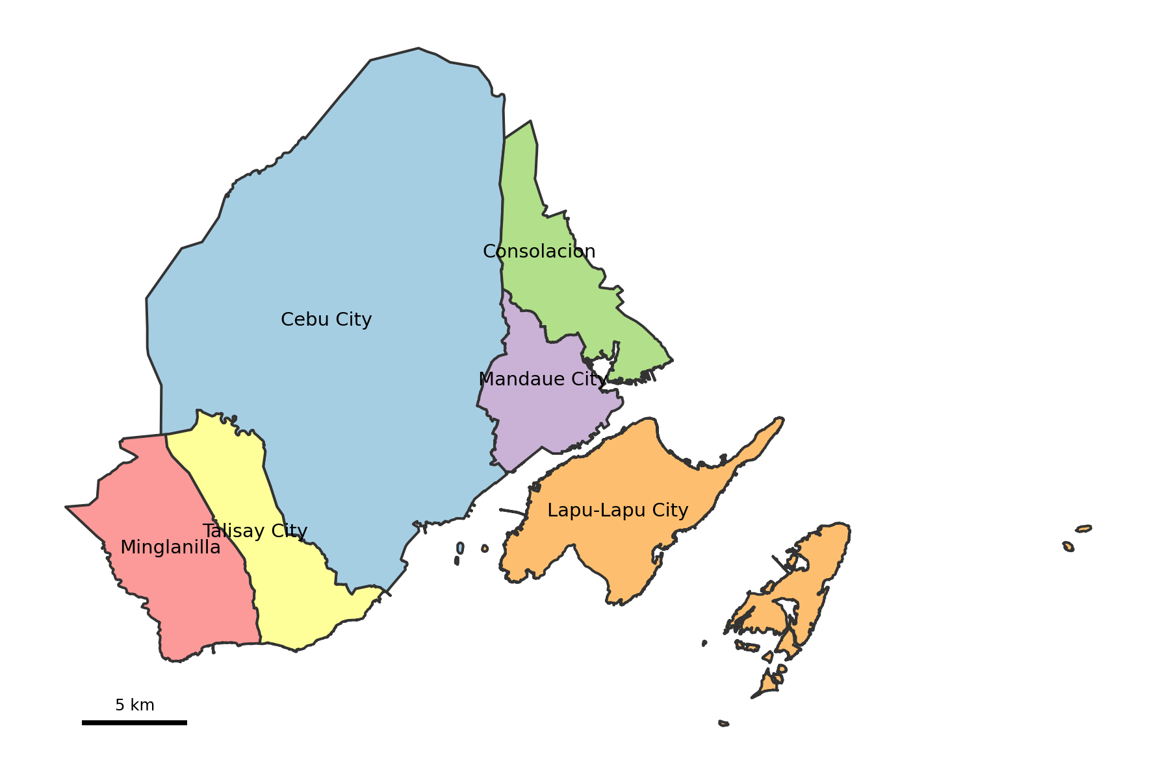
1 · INTRODUCTION
3 / 39
Where this study is set
▪ Metro Cebu is the country's second-largest urban region; this study focuses on its central core of six LGUs — Cebu City, Mandaue, Lapu-Lapu, Talisay, Minglanilla, Consolacion.
▪ A fast-growing economy: 7.3% growth in 2024, among the fastest outside Metro Manila (PSA Cebu, 2025).
▪ And a fast-rising housing market: 11.5% residential price growth in 2025, the highest rate outside the NCR (BSP, 2025).
▪ Major infrastructure (CBRT, Cebu–Cordova Expressway, SRP) is redrawing which barangays count as accessible.
TAKEAWAY Prices are moving faster than the references people use to interpret them.

Slide 4
1 · INTRODUCTION
4 / 39
How a price is decided — four partial references
A family buying, or an owner selling, asks the same question: what is this property worth? There is no single public source — price is pieced together from several partial references, each built to answer a different question.
Reference | Built for | What it misses
Broker & agent opinion | Local market knowledge | Not standardized or reproducible across people
Bank appraisals | Lending & collateral risk | Conservative; not the seller's market question
BIR zonal values | Taxation & assessment | Not live prices; often not updated (BIR, n.d.; Otsuka et al., 2023)
Online listings | Current, property-level | Asking prices — full of seller strategy and noise
They serve different purposes, follow different assumptions, and update at different speeds — so they cannot be compared.

Slide 5
1 · INTRODUCTION
5 / 39
The problem
Metro Cebu lacks a transparent, property-level, spatially detailed reference for interpreting residential price evidence.
TAKEAWAY This study builds that missing reference layer — a decision-support tool, not a replacement for professional appraisal .

Slide 6
1 · INTRODUCTION
6 / 39
Research questions and scope
▪ RQ1 — What value drivers significantly influence residential prices in Metro Cebu?
▪ RQ2 — Among Hedonic Regression, Random Forest, and XGBoost, which is most suitable for deployment — balancing accuracy, small-sample robustness, and interpretability?
▪ RQ3 — Do geospatial features improve accuracy over a structural-only model, and how does that differ across property types?
▪ RQ4 — How large is the valuation gap between model estimates and BIR zonal values across Metro Cebu?
Scope
▪ Six LGUs and eight polycentric CBD nodes; the open-market segment only for the deployed model.
▪ A prototype web application for triangulation; a cross-sectional snapshot, late 2025.

Slide 7
02
Review of Related Literature
What is known, and the gap

Slide 8
2 · REVIEW OF RELATED LITERATURE
8 / 39
The obstacle, and two modeling traditions
International work consistently finds the primary obstacle to valuation in developing markets is data scarcity — not valuer misconduct.
The evidence
Two modeling traditions
▪ Kenya — a census of 427 Nairobi valuers ranked “limited information” the top problem (Cheloti, 2021).
▪ Nigeria — 92.7% of 300 valuers cited insufficient market evidence (Ajibola, 2010).
▪ The fix is not better judgment but a better, shared evidence base.
▪ Hedonic regression — interpretable, one coefficient per attribute (Rosen, 1974).
▪ Machine learning — non-linear, interacting effects (Breiman, 2001); tree ensembles win on tabular data (Grinsztajn et al., 2022).
▪ Regional precedent in Surabaya (Tanamal et al., 2023), with small-sample caution.

Slide 9
2 · REVIEW OF RELATED LITERATURE
9 / 39
Location dominates — and why we model types separately
▪ Location is the dominant driver. Agosto (2020), the only Cebu-specific study, finds transport accessibility the primary driver of land value; accessibility is formalized through gravity indexing (Hansen, 1959), since raw distances alone are too fragmented (Rey-Blanco, 2024).
▪ Separate models per property type are grounded in evidence: modeling submarkets separately lifted R² from 0.637 to 0.782 (Dröes et al., 2019); segmenting before fitting improved fit ~7% and cut error >10% (Usman et al., 2020).
▪ Different property types are priced by different logic, so one pooled equation fits all of them worse.
TAKEAWAY The gap: no published, reproducible, property-level model for Metro Cebu integrates open-market listings, geospatial accessibility, and explainable ML. This study builds it.

Slide 10
03
Methodology
Data, geospatial features, modeling design

Slide 11
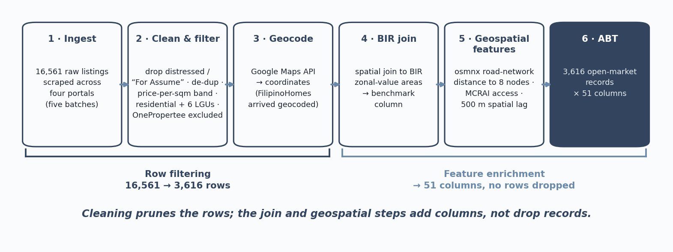
3 · METHODOLOGY
11 / 39
The data pipeline
Sources: Lamudi, FilipinoHomes, DotProperty (open-market listings); BIR zonal values (benchmark); Google Maps & OpenStreetMap (POIs, geocoding); the osmnx road network (node distances). Target: price per square meter.

Slide 12
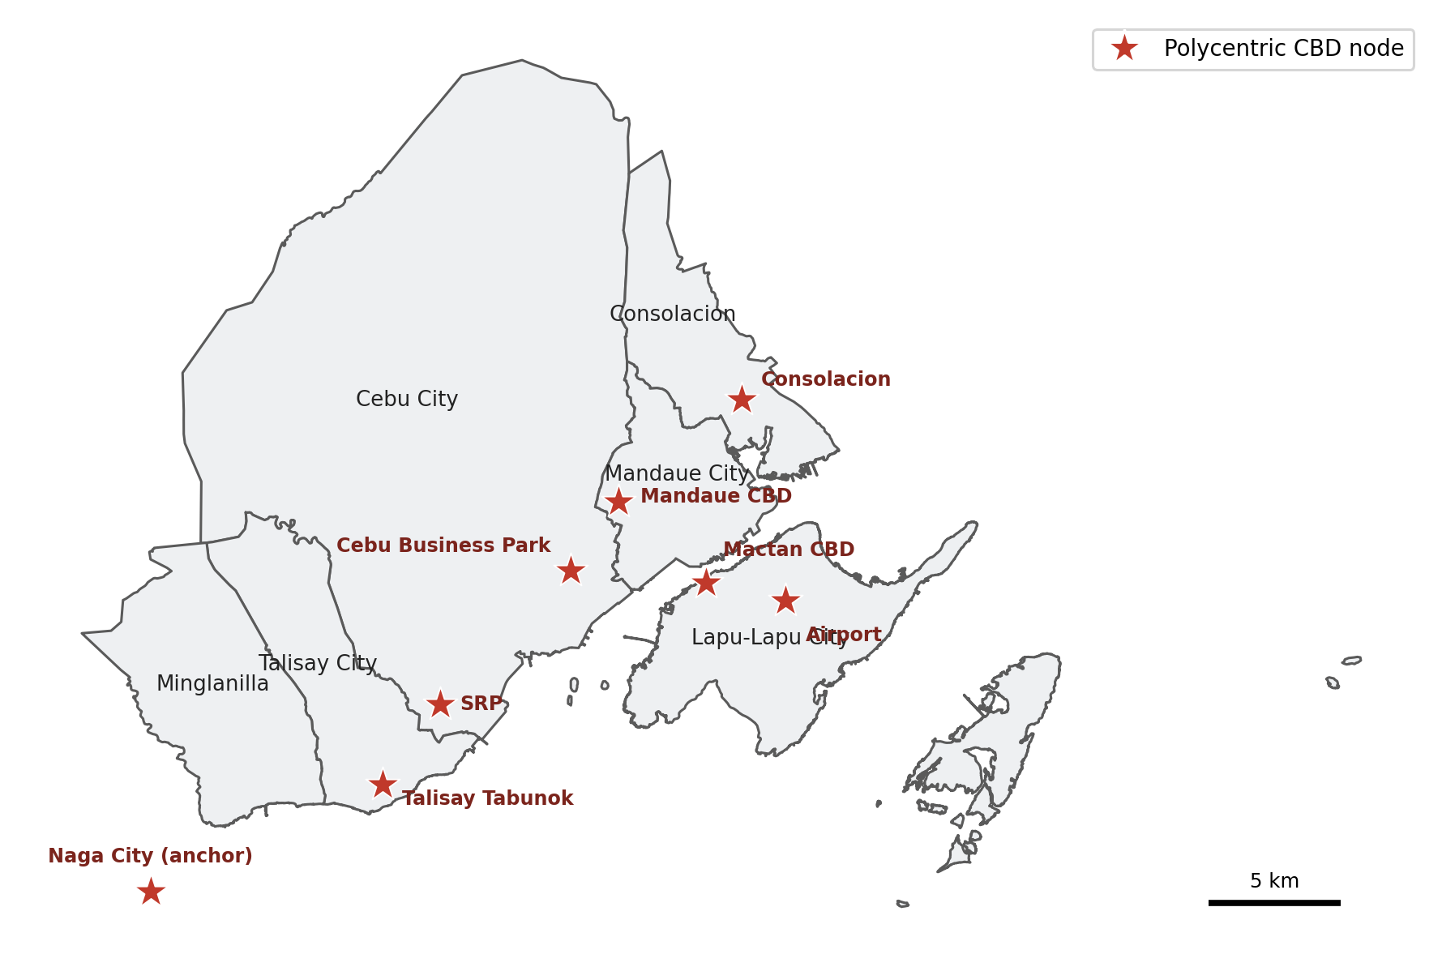
3 · METHODOLOGY
12 / 39
Geospatial features — distance, neighborhood, and the target
▪ Shortest-path road-network distance (not straight-line) to eight economic nodes — Cebu Business Park, Mandaue, Mactan, SRP, Talisay Tabunok, Consolacion, Naga, and the airport — grounded in polycentric urban economics (Giuliano & Small, 1991; JICA, 2015).
▪ A neighborhood price lag: the average price of nearby same-type listings within 500 m (Tobler, 1970).
▪ The model predicts the log of price per square meter; predictions are converted back for the price surface.
▪ Road distance captures real travel cost — including the Mactan bridge crossing.

Slide 13
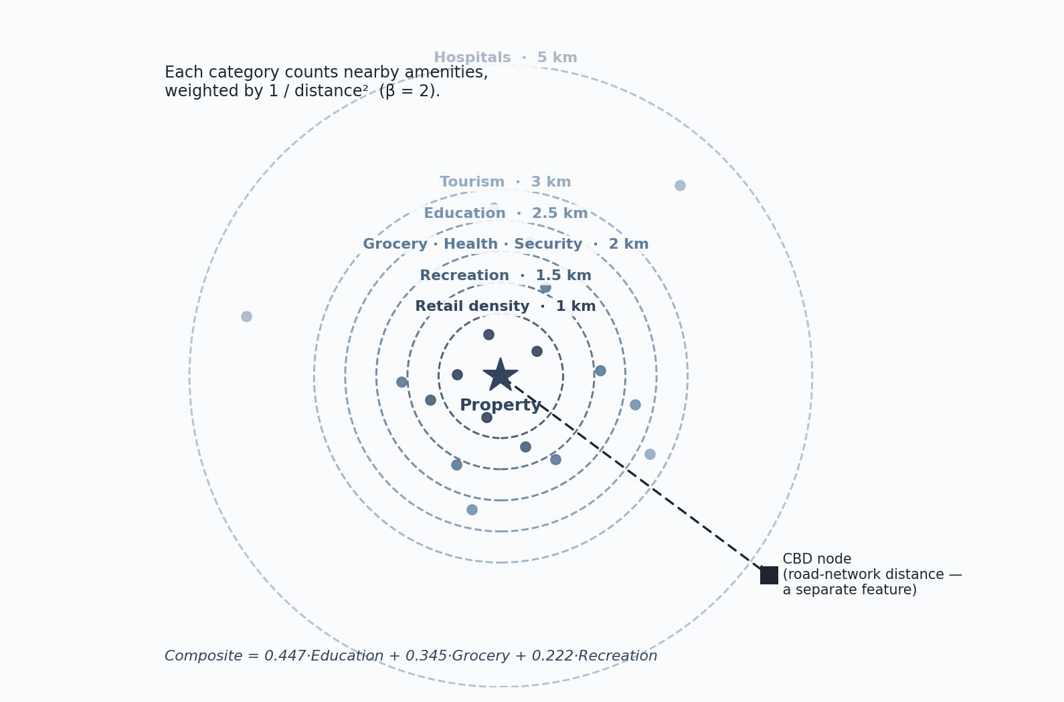
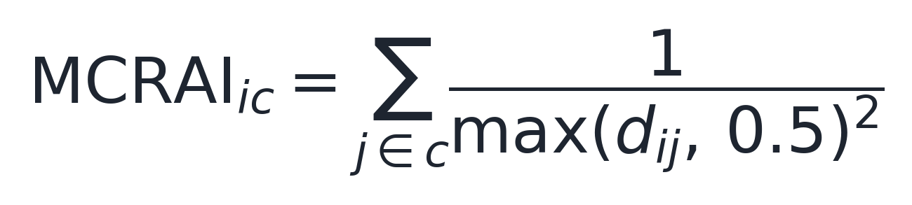
3 · METHODOLOGY
13 / 39
MCRAI — measuring access to amenities
The idea, in plain terms
▪ For each property, count the nearby amenities in a category (schools, groceries, hospitals, …).
▪ Closer amenities count more — the score fades with the square of road distance.
▪ Each category has its own reach, because a hospital serves a wider area than a corner store.
Distances in km, floored at 0.5 km. (Hansen, 1959)

Slide 14
3 · METHODOLOGY
14 / 39
MCRAI — categories, reach, and how the weights were chosen
Category | Reach (km)
Education | 2.5
Grocery | 2.0
Health | 2.0
Hospitals | 5.0
Recreation | 1.5
Security | 2.0
Tourism | 3.0
Retail density | 1.0
Weights from the market, in two stages
▪ Stage 1 — fit a hedonic regression; each category's coefficient is its implicit price (sign = premium or penalty; significance = reliable) (Rosen, 1974).
▪ Stage 2 — keep the positive, significant categories and normalize their coefficients to sum to one.
▪ Result: education 0.447, grocery 0.345, recreation 0.222; the others stay as standalone features, not in the composite.
Each reach is set to the category's catchment, refined for Metro Cebu. Transport is measured separately as road distance to the eight nodes.
TAKEAWAY The regression discovers the weights — we do not impose them.

Slide 15
04
Data Understanding
Collection and exploratory analysis

Slide 16
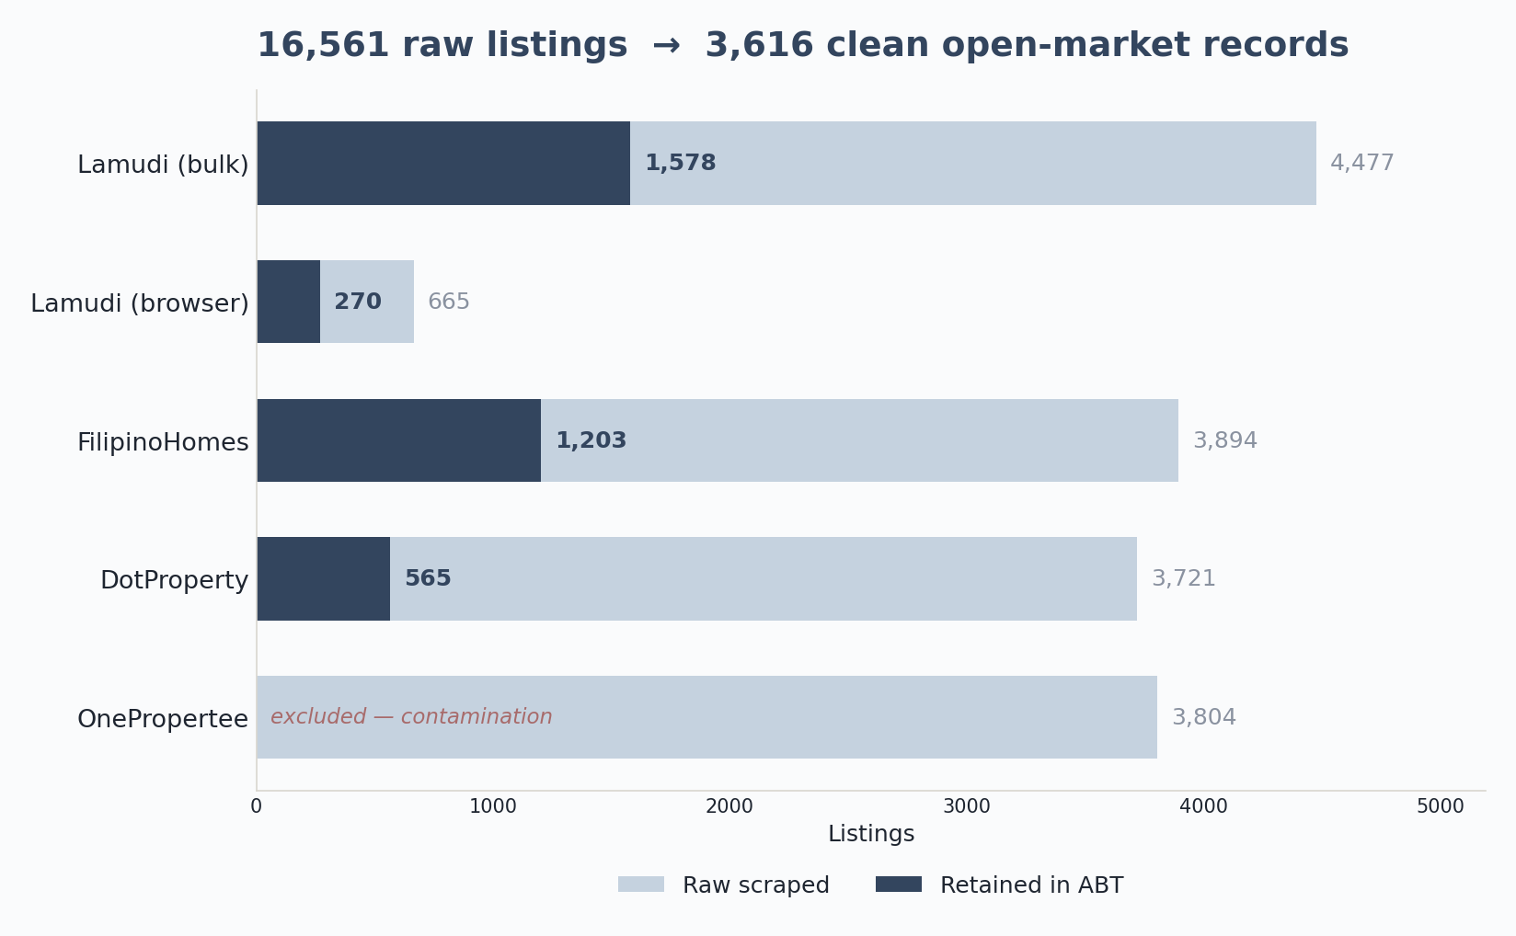
4 · DATA UNDERSTANDING
16 / 39
From collection to a clean ABT
▪ 16,561 listings scraped across three portals; 3,616 survived to the analytics base table.
▪ Filters: geocoding, the six-LGU and residential constraints, a price-per-sqm sanity band, distressed-listing removal, and de-duplication.
▪ OnePropertee was excluded entirely — bad geocoding and mis-extracted prices would have contaminated the model.
TAKEAWAY A conservative funnel: roughly one in five raw listings is kept.

Slide 17
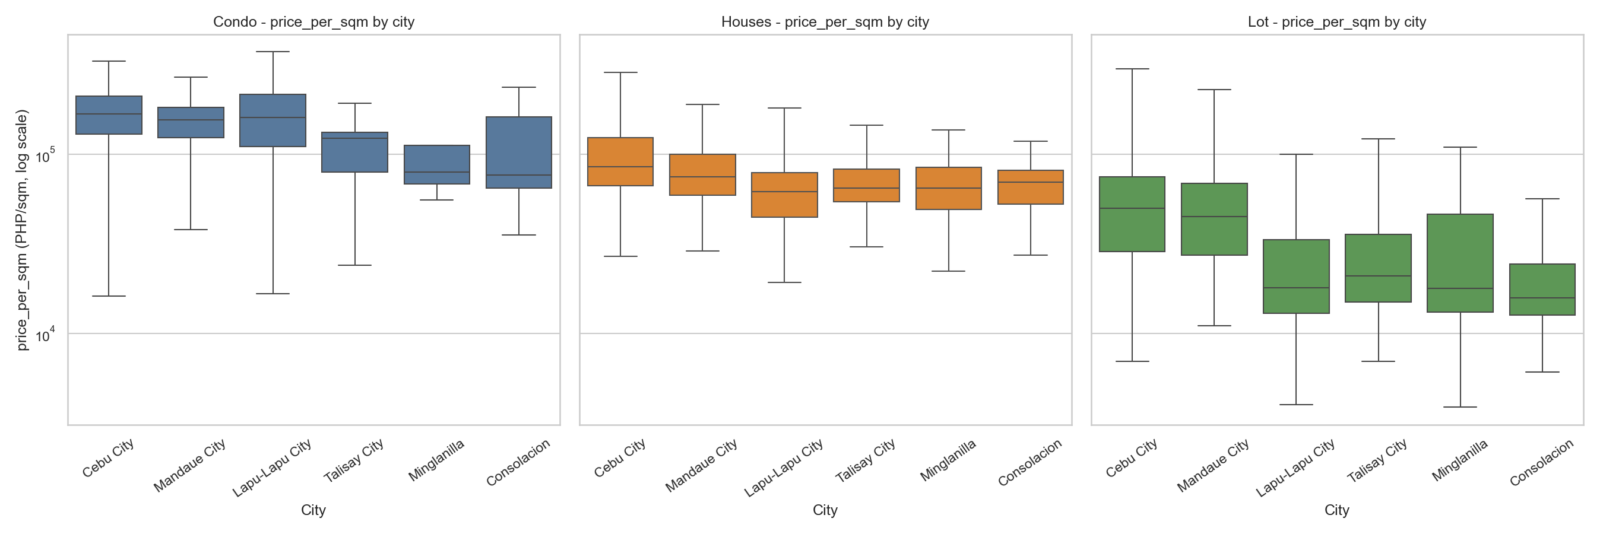
4 · DATA UNDERSTANDING
17 / 39
What the data shows
▪ Price per sqm is right-skewed (a few premium units) — which is why it is modeled in log.
▪ Sharp geographic spread: Cebu City ~₱113,600/sqm, Mandaue ~₱96,100, Lapu-Lapu ~₱92,100; a lower band ~₱47,100–56,800 for Talisay, Minglanilla, Consolacion.
▪ Some southern CBD distances move together — an early collinearity warning for the linear baseline (handled with VIF).
▪ MCRAI coverage checked before modeling: education and grocery near-complete, security sparsest — zero rates flag thin catchments, not data failure.

Slide 18
05
Data Preparation
Cleaning, and preparing data for the models

Slide 19
5 · DATA PREPARATION
19 / 39
Cleaning, and a data-integrity finding
▪ Imputed values were flagged, never silently filled; structurally-absent fields (beds/baths for vacant lots) were left unimputed, not faked.
▪ Hard duplicates were dropped and a price-per-square-meter sanity band applied; the modeling subset is 3,372 of the 3,616 assembled rows.
▪ Early models were dominated by one suspicious SHAP feature — the target had quietly come to mean two different things across scrape batches.
TAKEAWAY Tracing and fixing that — redefining the target to log price per square meter — is exactly why the final metrics are dependable.

Slide 20
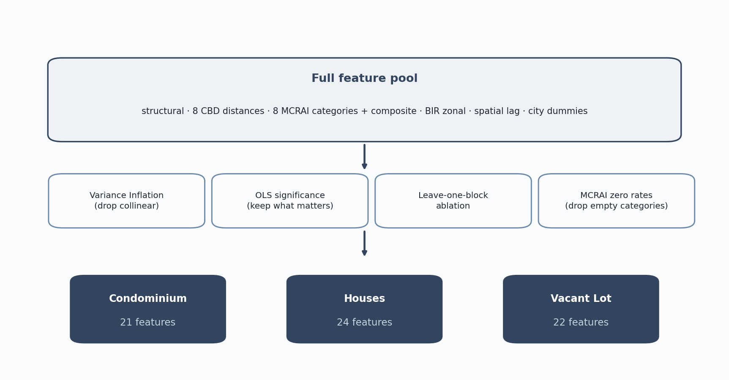
5 · DATA PREPARATION
20 / 39
Preparing the data for modeling
▪ Split by property type into three datasets; encode cities as indicators; assemble structural, distance, MCRAI, benchmark, and spatial-lag features.
▪ Every candidate passes four screens: variance inflation (drop duplicates), OLS significance (keep what moves price), leave-one-block ablation, and MCRAI zero rates.
▪ The result is three tailored feature sets: 21 / 24 / 22.

Slide 21
06
Modeling
Stratified models, selection, tuning

Slide 22
6 · MODELING
22 / 39
One model cannot price three markets
5.8×
The condominium median price per square meter runs about 5.8 times the vacant-lot median.
▪ Built area and land-only follow fundamentally different price logic; a single pooled model averages them into one blurred equation that fits none well.
▪ So the study fits three separate models, one per property type — backed by Dröes et al. (2019) and Usman et al. (2020).
TAKEAWAY Stratifying is itself an evidence-based finding, not a convenience.

Slide 23
6 · MODELING
23 / 39
The three feature sets
Shared core (all three strata)
Per-stratum differences
▪ Eight road-network CBD distances.
▪ BIR zonal benchmark + 500 m spatial lag.
▪ City indicators (Cebu City = reference).
▪ Condos & houses: structural attributes (area, beds, baths + flags) and the single MCRAI composite.
▪ Houses add property-type indicators (single-detached, house-and-lot, townhouse).
▪ Vacant lots: land area only (no beds/baths) + six individual MCRAI categories.
TAKEAWAY Collinearity shaped the OLS baseline (composite and redundant terms trimmed); the deployed trees tolerate it. The strata differ mainly by what each property type has. Final counts: 21 / 24 / 22.

Slide 24
6 · MODELING
24 / 39
Models, selection, and tuning
The lineup
Why these, and tuning
▪ OLS hedonic — interpretable baseline, HC3 robust errors (Rosen, 1974).
▪ Random Forest — non-linear, robust on small samples (Breiman, 2001).
▪ XGBoost — gradient boosting (Chen & Guestrin, 2016); SHAP explains every prediction (Lundberg & Lee, 2017).
▪ Set aside: SVR (hard to tune, weak interpretability), LASSO/Ridge (subsumed by OLS), deep nets (need >10,000 samples).
▪ Deployed Random Forest tuned per stratum (300 trees; max-features 0.7 / 1.0 / 1.0; min-leaf 1 / 2 / 1).
▪ Comparators run at standard settings, so the head-to-head stays fair.

Slide 25
07
Evaluation
Accuracy, model comparison, ablation

Slide 26
7 · EVALUATION
26 / 39
Headline accuracy — all three models
Estimated under a strict, leak-free protocol: GroupKFold(5) by coordinate cluster — the same location never appears in both train and test folds, so the model cannot memorize a neighborhood.
MdAPE — typical error (lower better)
PE20 — share within 20% (higher better)
Type | OLS | RF † | XGB
Condo | 24.5% | 19.3% | 19.8%
Houses | 25.1% | 22.7% | 23.6%
Lot | 44.8% | 38.4% | 40.2%
Type | OLS | RF † | XGB
Condo | 40% | 51% | 50%
Houses | 41% | 44% | 43%
Lot | 22% | 26% | 27%
TAKEAWAY † Deployed. Both tree models beat OLS in every stratum; Random Forest is best-or-tied and deployed. Condos and houses estimate well; vacant lots remain weakest. (The study does not claim IAAO assessment-grade compliance.)

Slide 27
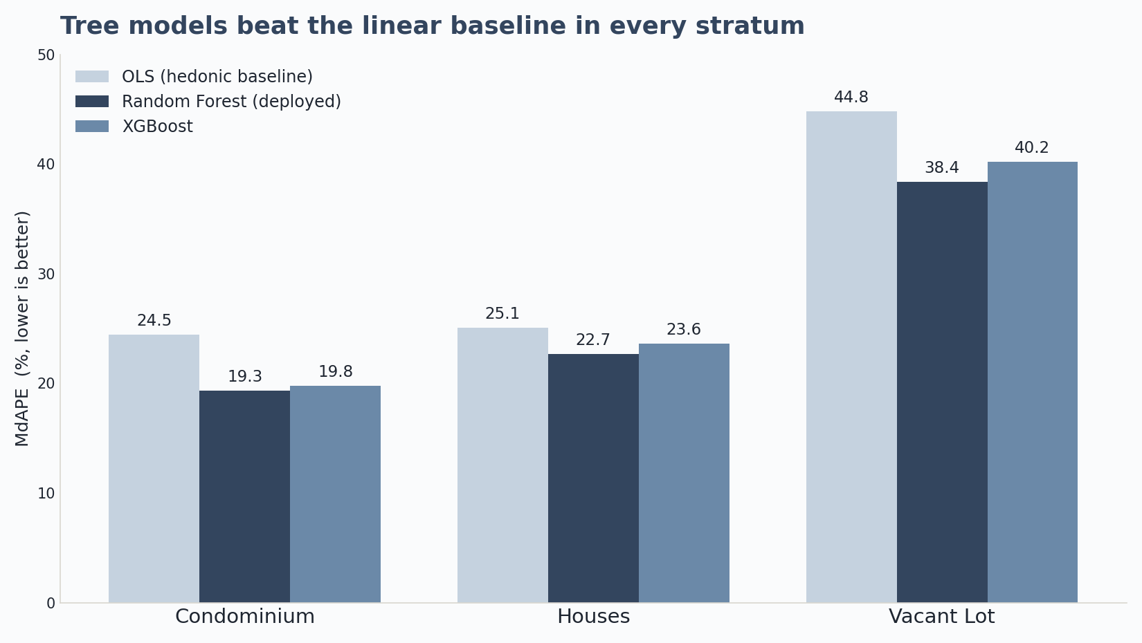
7 · EVALUATION
27 / 39
Which model performed best? (RQ2)
▪ Under identical leak-free folds, both tree models beat the OLS baseline in every stratum.
▪ Random Forest and XGBoost are close; RF edges it on grouped-CV (19.3 vs 19.8 / 22.7 vs 23.6 / 38.4 vs 40.2).
▪ Because the tree models are so close, the fair reading is “RF best-or-tied.”
▪ Random Forest was deployed — robust on small samples, and simpler to maintain.

Slide 28
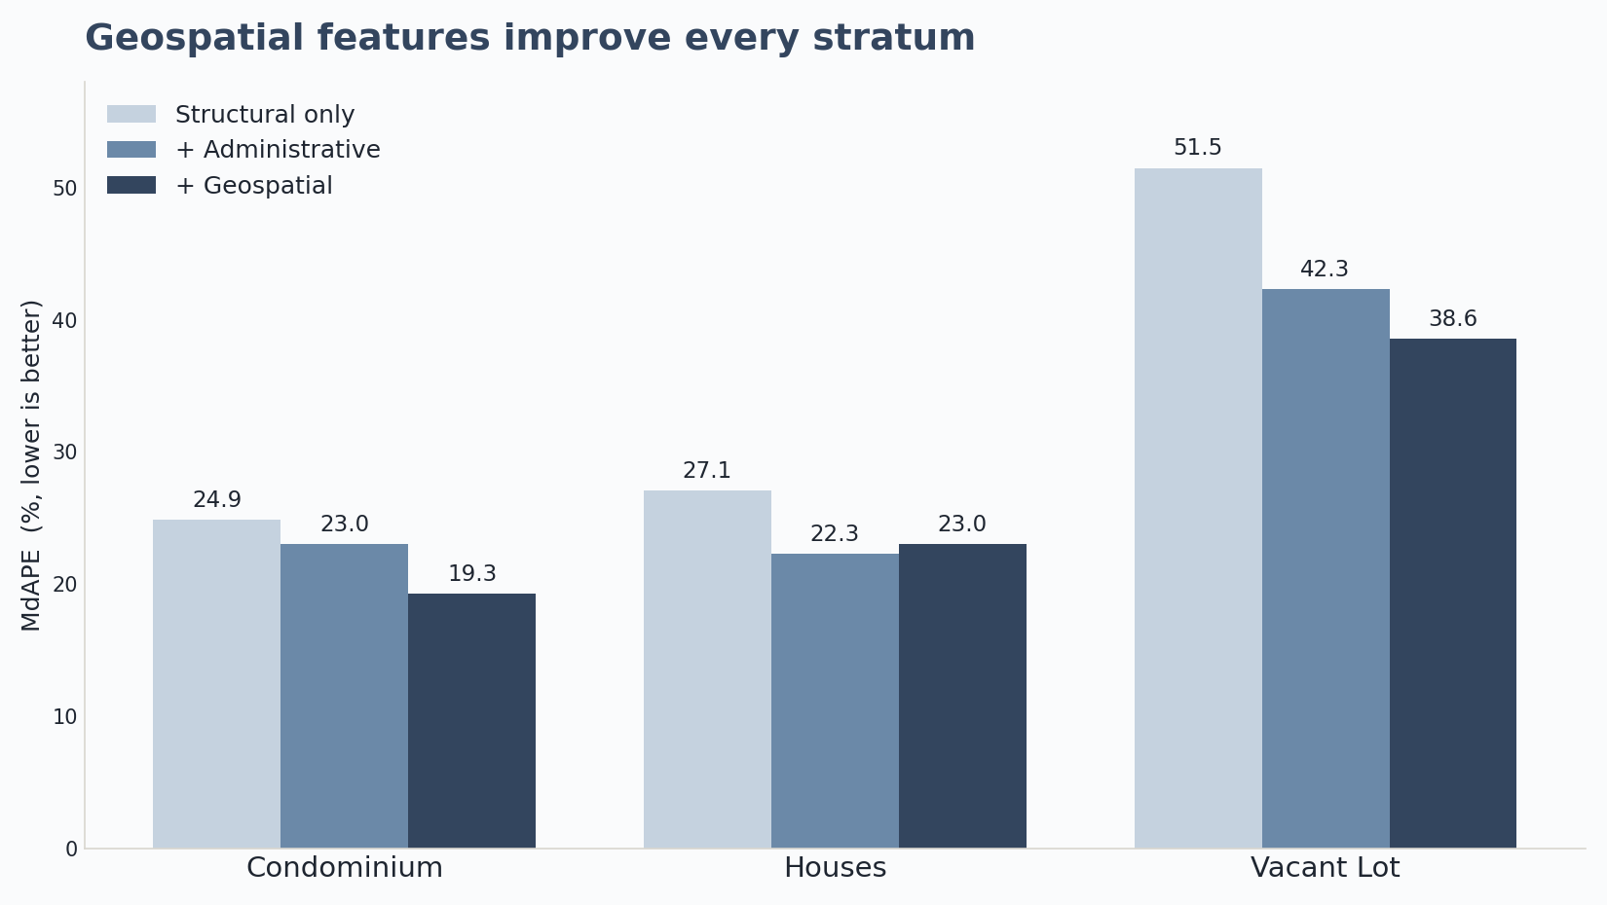
7 · EVALUATION
28 / 39
Do geospatial features earn their place? (RQ3)
▪ A three-tier ablation under identical folds: Structural → + Administrative → + Geospatial.
▪ Geospatial features improve every stratum vs structural-only: condo +5.7, houses +4.2, lot +13.0 points.
▪ On top of administrative location (city + BIR zonal): condo +3.7, lot +3.8, houses ≈ −0.7.
▪ They add the most where benchmarks are weakest — vertical condos and bare land.

Slide 29
08
Results and Discussion
Drivers and spatial structure

Slide 30
8 · RESULTS & DISCUSSION
30 / 39
What drives value, and the polycentric structure (RQ1)
▪ Location dominates in every stratum — the geospatial block carries most of the SHAP attribution.
▪ Drivers differ by type: condos track their neighborhood price (spatial lag); houses and lots are driven by distance to Cebu Business Park (classic bid-rent); bare land also responds to individual amenity access.
▪ MCRAI is selective — education, grocery, recreation carry positive weight; security, tourism, retail behave as diagnostics, not premiums.
▪ The model learned a polycentric, not monocentric, structure: CBP anchors land and housing, but condo weight spreads across the Mactan/airport corridor and the Mandaue–Consolacion nodes (Giuliano & Small, 1991; JICA, 2015).
TAKEAWAY Negative MCRAI signs reflect spatial sorting — these uses cluster where congestion deters some buyers — not proof of harm.

Slide 31
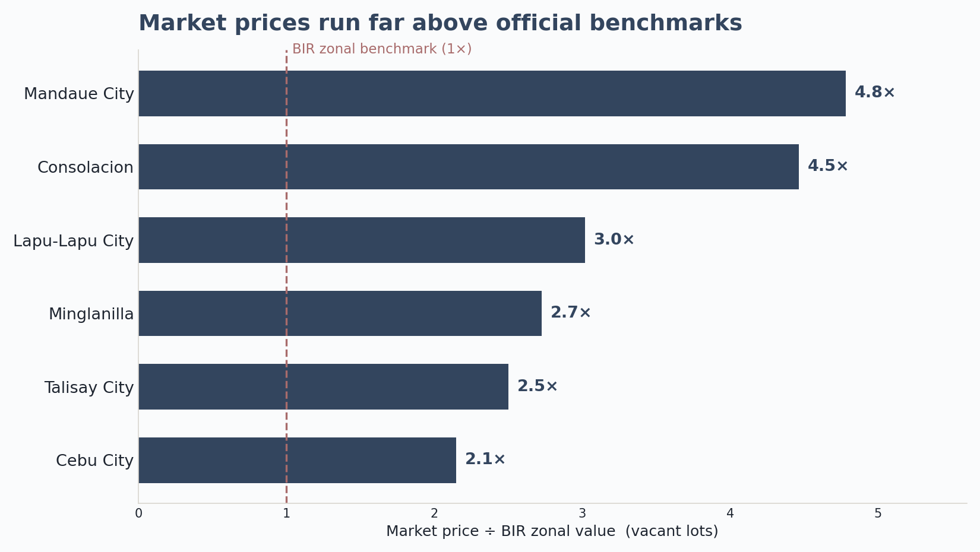
8 · RESULTS & DISCUSSION
31 / 39
The valuation gap (RQ4)
▪ On the clean land-to-land comparison, vacant-lot market price runs ~3× the BIR benchmark overall.
▪ From ~2.2× in Cebu City to ~4.8× in Mandaue; listings exceed the benchmark in nearly every LGU.
▪ The gap is large, positive, and systematic — BIR zonal values sit well below the open market.
▪ Read it as a research signal that benchmarks are stale — not a correction factor to apply.

Slide 32
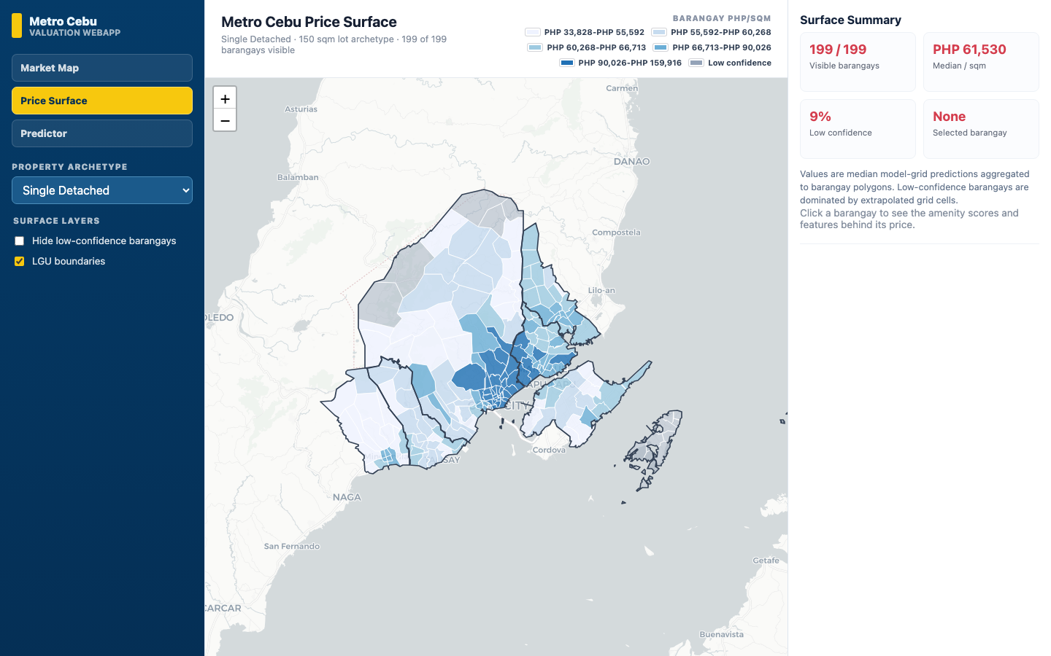
THE DECISION-SUPPORT TOOL
32 / 39
The decision-support tool — the applied deliverable
▪ Market Map — open-market listings with filters and market-intelligence summaries.
▪ Price Surface — the predicted price-per-square-meter surface, aggregated by barangay.
▪ Property Predictor — a property-level prediction with its SHAP breakdown; the tool always shows its reasoning.
▪ The backend runs the exact deployed Random Forest models.

Slide 33
09
Conclusions
Answers, contributions, limits

Slide 34
9 · CONCLUSIONS
34 / 39
Answers, contributions, and limits
Answers to the research questions
Contributions & limits
▪ RQ1 — Location dominates; drivers differ by type (spatial lag for condos; CBP distance for houses and lots; amenities for bare land).
▪ RQ2 — Tree models beat OLS everywhere; RF best-or-tied with XGBoost, deployed for robustness and simplicity.
▪ RQ3 — Geospatial features materially help, most where benchmarks are weakest.
▪ RQ4 — The BIR gap is large, positive, and systematic (~3× on the clean lot comparison).
▪ Per-type modeling with evidence-based feature selection; a polycentric distance set; a two-stage MCRAI; all results under leak-free grouped CV.
▪ A reproducible, explainable web prototype over the deployed models.
▪ Limits: an asking-price ceiling (listings, not deeds); a cross-sectional snapshot; a vacant-lot data ceiling; thin LGU×type cells.

Slide 35
10
Recommendations
Practice, policy, future work

Slide 36
10 · RECOMMENDATIONS
36 / 39
Recommendations
Practice & policy
Future research
▪ Read the surface as a triangulation tool, alongside zonal values and comparables — not a final appraisal.
▪ Weight polycentric distance and property type ahead of the amenity composite.
▪ Keep recognizing secondary and corridor subcenters (Mactan, Consolacion, Naga), not just CBP.
▪ Treat the valuation gap as a research signal; validate against transactions before operational use.
▪ Put MCRAI on an empirical footing — estimate the decay rate, radii, and weights from data.
▪ Test spatial heterogeneity directly with Geographically Weighted Regression (GWR / MGWR).
▪ Enrich inputs — parcel attributes (frontage, corner-lot), a time dimension, macro indicators (Udomsap & Abid, 2020).
▪ Triangulate against complementary reference prices, not a single target.

Slide 37
10 · RECOMMENDATIONS
37 / 39
Closing
A defensible, reproducible template for local valuation analytics — a clearer starting point for deciding what a home is worth, not the last word.
TAKEAWAY The contribution is a demonstrated workflow — a custom MCRAI, a polycentric distance set, and a Random Forest + SHAP pipeline that can be rebuilt, checked, and adapted for other Philippine secondary cities.

Slide 38
REFERENCES
38 / 39
References

Slide 39
Thank you
Chris Dominic Estreba · BS Data Science, UA&P

