Slide 1
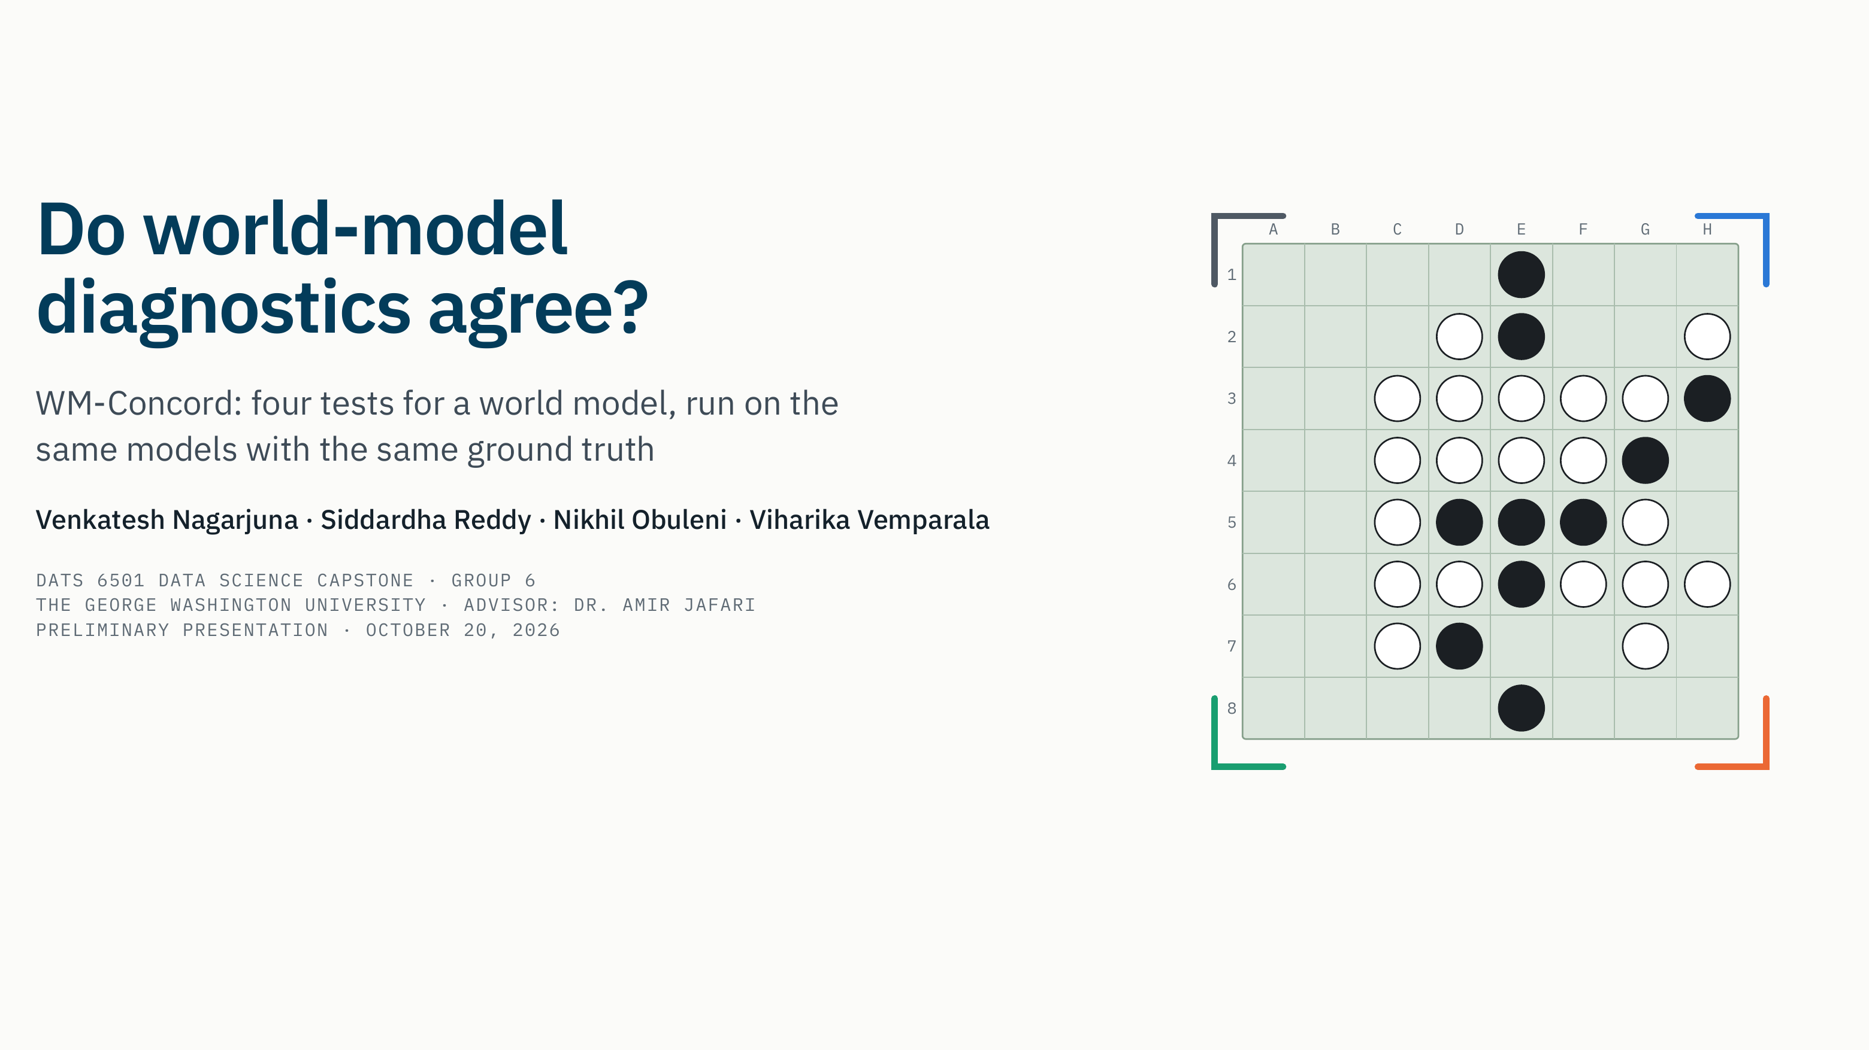
Notes:
Script · about 30 s
Hello everyone. We are Group 6, and our project is WM-Concord.
The question is in the title: when researchers test whether a neural network has learned a "world model" of its domain, do their tests agree? And if they don't, which one should we trust?
I'll cover why this matters, how we designed the study, what we have run on Othello, and what is still in progress.
Likely questions
- Q. Why the name WM-Concord?
A. World Model Concordance. "Concordance" is the statistical word for agreement between rankings. Kendall's coefficient of concordance, W, is one of our main statistics.
- Q. Why is everything about Othello so far?
A. That was the plan from the start. Othello has published reference models and published numbers we can check our code against. Navigation comes next, and the third domain, a small program interpreter, is held out to test whether our findings generalize.

Slide 2
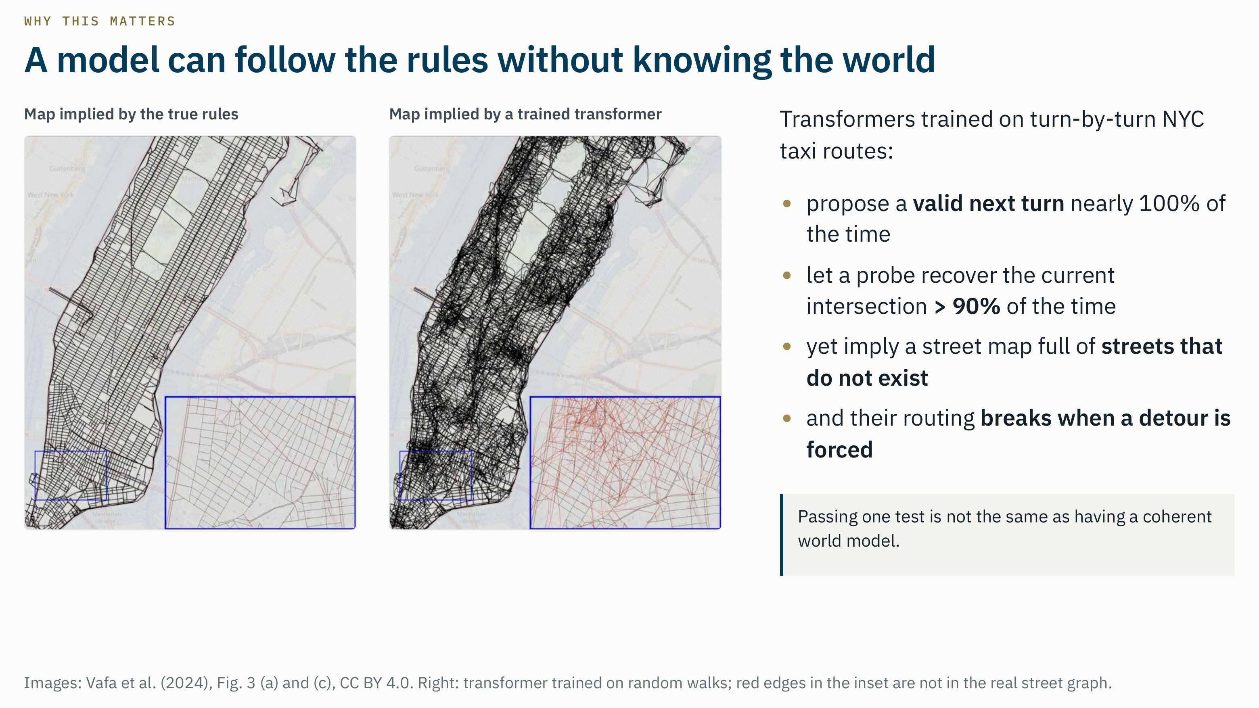
Notes:
Script · about 45 s
Here is the problem in one picture, from Vafa and colleagues at NeurIPS 2024.
They trained transformers on turn-by-turn directions from New York taxi rides. By the standard checks the models look excellent: almost every turn they predict is legal, and a probe recovers the current intersection more than 90 percent of the time.
But the street map the model implies, on the right, is full of streets that do not exist; they are the red edges in the zoomed box. And its routes break down when a detour is forced.
So a model can follow the rules without a coherent picture of the world. Which test should we believe?
Likely questions
- Q. How do they get a map out of a model?
A. They collect the turn sequences the model generates and rebuild the street graph those sequences imply. Any edge that is not in the real street graph is drawn in red. The details are in their appendix.
- Q. Isn't "the next turn is valid" exactly your D1?
A. Yes. That is our first diagnostic, next-move validity. This figure is the reason we never trust D1 on its own.
- Q. Does the same thing happen in Othello?
A. Yes. The same paper scores the two Othello-GPT models from Li and colleagues. Both have high legal-move rates, but only the model trained on synthetic games passes their state tests; the one trained on championship games fails, and it breaks immediately under detours. Our own D2 gives the same order: 0.999 against 0.766.

Slide 3
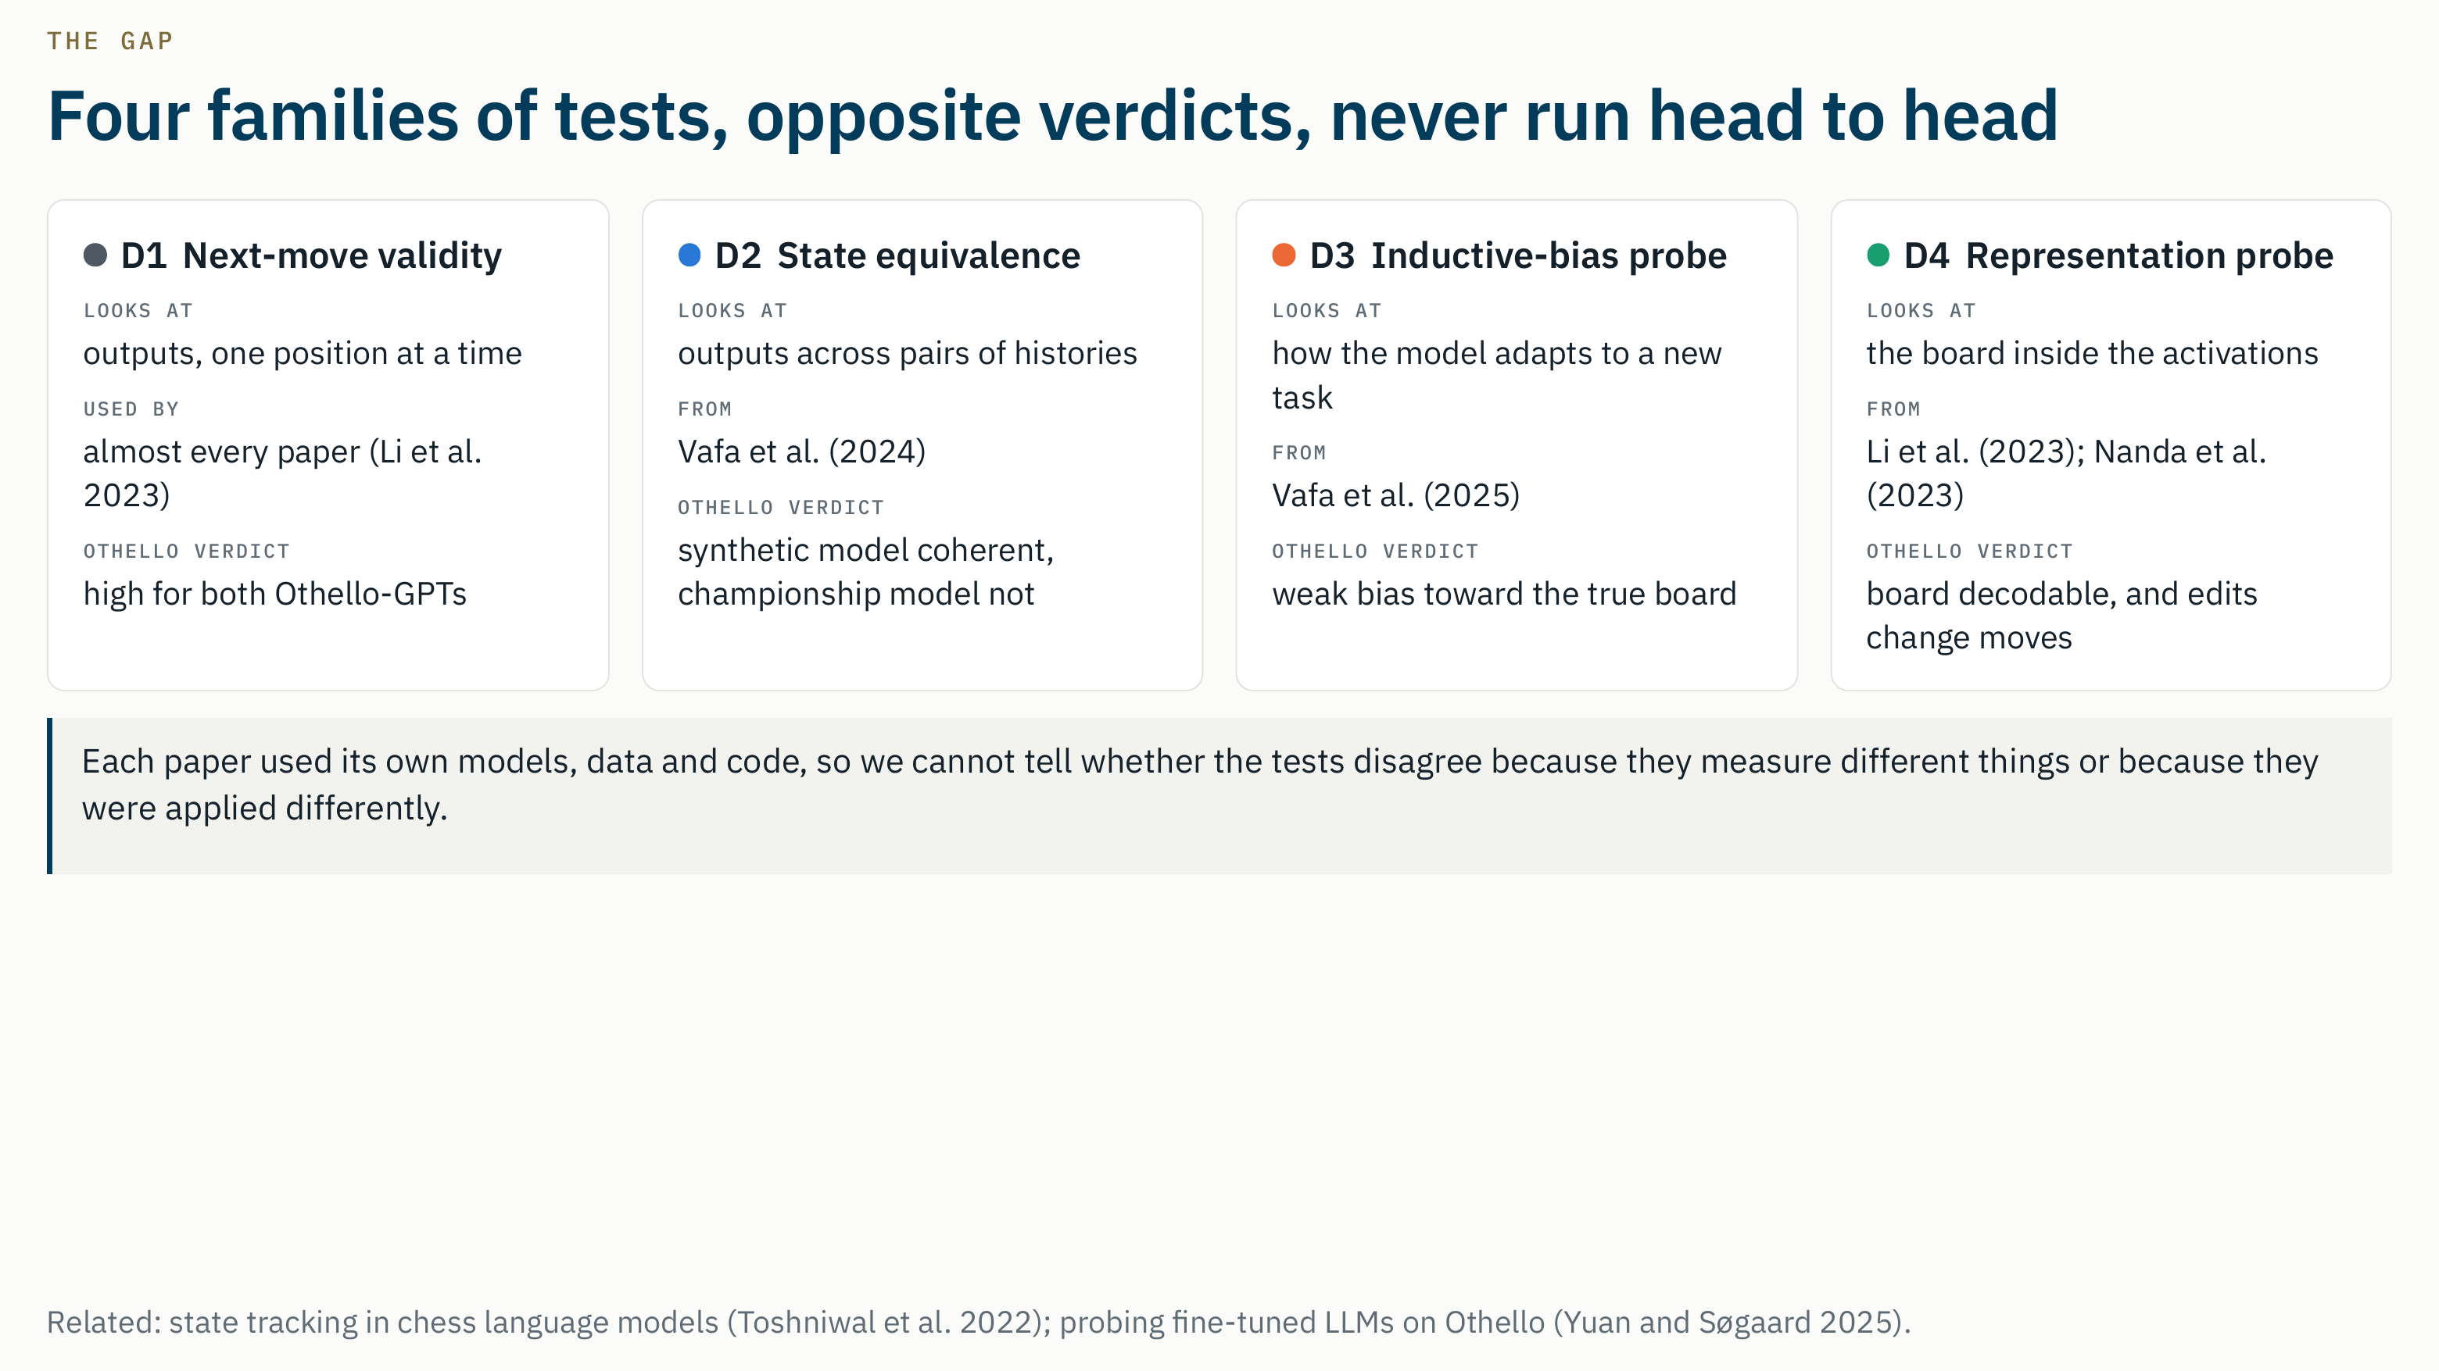
Notes:
Script · about 65 s
The field has four families of tests, and I'll keep these four colors for them throughout.
D1, next-move validity: does the model only propose legal moves? Both published Othello models pass it.
D2, state equivalence, from the same Vafa paper: histories that reach the same board should be treated alike, and different boards told apart. By that test the synthetic Othello model is coherent and the championship model is not.
D3, the inductive-bias probe, from Vafa and colleagues at ICML 2025: adapted to a new board question, the models show only a weak bias toward the true board.
D4, representation probing, from Li and colleagues and Nanda and colleagues: the board can be read out of the activations, and editing it changes the moves.
So: opposite headlines about the same models. But every paper used its own models, data and code, and nobody has compared the four head to head.
Likely questions
- Q. Are there other families, for example the video world-model benchmarks?
A. There are many video benchmarks, and we deliberately do not add another one. We stay with domains whose true state is known exactly, because all four families need that ground truth.
- Q. Li et al. needed a nonlinear probe. Why is your D4 linear?
A. Li et al. used black/white labels, where a linear probe fails. Nanda et al. showed the board is linear once you label squares as mine or theirs. A linear probe is also the cleaner measure, because a more expressive probe can learn the task by itself. We still report an MLP probe as a secondary result.
- Q. Who else says Othello models have a world model?
A. Yuan and Søgaard (2025) fine-tuned seven language models on Othello and could probe the board from all of them, with similar representations across models. They read that as evidence for a world model, the opposite conclusion to Vafa et al. on the same domain. Toshniwal et al. (2022) did similar state-tracking work on chess.

Slide 4
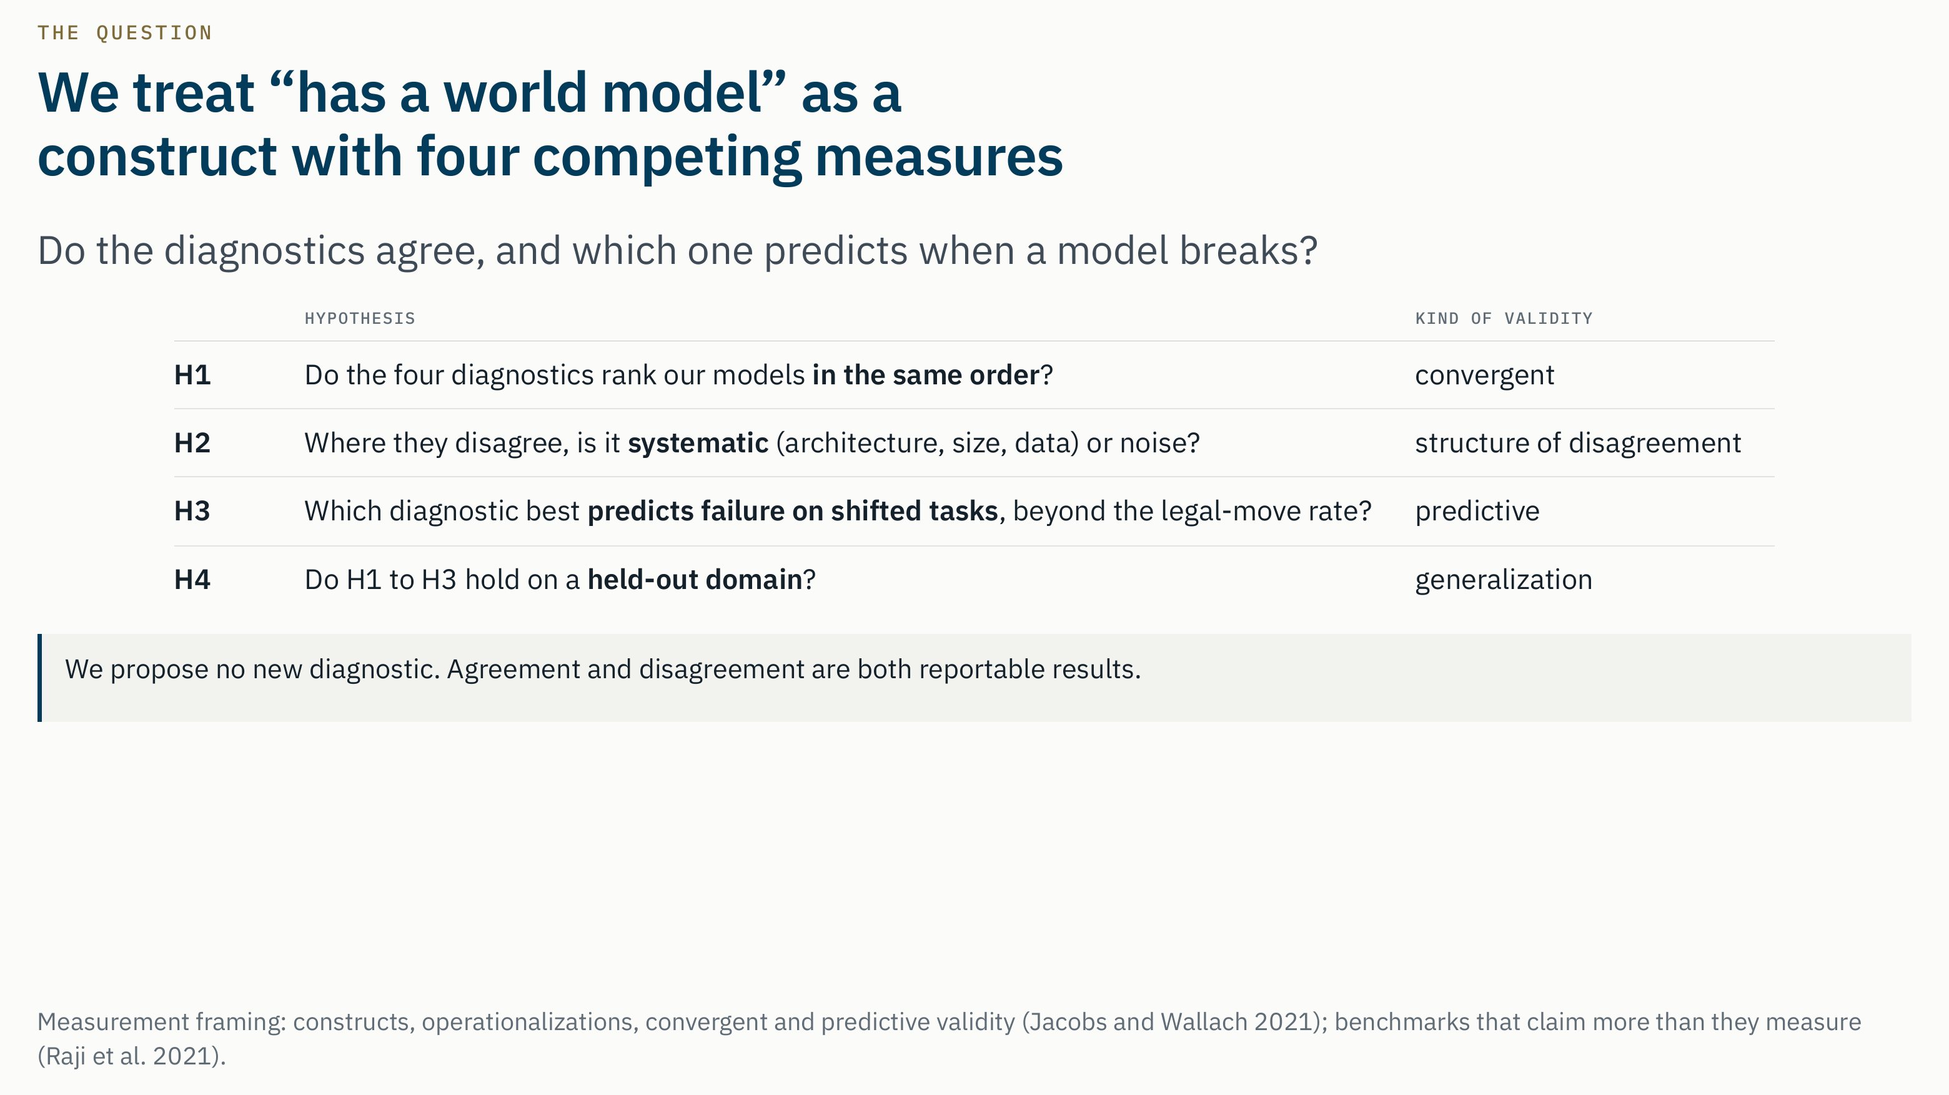
Notes:
Script · about 40 s
So this is a measurement-validity question. Following Jacobs and Wallach, "has a world model" is a construct, and the four diagnostics are four competing ways to measure it.
That gives four hypotheses. H1: do they rank our models in the same order? H2: where they disagree, is it systematic, tied to architecture, size or data, or is it just noise? H3: which one best predicts failure on shifted tasks, beyond the legal-move rate? And H4: do the answers hold on a domain we held out?
We propose no new diagnostic, and either outcome is worth reporting.
Likely questions
- Q. Why is this publishable if you do not propose a new method?
A. Validating the instruments is the open gap. Agreement would justify using cheap diagnostics as proxies for expensive ones; disagreement is a warning to anyone citing one diagnostic; and H3 tells people which one to trust. A concordance study also stays relevant when the next diagnostic appears, because it can be plugged into the same comparison.
- Q. What exactly counts as "agree"?
A. It is preregistered. A pair agrees if Kendall's tau is at least 0.50 and its 95 percent bootstrap interval excludes zero. It disagrees if the interval includes zero or tau is below 0.30. Anything in between is partial.
- Q. What if everything agrees?
A. Then we report the null result for H1, and the weight of the paper moves to H3 and H4. That is a stage gate written into the proposal.

Slide 5
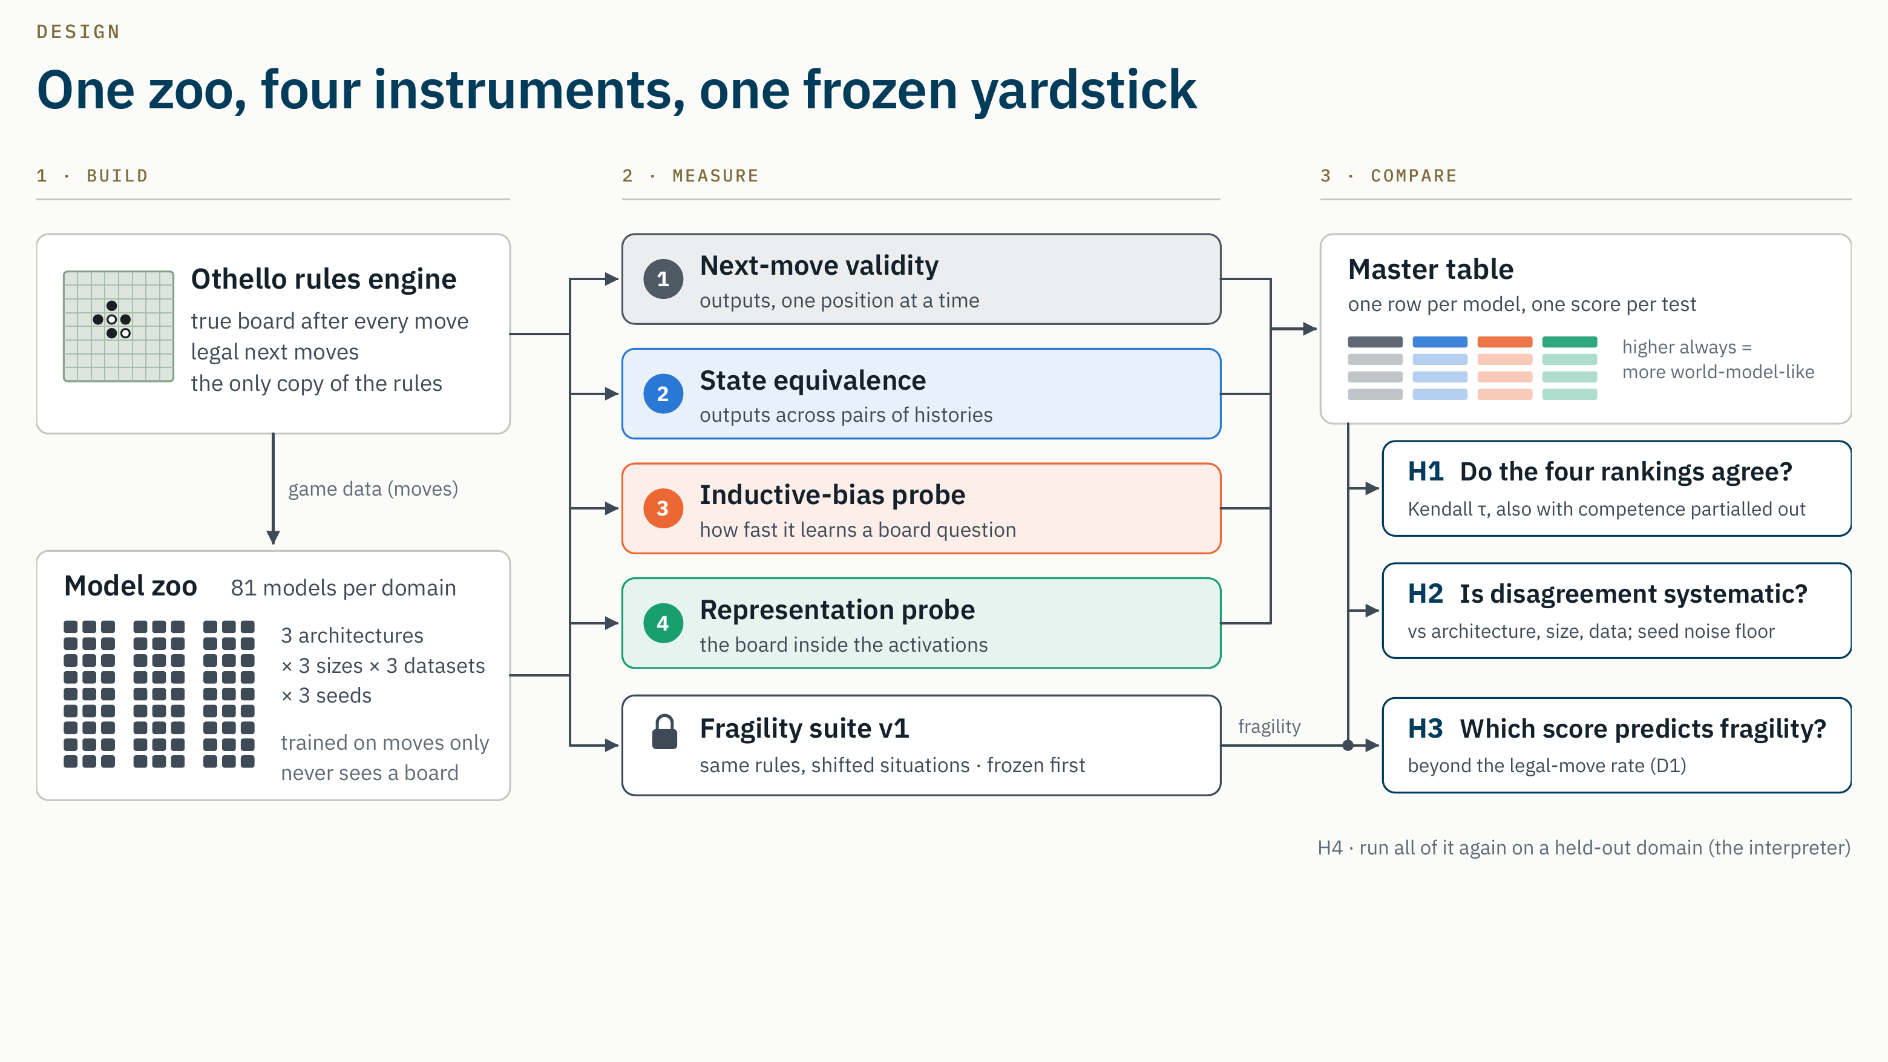
Notes:
Script · about 60 s
Here is the whole design, left to right.
First, build. One Othello rules engine gives the true board and the legal moves after every move. It is the only copy of the rules, so every diagnostic sees the same truth. From the game data we train 81 small models: three architectures, three sizes, three datasets and three seeds. They only ever see move sequences.
Second, measure. Every model goes through all four diagnostics, and each writes one number, where higher always means more world-model-like. A fragility suite, frozen before any score, measures how much each model breaks in shifted situations.
Third, compare. The scores form a master table. H1 asks whether the rankings agree, H2 whether disagreement follows architecture, size or data, and H3 which score predicts fragility. H4 reruns it all on a held-out domain.
Likely questions
- Q. Why must every score be "higher is better"?
A. So that rank correlations have a consistent sign. D2's raw errors are "lower is better", so its score is one minus the mean error.
- Q. Are the two published Othello-GPTs part of the analysis?
A. No. They are anchors: every diagnostic scores them to check the code, but they were trained with a different budget and different code, so they never enter H1 to H4.
- Q. Why freeze the fragility suite first?
A. So it cannot be tuned, even without meaning to, toward one of the diagnostics it will judge. It was tagged fragility-v1 on October 6, before any zoo model was scored by any diagnostic.
Note for the presenter: the fragility suite on this diagram has two frozen versions. Version 1 was frozen on October 6. Version 2, frozen on October 18 in Amendment 3 before any zoo score, plays detours to the end of the game and matches after pass positions more carefully. H3 uses version 2; version 1 is the robustness check. The Rigor 4 slide explains this.

Slide 6
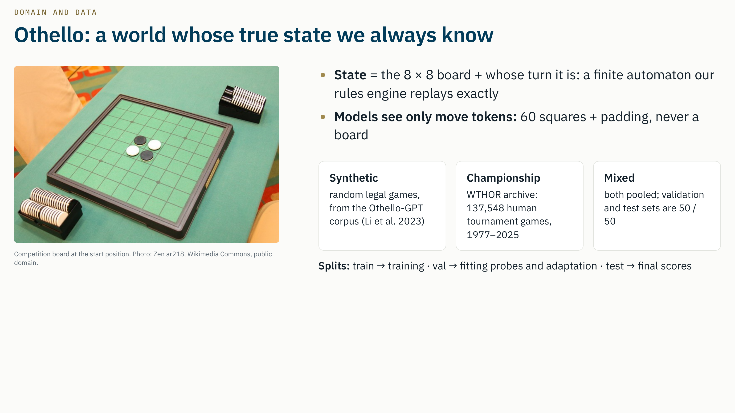
Notes:
Script · about 45 s
We start with Othello, the standard testbed here, because its true state is always known: the board plus whose turn it is. That is a finite automaton, and our rules engine replays it exactly.
The models never see a board, only move tokens, the same vocabulary as Othello-GPT.
We train on three datasets that reach very different boards: random legal games from the Othello-GPT corpus; about 137 thousand human tournament games from WTHOR, the French federation's archive; and a mix of the two.
Training data only trains. Validation data is the only data a diagnostic may fit on. Test data gives the final scores.
Likely questions
- Q. Why these three datasets?
A. Both Li et al. and Vafa et al. found that the training data changes the world model: the synthetic model is coherent and the championship model is not. So the dataset is a lever that spreads our models apart. Human games also cover a much narrower part of the game tree than random play.
- Q. Is "mixed" really 50/50?
A. In the validation and test sets, yes: 500 synthetic and 500 championship games out of 1,000. In training, the loader takes 640,000 synthetic games plus all 110,005 championship training games, and batches are drawn uniformly from that pool. So mixed training is about 85 percent synthetic and 15 percent championship by games. Likewise, a championship model draws 1.28 million games from 110,005, so it sees each game about 12 times on average. We will state this exactly in the methods section. (Backup slide "Training data per model".)
- Q. Why WTHOR and not the othello_world championship file?
A. The championship links in the othello_world repository no longer work. WTHOR is the federation's public archive. We removed 41 duplicate games, found no illegal games, and split 80/10/10 with a fixed seed: 110,005 / 13,751 / 13,751.
- Q. Why are there only 60 move tokens?
A. The four center squares are occupied at the start, so no move can ever be played there.

Slide 7
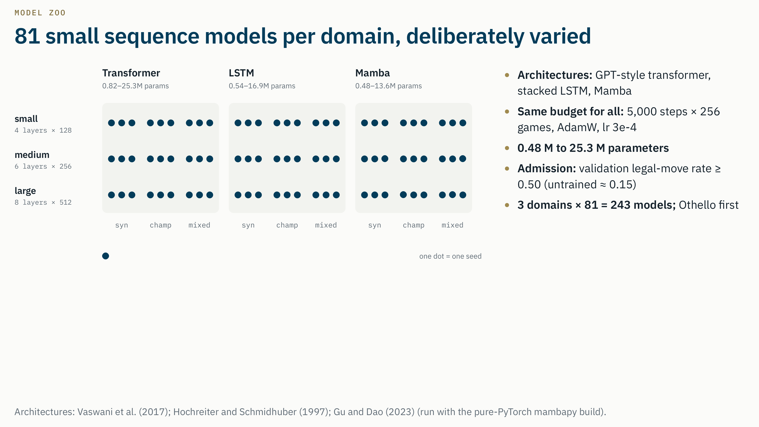
trained, admitted and scored (81 of 81)
Notes:
Script · about 40 s
The zoo varies four things on purpose, so that the diagnostics have real differences to rank: three architectures, a transformer, a stacked LSTM and Mamba; three sizes, from half a million to 25 million parameters; three datasets; and three seeds. That is 81 models for Othello, and 243 across the three domains.
Every model gets the same budget, 5,000 steps of 256 games, and it only counts if its validation legal move rate is at least 0.5. An untrained model scores about 0.15.
Each dot is one model. All 81 are trained, all 81 passed admission, and all 81 have been scored.
Likely questions
Q. Why these three architectures?
A. They remember the past in different ways: attention over the whole history, a fixed size recurrent state, and a selective state space recurrence. H2 asks whether the diagnostics disagree along exactly that axis.
Q. Why not train longer, to Othello-GPT quality?
A. The large transformer already reaches a 0.969 validation legal move rate. Four times the budget would cost about 150 GPU hours for Othello alone. And we need models of different quality: rank correlations only mean something when the models differ.
Q. Why is the admission threshold 0.5?
A. It was fixed before any diagnostic score existed. Below 0.5 a model has not learned the task, so a world model diagnostic has nothing to measure. In the end no model fell below it; the lowest is 0.559.
Q. Why Mamba through mambapy?
A. The official mamba_ssm CUDA kernels did not compile on our instances. mambapy implements the same architecture in plain PyTorch. It is slower; Mamba is 88 percent of our training time, which is why training was split across four instances.
Q. Where are the checkpoints?
A. On the training instances, with a SHA 256 hash in every training record; the scoring script checks that hash before it scores a model. They are being uploaded to the course S3 bucket.

Slide 8
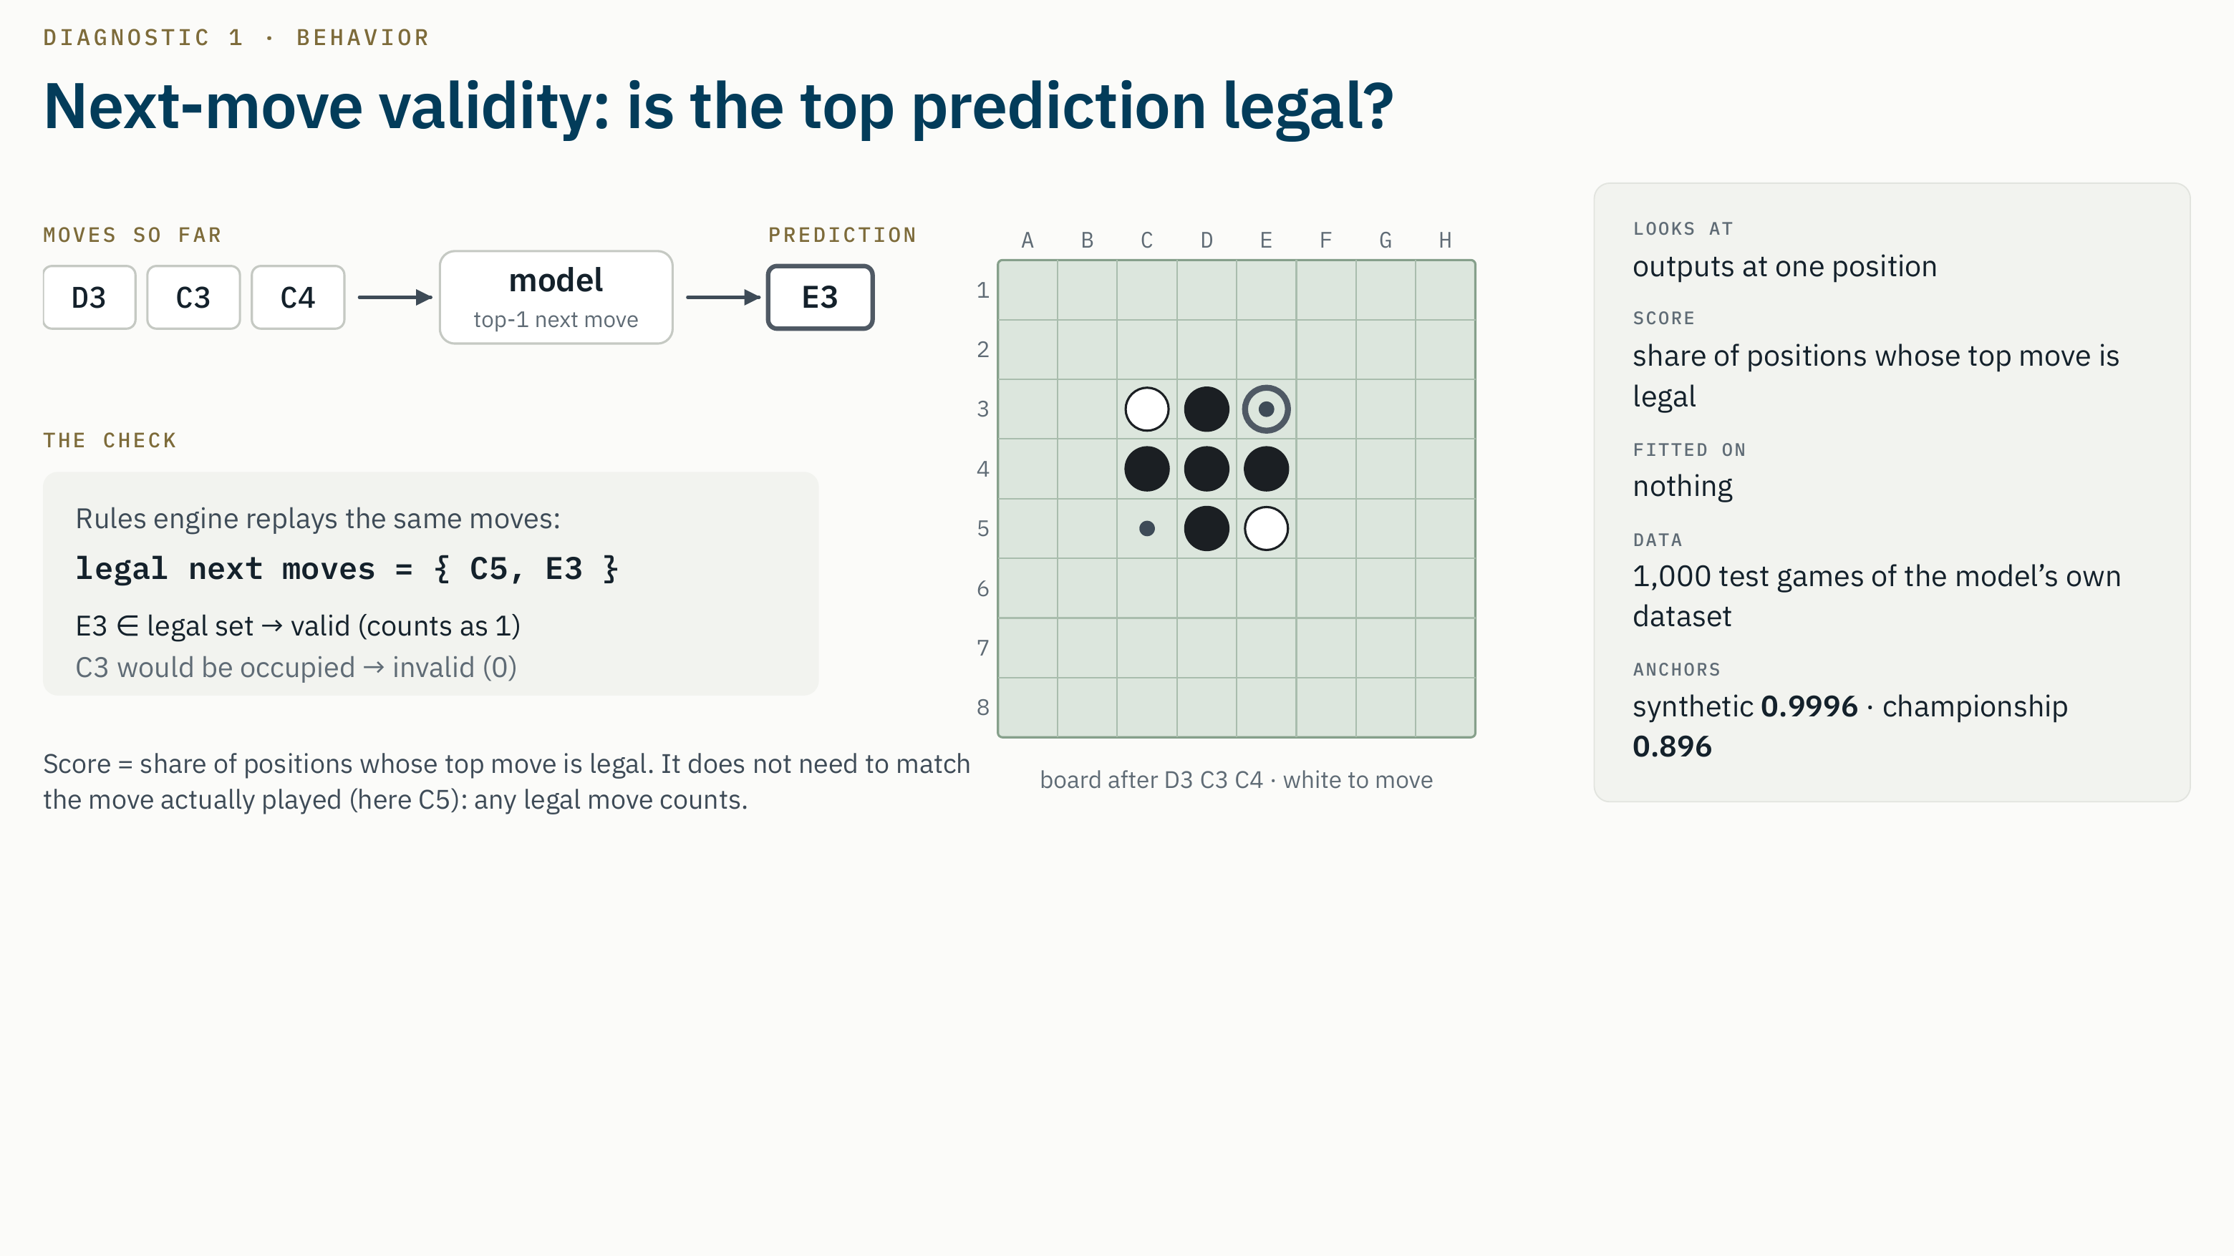
Notes:
Script · about 40 s
D1 is the baseline the literature already uses.
We give the model the moves so far, here D3, C3, C4, and take its top next move: E3. The rules engine says the legal moves are C5 and E3, so this position counts as valid. The model does not need to match the move that was actually played.
D1 is the share of valid positions over a thousand test games, and nothing is fitted. The two reference Othello-GPTs score 0.9996 and 0.896. D1 is also the reference the other three must beat in H3.
Likely questions
- Q. Why the top prediction and not sampling?
A. The top prediction is the preregistered score. We also store a sampled rate, 10 samples per position at temperature 1: 0.998 and 0.889 on the anchors.
- Q. Li et al. report a 5.17 percent error for the championship model. Why is yours about 10 percent?
A. Different test games. We score on our own WTHOR test split; Li et al. scored on their own championship validation set. On the synthetic model our 0.9996 is close to their 0.01 percent error.
- Q. Isn't D1 basically the same as competence?
A. Yes, almost. That is why the preregistration makes D1 the reference in H3, and why any D1 pair is marked "not interpretable" after the competence control if D1 and competence correlate at 0.90 or more.

Slide 9
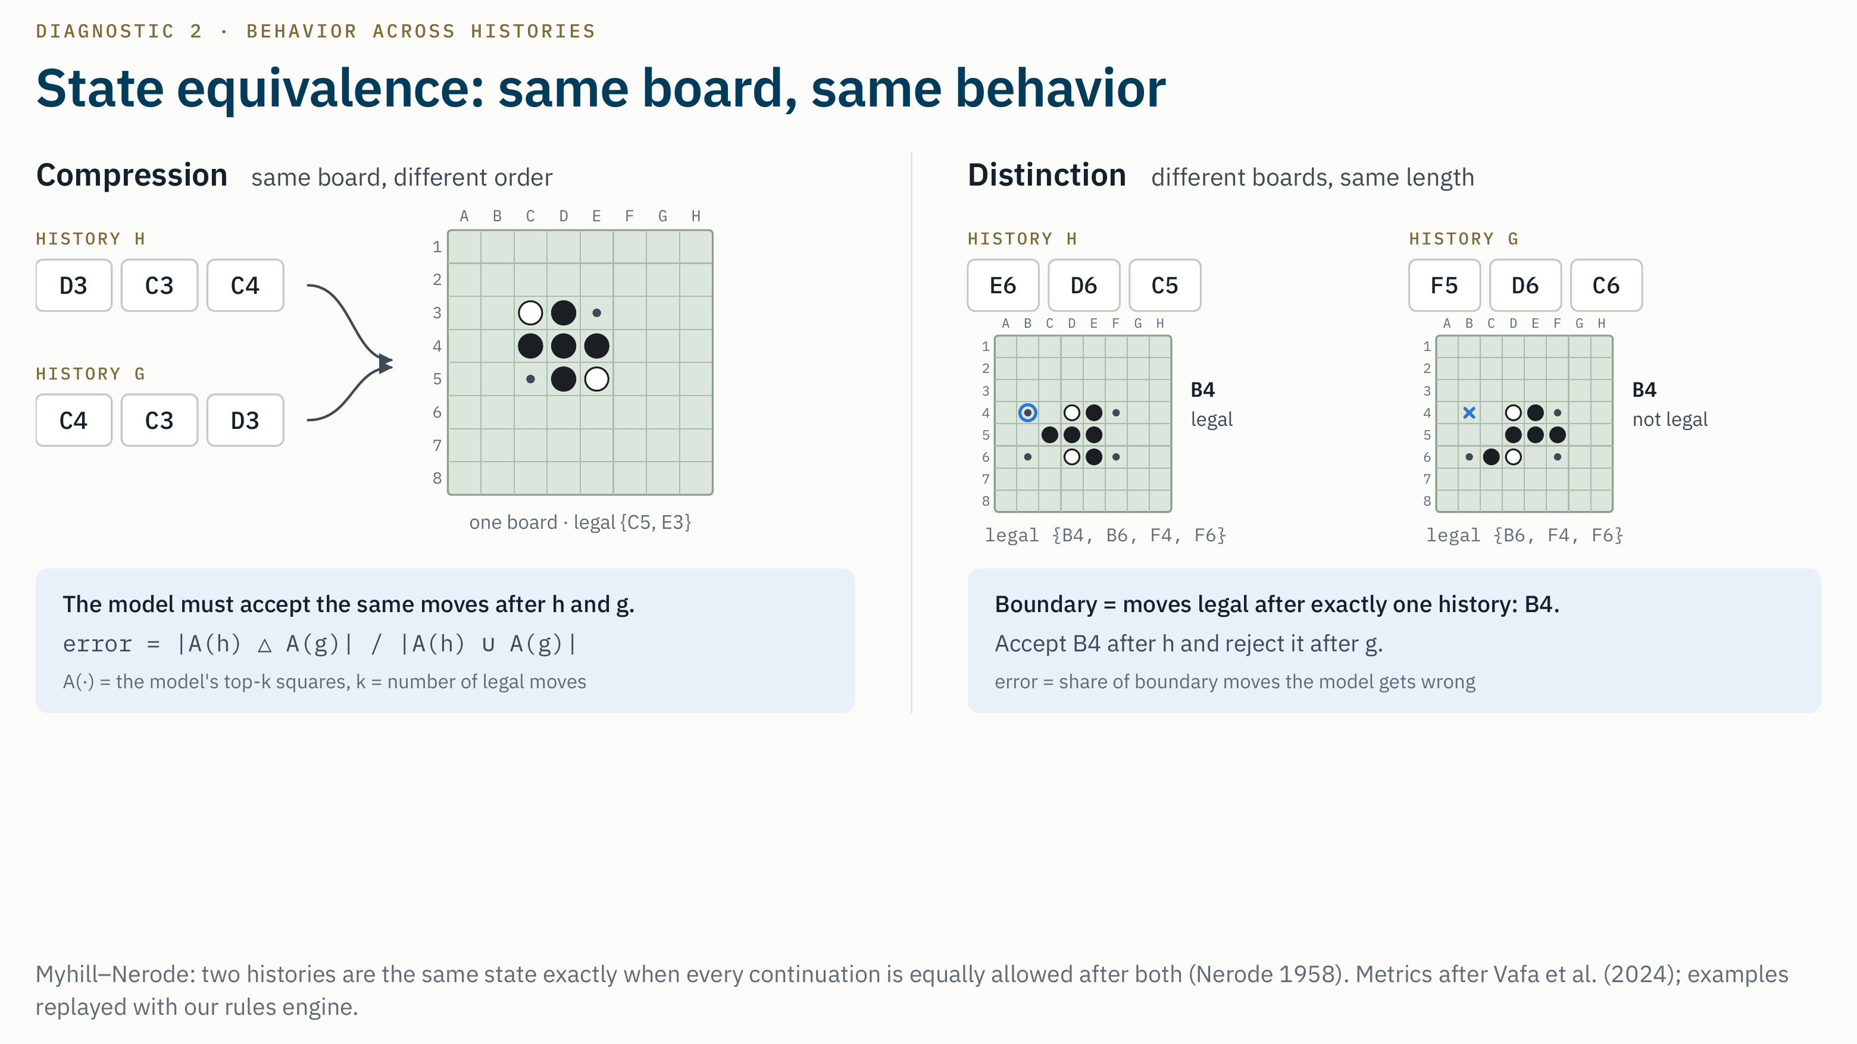
Notes:
Script · about 55 s
D2 comes from the Myhill–Nerode theorem: two histories are the same state exactly when every future is equally allowed after both. In Othello the state is the board and the player to move, so we get two checks.
Compression, on the left. D3 C3 C4 and C4 C3 D3 are the same moves in a different order, and they reach the identical board. A model that tracks the board must accept the same moves after both.
Distinction, on the right. These two histories reach different boards, and the only move legal after exactly one of them is B4, the boundary. The model must accept B4 after the first and reject it after the second.
D1 looks at one position at a time, so it misses both failures. D2 looks at pairs.
Likely questions
- Q. How do you decide which moves the model "accepts"?
A. Its top k squares, where k is the true number of legal moves at that position. There is no probability threshold to tune.
- Q. Where do same-board pairs come from?
A. From move orders that can be swapped, which mostly happens in the opening, around moves 3 to 11. So compression is measured mostly on early boards. We store the pair lengths in every result so that this is visible, and it is a stated limitation.
- Q. Vafa et al. use longer continuations. Isn't one move weaker?
A. Yes, it is a deliberate simplification. Next-move continuations keep D2 cheap enough for 81 models per domain and use the same ground truth as the other diagnostics. It is written into the preregistration as a limitation.

Slide 10
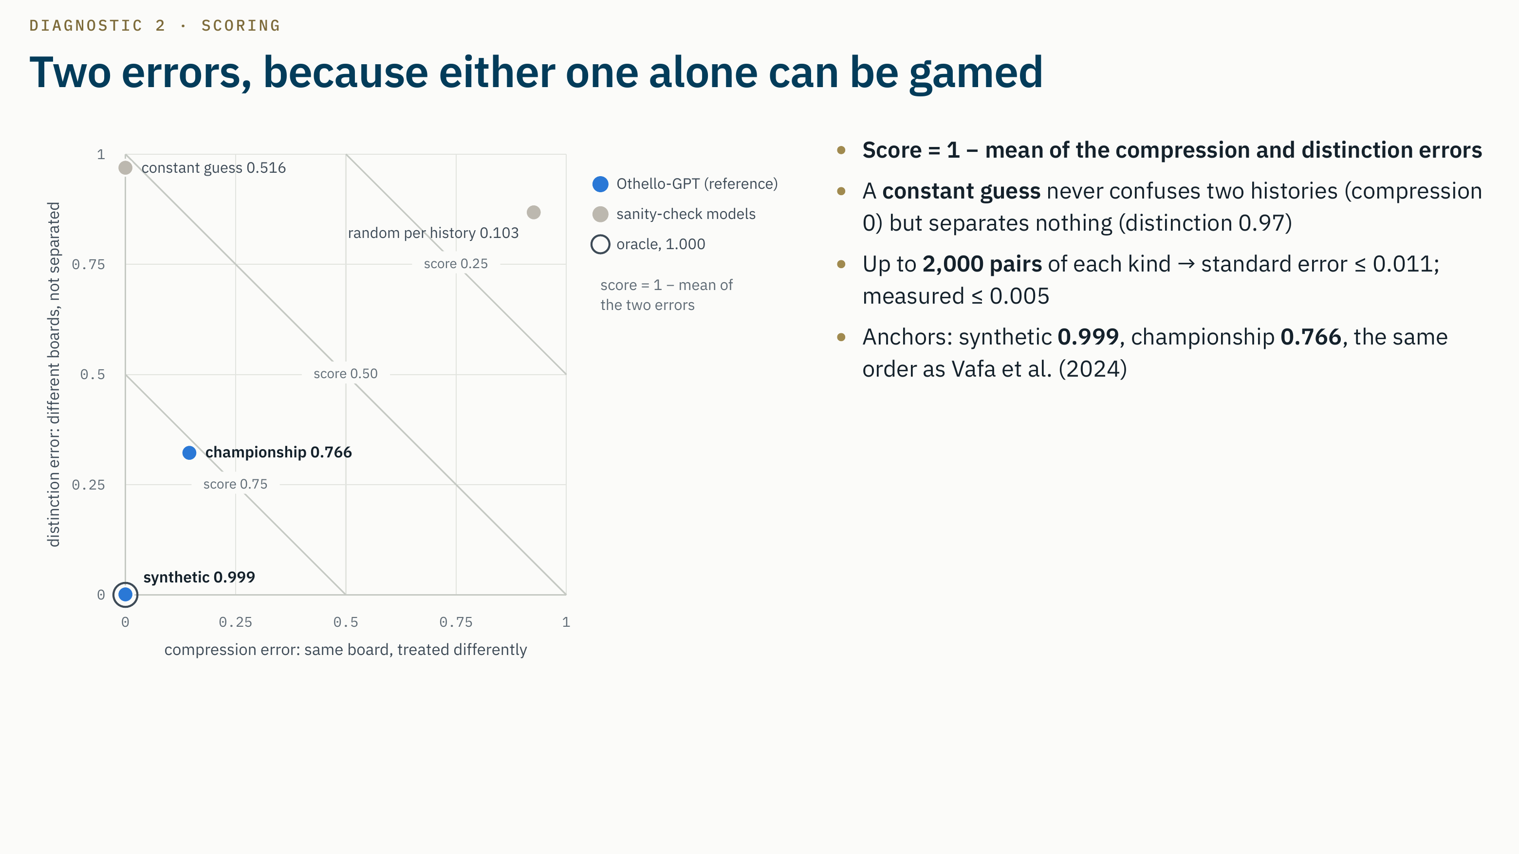
Notes:
Script · about 40 s · optional if short on time
The score is one minus the average of the two errors, and this plane shows why we need both. The ideal model sits at the origin.
A constant guess never confuses two histories, so its compression error is zero, but it separates nothing. The synthetic Othello-GPT sits on top of the oracle at 0.999. The championship model has 15 percent compression error and 32 percent distinction error: 0.766, the same order Vafa and colleagues reported.
With up to two thousand pairs of each kind, the standard error is at most about one point.
Likely questions
- Q. Why is 2,000 pairs enough?
A. Each error is a mean of numbers between 0 and 1, so its standard error is at most 0.5 over the square root of n: 0.011 at 2,000 pairs and 0.022 at our 500-pair minimum. On the anchors the measured standard errors are 0.005 or less.
- Q. Why weight the two errors equally?
A. That is the preregistered score. Both raw errors are stored in every result, so a different weighting could be run as a clearly labelled exploratory analysis.
- Q. How long does D2 take per model?
A. About 20 to 70 seconds on the A10G.

Slide 11
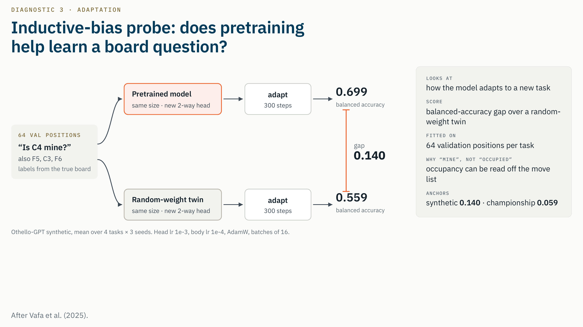
Notes:
Script · about 55 s
D3 is the inductive-bias probe. Instead of reading the model, we teach it something new with almost no data.
The task is a yes-or-no board question, like "is C4 mine?", meaning the disc belongs to the player who just moved. We use four squares. We copy the model, add a new head, and adapt it on just 64 labelled positions, with the body learning ten times more slowly than the head. A twin with random weights gets exactly the same treatment.
The score is the pretrained model's advantage in balanced accuracy on a thousand test positions, averaged over four tasks and three seeds: 0.14 for the synthetic Othello-GPT and 0.06 for the championship one.
We ask "mine", not "occupied", because occupancy can be read straight off the move list.
Likely questions
- Q. Why balanced accuracy?
A. The positive rate of the tasks is 0.41 to 0.45. With balanced accuracy, always answering the majority class scores exactly 0.5.
- Q. How did you choose the learning rates?
A. On the synthetic reference Othello-GPT only, never on a zoo model. Head 1e-3 with body 1e-4 gave the largest gap. A body rate of 1e-5 was also rejected because it nearly freezes the model, which would turn D3 into a linear probe on the last layer, too close to D4 by construction.
- Q. Why only 64 examples?
A. The point is the inductive bias: what the model assumes when it has little data. With many examples even a random model learns the task. Even a model whose last layer is the true board reaches only about 0.8 balanced accuracy from 64 examples, so D3 measures how much pretraining helps, not how close a model gets to perfect.
- Q. Why three seeds?
A. In our toy version the gap ranged from 0.12 to 0.33 across seeds, so one seed is not enough to rank models.

Slide 12
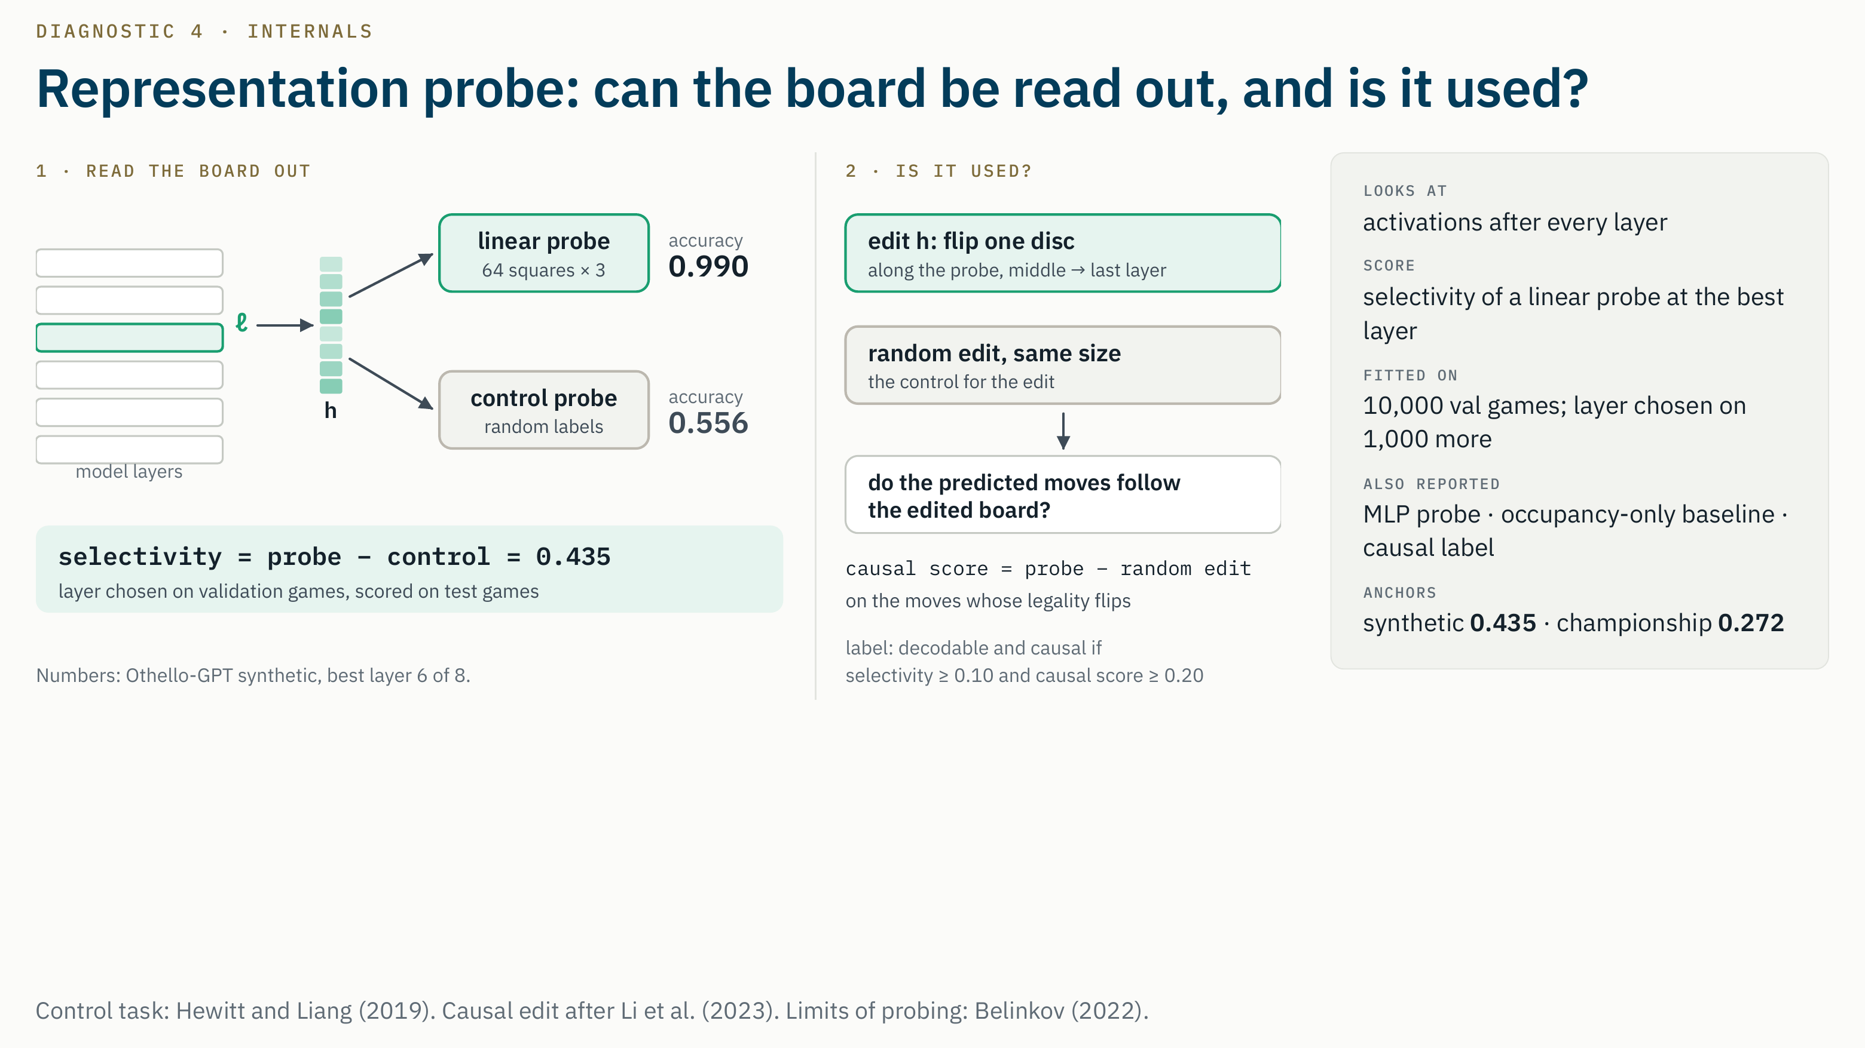
Notes:
Script · about 55 s
D4 opens the model up. After every layer, a linear probe reads each of the 64 squares as mine, theirs or empty.
Accuracy alone proves little, because a probe can learn the task by itself. So, following Hewitt and Liang, an identical control probe learns random labels that depend only on the move just played and the position in the game. Selectivity, probe minus control at the best layer chosen on validation games, is the D4 score.
Then the causal check, after Li and colleagues. We edit the activation so the probe reads one disc flipped, and ask whether the model's predicted moves follow, compared with a random edit of the same size. A model can be decodable but not causal, and we record that separately.
Likely questions
- Q. The probe is 99 percent accurate. Why is selectivity only 0.43?
A. Because the control probe already reaches about 0.56: it learns each square's class frequencies by position in the game, and early in the game most squares are empty. So the ceiling for selectivity is about 1 minus 0.56, and 0.43 is close to it.
- Q. Why mine/theirs labels instead of black/white?
A. Nanda et al. showed the board is linear in mine/theirs coordinates; with black/white a linear probe stays near 75 percent. Our reproduction gate shows the same thing.
- Q. Why is the score from the linear probe and not the MLP?
A. A more expressive probe also raises control accuracy. On the anchors the MLP's selectivity is lower than the linear one: 0.416 against 0.435, and 0.230 against 0.272. The MLP results are stored as secondary.
- Q. How do you avoid test leakage in choosing the layer?
A. Probes are fitted on the first 10,000 of 11,000 validation games, the layer is chosen on the last 1,000 validation games, and the score is measured on 1,000 test games.
- Q. What exactly is the edit?
A. In standardized activation space we step along the normalized gradient of each layer's probe loss toward the edited board, from the middle layer to the last, until the probe gives the flipped square its new class with at least 0.99 probability, for at most 100 steps. The random edit has exactly the same length.

Slide 13
DEMO
Streamlit app: pick any model, watch each diagnostic
Model zoo: registry and training record
D1 live: a real game replayed move by move: the board, the legal moves, the model's pick
D2, D3, D4: the saved result for that model, per layer or per task
Fragility: drop per shift, v1 and v2
Concordance: master table and rank agreement for all 81 models
Live demo
switch to the browser
streamlit run demo/app.py
Notes:
Script · about 60 s
Now the demo. Switch to the browser, with the app open.
The app only reads files from our repository. I pick a model in the sidebar, here the large synthetic transformer. The D1 page replays a real test game: the true board, the legal moves, and the model's pick, framed blue when it is legal and red when it is not.
Then the saved results for the same model: D2, D3 and D4, and its fragility per shift. Finally the concordance page, which shows the master table and the agreement between diagnostics for all 81 models.
Switch back to the slides.
Likely questions
Q. Does the demo compute anything live?
A. D1 runs live on the selected model. The D2 to D4 pages show saved results, because D3 takes minutes per model. Nothing is written to the repository.
Q. Can anyone run it?
A. Yes, on any machine with the checkpoints and the Othello data: streamlit run demo/app.py from the repository root.
Before the talk
Start the app with streamlit run demo/app.py, open it through the forwarded port, and paste a screenshot onto this slide in case the network fails.

Slide 14
WHERE WE STAND
Status against the plan for today
DONE
Reproduction gate passed (Nanda et al. 2023, 5 of 6 within 1 point)
DONE
Fragility suites v1 and v2 frozen; preregistration with four amendments tagged
DONE
D1 to D4 implemented, tested, run on both reference Othello-GPTs
DONE
Othello zoo: 81 of 81 trained and admitted
DONE
D1 to D4 and both fragility suites on all 81 models: 486 results
DONE
H1, H2, H3 on Othello (preregistered), plus labelled exploratory checks
DONE
Literature review in the LaTeX report
IN PROGRESS
Demo on the real results; reply to Instructor Review 5
IN PROGRESS
Methods and Othello results in the report; checkpoints to S3
NEXT
Navigation domain and zoo; interpreter held out for H4
Notes:
Script · about 30 s
Against the plan for today. Done: the reproduction gate; both fragility suites frozen; the preregistration with four amendments; all four diagnostics on the reference models; the full Othello zoo, trained, admitted and scored; and the preregistered H1 to H3 analysis on Othello, with the exploratory checks.
In progress: the demo on the real results, the methods and results sections of the report, our reply to your fifth review, and the checkpoint upload.
Next: navigation and the held out interpreter.
Likely questions
Q. What is the biggest risk to the schedule?
A. Compute for the remaining domains, mostly Mamba. Training is split across our four instances, and the scoring launcher we built for Othello resumes after an instance stops, so the next zoo can be scored in the same way.
Q. Why did the zoo finish when it did?
A. Training started once the trainer, budget and admission rule were fixed in early October, and Mamba in plain PyTorch is slow. Scoring then ran on all four instances in parallel.

Slide 15
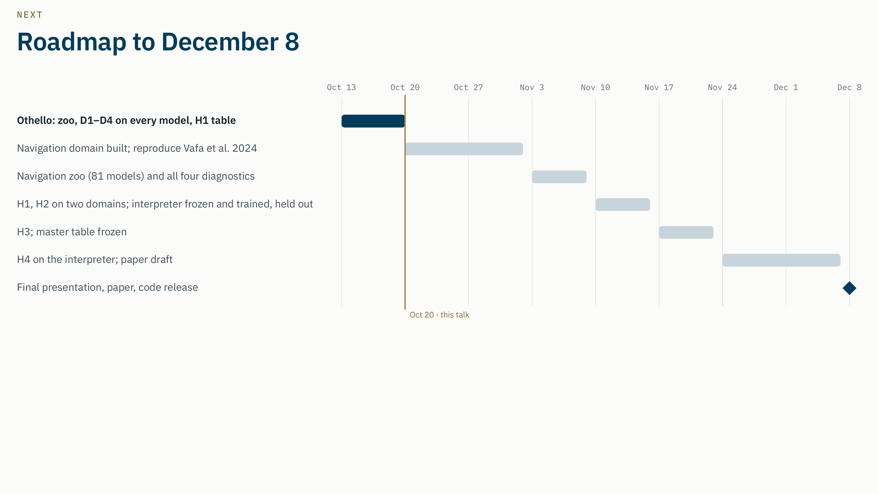
Notes:
Script · about 25 s
The plan to December 8. The Othello part is done: zoo, all diagnostics, and H1 to H3. Next, navigation, including a reproduction of Vafa's navigation metrics, with its zoo in early November. In mid November, H1 and H2 on both domains, while the interpreter is built and held out. Then H3 on both domains and the frozen master table, and finally H4 on the interpreter and the paper, for December 8.
Likely questions
Q. What is the interpreter domain?
A. A small deterministic stack or register machine whose full state is known at every step. It gives an automaton of tunable size, and this literature has never probed it, so it is a fair test of whether our findings generalize.
Q. What changes for navigation after the Othello results?
A. The analysis code is fixed and reusable. Based on the exploratory finding, we will consider preregistering a training data control for H3 before any navigation score exists.
Q. Where will you submit?
A. A world model or interpretability workshop at NeurIPS, ICML or ICLR, or TMLR; Neural Computing and Applications as the journal target.

Slide 16
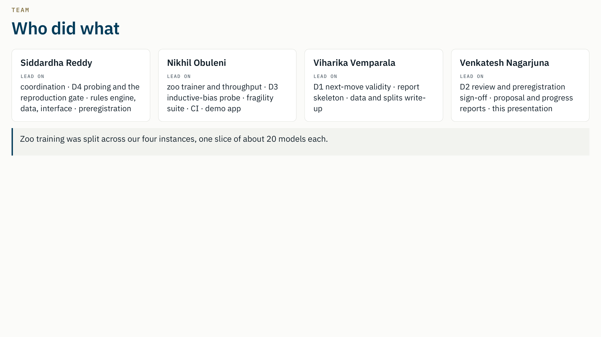
Notes:
Script · about 30 s
The team. Siddardha coordinates, and led D4, the reproduction gate, the rules engine and the preregistration. Nikhil built the trainer, D3, the fragility suite, CI and the demo. Viharika led D1 and the report skeleton. I reviewed and signed off D2, wrote the proposal update and the progress reports, and built this presentation. And each of us trained one slice of the zoo on our own instance.
⟨Check this slide with the team before presenting.⟩
Likely questions
- Q. What was your own contribution? ⟨Answer in your own words; a draft:⟩
A. I own the sign-off for D2 in the preregistration and reviewed its module and tests. I trained zoo slice 4, 20 models, on my instance and opened its pull request. I wrote the October 20 update of the proposal and the week 6 and 7 progress reports, and I built this presentation.
- Q. How do you coordinate four people on one codebase?
A. An issue first for every task, one owner per issue, a branch per person and topic, and a pull request with a teammate's review before anything reaches main. Weekly reviews from you are answered on the review issue.

Slide 17
SUMMARY
Takeaways
1
2
3
Agreement is competence
Disagreement is noise
No reliable fragility predictor
The four diagnostics agree on which models are better (W 0.87), but with competence controlled they disagree (W 0.27). D1 is competence.
Where they disagree, architecture, size and training data do not explain it (H2).
D4 adds to D1 in the preregistered test, but the signal comes from training data, not from comparable models.
For anyone using these tools: do not trust a single world model diagnostic, and always control for competence.
Next: navigation (reproducing Vafa et al. 2024), then the held out interpreter for H4; paper by December 8.
A readable board is not always a used board: 71 of 81 zoo models decode the board but do not use it.
Notes:
Script · about 45 s
To sum up, three findings on 81 Othello models.
First, the four diagnostics agree on which models are better, but that agreement is competence. With competence controlled, they disagree; and D1 cannot be separated from competence at all.
Second, where they disagree, it is not systematic across architecture, size or training data.
Third, no diagnostic reliably predicts which models break. D4 adds to D1 in the preregistered test, but that comes from the training data.
For anyone using these tools: do not trust a single diagnostic, and always control for competence.
Next: navigation, then the held out interpreter for H4, and the paper by December 8.
Thank you. We are happy to take questions.
Likely questions
Q. Did your earlier bet hold?
A. We expected raw agreement and at least one pair to disagree after the control. In fact all three pairs among D2, D3 and D4 lost their agreement, more than we expected.
Q. What would you do differently?
A. Start the zoo training earlier, fix the exact training mix of the mixed dataset in the preregistration, and preregister a training data control for H3.
Q. Which diagnostic would you recommend?
A. None on its own. D2 and D4 carry information beyond competence in places, but on Othello none of them predicts fragility among comparable models. Report several, with the competence control.

Slide 18
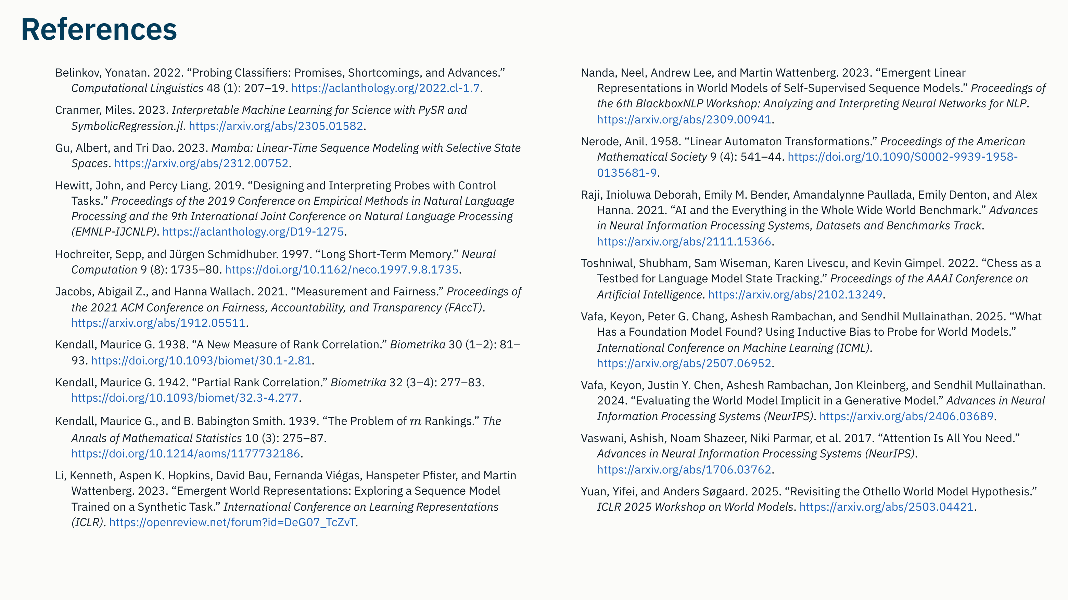
Bouthillier, Xavier, et al. 2021. “Accounting for Variance in Machine Learning Benchmarks.” Proceedings of Machine Learning and Systems 3.
Cameron, A. Colin, Jonah B. Gelbach, and Douglas L. Miller. 2008. “Bootstrap-Based Improvements for Inference with Clustered Errors.” Review of Economics and Statistics 90 (3): 414–27.
Notes:
Script
⟨No script. Leave this slide up only if asked about a source.⟩
Likely questions
- Q. Is the literature review in the report?
A. Yes. The LaTeX report has a related-work section covering ten works, each summarized in our own words with how WM-Concord differs, and all of them are in one bib file.
Added since the first draft: Cameron, Gelbach and Miller (2008) for the cluster bootstrap used in Amendment 4, and Bouthillier and colleagues (2021) on seed variance in machine learning benchmarks, the reason we use a seed noise floor.

Slide 19
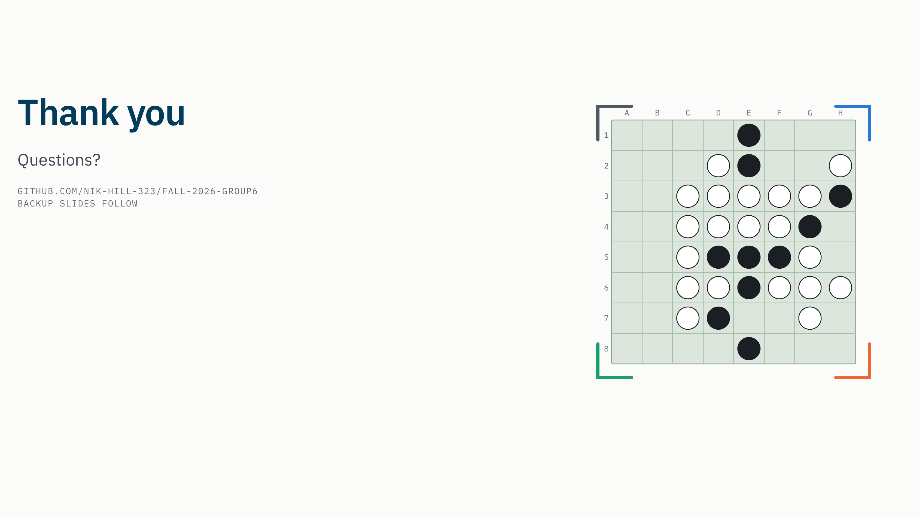
Notes:
Script
Thank you. We are happy to take questions.
⟨Backup slides follow this one: threats to validity, training data per model, the D4 causal-check settings, the D3 learning-rate choice, compute, and the H2 to H4 decision rules.⟩

