Slide 1
CSS Presentation
How to make things shiny?
Doncho Minkov
Technical Trainer
http://minkov.it
Telerik Software Academy
http://academy.telerik.com

Slide 2
Table of Contents
Text-related Properties
CSS 3 Fonts
Borders
Rounded Corners
Background Properties
Opacity

Slide 3
Text-related Properties

Slide 4
Text-related CSS Properties
color – specifies the color of the text
font-size – size of font: xx-small, x-small, small, medium, large, x-large, xx-large, smaller, larger or numeric value
font-family – comma separated font names
  Example: verdana, sans-serif, etc.
  The browser loads the first one that is available
  There should always be at least one generic font
font-weight can be normal, bold, bolder, lighter or a number in range [100 … 900]

Slide 5
CSS Rules for Fonts (2)
font-style – styles the font
  Values: normal, italic, oblique
text-decoration – decorates the text
  Values: none, underline, line-trough, overline, blink
text-align – defines the alignment of text or other content
  Values: left, right, center, justify

Slide 6
Shorthand Font Property
font
  Shorthand rule for setting multiple font properties at the same time
  is equal to writing this:
font:italic normal bold 12px/16px verdana
font-style: italic;
font-variant: normal;
font-weight: bold;
font-size: 12px;
line-height: 16px;
font-family: verdana;

Slide 7
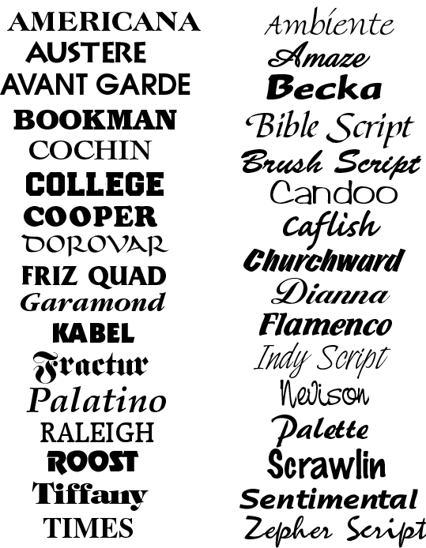




Text-related Properties
  Live Demo

Slide 8


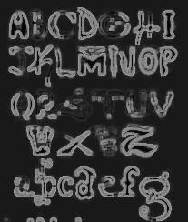

CSS 3 Fonts

Slide 9

Font Embeds
Use @font-face to declare font
Point to font file on server
Call font with font-family
Currently not supported in IE
Use font embedding instead of images
@font-face {
font-family: SketchRockwell;
src: url('SketchRockwell-Bold.ttf');
}
.my_CSS3_class {
font-family: SketchRockwell;
font-size: 3.2em;
}

Slide 10


Text Shadow
Applies shadow to text
Syntax: text-shadow: <horizontal-distance> <vertical-distance>
<blur-radius> <shadow-color>;
Do not alter the size of a box
text-shadow: 2px 2px 7px #000000;

Slide 11


Text Overflow
Specifies what should happen when text overflows the containing element
Syntax: text-overflow: <value>;
Possible values:
  ellipsis - Display ellipses to represent clipped text
  clip - Default value, clips text
Currently not supported in Firefox and IE

Slide 12
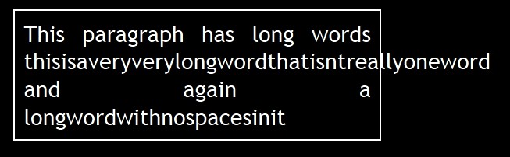
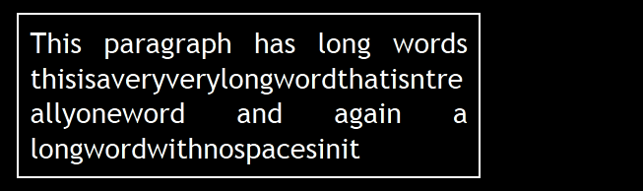
Word Wrapping
Allows long words to be able to be broken and wrap onto the next line
Syntax: word-wrap: <value>;
Possible values:
  normal
  break-word
Supported in all major browsers

Slide 13
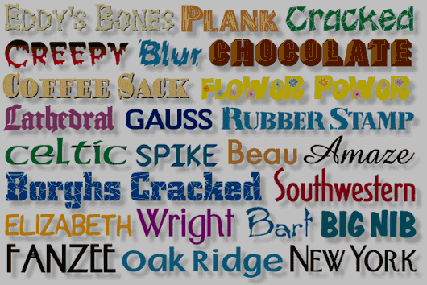
CSS 3 Fonts
  Live Demo

Slide 14
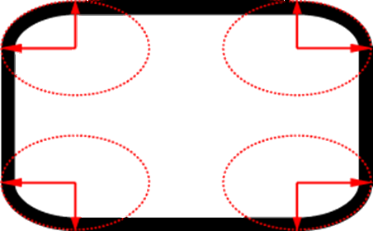
Borders

Slide 15
Borders
border-width: thin, medium, thick or numerical value (e.g. 10px)
border-color: color alias or RGB value
border-style: none, hidden, dotted, dashed, solid, double, groove, ridge, inset, outset
Each property can be defined separately for left, top, bottom and right
  border-top-style, border-left-color, …

Slide 16
Border Shorthand Property
border: shorthand rule for setting border properties at once:
is equal to writing:
Specify different borders for the sides via shorthand rules: border-top, border-left, border-right, border-bottom
When to avoid border:0
border: 1px solid red
border-width:1px;
border-color:red;
border-style:solid;

Slide 17
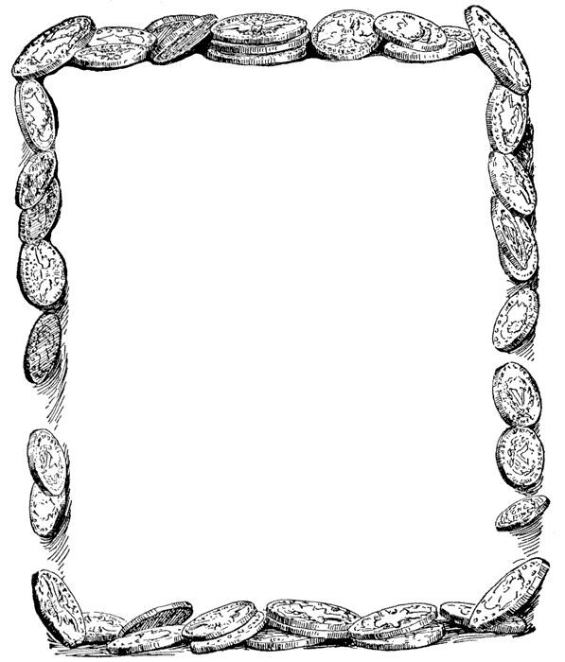
Borders
  Live Demo

Slide 18
Border color
Allows you to create cool colored borders
Only Firefox supports this type of coloring
border: 8px solid #000;
-moz-border-bottom-colors: #555 #666 #777 #888 #999 #aaa #bbb #ccc;
-moz-border-top-colors: #555 #666 #777 #888 #999 #aaa #bbb #ccc;
-moz-border-left-colors: #555 #666 #777 #888 #999 #aaa #bbb #ccc;
-moz-border-right-colors: #555 #666 #777 #888 #999 #aaa #bbb #ccc;

Slide 19

Border radius
Allows web developers to easily utilize rounder corners in their design elements
Widespread browser support
Syntax:
Example:
border-*-*-radius: [<length>|<%>][<length>|<%>]?
-moz-border-radius: 15px;
border-radius: 15px;
background-color: #FF00FF;

Slide 20

Box shadow
Allows to easily implement multiple drop shadows (outer or inner) on box elements
Specifying values for color, size, blur and offset
Example:
-moz-box-shadow: 10px 10px 5px #888;
-webkit-box-shadow: 10px 10px 5px #888;
box-shadow: 10px 10px 5px #888;

Slide 21


Rounded Corners

Slide 22
Rounded Corners
Rounded corners are actually a part of CSS 3
  Supported in all major browsers
  Firefox, IE 9, Chrome, Opera and Safari
Done by the border-radius property
Three ways to define corner radius:
border-radius: [<length>|<%>][<length>|<%>]?
border-radius: 15px;
border-radius: 15px 15px 15px 10px;
border-radius: 15px 20px;

Slide 23

Rounded Corners
  Live Demo

Slide 24
Background Properties

Slide 25
Backgrounds
background-image
  URL of image to be used as background, e.g.:
background-color
  Using color and image and the same time
background-repeat
  repeat-x, repeat-y, repeat, no-repeat
background-attachment
  fixed / scroll
background-image:url("back.gif");

Slide 26
Backgrounds (2)
background-position: specifies vertical and horizontal position of the background image
  Vertical position: top, center, bottom
  Horizontal position: left, center, right
  Both can be specified in percentage or other numerical values
  Examples:
background-position: top left;
  background-position: -5px 50%;

Slide 27
Background Shorthand Property
background: shorthand rule for setting background properties at the same time:
is equal to writing:
  Some browsers will not apply BOTH color and image for background if using shorthand rule
background: #FFF0C0 url("back.gif") no-repeat fixed top;
background-color: #FFF0C0;
background-image: url("back.gif");
background-repeat: no-repeat;
background-attachment: fixed;
background-position: top;

Slide 28
Background-image or <img>?
Background images allow you to save many image tags from the HTML
  Leads to less code
  More content-oriented approach
All images that are not part of the page content (and are used only for "beautification") should be moved to the CSS

Slide 29
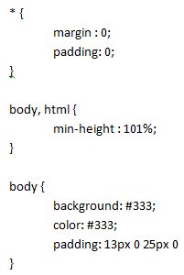

Background Styles
  Live Demo

Slide 30

Gradient Backgrounds
Gradients are smooth transitions between two or more specified colors
Use of CSS gradients can replace images and reduce download time
Create a more flexible layout, and look better while zooming
Supported in all major browsers via different keywords
This is still an experimental feature

Slide 31

Gradient Backgrounds Example
/* Firefox 3.6+ */
background: -moz-linear-gradient(100% 100% 90deg,
#FFFF00, #0000FF);
/* Safari 4-5, Chrome 1-9 */
background: -webkit-gradient(linear, 0% 0%, 0%
100%, from(#0000FF), to(#FFFF00));
/* Safari 5.1+, Chrome 10+ */
background: -webkit-linear-gradient(#FFFF00,
#0000FF);
/* Opera 11.10+ */
background: -o-linear-gradient(#2F2727, #0000FF);

Slide 32
Gradient Background
Live Demo

Slide 33



Multiple Backgrounds
CSS3 allows multiple background images
Simple comma-separated list of images
Supported in Firefox (3.6+), Chrome (1.0/1.3+), Opera (10.5+) and Internet Explorer (9.0+)
Comma separated list for the other properties
background-image: url(sheep.png), url(grass.png);

Slide 34
Multiple Backgrounds
Live Demo

Slide 35
Opacity

Slide 36
Opacity
opacity: specifies the opacity of the element
  Floating point number from 0 to 1
  For old Mozilla browsers use –moz-opacity
  For IE use filter:alpha(opacity=value) where value is from 0 to 100; also, "binary and script behaviors" must be enabled and hasLayout must be triggered, e.g. with zoom:1

Slide 37
Opacity
Live Demo

Slide 38
CSS Presentation
http://academy.telerik.com

Slide 39
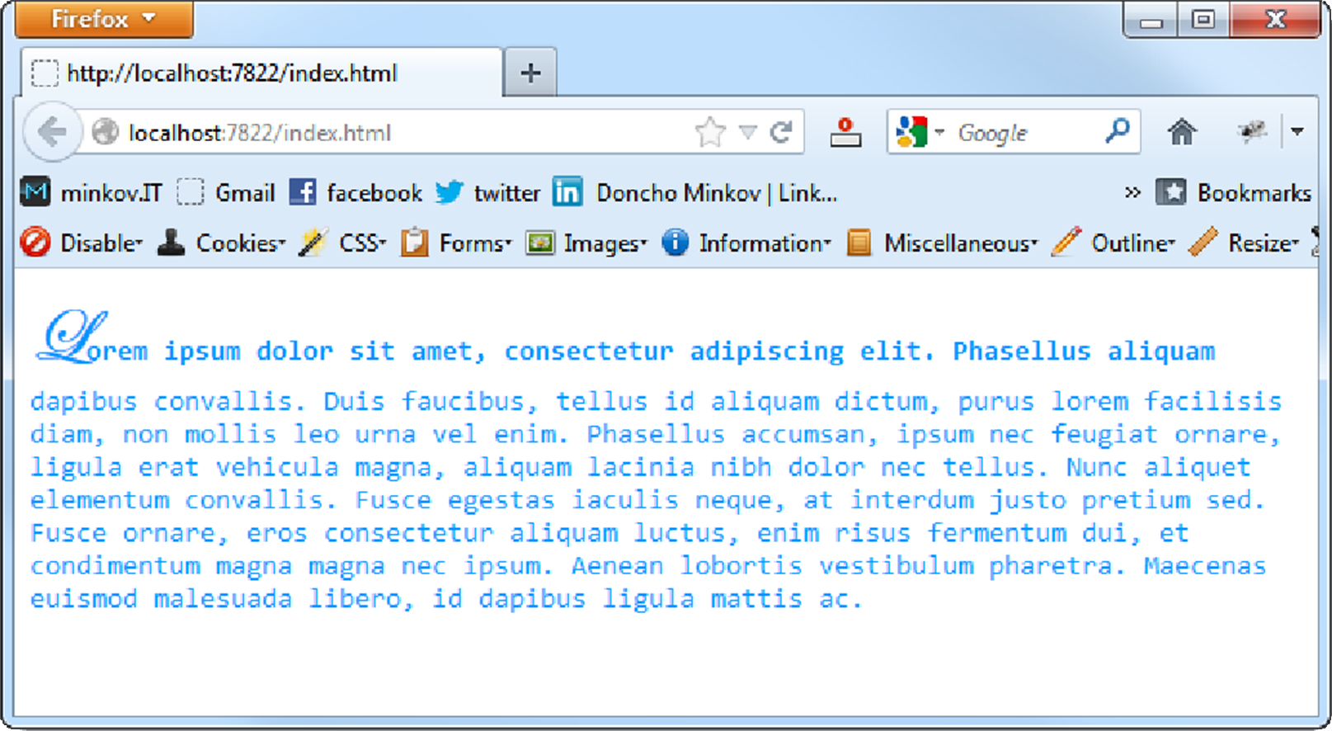
Homework
Create the following web page
  Fonts used: Consolas, Edwardian Script ITC
  Color: #0094ff

Slide 40
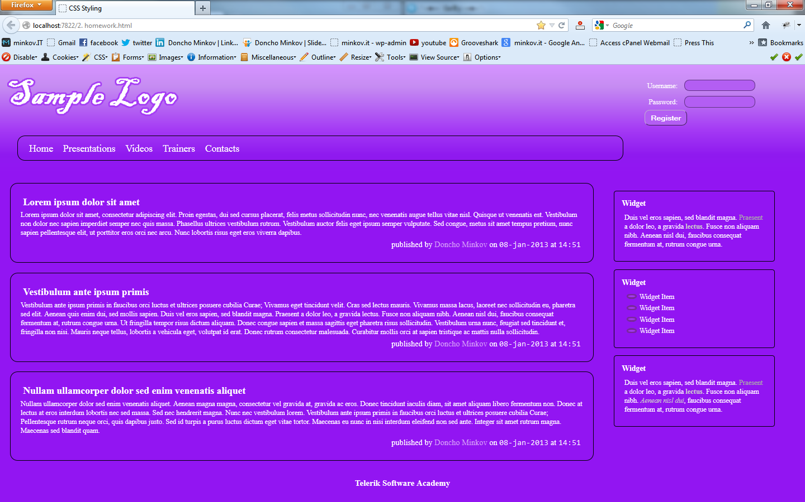
Homework (2)
You are given prewritten HTML and CSS code. Expand this code to make the web page to look exactly like the PNG image:
  You can find the files in 2. Homework.zip

Slide 41
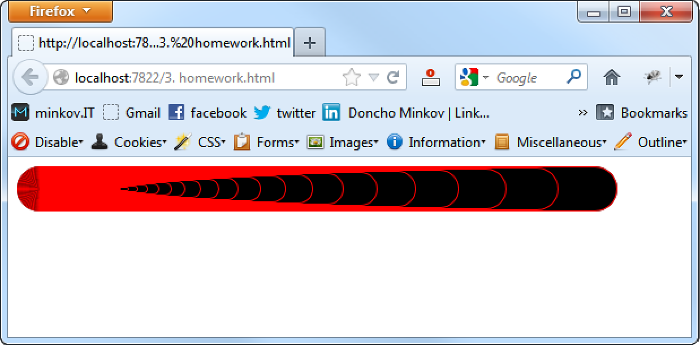
Homework (3)
Create the following web page
  Using 60 nested div elements

Slide 42
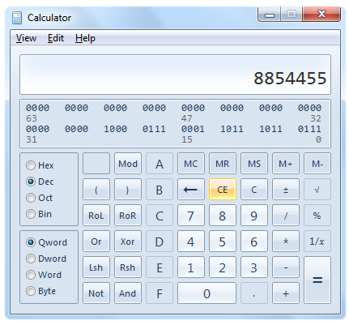
Homework (4)
Create a web page that looks like the Windows calculator in Programmer view
  It should look exactly
  the same
  Implement hover effects
  for the buttons
  The calculator should
  not have any functionality

