Slide 1


Fin PUG PASOE
Klaus de Vries
11.04.2023
Notes:
Ask… raise your hand… If you agree it is good, if you disagree – please leave the room :)
No – please give constructive feedback!

Slide 2

About IAP
Technical Service Provider
      Founded 1992 in Hamburg (DE)
      50+ Team Members
Service areas
      OE Custom Development
      Technical Consulting
Low-Code System OF-1
        Pure ABL and Multi-UI (.NET, HTML5)
Progress Service Delivery Partner
proALPHA certified Service Partner
Notes:
Key facts:
- Long term customer relations
- Experience of any modern OE Technology
- SDP

Slide 3












IAP partners and clients
Notes:
Key facts:
- Long term customer relations
- Experience of any modern OE Technology
- SDP

Slide 4

Progress Application Server
PAS is a Tomcat Java web application server with Progress customizations and extensions
Tomcat is a component of the J2EE Platform and provides:
• Catalina to run Servlets
• Coyote connector to provide an http-Server
• Jasper to interpret Java Server Pages
• Spring Security
Provides optional web applications for remote administration using text, html, or JMX proxy APIs

Slide 5

PAS for OpenEdge
PASOE is a PAS with a pre-installed extension to run ABL Code in ABL Agents in the context of Tomcat Web Applications.
The ABL Agents handle multiple sessions contexts using multiple threads to provide a multi-Sessioned Agent (MS-Agent)
You design, package, deploy, configure, debug, and control access to your ABL application in the context of a Tomcat web application

Slide 6
Why creating a next generation AppServer?
▪ Simplicity
• Administration, scalability, application migration, deployment
• AppServer connection and operating STATEs
▪ Security
• Spring Security
• Production license
▪ Better monitoring and management
• Built-in metrics gathering, current state queries
▪ Performance
• Runs same ABL application and client load with less memory and CPU
▪ WebSpeed
• Runs classic code but also OOABL WebHandlers

Slide 7
Why a Web Application Server?
▪ Todays Application Architecture needs to be ready
• to work with various UI Technologies, including GUI, Web Browser and Mobile
• Provide API-based access to business logic for „Client-Applications“ including Custom Extensions, Micro Apps and B2B-Integration
• Need for a standards-based, open and secure Interface in contrast to the proprietary binary OE GUI –AppServer protocol.
▪ Software as a Service is the main growth path
• Developing „Web- and Cloud-native“ applications
• Secure and Scalable
• Easy deployment and management in virtualized environments (VMs, Containers)

Slide 8
Classic Appserver versus PASOE
Runs ABL code
Supports GUI Clients directly
Supports other Clients by Adapters
• GUI Clients via http/s tunnel
• REST Adapter
• SOAP/WSA Adapter
• WebSpeed w/ Messenger
Adapters based on a number of technologies
Needs external Servers
Runs ABL code
Supports http-Clients
• GUI Clients via http/s tunnel (APSV)
• REST, SOAP
• WEB (ABL)
– WebSpeed Handler
– REST Handler
– PDS generated
– PDS mapped
Less Resources, Higher Performance

Slide 9
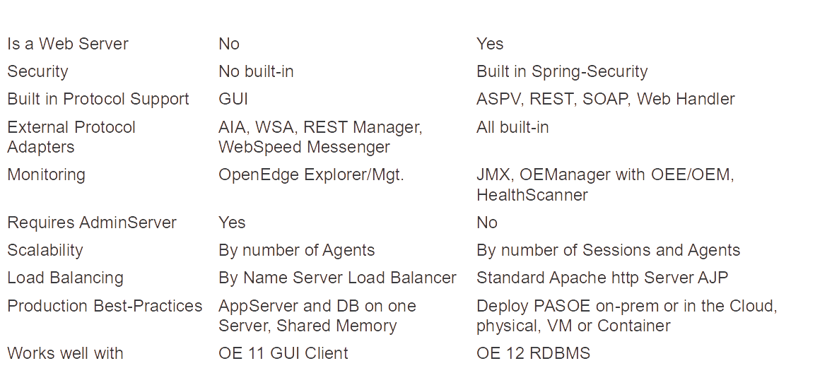
Comparison Classic AppServer vs. PASOE

Slide 10
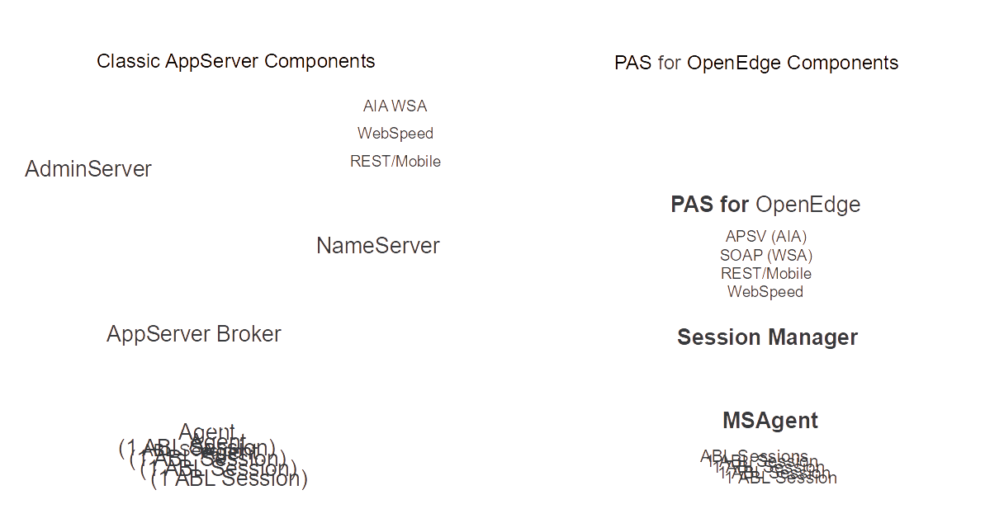
Architecture: Components

Slide 11
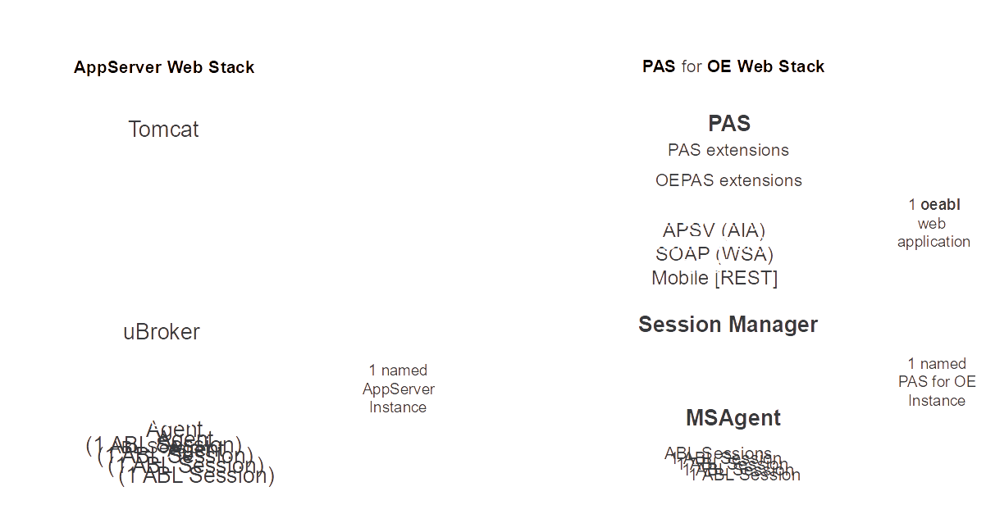
PASOE – find the AppServer components

Slide 12
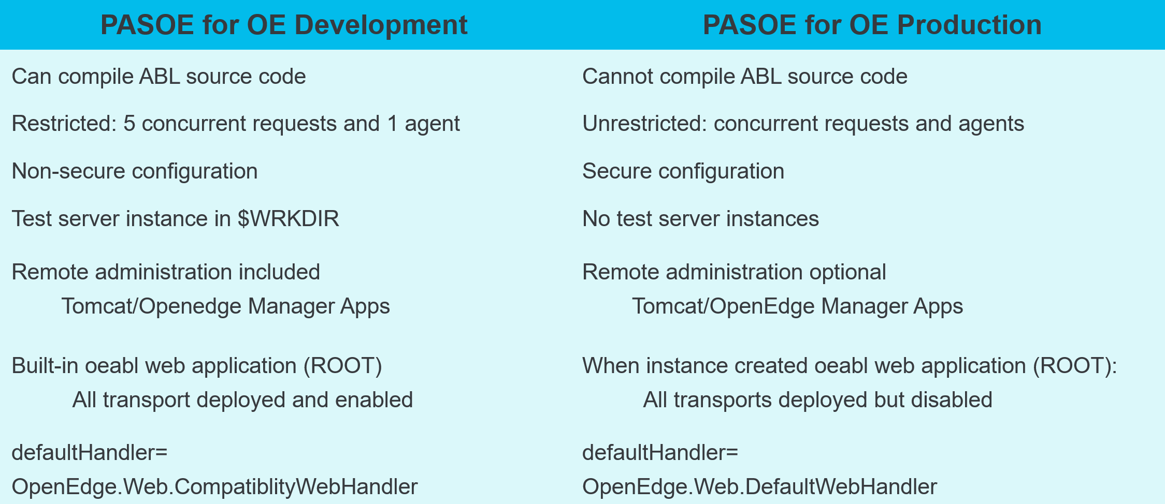
PASOE Development versus Production

Slide 13
PASOE Transport Layer Handler
REST
      the old REST Adapter of the classic Appserver
SOAP
      the old Web Service Adapter of classic AppServer
APSV
      the classic adapter OpenEdge client and OpenClient
WEB
      the new adapter for REST and SOAP web services
      very flexible
      easy to handle and configurate

Slide 14
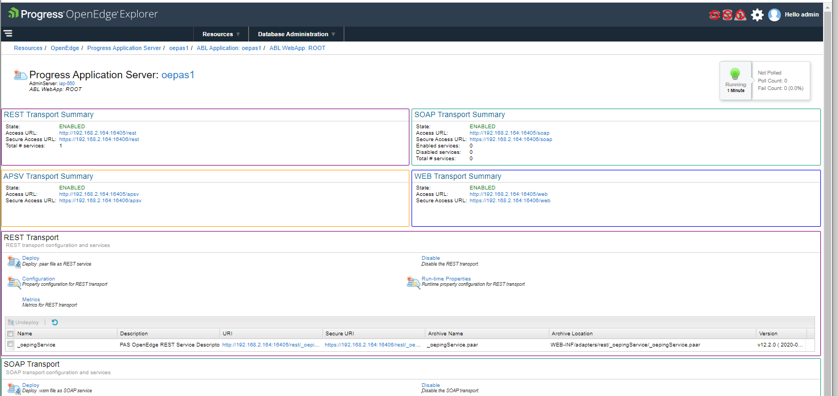
Transport Layer

Slide 15
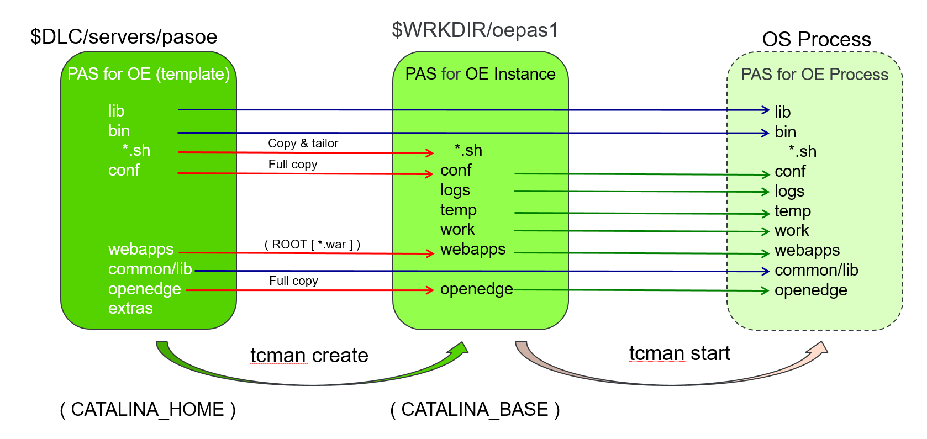
PASOE at Instance Create and Run-time

Slide 16
Important files and directories
CATALINA_HOME
Template root
Contains also all Tomcat executables
Location $DLC/severs/pasoe
CATALINA_BASE
PASOE instance
Contains the web applications
Contains the instance related scripts and settings
Location i.e. oepas1 $DLC_WRK/oepas1
$CATALINA_BASE/$OEPAS_instance/logs/$OEPAS_instance.agent.$date.log
i.e. d:\dlc\122-wrk.64bit\oepas1\logs\oepas1.agent.2023-04-07.log
OpenEdge agent log file
$CATALINA_BASE/$OEPAS_instance/logs/startupErrors
contains the error if an instance can’t be started

Slide 17
Important files and directories
$CATALINA_BASE/conf/openedge.properties
Appserver configuration file
the former ubroker.properties file in the classic appserver
$CATALINA_BASE/conf/catalina.properties
Contains all settings for the PASOE Tomcat instance like ports etc.
$CATALINA_BASE/conf/server.xml
The Tomcat configuration file
Copy of $CATALINA_BASE/conf/server.xml
The settings are here variables set in catalina.properties

Slide 18
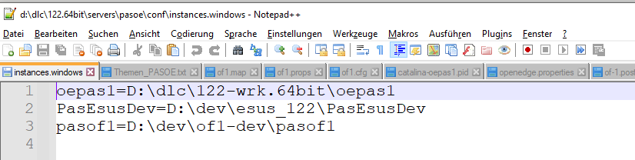
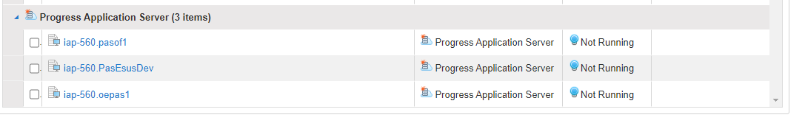
Important files and directories
{$CATALINA_HOME}\conf\instances.windows
Contains all known PASOE instances

Slide 19
TCMAN
TCMAN is a command-line utility for managing and administering a server instance.
Syntax: {$CATALINA_HOME|$CATALINA_BASE}
/bin/tcman action [general_options] [action_options]
For Windows use tcman.bat, for UNIX use tcman.sh
Frequent commands for developers
create Create a new server instance
delete Delete server instance
start Start an instance
stop Stop a running instance

Slide 20
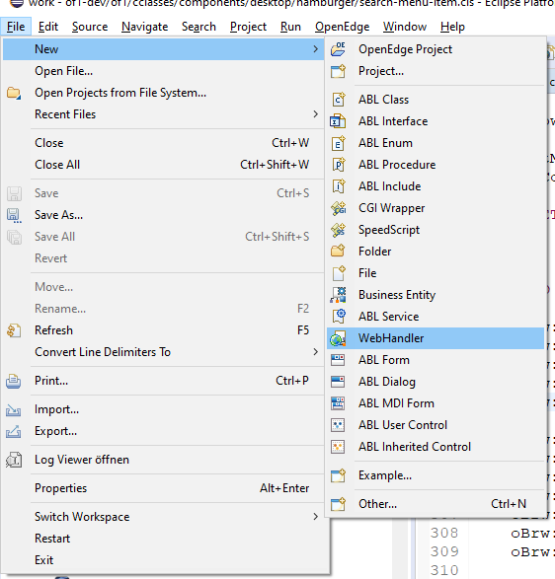
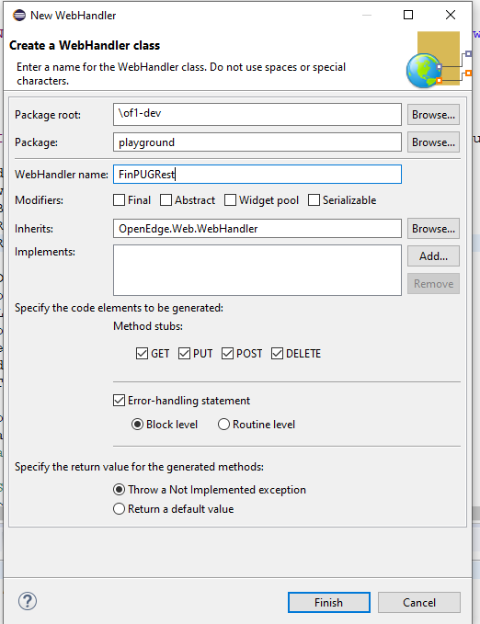
Create a Rest service with PDS

Slide 21
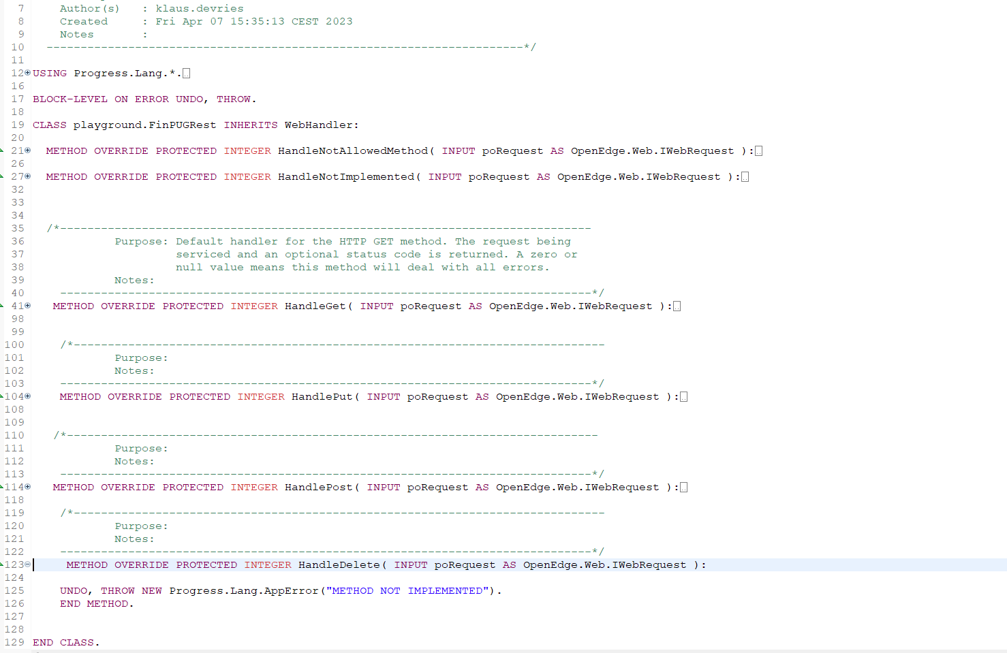
Create a Rest service with PDS

Slide 22
Create a Rest service Demo
Create an entry in openedge.properties
Create a handler for GET
Parse parameter
Access to the data base
Send back a JSON file

Slide 23
OF-1 Pcase ERD / Business Entity Designer
PCase was originally developed as a separate product
Since 1998 on the market
Pcase is very useful to develope and maintain your database
PCase is integrated in OF-1
With PCase you can also design and administrate BE’s
OF-1 has a build-in generic REST interface
CRUD operations for all entities are available by default

Slide 24
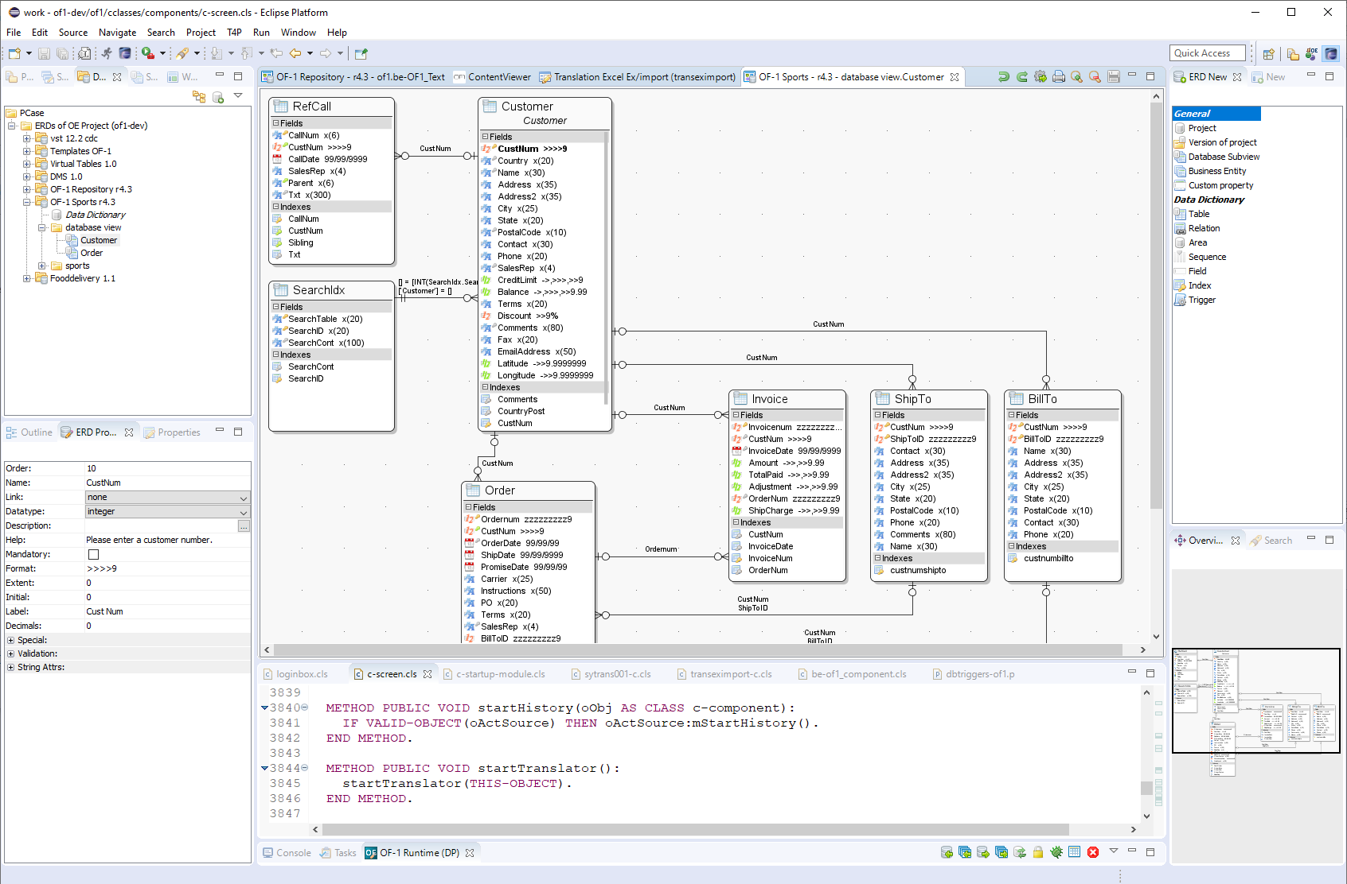
OF-1 Pcase ERD Designer

Slide 25
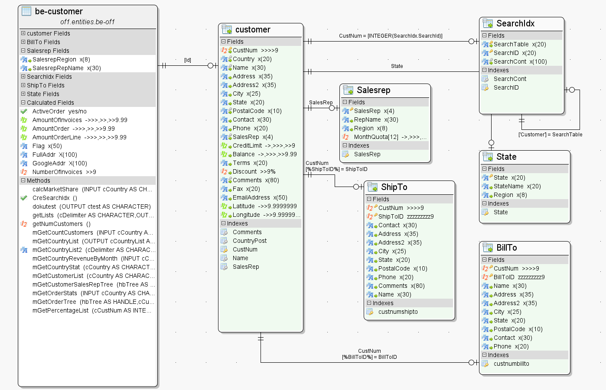
Business Entity Designer

Slide 26
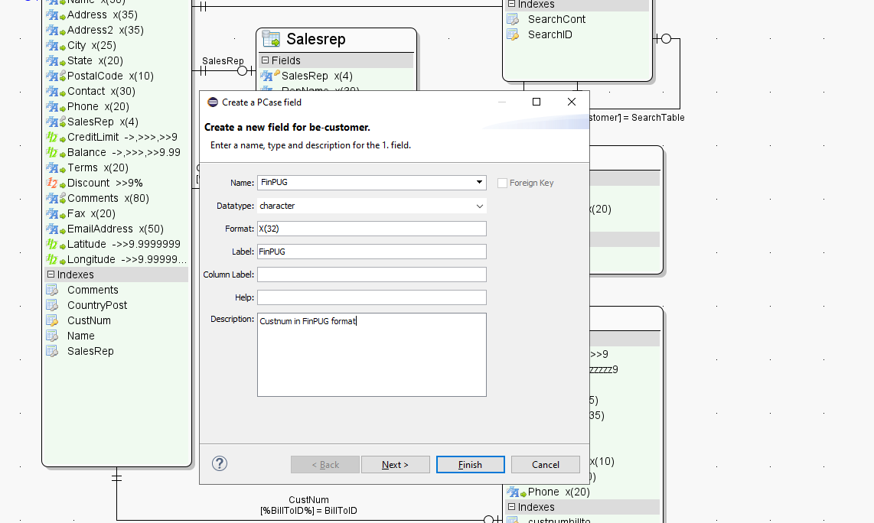
Create a new BE Field

Slide 27
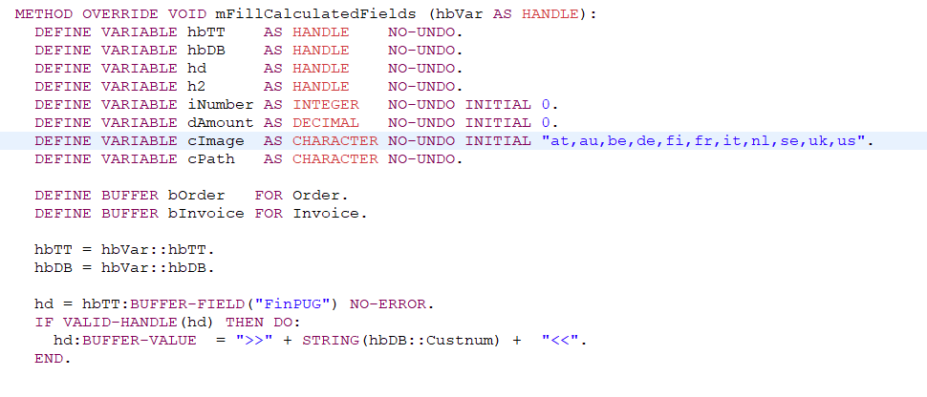
Create a new BE Field Fill logic

Slide 28

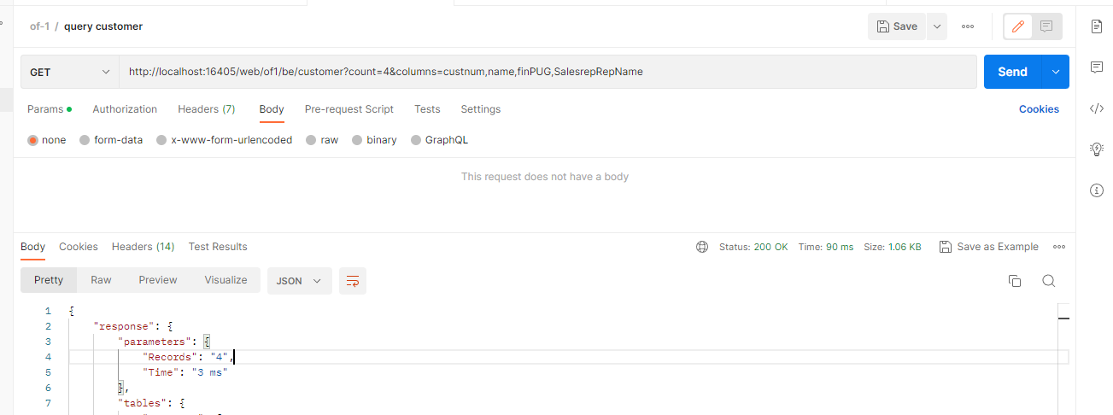
Test with Postman
Postman is very popolar tool for testing REST Api

Slide 29

Swagger
Swagger is a collection of open source tools
For designing, creating, documenting and using
HTTP web services
Swagger uses the OpenAPI description standard.

Slide 30
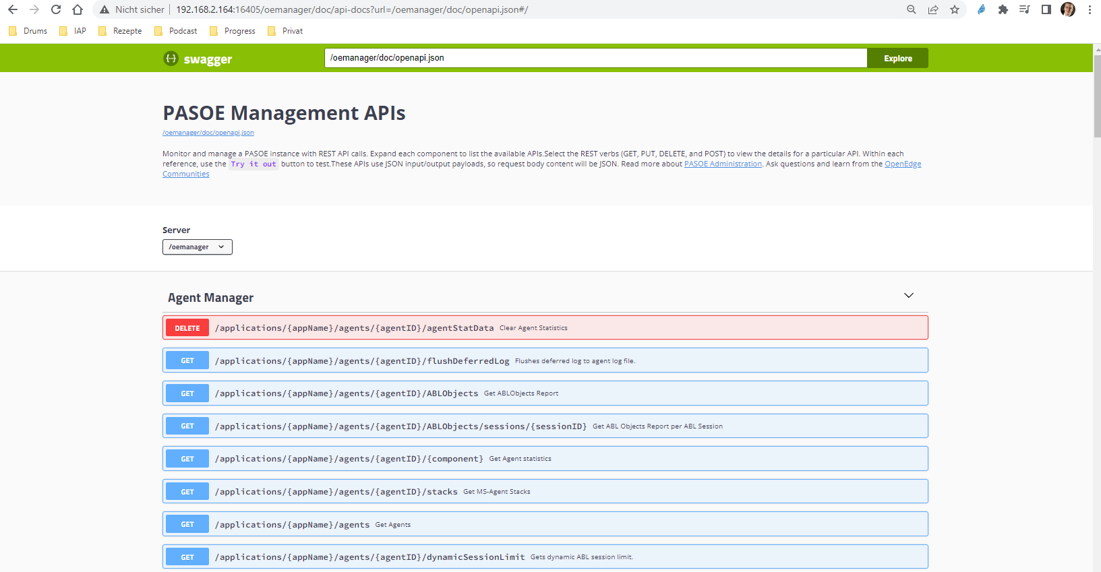
Swagger OF-1 Rest API Documentation

Slide 31
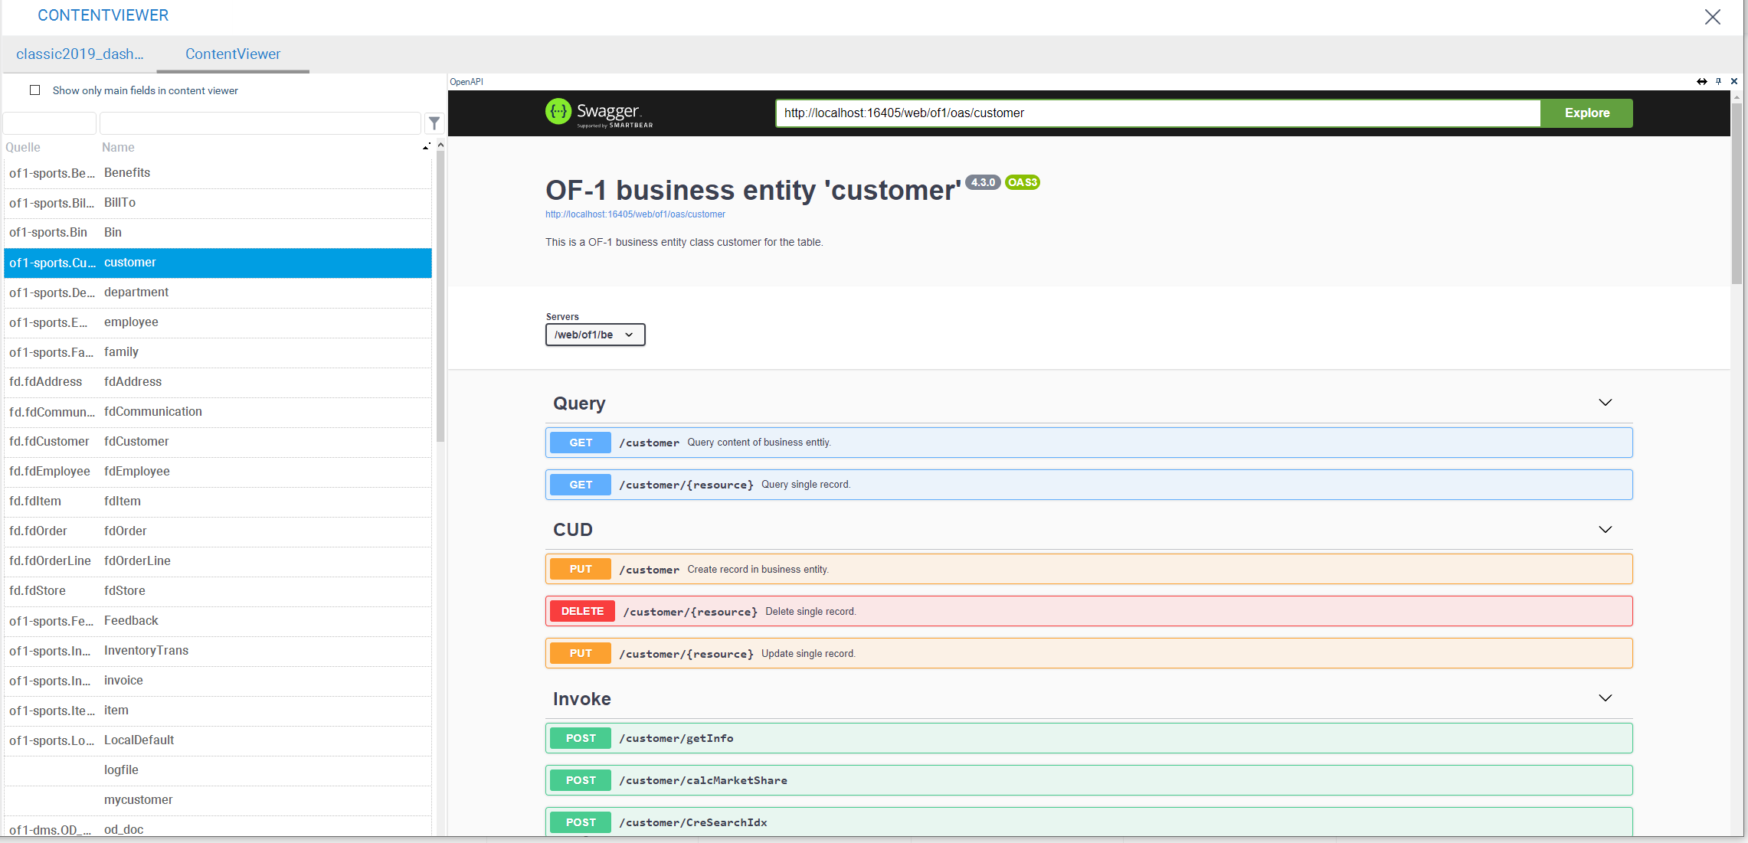
Swagger OF-1 Rest API Documentation

Slide 32
Additional infos
https://pugchallenge.org/downloads2017/284_web_handlers_deep_dive.pdf
Ask us
Klaus de Vries kdv@iap.de
Bernd Hellmann bh@iap.de
www.iap.de/of-1
info@iap.de

Slide 33
Open round
Questions?
www.iap.de/of-1
info@iap.de

