Slide 1

Notes:
Ask… raise your hand… If you agree it is good, if you disagree – please leave the room :)
No – please give constructive feedback!

Slide 2
Agenda
History of OOABL
OO Basics
Pattern
Exercises
Notes:
Key facts:
- Long term customer relations
- Experience of any modern OE Technology
- SDP

Slide 3
History of object oriented ABL
OpenEgde ABL was developed in the 80s
Various paradigm shifts in the last 30 years
In the beginning purly procedural architecture
Version 7 – Event driven UI architecture
Version 9 - PUBLISH, SUBSCRIBE SUPER procedures
Version 10.1 – First real OO implementation
OpenEdge makes it possible, to combine all programming styles

Slide 4
Progress OpenEdge versions
10.1A – First version with OO implementation
10.1A - Basics: Classes, Methods
10.1B - Properties, Interfaces, USING statement
10.1C – First dynamic OO statements, static class members, properties in Interfaces
10.2A - .NET Bridge , Garbage Collection
10.2B - Abstract classes , events , expanded .NET support
10.2B - OO implementation ready for (productiv/commercial) use
11.4 - Serialization
11.6 - Enumerations, reflection
Notes:
Zuschauer Fragen:
- Wer hat schonmal ein Interface implementiert?
- Wer hat schonmal eine abstrakte Klasse geschrieben?
- Wer hat Vererbung verwendet?
- Welche design Pattern könnt ihr mir nennen?

Slide 5
Agenda
History of OOABL
OO Basics
      Classes
      Attributes
      Methods
      Constructors
      Destructors
      Inheritance
      Overriding
      Overloading
      Interfaces
      Events
Pattern
Exercises
Notes:
Key facts:
- Long term customer relations
- Experience of any modern OE Technology
- SDP

Slide 6
Definition: OOP
Object oriented programing (OOP)
Structuring according to human thinking
Depicting things through classes and objects
Interplay of cooperating objects

Slide 7
Definition: classes
Are blueprints for real-world constructs
Have state (attributes) and behavior (methods)
A class defines the properties and functionality of objects at compiling
Classes can be seen as a kind of template for objects
Templates are used to create objects at runtime

Slide 8
What is an object?
Instance (concrete implementation) of a class
Attributes have their own values
Objects only exist at runtime of the program
An object has precisely defined properties and functionality and interacts with other objects in a defined way

Slide 9
Create objects
The keyword NEW <classname>() creates a new object of a certain class and returns it as an object reference (handle).
DEFINE VARIABLE oParrot AS Bird NO-UNDO.
oParrot = NEW Bird(“Cora”).

Slide 10
Constructor
The keyword CONSTRUCTOR defines a constructor of a class
The constructor is used to initialize the object and is always called when it is created
A constructor can define parameters that must be passed when it is created
Each class can define multiple constructors with different signatures
Constructors always have the same name as the class (without package)
CONSTRUCTOR PUBLIC Bird(cName AS CHARACTER):
THIS-OBJECT:cName = cName.
END CONSTRUCTOR.

Slide 11
Destructor
An object can be explicitly deleted using DELETE OBJECT <object reference>
The garbage collector handles implicit deletion
As soon as no part of the program has a valid reference to a specific object instance, the object is automatically deleted by the garbage collector
Destructors are always PUBLIC

Slide 12
Attributes: variable
An attribute, like a variable, holds a value of a specific data type
The names of the attributes are always unique within a class
Variable values can be read and set at any time
DEFINE VARIABLE oKonf AS Konfiguration NO-UNDO.
oKonf = Konfiguration:oInstance.

Slide 13
Attribute: property
Properties are variables encapsulated in a class
Describe properties or characteristics of the class
Program code can be executed when setting the value as well as when reading the value
DEFINE PUBLIC STATIC PROPERTY oInstance AS configuration
PUBLIC GET():
IF oInstance = ? THEN
oInstance = NEW configuration().
RETURN oInstance.
END GET.
PRIVATE SET.
Notes:
Ein Property ist damit eine Mischung aus Attribut und Methode: Der Aufrufer sieht das Property als Attribut, die Klasse intern sieht zwei Methoden: Die Getter-Methode zum Lesen und die Setter-Methode zum Schreiben des Attributes.
Variable or Property?
If you plan on accessing the value from outside the current class, then use a property. This is a good indication the value is a "property" and not just internal state of the object.
If you only need it inside the class, use a variable. If no one else needs to see the value, then the value is "state" and not "property".

Slide 14
Methods
Methods are used to implement an object's actions or capabilities
Like functions in procedures, methods can define parameters to be passed at execution
The names of the methods are not unique, but can be used multiple times as long as the parameters differ

Slide 15
Methods: implementation
/*Bird.cls*/
CLASS Bird:
DEFINE VARIABLE cText AS CHARACTER NO-UNDO.
METHOD VOID SetText(pcText AS CHARACTER):
cText= pcText.
END METHOD.
METHOD CHARACTER GetText():
RETURN(cText).
END METHOD.
END CLASS.
/*Story.p*/
DEFINE VARIABLE oMethod AS Bird NO-UNDO.
oMethod = NEW Bird().
oMethod:SetText("tschirp tschirp").
MESSAGE oMethod:GetText() VIEW-AS ALERT-BOX.
METHOD {return-type} method-name (<Param1>,<Param2>, …): method-body
Methods without a return value use the data type VOID
Notes:
Erwähnen das Privat markierte Member nicht vererbt werden können

Slide 16
Visibilities
CLASS Bird:
METHOD PUBLIC CHARACTER GetText():
RETURN(cText).
END METHOD.
END CLASS.
Visibilities
Regulate access to items
Visible: Element can be read/written
Not visible: Element cannot be read and changed
Within a class, all elements of the class are always visible
Notes:
Erwähnen das Privat markierte Member nicht vererbt werden können

Slide 17
Overview keywords: visibilities
PUBLIC
  The member can be accessed from anywhere
  Defines the interface of the class of objects
PRIVATE
  The member can only be accessed by an object instance of the defining class itself
PROTECTED
  The member can only be accessed by an object instance of the defining class itself or a derived class

Slide 18
Static members
STATIC keyword applicable to attributes and methods
Attribute or method is defined for the class, not for the object
Instantiated when a static member in the class is referenced or a dynamic object instance is created
Cannot call "super" methods

Slide 19
Static members, final class
CLASS of1.const.urban-colors FINAL:
DEFINE PUBLIC STATIC PROPERTY BGColorComponent AS CHARACTER NO-UNDO /* */
GET.
PRIVATE SET.
DEFINE PUBLIC STATIC PROPERTY FGColorComponent AS CHARACTER NO-UNDO /* */
GET.
PRIVATE SET.
CONSTRUCTOR STATIC urban-colors ( ):
BGColorComponent = of1.const.urban-colors:white.
FGColorComponent = of1.const.urban-colors:greyish-brown.
END CONSTRUCTOR.
METHOD STATIC PUBLIC CHARACTER getInvertedColor(cColor AS CHARACTER):
DEFINE VARIABLE iR AS INTEGER NO-UNDO.
DEFINE VARIABLE cInv AS CHARACTER NO-UNDO.
iR = INTEGER(ENTRY(1,cColor)).
RETURN cInv.
END METHOD.
END CLASS.
FINAL keyword applicable to classes, attributes, and methods
Final methods cannot be overridden
Final classes cannot be upgraded

Slide 20

Why inheritance?

Slide 21
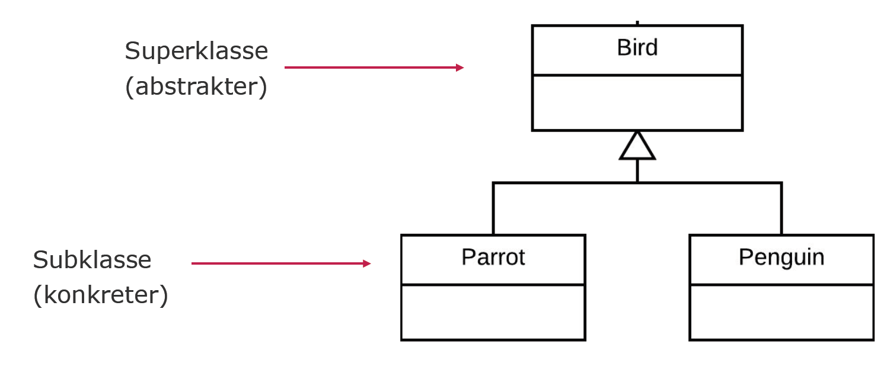
Inheritance
A parrot is a bird
A penguin is a bird
Superclass
(more abstract)
Subclass
(more concrete)

Slide 22
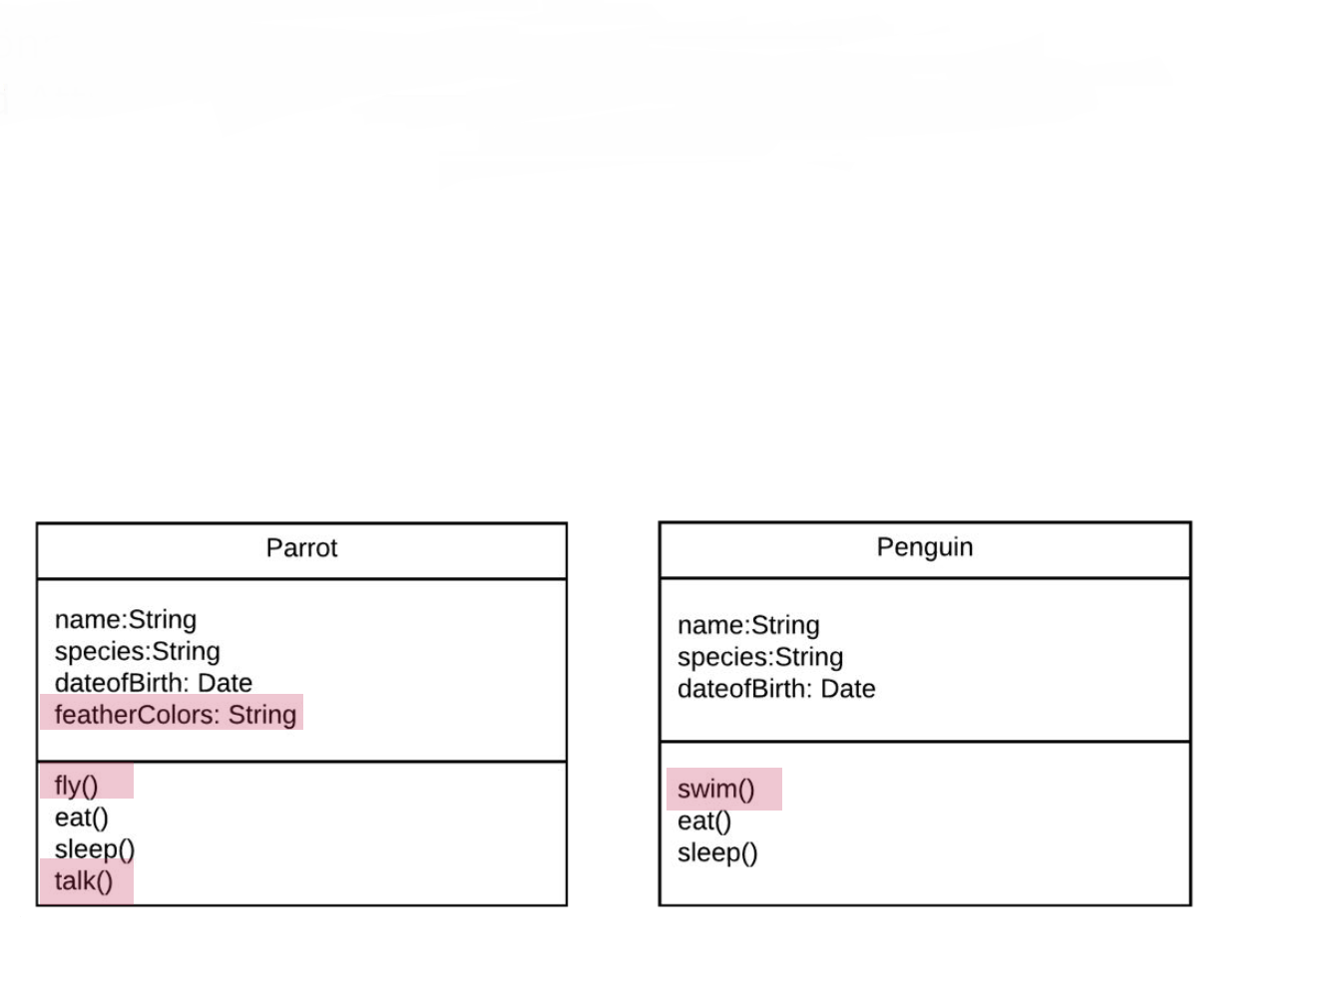
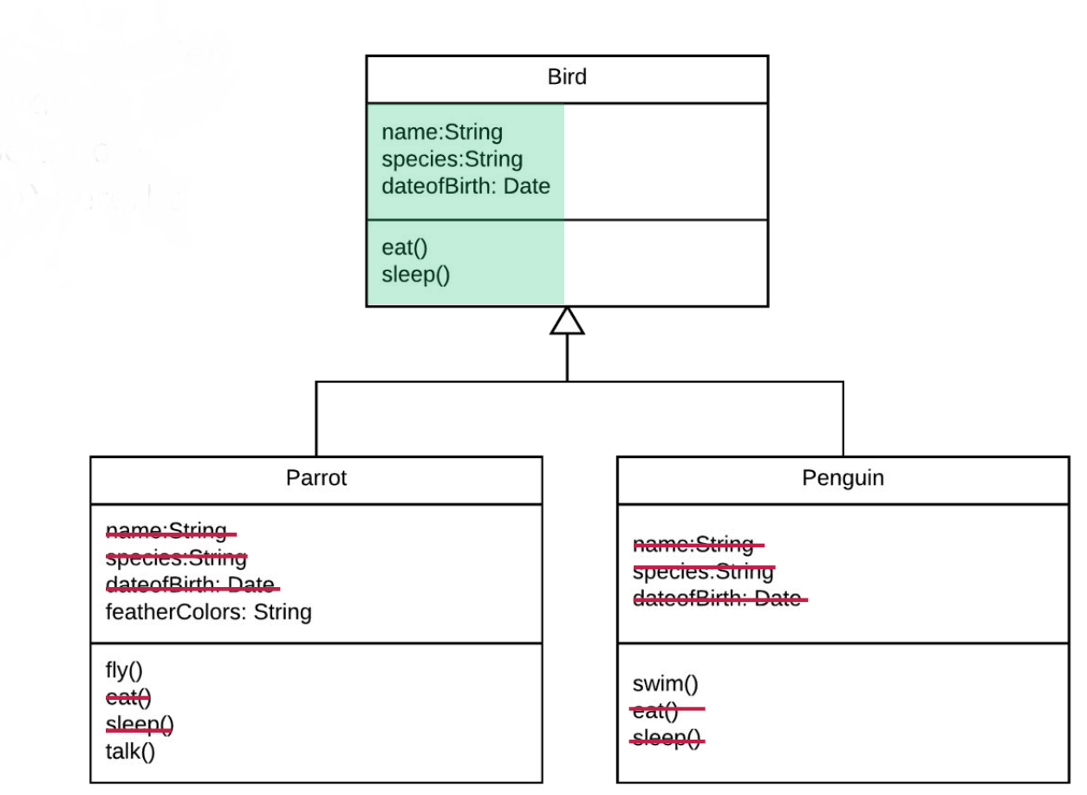
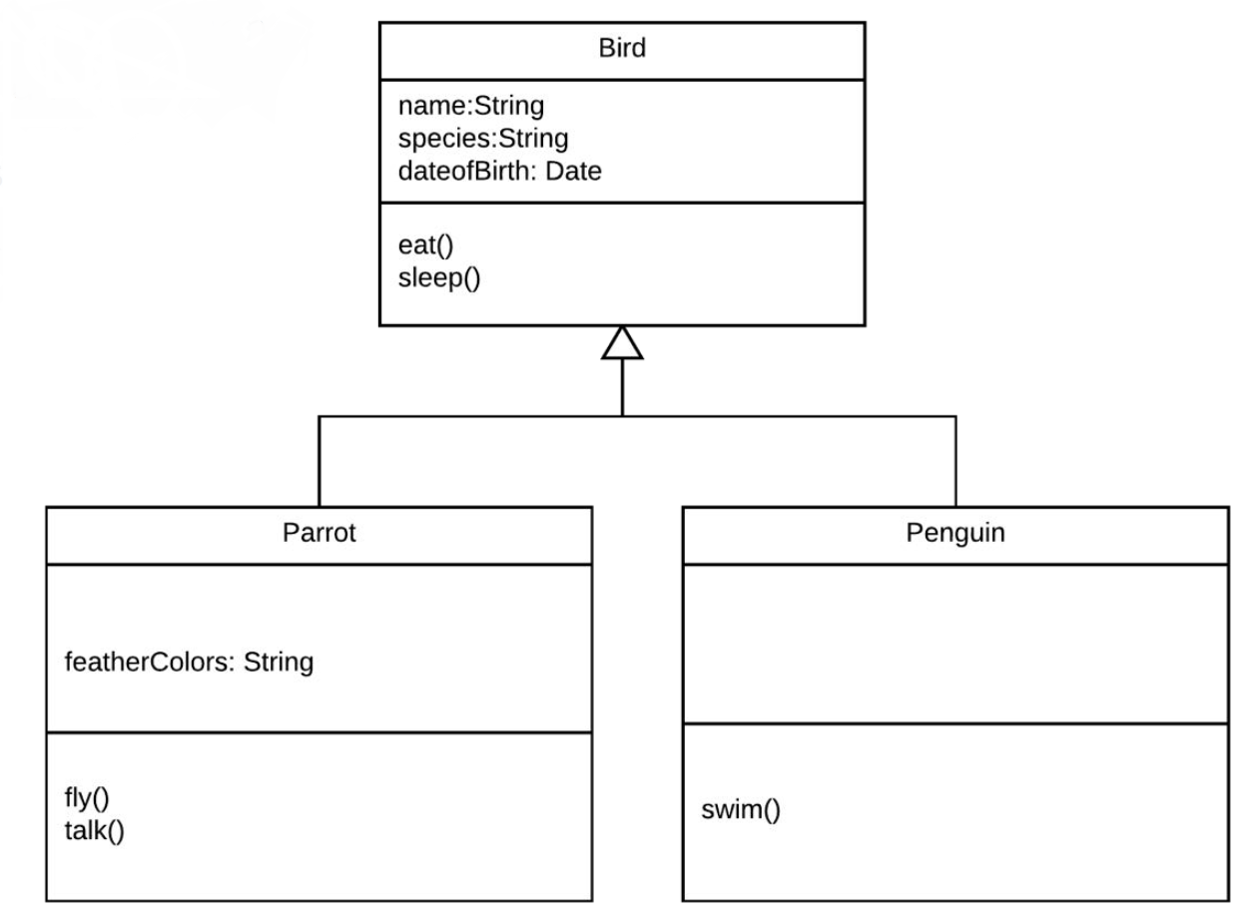
Superclass Bird
Attributes and methods are inherited from the superclass to the subclass(es).
Subclasses can add their own methods and attributes

Slide 23
Subclasses - keyword: inherits
CLASS Bird:
DEFINE PUBLIC PROPERTY cName AS CHARACTER NO-UNDO GET. PRIVATE SET.
METHOD PUBLIC VOID sayHello( ):
END METHOD.
END CLASS.
CLASS Parrot INHERITS Bird:
END CLASS.
The derived class inherits all PUBLIC and PROTECTED members of the superclass
Each class can derive from exactly one other class using INHERITS
Note: If no superclass is specified, a class automatically inherits from the class Progress.Lang.Object (Ultimate Superclass). All classes therefore basically have all the properties of the Progress.Lang.Object class
Notes:
Erwähnen das Privat markierte Member nicht vererbt werden können

Slide 24
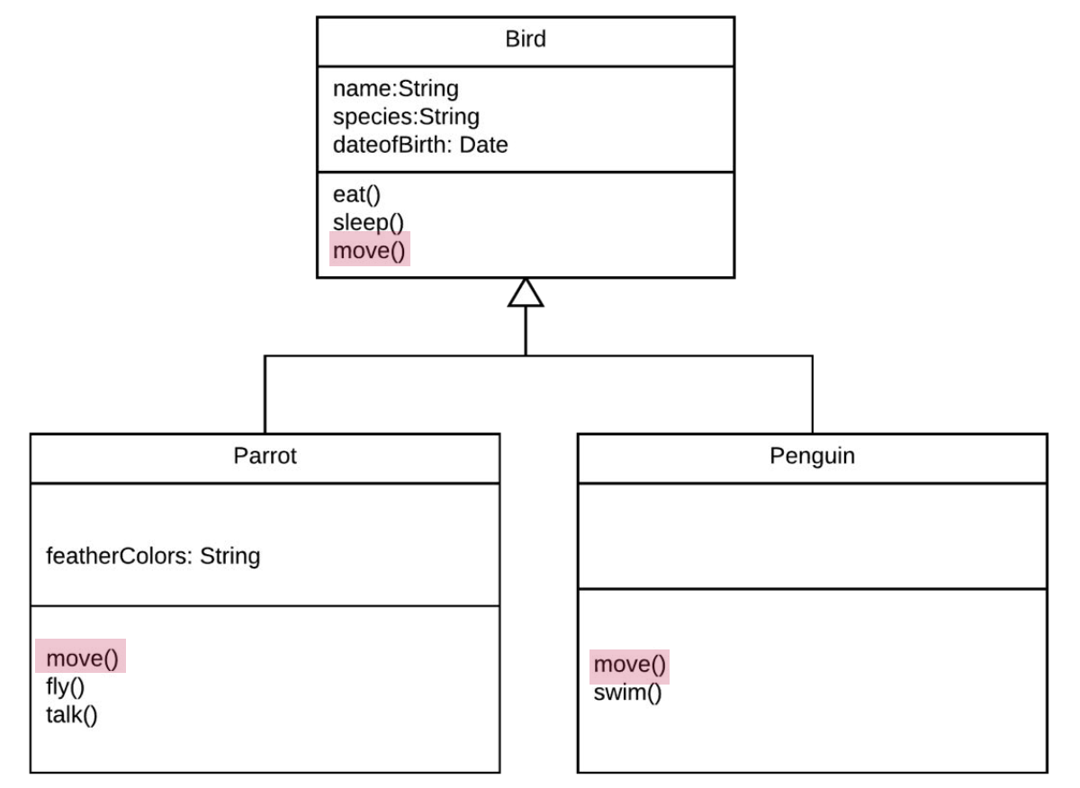
Method overriding
Subclasses can override methods and thus change inherited behavior individually

Slide 25
Overriding
CLASS Bird:
DEFINE PUBLIC PROPERTY cName AS CHARACTER NO-UNDO GET. PRIVATE SET.
METHOD PUBLIC VOID sayHello( ):
MESSAGE "tschirp tschirp" VIEW-AS ALERT-BOX.
END METHOD.
END CLASS.
CLASS Parrot INHERITS Bird:
METHOD OVERRIDE VOID sayHello():
MESSAGE "Cora wants peanuts" VIEW-AS ALERT-BOX.
END METHOD.
END CLASS.
Overriding class properties
  To do this, the method is defined again in the derived class and must be provided with the keyword OVERRIDE
  The implementation of the super class is not lost. It can be invoked using the SUPER keyword
Notes:
Hinweis: Bei Konstruktoren wird automatisch der parameterlose Standard-Konstruktor der Super-Klasse ausgeführt, wenn nicht explizit ein anderer mit SUPER aufgerufen wird.

Slide 26
Overloading of methods
METHOD PUBLIC INTEGER Sum(INPUT x AS INTEGER, INPUT y AS INTEGER):
RETURN x + y.
END METHOD.
METHOD INTEGER Sum(INPUT x AS INTEGER, INPUT y AS INTEGER, INPUT z AS INTEGER):
RETURN x + y + z.
END METHOD.
METHOD PRIVATE DECIMAL Sum(INPUT x AS DECIMAL, INPUT y AS DECIMAL):
RETURN x + y.
END METHOD.
Different methods have the same name within a class
Has nothing to do with inheritance
Must have different parameter lists
Return types can be different
Visibility may vary
Notes:
Konstruktor vorher

Slide 27


Motivation abstract classes
oPenguin = NEW Penguin().
oBird = NEW Bird().
oAnimal = NEW Animal().
?
Some classes shouldn't be instantiable!

Slide 28
Abstract Classes
CLASS Animal ABSTRACT:
DEFINE PUBLIC ABSTRACT PROPERTY cName AS CHARACTER NO-UNDO
GET.
PROTECTED SET.
METHOD PUBLIC ABSTRACT VOID eat( ).
END CLASS.
The keyword ABSTRACT in the CLASS statement is sufficient to define an abstract class
An object cannot be created from an abstract class

Slide 29
Abstract methods
CLASS Bird ABSTRACT INHERITS Animal:
METHOD PUBLIC ABSTRACT VOID fly( ).
END CLASS.
Are created by the keyword ABSTRACT
Have no method body and end with a period
Must be overridden (and thus defined) by the first concrete subclass
Abstract methods can only exist in abstract classes

Slide 30
First concrete subclass
CLASS Parrot INHERITS Bird:
DEFINE OVERRIDE PUBLIC PROPERTY cNAME AS CHARACTER NO-UNDO
GET.
SET.
METHOD OVERRIDE PUBLIC VOID eat( ):
...
END METHOD.
METHOD OVERRIDE PUBLIC VOID fly( ):
...
END METHOD.
END CLASS.
In addition to abstract properties, abstract classes can contain completely implemented properties as well as constructors and destructors

Slide 31
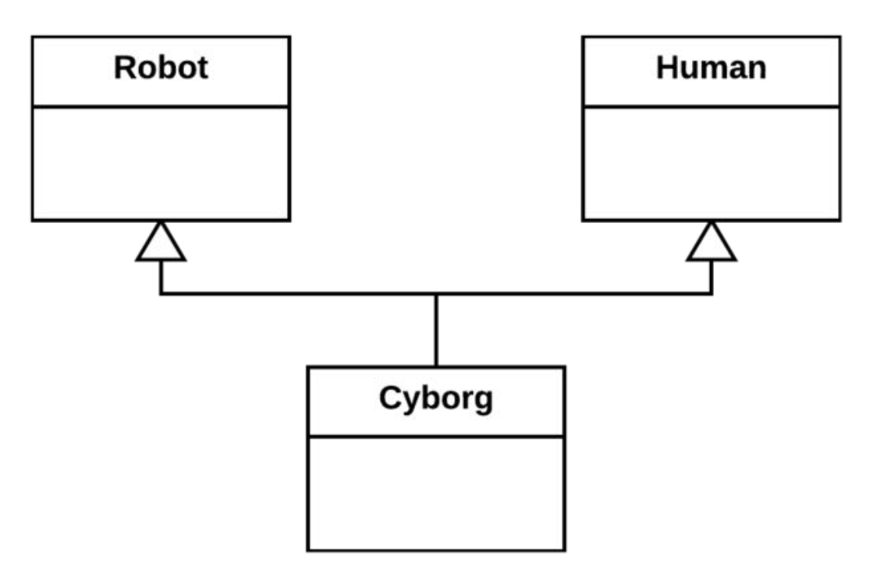
principle of multiple inheritance
A subclass Cyborg inherits from (potentially) different inheritance hierarchies
The Human and Robot classes define the heal( ) method in different ways
Which of the implementations does the cyborg inherit if heal( ) is not redefined?
heal( )
heal( )

Slide 32
Solution: interfaces
Why did we want multiple inheritance?
It should be ensured that both the methods of the Human class and the methods of the Robot class are present
Interfaces
  ABL does not support multiple inheritance
  Interfaces provide a “contract” that the implementing class must abide by
  The properties are not implemented, only specified in the form of names and signatures

Slide 33
Interfaces
/*Healable.cls*/
INTERFACE IHealable:
METHOD PUBLIC VOID healObj ( ).
METHOD PUBLIC VOID healObj (INPUT pcWounds AS INTEGER).
METHOD PUBLIC VOID logObj (INPUT pcFilename AS CHARACTER).
DEFINE PUBLIC PROPERTY Name AS CHARACTER NO-UNDO
GET.
SET.
END INTERFACE.
Interfaces do not contain any executable code
Only PUBLIC is allowed as visibility
Interfaces contain no constructor and no destructor
An object cannot be created from an interface

Slide 34
Interfaces
CLASS Cyborg IMPLEMENTS IHealable:
/* Must implement methods defined in the IHealable interface */
METHOD PUBLIC VOID healObj( ):
...
END METHOD.
/* Second version of healObj */
METHOD PUBLIC VOID printObj (INPUT piWounds AS INTEGER):
...
END METHOD.
/* Method to log information */
METHOD PUBLIC VOID logObj (INPUT pcFilename AS CHARACTER):
...
END METHOD.
DEFINE PUBLIC PROPERTY Name AS CHARACTER NO-UNDO
GET():
END GET.
SET():
END SET.
END CLASS.
Each class can implement multiple interfaces
All prototypes must be implemented

Slide 35
Enumerations
Enums
  Own data type for variable with a finite value set
  For example, as a list "RED, GREEN, BLUE", or min-max values
  Realisation within cls file
// const.objstatus.cls
ENUM const.objstatus:
DEFINE ENUM
Offer = 1
Order = 2
Calculated = 3
Completed = 8.
END ENUM.

Slide 36
Enumerated type
Makes it easier for the developer to deal with constants and code
_{// So far}
_{bObjekte.ObjStatus = 1.}
_{// Assignment}
bObjekte.ObjStatus = objstatus:Offer:GetValue().
//Unfortunately, this is not possible because different data types are used.
bObjekte.ObjStatus = objstatus:Offer.
Are treated like regular data types
DEFINE PUBLIC PROPERTY iObjStatus AS const.objstatus NO-UNDO
GET.
SET.
iObjStatus = objstatus:Offer.

Slide 37
Events
Events are used to perform actions in specific, defined situations
Events are defined in classes with DEFINE EVENT
The definition provides a signature in the form of parameters
The names of the events are always unique within a class.
DEFINE PUBLIC EVENT SimpleEvent SIGNATURE VOID(p_msg AS CHAR).

Slide 38
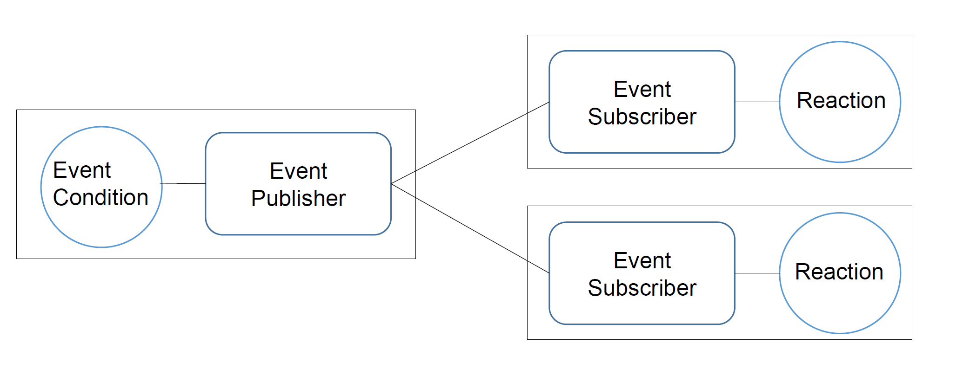
Events
Publish & Subscribe

Slide 39
Events
Publish
  Triggering an event is done by <Event>:PUBLISH(<Param1>,<Param2>, ...).
/* Event Definitions */
DEFINE PUBLIC EVENT SimpleEvent SIGNATURE VOID(p_msg AS CHAR).
/* Event Publishers */
THIS-OBJECT:SimpleEvent:Publish(p_msg).

Slide 40
Events
Subscribe
  If an object wants to register for a specific event, it registers one of its methods with a corresponding signature using <Event>:SUBSCRIBE(<Method>)
/* Event Definitions */
DEFINE PUBLIC EVENT SimpleEvent SIGNATURE VOID(p_msg AS CHAR).
/* Event Subscriber */
oPublishingClass:SimpleEvent:Subscribe(oSubscribingClass:EventMethod).

Slide 41
Classes
The characteristics of a class are called member, there are constructors, destructors, attributes, methods and events
In ABL the definition of a class must be in files with the extension .cls
Only one class can be defined in each file
CLASS Bird:
...
/* data definitions */
/* method definitions*/
/* constructor, destructor*/
...
END CLASS.

Slide 42
Agenda
History of OOABL
OO Basics
Pattern
      Builder
      Singleton
      Lazy Loading
      Adapter
Exercises
Notes:
Key facts:
- Long term customer relations
- Experience of any modern OE Technology
- SDP

Slide 43
Design Pattern
„In software engineering, a software design pattern is a general, reusable solution to a commonly occurring problem within a given context in software design.“ -Wikipedia
Design Patterns: Elements of Reusable Object-Oriented Software
Three types:
  Production patterns
  Structure pattern
  Behavioural patterns
Notes:
Design Pattern - Entwurfsmuster
Definition:„In software engineering, a software design pattern is a general, reusable solution to a commonly occurring problem within a given context in software design.“ -Wikipedia
Bewährte wiederverwendbare Lösung für ein Häufig Auftretendes Problem in der Softwareentwicklung
1977;Architektur Konzept;Christopher Alexander
1987;Kent Beck & Ward Cunningham; Experiment
Pattern in Software;Präsentierten Ergebnisse auf Konferenz
1995;Buch;“Design Patterns: Elements of Reusable Object-Oriented Software“;Erich Gamma;Richard Helm;Ralph Johnson;John Vlissides
4 Personen → GoF → oft erwähnt im Zusammenhang
Dadurch populär
Drei Arten: Erzeugungsmuster;Strukturmuster;Verhaltensmuster
7 Muster vorstellen

Slide 44
Pattern: Builder
Type: Production patterns
Prepare creation of one object by another
When:
  Constructors with many parameters
Why:
  Readability
  Fewer errors with parameters
  Auto-complete
  Easy to expand
Notes:
Erzeugungsmuster
Erzeugung eines Objekte durch ein anderes vorbereiten
Wann:
Konstruktoren mit vielen Parametern
Warum:
Lesbarer
Weniger Fehler mit Parametern
Auto-Complete in Entwicklungsumgebung
Gut änderbar(Builder und User können ergänzt werden)

Slide 45
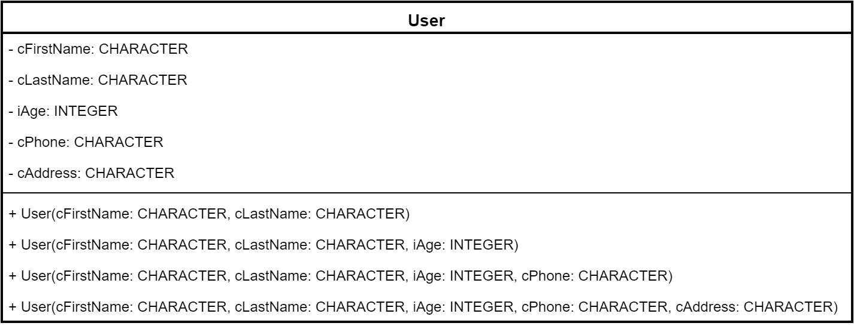
Pattern: Builder
Starting point
Notes:
Pattern Builder
Zum Verständnis zunächst das Problem
Klasse User
2 benötigte, 3 optionale Parameter
Teleskop
Lange Zeile
Reihenfolge

Slide 46
Pattern: Builder
Call with many parameters:
DEFINE VARIABLE oUser AS User NO-UNDO.
oUser = NEW User(
"Max",
"Mustermann",
23,
"+49 40-30 68 03-26",
"Valentinskamp 30, 20355 Hamburg"
).
Notes:
Konstruktor vorher

Slide 47
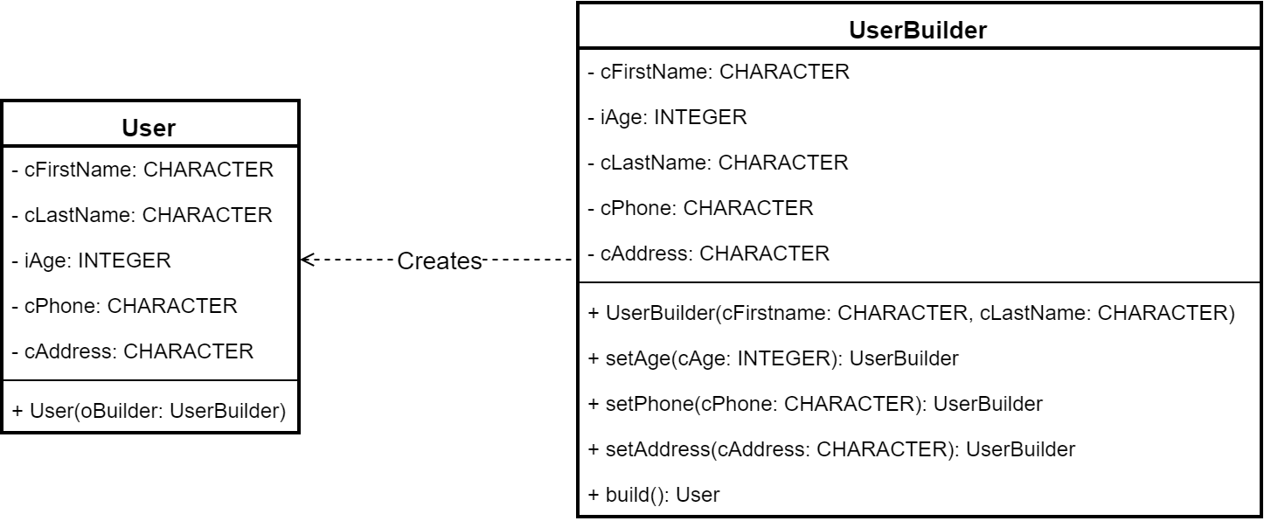
Pattern: Builder
With Builder Pattern:
Notes:
Beispiel mit Builder Klasse
Konstruktoren auflösen
UserBuilder beschreiben

Slide 48
Pattern: Builder
Builder Section of a setter:
CLASS UserBuilder:
…
METHOD PUBLIC UserBuilder setAge(iAge AS INTEGER):
THIS-OBJECT:iAge = iAge.
RETURN THIS-OBJECT.
END METHOD.
…
END CLASS.
Notes:
Ausschnitt aus UserBuilder
Rückgabe nach jedem Methodenaufruf von Objekt
→ Chaining
Vorteil:
Keine Variable für Builder
Leichter lesbar

Slide 49
Pattern: Builder
Call Builder:
DEFINE VARIABLE oUser AS User NO-UNDO.
oUser =
(NEW UserBuilder("Max", "Mustermann")
:setAge(23)
:setPhone("+49 40-30 68 03-26")
:setAddress("Valentinskamp 30, 20355 Hamburg")
:build()).
Notes:
Beispiel für Erzeugung User mit Pattern
Chaining ist Sichtbar

Slide 50
Pattern: Builder
Small excerpt:
Example of many parameters:
RUN StatusCreate IN l-Import-Library-Handle
( INPUT l-DB-Cust,
INPUT "",
INPUT 150,
...
INPUT
"QtyType=" + OrderQtyQualifier + "{&T}"
+ "UTCTime=" + l-UTCTime
+ "{&T}"
+ "ConC-ID=" + SSCO-Ord.ConC-ID
...
) NO-ERROR.
RUN StatusCreate IN l-Import-Library-Handle
( INPUT l-DB-Cust, /* Cust Code */
INPUT "", /* Cnee Code */
INPUT 150, /* status numeric */
/* tb, 100304; export 8645 with O-E instead of O-I */
&IF ("{&Exp_8645_with_O-E_v1}") = "TRUE" &THEN
INPUT "CreateNewRep2" + SSCO-Ord.OrderType + ",StartOrderExport665", /* Create report flag */
&ELSE
INPUT "CreateNewRep" + SSCO-Ord.OrderType + ",StartOrderExport665", /* Create report flag */
&ENDIF
INPUT TRUE, /* Report NEW = YES */
INPUT SSCO-o-Movement.Movement-ID, /* NOT Ord-ID */
INPUT "O", /* Status Type */
INPUT 0, /* Suborder Number */
INPUT 0, /* ? */
INPUT l-StatusDate, /* Status Date */
INPUT l-StatusTime, /* Status Time */
/* tb, 050801 */
INPUT "Customer EDI", /* User Code */
INPUT FALSE, /* Print 1 */
INPUT FALSE, /* Print 2 */
INPUT ?, /* default is Today */
INPUT "", /* Remarks */
INPUT SSCO-Ord.OrdQty, /* Qty */
INPUT 0, /* info code */
INPUT SSCO-Ord.Send-ID, /* Send-ID */
INPUT SSCO-Ord.Send-Code, /* Send-Code */
/* no transmission to CIEL for Road orderlines */
&IF ("{&Road_Order}") = "TRUE" &THEN
INPUT (SSCO-Ord.TrnsType-Code <> "R" AND b-Cust.Released), /* IsTransmit */
&ELSE
INPUT b-Cust.Released, /* IsTransmit */
&ENDIF
INPUT l-Import-Date-asDate, /* created on */
INPUT l-Import-Time-asChar, /* time on */
INPUT "", /* knref */
INPUT "", /* damaged code */
INPUT "", /* address type-code */
INPUT ?, /* docs delivery date */
INPUT "", /* docs delivery time */
INPUT 0, /* invoice header ID */
INPUT TRUE, /* check for duplicate status ? */
INPUT "", /* Reason Code */
INPUT "", /* Export/Import Flag */
INPUT "", /* SubStatus */
INPUT "QtyType=" + l-tt-{&ShipType}660.OrderQtyQualifier + "{&T}" +
"UTCTime=" + l-UTCTime + "{&T}" +
"ConC-ID=" + STRING(SSCO-Ord.ConC-ID), /* additional Fields ({&T}-separated list */
OUTPUT l-Stat-Code, /* status code. if ? then status invalid */
OUTPUT l-Return-Code /* returncode passed by called procedure */
) NO-ERROR.
Notes:
Beispiel aus der Progress-Welt vorher
Solche Aufrufe sind bekannt

Slide 51
Pattern: Builder
Call with Builder (small section):
DEFINE VARIABLE oStatusAttachment AS StatusAttachment NO-UNDO.
oStatusAnlage =
(NEW StatusAttachmentBuilder()
:setCustCode(l-DB-Cust)
:setStatusNumeric(150)
...
:setQtyType(OrderQtyQualifier)
:setUTCTime(l-UTCTime)
:setConCID(SSCO-Ord.ConC-ID)
...
:build()).
Notes:
Mit dem Builder

Slide 52
Pattern: Singleton
Type: Production pattern
A replacement for Global Objects in OO
When:
  Only one object is needed in several components of the application
Why:
  Inheritance is possible
  Logic during generation
  Resource-efficient
Example:
  Configuration
  Hard drive
  Printer
Notes:
Erzeugungsmuster
Eine Instanz
Wann: Nur ein Objekt
Warum: Vererbung; Erzeugungslogik; Ressourcenschonend
Beispiel:
Konfiguration

Slide 53
Pattern: Singleton
Class with singleton pattern:
CLASS Configuration:
...
DEFINE PUBLIC STATIC PROPERTY oInstance AS Configuration
PUBLIC GET():
IF oInstance = ? THEN
oInstance = NEW Configuration().
RETURN oInstance.
END GET.
PRIVATE SET.
CONSTRUCTOR PRIVATE Configuration():
reloadConfig().
END CONSTRUCTOR.
...
END CLASS.
Notes:
Beispiel Singelton oInstance Klasse Konfiguration
Static
Nur getter public
Konstruktor privat
Singelton in Konfiguration Klasse

Slide 54
Pattern: Singleton
Singleton call:
DEFINE VARIABLE oConf AS Configuration NO-UNDO.
oConf = Configuration:oInstance.
oConf:setValue("mode", "debug").
oConf:saveToFile().
Notes:
Beispiel Aufrufe

Slide 55
Pattern: Lazy Loading
Type: Production pattern
Delayed until first query:
  Object generation
  Value calculations
  Other costly processes
Often together with Singleton
When:
  Initialisation of a class takes a long time
Why:
  Performance
  Resource-efficient
Notes:
Erzeugungsmuster
Verzögern bis Bedarf von:
Objekt Erzeugung
Werte Berechnungen
Andere teure Prozesse
Oft zusammen mit Singelton
Warum:
Schnelleres Initiales starten
Ressourcenschond
https://en.wikipedia.org/wiki/Lazy_loading
http://developerdizzle.github.io/lazy-loading

Slide 56
Pattern: Lazy Loading
Example part 1 (Property):
CLASS Invoice:
...
DEFINE PUBLIC PROPERTY cCustomerName AS CHARACTER NO-UNDO INITIAL ? PRIVATE SET.
PUBLIC GET:
IF cCustomerName = ? THEN DO:
DEFINE VARIABLE iCN AS INTEGER NO-UNDO.
iCN = THIS-OBJECT:iCustNum.
DEFINE BUFFER bCustomer FOR Customer.
FIND FIRST bCustomer WHERE bCustomer.CustNum = iCN NO-LOCK NO-ERROR.
IF AVAILABLE bCustomer THEN DO:
cCustomerName = bCustomer.Name.
END.
END.
RETURN cCustomerName.
END GET.
...
END CLASS.
Notes:
cCustomerName ist initial ?
Eine andere nicht gezeigte Property CustNum
Private Set
Wird bei erstem Zugriff initialisiert

Slide 57
Pattern: Lazy Loading
Example Part 2 (Constructor & Other Properties):
CLASS Invoice:
...
CONSTRUCTOR PUBLIC Invoice(iInvoiceNum AS INTEGER):
DEFINE BUFFER bInvoice FOR Invoice.
FIND FIRST bInvoice WHERE bInvoice.Invoicenum = iInvoiceNum NO-LOCK NO-ERROR.
IF AVAILABLE bInvoice THEN DO:
THIS-OBJECT:iInvoiceNum = iInvoiceNum.
THIS-OBJECT:iCustNum = bInvoice.CustNum.
END.
END CONSTRUCTOR.
...
END CLASS.
Notes:
Befüllen der Properties
Konstruktor

Slide 58
Pattern: Adapter
Type: Structure pattern
Connecting two incompatible interfaces
When:
  Using an old class in a new system
  A new class with existing interface
Why:
  Old interface can be retained
Notes:
Strukturmuster
Zwei inkompatible Schnittstellen verbinden
Wann:
Eine alte Klasse in einem neuen System verwenden
Eine neue Klasse in einem existierenden System wie eine andere Benutzen
Warum
Altes Interface kann erhalten bleiben

Slide 59
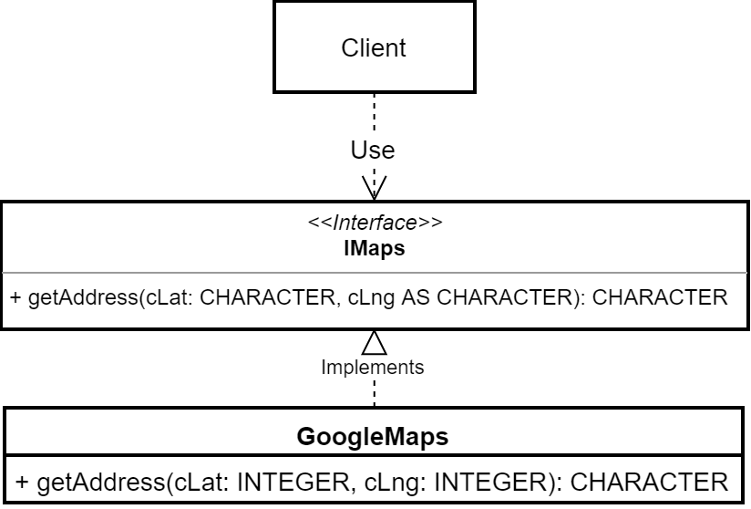
Pattern: Adapter
Notes:
Beipiel Ausgangssitutation
Interface vorhanden
Andere Klasse soll angesprochen werden
nicht kompatibel

Slide 60
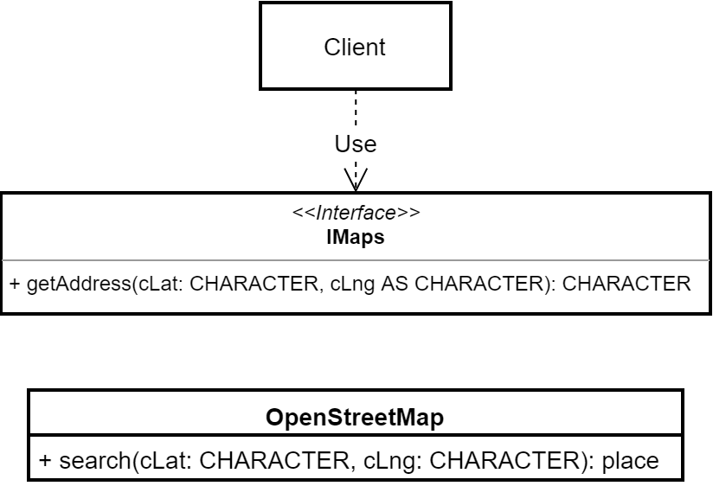
Pattern: Adapter
Notes:
Beipiel Ausgangssitutation
Interface vorhanden
Andere Klasse soll angesprochen werden
nicht kompatibel

Slide 61
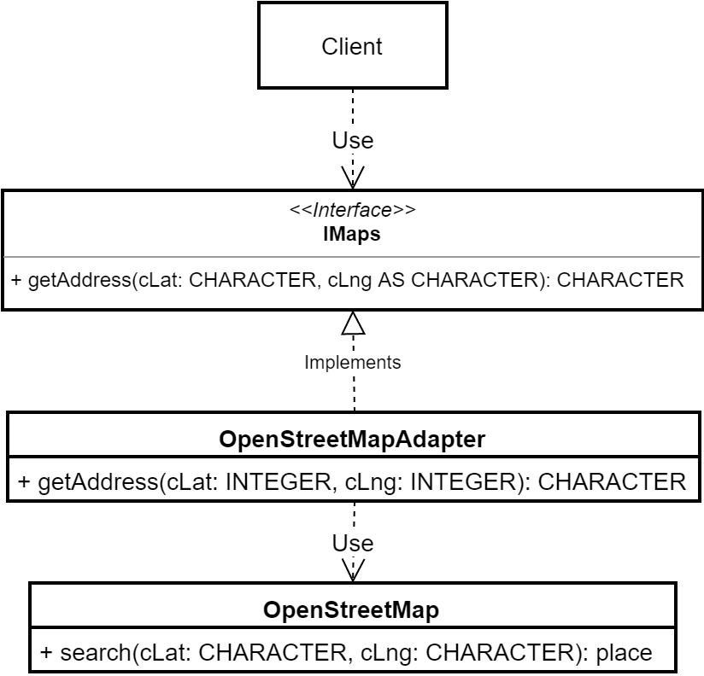
Pattern: Adapter
Notes:
Klasse die das interface implementiert
aufruf von Methoden des zu benutzenden Objektes mit übersetzung
hier umwandlung place → CHARACTER

Slide 62
Pattern: Adapter
CLASS OpenStreetMapAdapter IMPLEMENTS IMaps:
DEFINE PRIVATE PROPERTY oOpenStreetMap AS OpenStreetMap NO-UNDO
PRIVATE GET.
PRIVATE SET.
CONSTRUCTOR PUBLIC OpenStreetMapAdapter():
oOpenStreetMap = NEW OpenStreetMap().
END CONSTRUCTOR.
METHOD PUBLIC CHARACTER getAddress(cLat AS CHARACTER ,cLng AS CHARACTER):
RETURN oOpenStreetMap:search(cLat, cLng):Address.
END METHOD.
END CLASS.
Notes:
Code Adapter

Slide 63
Agenda
History of OOABL
OO Basics
Pattern
Exercises
Notes:
Key facts:
- Long term customer relations
- Experience of any modern OE Technology
- SDP

Slide 64
Exercise 1
Create an Item program similar to the customer mask
Save it under package ui.screens.Item.cls
Fields: Itemnum, ItemName, CatDescription
Notes:
Strukturmuster
Zwei inkompatible Schnittstellen verbinden
Wann:
Eine alte Klasse in einem neuen System verwenden
Eine neue Klasse in einem existierenden System wie eine andere Benutzen
Warum
Altes Interface kann erhalten bleiben

Slide 65
Exercise 2
Build an entity appl.server.entities.be-item analogous to be-customer
Parameter are Action(prev next)
Build a dynamic query
Notes:
Strukturmuster
Zwei inkompatible Schnittstellen verbinden
Wann:
Eine alte Klasse in einem neuen System verwenden
Eine neue Klasse in einem existierenden System wie eine andere Benutzen
Warum
Altes Interface kann erhalten bleiben

Slide 66
Exercise 3
Convert be-item into a singleton
Notes:
Strukturmuster
Zwei inkompatible Schnittstellen verbinden
Wann:
Eine alte Klasse in einem neuen System verwenden
Eine neue Klasse in einem existierenden System wie eine andere Benutzen
Warum
Altes Interface kann erhalten bleiben

Slide 67
Webhandler
1. Create a new Web Handler for items called "ItemsWebHandler"
2. Use the example code from "HelloWorldWebHandler" and add "ItemsWebHandler" to openedge.properties (PASOE). The PASOE has to be restarted for config changes to take effect.
3. "ItemsWebHandler" shall take Query parameters on GET requests to fetch a specific amount of records and some additional rules:
"batchcount": number of records to fetch
"itemnumfrom": item number to start counting from
"backwards": fetch records before or after "itemnumfrom"
3.1
Add a new method to "be-item" called "mGetBatch" with parameters:
- piBatchCount
- plBackwards
- rowId or itemNum to start at
The method shall return a temp-table handle of a temp-table filled with the result set
3.2
Use the parsed query parameters in "ItemsWebHandler" to call "be-item" and return the result set in the response body.
Make sure to handle all errors that might occur, e.g. by missing or invalid query parameters.
Extra:
Make up your own filter to accept as a query parameter and filter the results accordingly.

Slide 68
Exercise 4
Create a Date-Display class based on the Fill-In class. This should always be of the type Date
The screen value is to be incremented with "+" and decremented with "-".
The name of this class is:
      appl.ui.components.native.date-display.cls
Notes:
Strukturmuster
Zwei inkompatible Schnittstellen verbinden
Wann:
Eine alte Klasse in einem neuen System verwenden
Eine neue Klasse in einem existierenden System wie eine andere Benutzen
Warum
Altes Interface kann erhalten bleiben

Slide 69
Exercise 5
When a control (widget) is made invisible, the associated label remains visible for the moment.
Change the fill-in class appl.ui.components.native.fill-in.cls so that the label is only visible with the fill-in.
For testing purposes, we install a button in the screen that alternately makes the button visible.
Notes:
Strukturmuster
Zwei inkompatible Schnittstellen verbinden
Wann:
Eine alte Klasse in einem neuen System verwenden
Eine neue Klasse in einem existierenden System wie eine andere Benutzen
Warum
Altes Interface kann erhalten bleiben

