Slide 1

Can AI spot risky software in critical infrastructure?
Notes:
Wilfred

Slide 2
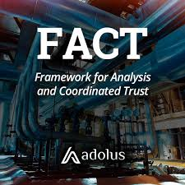
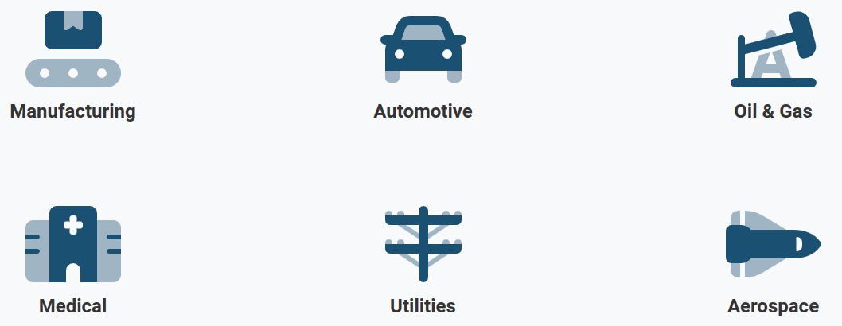
Background
Company aims to vet software packages used in critical infrastructure using FACT
Clients need some way to ensure the safety of their operations
Notes:
Wilfred

Slide 3
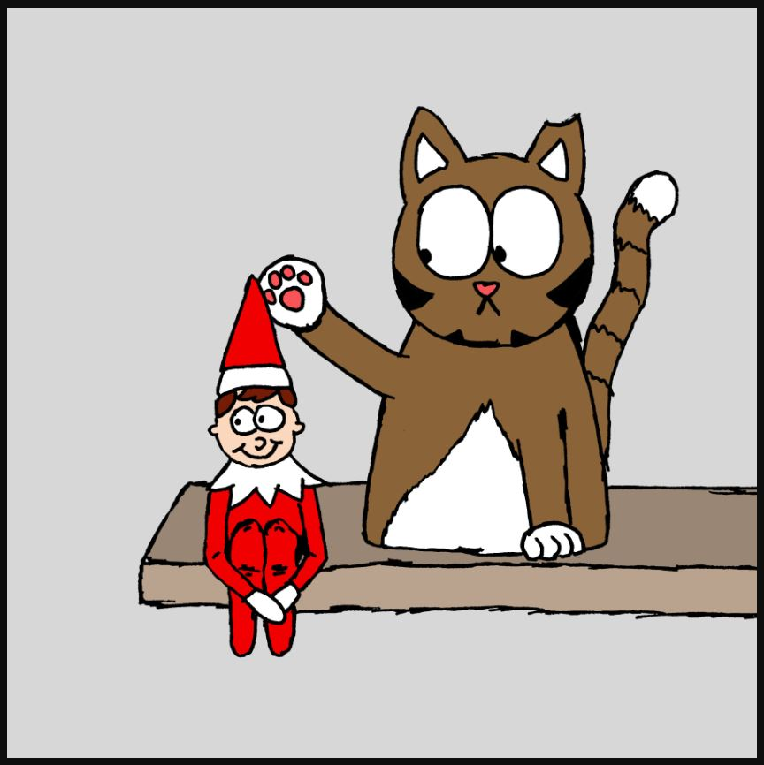
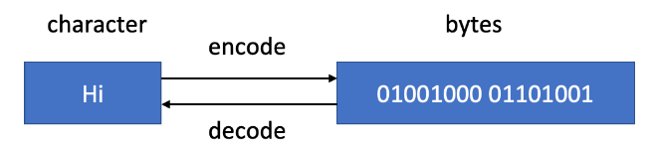
Background
Our Project
Given Executable and Linkable Format files (ELFs)
Binary files can be decoded to strings and other information
Extracted information turned into metadata that the FACT system can use
We need to extract the most relevant information (package names, versions, etc) from these files!
Notes:
Wilfred

Slide 4

Data
CSV -> json files + extrainfo
Current solution is manual regex and verification
Not all files conform to industry standards from (package names in specific places)
Notes:
Nikita

Slide 5

Products for the Partners
Documentation on
Engineered features
Research feasibility of models to predict
Recommendations for further research
Python Scripts (time-permitting)
https://www.diagnosticimaging.com/view/radiology-comic-long-report-covers-everything
Notes:
Nikita

Slide 6
The Science.
Preprocessing using regex
Feature Engineering
Feature Engineering
Feature Engineering
Supervised Learning with given labels
Unsupervised Learning by clustering similar files
Transformer Models and Entity Tagging

Slide 7
Project Steps
Week 1
Hackathon
Proposal & Presentation
Week 2
Data Analysis
Base Feature Engineering & Data Preprocessing
Week 3
Feature Engineering
Supervised Learning
Week 4
Data Annotation for NER
Unsupervised Learning
Week 5
Data Annotation for NER
NER using Transformers & Fine-Tuning
Week 6
NER using Transformers & Fine-Tuning
ML Scripts
Week 7
Report Draft
Comparison of traditional and deep learning ML
Week 8
Final Presentation
Report Finalization

Slide 8
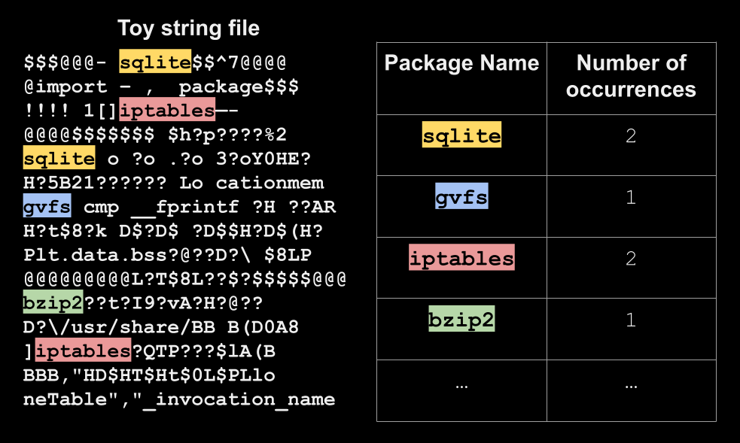
Tested Baseline Feature Engineering

Slide 9
Tested Baseline Feature Engineering
 | Approach 1 | Approach 2
Prediction Method for Package Label | Based on maximum occurrences | Logistic regression model
Prediction Accuracy | 67.7% | 96.8% (on the test set)

Slide 10


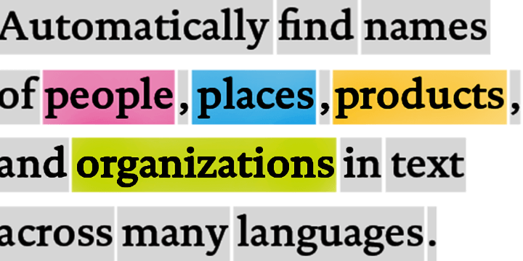
Challenges Faced
Heavy string preprocessing
Limited labels and package version numbers with baseline techniques
NER limitations
Need more sophisticated and advanced ML and NLP techniques!!!

Slide 11
Thank you! Any questions?

