Slide 1
NETRA
Network Threat Recognition and Automated response
A hybrid intrusion detection and response system:
signature rules + supervised learning + unsupervised anomaly detection,
with automated, time-limited firewall response.
Trained and evaluated on CIC-IDS2017 | Validated live in an isolated Docker attack lab
Notes:
Netra detects network attacks and then acts on them. Three detection methods, one fusion policy, and an automated response that is always time-limited and reversible.

Slide 2
THE PROBLEM
Detection alone is not a system
• Signature systems are precise and explainable, but blind to any attack nobody wrote a rule for.
• Anomaly systems generalise to unknown attacks, but produce alert volumes operators learn to ignore.
• Most academic work stops at offline accuracy on a benchmark. An alert that nobody reads changes nothing.
• Offline metrics are also optimistic: benchmark datasets carry artefacts that models happily learn (shown later in this deck).
The question this project asks
Can the three detection approaches be combined under an explicit policy, coupled to a safe automated response, and shown to work on real packets rather than only on a benchmark?
2
Notes:
Frame the gap: precision vs generalisation, and detection vs response. The honest framing at the bottom sets up the negative finding later.

Slide 3
SCOPE
Objectives
1
Detect
Combine four packet-level signature rules, two supervised classifiers and a benign-only autoencoder under an explicit fusion policy.
2
Respond
Block the attacking source automatically, with every rule time-limited, reversible and confined to one firewall chain.
3
Demonstrate
Validate end to end on live traffic in an isolated lab, not only as offline metrics on a benchmark.
3
Notes:
Three objectives: detect, respond, demonstrate. The third is what separates this from a pure ML exercise.

Slide 4
RELATED WORK
Literature review
Work | Contribution | How it shaped Netra
Tavallaee et al. 2009 [3] | KDD CUP 99 is full of duplicate records that inflate accuracy | Duplicate removal and cross-split leakage checks are part of the pipeline
Moustafa & Slay 2015 [2] | UNSW-NB15; KDD-era traffic no longer represents modern networks | Named as the cross-dataset test for future work
Sharafaldin et al. 2018 [1] | CIC-IDS2017: realistic 5-day capture, labelled flows + PCAPs | The dataset used here
Mirsky et al. 2018 [4] | Kitsune: online autoencoder ensemble, no labels needed | Benign-only autoencoder as one voice in the fusion policy
Ring et al. 2019 [5] | Survey: dataset quality matters more than classifier choice | Motivated auditing the data before trusting the metrics
Engelen et al. 2021 [6] | Audit of CIC-IDS2017: flag counting and labelling defects | Independently reproduced; drove the removal of all 12 flag features
4
Notes:
Two threads: dataset quality (3, 5, 6) and method (2, 4, 1). Engelen is highlighted because this project reproduced its finding and it changed the design.

Slide 5
DESIGN
System architecture
Five layers. Live capture, PCAP replay and dataset replay all produce the same feature schema.
Ingestion
Features
Detection
Fusion
Response
scapy capture
PCAP / dataset
replay
5-tuple flows
59 CIC features
6 lite features
4 signature rules
full + lite RF
autoencoder
priority policy
corroboration
per-source grouping
block / quarantine
timed + reversible
NETRA chain
Signature rules bypass flow assembly and fire on individual packets, in about one second, before any flow has completed.
Presentation layer
The engine publishes every alert, action and statistic on an event bus, exposed over WebSocket and REST. A native PySide6 desktop application consumes it, so the engine can run inside Docker while the operator watches from the host.
5
Notes:
Walk left to right. Emphasise that the signature path short-circuits the flow assembly, which is why the live demo fires in a second.

Slide 6
DETECTION
Layer 1: signature rules
Evaluated on every packet, with a 10 second per-source cooldown so a flood produces one alert, not thousands.
Rule | Condition | Class reported
syn_flood | more than 100 SYN packets per second from one source | DoS
port_scan | more than 30 distinct destination ports from one source in 5 s | PortScan
slow_dos | 50+ connections older than 5 s from one source, averaging under 50 B/s | DoS-Slow
brute_force | more than 10 HTTP 401 replies to one client in 10 s, or 20+ new connections to a login port in 5 s | BruteForce
Why keep rules at all?
They need no flow to complete, they are unaffected by feature mismatches between training and deployment, and their alerts explain themselves. They only cover attacks someone anticipated, which is exactly what the learned layers are for.
6
Notes:
These four rules are what make the live demo fire instantly. Be upfront that the demo attacks are ones the rules cover.

Slide 7
DETECTION
Layers 2 and 3: learned detectors
Supervised classifiers
Random Forest and XGBoost trained for each feature set; the higher validation macro F1 wins. Random Forest won both times.
Two feature sets
Full (59 features): everything CICFlowMeter reports, for offline accuracy.
Lite (6 features): duration, packets/s, bytes/s, mean packet size, distinct ports and hosts per source in 60 s. Computable from packet headers anywhere, so the live path never depends on feature parity.
Macro F1 selects the model, not accuracy: with 85% benign traffic, accuracy is nearly uninformative.
Autoencoder
A dense network (69-32-16-8-16-32-69) trained on benign flows only. It is never shown an attack.
Threshold
A flow is anomalous when reconstruction error exceeds the 99th percentile of benign validation error (0.14632). This fixes the false-alarm rate near 1% by construction and trades away recall.
Deployment
Weights are exported to NumPy, so the detection container needs no TensorFlow. Training verifies NumPy and Keras agree to within 1e-6.
7
Notes:
The key contrast: supervised models need labels and cover known families; the autoencoder needs no attack labels at all.

Slide 8
DETECTION
Fusion: combining evidence of different strengths
1
Signature hit
Alert immediately, severity HIGH
2
Full model, then lite model
Attack class at confidence ≥ 0.9 is HIGH; 0.6 to 0.9 is MEDIUM
3
Autoencoder error above threshold
Raise "Anomaly (unknown)": MEDIUM if error ≥ 2× threshold, else LOW
Corroboration: the rule that makes this practical
Weak evidence (lite model, medium confidence, or an anomaly) needs 3 flagged flows from one source within 10 s before any alert. Without it, the autoencoder's 1.01% false-alarm rate over 278,975 benign test flows would mean roughly 2,800 spurious alerts.
8
Notes:
Priority order, then corroboration. Sustained attacks generate many flows from one source, so corroboration costs almost nothing in recall.

Slide 9
RESPONSE
Automated response
Severity | Action | Mechanism | Duration
HIGH | Block | iptables -A NETRA -s <ip> -j DROP | 120 s (90 s in lab)
MEDIUM | Quarantine | accept 10 packets/s from the source, drop the rest | 60 s
LOW | Log only | written to logs/alerts.jsonl | n/a
Why automated blocking is defensible here
• Every rule is time-limited and removed by a background thread on expiry, so a false positive is a bounded outage for one address, never a permanent one.
• All rules live in one dedicated NETRA chain: the entire footprint is inspectable with one command and removable with one more.
• A never-block list protects loopback, the gateways and the protected server itself.
• Repeated alerts extend an existing block rather than stacking duplicate rules; a block supersedes a quarantine.
9
Notes:
The three safety properties are the argument that automated response is responsible rather than reckless: timed, contained, and with a never-block list.

Slide 10
DATA
Dataset: CIC-IDS2017
2,830,743
2,195,946
8
59
labelled flows published
flows after cleaning
classes retained
model features
Cleaning pipeline, with the effect of every step recorded
Step | Rows removed
Rows containing NaN or infinite values | 2,867
Exact duplicate rows | 631,253
Identical features with conflicting labels | 630
Classes with under 100 rows (Heartbleed 11, Infiltration 36) | 47
Remaining | 2,195,946
Duplicates alone are 22% of the data. Leaving them in leaks rows between train and test and inflates every score, which is exactly the criticism Tavallaee et al. levelled at KDD CUP 99.
10
Notes:
The duplicate figure is the headline: 22% of the published dataset. Cross-split duplicate vectors are verified to be zero after splitting.

Slide 11
DATA
Features and splitting
78 published flow statistics reduce to 59 model inputs:
• one column (Fwd Header Length.1) is an exact duplicate of another
• twelve TCP flag counters are dropped as unreliable (see the key finding slide)
• 6 bulk-transfer columns are constant across the entire dataset and carry no information
Excluded on purpose
Addresses, ports and timestamps are kept as metadata but never used as model inputs, so models cannot memorise hosts. Destination port is excluded too: most DoS traffic in this dataset targets port 80, and a model leaning on that would not generalise to another network.
Splitting: 70 / 15 / 15, stratified
Split | Rows | Class distribution | Row cap
Train | 635,280 | capped, so Benign is undersampled | 400,000 per class
Validation | 329,392 | natural | none
Test | 329,392 | natural | none
Validation and test keep the natural distribution and get no resampling, so the reported metrics reflect realistic traffic. Cross-split duplicate vectors: 0.
11
Notes:
Only training is capped. That is what makes the headline metrics honest.

Slide 12
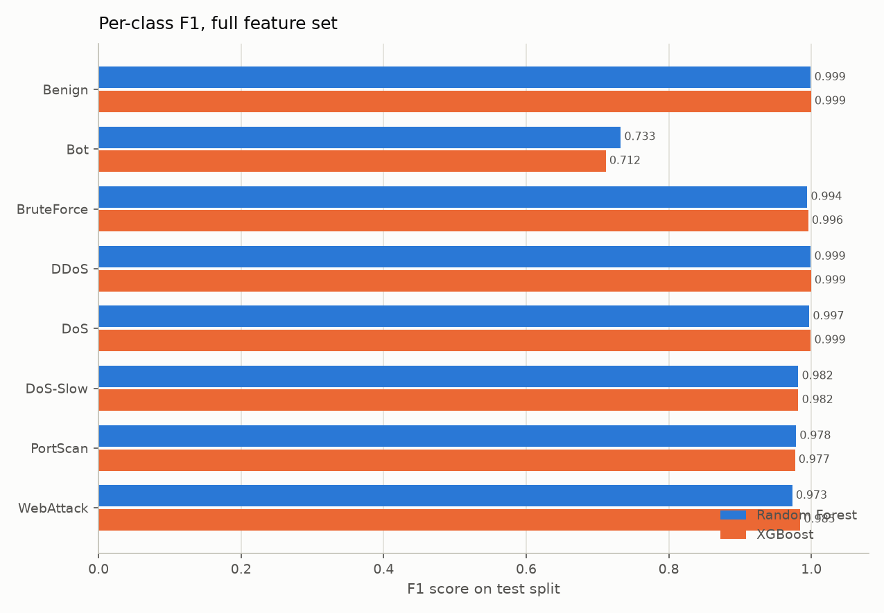
RESULTS
Results: full feature set (59 features)
0.9987
0.9570
99.80%
0.11%
Accuracy
Macro F1
Detection rate
False-positive rate
Model | Accuracy | Macro F1 | FP rate | us/flow
Random Forest (selected) | 0.9987 | 0.9570 | 0.00112 | 2.51
XGBoost | 0.9990 | 0.9561 | 0.00102 | 5.20
Reading the numbers
50,314 of 50,417 attack flows flagged; 313 of 278,975 benign flows wrongly flagged.
Per-class F1 exceeds 0.97 for every class except Bot (0.7326 on 209 test flows).
The two classifiers are close enough that the choice barely matters; Random Forest was selected on validation macro F1 and is twice as fast at inference.
12
Notes:
Lead with macro F1, not accuracy. Accuracy is high mostly because benign dominates.

Slide 13
RESULTS
Results: lite feature set (6 live features)
0.8400
99.76%
0.97%
-0.1170
Macro F1 (vs 0.9570 full)
Detection rate
False-positive rate
Macro F1 given up
Class | Full F1 | Lite F1 | Change
DDoS | 0.9991 | 0.9976 | -0.0016
DoS | 0.9971 | 0.9923 | -0.0048
DoS-Slow | 0.9817 | 0.9912 | +0.0095
BruteForce | 0.9942 | 0.8926 | -0.1016
PortScan | 0.9785 | 0.9139 | -0.0646
Bot | 0.7326 | 0.6869 | -0.0456
WebAttack | 0.9732 | 0.2503 | -0.7229
The loss is not spread evenly
Volumetric attacks survive almost intact. DDoS, DoS and DoS-Slow all stay above 0.99: they change the shape of traffic, and shape is exactly what six flow statistics measure.
WebAttack collapses from F1 0.9732 to 0.2503, but not by missing attacks: recall is identical at 0.9626. Precision falls from 0.9841 to 0.1439, because benign flows get labelled WebAttack.
Stated plainly: six header-derived statistics are sufficient to recognise attacks that change the shape of traffic, and insufficient for attacks that change only its content.
13
Notes:
Do not hide the WebAttack collapse. It is the honest limit of header-only features and it motivates the payload-inspection future work.

Slide 14
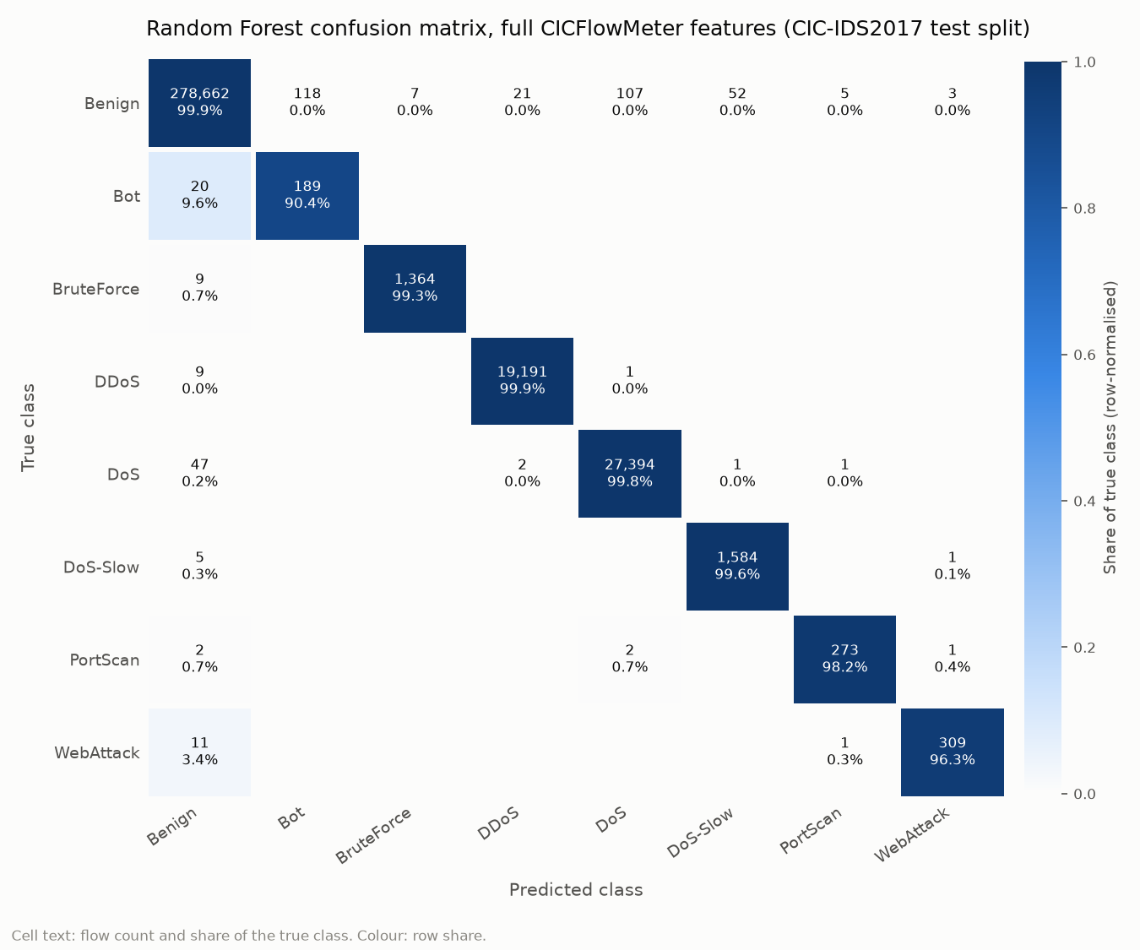
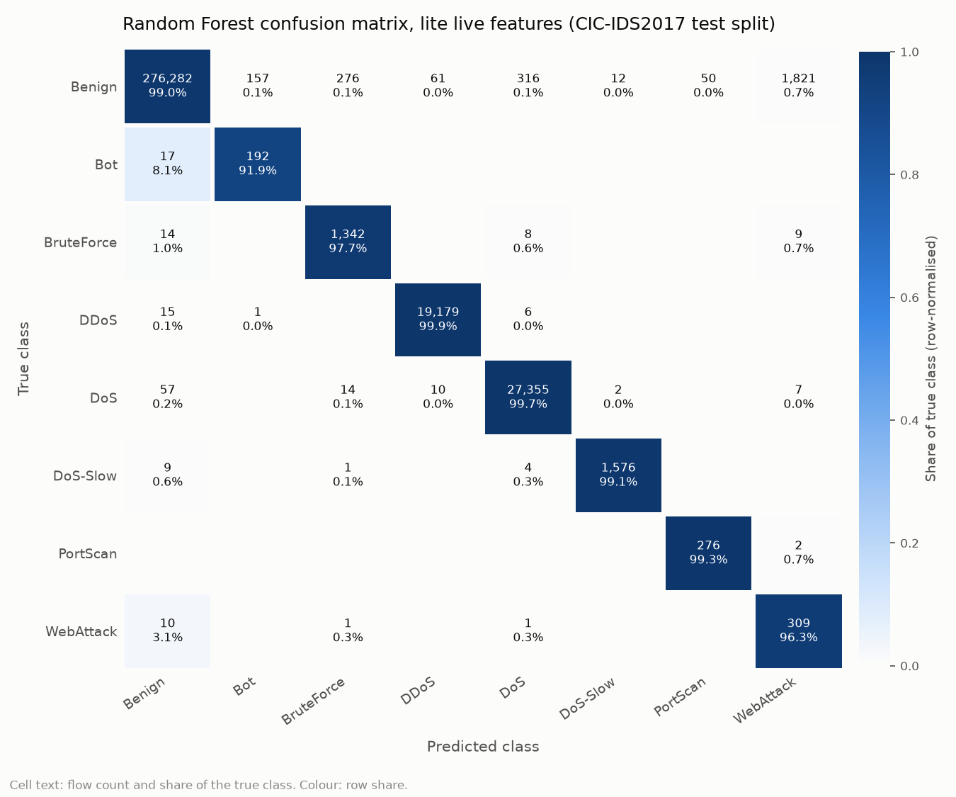
RESULTS
Where the errors actually are
Confusion matrices for the selected Random Forest on each feature set, row-normalised.
Full feature set (59 features)
Lite feature set (6 live features)
Both keep the diagonal almost everywhere. The difference is the Benign row: the lite model labels 1,821 benign flows as WebAttack. Its WebAttack recall is unchanged at 0.9626; it is precision that collapses, to 0.1439.
14
Notes:
Point at the Benign row, not the WebAttack row. The lite model finds the same 309 of 321 WebAttack flows as the full model. What it loses is precision: 1,821 benign flows are labelled WebAttack, so the class becomes unusable in practice even though recall is identical.

Slide 15
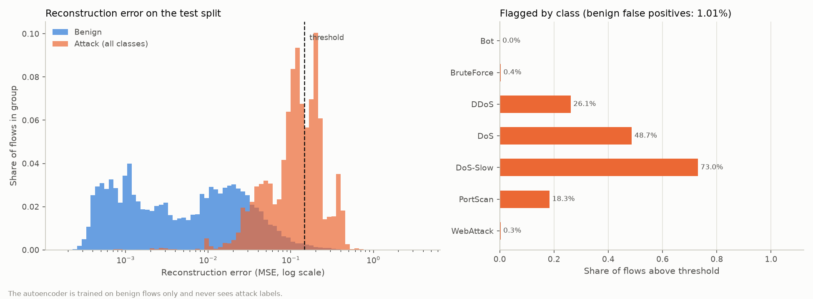
RESULTS
Results: autoencoder (trained on benign only)
0.9603
38.87%
1.01%
0.8748
ROC-AUC
Detection rate
False-positive rate
Precision
A low detection rate is the design, not a failure: the threshold is fixed at the 99th percentile of benign validation error, which buys a 1.01% false-alarm rate and gives up recall.
Class | Share flagged anomalous
DoS-Slow | 73.02%
DoS | 48.68%
DDoS | 26.14%
PortScan | 18.35%
BruteForce | 0.36%
WebAttack | 0.31%
Bot | 0.00%
Reconstruction error, benign versus attack, with the threshold
It sees exactly what deviates from benign flow statistics: slow-rate and volumetric denial of service. It is nearly blind to brute force, web attacks and bots, which are statistically ordinary at flow level, and which the supervised models cover.
15
Notes:
The complementarity argument: the autoencoder is strong precisely where it is cheap to be strong, and the supervised models cover the rest. It needs no attack labels at all, which is the point.

Slide 16
VALIDATION
The isolated attack lab
attacker
victim
nids
10.77.0.66
10.77.0.10
shares victim namespace
nmap, hping3,
slowhttptest, hydra
stock nginx
static page + /admin/
capture, detection,
iptables response
Containment, by construction
• The lab network is internal: no route to the internet, the campus network or the host.
• Published ports bind to 127.0.0.1 only.
• Every attack script refuses any target outside 10.77.0.0/24.
• The NIDS shares the victim's network namespace, so it sees every packet the victim sends or receives and its iptables rules apply to exactly that traffic. The host firewall is never touched.
On a real network this is a monitoring host on a switch SPAN port plus a firewall that enforces the decision. The detection logic is identical; only the enforcement point differs.
16
Notes:
Stress containment first. Then the SPAN-port equivalence, which is the Packet Tracer topology on the next slide.

Slide 17
VALIDATION
Enterprise topology (Cisco Packet Tracer)
Where Netra would sit in a small enterprise network, and how the lab maps onto it.
[Internet PC] external attacker
|
[R-EDGE ISR4331] 203.0.113.2 / 10.0.0.1
|
[FW ASA 5506-X] dmz 172.16.10.1 | inside 192.168.10.1
| |
[SW-DMZ 2960] [SW-CORE 2960]
| | | |
[WEB] [NIDS] [PC1] [PC2]
.10 SPAN destination, no IP on the sniffing port
Packet Tracer | Docker lab
Internet PC 203.0.113.10 | attacker 10.77.0.66
WEB server in DMZ | victim 10.77.0.10 (nginx)
NIDS on SPAN port | nids sharing victim namespace
Firewall deny rule | iptables NETRA chain
DMZ switch, VLAN 10 | internal network 10.77.0.0/24
One honest difference
On a real network a SPAN-port NIDS is passive and asks the firewall to block through an API. In the lab it shares the server's namespace and applies the block itself. Same detection, different enforcement point.
17
Notes:
Packet Tracer models the topology and traffic paths; the Docker lab performs the actual detection. Build steps are in docs/PACKET_TRACER_GUIDE.md.

Slide 18
VALIDATION
Live validation: four real attacks
Run from the attacker container against the victim, with the real iptables backend enabled.
Attack tool | Alert raised | Detector | Response
nmap SYN scan | PortScan | signature:port_scan | source blocked
hping3 SYN flood | DoS | signature:syn_flood | source blocked
slowhttptest slow headers | DoS-Slow | signature:slow_dos | source blocked
hydra HTTP basic auth | BruteForce | signature:brute_force | source blocked
curl, ordinary browsing | none | n/a | none
Two observations worth recording
• The SYN flood's half-open connections also satisfy the slow-DoS rule and raise the autoencoder's error, so the flood produces several corroborating alerts. The intended syn_flood alert fires first. This is realistic behaviour, not a bug.
• The slow HTTP attack genuinely exhausted nginx's connection pool, with slowhttptest reporting the service unavailable, while Netra detected it from the traffic pattern rather than from the victim's health. Detection did not depend on the victim being harmed.
18
Notes:
Every attack detected in about a second and answered with a real, timed DROP rule that expired on its own. The benign baseline raised nothing.

Slide 19
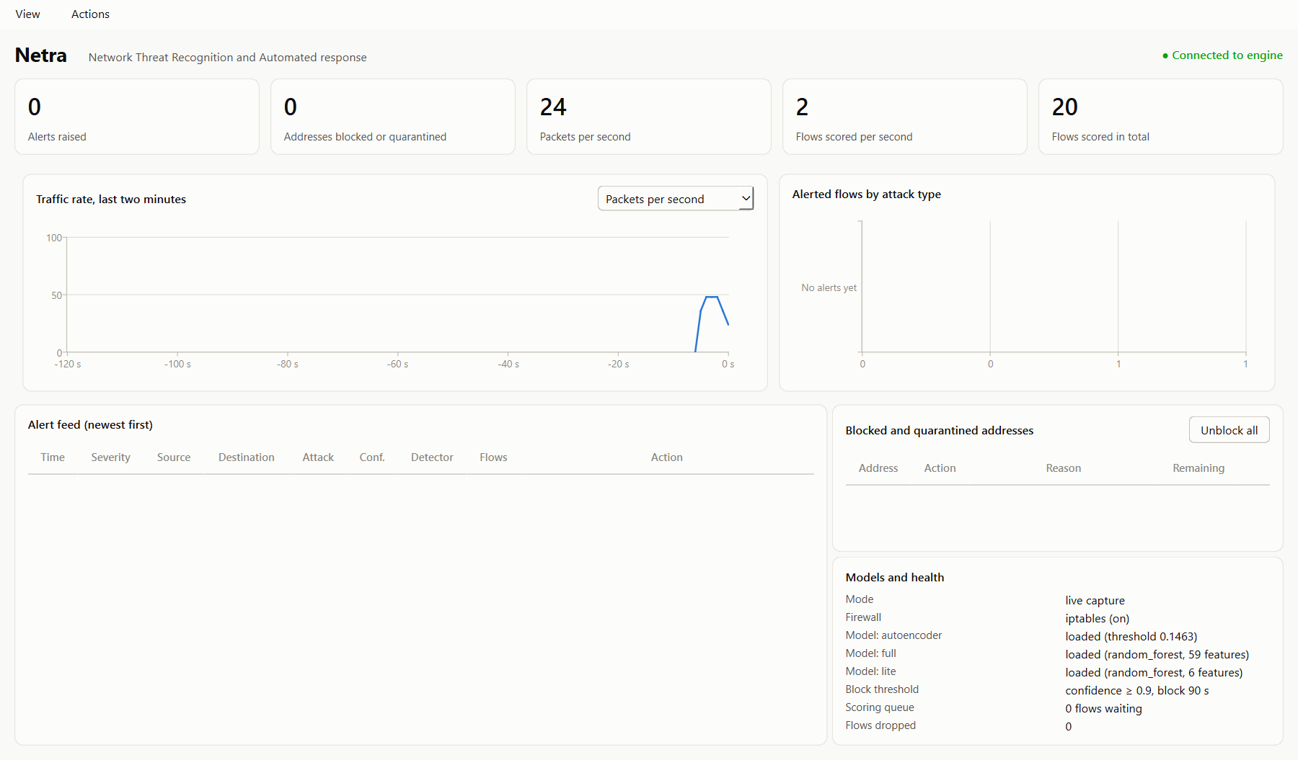
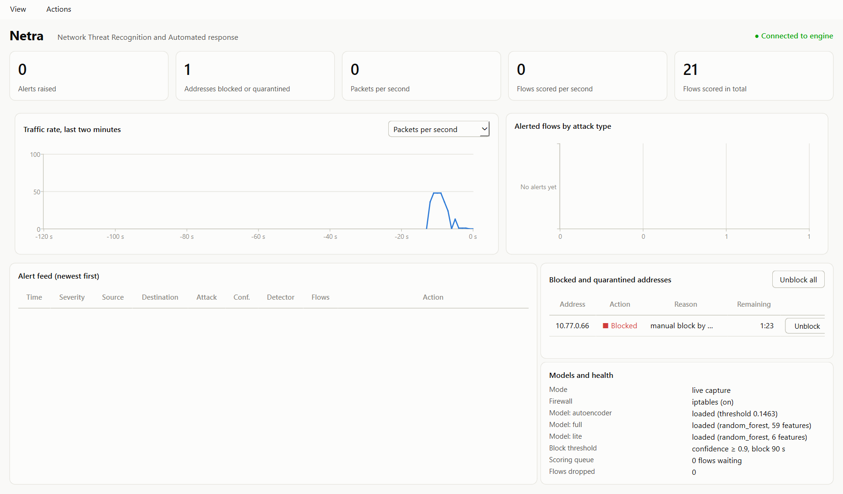
VALIDATION
The operator's view
A native PySide6 desktop application. The engine runs inside Docker; the app connects over WebSocket.
Connected: live traffic scored, no alerts on benign traffic
Attacker blocked, with a live countdown to expiry
Alert feed with severity, alerted flows by attack type, traffic-rate chart, and blocked addresses with countdowns and per-address unblock buttons. The operator can always override the automated decision.
19
Notes:
Show the real app during the demo rather than dwelling on these screenshots.

Slide 20
DISCUSSION
Key finding: an entire feature family is unusable
CIC-IDS2017's TCP flag counters are wrong.
SYN Flag Count is 0 on every PortScan flow, although every such flow is by definition a SYN probe. FIN and PSH are near zero throughout, although ordinary TCP connections carry both.
Why this matters more than it sounds
• Models trained on these columns learn the extraction tool's bug, not a property of network traffic.
• Offline this is invisible: the test split contains the same bug, so the metrics look excellent.
• It became visible within minutes in the lab: real benign web traffic, where connections legitimately carry FIN and PSH, was scored as anomalous and a normal client was quarantined.
• All twelve flag features were removed, leaving 59 inputs. The offline cost was small, and benign live flows now score around 0.08 against the 0.146 threshold.
The general lesson: a model evaluated only against the dataset it was trained on can score well by learning that dataset's artefacts. Offline metrics cannot detect this. Live testing can, and did.
20
Notes:
This is the most valuable result in the project and it is a negative one. It independently reproduces Engelen et al. 2021 and it changed the design.

Slide 21
DISCUSSION
Limitations
Single dataset
All learned components are trained and evaluated on CIC-IDS2017. Generalisation to another network is not demonstrated, and given the flag-counter finding it should not be assumed.
Payload-blind
No component inspects packet contents, so live WebAttack detection is weak and encrypted traffic is opaque to the flow-statistic detectors.
Source-address response
Blocking by source is defeated by spoofing and by distributed attacks, and could be weaponised by spoofing a legitimate address to get it blocked. Timed expiry and the never-block list bound the damage without eliminating it.
Lab scale
One attacker, one victim, one detector on a single host. Throughput under realistic volumes, and per-source state across many thousands of sources, are untested.
Known attacks in the live test
The four demonstrated attacks are ones the signature rules cover, so the live test does not independently validate the ML detectors against novel attacks. The offline results carry that argument.
21
Notes:
Stating limits precisely is stronger than overclaiming, and it is where most viva questions come from.

Slide 22
CONCLUSION
Future work
1
Cross-dataset evaluation
Measure how much of this performance is specific to CIC-IDS2017 by testing against UNSW-NB15 [2].
2
Payload features
Address the WebAttack and Bot weakness directly, which flow statistics provably cannot separate.
3
Online adaptation
Recalibrate the autoencoder threshold against the deployment network's own benign traffic rather than the dataset's.
4
Richer response
Honeypot redirection, graduated rate limiting before outright blocking, and enforcement through an external firewall API.
5
Ensemble anomaly detection
Test whether an ensemble of small autoencoders over feature subsets, as in Kitsune [4], beats the single network used here.
22
Notes:
Ordered by expected value. Cross-dataset evaluation is first precisely because of the flag-counter finding.

Slide 23
CONCLUSION
Conclusion
0.9570
0.8400
0.9603
4 / 4
Full model macro F1
Lite model macro F1
Autoencoder ROC-AUC
Live attacks detected
and blocked
• Signature rules, supervised classification and unsupervised anomaly detection can be combined under an explicit fusion policy and coupled to an automated response, on hardware as modest as a single laptop.
• The full model reaches macro F1 0.9570 at a 0.11% false-positive rate; the six-feature live model reaches 0.8400; the autoencoder adds label-free coverage of denial-of-service-shaped anomalies at ROC-AUC 0.9603.
• In live operation against four real attack tools, every attack was detected within about a second and answered with a timed, reversible firewall rule, while ordinary traffic raised no alert.
The most useful result may be the negative one.
An entire family of features in a widely used benchmark is unusable, models trained on it look excellent offline and fail on real packets, and only live testing revealed it. Work that reports offline metrics alone cannot rule out this class of error.
23
Notes:
Close on the negative finding. It is the most defensible contribution.

Slide 24
References
[1] Sharafaldin, I., Lashkari, A. H., and Ghorbani, A. A. (2018). Toward Generating a New Intrusion Detection Dataset and Intrusion Traffic Characterization. ICISSP.
[2] Moustafa, N., and Slay, J. (2015). UNSW-NB15: a comprehensive data set for network intrusion detection systems. MilCIS, IEEE.
[3] Tavallaee, M., Bagheri, E., Lu, W., and Ghorbani, A. A. (2009). A Detailed Analysis of the KDD CUP 99 Data Set. IEEE CISDA.
[4] Mirsky, Y., Doshi, T., Ju, M., Elovici, Y., and Shabtai, A. (2018). Kitsune: An Ensemble of Autoencoders for Online Network Intrusion Detection. NDSS.
[5] Ring, M., Wunderlich, S., Scheuring, D., Landes, D., and Hotho, A. (2019). A Survey of Network-based Intrusion Detection Data Sets. Computers and Security, 86, 147-167.
[6] Engelen, G., Rimmer, V., and Joosen, W. (2021). Troubleshooting an Intrusion Detection Dataset: the CICIDS2017 Case Study. IEEE Security and Privacy Workshops (SPW).
24

Slide 25
Thank you
Questions, and a live demonstration of the attack lab.

