Slide 1

CheerApp
All your events, in one place

Slide 2
The Company
Mission
Organize all events that’s net to you in one place, freeing you from the need of social medias to find where to spend the night
Vision
Build a network of applications which aim is to simplify people’s everyday life
Tiding up a world which is saturated with unorganized information
Value proposition
Collect events in one place:
Attendants will save time, avoiding searching events by consulting all the web pages of the clubs
Owners of less-known clubs can give more visibility to their events without paying large amount of money

Slide 3
The Company
The Strategy
Differentiation: we want users to say “That’s the application I’ve always needed!”
Opportunity
The large quantity of venues and events in Italy
High number of possible customers
No product does the same in such a complete way

Slide 4





CheerApp Team
Nikolas Sacchi
Evangelia Vratsanou
Jesùs Suero
Julie Grauls
Pierre Numa

Slide 5
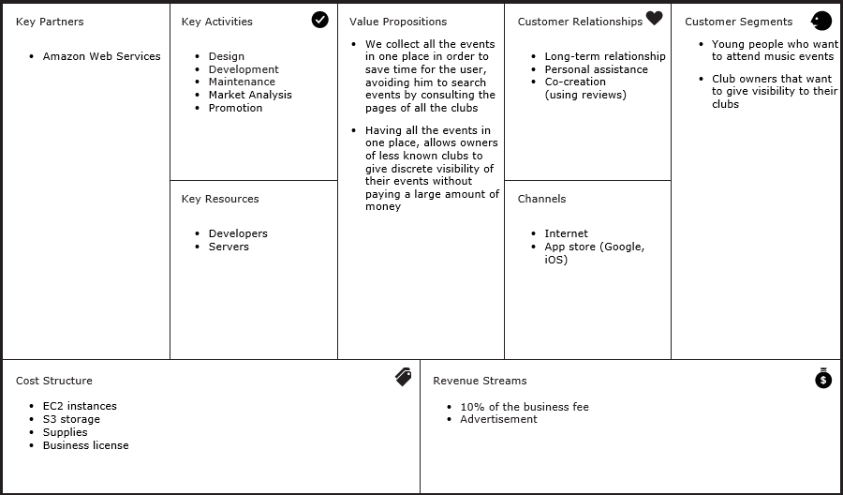
The Business Model Canvas

Slide 6
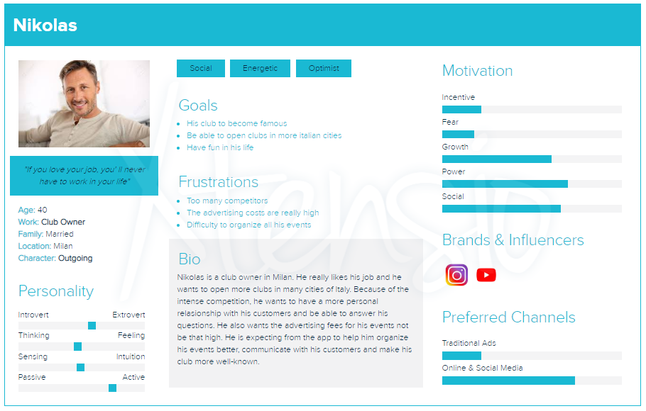
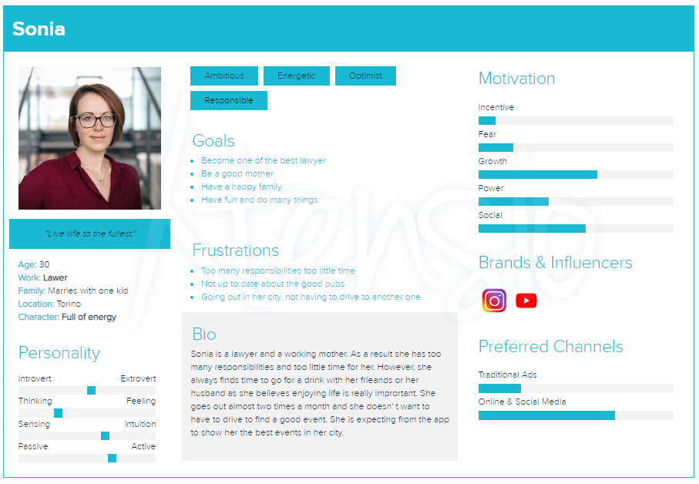
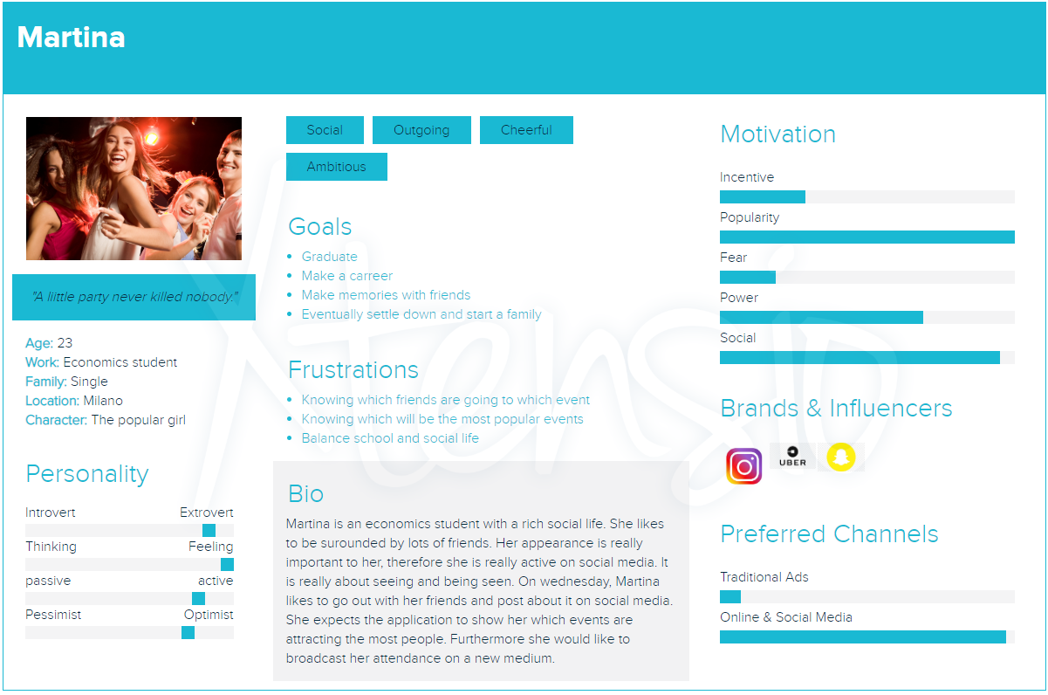
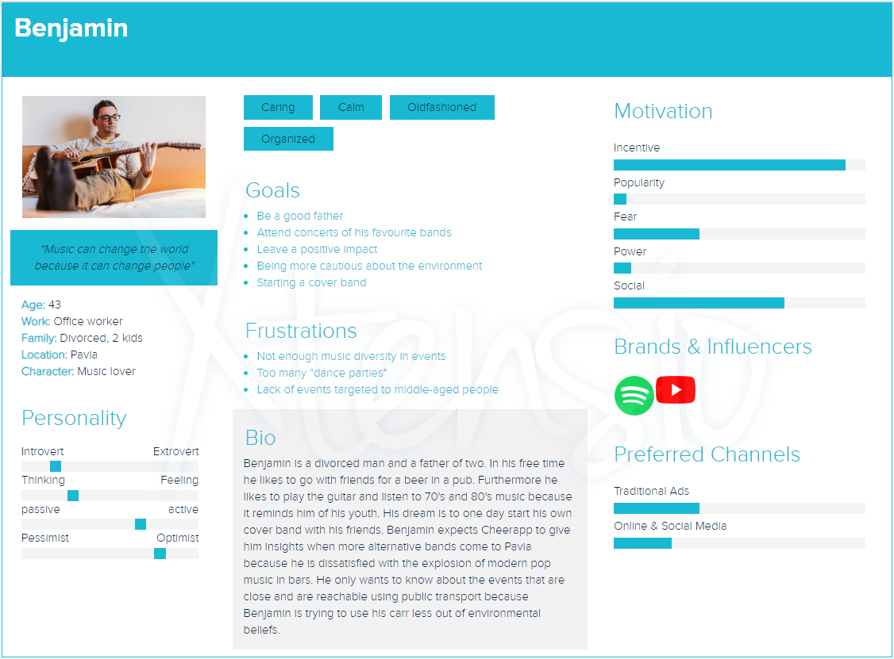
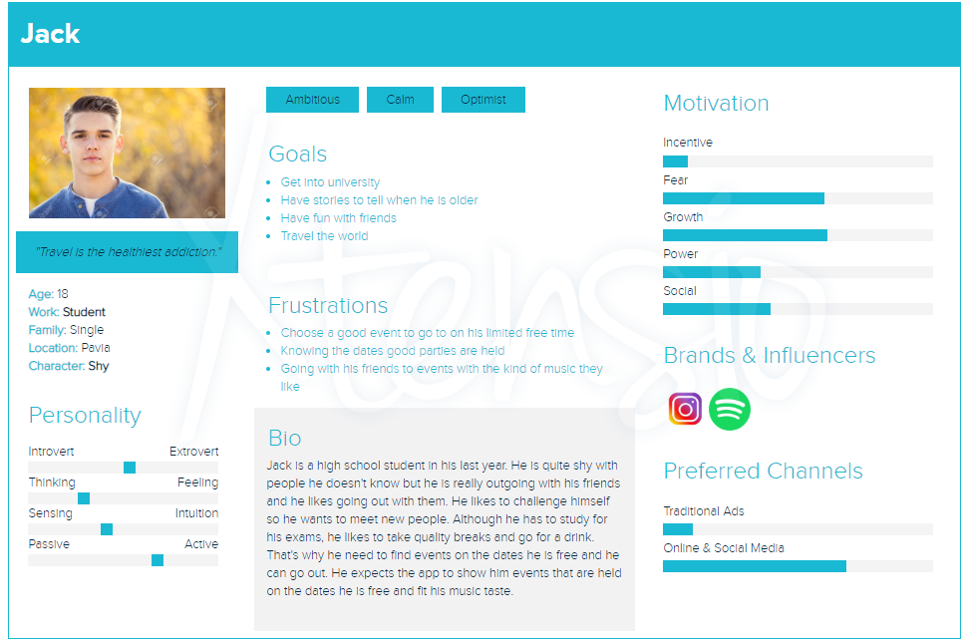
Personas

Slide 7
Key Features
Organizer
Registered user
Regular user (guest)
View their profile
Add a profile picture
See their invitations to events
Accept
Refuse
Search events
Attend events
Rate events
Buy tickets
Search users
Add users as friends
Invite friends to an event
Have suggestions about events that suit them most
Search events:
in a city
hosted on a particular day
based on their music tastes
Register as user
Register as organiser
Log in as a user
Log in as an organizer
View their profile
Add a profile picture
Create events
Add a photo to an event

Slide 8
User Stories + Acceptance Criteria
Regular User (guest)
Title | Date filter
As a | Regular User
I want to | Filter events based on their date
So that | I know which events take place on a specific date
ID | #2 | Effort* 2
Persona: Jack
Title | Registration User
As a | Regular User
I want to | Register in the app as user
So that | I can have my profile and find events easier
ID | #4 | Effort* 2
Persona: Martina
Title |  | Registration User
When I | Register as a user and don’t complete all the fields |  | This happens | I’ m asked to fill the empty fields
When I | Register as a user and use an already existed username or email |  | This happens | I can see a message that says that the username or the email already exist
When I | Register as a user but my age is under 18 |  | This happens | I can’t register
When I | Register as a user doing everything right |  | This happens | I see a message that the registration is done correctly and I see the log in page
Title |  | Date filter
When I | Search events based on a date and there are events that are taking place on this date |  | This happens | I can see a table with all the events that take place on the date I searched
When I | Search events based on a date and there aren’t events that are taking place on this date |  | This happens | I can see an empty table
*: expressed using a number of the Fibonacci sequence

Slide 9
User Stories + Acceptance Criteria
Registered User
Event Organizer
Title | Auto suggestion
As a | Registered User
I want to | Be able to receive an auto suggestion
So that | I can find fitted events with low effort
ID | #19 | Effort* 13
Persona: Martina
Title | Uploading events
As a | Event organizer
I want to | Upload my event to the application
So that | I can market my event to a broad audience
ID | #20 | Effort* 5
Persona: Nikolas
Title |  | Uploading events
When I | Create an event |  | This happens | I see the form I have to fill with all the information of the event
When I | Don’t fill all the information |  | This happens | I see a message saying to fill the empty fields
When I | Fill all the information |  | This happens | I see a message saying that the event was created correctly and I see the page of the event
Title |  | Auto suggestion
When I | Press the button “Suggest me” |  | This happens | I see the event that fits me better and I can enter its page
*: expressed using a number of the Fibonacci sequence

Slide 10
Requirements
Functional:
Represented with the user stories
Non functional:
Minimum password length
Password encryption
Auto scaling
Relatively high response time
Minimum age imposed by Art. 8 of GDPR of May 2018

Slide 11

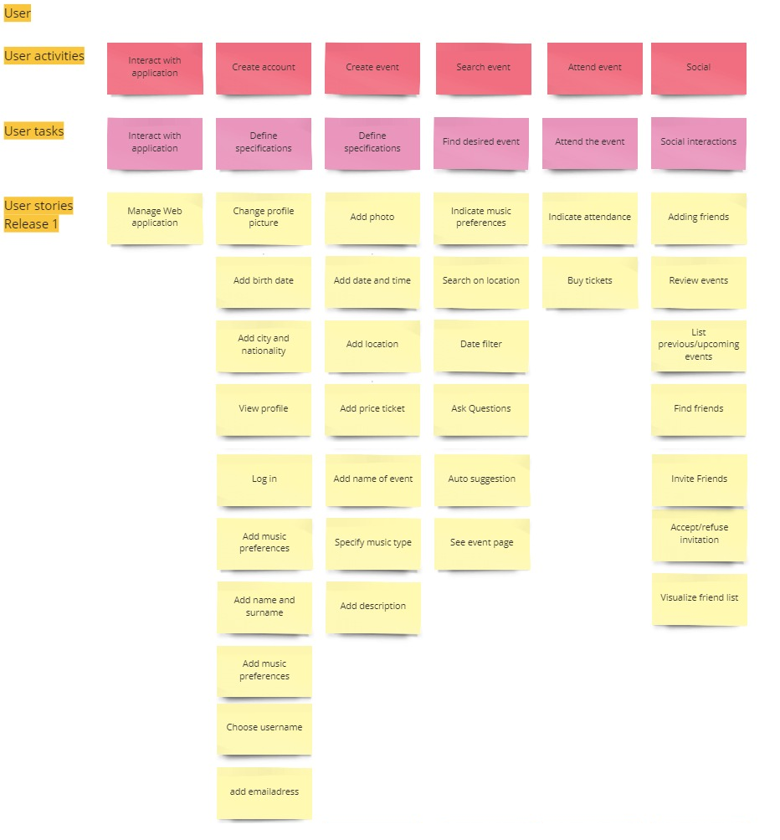



Roadmap

Slide 12
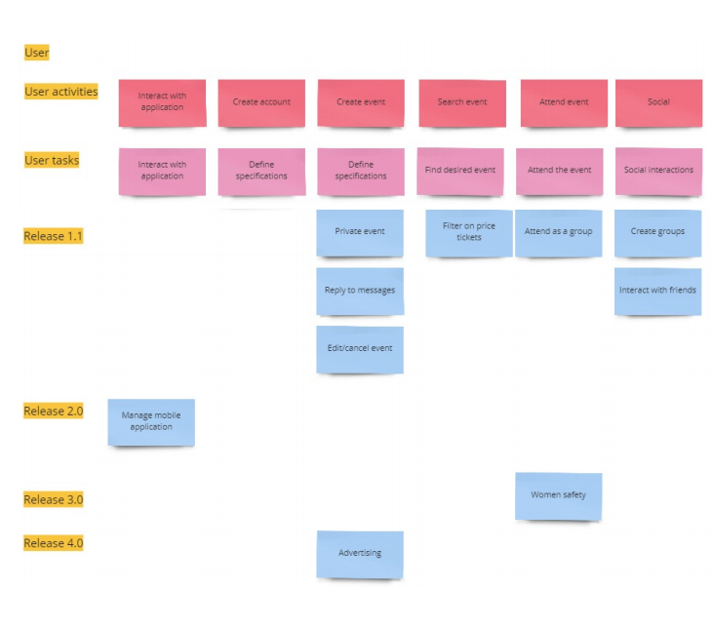
Future of CheerApp
Private events
Chat with friends
Mobile application
“Stay safe” feature

Slide 13
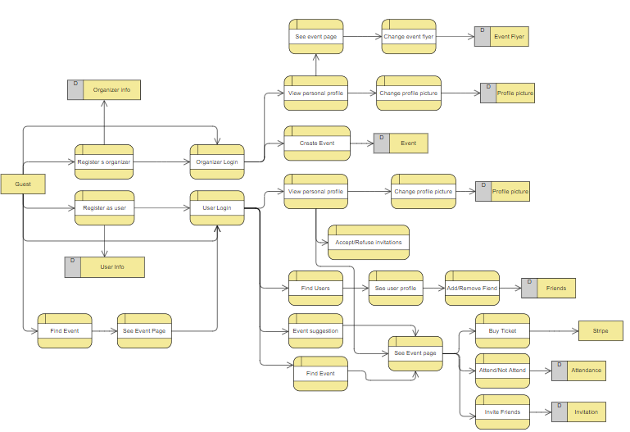
CheerApp Dataflow

Slide 14
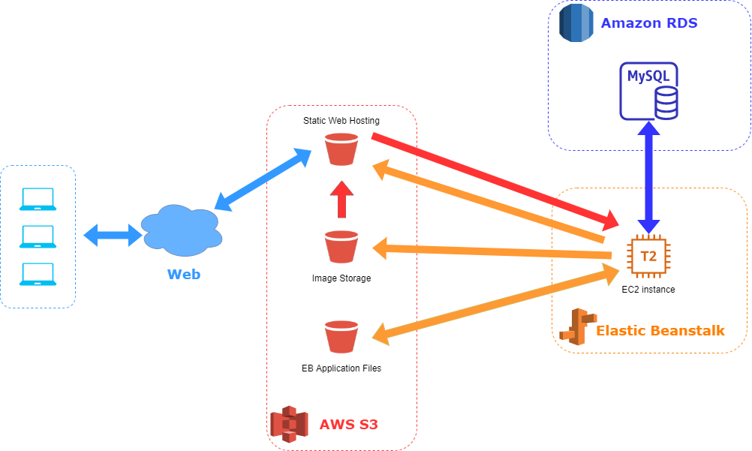
System Architecture

Slide 15

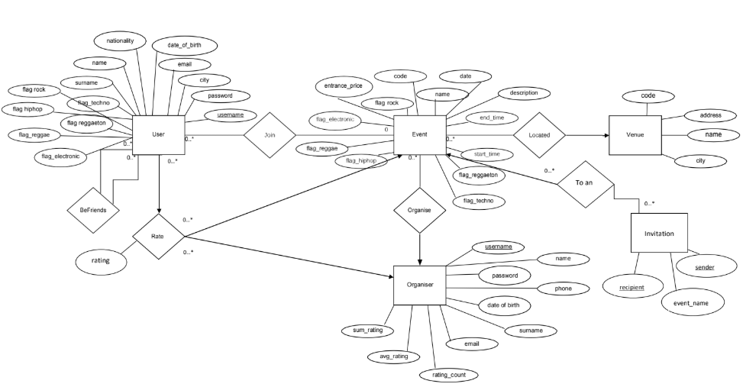
Database
Relational database
Easy to categorize data
Supports distributed database
Eliminate redundancy
Deployed on Amazon RDS
Uses an EC2 instance
Easy to scale
MySQL 8 engine
Simple to setup

Slide 16

Backend
Developed with Python Flask
Large number of libraries
Light framework
Suits well CheerApp needs
Less configuration than the competition
Deployed on Elastic Beanstalk
Uses EC2 instances
Native Python support
Elastic Load Balancer
Environment variables
Easy configuration and deployment
Dedicated S3 bucket for configuration files
Key libraries
Jsonify to send data to frontend
Boto3 to store images in the S3 storage
Mysql-connector-python to interact with database
Stripe to handle payments

Slide 17
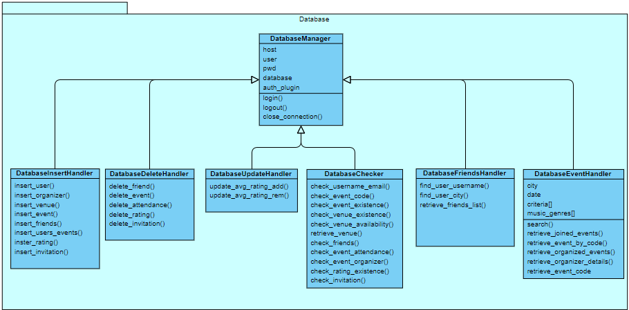
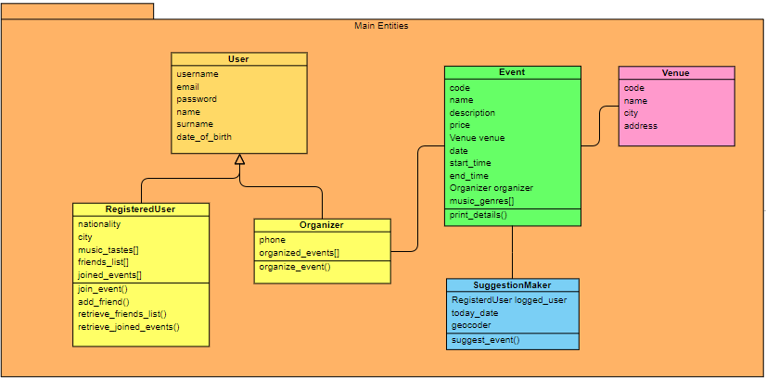
Class Diagram

Slide 18

Frontend
Developed using React JS
Single page application
Faster page render
Focused library
Easy to learn
Deployed on AWS S3
Static Web Hosting
Scales automagically
No worry about load balancing
Communication with Backend
POST requests
Using Axios

Slide 19
Testing
Before the integration each function was tested
Using unittest
Most of the operation involve the database
Test class for the insertions
Test class for the deletions

Slide 20
Demo

Slide 21
Thank you for the attention!

Slide 22
CheerApp
All your events, in one place

