Slide 1
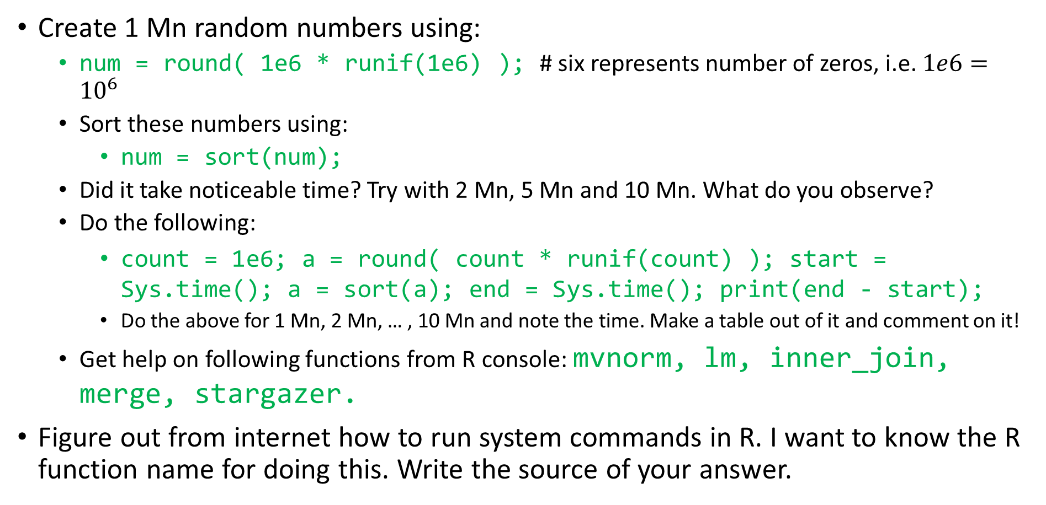
Assignment 1
Create 1 Mn random numbers using:
num = round( 1e6 * runif(1e6) ); # six represents number of zeros, i.e. $1e6={10}^{6}$
Sort these numbers using:
num = sort(num);
Did it take noticeable time? Try with 2 Mn, 5 Mn and 10 Mn. What do you observe?
Do the following:
count = 1e6; a = round( count * runif(count) ); start = Sys.time(); a = sort(a); end = Sys.time(); print(end - start);
Do the above for 1 Mn, 2 Mn, … , 10 Mn and note the time. Make a table out of it and comment on it!
Get help on following functions from R console: mvnorm, lm, inner_join, merge, stargazer.
Figure out from internet how to run system commands in R. I want to know the R function name for doing this. Write the source of your answer.

Slide 2
Assignment 2
Your default preloaded R library (called base) comes with a number of preloaded datasets. You can check them with data();
Use one of their datasets called: USPersonalExpenditure
You can also check for its help using ?USPersonalExpenditure
Load it as: df = USPersonalExpenditure;
Create a new dataset showing only the percentage consumption of each category in a particular year. Also add an additional row showing overall consumption in each year.
Do it with using for loop
You may use one or two loops
Your answer should look like the output of below code:
rbind(round( t( t(100*df) / colSums(df) ), 2 ), "Total" = colSums(df));
Try to understand what I did above. You can use internet help if you wish!

Slide 3
Instead of values, now find the growth rates of each category of consumption for each year
Use for loops!
Now again, compare your answer to the table: df[,-1] / df[,-5];
Do they match? What did I do above? Explain!
With explanation I mean what does the numbers represent and how the above code is doing that in R.
Find help (and read) about the following functions:
which, head, tail, rnorm, runif, cor, cov
Install dplyr package. Figure out how to do that from internet!

Slide 4
Assignment 3
Use the NASA dataset
ns = dplyr::nasa;
ns = as.data.frame(ns);
Plot avg pressure for each latitude. Do also for longitude
Hint: You will have to aggregate data!
Do you see any pattern?
How many cloudlow entries are NA ? Create a new data frame after excluding these. Repeat the above plots.
Does the level of ozone depend on latitude or longitude? How will you find that? Make multi-color plots with legends.

Slide 5
Do you expect temperature and surface temperature (surftemp) to be related? How can you find that?
Has the average temperature increased over the years? What about the average variability in temperature? Does that also vary with year?
The month of May shows least variability in both surftemp and temperature. Am I right or not? Support your answer with data!
Comment on the relation between surftemp and cloudmid! Use plots.
Take a random sample (w/o replacement) of 5000 points of the NASA dataset. Repeat the last 4 questions on this smaller dataset!
Make fractional year as:
ns$frac_yr = ns$year + (ns$month-1)/12;
Plot average surftemp for each frac_yr. Do you see a pattern? Comment!

