Slide 1
Intro to R Programming
-- Nikhil Vidhani

Slide 2
What this course is about?
Basics of Computer Architecture and Programming
Intro to Programming through R
Popular R methods and their use in Data analysis
Technical Documentation: Some tips for Word, Latex and R-markdown.

Slide 3
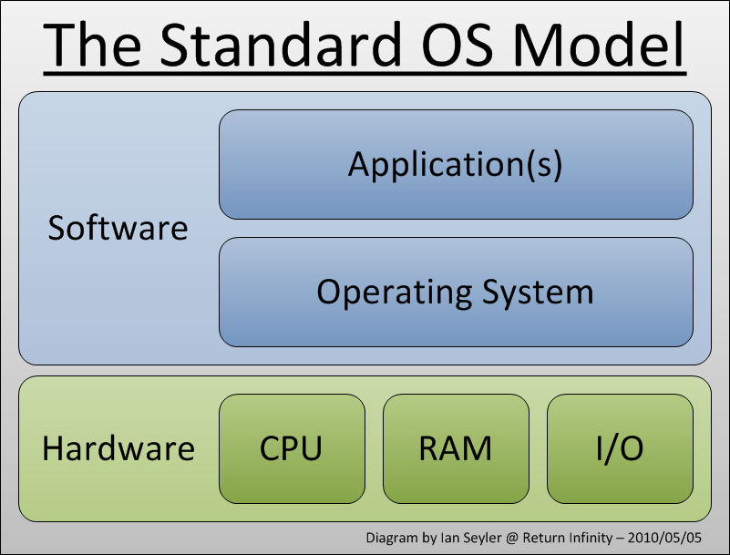
What’s a computer look like?

Slide 4
What does it do?
Perform Calculations!
Billions of them every second.
Cores, threads, clock speed
Stores data
Cache vs RAM vs HDD
Speed vs storage cost
Runs Software
System (OS): Linux, Windows and Mac-OS
Application: R, RStudio, Excel

Slide 5
What is a program?
Translation of an algorithm into a language that computer understands
An algorithm takes input, perform some operations and gives output
Executes in finite time
E.g. sorting, searching, reading, copying!
Complexity of a Program
Time and space!
E.g. Fibonacci series!
Programming Paradigms
Iterative vs Recursive
Procedural vs Object Oriented
Good Program
Re-readable, organized and modular

Slide 6
Typical Programing Errors
Syntactical (spelling mistake)
Will get caught very easily! Just run the program.
Semantic Errors (meaningless operations)
For e.g. “nikhil”+32
Exceptions: like divide by 0.
May get caught. A warning will be thrown nonetheless.
Logical Errors (Unintentional)
Program will crash, run forever or give a wrong answer!
Debugging requires some skill and experience.

Slide 7
What is R
Implementation of S Programming language
Started as statistical environment
Explains the deep rootedness of R in statistics
Mostly written in C (earlier FORTRAN)
More info on Wikipedia!
Philosophy behind R (or S, S+)
Interactive environment
Transition from users to Programmers as per need!
You don’t need to be a programmer to learn (and) use basic R
More info at http://ect.bell-labs.com/sl/S/history.html

Slide 8
What is R (cont.)
Features
Very easy to follow and understand
Require understanding of vector and matrix indexing!
Interactive
Runs on all platforms.
Small software to download and load. Use packages as per need.
Free of cost. Open source software (GNU GPL). More info at www.fsf.org
Very active development
Frequent updates and releases
Very active and responsive user community – Stackoverflow!
Drawbacks
Limited 3-D graphics capability
Everything must be in RAM – big data?
If a functionality is missing you got to code it yourself!

Slide 9
What if not R
Closest cousin is MATLAB
Although used much more in engineering than in statistics
Syntax is similar to R (Read: http://mathesaurus.sourceforge.net/octave-r.html)
Python is also very popular although its more meaningful for data science
Statistical Alternatives?
SAS and Stata
Both are paid software
Very different than R in syntax!
Non-interactive
Limited user community support
Despite the differences Stata is very popular in management research. And there are some die-hard SAS fans in Finance too.

Slide 10
Downloading and Installing R
Download R: https://cran.r-project.org/
Choose base package for your OS
Windows: https://cran.r-project.org/bin/windows/base/R-3.5.0-win.exe
Linux: Use apt-get (Debian based) OR yum install (RPM based) from terminal.
Mac: https://cran.r-project.org/bin/macosx/R-3.5.0.pkg
Install R
Download RStudio IDE
Choose the free RStudio Desktop edition
https://www.rstudio.com/products/rstudio/download/#download
Choose the appropriate one according to your OS
Install RStudio

Slide 11
Getting Help in R
From Console
Just type: ? followed by function name without parenthesis
E.g. ?mean; ?sum; ?length;
Clarify:
?mean - help for the function “mean”
??mean - will perform the search over the internet (CRAN database)
Look for base::mean!
mean() - call the function mean
mean - print the definition of the function “mean”
From Web sources
Most reliable and easy to incorporate is www.stackoverflow.com.
www.r-bloggers.com is also quite helpful.
You can use https://cran.r-project.org for any resource on R
Even typing your question in google will get you good results!
99% of your questions are already answered! You just need to find them!

Slide 12
R Input and Output
Simple assignment
X = 1; (or X <- 1;)
Assignment is always right to left
Read 1 goes into X
We aren’t comparing X with 1 here
The semi-colon isn’t necessary in R, but it’s a good practice to use it
X = ; is incomplete
# (prefix) is used as a comment. Use it for helpful comments.
Use Ctrl-Shift-C for multi-line comments
Value of X can be seen by
X;

Slide 13
Vectors
A sequence of numbers. Many ways to input!
Y = c(1,7,-3,41); # concatenate arbitrary numbers
Y = 1:10; # natural numbers
Y = seq(1,100,9); # skip by 9
Y = rep(2, 3); # repeat 3 times
Y = rep(1:2, 3); # repeat the vector
Y = rep(1:2, each = 3); # repeat each element 3 times
Y = c(); # empty vector
Execute this: c(1:3, rep(c(5,7), each = 2), rep(9, 4), 7);
Length of vector: length(Y);
Accessing i^{th} element of vector: Y[i]; # square brackets
i should be between 1 and length(Y)
Printing the entire vector is as before: Y;

Slide 14
Objects in R
5 basic (atomic) types of objects
character – strings
numeric – real numbers. Also called double.
integer – natural numbers. Default data type for numeric vectors.
typeof(1:10)
complex – complex numbers. We won’t use them now!
logical – True/False (binary)
Most basic collection of objects is a vector (also called an array)
Can only contain objects of same class (i.e. character or integer; not both)
“list” is a special type of object and can contain heterogeneous objects
Any Combination of vector, matrix, atomic types etc.
It can even contain another list as an object. E.g. linked-lists!
Due to its generality its very slow and hence rarely used with large datasets unless situation demands it

Slide 15
Numbers
Default type of any number is numeric (i.e. real). typeof(1)
R can differentiate between corner cases:
1/0 is Inf -- is.infinite();
0/0 is NaN -- is.nan();
Missing data is NA -- is.na();
Check what’s Inf-Inf ?
Arithmetic Operations
* multiplies
/ divides
^ takes exponent
%% is the modulo (remainder) operator. Try: 7 %% 2;

Slide 16
Coercion
Mixing Objects
Automatically coerced to the same class.
Try: c(1:7, "a"); c(T, 2); c("a", FALSE);
Implicit coercion!
Never use unless you know what you’re doing!
Explicit Coercion
as.character(1:5);
as.numeric("iimb"); # warning!
as.logical(seq(-2,2,1));

Slide 17
List
Can carry different types of data together
L = list(1, FALSE, 3.14, "iimb", "c", 4-3i);
Print list: L;
L is in fact a list of lists. Check: typeof(L); typeof(L[4]); typeof(L[[4]]);
Single square brackets [i] access the i^{th} list embedded in the list L
Double square brackets [[i]] access the i^{th} element
Can append elements in list: L = append(L, "7th");
unlist(L); will coerce all elements into a single type and return a vector
Delete an element from a list:
I don’t know how to do that!
Let’s google: “delete element from list in R”
Open the answer on www.stackoverflow.com

Slide 18
Matrices
Generalization of vectors
2 dimensions instead on one!
N x K matrix means a matrix having N rows and K columns. Total of NK elements.
M = matrix(nrow = 2, ncol = 3);
Dimensions: dim(M);
Can think of M as
3 columns vectors each of length 2, or
2 row vectors each of length 3
Populate matrix: M = rbind(1:3, 4:6);
Alternatively populate as: M = cbind(1:2, 3:4, 5:6);

Slide 19
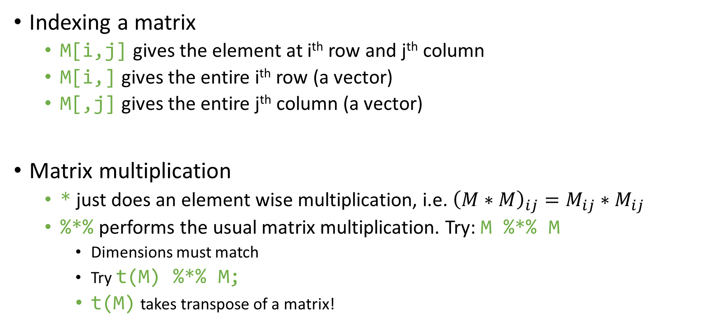
Matrices (cont.)
Indexing a matrix
M[i,j] gives the element at i^{th} row and j^{th} column
M[i,] gives the entire i^{th} row (a vector)
M[,j] gives the entire j^{th} column (a vector)
Matrix multiplication
* just does an element wise multiplication, i.e. ${\left(M∗M\right)}_{ij}=M_{ij}∗M_{ij}$
%*% performs the usual matrix multiplication. Try: M %*% M
Dimensions must match
Try t(M) %*% M;
t(M) takes transpose of a matrix!

Slide 20
Matrices (cont.)
Identity matrix: diag(3)
Diagonal Matrix: diag(c(1,5,7)); diag(1:7);
Diagonal of a matrix: diag(M)
Trace of a matrix: sum(diag(M))
Inverse of a matrix:
Must be a square matrix: M = matrix(1:9, nrow = 3, ncol = 3);
Another way to create a matrix. Data is entered column-wise.
Determinant must be non-zero: det(M); M[3,3] = 19; det(M);
Inverse: solve(M);

Slide 21
Factors
For categorical data.
Male, female
Cities in a dataset
Typically useful when the dataset is large but the no. of categories is small
Very useful in the regression framework using lm();
Automatically creates dummy for all but one categories.
Using factors is more descriptive than integer values
Rather than using 1 for PGP, 2 for FPM and 3 for Others; its more intuitive to use factors.
Example:
sex = rep(c("male", "female"), 5);
sex_f = as.factor(sex);
Check: typeof(sex_f); as.integer(sex_f);

Slide 22
Data Frame
Probably the most important data type you’ll use.
All external data (from excel, csv, tables, webpages etc) is read as data frame
It’s a list where each element of list must have the same length.
Think of it like a matrix but with the flexibility that each column can have different data type. E.g. set of Names, weights and heights
Example:
d = data.frame(name = c("a", "b"), weight = c(70, 75), height = c(1.78, 1.82));
d; d$name; d[1,]; d$weight; d[,3];
d$bmi = d$weight / (d$height)^2;
nrow(d); ncol(d); dim(d);
colnames(d)[1] = "names";
rownames(d) = c("I", "II");

Slide 23
Reading Data
Download some stock data from NSE
https://www.nseindia.com/products/content/equities/indices/historical_index_data.htm
Save the CSV file as data.csv
From CSV (most common)
setwd("D:/Opera Downloads/"); nifty = read.csv("data.csv");
Alternatively: nifty = read.csv("D:/Opera Downloads/data.csv");
From Excel
Search it yourself! It is not recommended btw.
From clipboard
read.table("clipboard");
This is quick fix for small data transfer between R and excel. Use read.csv() as your primary method for data reading!

Slide 24
Reading Data (cont.)
Viewing data
View(nifty);
Date
nifty$Date = as.Date(nifty$Date, format = "%d-%b-%Y");
n = nrow(nifty);
d = nifty$Date[1];
format(d, format = "%D"); # 04/02/18
format(d, format = "%d-%m-%y"); # 02-04-18
format(d, format = "%d.%b.%Y"); # 02.Apr.2018
format(d, format = "%d_%B_%Y"); # 02_April_2018
Alternatively,
read.table("data.csv", header = T, sep = ",", nrows = 5);

Slide 25
if-else
if(<COND_1>) { # do something! } else { # ... }
if(<COND_1>) { # do something! } else if(<COND_2>) { # ... } else { # ... }
if(<COND_1>) { # do something! }
if(nifty$Close[2] > nifty$Close[1]) {
str = paste("Stock market closed green on", nifty$Date[2]);
} else if(nifty$Close[2] > nifty$Open[2]) {
str = paste("Stock market closed above opening on", nifty$Date[2]);
} else {
str = paste("Stock market was red and closed below opening on", nifty$Date[2]);
}
print(str);

Slide 26
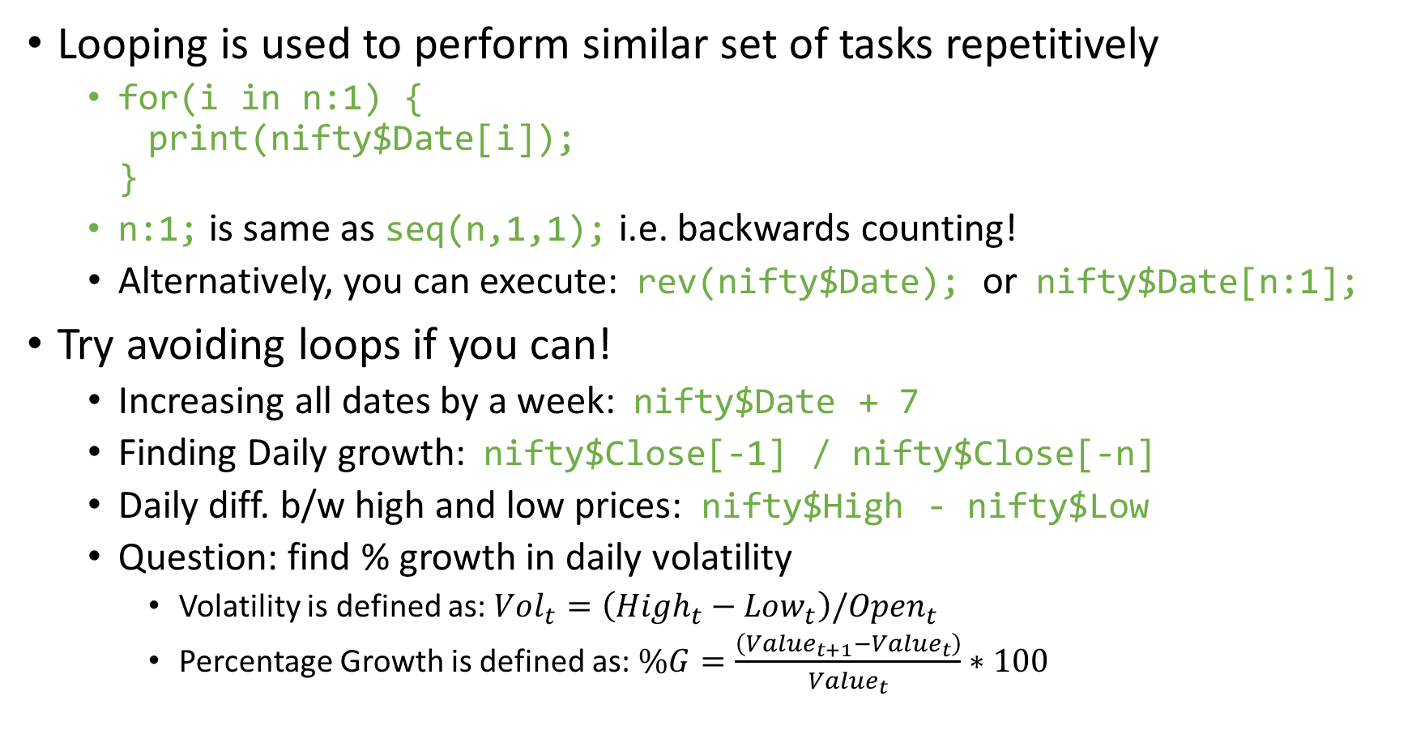
for loop
Looping is used to perform similar set of tasks repetitively
for(i in n:1) { print(nifty$Date[i]); }
n:1; is same as seq(n,1,1); i.e. backwards counting!
Alternatively, you can execute: rev(nifty$Date); or nifty$Date[n:1];
Try avoiding loops if you can!
Increasing all dates by a week: nifty$Date + 7
Finding Daily growth: nifty$Close[-1] / nifty$Close[-n]
Daily diff. b/w high and low prices: nifty$High - nifty$Low
Question: find % growth in daily volatility
Volatility is defined as: $Vol_{t}=\left(High_{t}−Low_{t}\right)/Open_{t}$
Percentage Growth is defined as: $\%G=\frac{\left(Value_{t+1}−Value_{t}\right)}{Value_{t}}∗100$

Slide 27
Nested if-else and for loop
for(i in 2:n) {
if(nifty$Close[i] > 1.01 * nifty$Close[i-1]) {
# market gained more than 1%
for(j in 1:ncol(nifty)) {
print( paste("Gain", i, colnames(nifty)[j], nifty[i,j], sep =":") );
} # end for(j)
} else if(nifty$Close[i] < 0.99 * nifty$Close[i-1]) {
# market lost more than 1%
for(j in 1:ncol(nifty)) {
print( paste("Loss", i, colnames(nifty)[j], nifty[i,j], sep =":") );
}
} else {
print(paste("Market movement was within 1% for i =", i));
} # end if()
} # end for(i)

Slide 28
Jumping
Till now all our commands executed sequentially
There may be circumstances when we need to jump
Next and Break
next is used to skip an iteration, while break exits the loop entirely.
for(i in 1:10) { if(i <= 3) { next; } if(i > 6) { break; } print(i); } i;
return() is used to exit a function with a value.

Slide 29
Function
Organize often-used set of instructions separately in a “function”
Calling a function will execute all the commands in the body of function
We have used many functions till now
They end with parenthesis: ()
E.g. sum(); rbind(); vector(); format(); read.csv(); etc
Note that curly braces {} are used for if-else and for loops, square braces [] for vector/matrix indexing and parenthesis () for grouping, if-else & for conditions and functions.
A function has
A name by which we call them, e.g. sum
A set of inputs to be put within parenthesis like numbers 1:10 in sum()
Return value which is the output of the function like the sum of numbers in sum()

Slide 30
Function Example
my_mean = function(x) {
n = length(x);
mean = sum(x) / n;
return(mean);
}
Name of the function is: my_mean
Input is: x
Output is: mean
Note that the mean here is just a name, we could well have used any other name without changing anything about our function

Slide 31
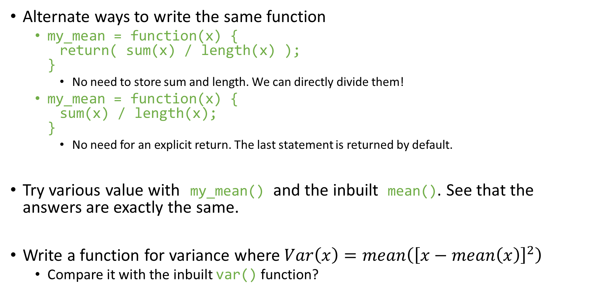
Function (Example) Cont.
Alternate ways to write the same function
my_mean = function(x) { return( sum(x) / length(x) ); }
No need to store sum and length. We can directly divide them!
my_mean = function(x) { sum(x) / length(x); }
No need for an explicit return. The last statement is returned by default.
Try various value with my_mean() and the inbuilt mean(). See that the answers are exactly the same.
Write a function for variance where $Var\left(x\right)=mean\left({\left[x−mean\left(x\right)\right]}^{2}\right)$
Compare it with the inbuilt var() function?

Slide 32
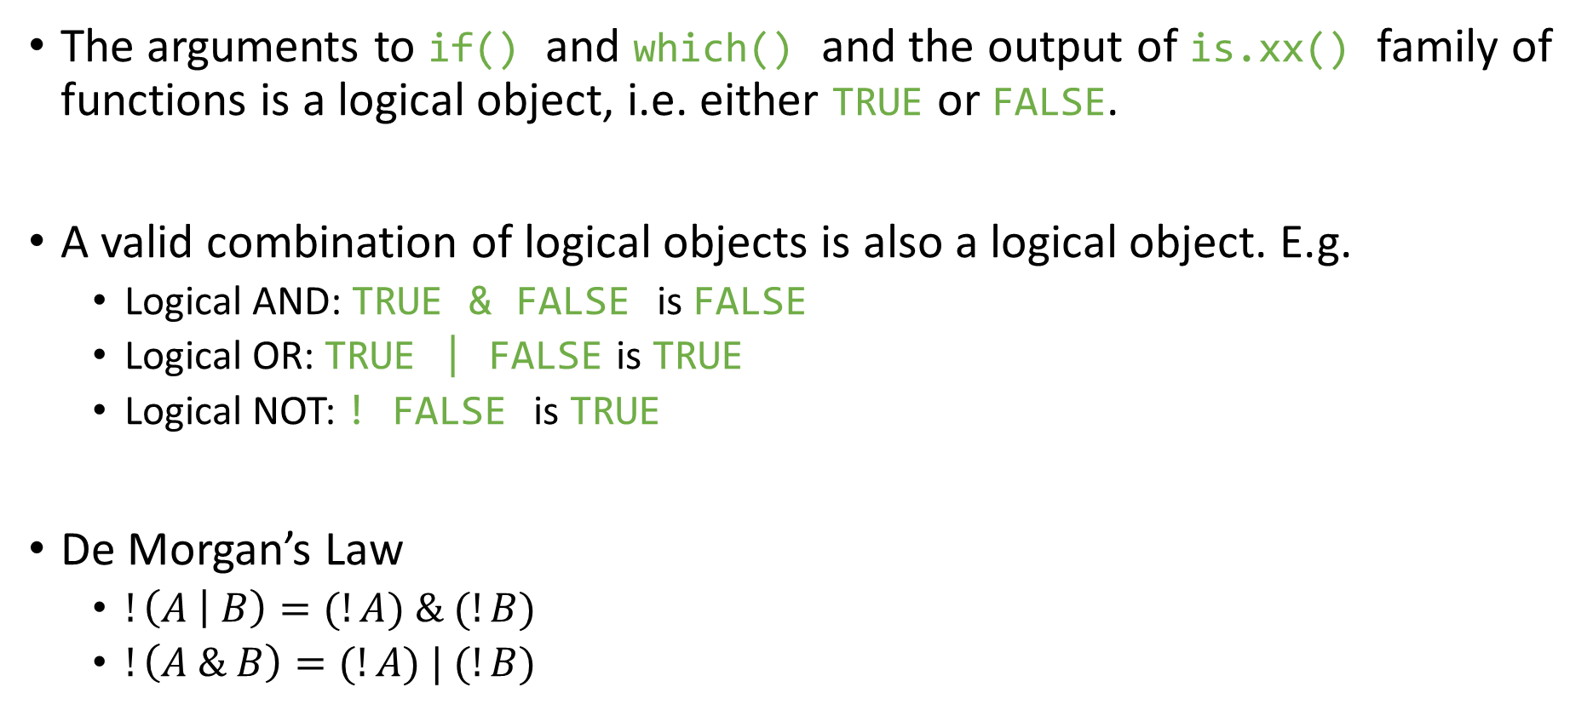
Multiple conditions & which() function
The arguments to if() and which() and the output of is.xx() family of functions is a logical object, i.e. either TRUE or FALSE.
A valid combination of logical objects is also a logical object. E.g.
Logical AND: TRUE & FALSE is FALSE
Logical OR: TRUE | FALSE is TRUE
Logical NOT: ! FALSE is TRUE
De Morgan’s Law
$!\left(A | B\right)=(!A) \& (!B)$
$!\left(A \& B\right)=(!A) | (!B)$

Slide 33
The below two indexes are one and same (by De Morgan Law),
day = as.numeric( substr(nifty$Date, 9, 10) );
OR day = as.numeric( format(df[,1], format = "%d") );
idx = which(nifty$Close > nifty$Open & (day < 5));
idx = which( !(nifty$Close < nifty$Open | (day >= 5)) );
which() gives the indexes matching the criterion. E.g. out of 101:200 which numbers are multiples of 2,3 and 5 ?
count = 101:200;
which( count %% 2 == 0 & count %% 3 == 0 & count %% 5 == 0 );
count[count %% 2 == 0 & count %% 3 == 0 & count %% 5 == 0];
We can do multi-way match using %in%
mult_17 = seq(17,300,17);
which(count %in% mult_17);
which(mult_17 %in% count);
which(!(count %in% mult_17));
which(!(mult_17 %in% count));

Slide 34
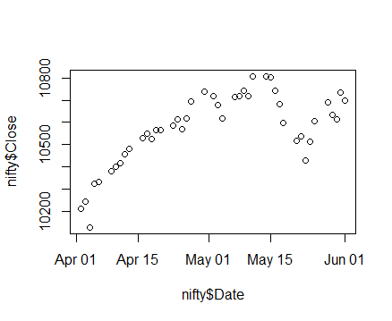
Plotting
plot(x, y, --options--);
plot(nifty$Date, nifty$Close);

Slide 35
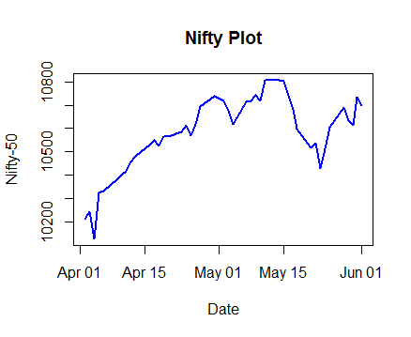
Plotting (cont.)
plot(nifty$Date, nifty$Close, type = 'l', col = "blue", lty = 1, lwd = 2, xlab = "Date", ylab = "Nifty-50", main = "Nifty Plot");

Slide 36
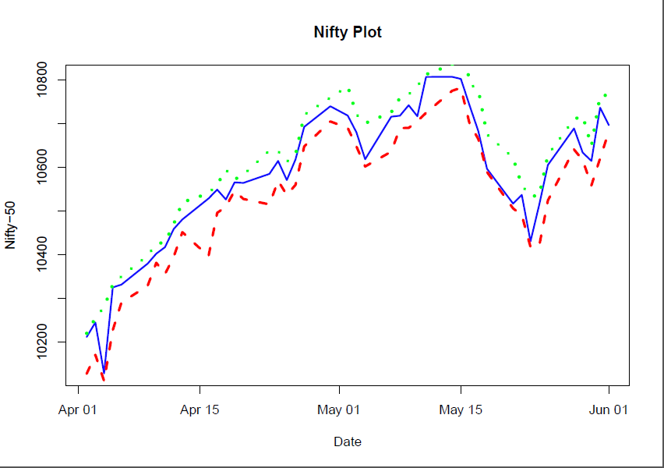
Plotting (cont.)
lines(nifty$Date, nifty$Low, type = 'l', lty = 2, col = "red", lwd = 3);
lines(nifty$Date, nifty$High, type = 'l', lty = 3, col = "green", lwd = 4);

Slide 37
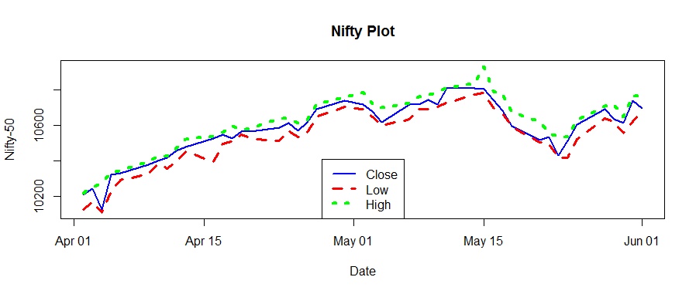
Plotting (cont.)
y_lmt = c(min(nifty$Low), max(nifty$High));
Use plot(..., ylim = y_lmt, ...)
legend("bottom", legend = c("Close", "Low", "High"), col = c("blue", "red", "green"), lty = 1:3, lwd = 2:4)

Slide 38
aggregate()
Aggregate values by subsets of data
Like mean air quality by month
Install the package: install.packages("datasets");
df = datasets::airquality;
n = nrow(df);
head(df, n = 10); # first 10 rows, i.e. from 1 to 10
head(df, n = -10); # all but last 10 rows, i.e. from 1 to (n-10)
tail(df, n = 10); # last 10 rows, i.e. from (n-9) to n
tail(df, n = -10); # all but first 10 rows, i.e. from 11 to n
Avg. Ozone, Temp levels by month:
aggregate(Ozone ~ Month, data = df, FUN = mean);
aggregate(Temp ~ Month, data = df, FUN = mean);

Slide 39
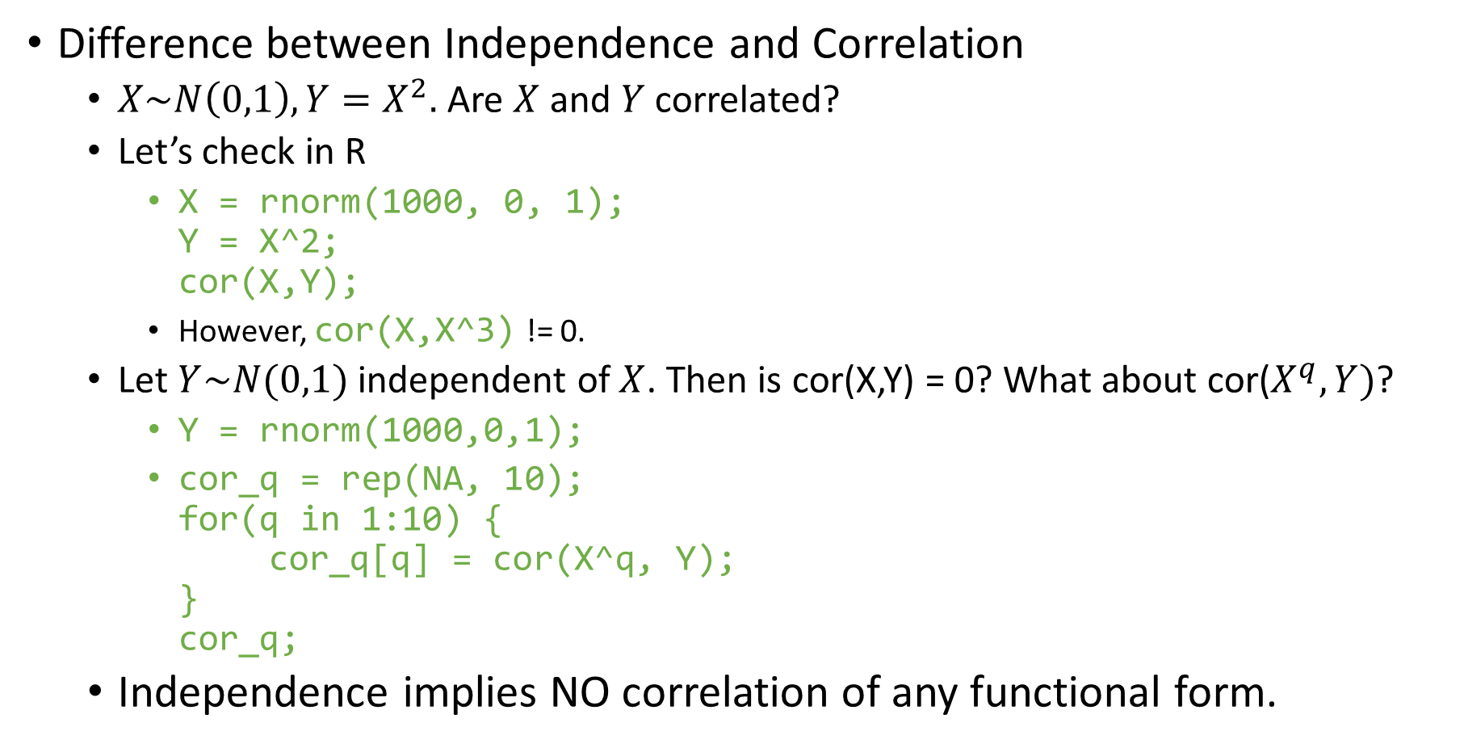
Correlation
Difference between Independence and Correlation
$X\sim N\left(0,1\right), Y=X^{2}.$ Are $X$ and $Y$ correlated?
Let’s check in R
X = rnorm(1000, 0, 1); Y = X^2; cor(X,Y);
However, cor(X,X^3) != 0.
Let $Y\sim N(0,1)$ independent of $X$. Then is cor(X,Y) = 0? What about cor($X^{q},Y)$?
Y = rnorm(1000,0,1);
cor_q = rep(NA, 10); for(q in 1:10) { cor_q[q] = cor(X^q, Y); } cor_q;
Independence implies NO correlation of any functional form.

Slide 40
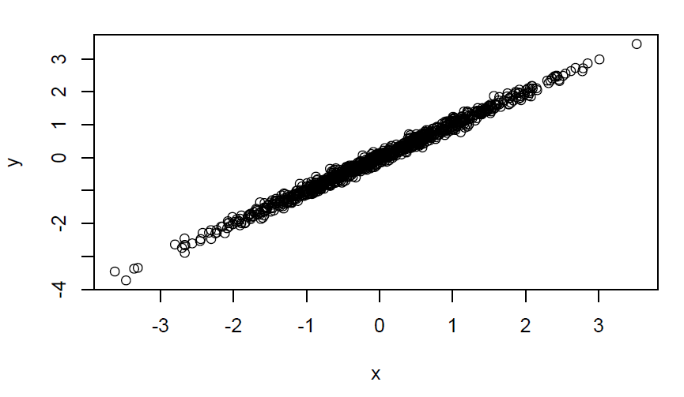

Regression
Let, $Y=β_{0}+β_{1}⋅X+u$ be the true model. By regressing $Y$ on $X$, we hope to recover an unbiased estimate of $β_{1}$ and see how much of the variation in $Y$ is explained by variation in $X$ unrelated to variation in $u$.
n = 1000;
x = rnorm(n, 0, 1);
u = rnorm(n, 0, 0.1);
y = u + x;
plot(x,y);

Slide 41
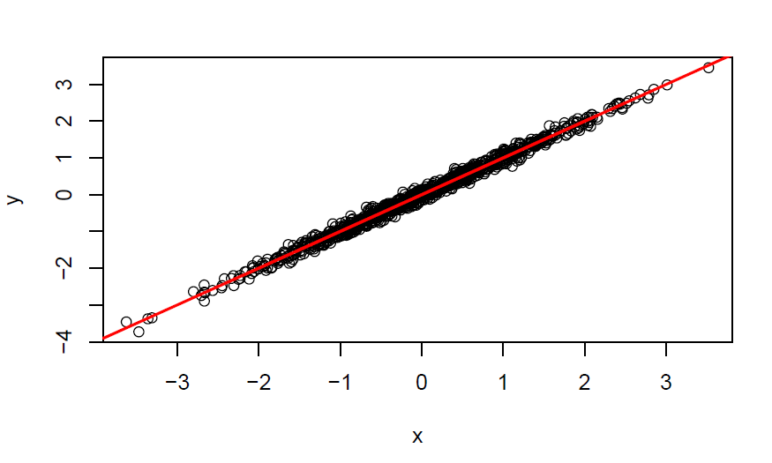
fit = lm(y ~ x);
summary(fit);
stargazer(fit, type = "html", out = "fit.html");
# Regression Line
abline(fit$coefficients, col = "red", lwd = 2);

Slide 42
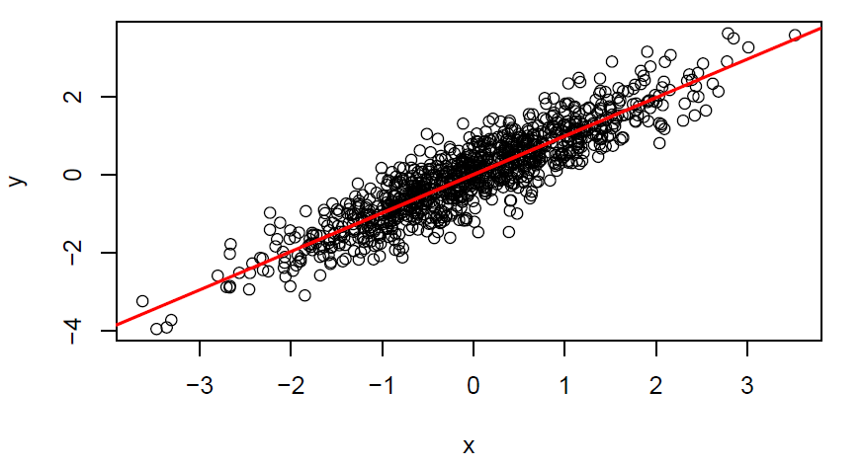
u = rnorm(n, 0, 0.5);
y = u + x;
plot(x,y);
fit = lm(y ~ x);
summary(fit);
# Regression Line
abline(fit$coefficients, col = "red", lwd = 2);

Slide 43
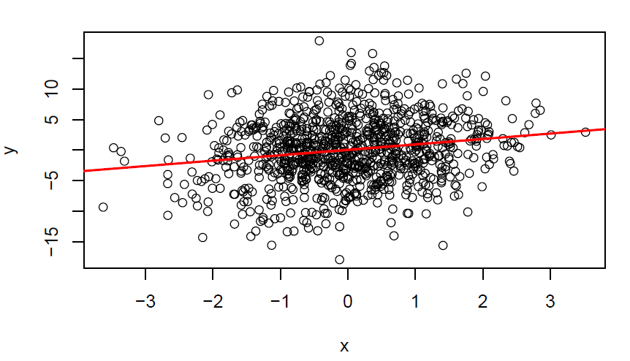
u = rnorm(n, 0, 5);
y = u + x;
plot(x,y);
fit = lm(y ~ x);
summary(fit);
# Regression Line
abline(fit$coefficients, col = "red", lwd = 2);

Slide 44
Some Useful functions
unique(), duplicated()
list.files()
Pattern matching using regex
All files starting from “s”: "^s"
All files starting with “b” or “d”: "^(b|d)“
All CSV files: ".*.csv"
order()
Sort data/dataframes
It gives the sequence of ordered indexes NOT the ordered numbers
Can do 2-way and 3-way sorts
union(), intersect()
cumsum(), cumprod()
cumprod() using only cumsum() ?

Slide 45
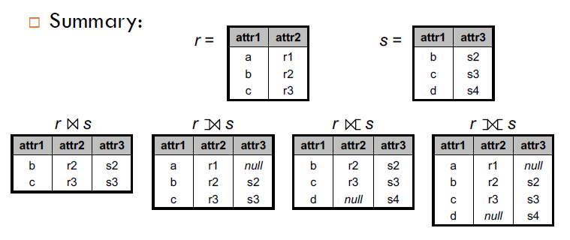
Merging
Combining two datasets is a very routine and important task
Merging is akin to Joining (in relational database, SQL etc)

Slide 46
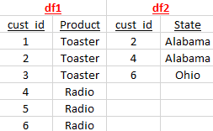
Merging Example
Taken from Stackoverflow webpage
Create two datasets:
df1 = data.frame(cust_id = c(1:6), Product = c(rep("Toaster", 3), rep("Radio", 3)));
df2 = data.frame(cust_id = c(2, 4, 6), State = c(rep("Alabama", 2), rep("Ohio", 1)));
The data looks like:
We will need to use a new package dplyr
install.packages("dplyr");

Slide 47
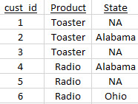

Inner Join
Full Join
dplyr::inner_join(df1, df2);
dplyr::full_join(df1, df2);

Slide 48
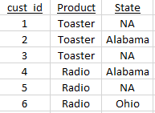
Left Join
Right Join
dplyr::left_join(df1, df2);
dplyr::right_join(df1, df2);
The above is identical to, dplyr::left_join(df2, df1);

Slide 49
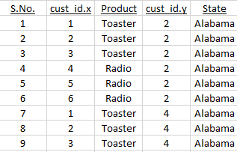
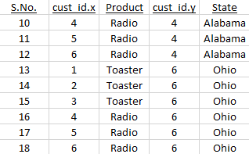
Cartesian Product
Every row of df1 multiplied with every row of df2
cart_prd = merge(df1, df2, by = NULL);

Slide 50
Cartesian products are extremely slow. Never do that even on a decent sized (> 1000 rows) dataset. Your computer will probably hang.
Although there is no use of Cartesian products, it encapsulates all types of merges. Meaning we can extract any type of merge from a Cartesian product.
Inner join can be extracted via
idx = which(cart_prd$cust_id.x == cart_prd$cust_id.y);
cart_prd[idx,];

Slide 51
Merging with more than one variable
Most of the merging usage is with two variables: date and company name. Generate data using below:
date = seq.Date(as.Date("2018-01-01"), by = 1, length.out = 5);
comp = c("A", "B", "C", "D", "E");
all_pairs = merge(comp, date, by = NULL);
# sales data - 15 points
idx = sample(1:nrow(all_pairs), 15, replace = F);
df1 = data.frame(comp = all_pairs$x[idx], date = all_pairs$y[idx],
sales = round(runif(15, min = 1e3, max = 1e5)));
# advertising data - 12 points
idx = sample(1:nrow(all_pairs), 12, replace = F);
df2 = data.frame(comp = all_pairs$x[idx], date = all_pairs$y[idx],
adv = round(runif(12, min = 1e2, max = 1e4)));

Slide 52
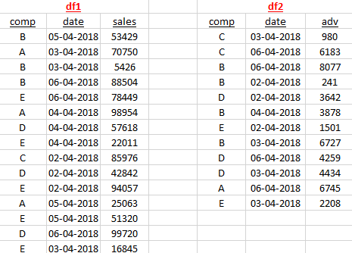

Slide 53
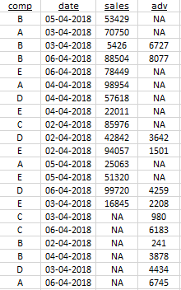
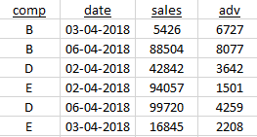
Inner Join
Full Join
dplyr::full_join(df1, df2);
dplyr::inner_join(df1, df2);

Slide 54
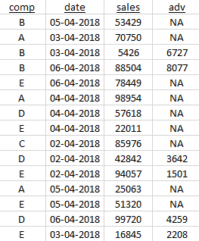
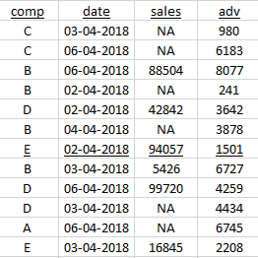
Left Join
Right Join
dplyr::left_join(df1, df2);
dplyr::right_join(df1, df2);
The above is identical to, dplyr::left_join(df2, df1);

Slide 55
Loop Functions
Writing loops in a single command. Can come very handy and compact. The function name ends with “apply”.
List of functions: lapply(), apply(), sapply(), tapply(), mapply()
These functions work on a list of inputs, not just one input!
E.g.
X = list(a = 1:10, b = rnorm(100, 0, 1), c = runif(1e3, 9, 91));
lappy(X, mean); # returns a list
sapply(X, mean); # returns a vector
Let’s say we want to find cor(X,X^i) for i in 1:10 w/o writing a loop?
X = rnorm(1000, 0, 1);
sapply(1:10, function(i) cor(X,X^i));
Here we have used anonymous function, i.e. a function w/o a name.

Slide 56
apply() is mostly used for applying functions on rows or cols of a matrix
Like taking means by rows
M = matrix(1:50, nrow = 10, ncol = 5);
apply(M, 1, mean); # mean of each row
apply(M, 2, mean); # mean of each col
You can do the above using a loop also, but apply() is more compact.
The faster version of above are also available:
rowSums(x) is equivalent to apply(x, 1, sum)
colMeans(x) is equivalent to apply(x, 2, mean)
tapply() is used to apply a function over a subset of vector. Lets say,
x = c(rnorm(100), runif(100));
f = rep(1:2, each = 100);
tapply(x, f, mean);

Slide 57
Pipe and the dplyr package
Download the tidyverse package and load it: library(tidyverse);
Also load dplyr: library(dplyr);
We will use the gapminder dataset.
Install gapminder package
df = gapminder::gapminder; df = as.data.frame(df);
Selecting a particular column
df %>% select(lifeExp);
Performing operation on data
df %>% select(lifeExp) %>% mean
Selecting some rows (based on a filtering criterion):
df %>% filter(year > 2000)
df %>% filter(year > 2000 & country == "India")

Slide 58
Selecting some rows (based on a filtering criterion):
df %>% filter(year > 2000)
df %>% filter(year > 2000 & country == "India")
Selecting and filtering together
df %>% select(country, year, lifeExp) %>% filter(year > 2000)
df %>% select(country, year, lifeExp) %>% filter(country == "India")
Grouping data
df %>% select(country, year, lifeExp) %>% group_by(lifeExp) %>% as.data.frame %>% head
df %>% group_by(country, gdpPercap) %>% as.data.frame %>% head
Create new columns (mutate)
df %>% mutate(decade = 10*(as.integer(year/10))) %>% head
Ordering
df %>% arrange(-pop) %>% head

Slide 59
Performing aggregation on grouped data is the most important usage of dplyr library
Aggregation:
df %>% select(-c(continent)) %>% group_by(country) %>% summarise_all(mean)
df %>% select(-c(continent)) %>% group_by(country) %>% summarise_all(mean)
df %>% group_by(continent) %>% summarise_all(mean)
df %>% group_by(continent, year) %>% summarise_all(mean) %>% filter(continent == "Asia")
Counting and ordering in Aggregation:
df %>% group_by(continent, year) %>% summarise(n()) %>% filter(continent == "Asia")
df %>% group_by(continent) %>% summarise(n())
df %>% filter(year == 2007) %>% group_by(pop) %>% arrange(-pop)
df %>% filter(year == 2007) %>% group_by(pop) %>% arrange(-gdpPercap)
df %>% filter(year == 2007) %>% group_by(pop) %>% mutate(GDP = gdpPercap*pop) %>% arrange(-GDP) %>% as.data.frame %>% select(country, GDP) %>% head(15)

