Slide 1
Applied R Programming 2021
-- Nikhil Vidhani
PhD Student,
Finance and Accounting

Slide 2
Course Objective

Slide 3
Course Objective
At the end of 10 weeks:
You should be able to perform basic programming tasks in R
Irrespective whether they are related to data analysis or your work
Appreciate programming as a means to accomplish huge no. of smaller tasks
Build complex logic and work-flow through small and concise functions
Have a good understanding of how to approach an empirical project
Data sources, merging, cleaning etc
Perform data analysis
Summaries, plots, regressions
Scale up your project

Slide 4
Course Objective
At the end of 10 weeks:
You should be able to perform basic programming tasks in R
Irrespective whether they are related to data analysis or your work
Appreciate programming as a means to accomplish huge no. of smaller tasks
Build complex logic and work-flow through small and concise functions
Have a good understanding of how to approach an empirical project
Data sources, merging, cleaning etc
Perform data analysis
Summaries, plots, regressions
Scale up your project
What should you do?
Practice, practice and practice. There is no other way to learn programming.
Programming nuances
Experiment

Slide 5
Course Outline
Module I (Lectures 1, 2 and 3)
Basics of Computer Architecture and Programming
Intro to Programming through R
Introduction to data.frame
Functions
useful R methods
Loop Functions

Slide 6
Course Outline
Module I (Lectures 1, 2 and 3)
Basics of Computer Architecture and Programming
Intro to Programming through R
Introduction to data.frame
Functions
useful R methods
Loop Functions
Module II (Lectures 4 and 5)
Introduction to data.table R package: syntax, usage and benefits
Merging datasets
Long form and wide form

Slide 7
Module III (Lectures 6, 7 and 8)
Mini Project
Study of NASA climate data
data.table one-liners
Introduction to Data Analysis
Steps in a Data analysis project
Nuances: missing values, repeating data and extremes
Plotting in R
legends, colors, line types, …
Multiple lines, multiple axes, multiple plots
Regression Basics
meaning of significance and R2
Introduction to felm package
Fixed effects, error clustering

Slide 8
Module IV (Lectures 9 and 10)
Mini Project
A country-wide panel of CO2 emissions
Miscellaneous
Running different types of regressions in R
OLS, GLS, IV, logit, GMM
Rmarkdown/latex for documenting your work
Other useful stuff!

Slide 9
Session-1

Slide 10
Module - I
Basics of Computer Architecture and Programming
Intro to Programming through R
Introduction to data.frame
Functions
useful R methods
Loop Functions

Slide 11
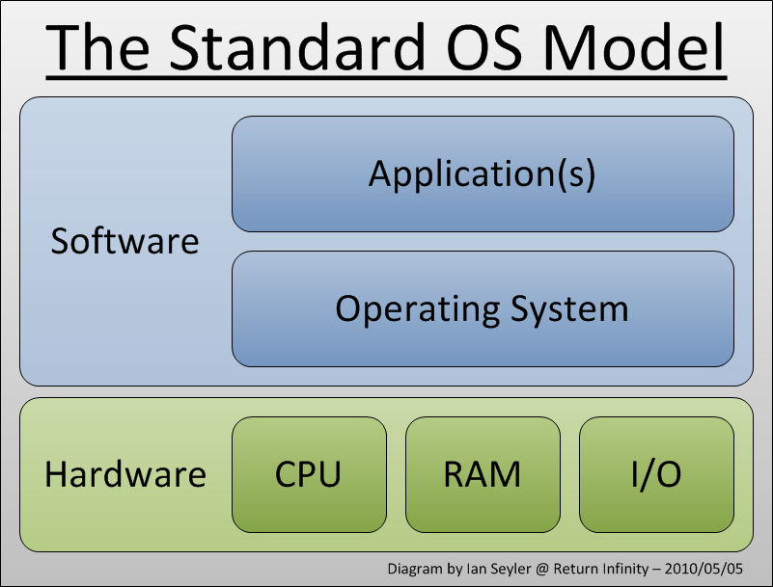
What’s a computer look like?

Slide 12
What does a Computer do?

Slide 13
What does a Computer do?
Perform Calculations!
Billions of them every second.
Cores, threads, clock speed

Slide 14
What does a Computer do?
Perform Calculations!
Billions of them every second.
Cores, threads, clock speed
Stores data
Cache vs RAM vs HDD
SSD
Speed vs storage cost

Slide 15
What does a Computer do?
Perform Calculations!
Billions of them every second.
Cores, threads, clock speed
Stores data
Cache vs RAM vs HDD
SSD
Speed vs storage cost
Runs Software
System (OS): Linux, Windows and Mac-OS
Application: R, RStudio, Excel

Slide 16
What is a program?

Slide 17
What is a program?
Translation of an algorithm into a language that computer understands
Think of it like a recipe. With the right ingredients and right procedure, you get the right dish

Slide 18
What is a program?
Translation of an algorithm into a language that computer understands
Think of it like a recipe. With the right ingredients and right procedure, you get the right dish
An algorithm takes input, perform some operations and gives output
Executes in finite time
E.g. sorting, searching, reading, copying!

Slide 19
What is a program?
Translation of an algorithm into a language that computer understands
Think of it like a recipe. With the right ingredients and right procedure, you get the right dish
An algorithm takes input, perform some operations and gives output
Executes in finite time
E.g. sorting, searching, reading, copying!
Complexity of a Program
Time and space!
E.g. Fibonacci series! (next slide)

Slide 20
What is a program?
Translation of an algorithm into a language that computer understands
Think of it like a recipe. With the right ingredients and right procedure, you get the right dish
An algorithm takes input, perform some operations and gives output
Executes in finite time
E.g. sorting, searching, reading, copying!
Complexity of a Program
Time and space!
E.g. Fibonacci series! (next slide)
Programming Paradigms
Iterative vs Recursive
Procedural vs Object Oriented
No need to understand OOP concepts unless you wish to build a software (like an R package)

Slide 21
Fibonacci Time Complexity Example

Slide 22
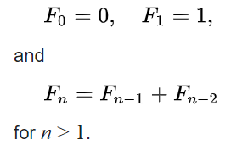
Fibonacci Time Complexity Example
Fibonacci numbers are defined as:

Slide 23
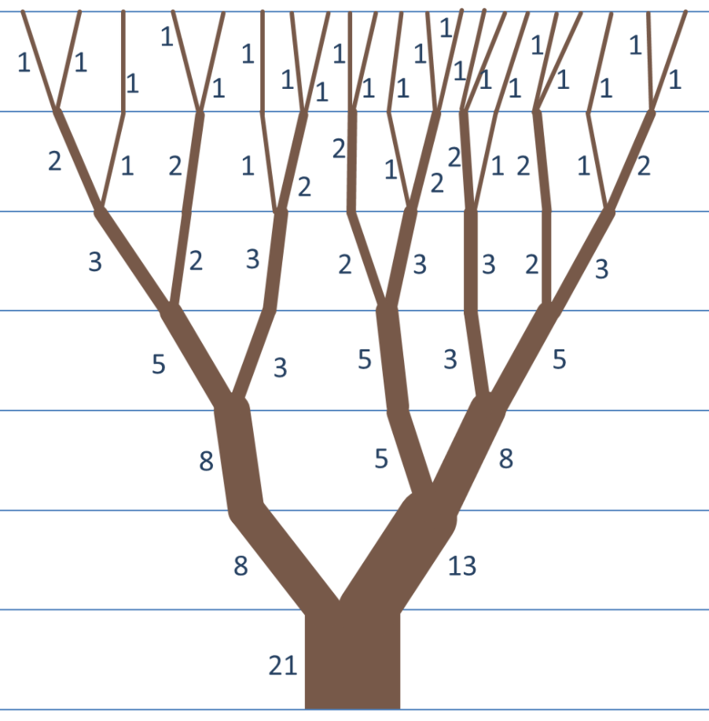
Fibonacci Time Complexity Example
Fibonacci numbers are defined as:

Slide 24
Fibonacci Time Complexity Example
Fibonacci numbers are defined as:
Thus, finding a Fibonacci number is pretty straight-forward.

Slide 25

3 ways to find Fib(n)

Slide 26
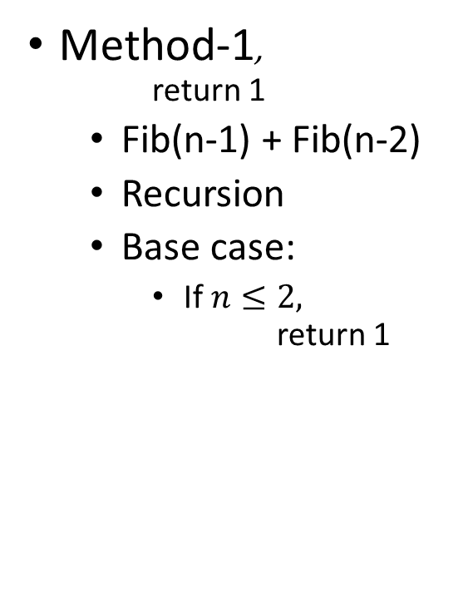
3 ways to find Fib(n)
Method-1, return 1
Fib(n-1) + Fib(n-2)
Recursion
Base case:
If $n≤2,$ return 1

Slide 27
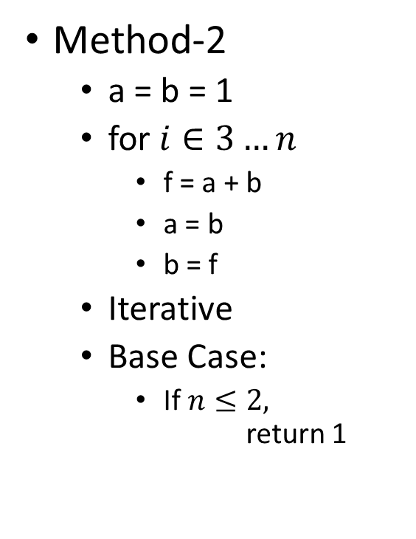
3 ways to find Fib(n)
Method-1, return 1
Fib(n-1) + Fib(n-2)
Recursion
Base case:
If $n≤2,$ return 1
Method-2
a = b = 1
for $i∈3…n$
f = a + b
a = b
b = f
Iterative
Base Case:
If $n≤2,$ return 1

Slide 28
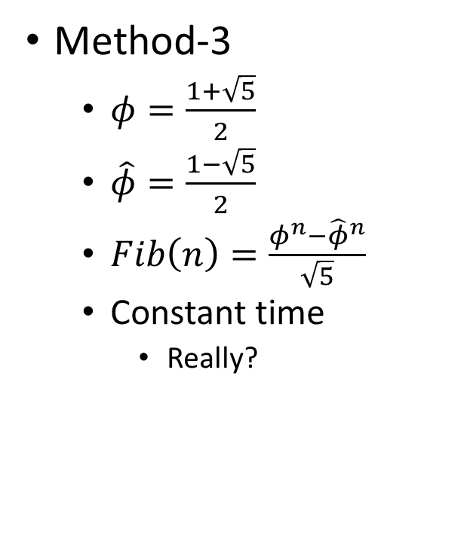
3 ways to find Fib(n)
Method-1, return 1
Fib(n-1) + Fib(n-2)
Recursion
Base case:
If $n≤2,$ return 1
Method-2
a = b = 1
for $i∈3…n$
f = a + b
a = b
b = f
Iterative
Base Case:
If $n≤2,$ return 1
Method-3
$φ=\frac{1+\sqrt{5}}{2}$
$\hat{φ}=\frac{1−\sqrt{5}}{2}$
$Fib\left(n\right)=\frac{φ^{n}−{\hat{φ}}^{n}}{\sqrt{5}}$
Constant time
Really?

Slide 29
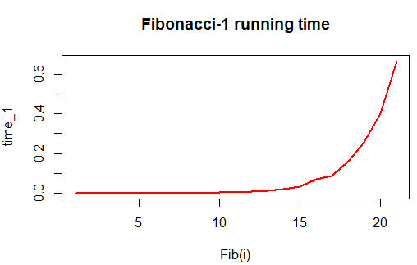

Slide 30
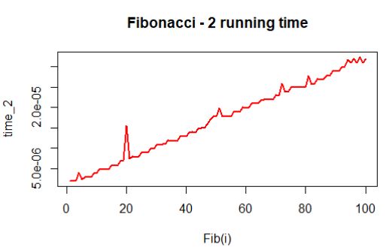

Slide 31
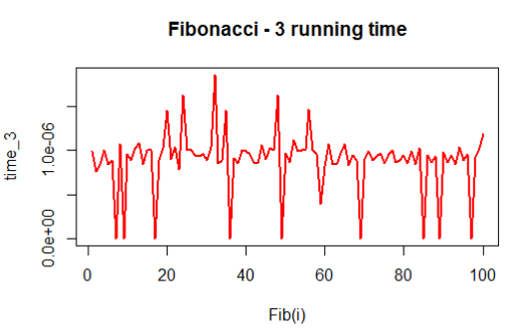
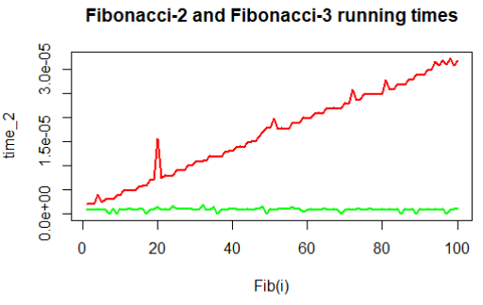

Slide 32
What makes a good program?

Slide 33
What makes a good program?
Efficient
Think about complexity
Will your code scale when input is 10x bigger? 100x?
Identify parts of your program that runs a million times
And optimize those the best you can
A project that takes forever to run isn’t worth pursuing

Slide 34
What makes a good program?
Efficient
Think about complexity
Will your code scale when input is 10x bigger? 100x?
Identify parts of your program that runs a million times
And optimize those the best you can
A project that takes forever to run isn’t worth pursuing
Readability
Make your code succinct and comments verbose
You will forget your code within weeks
The key to writing good code is the ability to quickly recap previously written code

Slide 35
What makes a good program?
Efficient
Think about complexity
Will your code scale when input is 10x bigger? 100x?
Identify parts of your program that runs a million times
And optimize those the best you can
A project that takes forever to run isn’t worth pursuing
Readability
Make your code succinct and comments verbose
You will forget your code within weeks
The key to writing good code is the ability to quickly recap previously written code
Organized
Writing code is an art. Much like a story!
Make small modules which can be reused later. Make it like a building: Bricks → Wall → floor → Building

Slide 36
What makes a good program?
Efficient
Think about complexity
Will your code scale when input is 10x bigger? 100x?
Identify parts of your program that runs a million times
And optimize those the best you can
A project that takes forever to run isn’t worth pursuing
Readability
Make your code succinct and comments verbose
You will forget your code within weeks
The key to writing good code is the ability to quickly recap previously written code
Organized
Writing code is an art. Much like a story!
Make small modules which can be reused later. Make it like a building: Bricks → Wall → floor → Building
Error Handling
Identify potential errors and print messages so that you know what and where problem occurred
For time consuming code, print regular messages (logs) in a file
You don’t want to run 4 hours of code just to find a small bug! Instead look at the log file.

Slide 37
Session-2

Slide 38
Reflection on Session-1

Slide 39
Reflection on Session-1
Why are you interested in data analysis? What you hope to achieve?

Slide 40
Reflection on Session-1
Why are you interested in data analysis? What you hope to achieve?
Why do you need to learn R?

Slide 41
Reflection on Session-1
Why are you interested in data analysis? What you hope to achieve?
Why do you need to learn R?
Why can’t you use Excel, Stata or SAS?

Slide 42
Reflection on Session-1
Why are you interested in data analysis? What you hope to achieve?
Why do you need to learn R?
Why can’t you use Excel, Stata or SAS?
Is it okay to write inefficient (time) programs?

Slide 43
Typical Programing Errors

Slide 44
Typical Programing Errors
Syntactical (spelling mistake)
Will get caught very easily! Just run the program.
a = c("hi"; "there")

Slide 45
Typical Programing Errors
Syntactical (spelling mistake)
Will get caught very easily! Just run the program.
a = c("hi"; "there")
Semantic Errors (meaningless operations)
For e.g. "iimb" + 32
Exceptions: like divide by 0.
May get caught. A warning will be thrown nonetheless.

Slide 46
Typical Programing Errors
Syntactical (spelling mistake)
Will get caught very easily! Just run the program.
a = c("hi"; "there")
Semantic Errors (meaningless operations)
For e.g. "iimb" + 32
Exceptions: like divide by 0.
May get caught. A warning will be thrown nonetheless.
Logical Errors (Unintentional)
Program will crash, run forever or give a wrong answer!
Like using i in place of j, adding in place of multiplying, …
These will happen when you first learn programming.
You’ll get better with skill and experience.

Slide 47
What is R

Slide 48
What is R
Implementation of S Programming language
Started as statistical environment
Explains the deep rootedness of R in statistics
Mostly written in C (earlier FORTRAN)
More info on Wikipedia!

Slide 49
What is R
Implementation of S Programming language
Started as statistical environment
Explains the deep rootedness of R in statistics
Mostly written in C (earlier FORTRAN)
More info on Wikipedia!
Philosophy behind R (or S, S+)
Interactive environment
Transition from users to Programmers as per need!
You don’t need to be a programmer to learn (and) use basic R
More info at http://ect.bell-labs.com/sl/S/history.html

Slide 50
What is R (cont.)

Slide 51
What is R (cont.)
Features
Very easy to follow and understand
Require understanding of vector and matrix indexing!
Interactive
Runs on all platforms.
Small software to download and load. Use packages as per need.
Free of cost. Open source software (GNU GPL). More info at www.fsf.org
Wide availability of user developed packages!
Very active development
Frequent updates and releases
Very active and responsive user community – Stackoverflow!

Slide 52
What is R (cont.)
Features
Very easy to follow and understand
Require understanding of vector and matrix indexing!
Interactive
Runs on all platforms.
Small software to download and load. Use packages as per need.
Free of cost. Open source software (GNU GPL). More info at www.fsf.org
Wide availability of user developed packages!
Very active development
Frequent updates and releases
Very active and responsive user community – Stackoverflow!
Drawbacks
Limited 3-D graphics capability
Rarely needed in management research or applications
Everything must be in RAM – big data?
Buy more RAM or use AWS!
If a functionality is missing you got to code it yourself!
Very rare! Opens new avenues for research!

Slide 53
Alternatives to R

Slide 54
Alternatives to R
There are several high-level and interpreted languages around
Most common are Python and MATLAB
MATLAB is used much more in engineering than in statistics
It may not support the great variety of linear/non-linear/regression models
Syntax is similar to R (Read: http://mathesaurus.sourceforge.net/octave-r.html)
Python is also very popular although its more used in data science
Computation heavy research (like text analysis and ML) also employ Python routinely
Nobody stops you from using multiple languages for your research
Several researchers also perform regressions in Stata as well

Slide 55
Alternatives to R
There are several high-level and interpreted languages around
Most common are Python and MATLAB
MATLAB is used much more in engineering than in statistics
It may not support the great variety of linear/non-linear/regression models
Syntax is similar to R (Read: http://mathesaurus.sourceforge.net/octave-r.html)
Python is also very popular although its more used in data science
Computation heavy research (like text analysis and ML) also employ Python routinely
Nobody stops you from using multiple languages for your research
Several researchers also perform regressions in Stata as well
Statistical Alternatives?
SAS and Stata
Paid and closed software
If Stata implements an algorithm, I can’t see their code. Only source is their documentation.
Very different than R in syntax!
Non-interactive
Limited user community support (huge deal-breaker)
Despite the differences Stata is very popular in management research.
SAS has a lot of legacy code and hence it is still used a lot in Finance research

Slide 56
Downloading and Installing R

Slide 57
Downloading and Installing R
Download R: https://cran.r-project.org/
Choose base package for your OS
Windows: https://cran.r-project.org/bin/windows/base/R-4.0.3-win.exe
Linux: Use apt-get (Debian based) OR yum install (RPM based) from terminal.
Mac: https://cran.r-project.org/bin/macosx/R-4.0.3.pkg
Install R

Slide 58
Downloading and Installing R
Download R: https://cran.r-project.org/
Choose base package for your OS
Windows: https://cran.r-project.org/bin/windows/base/R-4.0.3-win.exe
Linux: Use apt-get (Debian based) OR yum install (RPM based) from terminal.
Mac: https://cran.r-project.org/bin/macosx/R-4.0.3.pkg
Install R
Download RStudio IDE
Choose the free RStudio Desktop edition
https://www.rstudio.com/products/rstudio/download/#download
Choose the appropriate one according to your OS
Install RStudio

Slide 59
Getting Help in R

Slide 60
Getting Help in R
From Console
Just type: ? followed by function name without parenthesis
E.g. ?mean; ?sum; ?length;
Clarify:
?mean - help for the function “mean”
??mean - will perform the search over the internet (CRAN database)
Look for base::mean!
mean() - call the function mean
mean - print the definition of the function “mean”

Slide 61
Getting Help in R
From Console
Just type: ? followed by function name without parenthesis
E.g. ?mean; ?sum; ?length;
Clarify:
?mean - help for the function “mean”
??mean - will perform the search over the internet (CRAN database)
Look for base::mean!
mean() - call the function mean
mean - print the definition of the function “mean”
From Web sources
Most reliable and easy to incorporate is www.stackoverflow.com.
www.r-bloggers.com is also quite helpful.
You can use https://cran.r-project.org for any resource on R
Read the package vignette and manuals
e.g. data.table CRAN; data.table vignette; data.table manual
Even typing your question in google will get you good results!
99% of your questions are already answered! You just need to find them!

Slide 62
R Input and Output

Slide 63
R Input and Output
Simple assignment
X = 1; (or X <- 1;)
Assignment is always right to left
Read 1 goes into X
We aren’t comparing X with 1 here
Learn this by heart! (for first-time programmers)
The semi-colon isn’t necessary in R, but it’s a good practice to use it
semi-colon is an instruction demarcation. Meaning you can write a = 1; b = 2 in one line.
X = ; is incomplete
# (prefix) is used as a comment. Use it for helpful comments.
Use Ctrl-Shift-C for multi-line comments

Slide 64
R Input and Output
Simple assignment
X = 1; (or X <- 1;)
Assignment is always right to left
Read 1 goes into X
We aren’t comparing X with 1 here
Learn this by heart! (for first-time programmers)
The semi-colon isn’t necessary in R, but it’s a good practice to use it
semi-colon is an instruction demarcation. Meaning you can write a = 1; b = 2 in one line.
X = ; is incomplete
# (prefix) is used as a comment. Use it for helpful comments.
Use Ctrl-Shift-C for multi-line comments
Value of X can be seen by writing X and hitting enter

Slide 65
Vectors

Slide 66
Vectors
A sequence of numbers. Many ways to input!
Y = c(1,7,-3,41); # concatenate arbitrary numbers
Y = 1:10; # natural numbers
Y = seq(1,100,9); # skip by 9
Y = rep(2, 3); # repeat 2 3-times
Y = rep(1:2, 3); # repeat the vector c(1,2) 3-times
Y = rep(1:2, each = 3); # repeat each element of c(1,2) 3-times
Y = c(); # empty vector
Execute this: Y = c(1:3, rep(c(5,7), each = 2), rep(9, 4), 7);

Slide 67
Vectors
A sequence of numbers. Many ways to input!
Y = c(1,7,-3,41); # concatenate arbitrary numbers
Y = 1:10; # natural numbers
Y = seq(1,100,9); # skip by 9
Y = rep(2, 3); # repeat 2 3-times
Y = rep(1:2, 3); # repeat the vector c(1,2) 3-times
Y = rep(1:2, each = 3); # repeat each element of c(1,2) 3-times
Y = c(); # empty vector
Execute this: Y = c(1:3, rep(c(5,7), each = 2), rep(9, 4), 7);
Length of vector: length(Y);

Slide 68
Vectors
A sequence of numbers. Many ways to input!
Y = c(1,7,-3,41); # concatenate arbitrary numbers
Y = 1:10; # natural numbers
Y = seq(1,100,9); # skip by 9
Y = rep(2, 3); # repeat 2 3-times
Y = rep(1:2, 3); # repeat the vector c(1,2) 3-times
Y = rep(1:2, each = 3); # repeat each element of c(1,2) 3-times
Y = c(); # empty vector
Execute this: Y = c(1:3, rep(c(5,7), each = 2), rep(9, 4), 7);
Length of vector: length(Y);
Accessing i^{th} element of vector: Y[i];
square (not curly or parenthesis) brackets
i should be between 1 and length(Y)
Printing the entire vector is as before: Y

Slide 69
Objects in R

Slide 70
Objects in R
5 basic (atomic) types of objects
character – strings
numeric – real numbers. Also called double.
integer – natural numbers. Default data type for numeric vectors.
typeof(1:10)
Execute: as.integer(2^31 - 1) and then as.integer(2^31)
There is raw data type as well. It represents hexadecimal numbers. Try: as.raw(255)
complex – complex numbers. We won’t use them now!
2 + 3i
logical – True/False (binary)
T, F, TRUE, FALSE

Slide 71
Objects in R
5 basic (atomic) types of objects
character – strings
numeric – real numbers. Also called double.
integer – natural numbers. Default data type for numeric vectors.
typeof(1:10)
Execute: as.integer(2^31 - 1) and then as.integer(2^31)
There is raw data type as well. It represents hexadecimal numbers. Try: as.raw(255)
complex – complex numbers. We won’t use them now!
2 + 3i
logical – True/False (binary)
T, F, TRUE, FALSE
Most basic collection of objects is a vector (also called an array)
Can only contain objects of same class (i.e. character or integer; not both)
“list” is a general object type and can contain heterogeneous objects as its members
Any Combination of vector, matrix, atomic types etc.
It can even contain another list as an object. E.g. linked-lists!
Due to its generality its very slow and hence rarely used with large datasets unless situation demands it

Slide 72
Numbers

Slide 73
Numbers
Default type of any number is numeric (i.e. real). typeof(1)

Slide 74
Numbers
Default type of any number is numeric (i.e. real). typeof(1)
R can differentiate between corner cases:
1/0 is Inf -- is.infinite();
0/0 is NaN -- is.nan();
Missing data is NA -- is.na();
Check what’s Inf-Inf ?

Slide 75
Numbers
Default type of any number is numeric (i.e. real). typeof(1)
R can differentiate between corner cases:
1/0 is Inf -- is.infinite();
0/0 is NaN -- is.nan();
Missing data is NA -- is.na();
Check what’s Inf-Inf ?
Arithmetic Operations
* multiplies
/ divides
^ takes exponent
%% is the modulo (remainder) operator. Try: 7 %% 2;

Slide 76
Coercion

Slide 77
Coercion
Mixing Objects
Automatically coerced to the same class.
Try: c(1:7, "a"); c(T, 2); c("a", FALSE);
Implicit coercion!
Never use unless you know what you’re doing!
Even then its better to explicitly coerce objects

Slide 78
Coercion
Mixing Objects
Automatically coerced to the same class.
Try: c(1:7, "a"); c(T, 2); c("a", FALSE);
Implicit coercion!
Never use unless you know what you’re doing!
Even then its better to explicitly coerce objects
Explicit Coercion
as.character(1:5);
as.numeric("iimb"); # warning!
as.logical(seq(-2,2,1));

Slide 79
List

Slide 80
List
Can carry different types of data together
L = list(1, FALSE, 3.14, "iimb", "c", 4-3i, list("2nd-list"));
Print list: L;
Check: typeof(L); typeof(L[4]); typeof(L[[4]]); typeof(L[[7]]);
Single square brackets [i] access the i^{th} list embedded in the list L
It’s a pointer to the element (don’t bother if you don’t know what a pointer is!)
Double square brackets [[i]] access the i^{th} element
Can append elements in list: L = append(L, "8-th");
unlist(L); will coerce all elements into a single type and return a vector
Delete an element from a list:
I don’t know how to do that!
Let’s google: “delete element from list in R”
Open the answer on www.stackoverflow.com

Slide 81
Matrices

Slide 82
Matrices
Generalization of vectors
2 dimensions instead of one!

Slide 83
Matrices
Generalization of vectors
2 dimensions instead of one!
N x K matrix means a matrix having N rows and K columns. Total of NK elements.
M = matrix(nrow = 2, ncol = 3);
Dimensions: dim(M);
Can think of M as
3 columns vectors each of length 2, or
2 row vectors each of length 3
Populate matrix:
M = rbind(1:3, 4:6);
M = matrix(1:6, nrow = 2, byrow = T); # default is by column
M = cbind(1:2, 3:4, 5:6);

Slide 84
Matrices (cont.)
Indexing a matrix
M[i,j] gives the element at i^{th} row and j^{th} column
M[i,] gives the entire i^{th} row (a vector)
M[,j] gives the entire j^{th} column (a vector)

Slide 85
Matrices (cont.)
Indexing a matrix
M[i,j] gives the element at i^{th} row and j^{th} column
M[i,] gives the entire i^{th} row (a vector)
M[,j] gives the entire j^{th} column (a vector)
Matrix multiplication
%*% performs the usual matrix multiplication. Try: M %*% M
Dimensions must match
Try t(M) %*% M;
t(M) takes transpose of a matrix!
M*N perform element-wise multiplication

Slide 86
Matrices (cont.)
Identity matrix: diag(3)
Diagonal Matrix: diag(c(1,5,7)); diag(1:7);
Diagonal of a matrix: diag(M)
Trace of a matrix: sum(diag(M))
Inverse of a matrix:
Must be a square matrix: M = matrix(1:9, nrow = 3, ncol = 3);
Another way to create a matrix. Data is entered column-wise.
Determinant must be non-zero: det(M); M[3,3] = 19; det(M);
Inverse: solve(M);

Slide 87
Higher (> 2) dimension Arrays

Slide 88
Higher (> 2) dimension Arrays
A = array(1:24, dim = c(2,3,4),
dimnames = list(paste0("ROW-", 1:2),
paste0("COL-", 1:3),
paste0("MATRIX-", 1:4)));
A[,,i] will be a 2x3 matrix, A[,i,j] will be a 2x1 vector, A[i,j,k] is a scaler.
What the dimension of A[i,,], A[,j,], A[i,,k] and A[i,j,] ?

Slide 89
Higher (> 2) dimension Arrays
A = array(1:24, dim = c(2,3,4),
dimnames = list(paste0("ROW-", 1:2),
paste0("COL-", 1:3),
paste0("MATRIX-", 1:4)));
A[,,i] will be a 2x3 matrix, A[,i,j] will be a 2x1 vector, A[i,j,k] is a scaler.
What the dimension of A[i,,], A[,j,], A[i,,k] and A[i,j,] ?
They have a limited use
For instance, if you need to compute 10,000 matrices (of dimension NxN) and then add them, then it’s better to define an array of dimension c(N,N,10000) and after computation do apply(A, c(1,2), sum)
data.frames/data.tables are almost always easier to build, interpret and summarize!

Slide 90
Factors

Slide 91
Factors
For categorical data
Male, female
Cities in a dataset
Typically useful when the dataset is large but the no. of categories is small
Using factors is more descriptive than integer values
Rather than using 1 for PGP, 2 for FPM and 3 for Others; its more intuitive to use factors.

Slide 92
Factors
For categorical data
Male, female
Cities in a dataset
Typically useful when the dataset is large but the no. of categories is small
Using factors is more descriptive than integer values
Rather than using 1 for PGP, 2 for FPM and 3 for Others; its more intuitive to use factors.
Example:
sex = rep(c("male", "female"), 5);
sex_f = as.factor(sex);
Check: typeof(sex_f); as.integer(sex_f);

Slide 93
Factors
For categorical data
Male, female
Cities in a dataset
Typically useful when the dataset is large but the no. of categories is small
Using factors is more descriptive than integer values
Rather than using 1 for PGP, 2 for FPM and 3 for Others; its more intuitive to use factors.
Example:
sex = rep(c("male", "female"), 5);
sex_f = as.factor(sex);
Check: typeof(sex_f); as.integer(sex_f);
Useful in the regression framework using lm();
Automatically creates dummy for all but one categories.
Conversion between integers (like year) and factor can corrupt your data!
Try: as.integer(as.factor(2000:2020))

Slide 94
Session - 3

Slide 95
Reflection on Session-2

Slide 96
Data Frame

Slide 97
Data Frame
Probably the most important data type you’ll use.
All external data (from excel, csv, tables, webpages etc) is read as data frame
It’s a list where each element of list must have the same length.
Think of it like a matrix but with the flexibility that each column can have different data type. E.g. set of Names, weights and heights
Example:
d = data.frame(name = c("a", "b"), weight = c(70, 75), height = c(1.78, 1.82));
d; d$name; d[1,]; d$weight; d[,3];
d$bmi = d$weight / (d$height^2); # new row
nrow(d); ncol(d); dim(d);
colnames(d)[1] = "names";
rownames(d) = c("I", "II");

Slide 98
Reading Data

Slide 99
Reading Data
Download some stock data from NSE
https://www.nseindia.com/products/content/equities/indices/historical_index_data.htm
Save the CSV file as data.csv

Slide 100
Reading Data
Download some stock data from NSE
https://www.nseindia.com/products/content/equities/indices/historical_index_data.htm
Save the CSV file as data.csv
From CSV (most common)
setwd("C:/Users/nikhi/Downloads/");
nifty = read.csv("data.csv");
Alternatively: nifty = read.csv("C:/Users/nikhi/Downloads/data.csv");

Slide 101
Reading Data
Download some stock data from NSE
https://www.nseindia.com/products/content/equities/indices/historical_index_data.htm
Save the CSV file as data.csv
From CSV (most common)
setwd("C:/Users/nikhi/Downloads/");
nifty = read.csv("data.csv");
Alternatively: nifty = read.csv("C:/Users/nikhi/Downloads/data.csv");
From Excel
Search it yourself! It is not recommended btw.

Slide 102
Reading Data
Download some stock data from NSE
https://www.nseindia.com/products/content/equities/indices/historical_index_data.htm
Save the CSV file as data.csv
From CSV (most common)
setwd("C:/Users/nikhi/Downloads/");
nifty = read.csv("data.csv");
Alternatively: nifty = read.csv("C:/Users/nikhi/Downloads/data.csv");
From Excel
Search it yourself! It is not recommended btw.
From clipboard
read.table("clipboard");
This is quick fix for small data transfer between R and excel. Use read.csv() as your primary method for data reading!

Slide 103
Reading Data (cont.)

Slide 104
Reading Data (cont.)
Viewing data
View(nifty);

Slide 105
Reading Data (cont.)
Viewing data
View(nifty);
Date
nifty$Date = as.Date(nifty$Date, format = "%d-%b-%Y");
n = nrow(nifty);
d = nifty$Date[1];
format(d, format = "%D"); # 10/01/20
format(d, format = "%d-%m-%y"); # 01-10-20
format(d, format = "%d.%b.%Y"); # 01.Oct.2020
format(d, format = "%A, %B %d, %Y") # Thursday, October 01, 2020

Slide 106
Reading Data (cont.)
Viewing data
View(nifty);
Date
nifty$Date = as.Date(nifty$Date, format = "%d-%b-%Y");
n = nrow(nifty);
d = nifty$Date[1];
format(d, format = "%D"); # 10/01/20
format(d, format = "%d-%m-%y"); # 01-10-20
format(d, format = "%d.%b.%Y"); # 01.Oct.2020
format(d, format = "%A, %B %d, %Y") # Thursday, October 01, 2020
Alternatively,
read.table("data.csv", header = T, sep = ",", nrows = 5);

Slide 107
if-else

Slide 108
if-else
if(<COND_1>) { # do something! } else { # ... }
if(<COND_1>) { # do something! } else if(<COND_2>) { # ... } else { # ... }
if(<COND_1>) { # do something! }

Slide 109
if-else
if(<COND_1>) { # do something! } else { # ... }
if(<COND_1>) { # do something! } else if(<COND_2>) { # ... } else { # ... }
if(<COND_1>) { # do something! }
if(nifty$Close[2] > nifty$Close[1]) {
str = paste("Stock market closed green on", nifty$Date[2]);
} else if(nifty$Close[2] > nifty$Open[2]) {
str = paste("Stock market closed above opening on", nifty$Date[2]);
} else {
str = paste("Stock market was red and closed below opening on", nifty$Date[2]);
}
print(str);

Slide 110
for loop

Slide 111
for loop
Looping is used to perform similar set of tasks repetitively
for(i in n:1) { print(nifty$Date[i]); }
n:1; is same as seq(n,1,1); i.e. backwards counting!
Alternatively, you can execute: rev(nifty$Date); or nifty$Date[n:1];

Slide 112
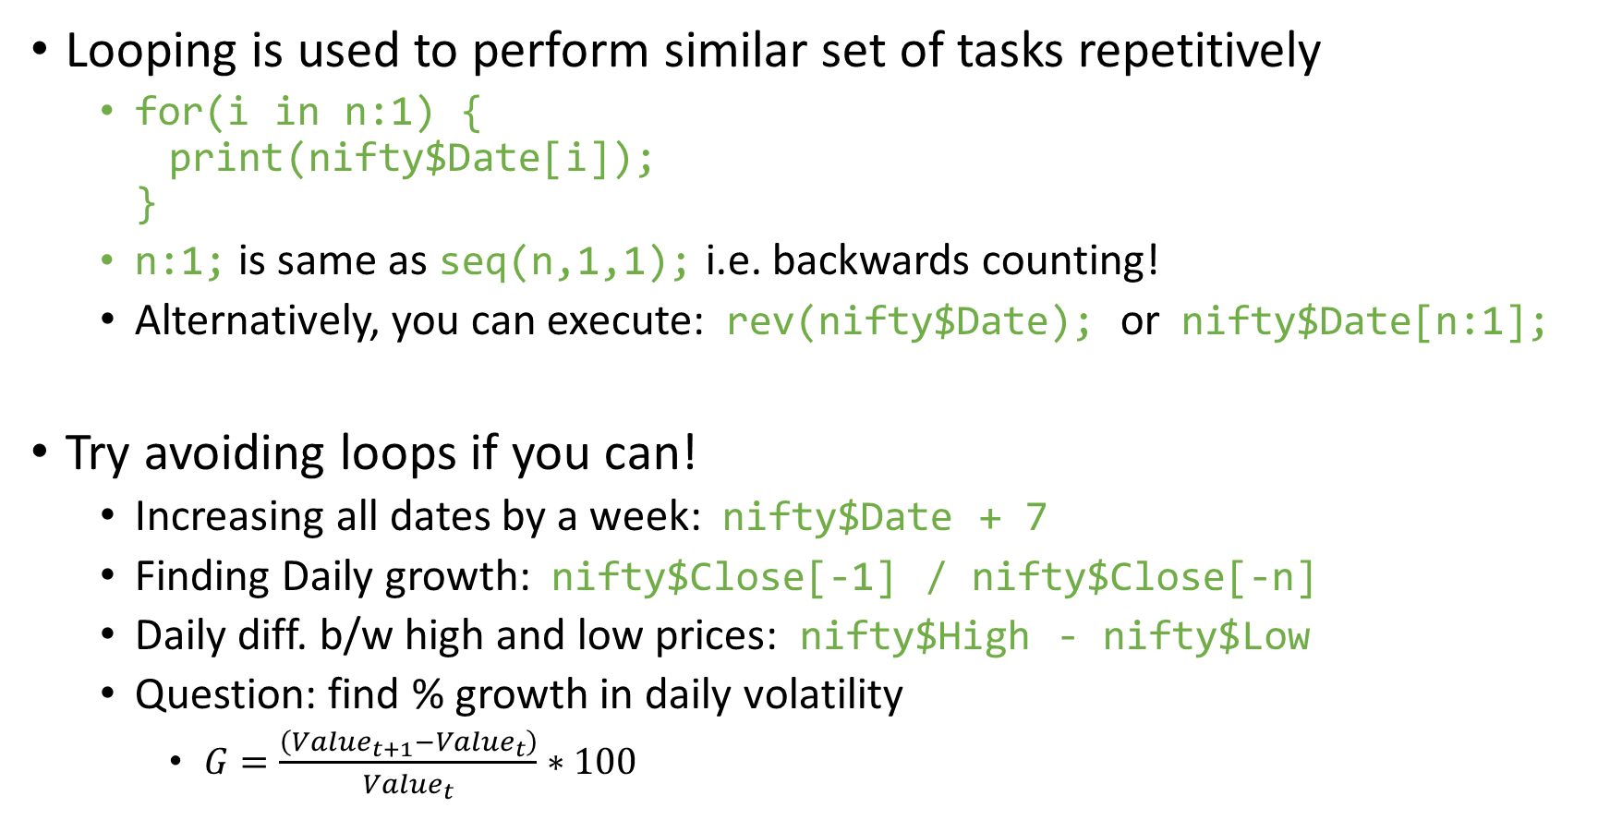
for loop
Looping is used to perform similar set of tasks repetitively
for(i in n:1) { print(nifty$Date[i]); }
n:1; is same as seq(n,1,1); i.e. backwards counting!
Alternatively, you can execute: rev(nifty$Date); or nifty$Date[n:1];
Try avoiding loops if you can!
Increasing all dates by a week: nifty$Date + 7
Finding Daily growth: nifty$Close[-1] / nifty$Close[-n]
Daily diff. b/w high and low prices: nifty$High - nifty$Low
Question: find % growth in daily volatility
$G=\frac{\left(Value_{t+1}−Value_{t}\right)}{Value_{t}}∗100$

Slide 113
Nested if-else and for loop

Slide 114
Nested if-else and for loop
for(i in 2:n) {
if(nifty$Close[i] > 1.01 * nifty$Close[i-1]) {
# market gained more than 1%
for(j in 1:ncol(nifty)) {
print( paste("Gain", i, colnames(nifty)[j], nifty[i,j], sep =":") );
} # end for(j)
} else if(nifty$Close[i] < 0.99 * nifty$Close[i-1]) {
# market lost more than 1%
for(j in 1:ncol(nifty)) {
print( paste("Loss", i, colnames(nifty)[j], nifty[i,j], sep =":") );
}
} else {
print(paste("Market movement was within 1% for i =", i));
} # end if()
} # end for(i)

Slide 115
Jumping

Slide 116
Jumping
Till now all our commands executed sequentially
There may be circumstances when we need to jump

Slide 117
Jumping
Till now all our commands executed sequentially
There may be circumstances when we need to jump
Next and Break
next is used to skip an iteration, while break exits the loop entirely.
for(i in 1:10) { if(i <= 3) { next; } if(i > 6) { break; } print(i); } i;

Slide 118
Jumping
Till now all our commands executed sequentially
There may be circumstances when we need to jump
Next and Break
next is used to skip an iteration, while break exits the loop entirely.
for(i in 1:10) { if(i <= 3) { next; } if(i > 6) { break; } print(i); } i;
return() is used to exit a function with a value

Slide 119
Function

Slide 120
Function
Organize often-used set of instructions separately in a “function”
Calling a function will execute all the commands in the body of function

Slide 121
Function
Organize often-used set of instructions separately in a “function”
Calling a function will execute all the commands in the body of function
We have used many functions till now
They end with parenthesis: ()
Not square or curly braces
E.g. sum(); rbind(); vector(); format(); read.csv(); etc
Note that curly braces {} are used for if-else, for and function body, square braces [] for vector/matrix indexing and parenthesis () for grouping, if-else condition, for condition and functions arguments.

Slide 122
Function
Organize often-used set of instructions separately in a “function”
Calling a function will execute all the commands in the body of function
We have used many functions till now
They end with parenthesis: ()
Not square or curly braces
E.g. sum(); rbind(); vector(); format(); read.csv(); etc
Note that curly braces {} are used for if-else, for and function body, square braces [] for vector/matrix indexing and parenthesis () for grouping, if-else condition, for condition and functions arguments.
A function has
A name by which we call them, e.g. sum
A set of inputs to be put within parenthesis like numbers 1:10 in sum()
A function can have no input: getwd()
Return value which is the output of the function like the sum of numbers in sum()

Slide 123
Function Example
my_mean = function(x) {
n = length(x);
mean = sum(x) / n;
return(mean);
}

Slide 124
Function Example
my_mean = function(x) {
n = length(x);
mean = sum(x) / n;
return(mean);
}
Name of the function is: my_mean
Input is: x
Output is: mean
Note that the mean here is just a name, we could well have used any other name without changing anything about our function

Slide 125
Function (Example) Cont.
Alternate ways to write the same function
my_mean = function(x) { return( sum(x) / length(x) ); }
No need to store sum and length. We can directly divide them!
my_mean = function(x) { sum(x) / length(x); }
No need for an explicit return. The last statement is returned by default.

Slide 126
Function (Example) Cont.
Alternate ways to write the same function
my_mean = function(x) { return( sum(x) / length(x) ); }
No need to store sum and length. We can directly divide them!
my_mean = function(x) { sum(x) / length(x); }
No need for an explicit return. The last statement is returned by default.
Try various value with my_mean() and the inbuilt mean(). See that the answers are exactly the same.

Slide 127
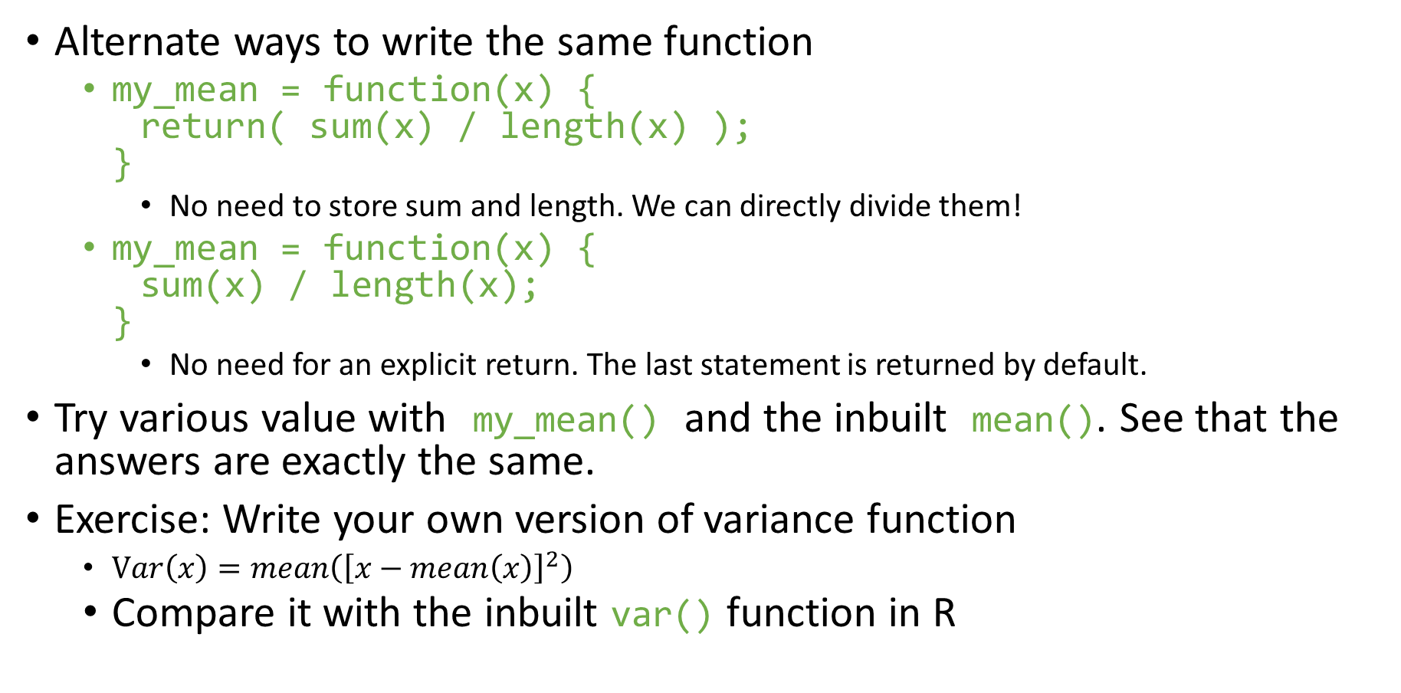
Function (Example) Cont.
Alternate ways to write the same function
my_mean = function(x) { return( sum(x) / length(x) ); }
No need to store sum and length. We can directly divide them!
my_mean = function(x) { sum(x) / length(x); }
No need for an explicit return. The last statement is returned by default.
Try various value with my_mean() and the inbuilt mean(). See that the answers are exactly the same.
Exercise: Write your own version of variance function
$Var\left(x\right)=mean\left({\left[x−mean\left(x\right)\right]}^{2}\right)$
Compare it with the inbuilt var() function in R

Slide 128

Multiple conditions & which() function

Slide 129
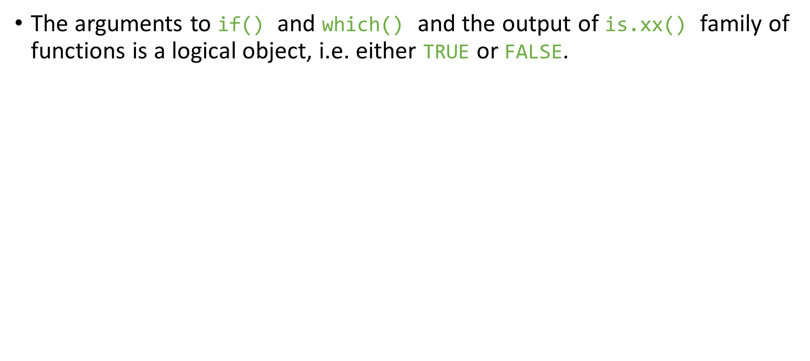
Multiple conditions & which() function
The arguments to if() and which() and the output of is.xx() family of functions is a logical object, i.e. either TRUE or FALSE.

Slide 130
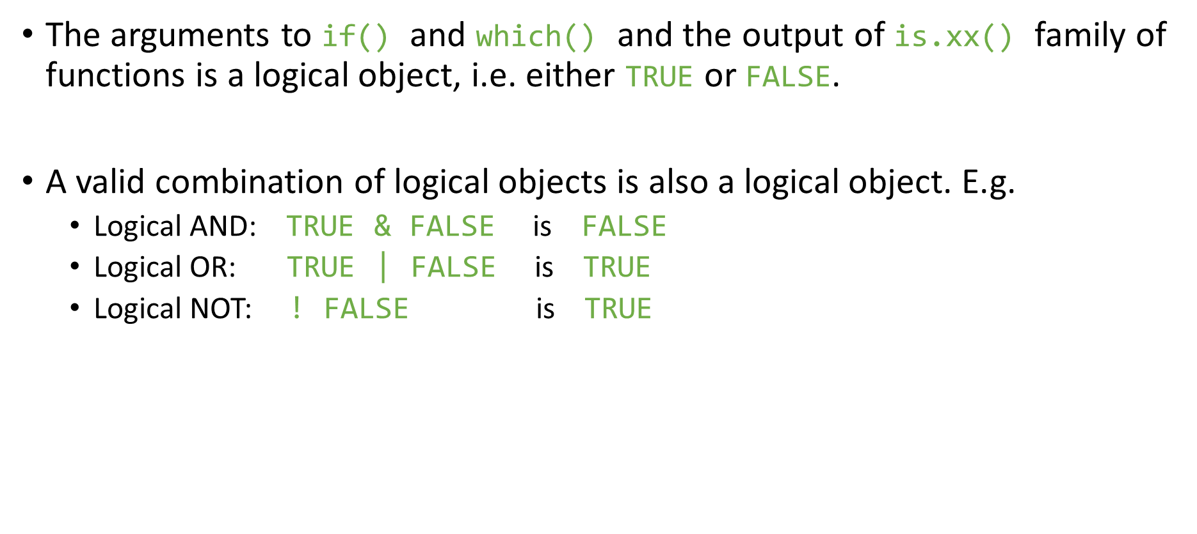
Multiple conditions & which() function
The arguments to if() and which() and the output of is.xx() family of functions is a logical object, i.e. either TRUE or FALSE.
A valid combination of logical objects is also a logical object. E.g.
Logical AND: TRUE & FALSE is FALSE
Logical OR: TRUE | FALSE is TRUE
Logical NOT: ! FALSE is TRUE

Slide 131
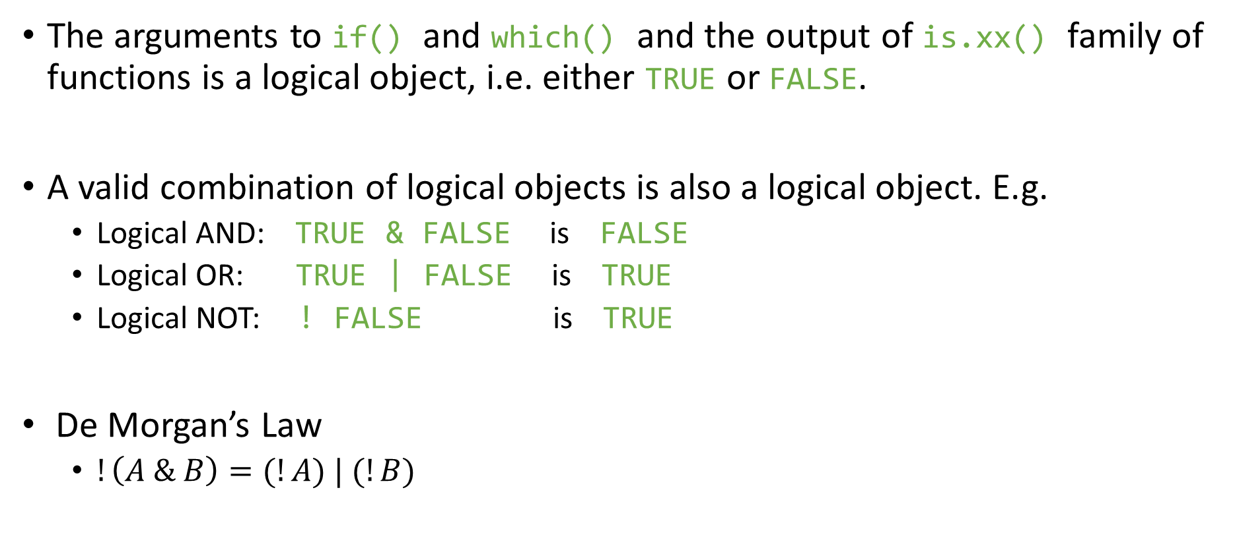
Multiple conditions & which() function
The arguments to if() and which() and the output of is.xx() family of functions is a logical object, i.e. either TRUE or FALSE.
A valid combination of logical objects is also a logical object. E.g.
Logical AND: TRUE & FALSE is FALSE
Logical OR: TRUE | FALSE is TRUE
Logical NOT: ! FALSE is TRUE
De Morgan’s Law
$!\left(A \& B\right)=(!A) | (!B)$

Slide 132
The below two indexes are one and same (by De Morgan Law),
day = as.numeric( substr(nifty$Date, 9, 10) );
OR day = as.numeric( format(df[,1], format = "%d") );
idx_1 = which( nifty$Close > nifty$Open & (day < 5) );
idx_2 = which(!(nifty$Close <= nifty$Open | (day >= 5)) );

Slide 133
The below two indexes are one and same (by De Morgan Law),
day = as.numeric( substr(nifty$Date, 9, 10) );
OR day = as.numeric( format(df[,1], format = "%d") );
idx_1 = which( nifty$Close > nifty$Open & (day < 5) );
idx_2 = which(!(nifty$Close <= nifty$Open | (day >= 5)) );
which() gives the indexes matching the criterion. E.g. out of 101:200 which numbers are multiples of 2,3 and 5 ?
count = 101:200;
which( count %% 2 == 0 & count %% 3 == 0 & count %% 5 == 0 );
count[count %% 2 == 0 & count %% 3 == 0 & count %% 5 == 0];

Slide 134
The below two indexes are one and same (by De Morgan Law),
day = as.numeric( substr(nifty$Date, 9, 10) );
OR day = as.numeric( format(df[,1], format = "%d") );
idx_1 = which( nifty$Close > nifty$Open & (day < 5) );
idx_2 = which(!(nifty$Close <= nifty$Open | (day >= 5)) );
which() gives the indexes matching the criterion. E.g. out of 101:200 which numbers are multiples of 2,3 and 5 ?
count = 101:200;
which( count %% 2 == 0 & count %% 3 == 0 & count %% 5 == 0 );
count[count %% 2 == 0 & count %% 3 == 0 & count %% 5 == 0];
We can do multi-way match using %in%
mult_17 = seq(17,300,17);
which(count %in% mult_17);
which(mult_17 %in% count);
which(!(count %in% mult_17));
which(!(mult_17 %in% count));

Slide 135
Some Useful functions

Slide 136
Some Useful functions
unique(), duplicated()

Slide 137
Some Useful functions
unique(), duplicated()
list.files()
Pattern matching using regex
All files starting from “s”: "^s"
All files starting with “b” or “d”: "^(b|d)“
All CSV files: ".*.csv"

Slide 138
Some Useful functions
unique(), duplicated()
list.files()
Pattern matching using regex
All files starting from “s”: "^s"
All files starting with “b” or “d”: "^(b|d)“
All CSV files: ".*.csv"
order()
Sort data/dataframes
It gives the sequence of ordered indexes NOT the ordered numbers
Can do 2-way and 3-way sorts

Slide 139
Some Useful functions
unique(), duplicated()
list.files()
Pattern matching using regex
All files starting from “s”: "^s"
All files starting with “b” or “d”: "^(b|d)“
All CSV files: ".*.csv"
order()
Sort data/dataframes
It gives the sequence of ordered indexes NOT the ordered numbers
Can do 2-way and 3-way sorts
union(), intersect()

Slide 140
Some Useful functions
unique(), duplicated()
list.files()
Pattern matching using regex
All files starting from “s”: "^s"
All files starting with “b” or “d”: "^(b|d)“
All CSV files: ".*.csv"
order()
Sort data/dataframes
It gives the sequence of ordered indexes NOT the ordered numbers
Can do 2-way and 3-way sorts
union(), intersect()
cumsum(), cumprod()
Can you write your own version of cumprod() using only cumsum() ?

Slide 141
Loop Functions

Slide 142
Loop Functions
Writing loops in a single command. Can come very handy and compact. The function name ends with “apply”.
lapply(), apply(), sapply(), tapply(), mapply()

Slide 143
Loop Functions
Writing loops in a single command. Can come very handy and compact. The function name ends with “apply”.
lapply(), apply(), sapply(), tapply(), mapply()
These functions work on a list of inputs, not just one input!
A data.frame is also a list.
Loop functions (esp. lapply) will be heavily used later!

Slide 144
Loop Functions
Writing loops in a single command. Can come very handy and compact. The function name ends with “apply”.
lapply(), apply(), sapply(), tapply(), mapply()
These functions work on a list of inputs, not just one input!
A data.frame is also a list.
Loop functions (esp. lapply) will be heavily used later!
E.g.
X = list(a = 1:10, b = rnorm(100, 0, 1), c = runif(1e3, 9, 91));
lappy(X, mean); # returns a list
sapply(X, mean); # returns a vector

Slide 145
Loop Functions
Writing loops in a single command. Can come very handy and compact. The function name ends with “apply”.
lapply(), apply(), sapply(), tapply(), mapply()
These functions work on a list of inputs, not just one input!
A data.frame is also a list.
Loop functions (esp. lapply) will be heavily used later!
E.g.
X = list(a = 1:10, b = rnorm(100, 0, 1), c = runif(1e3, 9, 91));
lappy(X, mean); # returns a list
sapply(X, mean); # returns a vector
Let’s say we want to find cor(X,X^i) for i in 1:10 w/o writing a loop?
X = rnorm(1000, 0, 1);
sapply(1:10, function(i) cor(X,X^i));
Here we have used anonymous function, i.e. a function w/o a name.

Slide 146
apply() is mostly used for applying functions on rows or cols of a matrix
Like taking means by rows
M = matrix(1:50, nrow = 10, ncol = 5); # data filled by column (default)
apply(M, 1, mean); # mean of each row (1st dimension)
apply(M, 2, mean); # mean of each col (2nd dimension)
You can do the above using a loop also, but apply() is more compact.
The faster version of above are also available:
rowSums(x) is equivalent to apply(x, 1, sum)
colMeans(x) is equivalent to apply(x, 2, mean)
apply() works with multi-dimensional (> 2) arrays as well

Slide 147
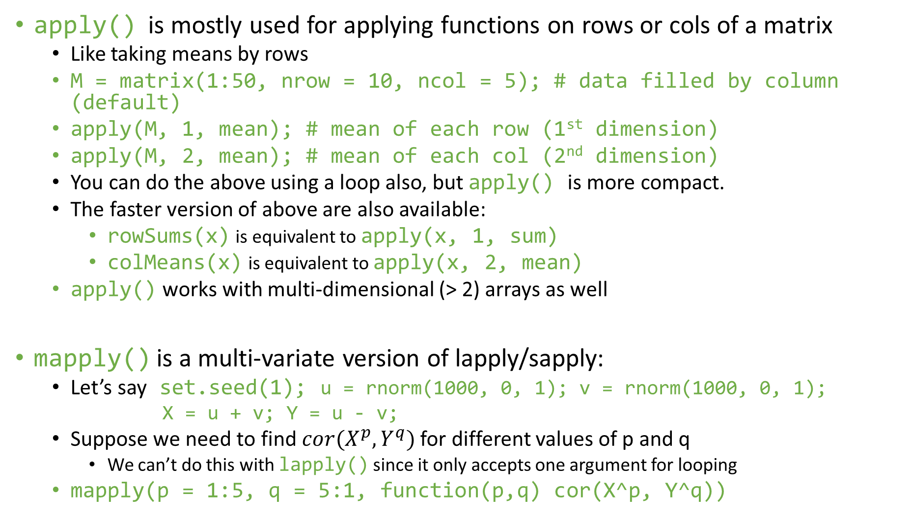
apply() is mostly used for applying functions on rows or cols of a matrix
Like taking means by rows
M = matrix(1:50, nrow = 10, ncol = 5); # data filled by column (default)
apply(M, 1, mean); # mean of each row (1st dimension)
apply(M, 2, mean); # mean of each col (2nd dimension)
You can do the above using a loop also, but apply() is more compact.
The faster version of above are also available:
rowSums(x) is equivalent to apply(x, 1, sum)
colMeans(x) is equivalent to apply(x, 2, mean)
apply() works with multi-dimensional (> 2) arrays as well
mapply() is a multi-variate version of lapply/sapply:
Let’s say set.seed(1); u = rnorm(1000, 0, 1); v = rnorm(1000, 0, 1);
X = u + v; Y = u - v;
Suppose we need to find $cor(X^{p},Y^{q})$ for different values of p and q
We can’t do this with lapply() since it only accepts one argument for looping
mapply(p = 1:5, q = 5:1, function(p,q) cor(X^p, Y^q))

Slide 148
Session - 4

Slide 149
Reflection on Session-3

Slide 150
Module - II
Introduction to data.table R package: syntax, usage and benefits
Merging datasets
Long form and wide form

Slide 151
data.table

Slide 152
data.table
It’s a (very) fast, memory efficient and flexible package to analyse data
I haven’t used data.frame since discovering data.table
Extends data.frame
Most of the data.frame code will work

Slide 153
data.table
It’s a (very) fast, memory efficient and flexible package to analyse data
I haven’t used data.frame since discovering data.table
Extends data.frame
Most of the data.frame code will work
Has a “different” and succinct syntax
May take some time to learn. But the effort is worth the benefits!
Have a look:
https://cran.r-project.org/web/packages/data.table/index.html
github: https://github.com/Rdatatable/data.table

Slide 154
data.table
It’s a (very) fast, memory efficient and flexible package to analyse data
I haven’t used data.frame since discovering data.table
Extends data.frame
Most of the data.frame code will work
Has a “different” and succinct syntax
May take some time to learn. But the effort is worth the benefits!
Have a look:
https://cran.r-project.org/web/packages/data.table/index.html
github: https://github.com/Rdatatable/data.table
Parallelized read and write
Very useful while reading GBs of raw data
Upto 5x – 10x speedup
Speed becomes a big issue when working with huge datasets

Slide 155
Syntax
Column names can be used as variables
dt[Date > “2020-01-01”] is valid.
Remember in data.frame you need dt[dt$Date > “2020-01-01”]
Column names are infact variables inside []
You can do dt[, min(Date)] to get the first date
In data.frame you must supply dt$Date to min externally.
setDT() and setDF()
Grouping within [] syntax
Most of data analysis requires some form of grouping

Slide 156
Syntax: general form
DT[i, j, by]

Slide 157
Syntax: general form
DT[i, j, by]
Which rows?
What to do?
Grouped by what?
vector of rownumbers
logical condition
another data.table
summarizing
updating variable(s)
adding variable(s)
one or more columns
on the fly grouping var(s)

Slide 158
Analogy with SQL (queries)
DT[i, j, by]
data.table: | i | j | by
SQL: | where | select | update | group by

Slide 159
Examples
subset rows
:
airquality[Day <= 10]
select columns
:
airquality[, .(Month)]
airquality dataset is present in package datasets

Slide 160
Examples
subset rows
:
airquality[Day <= 10]
select columns
:
airquality[, .(Month)]
subset rows & select columns :
airquality[Day %between% c(5, 10), .(Wind, Temp)]
airquality dataset is present in package datasets

Slide 161
Counts
syntax: DT[i, j, by]
special symbol: .N
count
iris[Species == "setosa", .N]
count distinct
iris[, uniqueN(Species)]
iris[Petal.Width < 0.9, uniqueN(Species)]

Slide 162
Aggregating
syntax: DT[i, j, by]
Simple aggregation: iris[, .(count = .N, average = mean(Petal.Width))]
Including filtering: iris[Petal.Width < 0.9, .(count = .N, average = mean(Petal.Width))]

Slide 163
Group by
syntax: DT[i, j, by]
iris[, .N, by = Species]
iris[, .(avg = mean(Petal.Width)), by = Species]
iris[Sepal.Length < 5.3, .(avg = mean(Petal.Width)), by = Species]
iris[, .(avg = mean(Petal.Width)), by = .(Species, logi = Sepal.Length < 5.3)]

Slide 164
Group by
special symbol: .SD
SD = Subset of Data
a data.table by itself
holds data of current goup as defined in by
when no by, .SD applies to whole data.table
allows for calculations on multiple columns

Slide 165
Group by
special symbol: .SD
iris[, lapply(.SD, mean), by = Species]
iris[Sepal.Length < 5.3, lapply(.SD, mean), by = Species]

Slide 166
Group by
special symbol: .SD
special symbol: .SDcols
iris[, lapply(.SD, mean), by = Species, .SDcols = 1:2]
iris[, lapply(.SD, mean), by = Species, .SDcols = grep("Length", names(iris))]

Slide 167
Examples
syntax: DT[i, j, by]
Count the number of days per month
airquality[, .N, by = Month]

Slide 168
Examples
syntax: DT[i, j, by]
Count the number of days per month
Calculate the average Wind speed by month for only those days that have an ozone value
airquality[, .N, by = Month]
airquality[!is.na(Ozone), mean(Wind), by = Month]

Slide 169
Examples
syntax: DT[i, j, by]
Count the number of days per month
Calculate the average Wind speed by month for only those days that have an ozone value
Calculate the mean temperature for the odd and even days for each month
airquality[, .N, by = Month]
airquality[!is.na(Ozone), mean(Wind), by = Month]
airquality[, mean(Temp)
, by = .(Month, odd = Day %% 2)]

Slide 170
Updating, adding & deleting variables
special operator: :=
updates a data.table in place (by reference)
can be used to:
update existing column(s)
add new column(s)
delete column(s)
you don’t need <- OR =

Slide 171
Updating variables
special operator: :=
iris[, Sepal.Length := Sepal.Length * 2]
iris[, `:=` (Sepal.Length = Sepal.Length * 2, Petal.Width = Petal.Width / 2)]

Slide 172
Updating variables by group
special operator: :=
iris[, Sepal.Length := Sepal.Length * uniqueN(Sepal.Width) / .N, by = Species]
iris[, `:=` (Sepal.Length = Sepal.Length * uniqueN(Sepal.Width), Petal.Width = Petal.Width / .N)
, by = Species]

Slide 173
Adding variables
special operator: :=
special symbol: .I
iris[, rownumber := .I]
iris[, Sepal.Area := Sepal.Length * Sepal.Width]
iris[, `:=` (Sepal.Area = Sepal.Length * Sepal.Width, Petal.Area = Petal.Length * Petal.Width)]

Slide 174
Adding variables by group
special operator: :=
iris[, Total.Sepal.Area := sum(Sepal.Area), by = Species]
iris[, `:=` (Total.Sepal.Area = sum(Sepal.Area), Total.Petal.Area = sum(Petal.Area))
, by = Species]

Slide 175
Deleting variables
special operator: :=
iris[, Sepal.Length := NULL]
iris[, (1:4) := NULL]
iris[, grep("Length", names(irisDT)) := NULL]

Slide 176
Examples
Change the Wind column from miles per hour to kilometers per hour (1 mph = 1.6 kmh)
airquality[, Wind := Wind * 1.6]

Slide 177
Examples
Change the Wind column from miles per hour to kilometers per hour (1 mph = 1.6 kmh)
Calculate a new chill variable (Wind * Temperature)
airquality[, Wind := Wind * 1.6]
airquality[, chill := Wind * Temp]

Slide 178
Examples
Change the Wind column from miles per hour to kilometers per hour (1 mph = 1.6 kmh)
Calculate a new chill variable (Wind * Temperature)
Calculate the average chill by month and add that as a new variable
airquality[, Wind := Wind * 1.6]
airquality[, chill := Wind * Temp]
airquality[, mean.chill := mean(chill) , by = Month]

Slide 179
Examples
Change the Wind column from miles per hour to kilometers per hour (1 mph = 1.6 kmh)
Calculate a new chill variable (Wind * Temperature)
Calculate the average chill by month and add that as a new variable
Remove the Ozone and Solar.R columns
airquality[, Wind := Wind * 1.6]
airquality[, chill := Wind * Temp]
airquality[, mean.chill := mean(chill) , by = Month]
airquality[, c("Ozone ", "Solar.R ") := NULL] airquality[, (1:2) := NULL]

Slide 180
Merging

Slide 181
Merging
Combining two datasets is a very routine and important task
Merging is akin to Joining (in relational database, SQL etc)

Slide 182
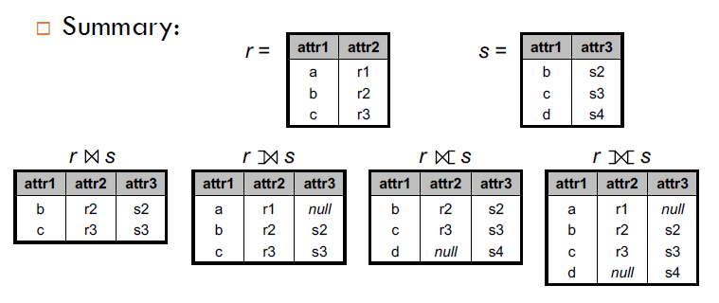
Merging
Combining two datasets is a very routine and important task
Merging is akin to Joining (in relational database, SQL etc)

Slide 183
Merging Example

Slide 184
Merging Example
Taken from Stackoverflow webpage
Create two datasets:
df1 = data.frame(cust_id = c(1:6), Product = c(rep("Toaster", 3), rep("Radio", 3)));
df2 = data.frame(cust_id = c(2, 4, 6), State = c(rep("Alabama", 2), rep("Ohio", 1)));
dt1 = as.data.table(df1); dt2 = as.data.table(df2);

Slide 185
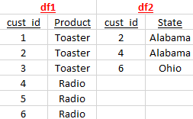
Merging Example
Taken from Stackoverflow webpage
Create two datasets:
df1 = data.frame(cust_id = c(1:6), Product = c(rep("Toaster", 3), rep("Radio", 3)));
df2 = data.frame(cust_id = c(2, 4, 6), State = c(rep("Alabama", 2), rep("Ohio", 1)));
dt1 = as.data.table(df1); dt2 = as.data.table(df2);

Slide 186
Merging Example
Taken from Stackoverflow webpage
Create two datasets:
df1 = data.frame(cust_id = c(1:6), Product = c(rep("Toaster", 3), rep("Radio", 3)));
df2 = data.frame(cust_id = c(2, 4, 6), State = c(rep("Alabama", 2), rep("Ohio", 1)));
dt1 = as.data.table(df1); dt2 = as.data.table(df2);
We can merge using merge() command on data.table OR we can use a new package dplyr
The function merge() works differently for data.frames and data.tables. It’s very slow on DFs and extremely fast on DTs
data.table class overrides its own implementation of merge for DTs

Slide 187

Inner Join
merge(dt1, dt2, by = "cust_id");
dplyr::inner_join(df1, df2);

Slide 188
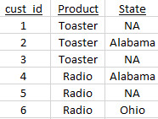
Inner Join
Full Join
merge(dt1, dt2, by = "cust_id");
dplyr::inner_join(df1, df2);
merge(dt1, dt2, by = "cust_id", all = T);
dplyr::full_join(df1, df2);

Slide 189
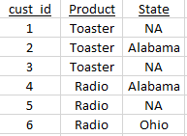
Left Join
merge(dt1, dt2, by = "cust_id", all.x = T);
dplyr::left_join(df1, df2);

Slide 190
Left Join
Right Join
merge(dt1, dt2, by = "cust_id", all.x = T);
dplyr::left_join(df1, df2);
merge(dt1, dt2, by = "cust_id", all.y = T);
dplyr::right_join(df1, df2);

Slide 191
Cartesian Product
Every row of df1 multiplied with every row of df2

Slide 192
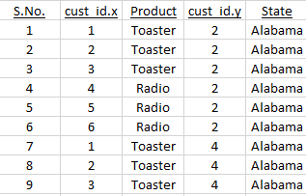
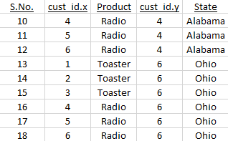
Cartesian Product
Every row of df1 multiplied with every row of df2
cart_prod = dt1[, as.list(dt2), by = "cust_id"];
cart_prd = merge(df1, df2, by = NULL);

Slide 193
Cartesian products are extremely slow. Never do that even on a decent sized (> 1e4 rows) dataset. Your computer will probably hang.
Although there is no use of Cartesian products, it encapsulates all types of merges. Meaning we can extract any type of merge from a Cartesian product.
Inner join can be extracted via
idx = which(cart_prd$cust_id.x == cart_prd$cust_id.y);
cart_prd[idx,];

Slide 194
Session - 5

Slide 195
Reflection on Session-4

Slide 196
Merging with more than one variable
Most of the merging usage is with two variables: date and company name.

Slide 197
Merging with more than one variable
Most of the merging usage is with two variables: date and company name. Generate data using below:
date = seq.Date(as.Date("2018-01-01"), by = 1, length.out = 5);
comp = c("A", "B", "C", "D", "E");
all_pairs = merge(comp, date, by = NULL);
# sales data - 15 points set.seed(1);
idx = sample(1:nrow(all_pairs), 15, replace = F);
df1 = data.frame(comp = all_pairs$x[idx], date = all_pairs$y[idx],
sales = round(runif(15, min = 1e3, max = 1e5)));
# advertising data - 12 points
idx = sample(1:nrow(all_pairs), 12, replace = F);
df2 = data.frame(comp = all_pairs$x[idx], date = all_pairs$y[idx],
adv = round(runif(12, min = 1e2, max = 1e4)));

Slide 198
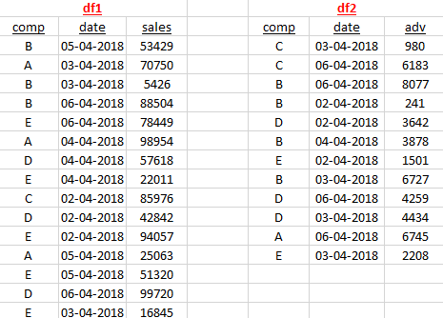

Slide 199
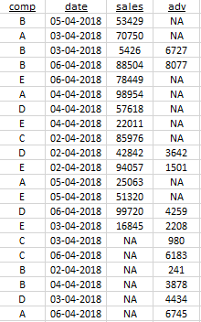
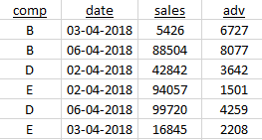
Inner Join
Full Join
merge(df1, df2, by = c(" comp", "date"), all = T)
merge(df1, df2, by = c(" comp", "date"))

Slide 200
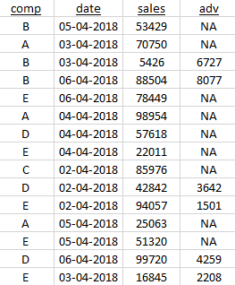
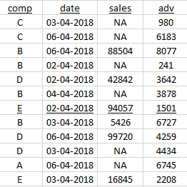
Left Join
Right Join
merge(df1, df2, by = c(" comp", "date"), all.x = T)
merge(df1, df2, by = c(" comp", "date"), all.y = T)

Slide 201
Anti Join
Sometimes, we wish to find observations in df1 that are not in df2
setkey(df1, comp, date); setkey(df2, comp, date);
df1[!df2] is anti-join.
df2[!df1] is also anti-join (but the other way round)
df1[df2] is the observations in df1 that are also in df2. This is same as merge(df1, df2, all.y = T); # right-join
df2[df1] is left-join. df1[df2, nomatch = 0] is inner-join.
There is no short-hand for full outer join and Cartesian product.
We can’t do anti-join using merge() commands.

Slide 202
Rolling Join
What if the sales data in df1 arrives on or after the advertising data.
We would then like to match sales date to any advertising date that happened on or before sales date
Such kind of tasks could be very complicated to using loops and if-else
data.table provides rolling joins
names(df1)[2] = "sales_date"; names(df2)[2] = "adv_date";
setkey(df1, comp, sales_date); setkey(df2, comp, adv_date);
You can still do df1[df2], df1[!df2],... to get left, right, anti and inner joins
While joining, sales_date of df1 will be merged with adv_date of df2

Slide 203
df1[df2] looks up df1 using df2, i.e. lookup df1[, .(comp, sales_date)] using df2[, .(comp, adv_date)].
This is similar to merge(df1, df2, by.x = c("comp", "sales_date"), by.y = c("comp", "adv_date"), all.y = T)
df1[df2, roll = Inf] will still lookup df1 using df2, but with a caveat. The last join column (2nd key) of df2 (adv_date) is rolled back to infinity until a match with the last join column (2nd key) of df1 (sales_date).
All other keys (except the last key) are matched exactly
df2[df1, roll = Inf] gives the desired match, i.e. matching advertising (df2) today with sales (df1) in future
df1[df2, roll = -Inf] will match sales (df1) today with advertising (df2) in past
df2[df1, roll = 1] will only look for 1 future sales date and stop looking
df2[df1, roll = "nearest“] matches the nearest match
Match advertising today with the most near sales data. Near can be past or future!
Be cautious and verify your results when using rolling joins

Slide 204
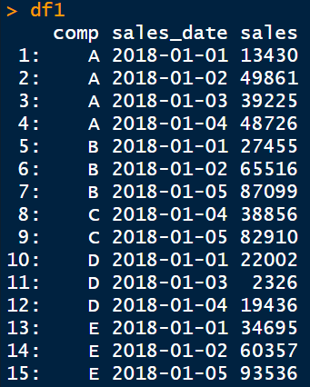
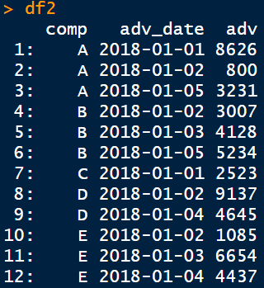
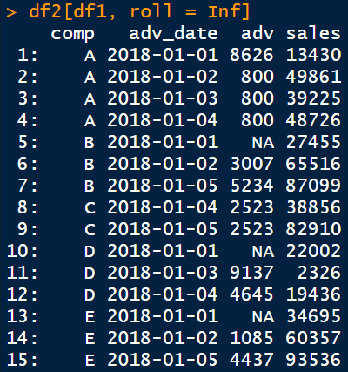
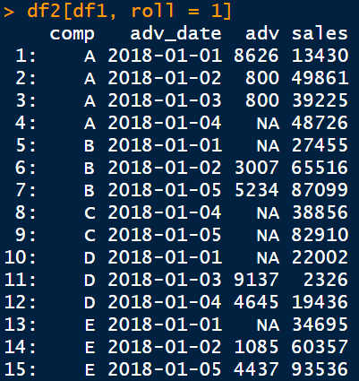
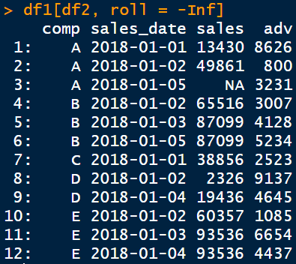
← Input tables
Output tables →

Slide 205
Reshaping (long to wide and vice-versa)
Example data (long form):
dt = fread("long_form_returns.csv", na.strings = "");
Four columns: cusip, Date, retadj, industry
Suppose, we want each firm (cusip) in a separate column
wide.ret = dcast(dt, Date + industry ~ cusip, value.var = "retadj");
The wide-form variable comes after ~
Long-form variables comes before ~
Finally, we want “returns” as the value of wide-from format
How do we get the long form back from wide.ret?
dt.org = melt(wide.ret,
id.vars = c("Date", "industry"),
measure.vars = 3:ncol(wide.ret),
variable.name = "cusip", value.name = "retadj",
variable.factor = F, na.rm = T);

Slide 206
Wide-form data has only one “value” variable:
Rows are dates and columns are company names and the matrix inside is returns. It’s very difficult to get more than one variable.
Try: dt[, ret2 := retadj];
dcast(dt, Date + industry ~ cusip, value.var = c("retadj", “ret2"));
The column names take the form: retadj_<cusip> and ret2_<cusip>
N cusips, D dates and M other variables (like retadj, ret2 etc)
long-form: N*D rows of M variables
wide-form: D rows of N*M variables
If there are multiple matches in converting to wide-form
We can aggregate data using any function like sum, mean, …
wide.ret = dcast(dt, Date ~ industry, value.var = "retadj", fun.aggregate = mean, na.rm = T);
This step is irreversible in the sense that we can’t get back original data
Most of the data will be in long-form but you should know how to quickly convert wide-form to long-form.
World bank provides data in wide-form

Slide 207
Session - 6

Slide 208
Reflection on Session-5

Slide 209
Module – III
Mini Project
Study of NASA climate data
data.table one-liners
Introduction to Data Analysis
Steps in a Data analysis project
Nuances: missing values, repeating data and extremes
Plotting in R
legends, colors, line types, …
Multiple lines, multiple axes, multiple plots
Regression Basics
meaning of significance and R2
Introduction to felm package
Fixed effects, error clustering

Slide 210
Session - 7

Slide 211
Reflection on Session-6

Slide 212
Data Analysis

Slide 213
Data Analysis
Wikipedia:
Data analysis is a process of inspecting, cleansing, transforming, and modeling data with the goal of discovering useful information, informing conclusions, and supporting decision-making.

Slide 214
Data Analysis
Wikipedia:
Data analysis is a process of inspecting, cleansing, transforming, and modeling data with the goal of discovering useful information, informing conclusions, and supporting decision-making.
Key Distinctions:
We are not supremely interested in data collection, organization and storage tasks. Although these are important in any project!
Data analysis is also NOT equivalent to data science. We are chiefly interested in testing our hypothesis from the dataset.

Slide 215
Key Steps in a Data Analysis Project

Slide 216
Key Steps in a Data Analysis Project
Collecting data
Tabular, qualitative, unstructured
Derive quantitative measures from qualitative/unstructured data

Slide 217
Key Steps in a Data Analysis Project
Collecting data
Tabular, qualitative, unstructured
Derive quantitative measures from qualitative/unstructured data
Cleaning and filtering
Missing data / extra data / extreme values
Different frequencies

Slide 218
Key Steps in a Data Analysis Project
Collecting data
Tabular, qualitative, unstructured
Derive quantitative measures from qualitative/unstructured data
Cleaning and filtering
Missing data / extra data / extreme values
Different frequencies
Combining Data
Merging from different sources
Deriving variables from multiple sources

Slide 219
Key Steps in a Data Analysis Project
Collecting data
Tabular, qualitative, unstructured
Derive quantitative measures from qualitative/unstructured data
Cleaning and filtering
Missing data / extra data / extreme values
Different frequencies
Combining Data
Merging from different sources
Deriving variables from multiple sources
Exploration
Plots, trends, summaries and correlations

Slide 220
Key Steps in a Data Analysis Project
Collecting data
Tabular, qualitative, unstructured
Derive quantitative measures from qualitative/unstructured data
Cleaning and filtering
Missing data / extra data / extreme values
Different frequencies
Combining Data
Merging from different sources
Deriving variables from multiple sources
Exploration
Plots, trends, summaries and correlations
Model Validation
Regression, out of sample tests, robustness analysis

Slide 221
Data Collection
Different types of data

Slide 222
Data Collection
Different types of data
Tabular data
Conventional and most common format
Usually fetched from popular data sources (prowess/world-bank), regulatory bodies (SEC/RBI), government websites or proprietary sources (firm’s internal data)

Slide 223
Data Collection
Different types of data
Tabular data
Conventional and most common format
Usually fetched from popular data sources (prowess/world-bank), regulatory bodies (SEC/RBI), government websites or proprietary sources (firm’s internal data)
Textual data
Getting increasingly important in Social sciences research
Tweets/News/Blogs/10-K reports

Slide 224
Data Collection
Different types of data
Tabular data
Conventional and most common format
Usually fetched from popular data sources (prowess/world-bank), regulatory bodies (SEC/RBI), government websites or proprietary sources (firm’s internal data)
Textual data
Getting increasingly important in Social sciences research
Tweets/News/Blogs/10-K reports
Graphical data
User network (facebook)
Map of suppliers and customers (Samsung → apple → facebook)

Slide 225
Textual Data

Slide 226
Textual Data
Not all text is same
Annual reports, tweets and blogs all use different lingo and can’t be compared or assessed uniformly
Each source of text will have it’s own dictionary

Slide 227
Textual Data
Not all text is same
Annual reports, tweets and blogs all use different lingo and can’t be compared or assessed uniformly
Each source of text will have it’s own dictionary
Bag of words
Count the number of positive, negative, hateful, pessimistic, … words
May wanna look at more than one word at a time
Better efficiency (‘good’ vs ‘so good’ vs ‘not so good’)
Dictionary will explode (most n-words will have 0 frequency)

Slide 228
Textual Data
Not all text is same
Annual reports, tweets and blogs all use different lingo and can’t be compared or assessed uniformly
Each source of text will have it’s own dictionary
Bag of words
Count the number of positive, negative, hateful, pessimistic, … words
May wanna look at more than one word at a time
Better efficiency (‘good’ vs ‘so good’ vs ‘not so good’)
Dictionary will explode (most n-words will have 0 frequency)
Natural Language Processing (realm of data science)
Checkout the Stanford YouTube course if interested

Slide 229
Tabular Data

Slide 230
Tabular Data
The focus of data analysis is on deriving value from data. Tabular data requires minimal efforts in deriving variables of interest.

Slide 231
Tabular Data
The focus of data analysis is on deriving value from data. Tabular data requires minimal efforts in deriving variables of interest.
Dimensions
Cross-section
Gold-standard for econometric analysis and causal inference
Cross-correlation, endogeneity.
Time-series
Auto-correlation, confounding effects
Panel (both time and firm variation)
Best of both worlds, difference-in-difference
Multi-dimensional (year, company, analyst)
Latest research is increasingly using bigger datasets

Slide 232
Data getting bigger!

Slide 233
Data getting bigger!
Finance datasets tend to be notoriously huge
Other fields are catching up
Mostly with non-tabular data
Stock market data is almost always used in all research fields
No other setting provides a dynamic, efficient and fast (informationally) source of data

Slide 234
Data getting bigger!
Finance datasets tend to be notoriously huge
Other fields are catching up
Mostly with non-tabular data
Stock market data is almost always used in all research fields
No other setting provides a dynamic, efficient and fast (informationally) source of data
Things to consider
Can you store your dataset in RAM?
Will your program run in “reasonable” amount of time?
Parallel computing?

Slide 235
Data getting bigger!
Finance datasets tend to be notoriously huge
Other fields are catching up
Mostly with non-tabular data
Stock market data is almost always used in all research fields
No other setting provides a dynamic, efficient and fast (informationally) source of data
Things to consider
Can you store your dataset in RAM?
Will your program run in “reasonable” amount of time?
Parallel computing?
Good programming practices and knowledge of space/time complexity will help to overcome issues with big data
Although at some point you may need to invest in hardware/cloud-computing

Slide 236
Cleaning Data

Slide 237
Cleaning Data
Real-world data is full of holes
Simply deleting all missing observations will leave your analysis craving power
Some data is only updated very infrequently (like ratings)
The sensible thing is to carry forward the ratings (indefinitely or up to some period)

Slide 238
Cleaning Data
Real-world data is full of holes
Simply deleting all missing observations will leave your analysis craving power
Some data is only updated very infrequently (like ratings)
The sensible thing is to carry forward the ratings (indefinitely or up to some period)
Extra Data
What if there are multiple observations for a firm and year pair?
Knowledge of the subject helps to understand and take a decision
For restated earnings, take the most recent number
In case of analyst recommendations, take the average/median
In case of bad news (rating downgrade), take the first item as most meaningful

Slide 239
Data with different frequencies?
Data from multiple sources rarely comes in same time durations
For instance how would you make sense of inflation (monthly) and GDP (quarterly/annual)?
use the most recent inflation OR carry-forward the GDP OR assume some process of interpolating GDP to monthly series
Quarterly earnings and daily stock trading?
Are you trying to learn about earnings quality OR are you trying to understand effect of earnings on returns?
The research question should guide you in choosing your method of mis-matching frequencies.
Twitter reaction to a new product launch and annual sales numbers?
Lots of tweets during launch (also maybe during sales). No need to match frequencies if the goal is to understand whether twitter reaction predicts sales.

Slide 240
Merging Datasets

Slide 241
Merging Datasets
Each datasets has their own key (or id) variables
CRSP (US stock prices) uses company id (permno) and date
Compustat (US company financials) uses (gvkey) and fiscal/announcement date
IBES (analyst forecasts) uses (ticker) and forecast date
Macroeconomic data (like GDP, inflation, employment etc) will only have year and quarter/month information
Twitter data will give userd_id (twitter handle) and time of tweet

Slide 242
Merging Datasets
Each datasets has their own key (or id) variables
CRSP (US stock prices) uses company id (permno) and date
Compustat (US company financials) uses (gvkey) and fiscal/announcement date
IBES (analyst forecasts) uses (ticker) and forecast date
Macroeconomic data (like GDP, inflation, employment etc) will only have year and quarter/month information
Twitter data will give userd_id (twitter handle) and time of tweet
In most cases there will be a cross-sectional identifier (like company name, ticker, key) and a time-series identifier (like quarter, date or timestamp)

Slide 243
There may be some rules (research practice) of how to merge
For instance, a company operating in 2014 will (hopefully) release its results by March 2015.
After the announcement of results, stock prices would reflect the new information
Hence, it makes sense to use the 2014 fiscal year data in stock prices from April 2015 till the next year’s (2015) announcement (again hopefully in March 2016)
Finance journals typically merge 2014 data from July 2015 onwards!

Slide 244
There may be some rules (research practice) of how to merge
For instance, a company operating in 2014 will (hopefully) release its results by March 2015.
After the announcement of results, stock prices would reflect the new information
Hence, it makes sense to use the 2014 fiscal year data in stock prices from April 2015 till the next year’s (2015) announcement (again hopefully in March 2016)
Finance journals typically merge 2014 data from July 2015 onwards!
Tweets and product launch
Twitter will be most active in a short window around product launch (a new iPhone!)
Capture tweets around a [-2,7] day window of each launch
What of iPhone-12 and S-12 are launched in the same week?
This will complicate things and create possibilities for asking better questions!

Slide 245
Case in Point: Book-to-Market Ratio
Very popular way to identify undervalued stocks (Warren Buffet). Also used to identify tech firms (TSLA has a BTM of 0.025)

Slide 246
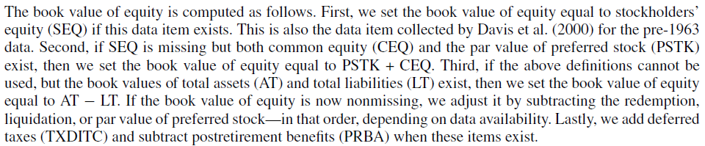
Case in Point: Book-to-Market Ratio
Very popular way to identify undervalued stocks (Warren Buffet). Also used to identify tech firms (TSLA has a BTM of 0.025)

Slide 247
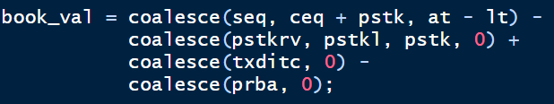
Case in Point: Book-to-Market Ratio
Very popular way to identify undervalued stocks (Warren Buffet). Also used to identify tech firms (TSLA has a BTM of 0.025)

Slide 248
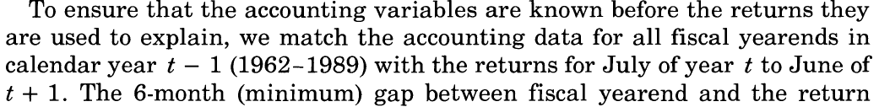

Slide 249
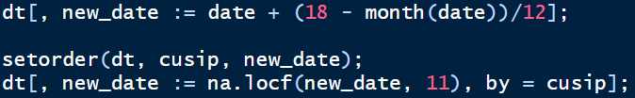

Slide 250
Deleting all missing entries to book_val components would give very few data points.
But you may want to delete negative book values (what does that even mean?)
Accounting data from past is merged onto stock data of future
Lower frequency accounting data is carried forward 11 months

Slide 251
Exploratory Analysis

Slide 252
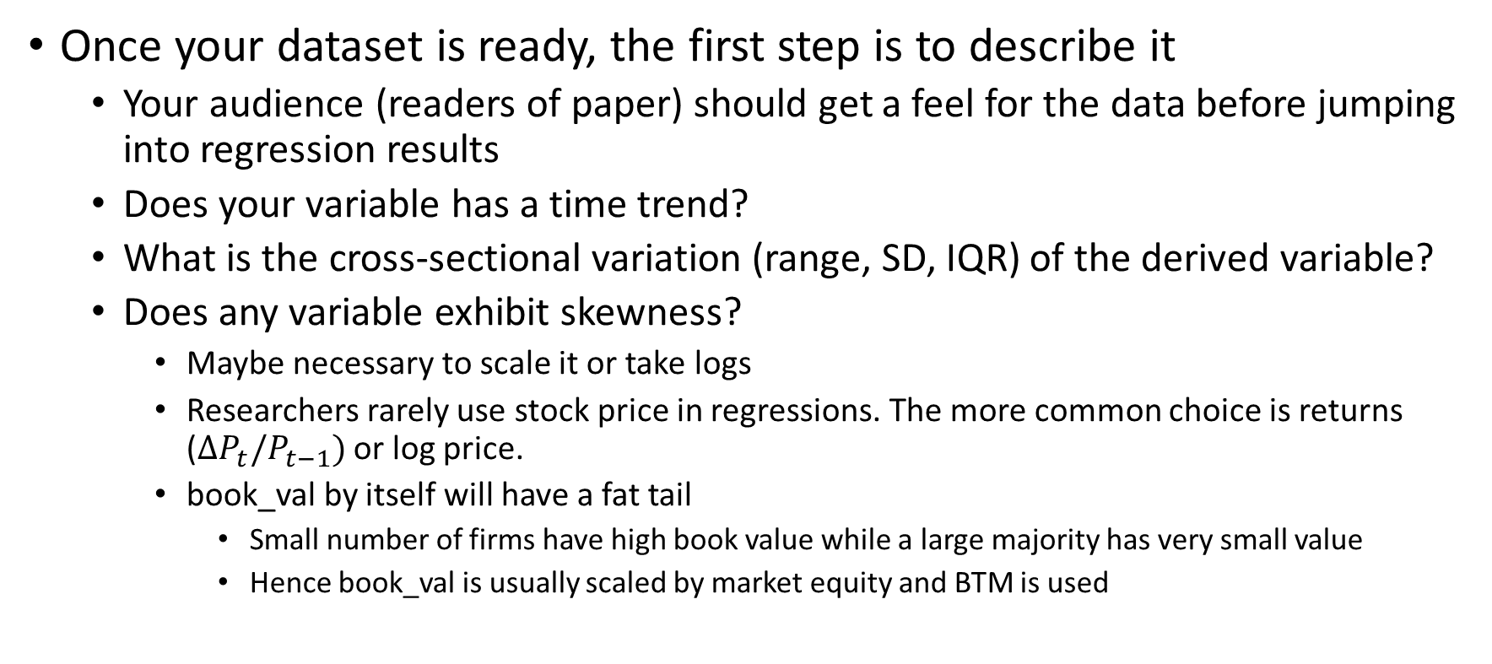
Exploratory Analysis
Once your dataset is ready, the first step is to describe it
Your audience (readers of paper) should get a feel for the data before jumping into regression results
Does your variable has a time trend?
What is the cross-sectional variation (range, SD, IQR) of the derived variable?
Does any variable exhibit skewness?
Maybe necessary to scale it or take logs
Researchers rarely use stock price in regressions. The more common choice is returns ($ΔP_{t}/P_{t−1})$ or log price.
book_val by itself will have a fat tail
Small number of firms have high book value while a large majority has very small value
Hence book_val is usually scaled by market equity and BTM is used

Slide 253
Correlations

Slide 254
Correlations
Every paper has a table of correlations.
This is usually overlooked (by readers) but contains wealth of information
Captures the degree of co-movement between variables
Invariant to scaling

Slide 255
Correlations
Every paper has a table of correlations.
This is usually overlooked (by readers) but contains wealth of information
Captures the degree of co-movement between variables
Invariant to scaling
How does different variables relate to each other?
Before running a regression, its important to ask whether the variables of interest are even related?
Are there pairs of variables which are heavily correlated?
First evidence of multi-collinearity. If present regression coefficients will be unstable.

Slide 256
How would you find correlations in panel data (with variables having time-trend)?
Like stock price and book value of companies
Both will grow over time
One-shot correlation will pick the time-trend rather than economic relation

Slide 257
How would you find correlations in panel data (with variables having time-trend)?
Like stock price and book value of companies
Both will grow over time
One-shot correlation will pick the time-trend rather than economic relation
Solution
De-trend variables
Report a series of cross-section correlation (one for each period)
This will give a time-series of correlation
But what about outliers?
Some firms have very small book value and huge stock price (TSLA). Others have opposite (Boeing?)
This is due to the fact that book value is a snapshot of past while price is an expectation of future.
Report correlations of ranks rather than variables (spearman rank correlation)
More and more papers nowadays report their analysis using ranks

Slide 258
How about correlating tweets? How would you find two closest tweets from a set of million tweets?
Correlation is only defined for quantitative data. Thus, we can only capture correlation between some quantitative measure of tweets (like sentiment, word count, number of emojis etc)
Some NLP tools can find distance between words (wrod2vec)
NLP is exciting but out of the scope of data analysis
Possible approach:
Assign a vector to each tweet where the vector comprises of:
Tweets with same hashtag
Tweets with same company tag ($AAPL)
Tweet’s timestamp, country of origin, …
Number of words in tweets, number of characters of longest word, …
Then compare tweets using distance between vectors
More features will improve the accuracy
One more: number of misspelled words

Slide 259
Regression

Slide 260
Regression
Core of any empirical social sciences paper

Slide 261
Regression
Core of any empirical social sciences paper
The best case is to find causal effects
Identification is very hard. Endogeneity spoils the party!
Omitted variable, simultaneous relations, reverse causality
Domain knowledge, institutional details and natural shocks can save the day.
Read “Mostly Harmless Econometrics” for more insight!
“Mastering Metrics” for a less technical approach

Slide 262
Regression
Core of any empirical social sciences paper
The best case is to find causal effects
Identification is very hard. Endogeneity spoils the party!
Omitted variable, simultaneous relations, reverse causality
Domain knowledge, institutional details and natural shocks can save the day.
Read “Mostly Harmless Econometrics” for more insight!
“Mastering Metrics” for a less technical approach
Need to challenge every OLS assumption in your paper
And provide supporting arguments, tests, corrections, robustness checks etc to counter that
Are errors homoscedastic? Correlated? Clustered?
Are regressors exogenous? Linearly independent?

Slide 263
Different types of regressions

Slide 264
Different types of regressions
Time-series and cross-sectional regressions
We do not do a lot of time-series regressions because of several problems
Co-integration (confounding effects)
Autocorrelation, non-stationarities

Slide 265
Different types of regressions
Time-series and cross-sectional regressions
We do not do a lot of time-series regressions because of several problems
Co-integration (confounding effects)
Autocorrelation, non-stationarities
OLS vs GLS
If residuals (errors) are correlated then we can do better than OLS
GLS imposes some structural form on errors to counter heteroscedasticity

Slide 266
Different types of regressions
Time-series and cross-sectional regressions
We do not do a lot of time-series regressions because of several problems
Co-integration (confounding effects)
Autocorrelation, non-stationarities
OLS vs GLS
If residuals (errors) are correlated then we can do better than OLS
GLS imposes some structural form on errors to counter heteroscedasticity
Fixed Effects
Very common in literature
A panel regression usually includes both firm level and time level FE
So that firm level (and time level) idiosyncrasies do not drive main results
Irrespective of operational performance, almost all firms’ stocks did poorly in 2008 (and early 2020).

Slide 267
Session - 8

Slide 268
Reflection on Session-7

Slide 269
Plotting in R

Slide 270
Plotting in R
plot(x, y, <OPTIONS>);
plot(nifty$Date, nifty$Close);

Slide 271
Plotting in R
plot(x, y, <OPTIONS>);
plot(nifty$Date, nifty$Close);
The below are equivalent to the plot command above:
plot(Date, Close, data = nifty);
nifty[, plot(Date, Close)]; # only if nifty is a DT

Slide 272
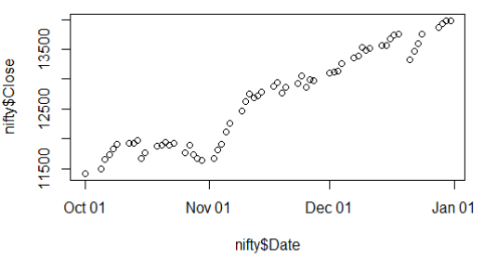
Plotting in R
plot(x, y, <OPTIONS>);
plot(nifty$Date, nifty$Close);
The below are equivalent to the plot command above:
plot(Date, Close, data = nifty);
nifty[, plot(Date, Close)]; # only if nifty is a DT

Slide 273
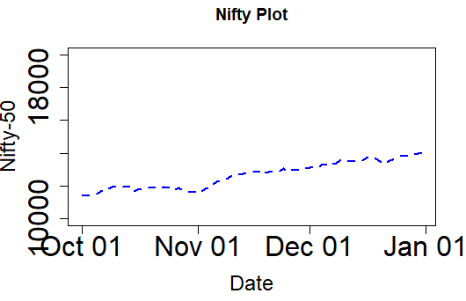
Plotting Options
plot(nifty$Date, nifty$Close,
type = 'l',
col = "blue",
lty = 2,
lwd = 2,
xlab = "Date",
ylab = "Nifty-50",
main = "Nifty Plot",
cex.axis = 2,
cex.lab = 1.5,
ylim = c(1e4, 2e4));

Slide 274
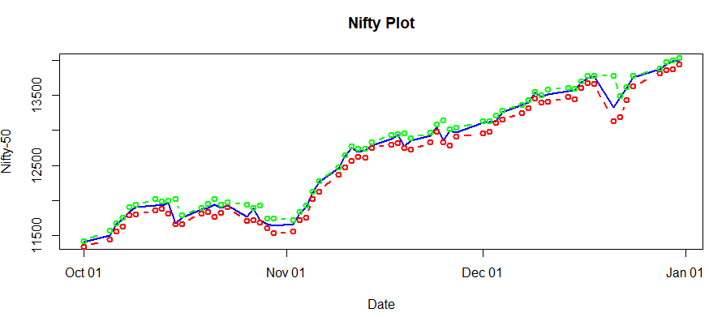
Multiple Lines
plot(nifty$Date, nifty$Close, type = 'l', col = "blue", lty = 1, lwd = 2, xlab = "Date", ylab = "Nifty-50", main = "Nifty Plot");
lines(nifty$Date, nifty$Low, type = 'b', col = "red", lty = 2, lwd = 2);
lines(nifty$Date, nifty$High, type = 'b', col = "green", lty = 2, lwd = 2);

Slide 275
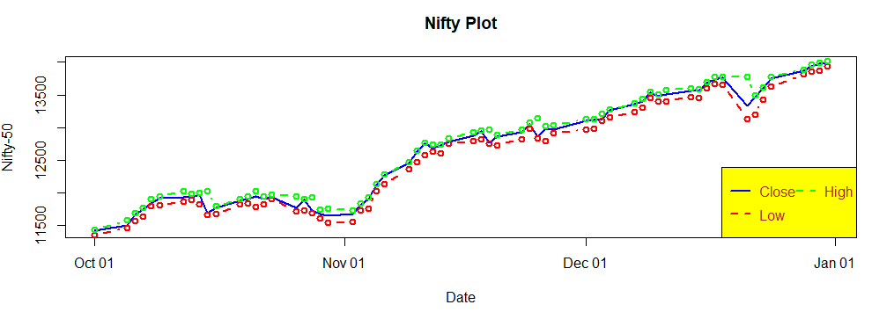
Legend
legend("bottomright", legend = c("Close", "Low", "High"),
col = c("blue", "red", "green"),
lty = c(1,2,2), lwd = 2,
bg = "yellow", text.col = "brown", ncol = 2)

Slide 276
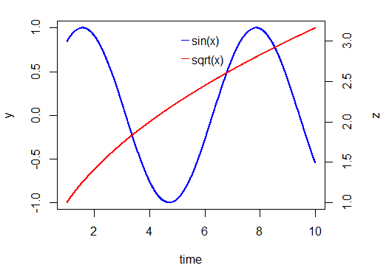
Multiple Axes
x = seq(1, 10, length.out = 1e3);
y = sin(x);
z = sqrt(x);
org_mar = par("mar");
par(mar = c(5,5,2,5)) # for extra margin on right y-axis
plot(x, y, type = "l", col = "blue", lwd = 2, xlab = "time", ylab = "y");
par(new = TRUE);
plot(x, z, type = "l", col = "red", lwd = 2, xlab = NA, ylab = NA, axes = F);
axis(4); # makes axis on RHS
mtext(side = 4, line = 3, "z"); # RHS text
legend("top", legend = c("sin(x)", "sqrt(x)"), lty = 1, col = c("blue", "red"), lwd = 2, bg = NULL);
par(mar = org_mar);

Slide 277
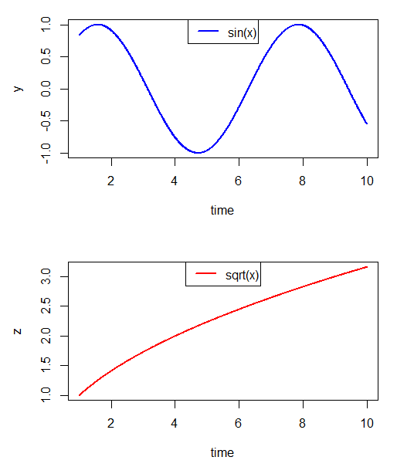
Multiple Plots
x = seq(1, 10, length.out = 1e3);
y = sin(x);
z = sqrt(x);
org_mfrow = par("mfrow");
par(mfrow = c(2,1));
plot(x, y, type = "l", col = "blue", lwd = 2, xlab = "time", ylab = "y");
legend("top", legend = c("sin(x)"), lty = 1, col = c("blue"), lwd = 2);
plot(x, z, type = "l", col = "red", lwd = 2, xlab = "time", ylab = "z");
legend("top", legend = c("sqrt(x)"), lty = 1, col = c("red"), lwd = 2);
par(mfrow = org_mfrow);

Slide 278
Regression Basics

Slide 279

Regression Basics
Let, $Y=β_{0}+β_{1}⋅X+u$ be the true model. By regressing $Y$ on $X$, we hope to recover an unbiased estimate of $β_{1}$ and see how much of the variation in $Y$ is explained by variation in $X$ unrelated to variation in $u$.

Slide 280
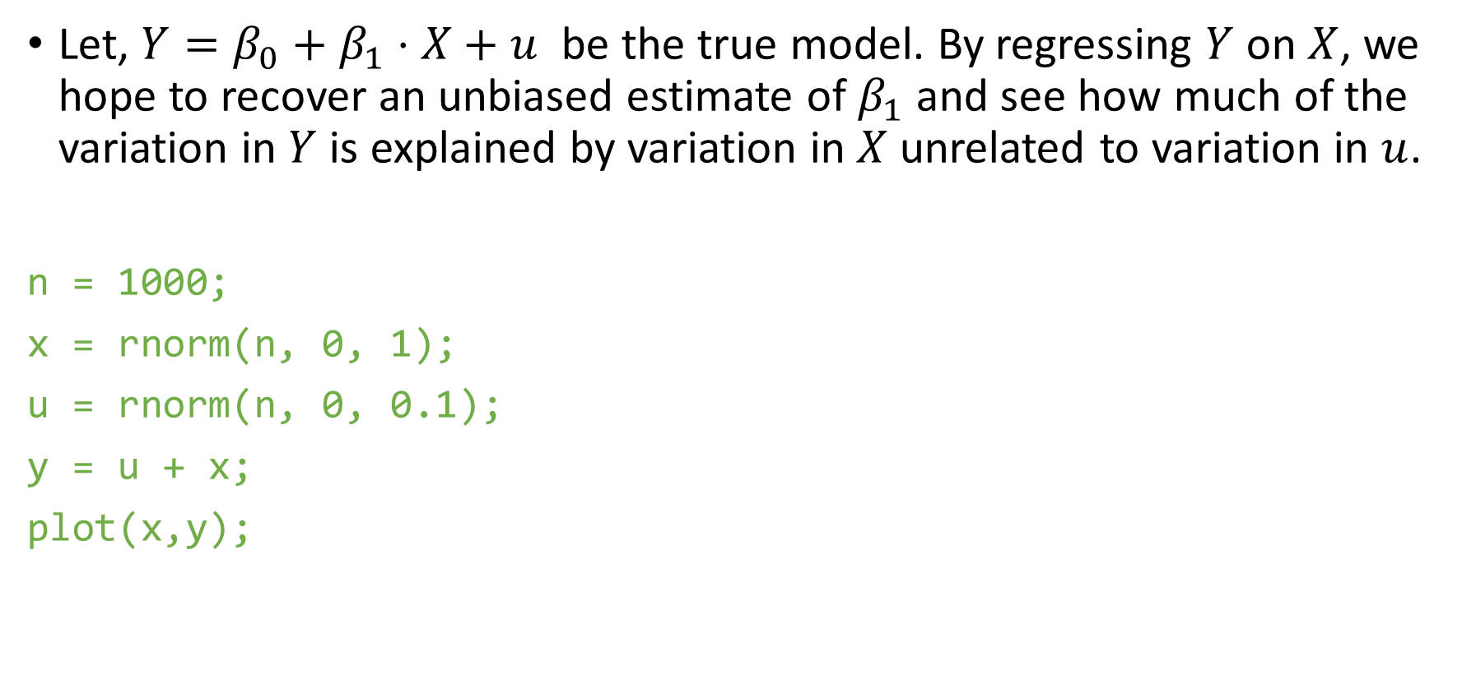
Regression Basics
Let, $Y=β_{0}+β_{1}⋅X+u$ be the true model. By regressing $Y$ on $X$, we hope to recover an unbiased estimate of $β_{1}$ and see how much of the variation in $Y$ is explained by variation in $X$ unrelated to variation in $u$.
n = 1000;
x = rnorm(n, 0, 1);
u = rnorm(n, 0, 0.1);
y = u + x;
plot(x,y);

Slide 281
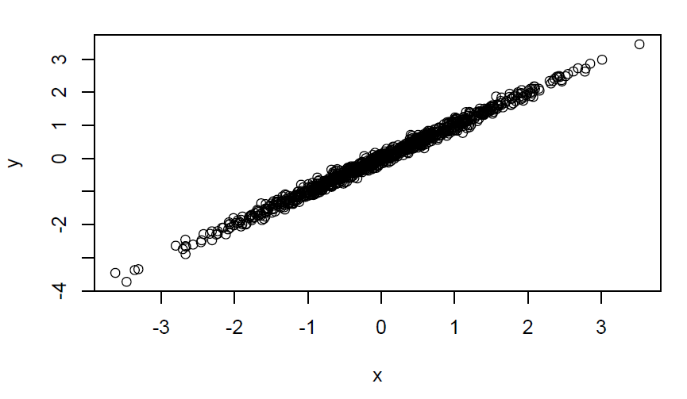
Regression Basics
Let, $Y=β_{0}+β_{1}⋅X+u$ be the true model. By regressing $Y$ on $X$, we hope to recover an unbiased estimate of $β_{1}$ and see how much of the variation in $Y$ is explained by variation in $X$ unrelated to variation in $u$.
n = 1000;
x = rnorm(n, 0, 1);
u = rnorm(n, 0, 0.1);
y = u + x;
plot(x,y);

Slide 282
fit = lm(y ~ x);
summary(fit);
stargazer(fit, type = "html", out = "fit.html");
# Regression Line
abline(fit$coefficients, col = "red", lwd = 2);

Slide 283
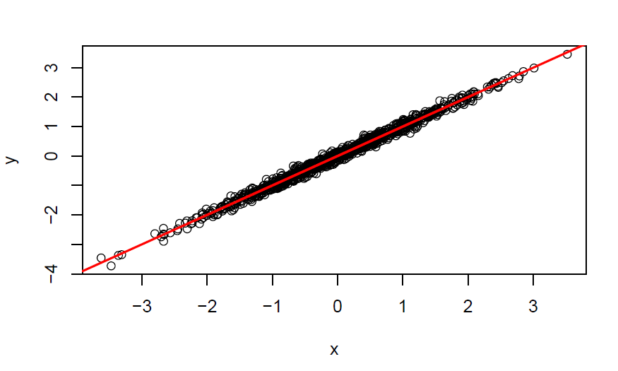
fit = lm(y ~ x);
summary(fit);
stargazer(fit, type = "html", out = "fit.html");
# Regression Line
abline(fit$coefficients, col = "red", lwd = 2);

Slide 284
u = rnorm(n, 0, 0.5);
y = u + x;
plot(x,y);
fit = lm(y ~ x);
summary(fit);
# Regression Line
abline(fit$coefficients, col = "red", lwd = 2);

Slide 285
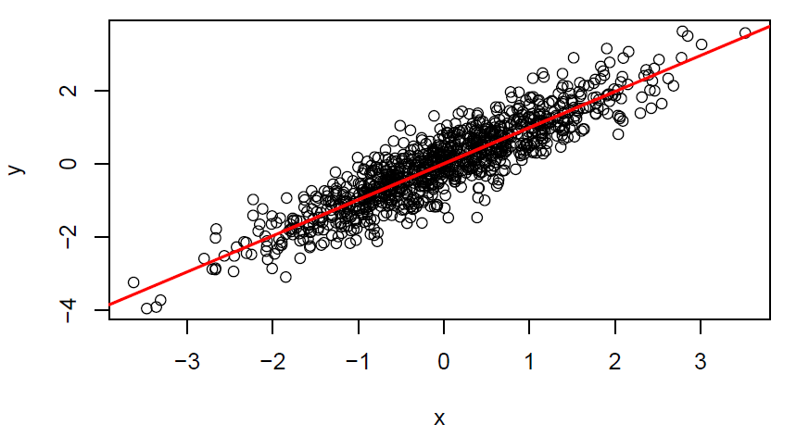
u = rnorm(n, 0, 0.5);
y = u + x;
plot(x,y);
fit = lm(y ~ x);
summary(fit);
# Regression Line
abline(fit$coefficients, col = "red", lwd = 2);

Slide 286
u = rnorm(n, 0, 5);
y = u + x;
plot(x,y);
fit = lm(y ~ x);
summary(fit);
# Regression Line
abline(fit$coefficients, col = "red", lwd = 2);

Slide 287
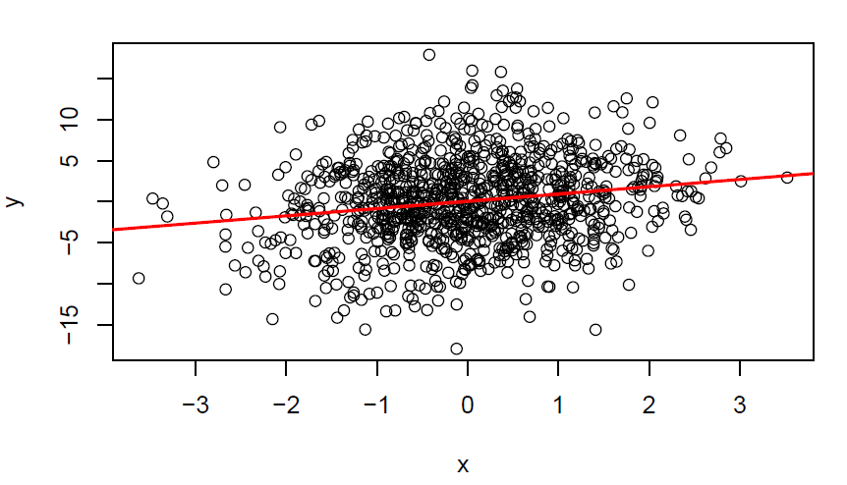
u = rnorm(n, 0, 5);
y = u + x;
plot(x,y);
fit = lm(y ~ x);
summary(fit);
# Regression Line
abline(fit$coefficients, col = "red", lwd = 2);

Slide 288
Fixed Effects and Clustering (lfe package)
This package is currently under repair. So we need to download an earlier version
rtools provides a set of tools to build and install earlier version of softwares
remotes::install_version("lfe");
OR try: remotes::install_github("cran/lfe");
The above will take some time

Slide 289
Fixed Effects and Clustering (lfe package)
This package is currently under repair. So we need to download an earlier version
rtools provides a set of tools to build and install earlier version of softwares
remotes::install_version("lfe");
OR try: remotes::install_github("cran/lfe");
The above will take some time
We ran basic regression as: lm(y ~ x)
Suppose we wish to add fixed effects, we can do
lm(y ~ x + factor(fe_1) + factor(fe_2) + ...)
The above works fine for a small number of fixed effects (FE)
lm() is prohibitively slow for large number of FE and FE with large num of levels

Slide 290
There are two ways to take care of FE
Include them in regression
De-mean the variables (both x and y) with respect to those FE levels
lfe:felm() is very efficient at this

Slide 291
There are two ways to take care of FE
Include them in regression
De-mean the variables (both x and y) with respect to those FE levels
lfe:felm() is very efficient at this
lm() offers no support for clustering of standard errors
Most recent research includes some form of clustering in the results
In panel data, you often need multi-way clustering
Earlier approach was to correct for heteroscedasticity and autocorrelation (HAC)
You might recognize terms like White (Robust) standard errors, Newey-West adjustment, etc while reading papers
lfe::felm() provides inbuilt cluster robust standard errors

Slide 292
There are two ways to take care of FE
Include them in regression
De-mean the variables (both x and y) with respect to those FE levels
lfe:felm() is very efficient at this
lm() offers no support for clustering of standard errors
Most recent research includes some form of clustering in the results
In panel data, you often need multi-way clustering
Earlier approach was to correct for heteroscedasticity and autocorrelation (HAC)
You might recognize terms like White (Robust) standard errors, Newey-West adjustment, etc while reading papers
lfe::felm() provides inbuilt cluster robust standard errors
Syntax: felm(formula, data)
formula: <MODEL> | <FE> | <INSTR> | <CLUSTERS>
felm( y ~ x1 + x2 | f1 + f2 | 0 | c1 + c2 )

Slide 293
?felm (Help page of felm command)

Slide 294
?felm (Help page of felm command)
The formula specification is a response variable followed by a four part formula.
The first part consists of ordinary covariates, the second part consists of factors to be projected out. The third part is an IV-specification. The fourth part is a cluster specification for the standard errors.
I.e. something like y ~ x1 + x2 | f1 + f2 | (Q|W ~ x3+x4) | clu1 + clu2 where y is the response, x1,x2 are ordinary covariates, f1,f2 are factors to be projected out, Q and W are covariates which are instrumented by x3 and x4, and clu1,clu2 are factors to be used for computing cluster robust standard errors.
Parts that are not used should be specified as 0, except if it's at the end of the formula, where they can be omitted.
The parentheses are needed in the third part since | has higher precedence than ~.
Multiple left hand sides like y|w|x ~ x1 + x2 |f1+f2|... are allowed.

Slide 295
Session - 9

Slide 296
Reflection on Session-8

Slide 297
Module - IV
Mini Project
A country-wide panel of CO2 emissions
Miscellaneous
Running different types of regressions in R
OLS, GLS, IV, logit, GMM
Rmarkdown/latex for documenting your work
Other useful stuff!

Slide 298
Session - 10

Slide 299
Reflection on Session-9

Slide 300
Different Regressions in R

Slide 301
Different Regressions in R
OLS is very simple
fit = lm(y ~ x)
You can check the summary using summary(fit). This gives std errors, t-stats and R2
lfe::felm(y ~ x)

Slide 302
Different Regressions in R
OLS is very simple
fit = lm(y ~ x)
You can check the summary using summary(fit). This gives std errors, t-stats and R2
lfe::felm(y ~ x)
GLS
nlme::gls(y ~ x, correlation = C, weights = w)
C is the group correlation mx, while w are heteroscedasticity weights

Slide 303
Different Regressions in R
OLS is very simple
fit = lm(y ~ x)
You can check the summary using summary(fit). This gives std errors, t-stats and R2
lfe::felm(y ~ x)
GLS
nlme::gls(y ~ x, correlation = C, weights = w)
C is the group correlation mx, while w are heteroscedasticity weights
IV
We can use lfe::felm for IV regression
lfe::felm(y ~ x1 + x2 | 0 | (x3|x4 ~ w3 + w4) | 0)
AER::ivreg(y ~ x1 + x2 + x3 + x4 | x1 + x2 + w3 + w4)
Requirements:
Instruments (w3, w4) must be correlated with endogenous variables (x3, x4)
Instruments (w3, w4) are unrelated to the error term, i.e. instruments affect y only through endogenous variables x3 and x4

Slide 304
Logit and Probit Models
glm(y ~ x1 + x2, family = binomial("logit"))
glm(y ~ x1 + x2, family = binomial("probit"))
Try ?family for more insights into how to use other models

Slide 305
Logit and Probit Models
glm(y ~ x1 + x2, family = binomial("logit"))
glm(y ~ x1 + x2, family = binomial("probit"))
Try ?family for more insights into how to use other models
For more details check out VGAM::vglm which implements vectorised glm for several other models
The need to perform a regression other than plain vanilla OLS rarely arises
Important exceptions are IV (2-SLS), FE and clustering.
Refer “Introductory Econometrics” by Woolridge for more theory and details on different regression models.

Slide 306
Logit and Probit Models
glm(y ~ x1 + x2, family = binomial("logit"))
glm(y ~ x1 + x2, family = binomial("probit"))
Try ?family for more insights into how to use other models
For more details check out VGAM::vglm which implements vectorised glm for several other models
The need to perform a regression other than plain vanilla OLS rarely arises
Important exceptions are IV (2-SLS), FE and clustering.
Refer “Introductory Econometrics” by Woolridge for more theory and details on different regression models.
Bootstrapping
In some models, its impossible to accurately judge the structure of standard errors. There we can employ boot-strapping to get standard errors.
Sample N data points (with repetition) from your dataset and estimate the model
Do this 1000 (or more) times
The standard error of coef. errors is then your standard errors

Slide 307
Time-series Regressions
The time-series regression is specified the same way as a cross-sectional regression

Slide 308
Time-series Regressions
The time-series regression is specified the same way as a cross-sectional regression
But we need to be careful about some issues
Non-stationarity in data
1st/2nd order integration?
Persistent time-series
AR (autoregressive) and moving average (MA) parameters
Fit arima(x, order) model where order = c(p, d, q)
p: AR order, d: integration order, q: MA order
Spurious Regression
Will return of SBI predict return of HDFC? Reliance?
Nifty (or broader market) return predicts both SBI and Reliance!
Co-integration
Does India’s GDP forecasts predict Nifty levels?
Learn more at https://en.wikipedia.org/wiki/Autoregressive%E2%80%93moving-average_model

Slide 309
Rmarkdown/Latex for Documentation

Slide 310
Rmarkdown/Latex for Documentation
Benefits of Rmarkdown/Latex over Word
Separation of formatting and content
Adding/deleting content doesn’t affect formatting
Changing formatting (fonts, size, columns, …) happens seamlessly
Managing citations, indexing (figure/table numbers)
Integration of your work (R) and writing (latex)
Reproducible research
Of utmost importance for an evolving research project

Slide 311
Rmarkdown/Latex for Documentation
Benefits of Rmarkdown/Latex over Word
Separation of formatting and content
Adding/deleting content doesn’t affect formatting
Changing formatting (fonts, size, columns, …) happens seamlessly
Managing citations, indexing (figure/table numbers)
Integration of your work (R) and writing (latex)
Reproducible research
Of utmost importance for an evolving research project
Drawbacks
No immediate feedback
Not many people use Latex outside of academia
Few people use latex at IIMB
Word has support for math symbols
Comments/Review/external feedback

Slide 312
Other Useful Stuff!

Slide 313
Other Useful Stuff!
Multiple tries for a command (TRY_CATCH)

Slide 314
Other Useful Stuff!
Multiple tries for a command (TRY_CATCH)
coalesce and CL0

Slide 315
Other Useful Stuff!
Multiple tries for a command (TRY_CATCH)
coalesce and CL0
time-series avg. of correlations

Slide 316
Other Useful Stuff!
Multiple tries for a command (TRY_CATCH)
coalesce and CL0
time-series avg. of correlations
Plotting 10s/100s of variables (PLT)

Slide 317
Other Useful Stuff!
Multiple tries for a command (TRY_CATCH)
coalesce and CL0
time-series avg. of correlations
Plotting 10s/100s of variables (PLT)
Winsorization

Slide 318
Other Useful Stuff!
Multiple tries for a command (TRY_CATCH)
coalesce and CL0
time-series avg. of correlations
Plotting 10s/100s of variables (PLT)
Winsorization
Working with ranks/quintiles/deciles

Slide 319
Other Useful Stuff!
Multiple tries for a command (TRY_CATCH)
coalesce and CL0
time-series avg. of correlations
Plotting 10s/100s of variables (PLT)
Winsorization
Working with ranks/quintiles/deciles
Filling missing dates

