Slide 1
Introduction to Latex
-- Nikhil Vidhani

Slide 2
Word vs Latex
Problems with Word
Great for short, text-only documents
If this is all you’ll ever need, do not learn Latex!
But academics need so many other things to work
Citations/bibliography, tables/figures, mathematics, cross-referencing, …
Word gets slow for large documents
Content keeps bugging the formatting and vice-versa
WYSIWYG vs WYSIWYM
Word: what you say is what you get
Latex: what you say is what you mean

Slide 3
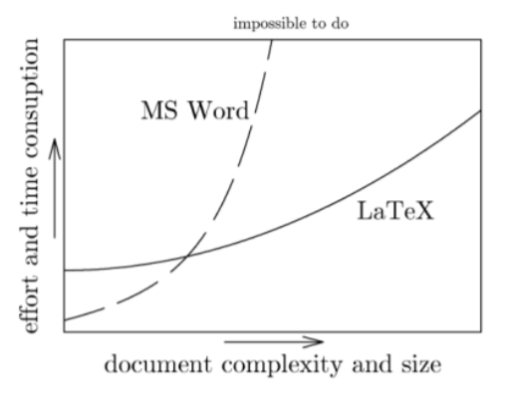
Why Latex
Word can’t handle serious maths
Donald Knuth wrote TeX to improve math typesetting. Leslie Lamport extended it to LaTeX.
Separate content from formatting whilst creating beautiful documents
Latex is free!
Its defacto in science, maths, CS etc
Not so in management (yet!)

Slide 4
Is Word useless?
Not at all!
In fact recent releases of Word have gotten way better at handling maths.
You can still make maths, references, ToC etc work in word
BUT it gets difficult as size of your document increases
My advice:
Decide whether Latex has much use for you OR not and then stick to whatever you choose!
Think about how much tables and maths would be there in your articles/thesis/reports.
I had to use Latex when I started to write me thesis
You just can’t make journal-quality tables work in MS-word

Slide 5
Latex Editors
Overleaf
Cloud based. Easiest to use! No package download needed! Good for writing term papers!
IIMB may have a subscription!
Miktex/Mactex/TexLive
You get lots of package pre-bundled! You will still need to download your own packages (if needed!)
Its free!
Tinytex
Only download the packages you need! (on the go)
Rmarkdown
Combine analysis and writing in one document!
Most of the web content today is written in some form of markdown!
Tinytex + Rmarkdown
This is what I use for thesis (with occasional use of overleaf!)

Slide 6
Minimal Example
\begin{document}
\maketitle
\begin{abstract}
\blindtext[1]
\end{abstract}
\section{Introduction}
\blindtext[20]
\end{document}
\documentclass[11pt,twoside,a4paper]{article}
\usepackage[english]{babel}
\usepackage{blindtext}
\title{Introduction to Latex}
\author{Nikhil Vidhani}

Slide 7
Document properties
Paper type
Font size
Document class
A document’s body starts with \begin{document} and end with \end{document}. Anything before \begin{document} is called preamble.
\documentclass[12pt,a4paper]{article}
\documentclass[11pt,a5paper,twocolumn,landscape]{book}

Slide 8
Page Margins / Geometry
\usepackage[margin=1in]{geometry}
\usepackage[top=1cm,bottom=2cm,left=3cm,right=4cm]{geometry}
\usepackage[a4paper,bindingoffset=2in,margin=0.5in]{geometry}
Try above with `twoside` option in `documentclass`
\usepackage[a4paper,inner=0.5in,outer=2in]{geometry}
Again, try with `twoside` option!

Slide 9
Fonts
Default: computer modern (cm)
\renewcommand\familydefault{cmss} % sans serif
\renewcommand\familydefault{cmtt} % tele-type
\renewcommand\familydefault{cmr} % roman
More info at https://www.overleaf.com/learn/latex/Font_typefaces#Reference_guide
\usepackage{lmodern} % latin modern
lmr, lmss, lmtt, lmdh
Other packages: mathpazo, avant, charter, … (endless list).
See https://tug.org/FontCatalogue/
\usepackage{microtype} % improves justification

Slide 10
Title, Author and Date
\title{ \textbf{ Introduction to \LaTeX{} } }
\author{By Nikhil Vidhani}
\date{December 21, 2018}
\date{\today}
Insert \maketitle after \begin{document}

Slide 11
Some other packages we will use
\usepackage{graphicx} % including external figures
\usepackage{wrapfig} % wrapping text around figures
\usepackage{enumitem} % enumerating/listing points
\usepackage{fancyhdr} % header/footer
\usepackage{amsmath} % maths
\usepackage{hyperref} % hyperlinks, cross-referencing

Slide 12
Title, ToC, LoT, LoF, page-numbering
\maketitle
\tableofcontents
\listoftables
\listoffigures
\pagenumbering{roman} % arabic, roman, Roman, alph, Alph
\setcounter{page}{1} % reset page counter
All of these go after \begin{document}

Slide 13
Header and Footers
\usepackage{fancyhdr}
\pagestyle{fancy} % use fancy header instead of default header
\fancyhf{} % clear existing header formatting
\renewcommand{\headrulewidth}{3pt} % header-line width
\renewcommand{\footrulewidth}{1pt} % footer-line width
\fancyhead[LE,RO]{Nikhil Vidhani} % name on left-side on even pages and right-side on odd pages
\fancyhead[LO,RE]{Intro to \LaTeX} % title on left-side on odd pages and right-side on even pages
\fancyfoot[C]{Page: \thepage} % centred footer on all pages
\fancyfoot[L]{Section: \thesection} % section number of left-side for all pages
\fancyfoot[R]{Article: 1} % article number of right-side for all pages

Slide 14
Items
\begin{itemize}
\item 1 Cup Spinach
\item 1 Cup Frozen Blueberries
\item 2 Bananas
\item 1.5 Cups Almond Milk
\item Powders
% List within a list
\begin{itemize}
\item 1 Tbs PBJ
\item 1 Tsp Amla Powder
% List within a list within a list
\begin{itemize}
\item 1 tsp sugar
\item 0.5 tsp salt
\end{itemize}
\end{itemize}
\item six Dates
\end{itemize}

Slide 15
Enumeration
\begin{enumerate}[font=\bfseries]
\item 1 Cup Spinach
\item 1 Cup Frozen Blueberries
\item 2 Bananas
\item 1.5 Cups Almond Milk
\item Powders
\begin{enumerate}[font=\itshape]
\item 1 Tbs PBJ
\item 1 Tsp Amla Powder
\begin{enumerate}
\item 1 tsp sugar
\item 0.5 tsp salt
\end{enumerate}
\end{enumerate}
\item six Dates
\end{enumerate}
\usepackage{enumitem} % enumerating points (named itemize)
You can use enumerate and itemize in a mix and match manner!

Slide 16
Adding a figure
Upload a pic/pdf to overleaf folder
\usepackage[margin=0.5in]{geometry}
\begin{figure}[t] % t: top, b: bottom (best-effort only)
\centering % to centre the figure
\includegraphics[width=4in]{universe.jpg}
\caption{This is a figure!}
% can be a pdf too. In fact, pdfs (vector graphics) are preferred for plots. Try playing with the width argument!
\end{figure}
\begin{figure} … \end{figure} acts like a container for the actual figure and caption.

Slide 17
Wrapping text around a figure
\usepackage{wrapfig}
\blindtext[1]
\begin{wrapfigure}{r}{0.5\textwidth} % r: right, l: left, i: inside-edge, o: outside-edge. i and o are w.r.t. odd/even page.
% Image width relative to text width
\centering % to centre the figure
\includegraphics[width=\linewidth]{universe.jpg} % \linewidth changes in different environments (wrapfigure)
\caption{This is a wrapped figure!}
\end{wrapfigure}
\blindtext[1]

Slide 18
Sections
\section{Name of Section}
Section body!
\subsection{Name of subsection}
Sub-section body!
\subsubsection{Name of subsubsection}
Sub-section body!
And so on…
Latex automatically takes care of section numbering.
An asterisk after section makes an un-numbered section
\section*{Section w/o a number}
Section body!
This works for other stuff in latex as well: equations, lists, chapters etc

Slide 19
Line-breaks
\section*{Spacing}
First-line of a section is not indented.
A simple carriage-return (enter) doesn't change anything.
To get a line-break enter two backslashes (\textbackslash\textbackslash) after the end of line.\\
This line appears after a line-break. Note that here also there is no-indent.\\\\
In fact, multiple line-breaks also do not create indent!
More space can be added by specifying amount.\\[20pt]
Lot of gap now!
Adding two carriage-returns (enters) means a change of paragraph. Here there will be indent.
You can use \textbackslash\texttt{noindent} to skip indentation.
\noindent No indent here! If you want no indentation in the entire document then use \textbackslash\texttt{usepackage\{parskip\}}

Slide 20
Special Characters
Latex has some special characters: `\{’, `\}’, `\#’, `\%', `\$', `\&', `\_' and, `\textbackslash'. To print them you must use a \textbackslash, i.e. \textbackslash\texttt{\{}, \textbackslash\texttt{\}}, \textbackslash\texttt{\#}, \textbackslash\texttt{\%}, \textbackslash\texttt{\$}, \textbackslash\texttt{\&} and, \textbackslash\texttt{\_}. For printing `\textbackslash' you have to use the command \textbackslash\texttt{textbackslash}
\noindent Alternatively, you could use \verb|\{| to print \{
Put the above in latex and then see the output!

Slide 21
Line-spacing
\usepackage[singlespacing]{setspace} % this is the accepted spacing for publication. Most documents are single-spaced
\usepackage[onehalfspacing]{setspace} % you can use this if you feel your document is difficult to read
\usepackage[doublespacing]{setspace} % this is used in a draft version. Double spacing allowes space for hand-written comments above each line
For other options of spacing use,
\usepackage{setspace}
\setstretch{2.5} % use a number suitable to you

Slide 22
Tabbing
\section*{Tabbing}
A simple tabbed list. Think of it like a bare-bone table without lines.
\begin{tabbing}
\textbf{S.No.} \hspace{0.5in} \= \textbf{Name} \hspace{0.5in} \= \textbf{City} \hspace{0.5in} \= \textbf{Area} \\
1 \> Nikhil \> Agra \> Finance \\
2 \> Abhishek \> Ranchi \> Economics \\
3 \> Pranjal \> Raipur \> Decision Sciences \\
\end{tabbing}

Slide 23
Tabular
\usepackage{booktabs} % provides different line thicknesses to be used in tables like \toprule, \midrule, \bottomrule, \hline
\begin{tabular}{| l || c ||| r ||||} % alignment of columns. The first alignment letter `L` not vertical bar. The second and third columns are centre and right aligned. Also note that the number of vertical bars correspond to number of vertical lines!
\toprule
\textbf{Name} & \textbf{Command} & \textbf{Sample Text} \\
\midrule
% if you want to print the command then put it inside \verb||. These are vertical bars not letter `L`
italic & \verb|\textit| & \textit{abcdefgh} \\ % italicized text
bold & \verb|\textbf| & \textbf{abcdefgh} \\ % bold face text
small capped & \verb|\textsc| & \textsc{abcdefgh} \\ % capital letters but in small face
roman family & \verb|\textrm| & \textrm{abcdefgh} \\ % roman fonts
sans serif & \verb|\textsf| & \textsf{abcdefgh} \\ % sans serif fonts (w/o pointiness!)
typewriter & \verb|\texttt| & \texttt{abcdefgh} \\ % (constant-width fonts)
% ampersand (`&`) align the table entries
\bottomrule
\end{tabular}

Slide 24
Table
Similar to a figure container, we can wrap around a tabular environment inside a table container.
We can add positioning (top/bottom) and captions as well.
\begin{table}[t]
\centering
\begin{tabular}{| l || c ||| r ||||}
\toprule
\textbf{Name} & \textbf{Command} & \textbf{Sample Text} \\
\midrule
italic & \verb|\textit| & \textit{abcdefgh} \\
bold & \verb|\textbf| & \textbf{abcdefgh} \\
\bottomrule
\end{tabular}
\caption{This is a table}
\end{table}

Slide 25
Changing font size
\begin{tabular}{| l | l | l |}
\toprule
\textbf{Fontsize} & \textbf{Latex command} & \textbf{Ouput} \\
\midrule
tiny & \verb|\tiny{Sampe text}| & \tiny{Sampe text} \\
scriptsize & \verb|\scriptsize{Sampe text}| & \scriptsize{Sampe text} \\
footnotesize & \verb|\footnotesize{Sampe text}| & \footnotesize{Sampe text} \\
small & \verb|\small{Sampe text}| & \small{Sampe text} \\
normalsize & \verb|\normalsize{Sampe text}| & \normalsize{Sampe text} \\
large & \verb|\large{Sampe text}| & \large{Sampe text} \\
Large & \verb|\Large{Sampe text}| & \Large{Sampe text} \\
LARGE & \verb|\LARGE{Sampe text}| & \LARGE{Sampe text} \\
huge & \verb|\huge{Sampe text}| & \huge{Sampe text} \\
Huge & \verb|\Huge{Sampe text}| & \Huge{Sampe text} \\
\bottomrule
\end{tabular}

Slide 26
Quote
It keeps some space both at front and at end
\blindtext[1]
\begin{quote}
\blindmathtrue
\blindtext[1]
\end{quote}
\blindtext[1]

Slide 27
Cross-referencing
Latex allows you to reference any object in the whole document
Put a (unique) label and then reference it
You can reference multiple times
Your reference can come before the label
This means you can reference section 5 inside section 1
Generally labels are created for
Equations, figures, tables and (sub…)-sections
You need hyperref package if you want to navigate by clicking on hyperlinks

Slide 28
\section{One}
\label{sec:one}
See Sections \ref{sec:one}, \ref{sec:two} and, \ref{subsec:inside-two}. Also see Table \ref{tab:my_label} and Figure \ref{fig:my_label}.
\section{Two}
\label{sec:two}
See Sections \ref{sec:one}, \ref{sec:two} and, \ref{subsec:inside-two}. Also see Table \ref{tab:my_label} and Figure \ref{fig:my_label}.
\subsection{Inside Two}
\label{subsec:inside-two}
See Sections \ref{sec:one}, \ref{sec:two} and, \ref{subsec:inside-two}. Also see Table \ref{tab:my_label} and Figure \ref{fig:my_label}.
\begin{table}[t]
\centering
\begin{tabular}{|c|c|}
a & b \\
c & d
\end{tabular}
\caption{Tabel Caption}
\label{tab:my_label}
\end{table}
\begin{figure}[t]
\centering
\includegraphics[width=2in]{universe.jpg}
\caption{Figure Caption}
\label{fig:my_label}
\end{figure}

Slide 29
Now include `\usepackage{hyperref}`
All cross-references are now clickable
We can color references as:
\hypersetup{
colorlinks=true,
linkcolor=red,
citecolor=blue,
urlcolor=blue
}

Slide 30
Website Link
URL: \url{https://sraf.nd.edu/}\\
Hyperlink: \hyperref[sec:intro]{Introduction}\\
Weblink: \href{https://www.google.com}{Google}\\
Notice that \hyperref[]{} is different from \ref{}

Slide 31
Footnote
Adding a footnote is as easy as writing your text\footnote{and then suddenly put everything inside \texttt{\textbackslash footnote\{\}}} and then continue writing where you left!
See how the above text appears!
Put \renewcommand{\thefootnote}{\textit{\alph{footnote}}} in preamble for getting italicized footnotes with alphabetic numbering.
Needless to say, you can further modify it!

Slide 32
Custom Commands
Suppose you frequently need to write boldfaced, italicized, underlined, bigger font, typewriter text in your document.
How would you do that?
\underline{\textit{\textbf{\texttt{\Large{A}}}}}
OR you can write a custom command
\newcommand{\mycmd}[1]{
\underline{\textit{\textbf{\texttt{\Large{#1}}}}}
}
% the above goes into preamble while the below in body
\mycmd{This is fun!}

Slide 33
Custom Commands: without argument
\newcommand{\tableinfo}{
All independent variables are one month lagged variables. Definitions of all the variables appears in Appendix A2. All regression specifications have industry and year fixed effects. Standard errors are double clustered by firm and year-month. Statistical significance of 10\%, 5\% and 1\% are indicated by *, ** and *** respectively.
}
% the above goes into preamble while the below in body
\tableinfo

Slide 34
Custom Commands: Multiple Arguments
\newcommand{\contact}[3]{
Author is a final year PhD student at \href{#1}{Indian Institute of Management, Bangalore}.
\emph{email}: \href{mailto:#2}{#2}
Phone: \href{tel:#3}{#3}
}
% the above goes into preamble while the below in body
\contact{https://sites.google.com/view/nikhilvidhani}{nikhil.vidhani16@iimb.ac.in}{+91-797-555-7296}

Slide 35
Sub-figures
\begin{figure}[h]
\begin{subfigure}{0.5\textwidth}
\includegraphics[width=0.9\linewidth]{universe.jpg}
\caption{Sub-caption 1}
\end{subfigure}
% there should be no gap here!
\begin{subfigure}{0.5\textwidth}
\includegraphics[width=0.9\linewidth]{universe.jpg}
\caption{Sub-caption 2}
\label{fig:subim2}
\end{subfigure}
\caption{Main caption}
\end{figure}
Need to include \usepackage{subcaption}

Slide 36
Parbox & minipage
\parbox{0.4\textwidth}{\raggedright \blindtext[1]} % raggedright justifies left
% no gaps here
\hspace{0.2\textwidth}
% no gaps here
\parbox{0.4\textwidth}{\raggedleft \blindtext[1]} % raggedleft justifies right
A \parbox{} may only contain a single paragraph. For more general case use \minipage{}

Slide 37
\begin{minipage}{0.45\textwidth}
\blindtext[1]
\end{minipage}
% no space in between
\hspace{0.1\textwidth} % horizontal space between 2 minipages
\begin{minipage}{0.45\textwidth}
\blindtext[1]
\end{minipage}
\vspace{11pt} % vertical space between two minipages
\hspace{0.1\textwidth} % horizontal space before 3rd minipage
\begin{minipage}{0.8\textwidth}
\blindtext[1]
\end{minipage}
\hspace{0.1\textwidth} % horizontal space after 3rd minipage

Slide 38
Math Symbols
A big advantage of latex is the availability of math symbols.
At any point in your test you can insert math by enclosing math formulas inside `$ $` or `\( \)`
You can math on a new line if you enclose math symbols within `\[ \]` or `$$ $$`
Quadratic equation is $ax^2 + bx + c = 0$ with \( a > 0 \). The roots are given by \[ \frac{-b \pm \sqrt{b^2 - 4ac}}{2a} \]

Slide 39
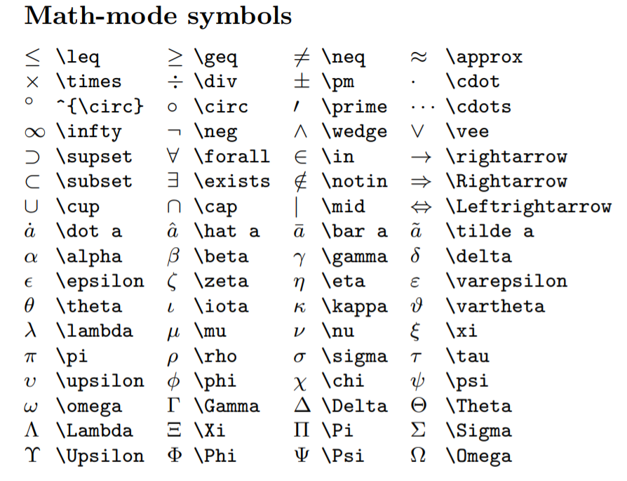
There are hundreds of maths symbols. Impossible to list all of them!
See: https://ctan.um.ac.ir/info/symbols/comprehensive/symbols-a4.pdf#page=123

Slide 40
Equation
\begin{flalign}
\nonumber (x+y)^2 & = (x+y)(x+y) \\
\nonumber & = x^2 +xy + yx + y^2 \\
\nonumber & = x^2 +2xy + y^2
\end{flalign}
\begin{flalign}
&& (x+y)^2 & = (x+y)(x+y) \\
&& & = x^2 +xy + yx + y^2 \\
&& & = x^2 +2xy + y^2
\end{flalign}
\begin{flalign}
\nonumber (x+y)^2 & = (x+y)(x+y) && \\
\nonumber & = x^2 +xy + yx + y^2 && \\
& = x^2 +2xy + y^2 &&
\end{flalign}
\begin{equation}
\frac{df}{dt} = \lim_{h \to 0} \frac{f(x+h) - f(x)}{h}
\end{equation}
\begin{equation*}
F = G \frac{m_1 m_2}{r^2}
\end{equation*}
% begin{equation*} is similar to $$ … $$ or \[ … \]

Slide 41
Matrices
\[
\begin{matrix} \leq & \geq \\ \neq & \cong \end{matrix} \hspace{2em}
\begin{pmatrix} \infty & \lim \\ \forall & \exists \end{pmatrix} \hspace{2em}
\begin{bmatrix} \int & \iint \\ \oint & \sum \end{bmatrix} \hspace{2em}
\begin{Bmatrix} \oplus & \otimes \\ \circ & \subset \end{Bmatrix} \hspace{2em}
\begin{vmatrix} 1/2 & a^2 \\ \sqrt{5} & a_{22} \end{vmatrix} \hspace{2em}
\]

Slide 42
Multi-page Table
\begin{longtable}[t]{lccc}
\caption{\label{tab:mytab}Disagreement by Industry}\\
\multicolumn{4}{p{\linewidth}}{
\underline{\textbf{Optional Description}}: \blindtext[1]
}\\
\toprule
\textbf{Industry} &
\textbf{\% Sample} &
\textbf{\shortstack{Avg. Disagreement \\ (Ranks)}} &
\textbf{\shortstack{Std. Dev. of \\ Disagreement \\ (Ranks)}} \\
\midrule
\usepackage{longtable}

Slide 43
Multi-page Table
\endfirsthead
\caption{Disagreement by Industry \textit{(continued)}}\\
\toprule
\endhead
\multicolumn{4}{p{\linewidth}}{
\centerline{\textit{to be continued...}}
}
\endfoot
\bottomrule
\multicolumn{4}{p{\linewidth}}{
\textit{Note:} This marks the end of table!
}
\endlastfoot
…continued

Slide 44
Multi-page Table
\textbf{Coal} & 0.19 & 53.2 & 24.4 \\
Pharmaceuticals & 5.52 & 69.6 & 22.3 \\
Precious-Metals & 0.28 & 59.9 & 23.9 \\
Medical-Equipment & 2.88 & 58.1 & 25.8 \\
Computers & 3.43 & 56.2 & 24.9 \\
Real-Estate & 0.75 & 56.0 & 24.6 \\
IT Services & 9.87 & 54.3 & 24.9 \\
Construction & 1.27 & 53.4 & 24.3 \\
…continued
Repeat these 6/7 times
\end{longtable}

Slide 45
Bibliography and Citations
To manage bibliography, you need to create a master bibliography file. Lets call it `references.bib`
You can create this file in overleaf itself
Populate the file with references from google scholar
Choose the BibTeX entry
Make sure each entry has a unique tag
\usepackage[natbibapa]{apacite}
\bibliographystyle{apacite}
The above is an accepted way to cite papers in most management journals.

Slide 46
It is no surprise that the year 1905 is hailed as the miracle year of science. In a series of four papers Einstein (\citeyear{einstein1905_photo_electric, einstein_brownian, einstein_spc_rel, einstein_emc2}) changed the way we understand modern physics. \cite{einstein1905_photo_electric} demonstrated particle nature of light, \cite{einstein_brownian} gave evidence of existence of atoms, \cite{einstein_spc_rel} proposed modifications to notion of time at speeds approaching $c$ and \cite{einstein_emc2} finally showed equivalence between mass and energy through $E=mc^2$. Later, \cite{einstein_gen_rel} explained gravity as a curvature of spacetime against the accepted notion of it being a perceived force.
The first citation \cite{example} always list all authors. Subsequent citations \cite{example} will be abbreviated with `\verb|et al.|'. To get a full citation \cite*{example} use `\verb|\cite*|' instead.

Slide 47
Sources
https://www.brown.edu/academics/sciencecenter/sites/brown.edu.academics.science-center/files/uploads/beginningLaTeX.pdf
https://www.cse.iitb.ac.in/~vahanwala/latex/introduction.pdf
https://wch.github.io/latexsheet/latexsheet-a4.pdf

