Slide 1
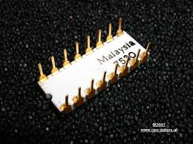
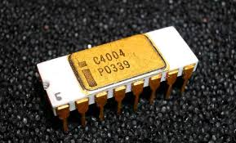
History of cpu
Discussing Intel History In CPU

Slide 2
What is a cpu?
C.P.U stands for central processing unit the CPU is the brain of the system unit
CPU controls and executes the processes ran by computer
CPU is integrated to the motherboard
CPU varies in speed
The main vendors of CPU are Intel and AMD

Slide 3
Intel’s rise in cpu
First CPU was developed in 1971 by Intel
It was a single chip CPU
The first ever CPU which was created by Intel is Intel 4004 a 4-bit CPU
First CPU was created under the leadership of Federico Faggin

Slide 4
First cpu intel4004 in 1971

Slide 5
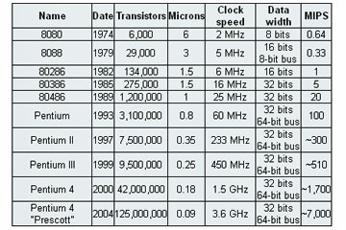
History of Intel’s cpu (1974-2004)

Slide 6
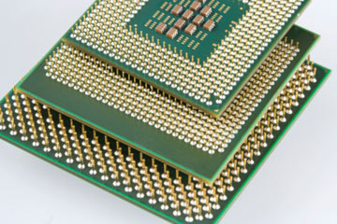
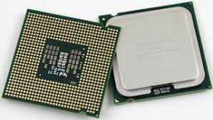
Some pic from cpu

Slide 7
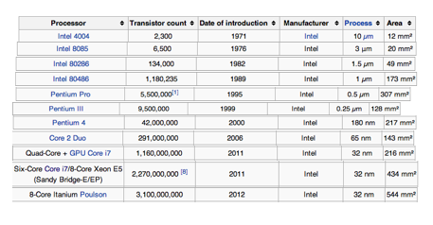
History of intel’s cpu (recent history)

Slide 8
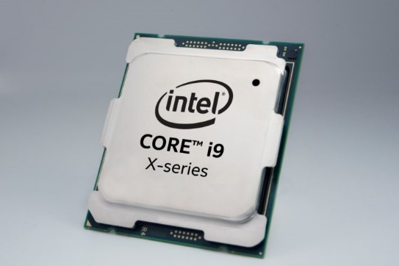
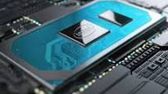
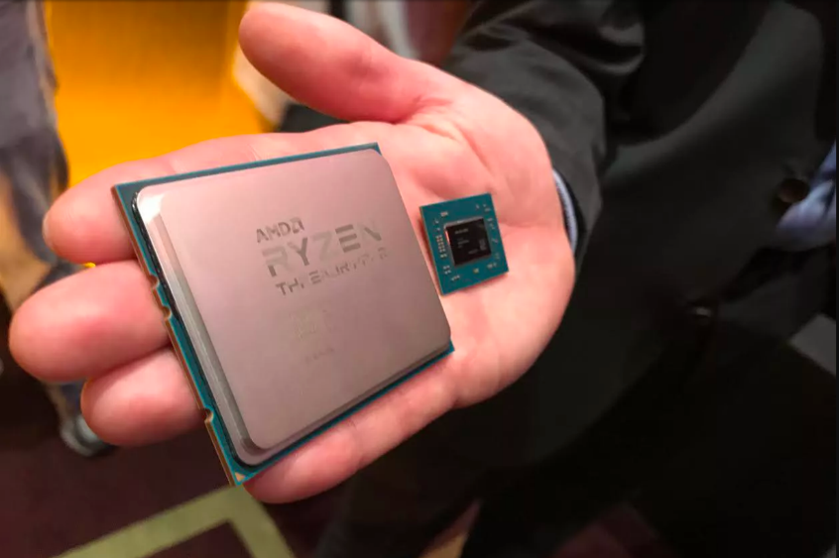
Some pic from new generation of cpu

Slide 9
video
https://www.youtube.com/watch?v=e5Iz74wXy50

Slide 10
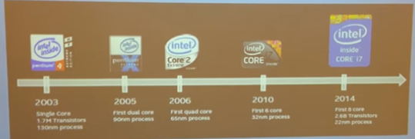
From p4 –core i7

Slide 11

From Hossein of ITD Canada team!!!

