Slide 1

CS 578
Statistical Machine Learning
Cold Start Problem in Recommender Systems
Felicia Grace Ravichandran, Nikhil Gupta,
Shreya Shivpuje, Tsu-Hao Fu

Slide 2
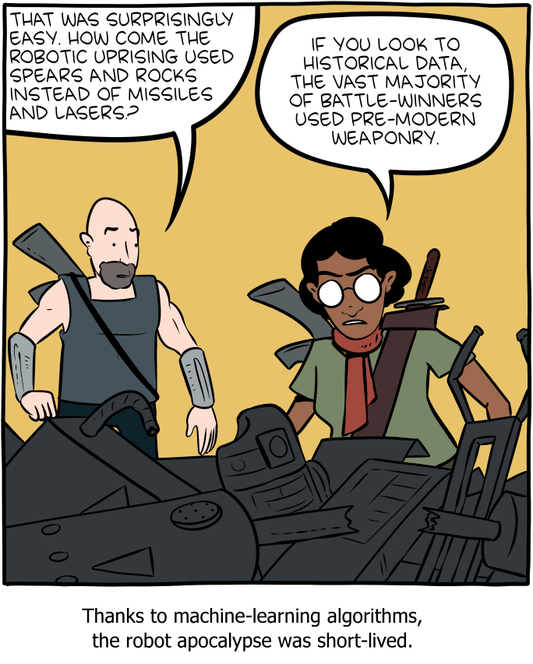
Recommender Systems and the Cold Start Problem
SMBC
Recommender Systems:
Recommender systems act as information filtering tools, offering users suitable and personalized content or information.
Usage: Widely used in e-commerce (Amazon), books (Goodreads), music (Spotify), streaming services (Netflix), e-learning (Coursera), and content platforms.
Methods: Collaborative filtering, content-based filtering, hybrid methods.
Cold Start Problem:
A condition when the system cannot produce efficient recommendations for the cold (or new) users who have not rated any item or have rated a very few items.
Reference: Roy, D., Dutta, M. A systematic review and research perspective on recommender systems. J Big Data 9, 59 (2022). https://doi.org/10.1186/s40537-022-00592-5

Slide 3
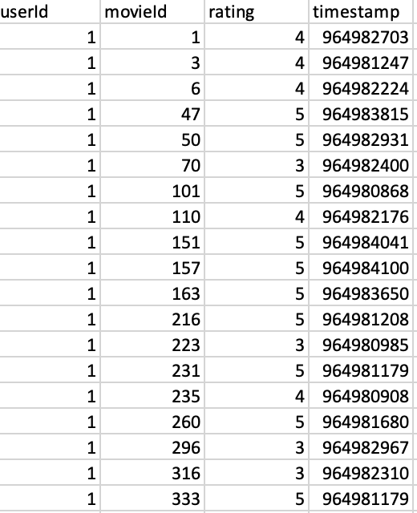
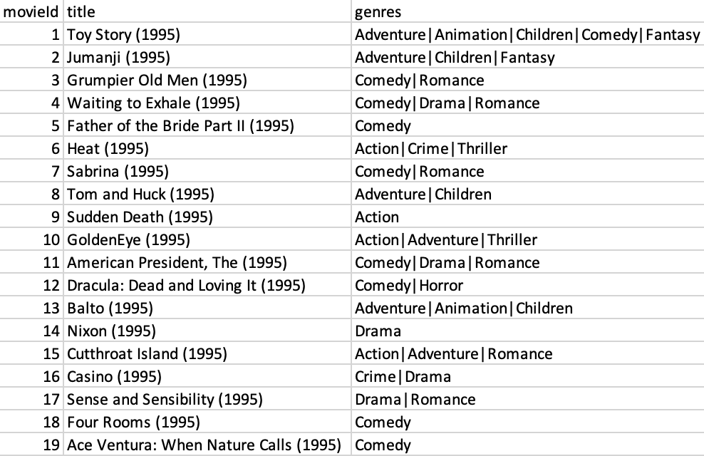
MovieLens 100K Dataset
100,000 ratings
9,000 movies rated by 600 users
movies
ratings
Reference: https://grouplens.org/datasets/movielens/latest/

Slide 4
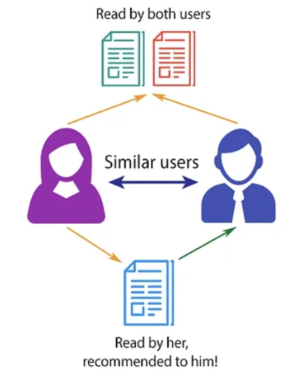
Collaborative Filtering
Technique where recommendations are made based on the preferences of other users.
Types:
User-Based: Based on similarities between users.
Item-Based: Based on similarities between items.
Key Concepts:
Similarity Measure: Measures similarity of two users based on their ratings. e.g. Pearson correlation, cosine similarity
Neighborhood Selection: Select a subset of similar users or items (neighbors) for predictions.
Advantages:
Personalized, improves with more user data.
Challenges:
Scalability, data sparsity, cold start problem.
Reference: https://medium.com/fnplus/neighbourhood-based-collaborative-filtering-4b7caedd2d11

Slide 5
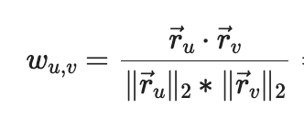
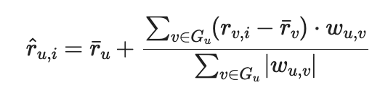
The Algorithm Behind User-Based Collaborative Filtering
Algorithm:
Step 1: Identify k most similar users to active user u using cosine similarity.
Step 2: Find items popular among the similar users but not yet rated by user u.
Step 3: Aggregate ratings of similar users to predict preferences of u.
Step 4: Recommend top N items.
Simulate Cold Start:
Use only 5 ratings of user u to recommend items.
Compute mean squared error over all users.
Loss per user = 0.73, suggesting cold-start.
Reference: https://github.com/nzhinusoftcm/review-on-collaborative-filtering/

Slide 6
Matrix Factorization
Technique commonly used in collaborative filtering-based recommendation systems.
Drawbacks of memory-based collaborative filtering recommender systems :
Data Sparsity: Missing entries in user-item interaction matrix.
Scalability: Number of users and items increases, matrix grows.
Matrix Factorization helps to address these drawbacks of memory-based collaborative filtering by reducing the dimension of the rating matrix.
Decompose the original rating matrix into the product of two lower-dimensional matrices user matrix U and item matrix V^{T} ,where U and V^{T} represent latent factors.
These latent factors address sparsity issues and make recommender systems more scalable.
Achieved 3.63 as average loss per user.
Reference: https://baotramduong.medium.com/recommender-system-matrix-factorization-3ffb17ac9adb

Slide 7
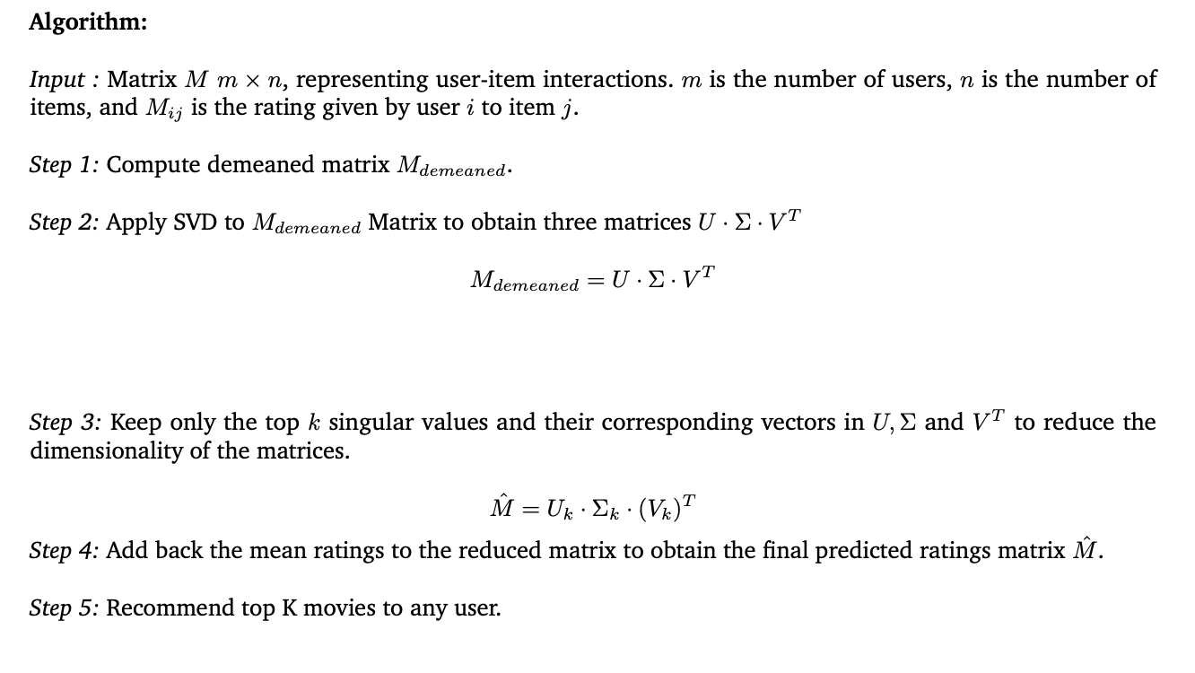
Matrix Factorization

Slide 8
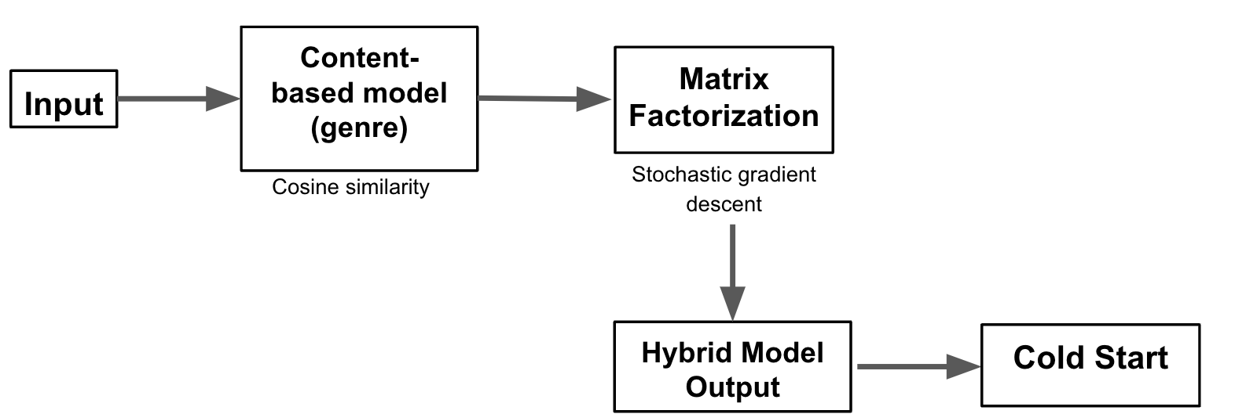
Hybrid Method 1: Merging Content-Based and Matrix Factorization
Initial recommendations: Capture user preferences based on content similarity
Refinement with matrix factorization: Improve suggestions based on similar users' preferences
Final recommendations: Offer a balanced, personalized selection, considering both individual preferences and collaborative patterns
Flowchart of hybrid model
Regularized
squared error
Top N movies
Based on 5 ratings by user u
Achieved a loss per user of 0.64, for a cold-start problem

Slide 9
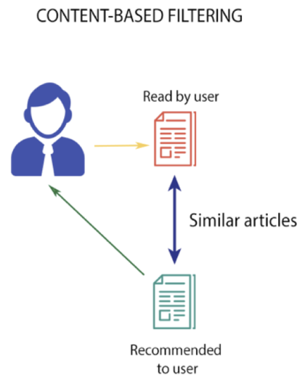
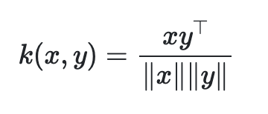
Model 1: Content Based Analysis
Suggestions are made based on the user's individual tastes and preferences
Identified movies with content similar to the genres the user has enjoyed in the past
Algorithm:
Step 1: Convert textual genre information into numerical format using vectorization method
Step 2: Compute the cosine similarity using linear kernel function
Step 3: Recommend movies rated by the specified user u using similarity matrix
Reference: https://github.com/potato-patata/Movie-recommendation-engine-using-SVD-and-content-based-filtering/tree/main

Slide 10
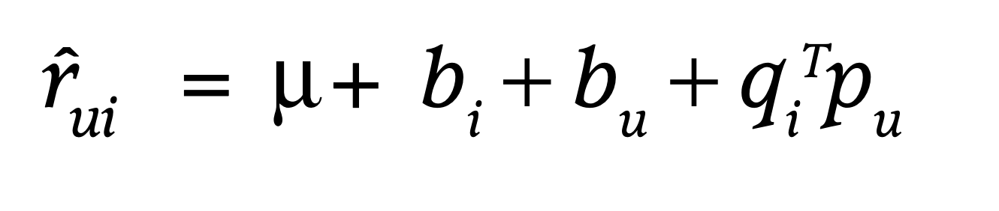
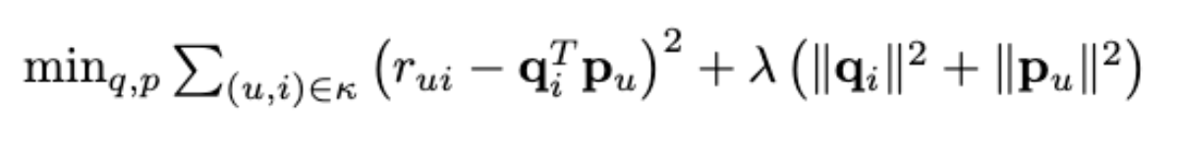
Model 2: Matrix Factorization Method
Considering what similar users prefer, predicted how a user might rate other films
This model effectively handle sparsity in the user-item ratings matrix, enabling accurate predictions even with missing values
Algorithm:
Step 1: When user or item information is missing, assume biases and factors are set to zero
Step 2: Minimize the regularized squared error, employing stochastic gradient descent
Step 3: Iterate through all training set ratings for 20 epochs, optimizing user and item factors
Step 4: Recommend top N movies for the input user
Prediction rating
Regularized squared error
Reference: Koren, Y., Bell, R., & Volinsky, C. (Year). "Matrix Factorization Techniques for Recommender Systems." IEEE.

Slide 11
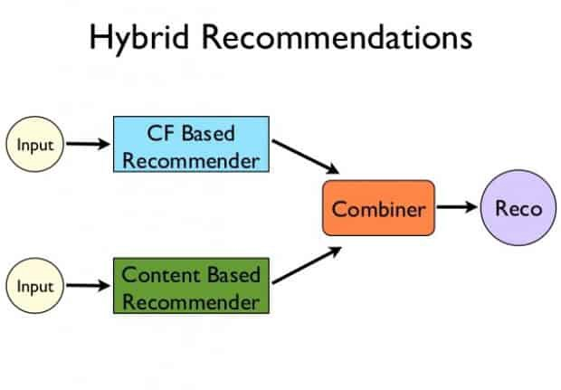
Hybrid Method 2: Combining Content-Based and Collaborative Filtering
Limitations of Singular Approaches:
Content-Based Filtering might lack the ability to capture diverse user preferences.
User-Based Collaborative Filtering may struggle when user-item interactions are sparse.
Our Hybrid Method combines the two methods parrelly to tackle the cold-start problem and improve the recommendation accuracy.
The procedure of the hybrid method:
Recommend movies by analyzing content similarity with the highly-rated films by the user.
Generate collaborative recommendations based on users with similar preferences.
Aggregate recommendations from Content-Based and Collaborative Filtering using the specified weights.
(Cold Start) average MSE loss per user = 0.69
Reference: https://pritamaich.github.io/Books-Recommendation-System

Slide 12
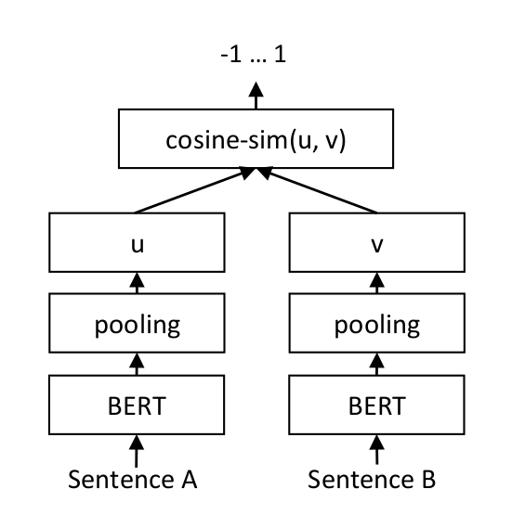


Content-Based (BERT)
BERT's bidirectional architecture enhances the ability to capture contextual relationships between contents.
The contextual understanding enhances precision by recommending items that align more closely with user preferences.
Algorithm:
For each user-rated movie, determine the most similar movies using pre-trained BERT and the adjusted cosine similarity.
Identify popular movies among the previously found similar movies, excluding those rated by user u.
Predict user u's preferences based on the rated movies and their similarity with similar movies.
Recommend top N movies.
Reference: https://github.com/nzhinusoftcm/review-on-collaborative-filtering/blob/master/3.Item-basedCollaborativeFiltering.ipynb &
https://www.sbert.net/examples/training/sts/README.html

Slide 13
Conclusion
Key insights:
Based on the experimental results, we can see that the hybrid methods have lower losses compared to singular methods.
The cold-start problem can be alleviate by hybrid methods even when there is limited historical data.
Challenges:
The computational complexity increases due to the need to retrain the model for each distinct cold-start condition, but this trade-off results in enhanced accuracy.
Integrating vastly different methods for prediction and comparing their results can be challenging.
Future Work:
Migrate the entire project to a similar dataset for comparative analysis, such as Netflix Prize.
Incorporate additional diverse hybrid methods to expand the range of comparisons.

