Slide 1
EPAM 2019 DevOps Automation of building process and deployment of the project
Nikita Astanin

Slide 2
Project description & tools
Description
Main idea of the project – automation of web-site building process and deployment it on web-server
Services
GitHub
AWS for creating instances
Jenkins on the first instance
Apache on the second instance
Ansible on the third instance
In perspective
Docker

Slide 3
Project structure

Slide 4
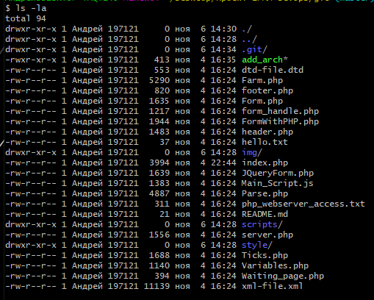
Developer’s directory with web-project

Slide 5
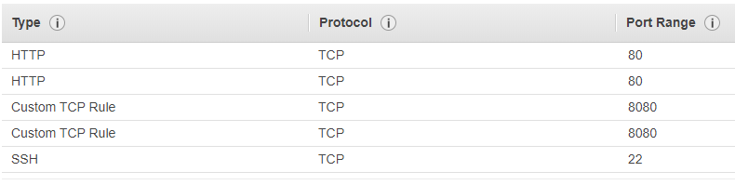

Launching instances on AWS & Security groups
Security groups (for both instances)
Running instances

Slide 6

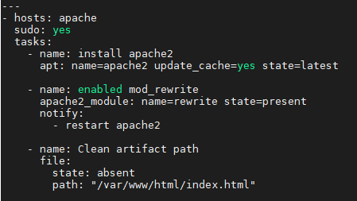
Using Ansible for installing Apache on remote host
Hosts
Config
Playbook

Slide 7
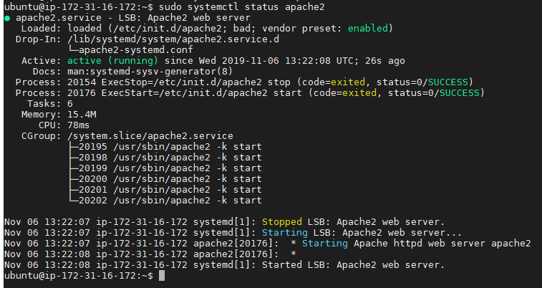
Apache with running web-server

Slide 8
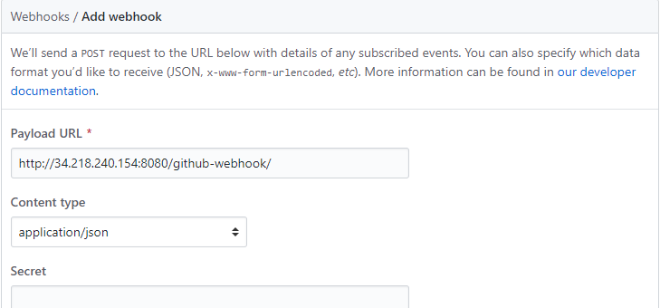
Git webhook

Slide 9
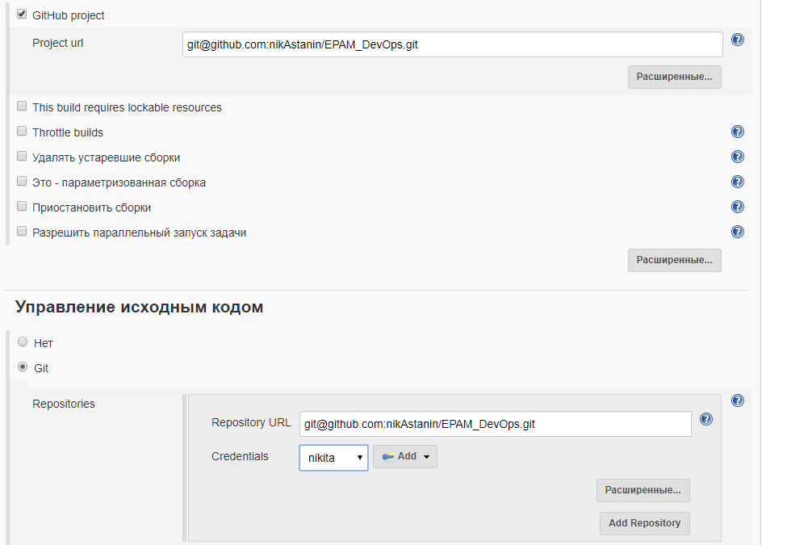
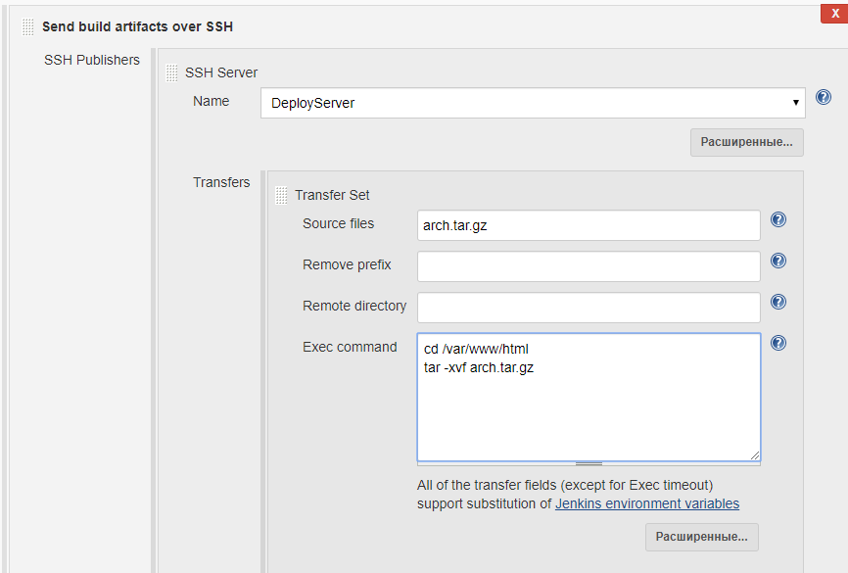
Job settings

Slide 10
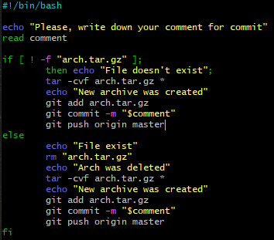
Script for pushing file to GitHub
After editing file (or files) developer has to use script ./add_arch to create special archive with project and push it to the GitHub.

Slide 11
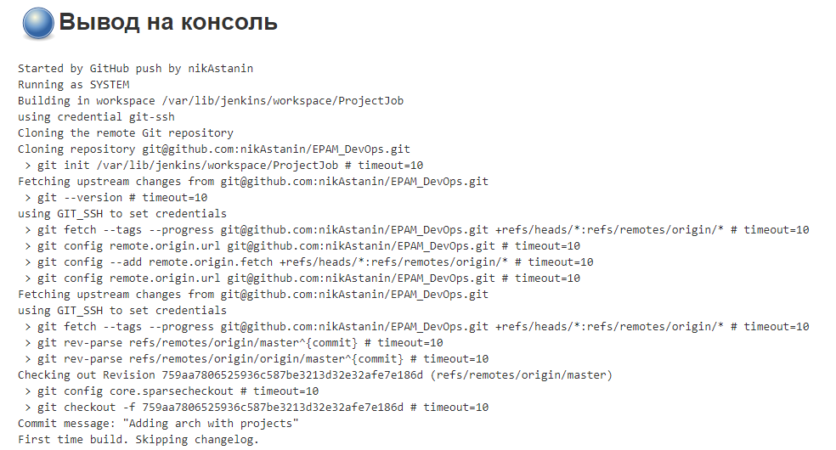
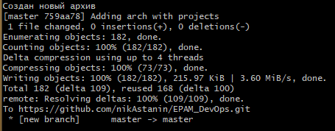
Using script for pushing and running Job
Script after editing file(s)
Job result

Slide 12
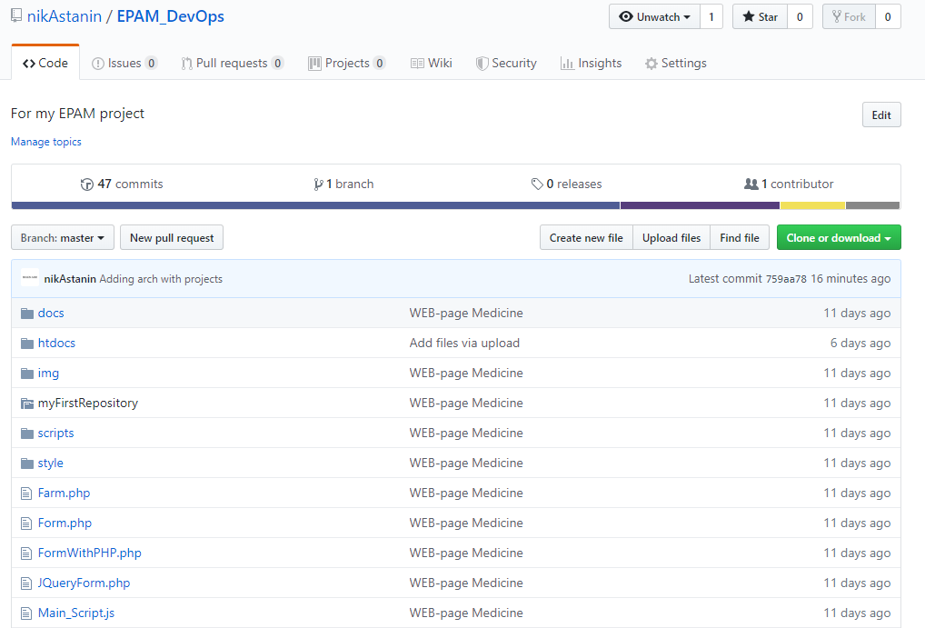
Project files on GitHub

Slide 13
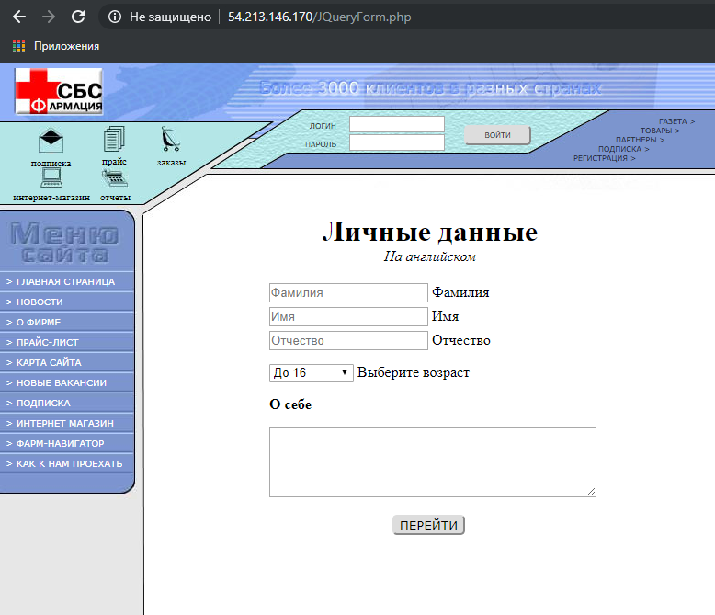
Result web-page

Slide 14

Thanks for your attention! Any questions?

