Slide 1
Revenue leans on a few customers and one busy season
ONLINE RETAIL SALES REVIEW | MANAGEMENT BRIEFING
Niharika Goswami | VirtuBox Data Analyst Assessment
73.9%
of customer revenue comes from the top 20% of customers
35.8%
The problem we investigated
Where does our revenue come from, which customers are valuable or drifting away, and when should we prepare? We studied 13 months of orders from a UK gift-ware wholesaler to find ways to protect and grow revenue.
of all revenue was earned in just three months (Sep to Nov 2011)
£1.0M
Questions we asked: When do sales peak? How concentrated are they? Which customers are at risk? Does export differ? When do customers order?
was earned by 643 valuable customers who have gone quiet
Notes:
Open with the problem in plain words: our sales look healthy, but they depend heavily on a small group of customers and on one short season. Three numbers frame the talk: the top 20% of customers bring in about 74% of customer revenue; three autumn months bring in about 36% of all revenue; and about GBP 1.0 million came from valuable customers who have gone quiet. The rest of the deck explains where these numbers come from and what to do about them.

Slide 2





The data: 13 months of real wholesale orders
541,909
13 months
4,333
3,899
order lines in the raw file
1 Dec 2010 to 9 Dec 2011
identified customers in 38 countries
different products sold
HOW WE TURNED RAW ORDERS INTO ANSWERS
1. Collect
2. Clean
3. Enrich
4. Analyse
5. Report
Public UCI Online Retail dataset, open licence (CC BY 4.0).
Removed duplicates, cancellations and non-product codes: 541,909 lines became 522,502.
Added revenue, month, weekday, hour, UK or export, and customer groups.
Trends, concentration, customer groups, UK vs export, returns.
Dashboard and this briefing for management.
Source: Chen, Sain and Guo (2012), UCI Machine Learning Repository, Online Retail. archive.ics.uci.edu/dataset/352/online-retail
Notes:
Keep this simple. We used a public record of every order line from a UK online gift-ware wholesaler, about 540 thousand lines over 13 months. It behaves like a B2B sales ledger because many buyers are trade customers. We cleaned it (duplicates, cancellations, postage and fee codes), added useful fields such as revenue and weekday, and then looked at trends, customer groups, UK versus export and returns. Customers without an ID (about 15% of revenue) stay in the revenue totals but are left out of customer-level findings.

Slide 3
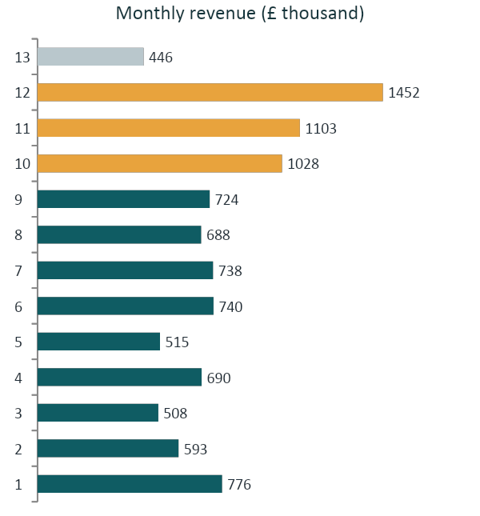
Five things management should know
35.8%
of revenue came in Sep to Nov. November alone was 2.2x an average Jan to Aug month.
73.9%
of customer revenue comes from the top 20% of customers; the top 1% alone is 30.5%.
8x
Repeat customers are worth about 8x one-time buyers (£2,808 vs £365 each).
1.0M
was earned by 643 valuable customers who have not ordered for 118 days on average.
75.5%
of revenue is ordered between 10:00 and 15:59. No Saturday orders were recorded.
Amber = Sep to Nov peak. *December 2011 is partial (data ends 9 Dec).
Notes:
Walk through the five facts top to bottom. 1) Seasonality: three autumn months bring in over a third of revenue. 2) Concentration: a small group of customers carries the business. 3) Retention: customers who come back are worth about eight times one-time buyers. 4) Risk: 643 valuable customers have gone quiet. 5) Timing: orders cluster in mid-week office hours. The chart shows the autumn peak clearly; December 2011 looks low only because the data stops on 9 December.

Slide 4
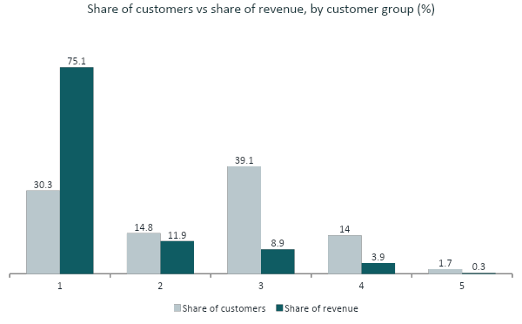
30% of customers deliver 75% of revenue
And 643 once-valuable customers have gone quiet
1,315 Champions
75% of revenue. They last ordered 17 days ago on average.
643 At risk
£1.0M earned (12% of revenue). Quiet for 118 days on average.
About £250k
Possible revenue if we win back 1 in 4 at-risk customers at past spending.
Identified customers only (4,333). Groups are based on how recently, how often and how much each customer buys.
Notes:
This is the most important finding. Grey bars show each group's share of customers; teal bars show its share of revenue. Champions are 30% of customers but 75% of revenue. At-risk customers used to buy often and spend well, but have not ordered for about 118 days, versus 17 days for Champions. That is recoverable revenue management can act on now. The 250k figure assumes we win back one in four at their historical spend; it is an estimate, not a forecast.

Slide 5
Three actions, in order of impact and ease
Win back valuable customers who went quiet
WHAT TO DO
WHO ACTS
1
Call the top 50 of the 643 at-risk customers (ranked by past spend) and send a tailored offer to the rest.
Sales and account management
High impact | High feasibility
£1.0M earned; quiet for 118 days
Protect and grow key accounts
WHAT TO DO
WHO ACTS
2
Give a named owner to the top 1% of customers and the top 5 export accounts, and review their ordering every month.
Sales leadership
High impact | Medium feasibility
Top 1% = 30.5% of revenue
Plan around the autumn peak
WHAT TO DO
WHO ACTS
3
Order stock by July, staff up for Sep to Nov, push early offers in August and offer a second-order incentive.
Operations and marketing
Medium impact | High feasibility
Sep to Nov = 35.8% of revenue
Notes:
Recommendations are ordered by business impact and ease of doing. Number 1 is the quickest win: a defined list of valuable customers who have gone quiet, so sales can start calling this month. Number 2 protects the accounts that carry the business. Number 3 is a planning discipline that pays off every year; stock and staffing decisions for the autumn need to be made by July.

Slide 6
What success looks like, and how we will measure it
1. Win-back
2. Key accounts
3. Autumn peak
~250k
~30%
35.8%
if 1 in 4 quiet customers return, at past spending
of revenue sits with the top 1% of customers
of revenue falls in Sep to Nov, our biggest window
WHAT COULD IMPROVE
WHAT COULD IMPROVE
WHAT COULD IMPROVE
Recover part of the £1.0M these customers once generated.
Less risk of losing the accounts that carry the business, and more chances to sell to them.
Fewer stock-outs at the peak, and more one-time buyers becoming repeat buyers.
HOW WE WILL MEASURE
HOW WE WILL MEASURE
HOW WE WILL MEASURE
Reactivation rate within 90 days
Revenue from this group vs last year
Top-account share of revenue
Days since last order
Churn among the top 50
Sep to Nov revenue growth
Stock-out rate
Share placing a second order within 60 days
Notes:
Each recommendation has a number we can track. The 250k is an estimate based on historical spending, not a promise. We would agree a baseline for each measure before launching, then review monthly. The easiest to start is the win-back list because success is simply whether quiet customers place an order again within 90 days.

Slide 7
Handle with care: limits and next steps
BE CAUTIOUS ABOUT
WHAT TO ANALYSE NEXT
Short history: 13 months only, and December 2011 is partial (data ends 9 Dec). The autumn peak rests on one year.
No profit view: there is no cost or margin data, so findings describe revenue, not profit.
Missing customer IDs: 15% of revenue is not linked to a customer, so customer findings cover identified buyers only.
Export surprise: export orders look 72% larger (£813 vs £474), but five accounts make up 46% of export revenue. We cannot say export is more profitable.
Add cost data to see profit by customer and product.
Add a second year of sales to confirm the seasonal pattern.
Add customer details (trade or shopper) and learn why the top export accounts buy so much.
Pilot the win-back offer and measure the results.
Notes:
Be upfront about what the data cannot tell us. It covers one autumn, has no cost or margin data, and 15% of revenue is not tied to a customer. The export result is the surprise of the analysis: export orders look much larger on average, but a handful of accounts drive it, and we cannot say export is more profitable. The next steps close those gaps: add cost data, add a second year, add customer detail, and run a small win-back pilot to test the biggest recommendation.

