Slide 1
Exploratory Analaysis of Customer Purchase History

Slide 2
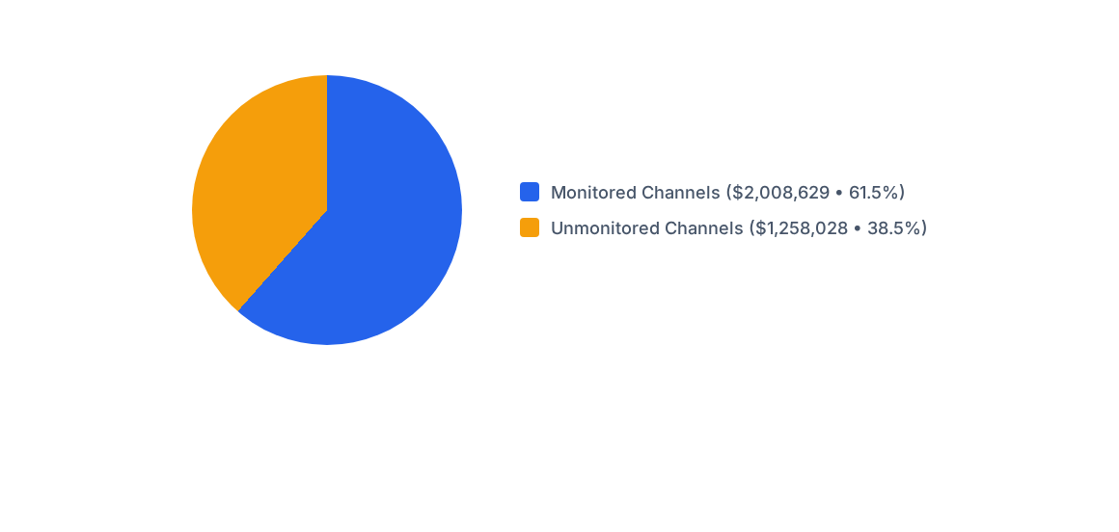

Channel Monitoring Exposure
Unmonitored channels represent 38.5% of total settlement volume.
Cash and gift cards require heightened regulatory compliance oversight.

Slide 3
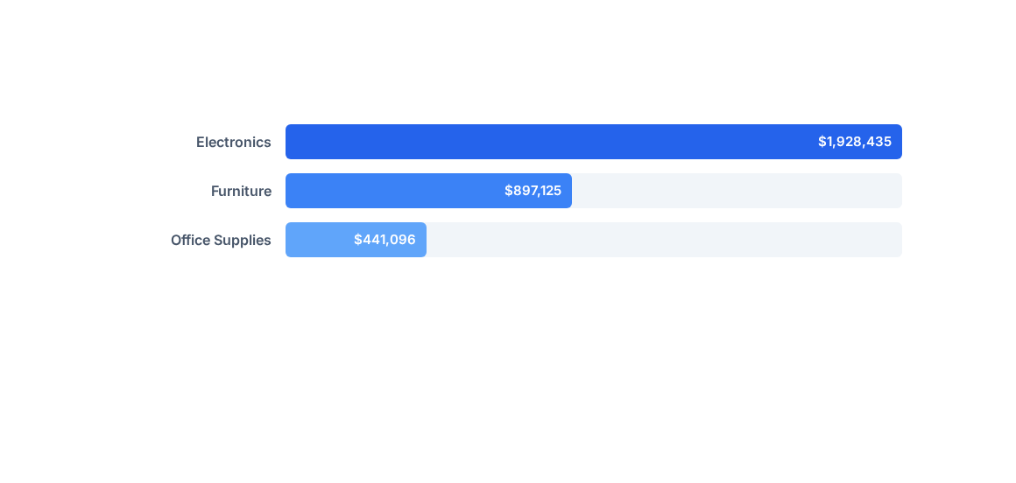

Category Settlement Volumes
Electronics dominates overall volume, accounting for over $1.93 million.
Automated product reclassification ensures accurate regulatory category reporting.

Slide 4
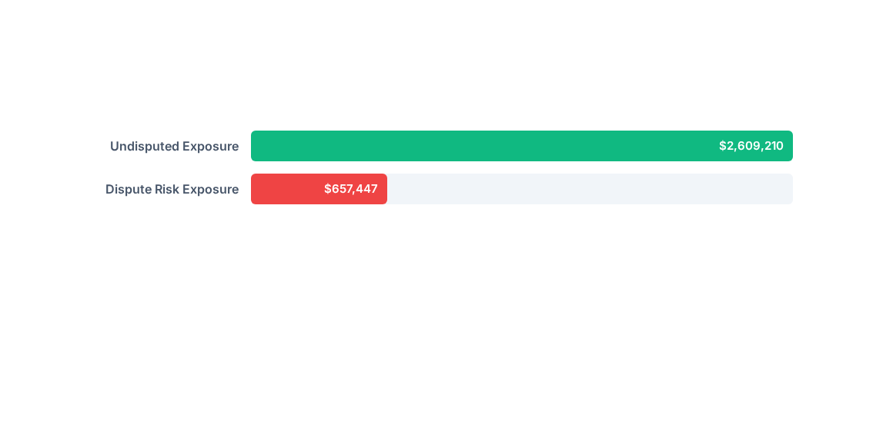

Dispute Exposure Analysis
Dispute exposure accounts for $657K across low-rated customer transactions.
Automated flags isolate high-risk settlement records for audit review.

Slide 5
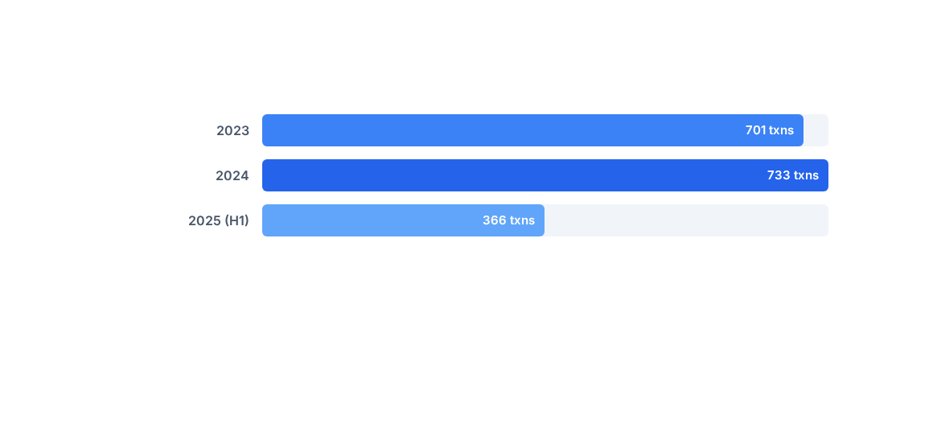

Annual Transaction Counts
Annual transaction volume peaked in 2024 with 733 processed transactions.
Partial year 2025 tracks on pace with historical annual averages.

Slide 6


Annual Settlement Volumes
Settlement values reached $1.32M in 2024, showing steady year-over-year growth.
Run-rate performance through mid-2025 demonstrates stable processing capacity.

