Slide 1
Classes And OOP In Python

Slide 2


OOP

Slide 3

Classes And Instances

Slide 4
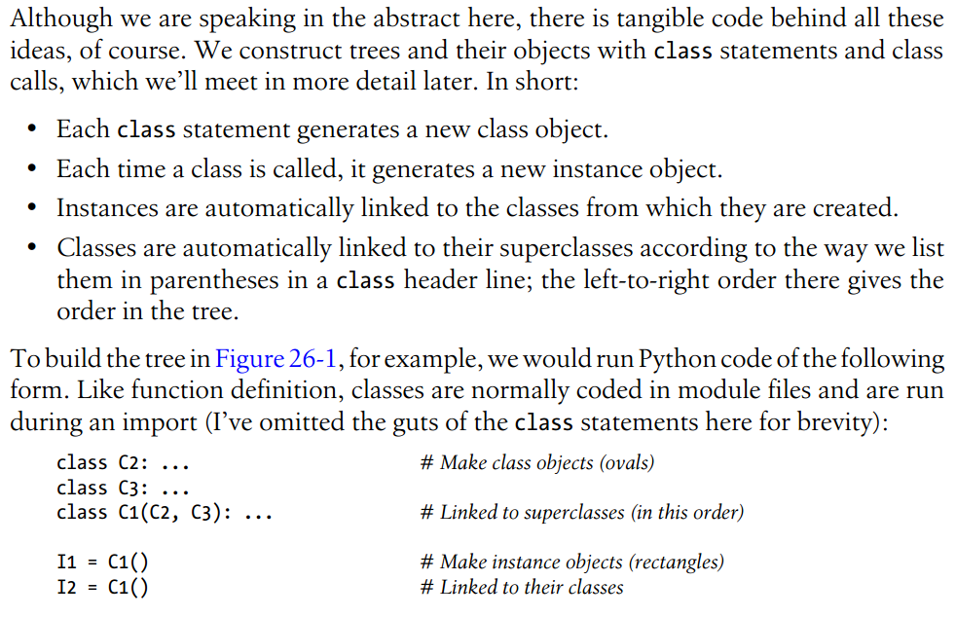
Coding Class Trees

Slide 5
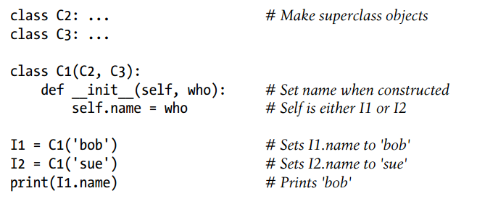
__init__

Slide 6




Polymorphism

Slide 7
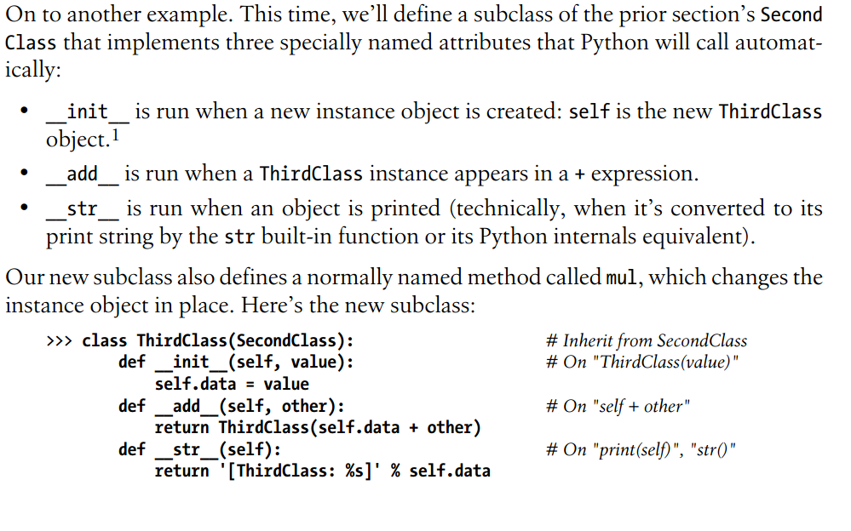
Polymorphism

Slide 8
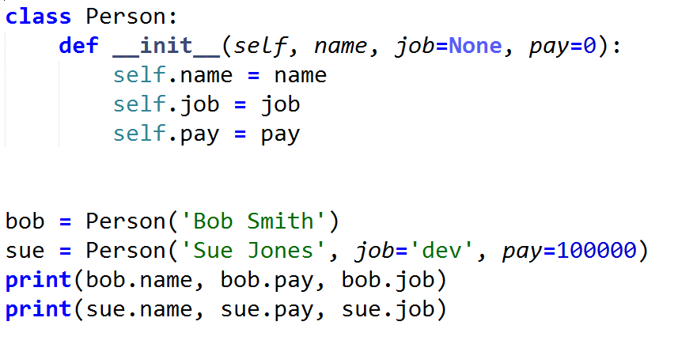
Person class

Slide 9
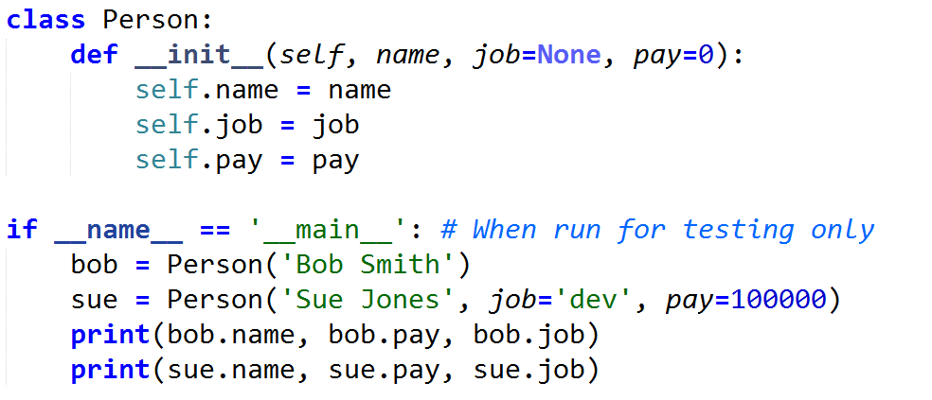
Class Test in module

Slide 10
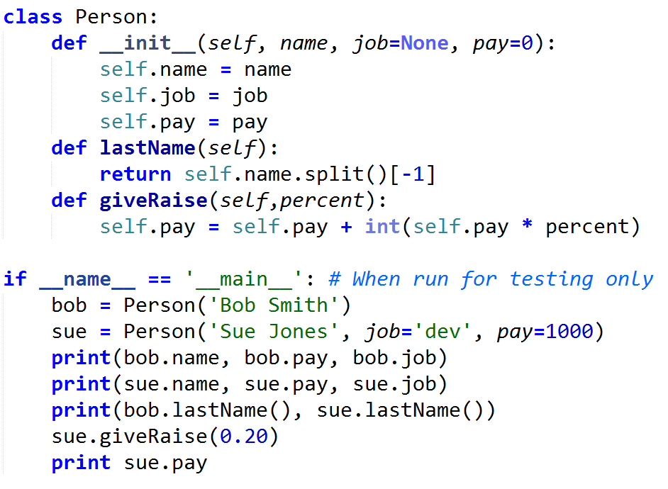
Coding Methods

Slide 11
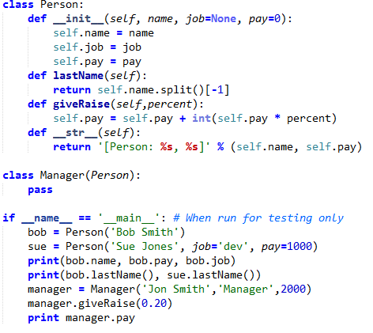
Inheritance

Slide 12
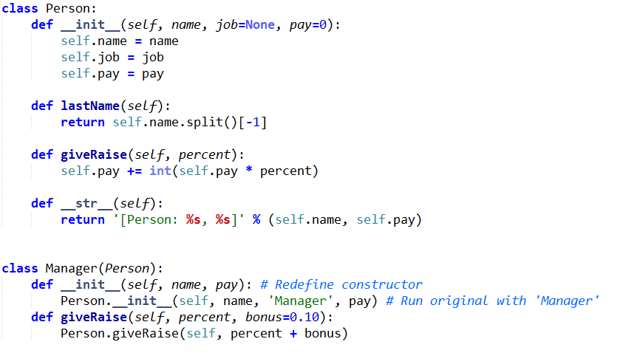
Polymorphism

Slide 13

Pickles and Shelves

Slide 14
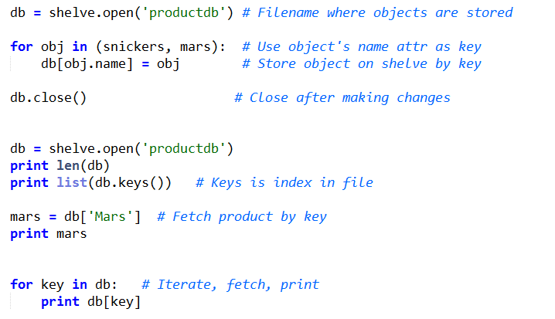
Pickles and Shelves

