Slide 1
Benchmark
helper/benchmark.py
Database and backend run in Docker
Each run for 60 seconds
Processor: Intel(R) Core(TM) i5-8365U CPU @ 1.60GHz (1.90 GHz)
16GB RAM (2133 MT/s)

Slide 2
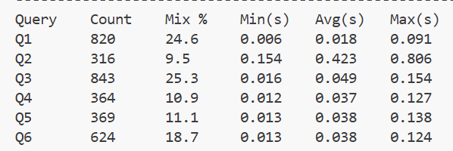
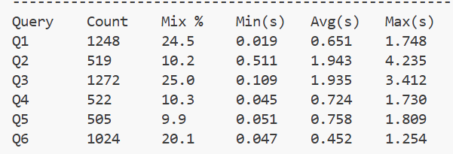
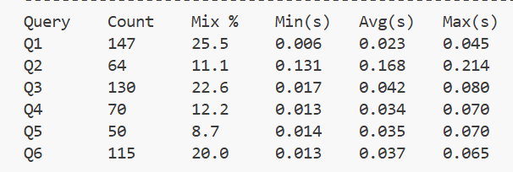
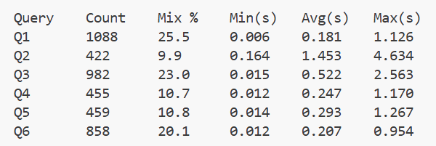
10 terminals
100 terminals
wait
0.1s
wait
1.0s

