Slide 1

STUDENT ATTENDANCE ANALYSIS
Exploratory Data Analysis Report
Uncovering what really drives student attendance across 20,000 records
Dataset: Attendance_Prediction.csv | 20,000 students | 15 features

Slide 2




Objective
Why we analyzed this dataset
Identify which factors most strongly influence whether a student attends class — and quantify the size of each effect — to inform practical, evidence-based interventions.
Explore patterns
Surface key drivers
Guide action
Examine how attendance varies by environment, behavior, and demographics.
Rank which factors show the strongest real relationship with attendance.
Translate findings into concrete, data-backed recommendations.
Student Attendance — Exploratory Data Analysis
02

Slide 3

Dataset Description
What we're working with
20,000
15
Feature Groups
Student records
Features
Demographics
age, gender, course, year of study
0
0
Environment
parent's education, internet access, hostel residency, weather, travel time
Missing values
Duplicate rows
Behavior
study hours, sleep hours, class type (online/offline)
Source file: Attendance_Prediction.csv
Target
attendance (1 = present, 0 = absent) · also: absence_reason
Student Attendance — Exploratory Data Analysis
03

Slide 4





Data Cleaning Steps
Preparing the data for analysis
Removed identifier column
Checked data integrity
Dropped student_id — unique per row, no predictive value.
Verified missing values and duplicate rows — none found.
Encoded categories
Engineered study_sleep_ratio
Label-encoded all categorical columns for numerical analysis.
New feature: study hours ÷ sleep hours, to capture balance.
Binned travel time
Standardized numeric features
Created travel_category: Near / Medium / Far from travel_time_minutes.
Scaled age, study hours, sleep hours, and travel time for fair comparison.
Student Attendance — Exploratory Data Analysis
04

Slide 5
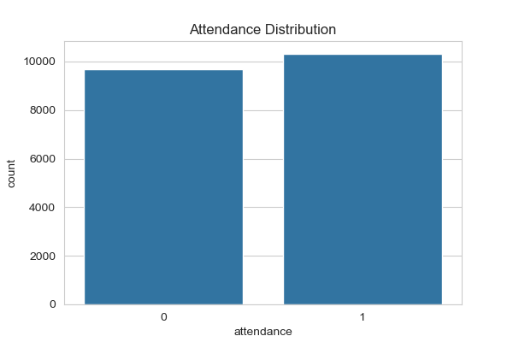
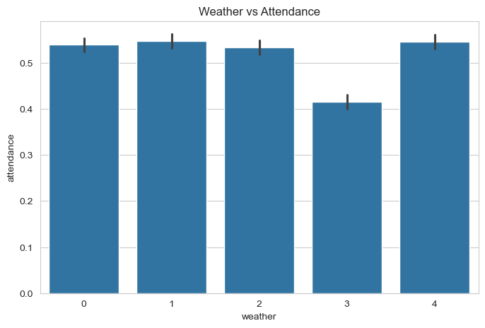
Visualizations
Attendance distribution & weather effect
Figure 1 — Attendance is balanced: ~51.6% present vs. ~48.4% absent across 20,000 records.
Figure 2 — Rainy days (code 3) show the lowest attendance at 41.6%, vs. ~53–55% for other weather.
Student Attendance — Exploratory Data Analysis
05

Slide 6
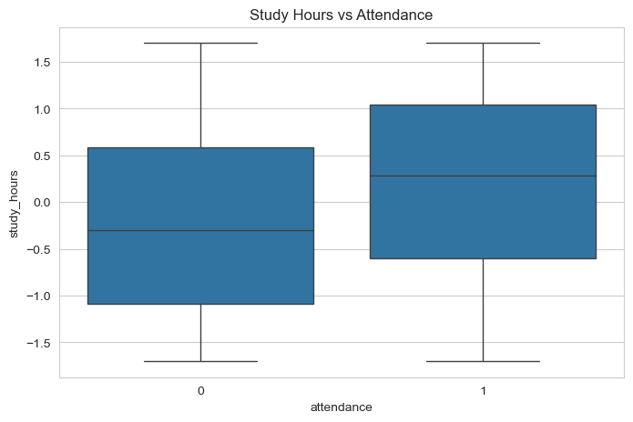
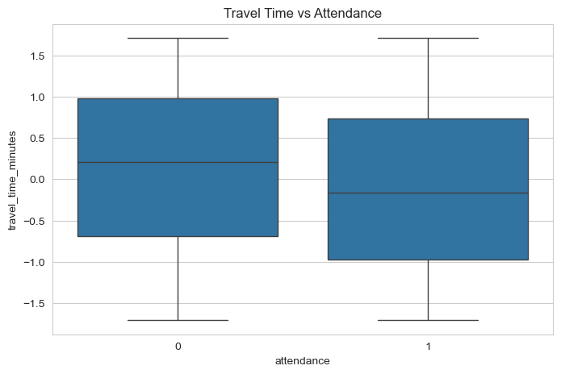
Visualizations
Study hours & travel time effects
Figure 3 — Students who attend report higher study hours on average (r ≈ 0.20).
Figure 4 — Longer commutes trend with lower attendance (r ≈ -0.13).
Student Attendance — Exploratory Data Analysis
06

Slide 7




Key Insights
What the data tells us
Class type is the #1 driver
Weather drags attendance down
Study habits track attendance
Online classes: 59.9% attendance vs. offline: 48.0% — a 12-point gap.
Rainy days fall to 41.6% attendance, well below all other conditions.
Study hours (+0.20) and sleep hours (+0.13) both correlate positively.
Commute length matters
Demographics barely move the needle
Watch for data leakage
Travel time correlates negatively with attendance (r ≈ -0.13).
Gender, course, year, parent education: all under a 2-point spread.
absence_reason perfectly predicts attendance — exclude it from modeling.
Student Attendance — Exploratory Data Analysis
07

Slide 8


Conclusion
Class format and weather conditions matter most — flexible or hybrid options on rainy days could meaningfully lift attendance.
Commute length is a real barrier — flexible policies could help students with long travel times.
Demographic-based interventions are not supported by this data — focus efforts elsewhere.
Exclude absence_reason from any predictive model — it leaks the outcome rather than predicting it.
Thank you

