Slide 1



GRAINS
Enabling High-Performance and Low-Cost
Graph-Based Genome Analysis
via Storage-Aware Algorithm-Architecture Co-Design
Nika Mansouri Ghiasi Harun Mustafa Talu Güloglu Rakesh Nadig
Konstantina Koliogeorgi Susana Rebolledo Ruiz Marc Rautmann Furkan Eris
Mohammad Sadrosadati Jisung Park Onur Mutlu

Slide 2


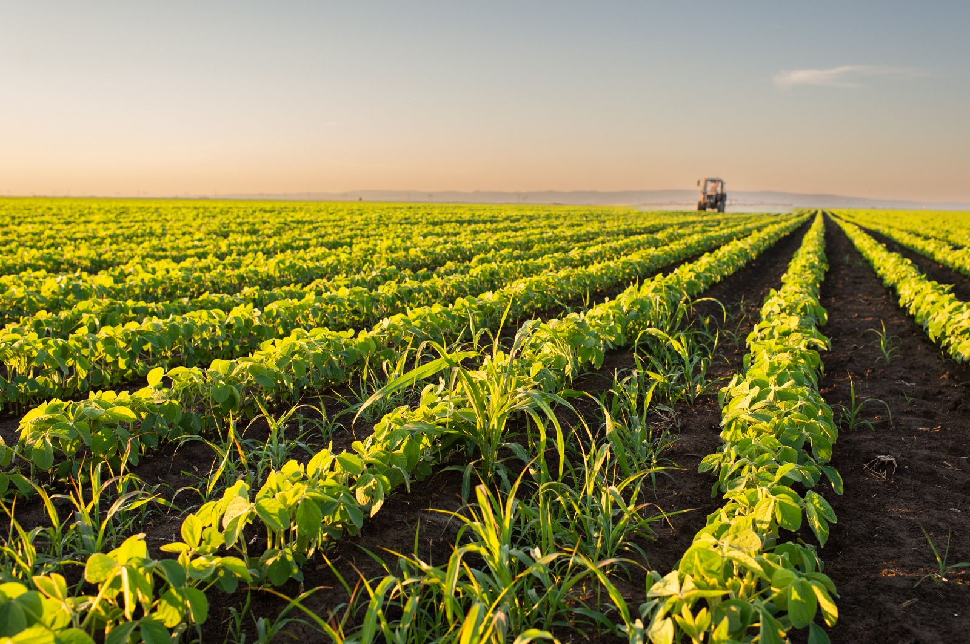

Applications of Genome Analysis
Precision Medicine
Outbreak Prevention
and Management
Agriculture
Scientific Discovery
& Many More…
Notes:
Genome analysis plays key roles in many applications
Related to health
Life sciences
And beyond

Slide 3
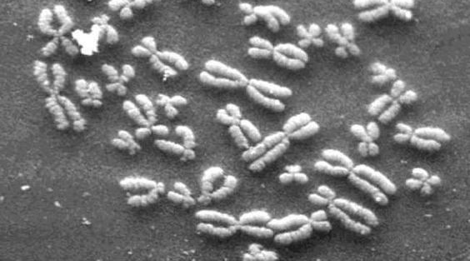
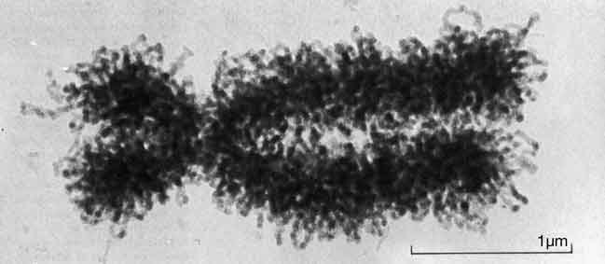
DNA Under Electron Microscope
human chromosome #12
from HeLa cell
Notes:
To get the organisms' genomic information
encoded in their nucleotide sequences,
such as DNA,
into a digital format for analysis…

Slide 4
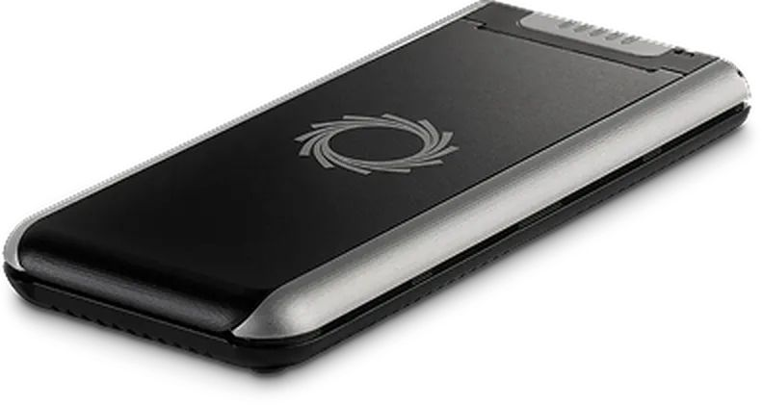
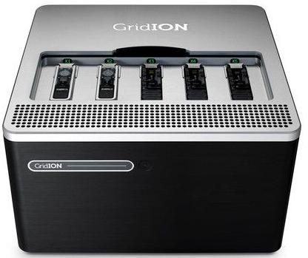
High-Throughput Sequencers
Oxford
Nanopore
PromethION
Pacific
Biosciences
Sequel II
Illumina MiSeq
Oxford
Nanopore
MinION
Oxford
Nanopore GridION
Illumina NovaSeq 6000
Pacific Biosciences RS II
… and more! All produce data with different properties.
Notes:
We rely on high-throughput sequencers

Slide 5

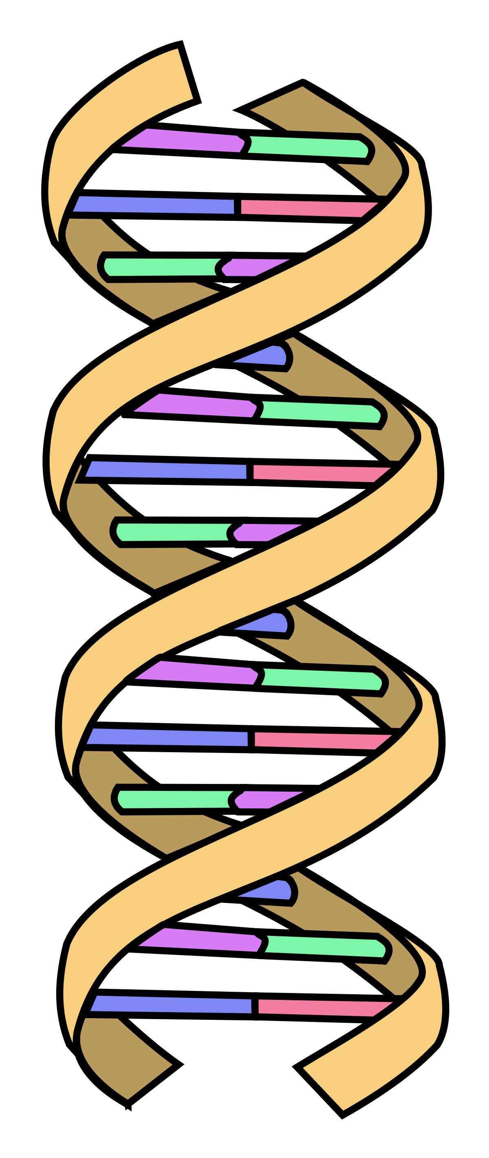
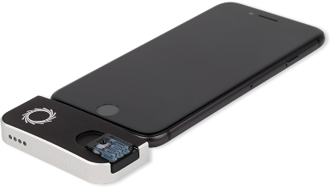
High-Throughput Sequencers
Oxford
Nanopore
PromethION
Sequencing technologies
extract smaller fragments of the original DNA sequence, known as reads
Pacific
Biosciences
Sequel II
Illumina MiSeq
Oxford Nanopore MinION
AAGCTTCCATGG
Oxford
Nanopore SmidgION
AAATGGGCTTTC
GCTTCCAGAATG
GCCCAAATGGTT
Illumina NovaSeq 6000
Pacific Biosciences RS II
… and more! All produce data with different properties.
Notes:
Sequencing technologies
extract smaller fragments of the original DNA sequence, known as reads

Slide 6

Genome Analysis
Read Set
Reference Genome
AAGCTTCCATGG
AAATGGGCTTTC
GCTTCCAGAATG
Large-Scale Databases
(e.g., containing reference genomes
from many species
or previously sequenced samples)
GCCCAAATGGTT
Determine species or genomic features present in the sample
Find differences from genomes in the reference genome or database
Notes:
A set of reads sequenced from an organism, called a read set
Then goes through genome analysis
Which involves looking up the reads
In a reference genome or
In Large-Scale Databases (e.g., containing reference genomes from many species or previously sequenced samples)
TO
Determine species or genomic features present in the sample
Find differences from genomes in the reference genome or database

Slide 7
Large-Scale Genome Graphs
GTGGATTATGCCGAGGCTA
GTGGATTATGCCGAGGCTA
GTGGATTATGTCGAGGCTA
GTGGATTATGACGAGGCTA
GTGGATTATGTCGAGGCTA
GTGGATTATGACGAGGCTA
GTGG
GTGG
GTGG
GTGG
GTGG
GTGG
TGGA
TGGA
TGGA
TGGA
TGGA
…
TGGA
…
…
…
…
…
TATG
Input
Sequences
TATG
TATG
TATG
TATG
TATG
ATGC
ATGC
ATGT
ATGA
ATGT
ATGA
TGCC
TGCC
TGTC
TGAC
TGTC
TGAC
GCCG
GCCG
GTCG
GACG
GTCG
GACG
CCGA
CCGA
TCGA
ACGA
TCGA
ACGA
CGAG
CGAG
CGAG
CGAG
CGAG
CGAG
…
…
…
…
…
…
Graph Representation
ATGACGA
GTGGATTATG
ATGCCGA
CGAGGCTA
ATGTCGA
Powerful and efficient representation of genomic data
✓
✓
Great expressive power
Compact representation
Notes:
Unlike traditional models, which represent genomic databases as a collection of disjoint, linear sequences, sequences in a graph are represented by graph walks
And that leads to a powerful and efficient representation of genomic data due to
great expressive power of graph topology and
its compact representation

Slide 8

Large-Scale Genome Graphs
Critical for enabling massive, population-scale analyses
https://sangerinstitute.blog/2023/05/10/a-representative-reference-genome/
Notes:
Which are Critical for enabling massive, population-scale analyses

Slide 9
Data Movement Overheads
Data Movement
Storage
System
Main
Memory
Cache
Computation
Unit
(CPU or Accelerator)
Data movement overhead
Notes:
Due to large sizes of genome graph databases,
Graph-based genome analysis incurs large data movement overheads from the storage system

Slide 10
Storage-Centric Computing
Storage
System
Main
Memory
Cache
Computation
Unit
(CPU or Accelerator)
Notes:
While storage-centric computing,
Which refers to processing data inside the storage system
Where it originally resides
Can be a fundamental approach to address this data movement overhead

Slide 11
Challenges
Storage
System
Main
Memory
Cache
Computation
Unit
(CPU or Accelerator)
Graph-based sequence analysis tools
cannot run in storage due to SSD limitations
Dependent and random accesses to the sequence graph
Different properties from conventional, non-genome graphs
Notes:
None of the Graph-based sequence analysis tools
can run in storage due to SSD limits
And this challenge are exacerbated due to Dependent and random accesses to the sequence graph
The fact that genome graphs show Different properties from conventional, non-genome graphs

Slide 12
GRAINS
The first system for analysis with large-scale genome graphs in storage
Enabled via storage-aware algorithm-architecture co-design, based on the properties of large-scale genome graphs to
  Make the execution pipeline more storage-friendly
  Further improve performance, energy-efficiency, and cost-effectiveness via
  storage-centric computing
Host
System
Internal
DRAM
SSD Controller
Flash
Cntrl.
Channel#1
NAND
Die#1
NAND
Die#2
…
NAND
Die#M
Cores
…
FTL
Flash
Cntrl.
Baseline
Metadata
Channel#N
NAND
Die#1
NAND
Die#2
…
NAND
Die#M
GRAINS-Enabled SSD
Notes:
By addressing these challenges, we introduce GRAINS…

Slide 13
GRAINS
The first system for analysis with large-scale genome graphs in storage
Enabled via storage-aware algorithm-architecture co-design, based on the properties of large-scale genome graphs to
  Make the execution pipeline more storage-friendly
  Further improve performance, energy-efficiency, and cost-effectiveness via
  storage-centric computing
Higher performance
(by 1.5×–47.8×)
Higher energy efficiency
(by 3.1×–31.6x)
Higher cost effectiveness
Host
System
Internal
DRAM
SSD Controller
Flash
Cntrl.
Channel#1
NAND
Die#1
NAND
Die#2
…
NAND
Die#M
Cores
…
FTL
Flash
Cntrl.
Baseline
Metadata
Channel#N
NAND
Die#1
NAND
Die#2
…
NAND
Die#M
GRAINS-Enabled SSD
Notes:
We show that compared to the state-of-the-art software and hardware baselines,
GRAINS significantly improves performance, energy-efficiency, and cost-effectiveness of
Graph-based genome analysis
2:45

Slide 14
Outline
Background
Motivation and Goal
GRAINS
Evaluation
Conclusion
Notes:
That was a brief overview of my talk. Let me tell you a little more about background on genome graphs

Slide 15


Genome Graphs
GTGGATTATGCCGAGGCTA
GTGGATTATGCCGAGGCTA
GTGGATTATGTCGAGGCTA
GTGGATTATGACGAGGCTA
GTGGATTATGTCGAGGCTA
GTGGATTATGACGAGGCTA
GTGG
GTGG
GTGG
GTGG
GTGG
GTGG
TGGA
TGGA
TGGA
TGGA
TGGA
…
TGGA
…
…
…
…
…
TATG
Input
Sequences
TATG
TATG
TATG
TATG
TATG
ATGC
ATGC
ATGT
ATGA
ATGT
ATGA
TGCC
TGCC
TGTC
TGAC
TGTC
TGAC
GCCG
GCCG
GTCG
GACG
GTCG
GACG
CCGA
CCGA
TCGA
ACGA
TCGA
ACGA
CGAG
CGAG
CGAG
CGAG
CGAG
CGAG
…
…
…
…
…
…
u
v
K-mer:
subsequence of length k
De Bruijn
Graph
Unitig
Compacted
De Bruijn
Graph
Notes:
As mentioned before, Unlike traditional models, which represent genomic databases as a collection of disjoint, linear sequences, sequences in a graph are represented by graph walks
To efficiently represent large-scale genome graphs, de Bruijn graphs have been widely adopted due to their great scalability as graph database entries grow
Here, I am showing an example of a de Bruijn graph, where each node is a unique k-mer (i.e., a subsequence of length k) that is observed in the input,
and there is a directed edge from node u to node v if the suffix of length (k − 1) of u is equal to the prefix of length (k −1) of v.
This powerful representation enables storing the graph by only storing nodes or only storing edges, and representing the other one implicitly.
Also note that Each node’s color represents its metadata (which refers to the database entry it corresponds to).
A common strategy to reduce a de Bruijn graph’s size is to instead store its corresponding compacted de Bruijn graph, where all k-mers from a maximal non-branching path (called a unitig) are merged into a single node.

Slide 16


Graph-Based Genome Analysis
Read Set
Input Query Preparation
AAGCTTCCATGG
AAGCTTCCATGG
AAATGGGCTTTC
AAGC
GCTTCCAGAATG
AGCT
…
GCTT
…
GCCCAAATGGTT
Graph Query
Graph-Based Database
K-Mer Lookup
Read Mapping
Notes:
Graph-based genome analysis involves querying reads against the graph
To this end, graph-based genome analysis tools first prepare input queries by extracting k-mers out of the reads
And query the graphs, which involves k-mer lookups and/or
Read mapping, to find exact similarities and differences between reads against sub-sequences of the graph

Slide 17
Outline
Background
Motivation and Goal
GRAINS
Evaluation
Conclusion
Notes:
Since graph-based genome analysis requires accessing large genome graph databases…

Slide 18
Motivation
Case study of the performance of graph-based genome analysis tools
With various state-of-the-art SSD configurations
Node-Centric Tool
Edge-Centric Tool
2.7x
4.3x
8.2x
17.4x
4.3x
7.5x
13.4x
23.6x
Normalized Throughput
Graph Database
Graph Database
I/O data movement causes significant performance overhead
Overhead increases as databases grow
Notes:
We perform a case study on the throughput of node-centric and edge-centric graph-based genome analysis tools
with various state-of-the-art SSD configurations
We observe that compared to a hypothetical configuration with zero performance overhead due to storage I/O,
I/O data movement causes significant performance overhead
And this overhead increases as databases grow

Slide 19
I/O Overhead is Hard to Avoid
I/O overhead due to accessing large, low-reuse data is hard to avoid
Sampling techniques to shrink database sizes
[Wood+, Genome Biology’19], [Ounit+, BMC Genomics’15], [Kim+, Genome Research’16], …
Reduce accuracy to levels unacceptable for many use cases
Keeping all data required by graph-based genome analysis
completely and always resident in main memory
Energy inefficient, costly, unscalable, and unsustainable
Database sizes increase rapidly
Different analyses need different databases
Notes:
I/O overhead from moving large, low-reuse data is hard to avoid
One might think it is possible to avoid this overhead by
using sampling techniques to shrink database sizes
However, this approach inevitably reduces accuracy to levels unacceptable for many use cases
Or another potential solution might seem to be
Keeping all data required by graph-based genome analysis
completely and always resident in main memory
However, this is energy inefficient, costly, unscalable, and unsustainable due to two reasons
First, the sizes of genome graph databases (which are already large) have been increasing rapidly.
Second, regardless of the sizes of individual databases, different analyses need different databases,
with information from different sets of genomes or with varying parameters.
Therefore, it is inefficient and unsustainable to maintain all data required by all possible analyses in main memory at all times

Slide 20
Our Goal
Improve graph-based genome analysis performance
by reducing large data movement overhead
from the storage system
in a cost-effective manner and with high accuracy
Notes:
Motivated by these points, Our Goal is to Improve graph-based genome analysis performance
by reducing the large data movement overhead from the storage system in a cost-effective manner

Slide 21
Challenges of In-Storage Processing
No graph-based genome analysis tools can run in-storage due to SSD limitations
  Long access latency of NAND flash chips
  Limited DRAM capacity inside the SSD
  Limited DRAM bandwidth inside the SSD
FTL
SSD
Controller
SSD DRAM
Cores
SSD
Cntrl
Cntrl
⋯
Channel#1
⋯
Channel#N
Notes:
While storage-centric computing (SCC) can be a promising direction to achieve our goal by processing data directly inside the storage device,
none of the existing approaches can be effectively implemented
as an SCC system due to limited hardware resources in the SSD such as
Long latency of NAND flash chips
Limited DRAM capacity inside the SSD
And its limited bandwidth

Slide 22
Challenges of In-Storage Processing
No graph-based genome analysis tools can run in-storage due to SSD limits
  Long latency of NAND flash chips
  Limited DRAM capacity inside the SSD
  Limited DRAM bandwidth inside the SSD
Dependent and random accesses to the sequence graph
Different properties from conventional, non-genome graphs
FTL
SSD
Controller
SSD DRAM
Cores
SSD
Cntrl
Cntrl
⋯
Channel#1
⋯
Channel#N
Notes:
All these limitations are pronounced due to
Dependent and random accesses to the sequence graph
Different properties that these graphs have from conventional, non-genome graphs

Slide 23
Outline
Background
Motivation and Goal
GRAINS
Evaluation
Conclusion
Notes:
By addressing these challenges…

Slide 24
GRAINS
The first system for analysis with large-scale genome graphs in storage
Enabled via storage-aware algorithm-architecture co-design, based on the properties of large-scale genome graphs to
  Make the execution pipeline more storage-friendly
  Further improve performance, energy-efficiency, and cost-effectiveness via
  storage-centric computing
Host
System
Internal
DRAM
SSD Controller
Flash
Cntrl.
Channel#1
NAND
Die#1
NAND
Die#2
…
NAND
Die#M
Cores
…
FTL
Flash
Cntrl.
Baseline
Metadata
Channel#N
NAND
Die#1
NAND
Die#2
…
NAND
Die#M
GRAINS-Enabled SSD

Slide 25
GRAINS’s Algorithm-Architecture Co-Design
New batching technique and execution flow
based on the unique features of genome graphs
that reduces #random accesses
Host
System
Internal
DRAM
SSD Controller
Flash
Cntrl.
Channel#1
NAND
Die#1
NAND
Die#2
…
NAND
Die#M
Cores
…
Input Query Processing
Flash
Cntrl.
Channel#N
NAND
Die#1
NAND
Die#2
…
NAND
Die#M
GRAINS-Enabled SSD
Notes:
GRAINS's algorthim-architecture co-design consists of four key aspects...

Slide 26
GRAINS’s Algorithm-Architecture Co-Design
New batching technique and execution flow
based on the unique features of genome graphs
that reduces #random accesses
In-storage and In-flash processing
to avoid transferring low-reused pages
and bandwidth waste
Host
System
Internal
DRAM
SSD Controller
Flash
Cntrl.
Channel#1
NAND
Die#1
PE
NAND
Die#2
PE
NAND
Die#M
…
PE
ECC_{LITE}
ECC_{LITE}
ECC_{LITE}
Cores
…
Input Query Processing
Flash
Cntrl.
Channel#N
NAND
Die#1
PE
NAND
Die#2
PE
NAND
Die#M
…
PE
ECC_{LITE}
ECC_{LITE}
ECC_{LITE}
PE
GRAINS-Enabled SSD

Slide 27
GRAINS’s Algorithm-Architecture Co-Design
New batching technique and execution flow
based on the unique features of genome graphs
that reduces #random accesses
In-storage and In-flash processing
to avoid transferring low-reused pages
and bandwidth waste
Host
System
Internal
DRAM
SSD Controller
Flash
Cntrl.
Channel#1
NAND
Die#1
PE
NAND
Die#2
PE
NAND
Die#M
…
PE
ECC_{LITE}
ECC_{LITE}
ECC_{LITE}
Cores
…
GRAINS FTL
Flash
Cntrl.
Input Query Processing
Channel#N
GRAINS
Metadata
NAND
Die#1
PE
NAND
Die#2
PE
NAND
Die#M
…
PE
ECC_{LITE}
ECC_{LITE}
ECC_{LITE}
PE
GRAINS-Enabled SSD
FTL and data placement
based on genome graph properties,
to leverage SSD’s full internal bandwidth

Slide 28
GRAINS’s Algorithm-Architecture Co-Design
New batching technique and execution flow
based on the unique features of genome graphs
that reduces #random accesses
In-storage and In-flash processing
to avoid transferring low-reused pages
and bandwidth waste
Host
System
Internal
DRAM
SSD Controller
Flash
Cntrl.
Channel#1
NAND
Die#1
PE
NAND
Die#2
PE
NAND
Die#M
…
PE
Scheduler Tables
ECC_{LITE}
ECC_{LITE}
ECC_{LITE}
Lightweight Scheduler
Cores
…
GRAINS FTL
Flash
Cntrl.
Input Query Processing
Channel#N
GRAINS
Metadata
NAND
Die#1
PE
NAND
Die#2
PE
NAND
Die#M
…
PE
ECC_{LITE}
ECC_{LITE}
ECC_{LITE}
PE
GRAINS-Enabled SSD
FTL and data placement
based on genome graph properties,
to leverage SSD’s full internal bandwidth
Lightweight scheduling technique
enabled by repurposing the existing SSD structures to leverage the full parallelism of all flash dies

Slide 29
GRAINS
❶
Read Set
Input Query Preparation
AAGCTTCCATGG
AAGCTTCCATGG
AAATGGGCTTTC
AAGC
GCTTCCAGAATG
AGCT
…
GCTT
…
GCCCAAATGGTT
❷
Graph Query
Graph-Based Database
K-Mer Lookup
Read Mapping
Notes:
Now, let me give a walkthrough of GRAINS’s steps, which involves
Input query preparation an
Graph query

Slide 30
Data Structures
❶
Read Set
Input Query Preparation
AAGCTTCCATGG
AAGCTTCCATGG
AAATGGGCTTTC
AAGC
GCTTCCAGAATG
AGCT
…
GCTT
…
GCCCAAATGGTT
❷
Graph Query
Graph-Based Database
K-Mer Lookup
Read Mapping
Notes:
First, let’s take a look at data structures

Slide 31
Data Structures
Unitig
ACGTAGCTGACTATCCTGAAGTTCGATCGATGCTAGCTTCTT.GATAGCTGCGTAGTAGCTAGTCGATTTTCGAAGCTAGTCGTTGC.TAGTCGAGCCATCAGTCGACTGCCGAT.CGTAGCGACATCCTGAAAATTGACTAGTCTAGTTCGTTTAGGCCAATGCTAGCTAGTC.GATCGTAGGACTGCTA…
Strings
[SSHash, Bioinformatics’22]
Notes:
GRAINS adopts a node-centric De Bruijn Graph representation based on an fast and space-efficient associative dictionary
to compactly represent graph sequences and their associated colors
We store De Bruijn Graph’s unitigs as contiguous strings in a predetermined order,
so that a k-mer occurring in any unitig can be quickly located using a minimal perfect hash function built for the set of k-mers.
The unitigs in Strings are indexed via Sizes and Offsets.
Consider a query k-mer g.
First, its minimizer (i.e., the first m-mer with the smallest hash value) is extracted
Second, with the minimizer’s minimal perfect hash value, Sizes is indexed
Third, with the Sizes values, here 7, Offsets is indexed.
Fourth, with the Offsets values, Strings is indexed and a window of a specific length in Strings is checked to
find the minimizer and check if the rest of the k-mer matches

Slide 32
Data Structures
Query k-mer g = ACATCCTGAAAATTGA
Hash
0 | 1 | 2 | 3 | 4 | 5 | 6 | 7 | 8 | 9 | 10 | 11 | 12 | …
Sizes
0 | 1 | 2 | 3 | 5 | 7 | 8 | 10 | 11 | 12 | 13 | 15 | 16 | …
0 | 1 | 2 | 3 | 4 | 5 | 6 | 7 | 8 | 9 | 10 | 11 | 12 | …
Offsets
29 | 172 | 20 | 50 | 329 | 0 | 246 | 118 | 9 | 364 | 105 | 30 | 319 | …
ACGTAGCTGACTATCCTGAAGTTCGATCGATGCTAGCTTCTT.GATAGCTGCGTAGTAGCTAGTCGATTTTCGAAGCTAGTCGTTGC.TAGTCGAGCCATCAGTCGACTGCCGAT.CGTAGCGACATCCTGAAAATTGACTAGTCTAGTTCGTTTAGGCCAATGCTAGCTAGTC.GATCGTAGGACTGCTA…
Strings
[SSHash, Bioinformatics’22]
Notes:
GRAINS adopts a node-centric De Bruijn Graph representation based on an fast and space-efficient associative dictionary
to compactly represent graph sequences and their associated colors
We store De Bruijn Graph’s unitigs as contiguous strings in a predetermined order,
so that a k-mer occurring in any unitig can be quickly located using a minimal perfect hash function built for the set of k-mers.
The unitigs in Strings are indexed via Sizes and Offsets.
Consider a query k-mer g.
First, its minimizer (i.e., the first m-mer with the smallest hash value) is extracted
Second, with the minimizer’s minimal perfect hash value, Sizes is indexed
Third, with the Sizes values, here 7, Offsets is indexed.
Fourth, with the Offsets values, Strings is indexed and a window of a specific length in Strings is checked to
find the minimizer and check if the rest of the k-mer matches

Slide 33
Data Structures
Query k-mer g = ACATCCTGAAAATTGA
Hash
0 | 1 | 2 | 3 | 4 | 5 | 6 | 7 | 8 | 9 | 10 | 11 | 12 | …
Sizes
0 | 1 | 2 | 3 | 5 | 7 | 8 | 10 | 11 | 12 | 13 | 15 | 16 | …
0 | 1 | 2 | 3 | 4 | 5 | 6 | 7 | 8 | 9 | 10 | 11 | 12 | …
Offsets
29 | 172 | 20 | 50 | 329 | 0 | 246 | 118 | 9 | 364 | 105 | 30 | 319 | …
ACGTAGCTGACTATCCTGAAGTTCGATCGATGCTAGCTTCTT.GATAGCTGCGTAGTAGCTAGTCGATTTTCGAAGCTAGTCGTTGC.TAGTCGAGCCATCAGTCGACTGCCGAT.CGTAGCGACATCCTGAAAATTGACTAGTCTAGTTCGTTTAGGCCAATGCTAGCTAGTC.GATCGTAGGACTGCTA…
Strings
0
0
1
0
1
…
C₁
Graph Metadata for Unitigs with Color C₁
C₂
Graph Metadata for Unitigs with Color C₂
Color
Bitmap
C₃
…
[SSHash, Bioinformatics’22]
[Fulgor, WABI’23]
Notes:
For storing colors, we use an approach where we sort the unitigs in Strings based on their colors
We use a simple Color Bitmap to mark the start of each new color.
Colors are then the IDs pointing to the metadata for graph unitigs with those colors
This encoding efficiently stores repeated colors at low storage overhead

Slide 34
Input Query Processing
❶
Read Set
Input Query Preparation
AAGCTTCCATGG
AAGCTTCCATGG
AAATGGGCTTTC
AAGC
GCTTCCAGAATG
AGCT
…
GCTT
…
GCCCAAATGGTT
❷
Graph Query
Graph-Based Database
K-Mer Lookup
Read Mapping
Notes:
Now let’s go through the first step: Input Query Preparation

Slide 35
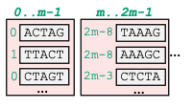
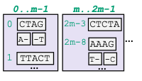

Input Query Processing
GRAINS prepares reads for efficient queries in the next step
  Performed in the host system due to large #writes
Cross-read k-mer batching
to reduce #random accesses
Genome-graph-aware query reordering
to improve access patterns
Read:
Batch#0
Batch#1
Batch#0
Batch#1
ACTAGTCGT…
K-mers:
Sizes
Hash
ACTAG
CTAGT
…
❶ K-mer
Extraction
❷ Sizes
Lookup
❹ Sorting
and Compaction
❸ Batching
Significantly smaller
than other sub-structures
+
Enables efficient
batching and compaction
Notes:
In this step, GRAINS prepares reads for efficient queries in the next step
This step is performed in the host system due to large #writes
In this step, GRAINS performs:
Cross-read k-mer batching to reduce #random accesses AND
Genome-graph-aware query reordering to improve access patterns
First, GRAIN extracts k-mers from query reads
Second, GRAINS performs Sizes lookup. We perform this step in the host system because
Sizes is significantly smaller than other sub-structures AND
Looking up Sizes in the host system enables opportunities for efficient batching and compaction of queries
Third, GRAINS batches the k-mers based on their sizes values
Fourth, GRAINS sorts the k-mers based on their sizes values.
during sorting, we further compact k-mers by exploiting the fact that consecutive k-mers sorted by Sizes share the same minimizer
So, we store the minimizer once
and keep only the differences, thereby significantly reducing the transferred data size

Slide 36
Graph Query
❶
Read Set
Input Query Preparation
AAGCTTCCATGG
AAGCTTCCATGG
AAATGGGCTTTC
AAGC
GCTTCCAGAATG
AGCT
…
GCTT
…
GCCCAAATGGTT
❷
Graph Query
Graph-Based Database
K-Mer Lookup
Read Mapping
Notes:
Now, let’s go through the second step, Graph Query

Slide 37
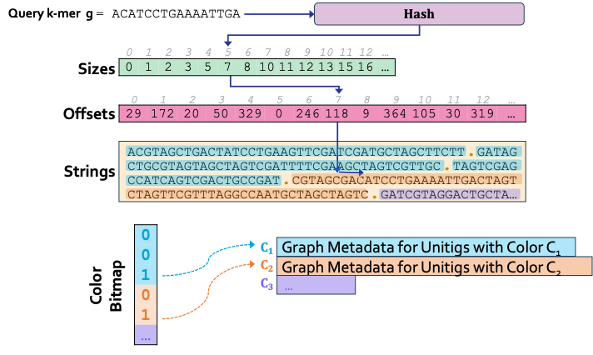
Graph Query: Overview
GRAINS looks up the query k-mers in the graph and retrieves their associated IDs
  By accessing Offsets

Slide 38
Graph Query: Overview
GRAINS looks up the query k-mers in the graph and retrieves their associated IDs
  By accessing Offsets, Strings

Slide 39
Graph Query: Overview
GRAINS looks up the query k-mers in the graph and retrieves their associated IDs
  By accessing Offsets, Strings, and Colors

Slide 40
Graph Query: Overview
GRAINS looks up the query k-mers in the graph and retrieves their associated IDs
  By accessing Offsets, Strings, and Colors
GRAINS executes this step inside the SSD since it
  Involves accessing large graph structures with low reuse
  Requires only lightweight computation
To efficiently execute this step, GRAINS needs to
  Leverage the large internal bandwidth
  Not require expensive hardware resources in the SSD
  (e.g., costly logic units or large DRAM capacity/bandwidth)

Slide 41
Graph Query: Offsets
Channel#1
Plane#1
Internal
DRAM
Page
Buffer
Die#1
…
Die#M
Host System
Chunk#i+1
SSD
Controller
…
Die I/O
Channel#N
ECC_{LITE}
…
Select
Chunk#i
Plane#L
Die#1
…
Die#M
Page
Buffer
GRAINS-Enabled SSD
Efficient pipeline between host and SSD
Sequential accesses to fully exploit internal bandwidth
Only a small part of each page moves outside the dies
Notes:
Now let me show you an overview of GRAINS’s Offsets lookups.
GRAINS receives Offsets indices and compacted k-mers from the host in chunks.
While a chunk is being analyzed inside the SSD
The next chunk is incoming from the host
Forming an efficient pipeline between the host and the in-SSD executions
Since the Sizes values are sorted by the host and Offsets are uniformly placed across flash dies,
the Offsets lookups lead to sequential accesses that fully exploit the SSD’s internal bandwidth
Now let’s look deeper inside a flash die
After loading a page into a die’s page buffer, GRAINS applies an adopted light ECC to correct errors
The in-flash processing units then select and extract only the targeted Offsets entry and send it to the controller,
avoiding the transfer of full pages.
GRAINS caches the extracted values in internal DRAM for Strings queries, as we will see next.

Slide 42
Graph Query: Strings
We aim for Strings accesses to fully exploit internal bandwidth as well
  However, unlike Offsets, the indices into Strings arrive unsorted
Channel#1
Internal DRAM
SSD
Cntrl.
GRAINS Scheduler Table_{1,1}
GST_{1,M}
Die#1
…
Die#M
…
Lightweight
Scheduler
Channel#N
GST_{N,M}
GST_{N,M}
Die#1
…
Die#M
GRAINS-Enabled SSD
One row per Strings page, each row storing
1) bit address in the page, 2) compacted k-mer info, 3) an overflow flag and pointer
Efficient address mapping frees most of the DRAM
Compact k-mer representation keeps GST entries small
Notes:
We aim for Strings accesses to fully exploit internal bandwidth as well
However, unlike Offsets, the indices into Strings arrive unsorted
To address this challenge, we introduce a lightweight scheduler on the SSD controller
Which maintains a small per-die GRAINS Scheduler Table (GST) in the internal DRAM,
with one row per Strings page. Each row stores
1) bit address in the page, 2) compacted k-mer info, and 3) an overflow flag and pointer
GRAINS can store GSTs in the internal DRAM because of
its efficient address mapping, which frees most of the DRAM, AND
its compact k-mer representation, which keeps GST entries small

Slide 43
Graph Query: Strings
We aim for Strings accesses to fully exploit internal bandwidth as well
  However, unlike Offsets, the indices into Strings arrive unsorted
Channel#1
Internal DRAM
SSD
Cntrl.
GRAINS Scheduler Table_{1,1}
GST_{1,M}
Plane#1
Die#1
…
Die#M
Page Buffer
…
Shift Reg
Lightweight Scheduler
Channel#N
Die I/O
…
GST_{N,M}
GST_{N,M}
ECC_{LITE}
Die#1
…
Die#M
Plane#L
==
Page Buffer
GRAINS-Enabled SSD
Avoids redundant page accesses
Maximizes die-level parallelism,
without relying on sorting accelerators
Notes:
When accessing Strings, GRAINS light scheduler schedules requests by simply reading one row per each GST sequentially
and issuing requests across all dies and planes in a round-robin manner.
This naturally coalesces requests to the same page and avoids redundant page accesses AND
Maximizes die-level parallelism, without relying on sorting accelerators
Next, again looking deeper into the flash die
GRAINS reads the corresponding Strings page,
and after ECCLITE,
the in-flash processing unit finds the matching unitig IDs and sends to the internal DRAM

Slide 44
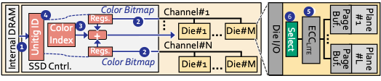
Graph Query: Colors
For each k-mer matching a unitig in Strings, GRAINS retrieves
the color of that unitig
GRAINS returns the colors to the host,
with colors identifying database entries (e.g., species or samples) containing the matched sequence
Design details are in the paper
Notes:
For each k-mer matching a unitig in Strings, GRAINS retrieves the color of that unitig
Retrieved colors are returned to the host,
where each color identifies the database entries (e.g., species or samples) containing the matched sequence
I invite you to check the paper for more design details for this step

Slide 45

Graph Query
❶
Read Set
Input Query Preparation
AAGCTTCCATGG
FTL Design details are in the paper
AAGCTTCCATGG
AAATGGGCTTTC
AAGC
GCTTCCAGAATG
AGCT
…
GCTT
…
GCCCAAATGGTT
❷
Graph Query
Graph-Based Database
K-Mer Lookup
Read Mapping
Notes:
Similary, more FTL design details are in the paper.

Slide 46
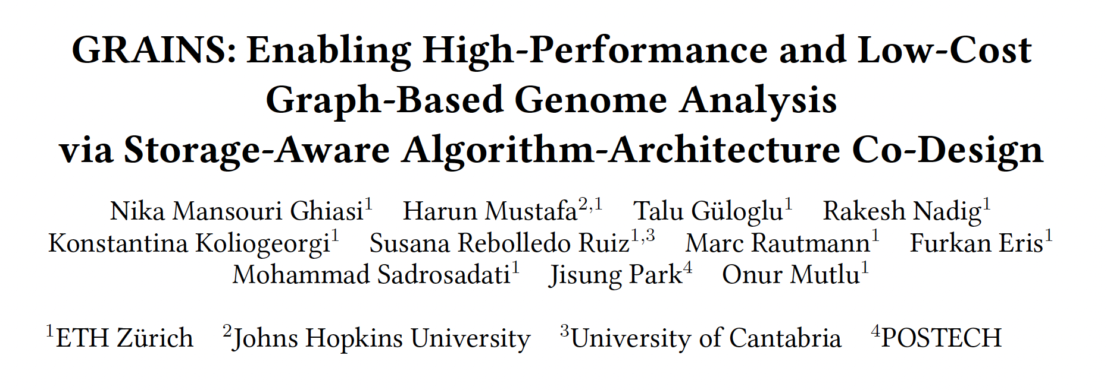

More in the Paper
https://arxiv.org/abs/2606.26468

Slide 47
Outline
Background
Motivation and Gaol
GRAINS
Evaluation
Conclusion
Notes:
Now, let’s go through evaluations

Slide 48
Evaluation Methodology Overview (I)
Performance, Energy, and Power Analysis
Hardware Components
Synthesized Verilog model for the in-storage accelerators
MQSim [Tavakkol+, FAST’18] for SSD’s internal operations
Ramulator [Kim+, CAL’15] for SSD’s internal DRAM
Software Components
Measure on a real system:
AMD® EPYC® host CPU with 128 physical cores
1.5 TB host DRAM
Baseline Comparison Points
Fulgor [WABI’23]: A state-of-the-art node-centric tool
MetaGraph [Nature’25]: A state-of-the-art edge-centric tool
AccIdealMem: An idealized accelerator for graph queries with no main memory overheads, but still suffers from the I/O overhead of moving a large amount of low-reuse data
SSD Configurations
SSD-G4: With PCIe Gen4 interface (7 GB/s sequential read bandwidth)
SSD-G5: With PCIe Gen5 interface (14.8 GB/s sequential read bandwidth)
Notes:
We model performance, energy, and power of the systems based on
each hardware-based and software-based component
We valuate the following baselines:
...
We evaluate these tools on systems with different state-of-the-art SSD configurations

Slide 49
Evaluation Methodology Overview (II)
Graph-Based Genome Analysis Task
K-mer set lookup
Alignment-based read mapping
Alignment-free read mapping
Query Samples
With varying sizes
  Small
  Medium
  Large
Notes:
We evaluate two graph-based genome analysis tasks
on querying samples of varying sizes

Slide 50
Benefits over Software
When performing k-mer set lookups
SSD-G4
SSD-G5
22.3
16.1
8.4
5.5x
8.5x
11.9
Speedup
GRAINS provides significant speedup over
Fulgor and Metagraph baselines, with both SSD-G4 and SSD-G5
GRAINS improves average energy-efficiency
by 11.3x and 21.5x over Fulgor and Metagraph, respectively
Notes:
We observe that on systems with both types of SSDs
GRAINS provides significant speedups compared to both software baselines
While also significantly improving energy efficiency

Slide 51
Benefits over Hardware
When performing k-mer set lookups
SSD-G4
17.0
SSD-G5
11.6
7.4x
Speedup
4.3x
GRAINS provides significant speedups over
AccIdealMem baseline
GRAINS improves average energy-efficiency
by 3.1—20.7x over AccIdealMem
Notes:
Similarly, we observe large performance and energy benefits compared to the hardware baseline

Slide 52
System Cost-Efficiency
Cost-optimized system ($): With SSD-G4 and 64-GB Host DRAM
Performance-optimized system ($$$): With SSD-G5 and 1-TB Host DRAM
13.2x
26.9x
4.7x
7.2x
Speedup
($)
($)
($$$)
($$$)
($)
GRAINS outperforms the baselines
even when running on a much less costly system
Notes:
Next, I am going to show you the impact of GRAINS on system cost efficiency
Consider a cost-optimized system with PCIe Gen4 SSD and 64-GB DRAM
a performance-optimized system with PCIe Gen5 SSD and 1-TB DRAM
We compare baselines on both systems with GRAINS on the cost-optimized system
And observe that GRAINS provides large benefits when compared to baselines on the cost-optimized system
And we also observe that GRAINS outperforms the baselines
even when running on a much less costly system

Slide 53
System Cost-Efficiency
Cost-optimized system ($): With SSD-G4 and 64-GB Host DRAM
Performance-optimized system ($$$): With SSD-G5 and 1-TB Host DRAM
GRAINS improves system cost-efficiency
and makes graph-based genome analysis
more accessible for wider adoption
13.2x
26.9x
4.7x
7.2x
Speedup
($)
($)
($$$)
($$$)
($)
GRAINS outperforms the baselines
even when running on a much less costly system
Notes:
Next, I am going to show you the impact of GRAINS on system cost efficiency
Consider a cost-optimized system with PCIe Gen4 SSD and 64-GB DRAM
a performance-optimized system with PCIe Gen5 SSD and 1-TB DRAM
We compare baselines on both systems with GRAINS on the cost-optimized system
And observe that GRAINS provides large benefits when compared to baselines on the cost-optimized system
And we also observe that GRAINS outperforms the baselines
even when running on a much less costly system

Slide 54
Area and Power
Based on Synthesis of GRAINS’s hardware units using the Synopsys Design Compiler @ 22nm technology node
ECC_{LITE} area based on the original paper [AiF, ISCA’25]
Logic unit | Area [mm²] | Power [mW]
On SSD Controller | 0.0025 | 0.21
On Die (ECC_LITE) | 0.036 | 18.04
On Die (Others) | 0.000093 | 0.01
On-controller logic units are 0.7% of the four cores on an SSD controller
On-die logic units take only 0.2% of the flash die’s area
and fit well within its power budget
Notes:
Based on Synthesis of GRAINS’s hardware units
We observe that
On-controller logic units are only a small fraction of the four cores on an SSD controller
And
On-die logic units take only also a very small fraction of the flash die’s area
and fit well within its power budget

Slide 55
More in the Paper
GRAINS’s speedups as an accelerator outside the SSD
Impact of different GRAINS optimizations in isolation
  Batching
  Batching + Scheduling
  Batching + Scheduling + SCC
GRAINS’s speedups with varying #SSDs
Execution time breakdown of different steps
GRAINS’s integration with state-of-the-art graph alignment accelerator
GRAINS’s speedup when performing Alignment-Free Read Mapping
Notes:
There are may more results in the paper, that I invite you to check, such as

Slide 56
More in the Paper
https://arxiv.org/abs/2606.26468

Slide 57
Outline
Background
Motivation and Goal
GRAINS
Evaluation
Conclusion

Slide 58
Conclusion
Graph-based genome analysis analysis suffers from
significant storage I/O data movement overhead
GRAINS
The first system for large-scale genome graphs analysis in storage
Enabled via storage-aware algorithm-architecture co-design,
exploiting the properties of large-scale genome graphs
Improves performance
2.7×–47.8× over software baselines
1.5×–17.0× over hardware software
Reduces energy consumption
4.4×–31.6× over software baseline
3.1×–20.7× over hardware baseline
Improves system cost-effectiveness
Makes graph-based genome analysis
more accessible for wider adoption

Slide 59
GRAINS:
Enabling High-Performance and Low-Cost
Graph-Based Genome Analysis
via Storage-Aware Algorithm-Architecture Co-Design
Nika Mansouri Ghiasi Harun Mustafa Talu Güloglu Rakesh Nadig
Konstantina Koliogeorgi Susana Rebolledo Ruiz Marc Rautmann Furkan Eris
Mohammad Sadrosadati Jisung Park Onur Mutlu

Slide 60
Backup Slides

Slide 61
Unique Characteristics of Genome Graphs
Different Node and Edge Encodings
  Traditional graphs must explicitly store O(N) to O(N²) edges
  DBGs store only nodes or edges and the other is derived implicitly
  Enabled by the inherent overlap structure of encoded sequences
Different Structural Characteristics
  In/out-degrees capped at 4 (A, C, G, T), regardless of graph size
  Power-law hub optimizations from conventional graphs are inapplicable
  Necessitates fundamentally different optimization approaches
Different Access Pattern Optimizations
  Compressed data structures enforce node orderings ➔ no reordering possible
  Structural coupling between queries and graph enables unique locality optimizations
  Query reads sharing k-mer substrings map to nearby index regions

Slide 62
Benefits Outside the SSD (I)
Key benefits of storage-centric designs outside storage
  Alleviating the burden of moving and analyzing low-reuse data
  More storage-friendly execution pipelines: Efficient access patterns, and fewer random accesses
    Efficient use of the available I/O bandwidth
    Less reliance on large DRAM capacity
However, there are more benefits from analysis inside the storage
  Higher IFP/ISP bandwidth
  Avoid moving low-reuse data
  Does not rely on wider external interfaces

Slide 63
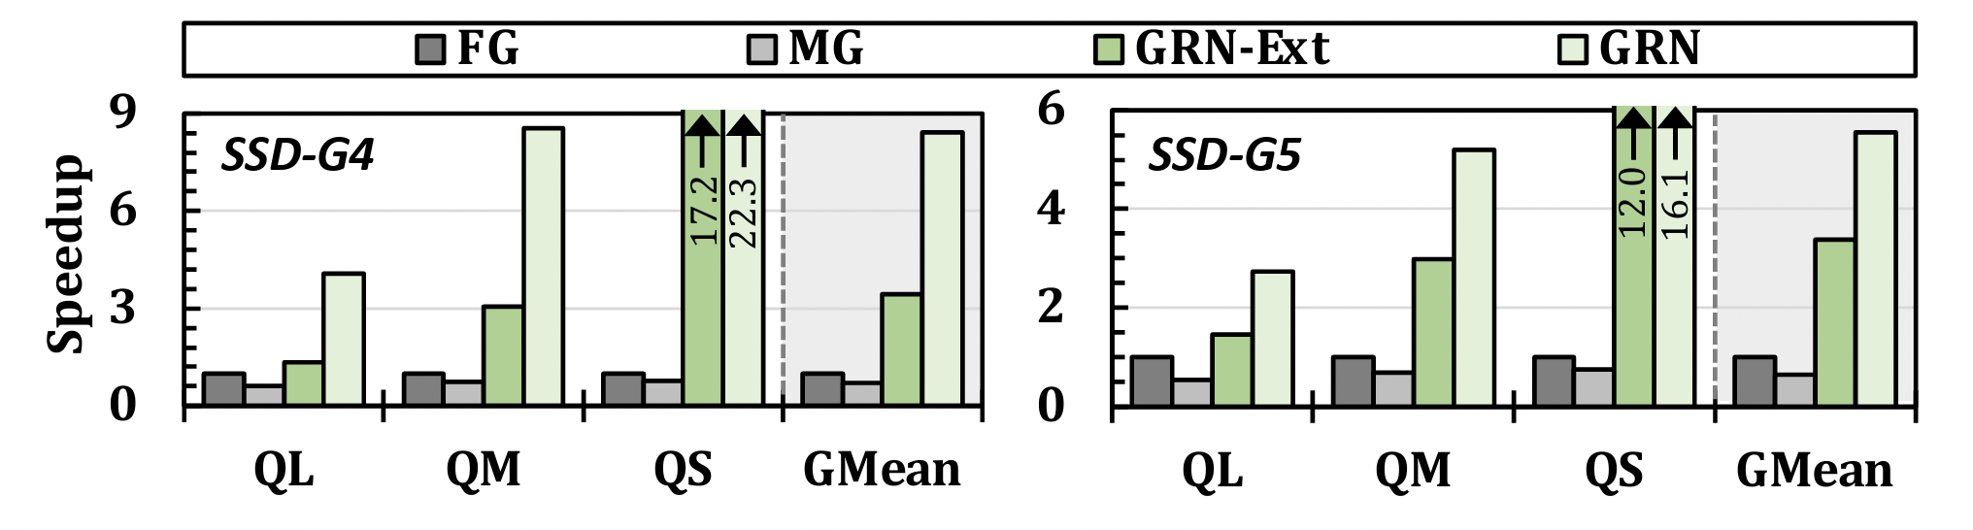
Benefits Outside the SSD (II)

Slide 64
Motivation
Case study of the performance of genome graph analysis tools
With various state-of-the-art SSD configurations and data sizes
(i)
(ii)
Normalized
Throughput
#Query Reads
#Query Reads
(i)
(ii)
Normalized
Throughput
SRArep (161 GB) MetaSUB (659 GB)
SRArep (161 GB) MetaSUB (659 GB)
Graph Database
Graph Database
I/O data movement causes significant performance overhead

Slide 65
Effect of Different GRAINS Optimizations
SSD-G4
SSD-G5
10.0
8.8
17.2
12.0
Speedup

Slide 66
Speedup for Alignment-Free Read Mapping
SSD-G4
SSD-G5
9.9
19.1
13.8
Speedup
10.6

Slide 67
Alignment-Based Read Mapping
Integrating GRAINS with a state-of-the-art graph alignment accelerator, SeGraM [ISCA’22]
Speedup
When integrated with SeGraM,
GRAINS provides significant speedup over
Fulgor and Metagraph baselines, with both SSD-G4 and SSD-G5
Notes:
Next, we evaluate GRAINS when integrated with a state-of-the-art graph alignment accelerator, SeGraM
And show that GRAINS integrated with SeGraM significantly outperforms other baselines integrated with SeGraM

Slide 68
Speedup with Different Numbers of SSDs
SSD-G4
SSD-G5
Speedup

