Slide 1
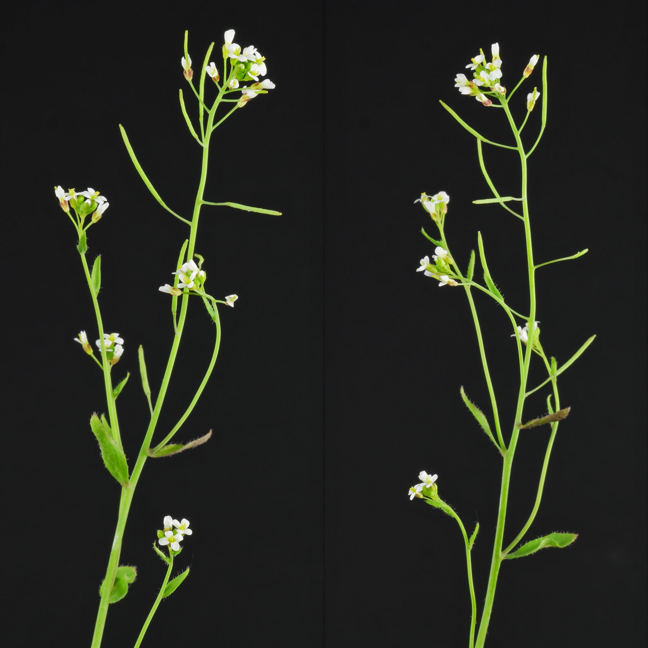
From root images to robot motion
N P E C × B U A S
Autonomous root tip targeting with computer vision,
PI control and reinforcement learning
Arabidopsis thaliana
HADES / NPEC
Nika Soleimanzadeh | 244258 | BUas ADSAI
01 / 15

Slide 2
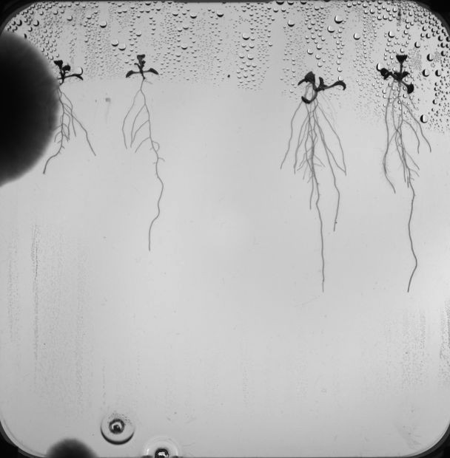
The biological problem
0 1 · P L A N T - S C I E N C E M O T I VAT I O N
Joint initiative of Wageningen University & Research and Utrecht University
C L I E N T
Netherlands Plant Eco-phenotyping Centre (NPEC)
S T U D Y S P E C I E S
R E S E A R C H C O N T E X T
Arabidopsis thaliana
Plant–microbe interactions
The opportunity
More consistent root inoculation could support larger experiments comparing responses across plant genotypes.
NPEC / BUas
Sources: npec.nl/about-npec · dataset specimen imaging
02 / 1₂5

Slide 3
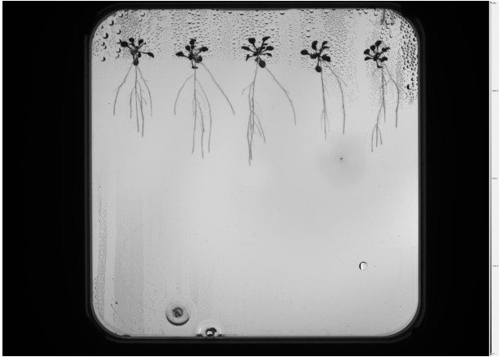
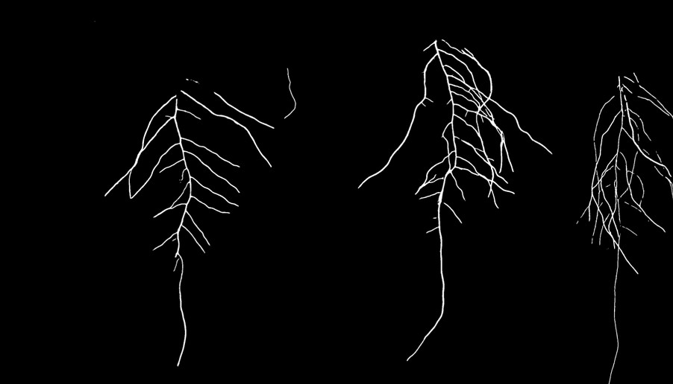
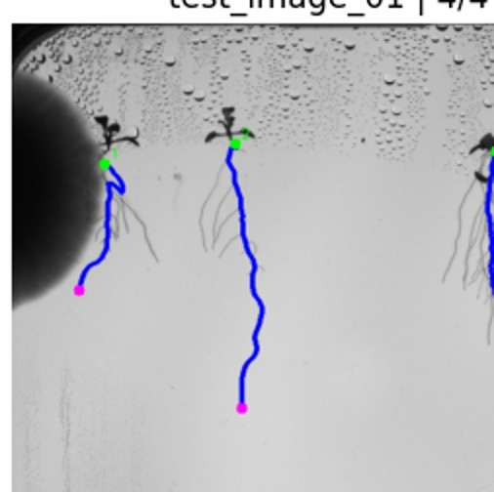
One pipeline, three disciplines
0 2 · P R O P O S E D S O L U T I O N
Computer vision provides the target; robotics delivers the motion
01 HADES image
02 Root segmentation
03 Root extraction
Raw Petri dish
512 px U-Net mask
Tip & length estimates
04 Image coordinates
05 Assumed affine map
06 OT-2: PI / SAC
NPEC / Buas
Source: Tasks 2–13; Task 12 integration README
03 / 1₃5

Slide 4
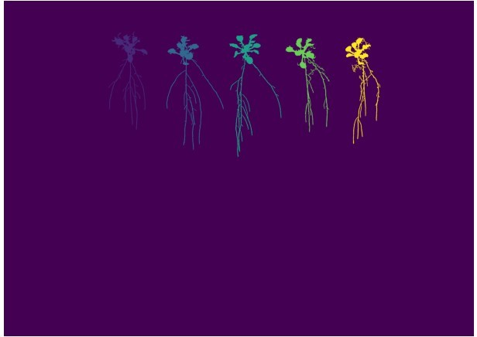
Five plants, individually segmented
0 3 · C O M P U T E R V I S I O N
INPUT · MATURE SPECIMEN OUTPUT · FIVE INSTANCE LABELS
Thresholding + connected components + directional morphology + global root-to-shoot assignment
NPEC / BUas
Source: corrected instant segmentation notebook (both test images)
04 / 1₄5

Slide 5

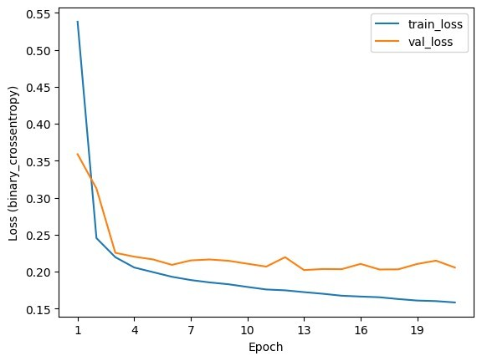
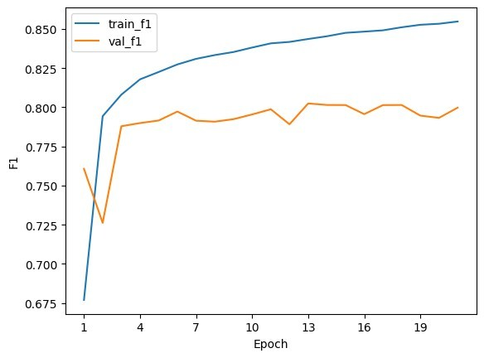
The 512 × 512 root segmentation model
0 4 · D E E P L E A R N I N G
Residual U-Net · group normalization · Dice + BCE + soft-clDice
0.8024
best validation F1
Train: 9,600 patches · Y2B_23 / _24
Val: 612 patches · Y2B_25
Faint or disconnected roots remain difficult, despite learned structure.
NPEC / BUas
Source: Model training notebook + binary prediction image
05 / 1₅5

Slide 6
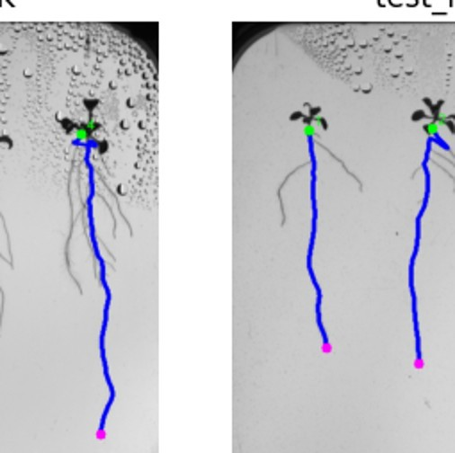
From a pixel mask to primary root measurements
0 5 · C O M P U T E R V I S I O N O U T P U T S
Root-start refinement V5.1 → plant assignment → traced root length
19/19
images processed
87
root measurements
11
flagged for review
76
labelled OK
16.159%
FINAL PRIVATE KAGGLE s MAPE
Measurement quality flags are diagnostic; they do not guarantee accuracy.
NPEC / BUas
Source: Task 8 notebook/README + Kaggle private screenshot
06 / 1₆5

Slide 7
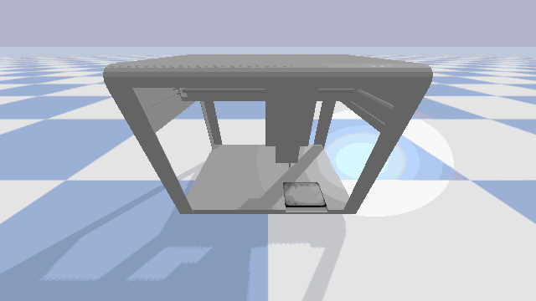
Mapping root tips into the OT-2 workspace
0 6 · R O B O T I C S
Reachability + image-to-robot integration
W O R K F L O W
1
Root-tip pixel (x, y)
2
Assumed image-to-plate transform
3
Mapped robot target (x, y, z)
4
Approach · hover · retreat
Calibration caveat: simulator geometry was checked, but real photo-to-robot registration remains unverified.
NPEC / BUas
Source: Eight vorner GIF + calibration checks/README
07 / 1₇5

Slide 8
Two controllers, one positioning objective
0 7 · R O B O T I C C O N T R O L
Both target continuous 3-D pipette positioning inside the same simulation
CLASSICAL CONTROL
REINFORCEMENT LEARNING
PI controller
Tuned proportional + integral feedback
Soft Actor-Critic (SAC)
Learned 12-D observation → continuous actions
Independent gains for X, Y, Z
87 / 100
settled on independent holdout
Derivative gain set to zero
No PID teacher at inference
Same goal: get within 1 mm, then remain there long enough to count as settled.
NPEC / BUas
Source: tuned gains · Path Y holdout
08 / 1₈5

Slide 9
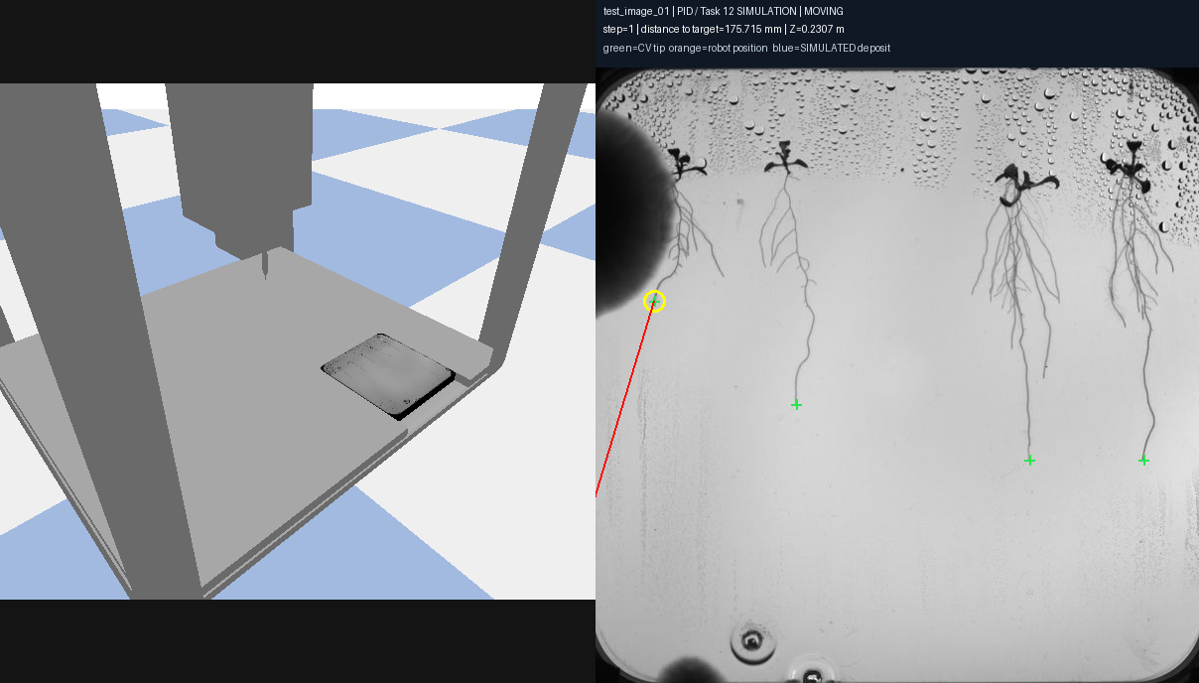

Autonomous route demonstrations
0 8 · I N T E G R AT I O N D E M O
Three specimen images · 13 accepted computer-vision-derived targets
TUNED PI
SAC POLICY
13/13 simulated route markers
9/13 simulated route markers
Markers represent simulated success events, not liquid dispensing or biological inoculation.
NPEC / BUas
Source: saved simulation GIFs; different protocol from slide 10
09 / 1₉5

Slide 10
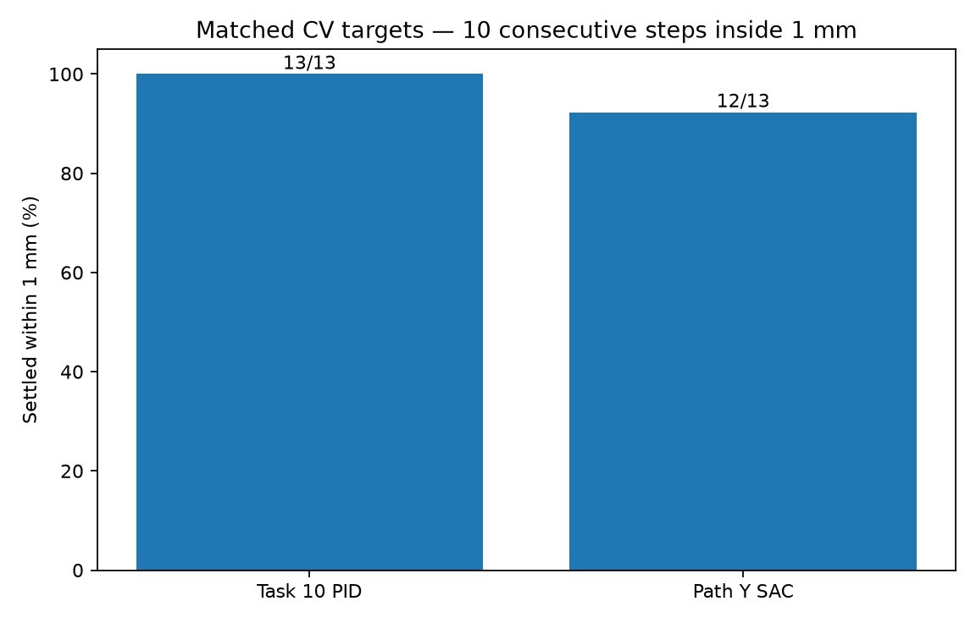
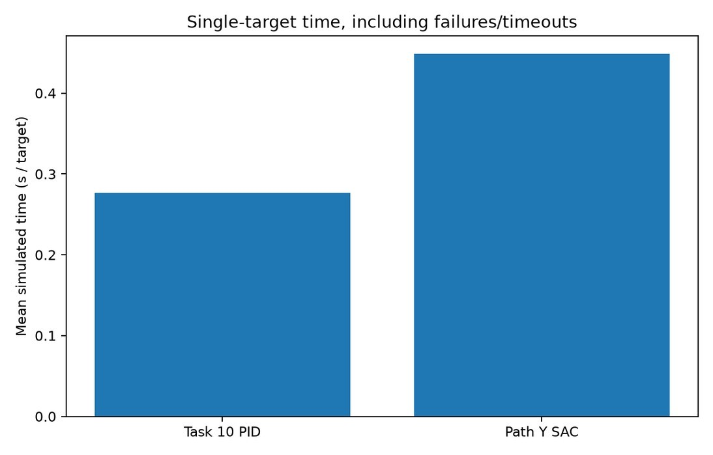
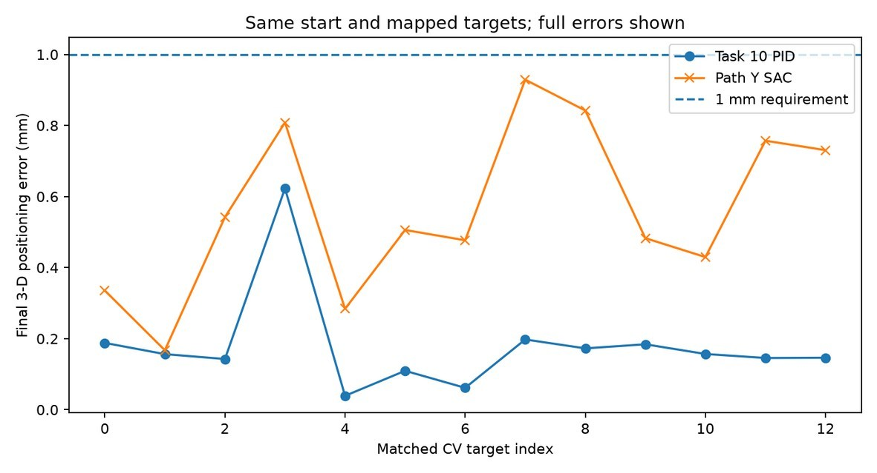
PI outperforms SAC on matched targets
0 9 · F I N A L B E N C H M A R K I N G
Identical 13 targets · reset pose · 600-step budget · 10-step dwell inside 1 mm
13/13
PI settled
12/13
SAC settled
0.179 mm
PI mean final error
0.561 mm
SAC mean final error
Mean simulated time per target: PI 0.277 s • SAC 0.448 s | No unsafe terminations
NPEC / BUas
Source: matched_targets.csv + benchmark summary
10 / 1₁5₀

Slide 11
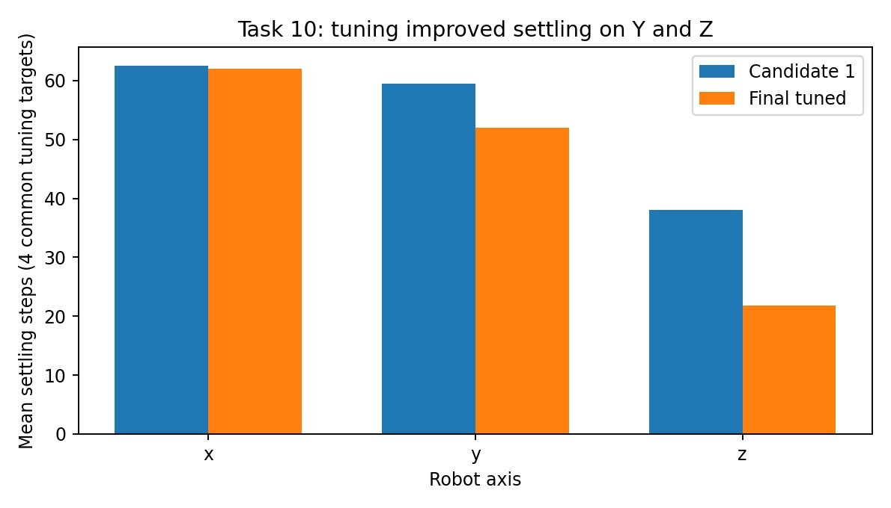
Tuning the PI positioning controller
1 1 · I T E R AT I O N 2
Error: different axes required different correction behaviour
Y 59.5 → 52
mean settling steps
Z 38 → 21.75
mean settling steps
F I N A L D E S I G N
Separate axis gains Kd = 0 (PI)
NPEC / BUas
Source: tuning_results.csv + gains_final.json
12 / 1₁5₂

Slide 12
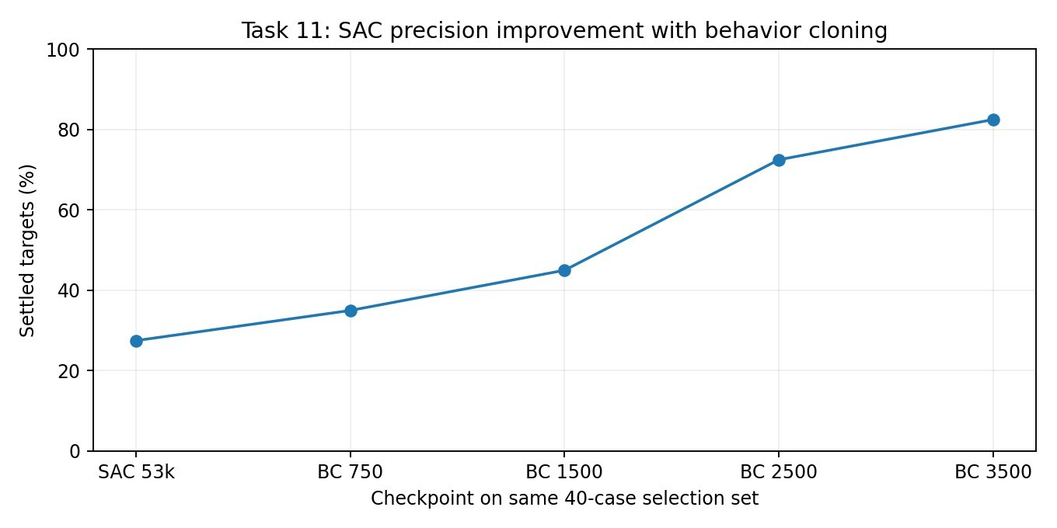
SAC learned to approach — but not settle
1 2 · I T E R AT I O N 3
Behavior cloning from successful controller trajectories improved precision
11/40 → 33/40
settled targets
1.938 → 0.717 mm
mean final error
Holdout: 87/100 settled
Additional guided RL did not beat BC.
NPEC / BUas
Source: Path Y final_summary.json (same 40 selection cases)
13 / 1₁5₃

Slide 13
What the results do and do not show
1 3 · C R I T I C A L E VA L U AT I O N
Assumptions define the valid scope of the system
ASSUMPTIONS
LIMITATIONS
Five seedlings in the Task 3 image layout
Faint and overlapping root structures
Comparable HADES image appearance
Only 13 selected integrated targets
Known simulated plate geometry
No measured physical registration
Assumed image-to-robot mapping
No real droplet / infection validation
All reported controller errors are to simulated mapped coordinates — not independently measured biological root-tip locations.
NPEC / BUas
Source: README, calibration notes, evaluation
14 / 1₁5₄

Slide 14
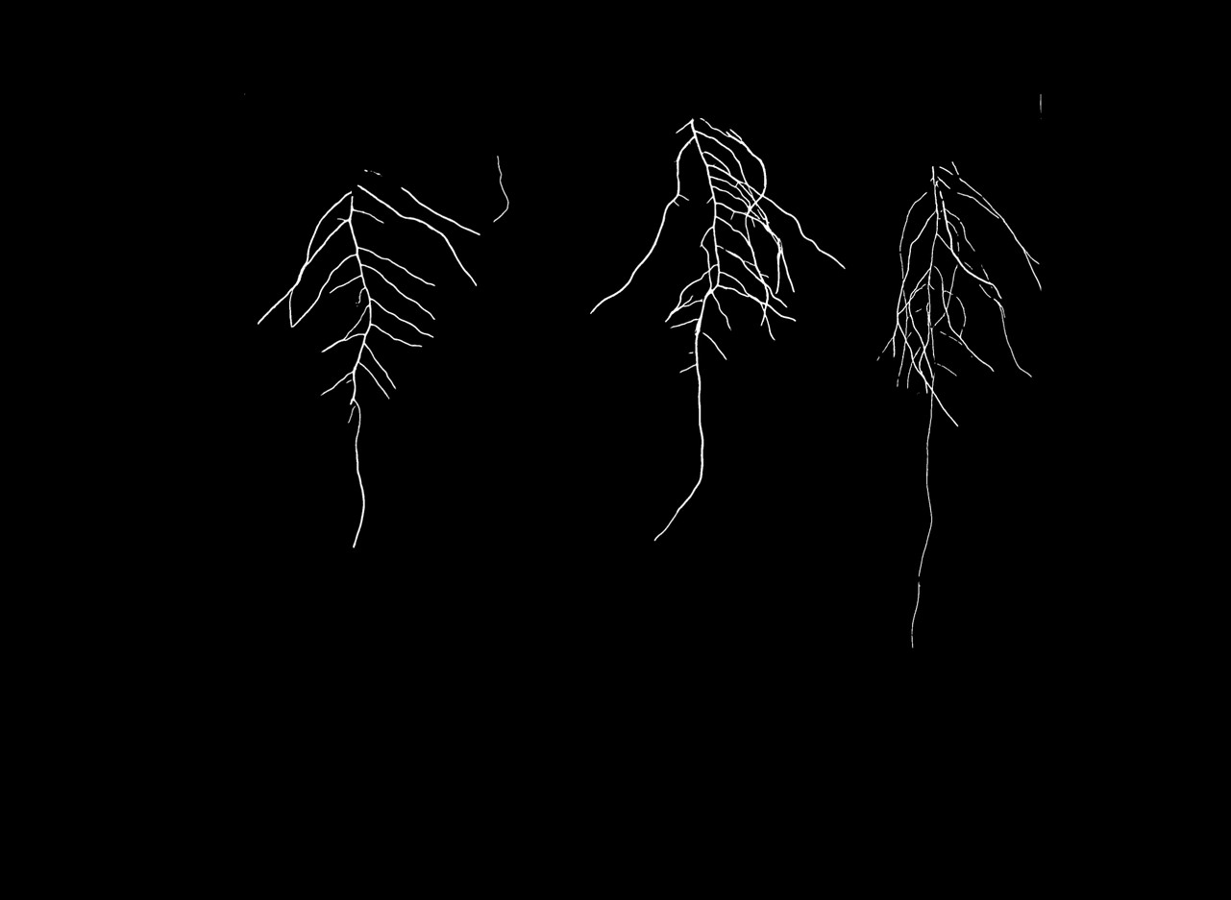
The reliable controller today is PI.
1 5 · C O N C L U S I O N S & N E X T S T E P S
The meaningful result is a working simulated pipeline — from biological images to autonomous robot positioning.
13/13
PI settled
0.179 mm
PI mean error
0
unsafe episodes
NEXT: stronger root detection / measured calibration / real OT-2 deposition tests
For NPEC: a foundation for scalable, consistent plant–microbe experiments.

