Slide 1
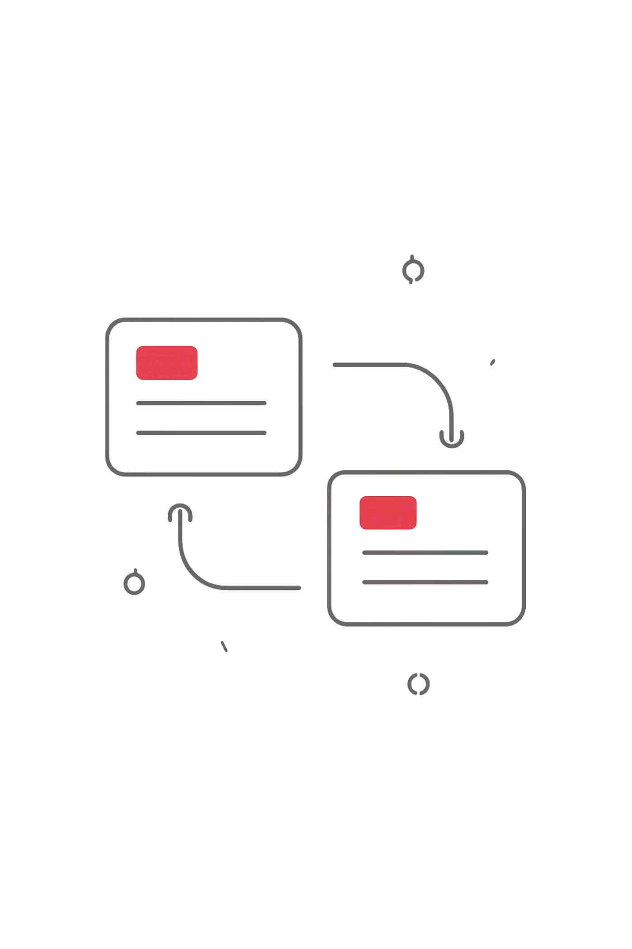
DRIFTLESS
API contracts that never go stale.
driftless.nikatopu.dev

Slide 2
The Pain Is Real and Validated
"Actual API behavior doesn't match documentation."
"Costs hours or days of rework."
"Blocked until backend writes documentation."
— Discovery interview participants
6
10
70%
Discovery interviews
Validation participants
Willing to try
83%
83%
66%
Documentation Mismatch
Rework & Debugging Loops
Missing API Contracts
Pain 5/5
Pain 4/5
Pain 5/5

Slide 3
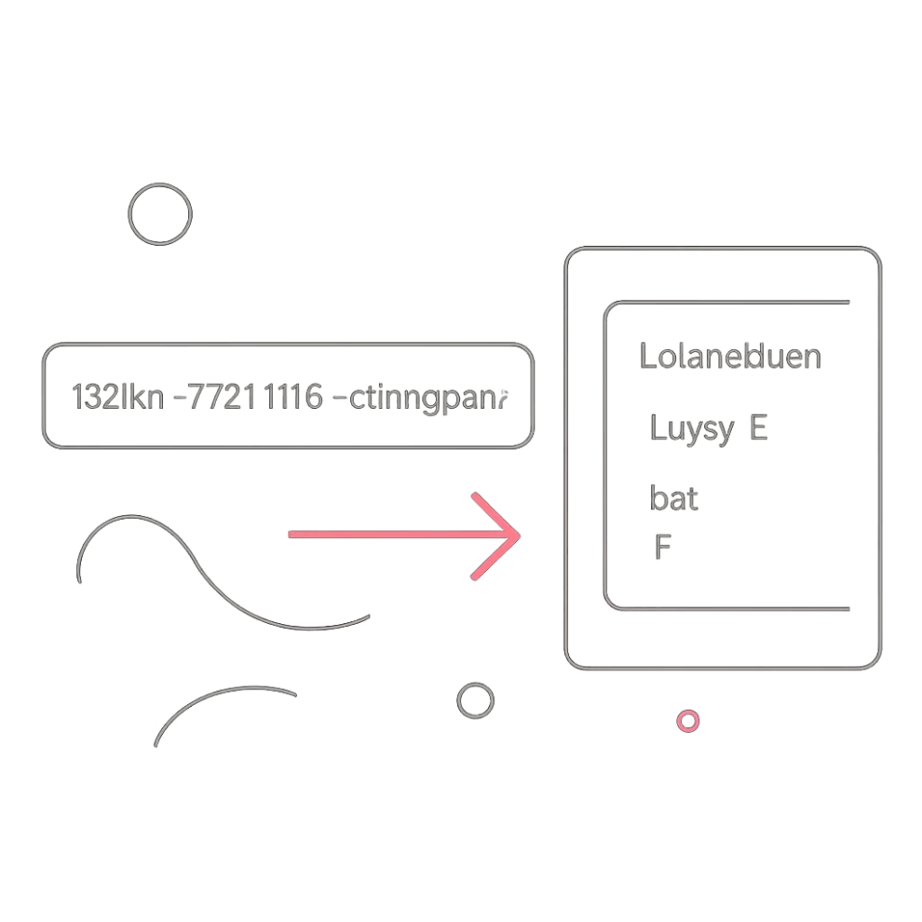
Paste a URL. Get Every Contract.
DRIFTLESS extracts every API contract, route, and TypeScript type directly from the implementation — no annotations, no configuration, no drift.
Built for ASP.NET Core
Powered by Roslyn
Targets professional .NET backend teams
Microsoft's C# compiler API — compiler-accurate output

Slide 4
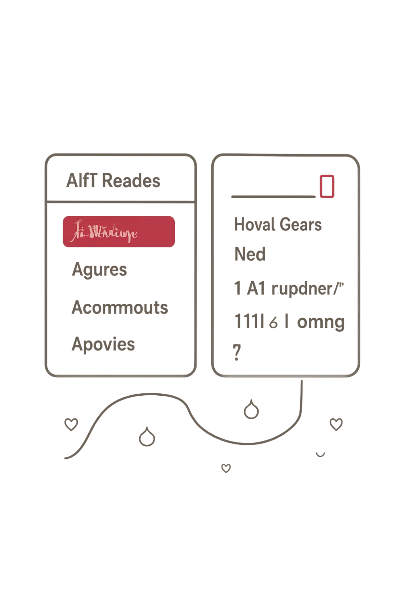
LIVE DEMO
driftless.nikatopu.dev
A public ASP.NET Core repository URL submitted. Every endpoint discovered. TypeScript interfaces generated. Zero configuration required.
① Input URL
② Routes Discovered
Any public GitHub repo
All endpoints extracted automatically
③ TypeScript Output
Interfaces ready to import

Slide 5
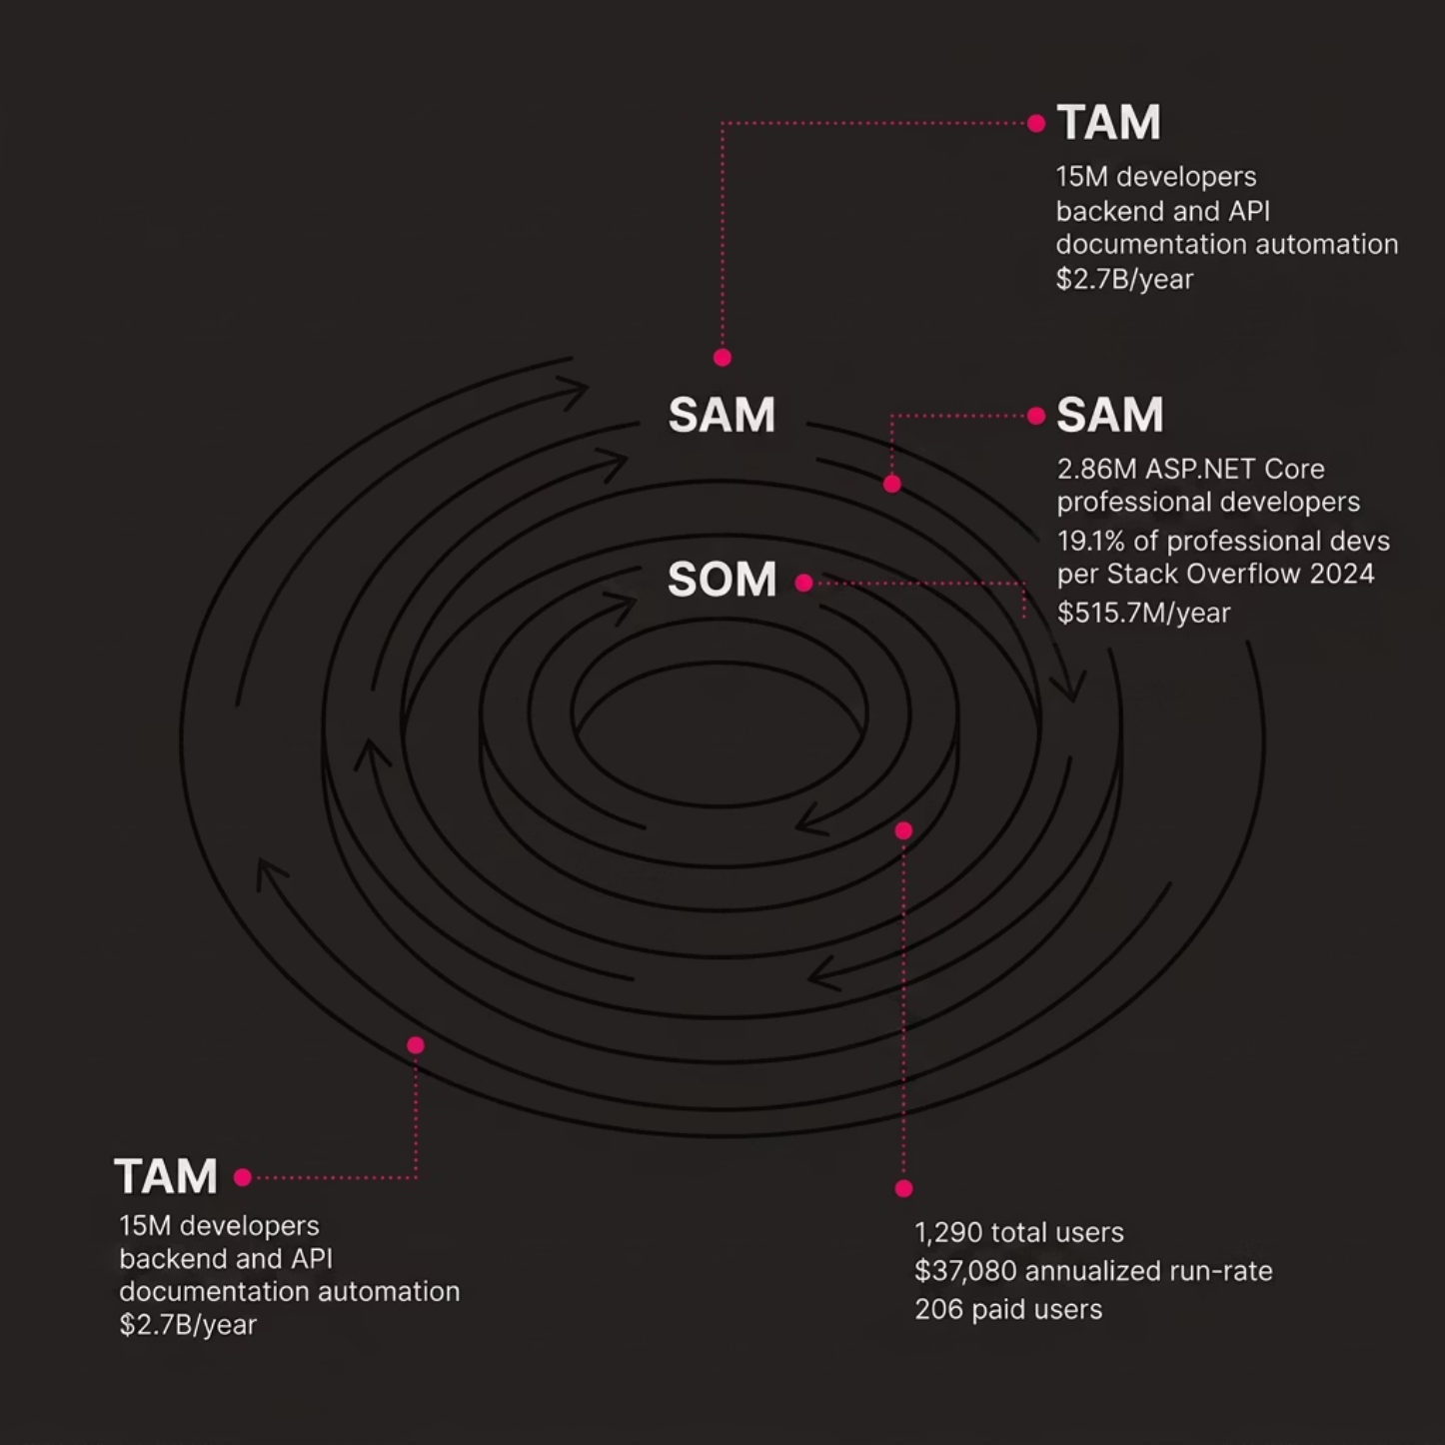
A Credible, Bottom-Up Market
Three concentric circles from the broadest addressable market down to our focused year-one opportunity — each grounded in visible arithmetic.
TAM: 15M developers × $180/yr = $2.7B/yr
SAM: 2.86M ASP.NET Core devs (19.1% of pros, Stack Overflow 2024) = $515.7M/yr
SOM: 1,290 users | 206 paid = $37,080 annualized run-rate
Source: Stack Overflow Developer Survey 2024

Slide 6

Business Model & Unit Economics
Free — $0/mo
Pro — $15/mo
Team — $50/mo
Limited scans, basic output
Unlimited scans, exports, integrations
Collaboration, CI/CD integration
Channel
CAC
LTV
LTV:CAC
Payback
GitHub outreach
$5
$120
24:1
0.33 mo
University / community
$2.50
$120
48:1
0.17 mo
LinkedIn outreach
$20
$120
6:1
1.33 mo
Month-12 projection: 206 paid users | $3,090 MRR | $1,195 monthly profit — pre-revenue today, monetization planned.

Slide 7
Competition & Moat
Every competitor requires manual setup, annotations, or configuration. Driftless is the only solution that reads the implementation directly — zero friction, compiler-accurate output.
Tool
Auto-discovery
.NET native
Real-time sync
Zero annotation
TypeScript out
Free tier
Swagger/Swashbuckle
✗
✓
✗
✗
✗
✓
Postman
✗
✗
✗
✗
✗
✓
NSwag
✗
✓
✗
✗
✓
✗
Stoplight
✗
✗
✗
✗
✗
✗
Readme.com
✗
✗
✗
✓
✗
✓
Redocly
✗
✗
✗
✓
✗
✗
DRIFTLESS
✓
✓
✓
✓
✓
✓

Slide 8
Roadmap to Month 18
✓ Sprint 1 — Complete
Sprint 3 — Expansion
Public repo analysis · Roslyn extraction · TypeScript generation · Live dashboard deployed
FastAPI & Express.js support · Multi-framework dashboard · Team collaboration features
1
2
3
4
Sprint 2 — Next
🎯 Funded Milestone — Month 18
Private repos (GitHub OAuth) · Breaking change detection · CI/CD integration · OpenAPI export
500 paying users · $7,500 MRR · 3 institutional pilots

Slide 9




The Team
Nikoloz Topuridze
Toma Danelia
Giorgi Tkebuchava
Nikoloz Bujiashvili
Tech Lead — Built the Roslyn extraction pipeline and backend API
Discovery Lead — 6 interviews, 10 validators, ICP framework
Program Lead — Growth strategy, financial model, unit economics
Design Lead — High-fidelity prototype, 5-participant usability study

Slide 10
We Are Raising $25,000
Use of Funds
Funded Milestone Month 18
Infrastructure & compliance
$8,000
Pre-revenue. Deployed product. Validated pain. Clear path.
driftless.nikatopu.dev
Multi-framework development
$12,000
Institutional pilot program
$5,000
Pre-money valuation: $100,000 · Dilution: 20%
500 paying users
$7,500 MRR
3 institutional pilots

