Slide 1


Chapter 11
Approximation
Algorithms
Slides by Kevin Wayne.
Copyright @ 2005 Pearson-Addison Wesley.
All rights reserved.

Slide 2
Approximation Algorithms
Q. Suppose I need to solve an NP-hard problem. What should I do?
A. Theory says you're unlikely to find a poly-time algorithm.
Must sacrifice one of three desired features.
  Solve problem to optimality.
  Solve problem in poly-time.
  Solve arbitrary instances of the problem.
ρ-approximation algorithm.
  Guaranteed to run in poly-time.
  Guaranteed to solve arbitrary instance of the problem
  Guaranteed to find solution within ratio ρ of true optimum.
Challenge. Need to prove a solution's value is close to optimum, without even knowing what optimum value is!

Slide 3
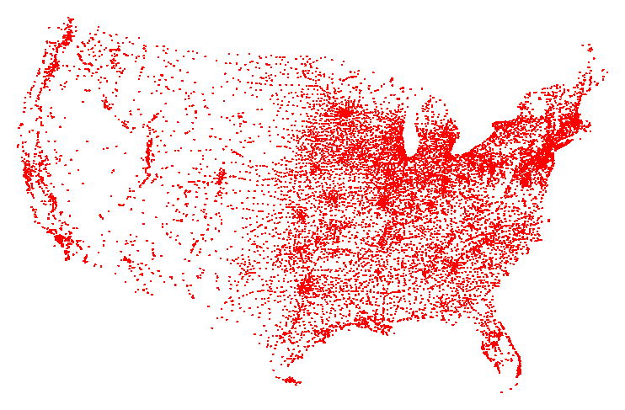
Traveling Salesperson Problem
TSP. Given a set of n cities and a pairwise distance function d(u, v), is there a tour of length ≤ D?
All 13,509 cities in US with a population of at least 500
Reference: http://www.tsp.gatech.edu

Slide 4
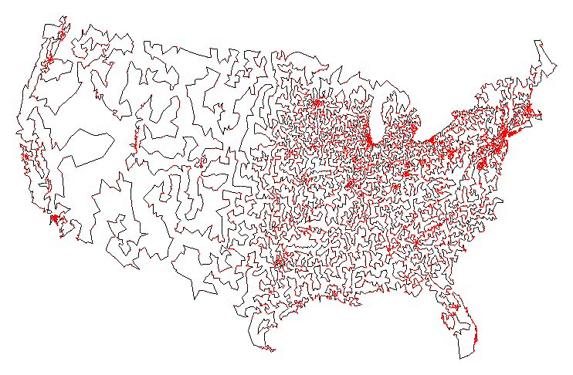
Traveling Salesperson Problem
TSP. Given a set of n cities and a pairwise distance function d(u, v), is there a tour of length ≤ D?
Optimal TSP tour
Reference: http://www.tsp.gatech.edu

Slide 5
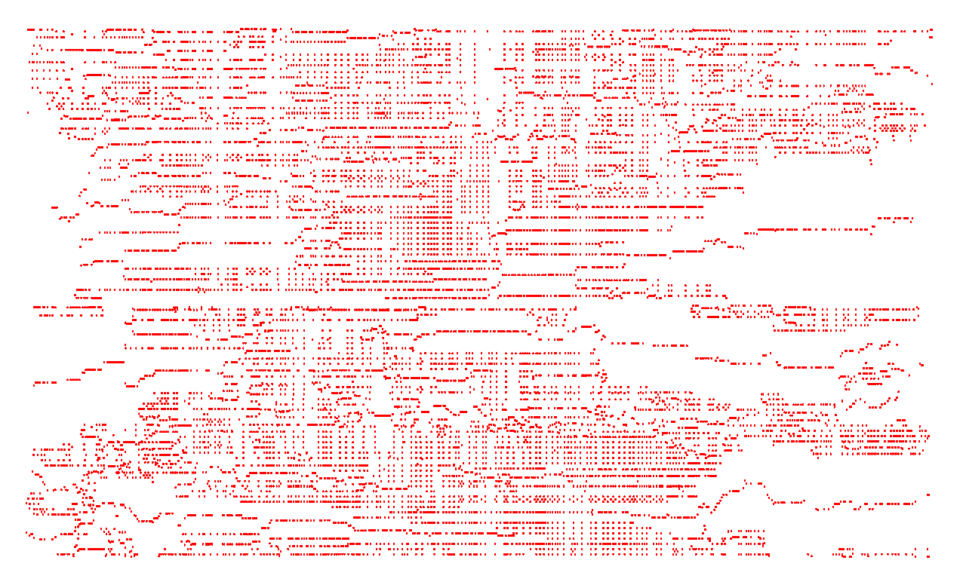
Traveling Salesperson Problem
TSP. Given a set of n cities and a pairwise distance function d(u, v), is there a tour of length ≤ D?
11,849 holes to drill in a programmed logic array
Reference: http://www.tsp.gatech.edu

Slide 6
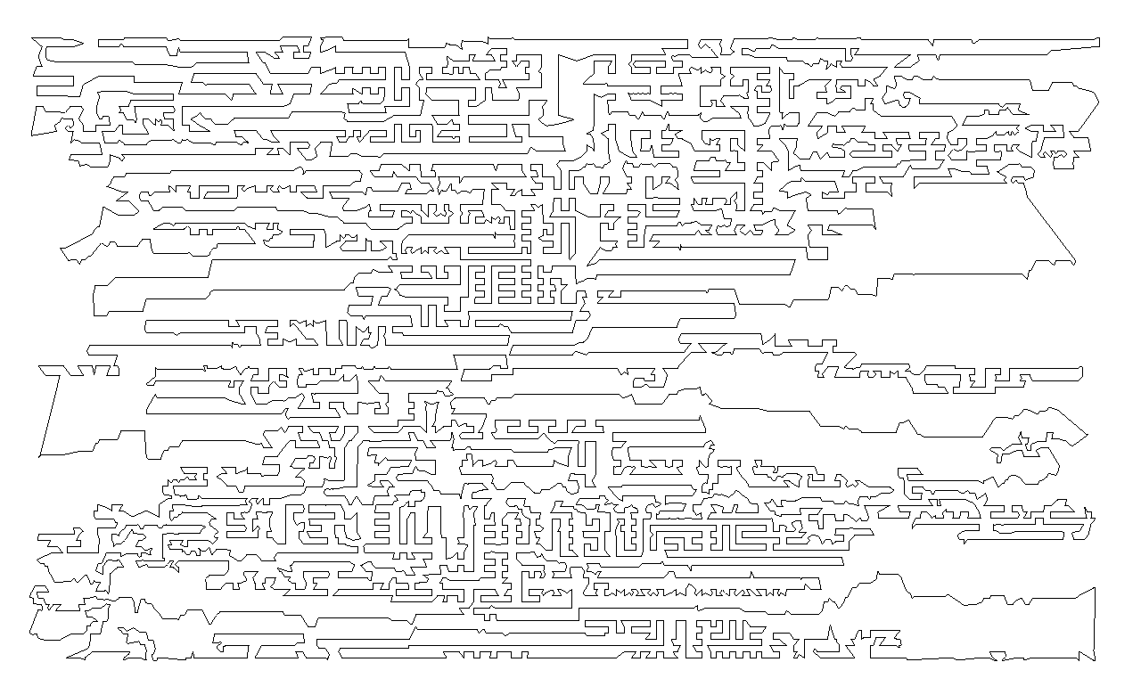
Traveling Salesperson Problem
TSP. Given a set of n cities and a pairwise distance function d(u, v), is there a tour of length ≤ D?
Optimal TSP tour
Reference: http://www.tsp.gatech.edu

Slide 7
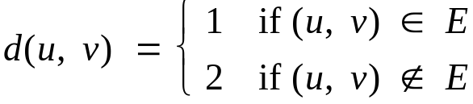
Traveling Salesperson Problem
TSP. Given a set of n cities and a pairwise distance function d(u, v), is there a tour of length ≤ D?
HAM-CYCLE: given a graph G = (V, E), does there exists a simple cycle that contains every node in V?
Claim. HAM-CYCLE ≤ _{P} TSP.
Pf.
  Given instance G = (V, E) of HAM-CYCLE, create n cities with distance function
  TSP instance has tour of length ≤ n iff G is Hamiltonian. ▪
Remark. TSP instance in reduction satisfies Δ-inequality.

Slide 8
Traveling Salesperson Problem
16.4 - The Traveling Salesman Problem - Faster Exact Algorithms For NP-C...: http://youtu.be/njXvR0LWebk
16.4 - The Traveling Salesman Problem - Faster Exact Algorithms For NP-C...: http://youtu.be/njXvR0LWebk

Slide 9
Load Balancing
Input. m identical machines; n jobs, job j has processing time t_{j}.
  Job j must run contiguously on one machine.
  A machine can process at most one job at a time.
Def. Let J(i) be the subset of jobs assigned to machine i. The
load of machine i is L_{i} = Σ_{j ∈ J(i)} t_{j}.
Def. The makespan is the maximum load on any machine L = max_{i} L_{i}.
Load balancing. Assign each job to a machine to minimize makespan.

Slide 10
Load Balancing: List Scheduling
List-scheduling algorithm.
  Consider n jobs in some fixed order.
  Assign job j to machine whose load is smallest so far.
Implementation. O(n log n) using a priority queue.
List-Scheduling(m, n, t₁,t₂,…,t_{n}) {
for i = 1 to m {
L_{i} ← 0
J(i) ← φ
}
for j = 1 to n {
i = argmin_{k} L_{k}
J(i) ← J(i) ∪ {j}
L_{i} ← L_{i} + t_{j}
}
}
load on machine i
jobs assigned to machine i
machine i has smallest load
assign job j to machine i
update load of machine i
Notes:
Remark. This is an "on-line" algorithm.

Slide 11

Load Balancing: List Scheduling Analysis
Theorem. [Graham, 1966] Greedy algorithm is a 2-approximation.
  First worst-case analysis of an approximation algorithm.
  Need to compare resulting solution with optimal makespan L*.
Lemma 1. The optimal makespan L* ≥ max_{j} t_{j}.
Pf. Some machine must process the most time-consuming job. ▪
Lemma 2. The optimal makespan
Pf.
  The total processing time is Σ_{j} t_{j} .
  One of m machines must do at least a 1/m fraction of total work. ▪
Notes:
Need to compare greedy solution with optimal makespan. Need good lower bounds on the optimal value.
Lower bound too weak in following case: one job is extremely long relative to sum of all processing times. If sufficiently extreme, optimal solution will place long job on a machine all by itself and it will be last to finish. In this case, greedy will do well, but first lower bound will not establish this.

Slide 12
Load Balancing: List Scheduling Analysis
Theorem. Greedy algorithm is a 2-approximation.
Pf. Consider load L_{i} of bottleneck machine i.
  Let j be last job scheduled on machine i.
  When job j assigned to machine i, i had smallest load. Its load before assignment is L_{i} - t_{j} ⇒ L_{i} - t_{j} ≤ L_{k} for all 1 ≤ k ≤ m.
blue jobs scheduled before j
machine i
j
0
L_{i} - t_{j}
L = L_{i}

Slide 13
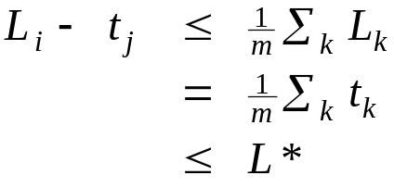
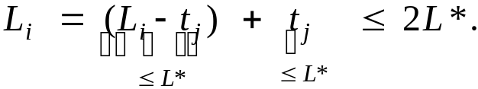
Load Balancing: List Scheduling Analysis
Theorem. Greedy algorithm is a 2-approximation.
Pf. Consider load L_{i} of bottleneck machine i.
  Let j be last job scheduled on machine i.
  When job j assigned to machine i, i had smallest load. Its load before assignment is L_{i} - t_{j} ⇒ L_{i} - t_{j} ≤ L_{k} for all 1 ≤ k ≤ m.
  Sum inequalities over all k and divide by m:
  Now ▪
Lemma 1
Lemma 2

Slide 14
Load Balancing: List Scheduling Analysis
Q. Is our analysis tight?
A. Essentially yes.
Ex: m machines, m(m-1) jobs length 1 jobs, one job of length m
machine 2 idle
machine 3 idle
machine 4 idle
m = 10
machine 5 idle
machine 6 idle
machine 7 idle
machine 8 idle
machine 9 idle
machine 10 idle
list scheduling makespan = 19

Slide 15
Load Balancing: List Scheduling Analysis
Q. Is our analysis tight?
A. Essentially yes.
Ex: m machines, m(m-1) jobs length 1 jobs, one job of length m
m = 10
optimal makespan = 10

Slide 16
Load Balancing: LPT Rule
Longest processing time (LPT). Sort n jobs in descending order of processing time, and then run list scheduling algorithm.
LPT-List-Scheduling(m, n, t₁,t₂,…,t_{n}) {
Sort jobs so that t₁ ≥ t₂ ≥ … ≥ t_{n}
for i = 1 to m {
L_{i} ← 0
J(i) ← φ
}
for j = 1 to n {
i = argmin_{k} L_{k}
J(i) ← J(i) ∪ {j}
L_{i} ← L_{i} + t_{j}
}
}
load on machine i
jobs assigned to machine i
machine i has smallest load
assign job j to machine i
update load of machine i

Slide 17
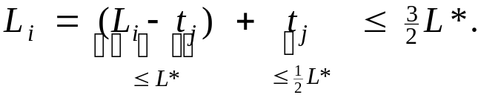
Load Balancing: LPT Rule
Observation. If at most m jobs, then list-scheduling is optimal.
Pf. Each job put on its own machine. ▪
Lemma 3. If there are more than m jobs, L* ≥ 2 t_{m+1}.
Pf.
  Consider first m+1 jobs t₁, …, t_{m+1}.
  Since the t_{i}'s are in descending order, each takes at least t_{m+1} time.
  There are m+1 jobs and m machines, so by pigeonhole principle, at least one machine gets two jobs. ▪
Theorem. LPT rule is a 3/2 approximation algorithm.
Pf. Same basic approach as for list scheduling.
▪
Lemma 3
( by observation, can assume number of jobs > m )
Notes:
j = last job scheduled on bottleneck machine.

Slide 18
Load Balancing: LPT Rule
Q. Is our 3/2 analysis tight?
A. No.
Theorem. [Graham, 1969] LPT rule is a 4/3-approximation.
Pf. More sophisticated analysis of same algorithm.
Q. Is Graham's 4/3 analysis tight?
A. Essentially yes.
Ex: m machines, n = 2m+1 jobs, 2 jobs of length m+1, m+2, …, 2m-1 and one job of length m.
Notes:
Best known: PTAS, 4/3-analysis not too hard

Slide 19
11.2 Center Selection

Slide 20
Center Selection Problem
Input. Set of n sites s₁, …, s_{n}.
Center selection problem. Select k centers C so that maximum distance from a site to nearest center is minimized.
k = 4
r(C)
center
site

Slide 21
Center Selection Problem
Input. Set of n sites s₁, …, s_{n}.
Center selection problem. Select k centers C so that maximum distance from a site to nearest center is minimized.
Notation.
  dist(x, y) = distance between x and y.
  dist(s_{i}, C) = min _{c ∈ C} dist(s_{i}, c) = distance from s_{i} to closest center.
  r(C) = max_{i} dist(s_{i}, C) = smallest covering radius.
Goal. Find set of centers C that minimizes r(C), subject to |C| = k.
Distance function properties.
  dist(x, x) = 0 (identity)
  dist(x, y) = dist(y, x) (symmetry)
  dist(x, y) ≤ dist(x, z) + dist(z, y) (triangle inequality)
Notes:
Note: if we don't assume weights satisfy the triangle inequality (or put some other restriction on the distances) the problem cannot be approximated
within any computable factor

Slide 22
Center Selection Example
Ex: each site is a point in the plane, a center can be any point in the plane, dist(x, y) = Euclidean distance.
Remark: search can be infinite!
r(C)
center
site

Slide 23
Greedy Algorithm: A False Start
Greedy algorithm. Put the first center at the best possible location for a single center, and then keep adding centers so as to reduce the covering radius each time by as much as possible.
Remark: arbitrarily bad!
greedy center 1
center
k = 2 centers
site

Slide 24
Center Selection: Greedy Algorithm
Greedy algorithm. Repeatedly choose the next center to be the site farthest from any existing center.
Observation. Upon termination all centers in C are pairwise at least r(C) apart.
Pf. By construction of algorithm.
Greedy-Center-Selection(k, n, s₁,s₂,…,s_{n}) {
C = φ
repeat k times {
Select a site s_{i} with maximum dist(s_{i}, C)
Add s_{i} to C
}
return C
}
site farthest from any center
Notes:
Note: in first iteration, can choose any site s

Slide 25
Center Selection: Analysis of Greedy Algorithm
Theorem. Let C* be an optimal set of centers. Then r(C) ≤ 2r(C*).
Pf. (by contradiction) Assume r(C*) < ½ r(C).
  For each site c_{i} in C, consider ball of radius ½ r(C) around it.
  Exactly one c_{i}* in each ball; let c_{i} be the site paired with c_{i}*.
  Consider any site s and its closest center c_{i}* in C*.
  dist(s, C) ≤ dist(s, c_{i}) ≤ dist(s, c_{i}*) + dist(c_{i}*, c_{i}) ≤ 2r(C*).
  Thus r(C) ≤ 2r(C*). ▪
Δ-inequality
≤ r(C*) since c_{i}* is closest center
½ r(C)
½ r(C)
c_{i}
½ r(C)
C*
sites
c_{i}*
s

Slide 26
Center Selection
Theorem. Let C* be an optimal set of centers. Then r(C) ≤ 2r(C*).
Theorem. Greedy algorithm is a 2-approximation for center selection problem.
Remark. Greedy algorithm always places centers at sites, but is still within a factor of 2 of best solution that is allowed to place centers anywhere.
Question. Is there hope of a 3/2-approximation? 4/3?
e.g., points in the plane
Theorem. Unless P = NP, there no ρ-approximation for center-selection
problem for any ρ < 2.

Slide 27
11.4 The Pricing Method: Vertex Cover

Slide 28
Weighted Vertex Cover
Weighted vertex cover. Given a graph G with vertex weights, find a vertex cover of minimum weight.
2
4
2
4
2
9
2
9
weight = 2 + 2 + 4
weight = 9

Slide 29
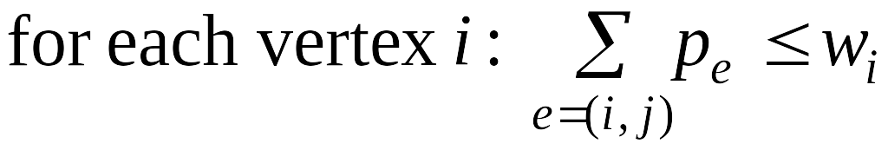
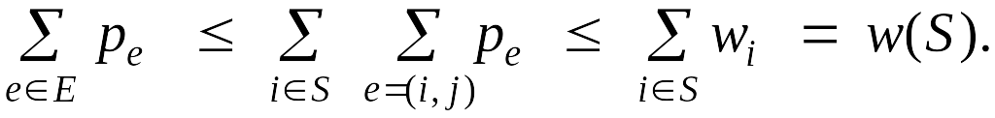
Weighted Vertex Cover
Pricing method. Each edge must be covered by some vertex i. Edge e pays price p_{e} ≥ 0 to use vertex i.
Fairness. Edges incident to vertex i should pay ≤ w_{i} in total.
Claim. For any vertex cover S and any fair prices p_{e}: ∑_{e} p_{e} ≤ w(S).
Proof. ▪
2
4
2
9
each edge e covered by
at least one node in S
sum fairness inequalities
for each node in S

Slide 30
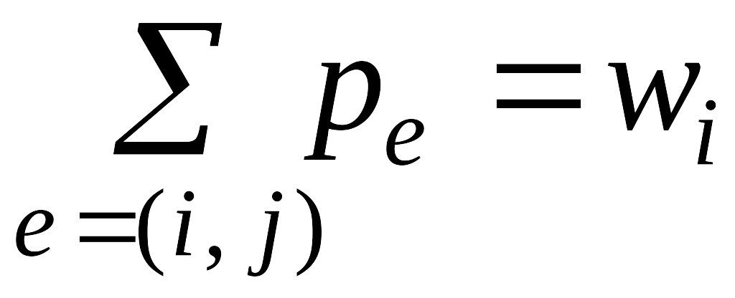
Pricing Method
Pricing method. Set prices and find vertex cover simultaneously.
Weighted-Vertex-Cover-Approx(G, w) {
foreach e in E
p_{e} = 0
while (∃ edge i-j such that neither i nor j are tight)
select such an edge e
increase p_{e} without violating fairness
}
S ← set of all tight nodes
return S
}

Slide 31
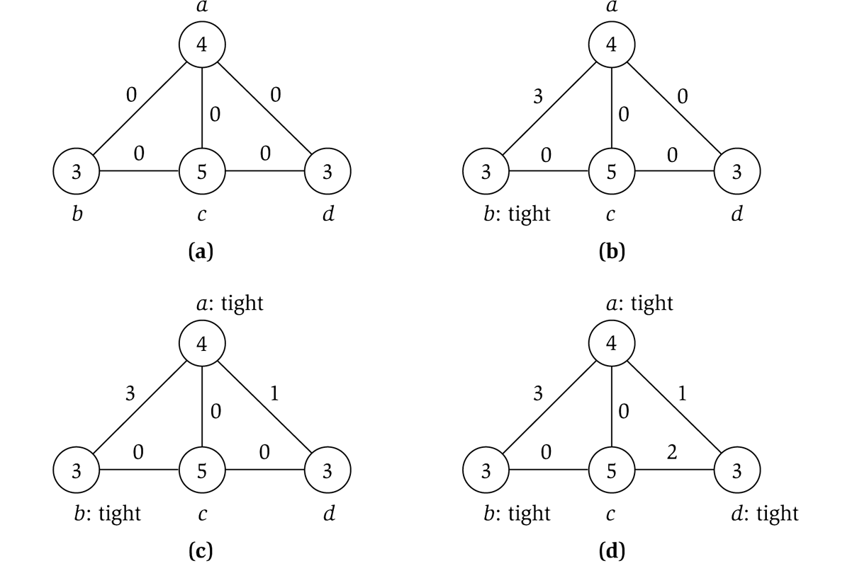
Pricing Method
price of edge a-b
vertex weight
Figure 11.8

Slide 32
Pricing Method: Analysis
Theorem. Pricing method is a 2-approximation.
Pf.
  Algorithm terminates since at least one new node becomes tight after each iteration of while loop.
  Let S = set of all tight nodes upon termination of algorithm. S is a vertex cover: if some edge i-j is uncovered, then neither i nor j is tight. But then while loop would not terminate.
  Let S* be optimal vertex cover. We show w(S) ≤ 2w(S*).
all nodes in S are tight
S ⊆ V,
prices ≥ 0
each edge counted twice
fairness lemma

Slide 33
11.6 LP Rounding: Vertex Cover

Slide 34
Weighted Vertex Cover
Weighted vertex cover. Given an undirected graph G = (V, E) with vertex weights w_{i} ≥ 0, find a minimum weight subset of nodes S such that every edge is incident to at least one vertex in S.
10
A
F
9
6
16
B
G
10
7
6
C
H
9
3
23
D
I
33
7
E
J
32
10
total weight = 55
Notes:
min weight vertex cover may not be a min cardinality vertex cover

Slide 35
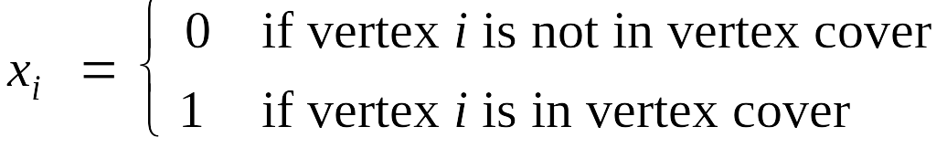
Weighted Vertex Cover: IP Formulation
Weighted vertex cover. Given an undirected graph G = (V, E) with vertex weights w_{i} ≥ 0, find a minimum weight subset of nodes S such that every edge is incident to at least one vertex in S.
Integer programming formulation.
  Model inclusion of each vertex i using a 0/1 variable x_{i}.
  Vertex covers in 1-1 correspondence with 0/1 assignments:
  S = {i ∈ V : x_{i} = 1}
  Objective function: maximize Σ_{i} w_{i} x_{i}.
  Must take either i or j: x_{i} + x_{j} ≥ 1.

Slide 36
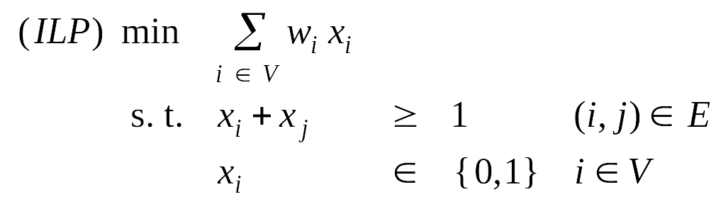
Weighted Vertex Cover: IP Formulation
Weighted vertex cover. Integer programming formulation.
Observation. If x* is optimal solution to (ILP), then S = {i ∈ V : x*_{i} = 1} is a min weight vertex cover.

Slide 37
Weighted Vertex Cover
  16.1 - The Vertex Cover Problem - Faster Exact Algorithms For NP-Complet...: http://www.youtube.com/watch?v=bOtF5h8uVn4
  16.2 - Smarter Search for Vertex Cover 1 - Faster Exact Algorithms For N...: http://www.youtube.com/watch?v=QrVPW0PacC8
  16.3 - Smarter Search for Vertex Cover 2 - Faster Exact Algorithms For N...: http://youtu.be/qktlh745NWs
10 √5 - 21
Notes:
NP-hard even on 3-regular planar graphs with unit weights.

Slide 38
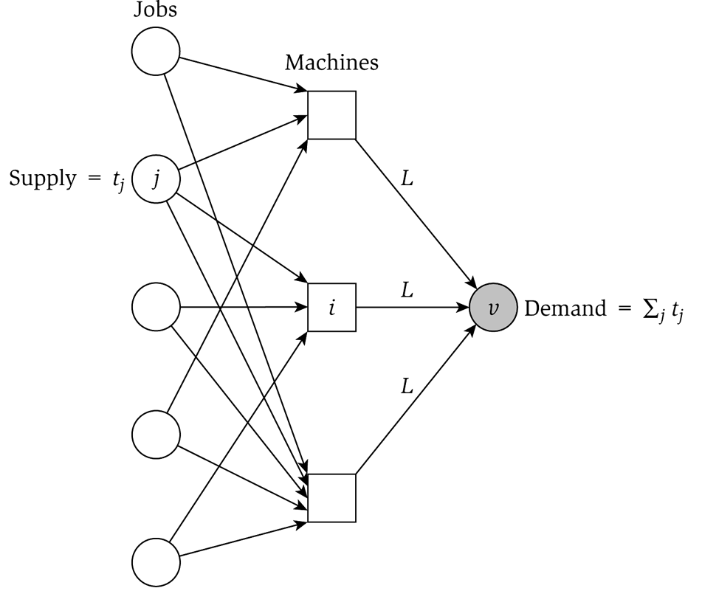
Generalized Load Balancing: Flow Formulation
Flow formulation of LP.
Observation. Solution to feasible flow problem with value L are in one-to-one correspondence with LP solutions of value L.
∞

Slide 39
Generalized Load Balancing: Structure of Solution
Lemma 3. Let (x, L) be solution to LP. Let G(x) be the graph with an edge from machine i to job j if x_{ij} > 0. We can find another solution (x', L) such that G(x') is acyclic.
Pf. Let C be a cycle in G(x).
  Augment flow along the cycle C.
  At least one edge from C is removed (and none are added).
  Repeat until G(x') is acyclic.
flow conservation maintained
3
3
3
3
6
6
2
3
4
4
2
1
1
5
5
4
3
4
4
G(x)
augment along C
G(x')

Slide 40
Conclusions
Running time. The bottleneck operation in our 2-approximation is
solving one LP with mn + 1 variables.
Remark. Can solve LP using flow techniques on a graph with m+n+1 nodes: given L, find feasible flow if it exists. Binary search to find L*.
Extensions: unrelated parallel machines. [Lenstra-Shmoys-Tardos 1990]
  Job j takes t_{ij} time if processed on machine i.
  2-approximation algorithm via LP rounding.
  No 3/2-approximation algorithm unless P = NP.

Slide 41
11.8 Knapsack Problem

Slide 42
Polynomial Time Approximation Scheme
PTAS. (1 + ε)-approximation algorithm for any constant ε > 0.
  Load balancing. [Hochbaum-Shmoys 1987]
  Euclidean TSP. [Arora 1996]
Consequence. PTAS produces arbitrarily high quality solution, but trades off accuracy for time.
This section. PTAS for knapsack problem via rounding and scaling.

Slide 43
Knapsack Problem
Knapsack problem.
  Given n objects and a "knapsack."
  Item i has value v_{i} > 0 and weighs w_{i} > 0.
  Knapsack can carry weight up to W.
  Goal: fill knapsack so as to maximize total value.
Ex: { 3, 4 } has value 40.
we'll assume w_{i} ≤ W
Item
Value
Weight
1
1
1
2
6
2
W = 11
3
18
5
4
22
6
5
28
7

Slide 44
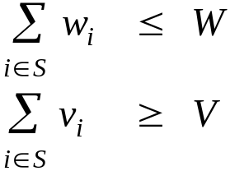
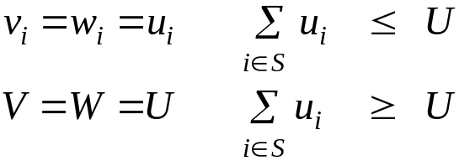
Knapsack is NP-Complete
KNAPSACK: Given a finite set X, nonnegative weights w_{i}, nonnegative values v_{i}, a weight limit W, and a target value V, is there a subset S ⊆ X such that:
SUBSET-SUM: Given a finite set X, nonnegative values u_{i}, and an integer U, is there a subset S ⊆ X whose elements sum to exactly U?
Claim. SUBSET-SUM ≤ _{P} KNAPSACK.
Pf. Given instance (u₁, …, u_{n}, U) of SUBSET-SUM, create KNAPSACK instance:

Slide 45
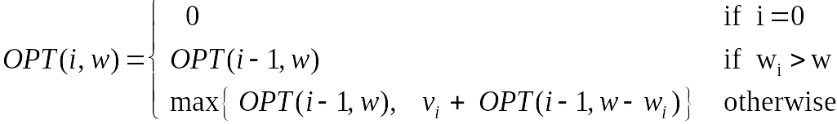
Knapsack Problem: Dynamic Programming 1
Def. OPT(i, w) = max value subset of items 1,..., i with weight limit w.
  Case 1: OPT does not select item i.
    OPT selects best of 1, …, i–1 using up to weight limit w
  Case 2: OPT selects item i.
    new weight limit = w – w_{i}
    OPT selects best of 1, …, i–1 using up to weight limit w – w_{i}
Running time. O(n W).
  W = weight limit.
  Not polynomial in input size!

Slide 46
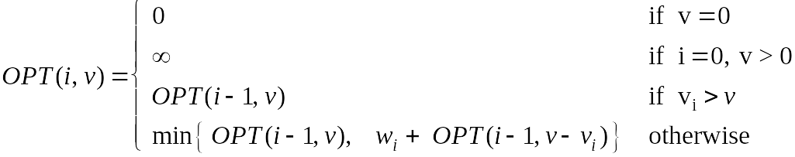
Knapsack Problem: Dynamic Programming II
Def. OPT(i, v) = min weight subset of items 1, …, i that yields value exactly v.
  Case 1: OPT does not select item i.
    OPT selects best of 1, …, i-1 that achieves exactly value v
  Case 2: OPT selects item i.
    consumes weight w_{i}, new value needed = v – v_{i}
    OPT selects best of 1, …, i-1 that achieves exactly value v
Running time. O(n V*) = O(n² v_{max}).
  V* = optimal value = maximum v such that OPT(n, v) ≤ W.
  Not polynomial in input size!
V* ≤ n v_{max}

Slide 47
Knapsack: FPTAS
Intuition for approximation algorithm.
  Round all values up to lie in smaller range.
  Run dynamic programming algorithm on rounded instance.
  Return optimal items in rounded instance.
Item
Value
Weight
Item
Value
Weight
1
134,221
1
1
2
1
2
656,342
2
2
7
2
3
1,810,013
5
3
19
5
4
22,217,800
6
4
23
6
5
28,343,199
7
5
29
7
W = 11
W = 11
original instance
rounded instance

Slide 48
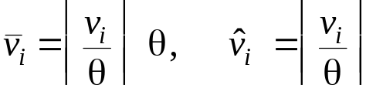



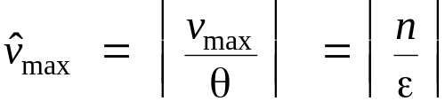
Knapsack: FPTAS
Knapsack FPTAS. Round up all values:
    v_{max} = largest value in original instance
    ε = precision parameter
    θ = scaling factor = ε v_{max} / n
Observation. Optimal solution to problems with or are equivalent.
Intuition. close to v so optimal solution using is nearly optimal;
small and integral so dynamic programming algorithm is fast.
Running time. O(n³ / ε).
  Dynamic program II running time is , where

Slide 49
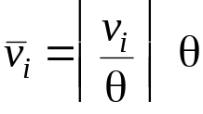

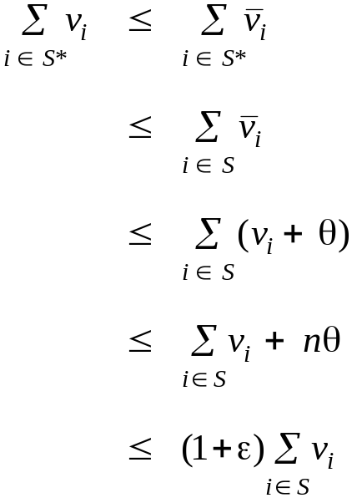
Knapsack: FPTAS
Knapsack FPTAS. Round up all values:
Theorem. If S is solution found by our algorithm and S* is any other feasible solution then
Pf. Let S* be any feasible solution satisfying weight constraint.
always round up
solve rounded instance optimally
never round up by more than θ
|S| ≤ n
DP alg can take v_{max}
n θ = ε v_{max}, v_{max} ≤ Σ_{i∈S} v_{i}
Notes:
WLOG assume no individual item has weight w_n that exceeds weight limit W all by itself

Slide 50
Knapsack: FPTAS
17.1 - A Greedy Knapsack Heuristic - Approximation Algorithms For NP-Com...: http://www.youtube.com/watch?v=f1AqWvyXYsc
17.2 - Analysis of a Greedy Knapsack Heuristic 1 - Approximation Algorit...: http://www.youtube.com/watch?v=yyGB8wwGWHQ
17.3 - Analysis of a Greedy Knapsack Heuristic 2 - Approximation Algorit...: http://www.youtube.com/watch?v=0EAV6VxsUzg
Notes:
WLOG assume no individual item has weight w_n that exceeds weight limit W all by itself

