Slide 1


Chapter 12
Local Search
Slides by Kevin Wayne.
Copyright @ 2005 Pearson-Addison Wesley.
All rights reserved.

Slide 2
Coping With NP-Hardness
Q. Suppose I need to solve an NP-hard problem. What should I do?
A. Theory says you're unlikely to find poly-time algorithm.
Must sacrifice one of three desired features.
  Solve problem to optimality.
  Solve problem in polynomial time.
  Solve arbitrary instances of the problem.

Slide 3
12.1 Landscape of an Optimization Problem

Slide 4
Gradient Descent: Vertex Cover
VERTEX-COVER. Given a graph G = (V, E), find a subset of nodes S of minimal cardinality such that for each u-v in E, either u or v (or both) are in S.
Neighbor relation. S ∼ S' if S' can be obtained from S by adding or deleting a single node. Each vertex cover S has at most n neighbors.
Gradient descent. Start with S = V. If there is a neighbor S' that is a vertex cover and has lower cardinality, replace S with S'.
Remark. Algorithm terminates after at most n steps since each update decreases the size of the cover by one.

Slide 5
Gradient Descent: Vertex Cover
Local optimum. No neighbor is strictly better.
optimum = center node only
local optimum = all other nodes
optimum = all nodes on left side
local optimum = all nodes on right side
optimum = even nodes
local optimum = omit every third node

Slide 6
Local Search
Local search. Algorithm that explores the space of possible solutions in sequential fashion, moving from a current solution to a "nearby" one.
Neighbor relation. Let S ∼ S' be a neighbor relation for the problem.
Gradient descent. Let S denote current solution. If there is a neighbor S' of S with strictly lower cost, replace S with the neighbor whose cost is as small as possible. Otherwise, terminate the algorithm.
A funnel
A jagged funnel

Slide 7
12.2 Metropolis Algorithm

Slide 8
Metropolis Algorithm
Metropolis algorithm. [Metropolis, Rosenbluth, Rosenbluth, Teller, Teller 1953]
  Simulate behavior of a physical system according to principles of statistical mechanics.
  Globally biased toward "downhill" steps, but occasionally makes "uphill" steps to break out of local minima.
Gibbs-Boltzmann function. The probability of finding a physical system in a state with energy E is proportional to e ^{-E / (kT)}, where T > 0 is temperature and k is a constant.
  For any temperature T > 0, function is monotone decreasing function of energy E.
  System more likely to be in a lower energy state than higher one.
    T large: high and low energy states have roughly same probability
    T small: low energy states are much more probable
Notes:
ordered chronologically

Slide 9
Metropolis Algorithm
Metropolis algorithm.
  Given a fixed temperature T, maintain current state S.
  Randomly perturb current state S to new state S' ∈ N(S).
  If E(S') ≤ E(S), update current state to S'
  Otherwise, update current state to S' with probability e ^{- ΔE / (kT)}, where ΔE = E(S') - E(S) > 0.
Theorem. Let f_{S}(t) be fraction of first t steps in which simulation is in state S. Then, assuming some technical conditions, with probability 1:
Intuition. Simulation spends roughly the right amount of time in each state, according to Gibbs-Boltzmann equation.
Notes:
simulation spends roughly correct amount of time in each state, according to Gibbs-Boltzmann equation

Slide 10
Simulated Annealing
Simulated annealing.
  T large ⇒ probability of accepting an uphill move is large.
  T small ⇒ uphill moves are almost never accepted.
  Idea: turn knob to control T.
  Cooling schedule: T = T(i) at iteration i.
Physical analog.
  Take solid and raise it to high temperature, we do not expect it to maintain a nice crystal structure.
  Take a molten solid and freeze it very abruptly, we do not expect to get a perfect crystal either.
  Annealing: cool material gradually from high temperature, allowing it to reach equilibrium at succession of intermediate lower temperatures.

Slide 11
12.3 Hopfield Neural Networks

Slide 12
Hopfield Neural Networks
Hopfield networks. Simple model of an associative memory, in which a large collection of units are connected by an underlying network, and neighboring units try to correlate their states.
Input: Graph G = (V, E) with integer edge weights w.
Configuration. Node assignment s_{u} = ± 1.
Intuition. If w_{uv} < 0, then u and v want to have the same state;
if w_{uv} > 0 then u and v want different states.
Note. In general, no configuration respects all constraints.
positive or negative
7
5
6

Slide 13

Hopfield Neural Networks
Def. With respect to a configuration S, edge e = (u, v) is good if
w_{e} s_{u} s_{v} < 0. That is, if w_{e} < 0 then s_{u} = s_{v}; if w_{e} > 0, s_{u} ≠ s_{v}.
Def. With respect to a configuration S, a node u is satisfied if the weight of incident good edges ≥ weight of incident bad edges.
Def. A configuration is stable if all nodes are satisfied.
Goal. Find a stable configuration, if such a configuration exists.
4
-1
-10
satisfied node: 5 - 4 - 1 - 1 < 0
-5
-1
bad edge

Slide 14
Hopfield Neural Networks
Goal. Find a stable configuration, if such a configuration exists.
State-flipping algorithm. Repeated flip state of an unsatisfied node.
Hopfield-Flip(G, w) {
S ← arbitrary configuration
while (current configuration is not stable) {
u ← unsatisfied node
s_{u} = -s_{u}
}
return S
}

Slide 15
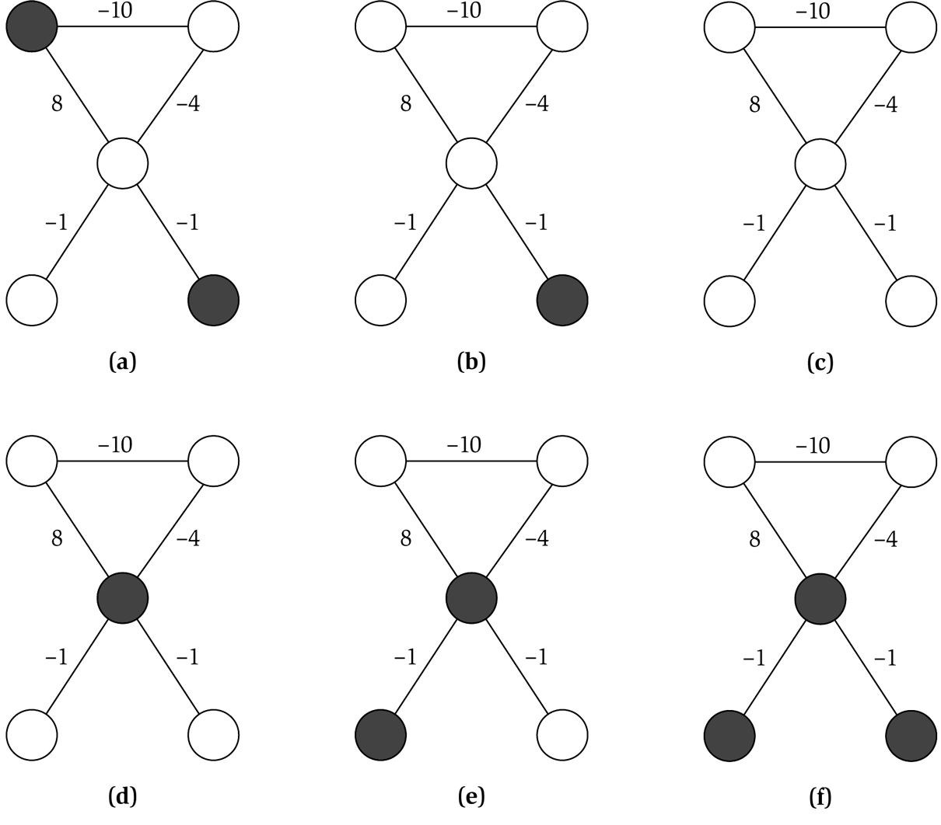
State Flipping Algorithm
unsatisfied node
10 - 8 > 0
unsatisfied node
8 - 4 - 1 - 1 > 0
stable

Slide 16
Hopfield Neural Networks
Claim. State-flipping algorithm terminates with a stable configuration after at most W = Σ_{e}|w_{e}| iterations.
Pf attempt. Consider measure of progress Φ(S) = # satisfied nodes.
Notes:
phi(S') > phi(S) -> phil(S') >= phi(S) + 1 since all weights are integers.

Slide 17

Hopfield Neural Networks
Claim. State-flipping algorithm terminates with a stable configuration after at most W = Σ_{e}|w_{e}| iterations.
Pf. Consider measure of progress Φ(S) = Σ_{e good} |w_{e}|.
  Clearly 0 ≤ Φ(S) ≤ W.
  We show Φ(S) increases by at least 1 after each flip.
  When u flips state:
    all good edges incident to u become bad
    all bad edges incident to u become good
    all other edges remain the same
u is unsatisfied
Notes:
phi(S') > phi(S) -> phil(S') >= phi(S) + 1 since all weights are integers.

Slide 18
Complexity of Hopfield Neural Network
Hopfield network search problem. Given a weighted graph, find a stable configuration if one exists.
Hopfield network decision problem. Given a weighted graph, does there exist a stable configuration?
Remark. The decision problem is trivially solvable (always yes), but there is no known poly-time algorithm for the search problem.
polynomial in n and log W

Slide 19
12.4 Maximum Cut

Slide 20

Maximum Cut
Maximum cut. Given an undirected graph G = (V, E) with positive integer edge weights w_{e}, find a node partition (A, B) such that the total weight of edges crossing the cut is maximized.
Toy application.
  n activities, m people.
  Each person wants to participate in two of the activities.
  Schedule each activity in the morning or afternoon to maximize number of people that can enjoy both activities.
Real applications. Circuit layout, statistical physics.

Slide 21
Maximum Cut
Single-flip neighborhood. Given a partition (A, B), move one node from A to B, or one from B to A if it improves the solution.
Greedy algorithm.
Max-Cut-Local (G, w) {
Pick a random node partition (A, B)
while (∃ improving node v) {
if (v is in A) move v to B
else move v to A
}
return (A, B)
}

Slide 22




Maximum Cut: Local Search Analysis
Theorem. Let (A, B) be a locally optimal partition and let (A*, B*) be optimal partition. Then w(A, B) ≥ ½ Σ_{e} w_{e} ≥ ½ w(A*, B*).
Pf.
  Local optimality implies that for all u ∈ A :
  Adding up all these inequalities yields:
  Similarly
  Now,
weights are nonnegative
each edge counted once

Slide 23

Maximum Cut: Big Improvement Flips
Local search. Within a factor of 2 for MAX-CUT, but not poly-time!
Big-improvement-flip algorithm. Only choose a node which, when flipped, increases the cut value by at least
Claim. Upon termination, big-improvement-flip algorithm returns a cut (A, B) with (2 +ε) w(A, B) ≥ w(A*, B*).
Pf idea. Add to each inequality in original proof.
Claim. Big-improvement-flip algorithm terminates after O(ε⁻¹ n log W) flips, where W = Σ_{e} w_{e}.
  Each flip improves cut value by at least a factor of (1 + ε/n).
  After n/ε iterations the cut value improves by a factor of 2.
  Cut value can be doubled at most log W times.
if x ≥ 1, (1 + 1/x)^{x} ≥ 2

Slide 24
Maximum Cut: Context
Theorem. [Sahni-Gonzales 1976] There exists a ½-approximation algorithm for MAX-CUT.
Theorem. [Goemans-Williamson 1995] There exists an 0.878567-approximation algorithm for MAX-CUT.
Theorem. [Håstad 1997] Unless P = NP, no 16/17 approximation algorithm for MAX-CUT.
0.941176

Slide 25
12.5 Neighbor Relations

Slide 26
Neighbor Relations for Max Cut
1-flip neighborhood. (A, B) and (A', B') differ in exactly one node.
k-flip neighborhood. (A, B) and (A', B') differ in at most k nodes.
  Θ(n^{k}) neighbors.
KL-neighborhood. [Kernighan-Lin 1970]
  To form neighborhood of (A, B):
    Iteration 1: flip node from (A, B) that results in best cut value (A₁, B₁), and mark that node.
    Iteration i: flip node from (A_{i-1}, B_{i-1}) that results in best cut value (A_{i}, B_{i}) among all nodes not yet marked.
  Neighborhood of (A, B) = (A₁, B₁), …, (A_{n-1}, B_{n-1}).
  Neighborhood includes some very long sequences of flips, but without the computational overhead of a k-flip neighborhood.
  Practice: powerful and useful framework.
  Theory: explain and understand its success in practice.
cut value of (A₁, B₁) may be
worse than (A, B)
Notes:
Note: there are bad examples for KL-neighborhood in theory. Understanding why it usually works remains an open problem.

Slide 27
12.7 Nash Equilibria

Slide 28
Multicast Routing
Multicast routing. Given a directed graph G = (V, E) with edge costs
c_{e} ≥ 0, a source node s, and k agents located at terminal nodes t₁, …, t_{k}. Agent j must construct a path P_{j} from node s to its terminal t_{j}.
Fair share. If x agents use edge e, they each pay c_{e} / x.
s
1
2
1 pays
2 pays
outer
outer
4
8
4
5
8
outer
middle
4
5 + 1
v
middle
outer
5 + 1
8
middle
middle
5/2 + 1
5/2 + 1
1
1
t₁
t₂

Slide 29
Nash Equilibrium
Best response dynamics. Each agent is continually prepared to improve its solution in response to changes made by other agents.
Nash equilibrium. Solution where no agent has an incentive to switch.
Fundamental question. When do Nash equilibria exist?
Ex:
  Two agents start with outer paths.
  Agent 1 has no incentive to switch paths
  (since 4 < 5 + 1), but agent 2 does (since 8 > 5 + 1).
  Once this happens, agent 1 prefers middle
  path (since 4 > 5/2 + 1).
  Both agents using middle path is a Nash
  equilibrium.
s
4
5
8
v
1
1
t₁
t₂

Slide 30
Nash Equilibrium and Local Search
Local search algorithm. Each agent is continually prepared to improve its solution in response to changes made by other agents.
Analogies.
  Nash equilibrium : local search.
  Best response dynamics : local search algorithm.
  Unilateral move by single agent : local neighborhood.
Contrast. Best-response dynamics need not terminate since no single objective function is being optimized.

Slide 31
Socially Optimum
Social optimum. Minimizes total cost to all agent.
Observation. In general, there can be many Nash equilibria. Even when its unique, it does not necessarily equal the social optimum.
s
s
3
5
5
1 + ε
k
v
k agents
t
1
1
t₁
t₂
Social optimum = 1 + ε
Nash equilibrium A = 1 + ε
Nash equilibrium B = k
Social optimum = 7
Unique Nash equilibrium = 8

Slide 32
Price of Stability
Price of stability. Ratio of best Nash equilibrium to social optimum.
Fundamental question. What is price of stability?
Ex: Price of stability = Θ(log k).
Social optimum. Everyone takes bottom paths.
Unique Nash equilibrium. Everyone takes top paths.
Price of stability. H(k) / (1 + ε).
s
1 + 1/2 + … + 1/k
1
1/2
1/3
1/k
. . .
t₁
t₂
t₃
t_{k}
1 + ε
0
0
0
0
s

Slide 33
Finding a Nash Equilibrium
Theorem. The following algorithm terminates with a Nash equilibrium.
Pf. Consider a set of paths P₁, …, P_{k}.
  Let x_{e} denote the number of paths that use edge e.
  Let Φ(P₁, …, P_{k}) = Σ_{e∈E} c_{e}· H(x_{e}) be a potential function.
  Since there are only finitely many sets of paths, it suffices to show that Φ strictly decreases in each step.
Best-Response-Dynamics(G, c) {
Pick a path for each agent
while (not a Nash equilibrium) {
Pick an agent i who can improve by switching paths
Switch path of agent i
}
}
H(0) = 0,

Slide 34
Finding a Nash Equilibrium
Pf. (continued)
  Consider agent j switching from path P_{j} to path P_{j}'.
  Agent j switches because
  Φ increases by
  Φ decreases by
  Thus, net change in Φ is negative. ▪

Slide 35
Bounding the Price of Stability
Claim. Let C(P₁, …, P_{k}) denote the total cost of selecting paths P₁, …, P_{k}.
For any set of paths P₁, …, P_{k} , we have
Pf. Let x_{e} denote the number of paths containing edge e.
  Let E⁺ denote set of edges that belong to at least one of the paths.

Slide 36
Bounding the Price of Stability
Theorem. There is a Nash equilibrium for which the total cost to all agents exceeds that of the social optimum by at most a factor of H(k).
Pf.
  Let (P₁*, …, P_{k}*) denote set of socially optimal paths.
  Run best-response dynamics algorithm starting from P*.
  Since Φ is monotone decreasing Φ(P₁, …, P_{k}) ≤ Φ(P₁*, …, P_{k}*).
previous claim
applied to P
previous claim
applied to P*

Slide 37
Summary
Existence. Nash equilibria always exist for k-agent multicast routing with fair sharing.
Price of stability. Best Nash equilibrium is never more than a factor of H(k) worse than the social optimum.
Fundamental open problem. Find any Nash equilibria in poly-time.

