Slide 1
CSYE 7374 Autonomous Learning in Games
Nik Bear Brown
nikbearbrown@gmail.com
Data Structures

Slide 2
Topics
Arrays
Linked Lists
Doubly linked
Stacks
Trees (Binary Trees, AVL (Adelson-Velskii and Landis) Trees, m-way trees , B+ trees)
Hash Tables
Heaps

Slide 3
Artificial Intelligence: A Modern Approach
Stuart and Norvig
Some slides from Artificial Intelligence: A Modern Approach
Stuart Russell, Peter Norvig
https://www.amazon.com/dp/9332543518/ref=cm_sw_r_tw_dp_U_x_rZufEbGBSJ2J7

Slide 4
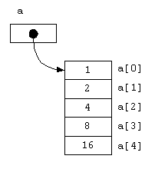
Data Structures - Arrays

Slide 5
Array Limitations
Arrays
Simple,
Fast
but
Must specify size at construction time
Murphy’s law
Construct an array with space for n
n = twice your estimate of largest collection
Tomorrow you’ll need n+1
More flexible system?

Slide 6
Linked Lists
Flexible space use
Dynamically allocate space for each element as needed
Include a pointer to the next item
Linked list
Each node of the list contains
the data item (an object pointer in our ADT)
a pointer to the next node
Data
Next
object

Slide 7
Linked Lists
Collection structure has a pointer to the list head
Initially NULL
Collection
Head

Slide 8
Linked Lists
Collection structure has a pointer to the list head
Initially NULL
Add first item
Allocate space for node
Set its data pointer to object
Set Next to NULL
Set Head to point to new node
Collection
node
Head
Data
Next
object

Slide 9
Linked Lists
Add second item
Allocate space for node
Set its data pointer to object
Set Next to current Head
Set Head to point to new node
Collection
Head
node
node
Data
Next
Data
Next
object2
object

Slide 10
Linked Lists C/C++
struct t_node {
void *item; struct t_node *next; } node;
typedef struct t_node *Node;
struct collection {
Node head;
……
};
int AddToCollection( Collection c, void *item ) {
Node new = malloc( sizeof( struct t_node ) );
new->item = item;
new->next = c->head; c->head = new;
return TRUE;
}

Slide 11
Linked Lists - C/C++
struct t_node {
void *item; struct t_node *next; } node;
typedef struct t_node *Node;
struct collection {
Node head;
……
};
int AddToCollection( Collection c, void *item ) {
Node new = malloc( sizeof( struct t_node ) );
new->item = item;
new->next = c->head; c->head = new;
return TRUE;
}
Recursive type definition -
C allows it!
Error checking, asserts
omitted for clarity!

Slide 12
Linked Lists
Insertion/Deletion
Constant - independent of n
Search time
Worst case - n
Collection
Head
node
node
Data
Next
Data
Next
object2
object

Slide 13
Linked Lists – C/C++
void *FindinCollection( Collection c, void *key ) {
Node n = c->head;
while ( n != NULL ) {
if ( KeyCmp( ItemKey( n->item ), key ) == 0 ) {
return n->item;
n = n->next;
}
return NULL;
}

Slide 14
Linked Lists - Delete implementation
void *DeleteFromCollection( Collection c, void *key ) {
Node n, prev;
n = prev = c->head;
while ( n != NULL ) {
if ( KeyCmp( ItemKey( n->item ), key ) == 0 ) {
prev->next = n->next;
return n;
}
prev = n; n = n->next;
}
return NULL;
}
head

Slide 15
Linked Lists - Delete implementation
void *DeleteFromCollection( Collection c, void *key ) {
Node n, prev;
n = prev = c->head;
while ( n != NULL ) {
if ( KeyCmp( ItemKey( n->item ), key ) == 0 ) {
prev->next = n->next;
return n;
}
prev = n; n = n->next;
}
return NULL;
}
head
Minor addition needed to allow
for deleting this one! An exercise!

Slide 16
Linked Lists - LIFO and FIFO
Simplest implementation
Add to head
Last-In-First-Out (LIFO) semantics
Modifications
First-In-First-Out (FIFO)
Keep a tail pointer
head
struct t_node {
void *item; struct t_node *next; } node;
typedef struct t_node *Node;
struct collection {
Node head, tail;
};
tail
tail is set in
the AddToCollection
method if
head == NULL

Slide 17
Linked Lists - Doubly linked
Doubly linked lists
Can be scanned in both directions
struct t_node {
void *item; struct t_node *prev,
*next; } node;
typedef struct t_node *Node;
struct collection {
Node head, tail;
};
head
prev
prev
prev
tail

Slide 18
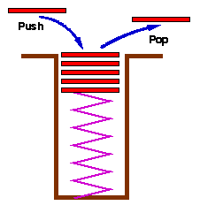
Stacks
Stacks are a special form of collection with LIFO semantics
Two methods
int push( Stack s, void *item ); - add item to the top of the stack
void *pop( Stack s ); - remove an item from the top of the stack
Like a plate stacker
Other methods
int IsEmpty( Stack s ); /* Return TRUE if empty */ void *Top( Stack s ); /* Return the item at the top, without deleting it */

Slide 19
Stacks - Implementation
Arrays
Provide a stack capacity to the constructor
Flexibility limited but matches many real uses
Capacity limited by some constraint
Memory in your computer
Size of the plate stacker, etc
push, pop methods
Variants of AddToC…, DeleteFromC…
Linked list also possible

Slide 20
Stacks - Relevance
Stacks appear in computer programs
Key to call / return in functions & procedures
Stack frame allows recursive calls
Call: push stack frame
Return: pop stack frame
Stack frame
Function arguments
Return address
Local variables

Slide 21
Stacks - Implementation
Arrays common
Provide a stack capacity to the constructor
Flexibility limited but matches many real uses
Stack created with limited capacity
struct t_node {
void *item; struct t_node *prev,
*next; } node;
typedef struct t_node *Node;
struct collection {
Node head, tail;
};
head
prev
prev
prev
tail

Slide 22
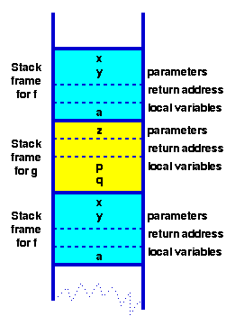
Stack Frames - Functions in HLL
function f( int x, int y) { int a; if ( term_cond ) return …; a = ….; return g( a ); } function g( int z ) { int p, q; p = …. ; q = …. ; return f(p,q); }
Context
for execution of f

Slide 23
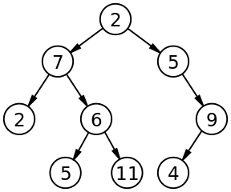
Binary Trees
Binary Tree
Consists of
Node
Left and Right sub-trees
Both sub-trees are binary trees

Slide 24
Trees - Implementation
struct t_node {
void *item; struct t_node *left;
struct t_node *right; };
typedef struct t_node *Node;
struct t_collection { Node root;
……
};

Slide 25
Trees - Implementation
extern int KeyCmp( void *a, void *b );
/* Returns -1, 0, 1 for a < b, a == b, a > b */
void *FindInTree( Node t, void *key ) {
if ( t == (Node)0 ) return NULL;
switch( KeyCmp( key, ItemKey(t->item) ) ) {
case -1 : return FindInTree( t->left, key );
case 0: return t->item;
case +1 : return FindInTree( t->right, key );
}
}
void *FindInCollection( collection c, void *key ) {
return FindInTree( c->root, key );
}

Slide 26
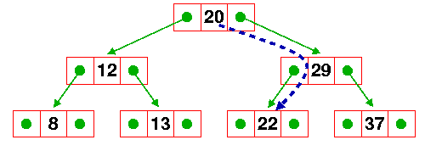
Trees - Implementation
Find
key = 22; if ( FindInCollection( c , &key ) ) ….
n = c->root;
FindInTree( n, &key );
FindInTree(n->right,&key );
FindInTree(n->left,&key );
return n->item;

Slide 27
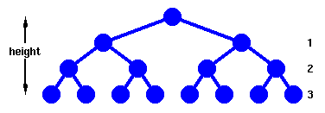
Trees - Performance
Find
Complete Tree
Height, h
Nodes traversed in a path from the root to a leaf
Number of nodes, h
n = 1 + 2¹ + 2² + … + 2^{h} = 2^{h+1} - 1
h = floor( log₂ n )

Slide 28
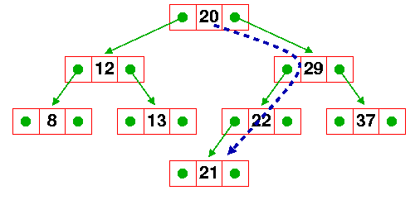
Trees - Addition
Add 21 to the tree
We need at most h+1 comparisons
Create a new node (constant time)
add takes c₁(h+1)+c₂ or c log n
So addition to a tree takes time proportional to log n also

Slide 29
Trees - Addition - implementation
static void AddToTree( Node *t, Node new ) {
Node base = *t;
/* If it's a null tree, just add it here */
if ( base == NULL ) {
*t = new; return; }
else
if( KeyLess(ItemKey(new->item),ItemKey(base->item)) )
AddToTree( &(base->left), new );
else
AddToTree( &(base->right), new );
}
void AddToCollection( collection c, void *item ) {
Node new, node_p;
new = (Node)malloc(sizeof(struct t_node));
/* Attach the item to the node */
new->item = item;
new->left = new->right = (Node)0;
AddToTree( &(c->node), new );
}

Slide 30
Trees - Addition
Find c log n
Add c log n
Delete c log n
Usually efficient in every respect!
But there’s a catch ……….. Balance!!!

Slide 31
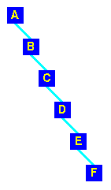
Trees - Addition
Take this list of characters and form a tree A B C D E F
In this case
Find
Add
Delete

Slide 32
Searching - Re-visited
Binary tree O(log n) if it stays balanced
Simple binary tree good for static collections
Low (preferably zero) frequency of insertions/deletions
but my collection keeps changing!
It’s dynamic
Need to keep the tree balanced
First, examine some basic tree operations
Useful in several ways!

Slide 33
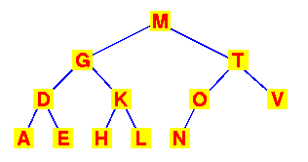
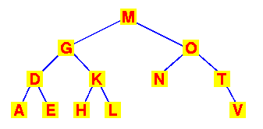
Trees - Searching
Binary search tree
Preserving the order
Observe that this transformation preserves the search tree

Slide 34
Trees - Searching
Binary search tree
Preserving the order
Observe that this transformation preserves the search tree
We’ve performed a rotation of the sub-tree about the T and O nodes

Slide 35
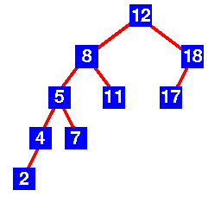
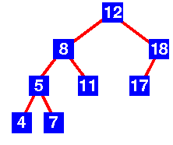
AVL and other balanced trees
AVL Trees
First balanced tree algorithm
Discoverers: Adelson-Velskii and Landis
Properties
Binary tree
Height of left and right-subtrees differ by at most 1
Subtrees are AVL trees
AVL Tree
AVL Tree

Slide 36
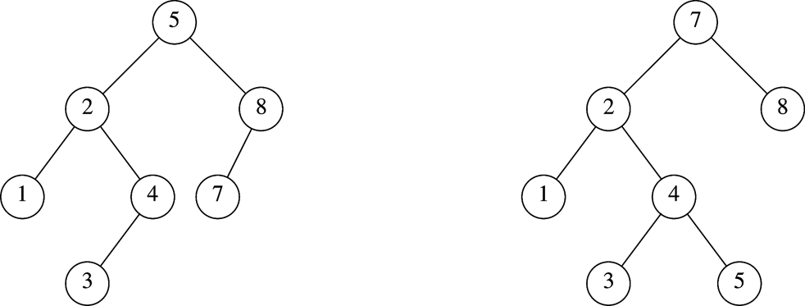
Which is an AVL Tree?

Slide 37
AVL (Adelson-Velskii and Landis) Trees
An AVL Tree is a binary search tree such that for every internal node v of T, the heights of the children of v can differ by at most 1.

Slide 38
Motivation
When building a binary search tree, what type of trees would we like? Example: 3, 5, 8, 20, 18, 13, 22
3
5
13
8
5
20
13
18
3
8
18
22
20
22

Slide 39
Motivation
Complete binary tree is hard to build when we allow dynamic insert and remove.
We want a tree that has the following properties
Tree height = O(log(N))
allows dynamic insert and remove with O(log(N)) time complexity.
The AVL tree is one of this kind of trees.
8
13
5
18
5
20
3
13
20
3
8
18
22
22

Slide 40
AVL (Adelson-Velskii and Landis) Trees
AVL tree is a binary search tree with balance condition
To ensure depth of the tree is O(log(N))
And consequently, search/insert/remove complexity bound O(log(N))
Balance condition
For every node in the tree, height of left and right subtree can differ by at most 1

Slide 41
Height of an AVL tree
Theorem: The height of an AVL tree storing n keys is O(log n).
Proof:
Let us bound n(h), the minimum number of internal nodes of an AVL tree of height h.
We easily see that n(0) = 1 and n(1) = 2
For h > 2, an AVL tree of height h contains the root node, one AVL subtree of height h-1 and another of height h-2 (at worst).
That is, n(h) >= 1 + n(h-1) + n(h-2)
Knowing n(h-1) > n(h-2), we get n(h) > 2n(h-2). So
n(h) > 2n(h-2), n(h) > 4n(h-4), n(h) > 8n(n-6), … (by induction),
n(h) > 2^{i}n(h-2i)
Solving the base case we get: n(h) > 2 ^{h/2-1}
Taking logarithms: h < 2log n(h) +2
Since n>=n(h), h < 2log(n)+2 and the height of an AVL tree is O(log n)

Slide 42
AVL Trees - Data Structures
typedef enum { LeftHeavy, Balanced, RightHeavy } BalanceFactor;
struct AVL_node { BalanceFactor bf; void *item; struct AVL_node *left, *right; }
Insertion
Insert a new node (as any binary tree)
Work up the tree re-balancing as necessary to restore the AVL property

Slide 43
m-way trees (Multiway Trees)
A multiway tree is a tree that can have more than two children. A multiway tree of order m (or an m-way tree) is one in which a tree can have m children.
But you have to search through the m keys in each node!
Reduces your gain from having fewer levels.

Slide 44
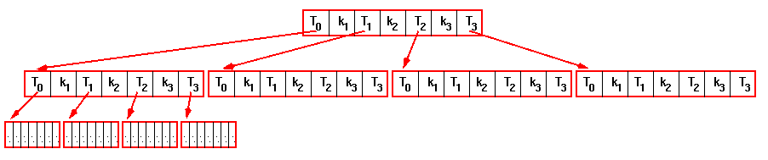
m-way trees
Only two children per node?
Reduce the depth of the tree to O(log_{m}n) with m-way trees
m children, m-1 keys per node
m = 10 : 10⁶ keys in 6 levels vs 20 for a binary tree

Slide 45
B-trees
All leaves are on the same level
All nodes except for the root and the leaves have
at least m/2 children
at most m children
B+ trees
All the keys in the nodes are dummies
Only the keys in the leaves point to “real” data
Linking the leaves
Ability to scan the collection in order without passing through the higher nodes

Slide 46
Motivation for B-Trees
Index structures for large datasets cannot be stored in main memory
Storing it on disk requires different approach to efficiency
Assuming that a disk spins at 3600 RPM, one revolution occurs in 1/60 of a second, or 16.7ms
Crudely speaking, one disk access takes about the same time as 200,000 instructions

Slide 47
Motivation B-trees
Assume that we use an AVL tree to store about 20 million records
We end up with a very deep binary tree with lots of different disk accesses; log₂ 20,000,000 is about 24, so this takes about 0.2 seconds
We know we can’t improve on the log n lower bound on search for a binary tree
But, the solution is to use more branches and thus reduce the height of the tree!
As branching increases, depth decreases

Slide 48
Definition of B-Tree
Definition assumes external nodes (extended m-way search tree).
B-tree of order m.
m-way search tree.
Not empty => root has at least 2 children.
Remaining internal nodes (if any) have at least ceil(m/2) children.
External (or failure) nodes on same level.
Notes:
Alternative definition has pairs only in leaves; remaining nodes have keys only. Leaf-pushed B-tree or B+-tree.

Slide 49
An example B-Tree
26
A B-tree of order 5 containing 26 items
6
12
42
51
62
1
2
4
7
8
13
15
18
25
27
29
45
46
48
53
55
60
64
70
90
Note that all the leaves are at the same level

Slide 50
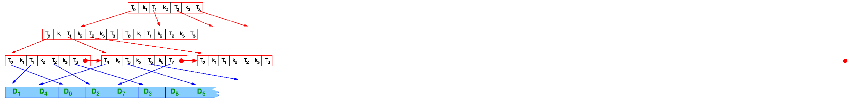
B+-trees
B+ trees
All the keys in the nodes are dummies
Only the keys in the leaves point to “real” data
Data records kept in a separate area

Slide 51
Hash Tables
All search structures so far
Relied on a comparison operation
Performance O(n) or O( log n)
Assume I have a function
f ( key ) ® integer
ie one that maps a key to an integer
What performance might I expect now?

Slide 52
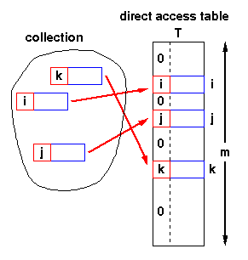
Hash Tables - Structure
Simplest case:
Assume items have integer keys in the range 1 .. m
Use the value of the key itself to select a slot in a direct access table in which to store the item
To search for an item with key, k, just look in slot k
If there’s an item there, you’ve found it
If the tag is 0, it’s missing.
Constant time, O(1)

Slide 53
Hash Tables - Constraints
Constraints
Keys must be unique
Keys must lie in a small range
For storage efficiency, keys must be dense in the range
If they’re sparse (lots of gaps between values), a lot of space is used to obtain speed
Space for speed trade-off

Slide 54
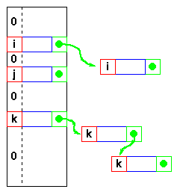
Hash Tables - Relaxing the constraints
Keys must be unique
Construct a linked list of duplicates “attached” to each slot
If a search can be satisfied by any item with key, k, performance is still O(1)
but
If the item has some other distinguishing feature which must be matched, we get O(n^{max})
where n^{max} is the largest number of duplicates - or length of the longest chain

Slide 55
Hash Tables - Relaxing the constraints
Keys are integers
Need a hash function h( key ) ® integer
ie one that maps a key to an integer
Applying this function to the key produces an address
If h maps each key to a unique integer in the range 0 .. m-1 then search is O(1)

Slide 56
Hash Tables - Hash functions
Example - using an n-character key
int hash( char *s, int n ) { int sum = 0; while( n-- ) sum = sum + *s++; return sum % 256; } returns a value in 0 .. 255
xor function is also commonly used sum = sum ^ *s++;
But any function that generates integers in 0..m-1 for some suitable (not too large) m will do

Slide 57
Hash Tables - Collisions
Hash function
With this hash function
int hash( char *s, int n ) { int sum = 0; while( n-- ) sum = sum + *s++; return sum % 256; }
hash( “AB”, 2 ) and hash( “BA”, 2 ) return the same value!
This is called a collision
A variety of techniques are used for resolving collisions

Slide 58
Hash Tables - Collision handling
Collisions
Occur when the hash function maps two different keys to the same address
The table must be able to recognise and resolve this
Recognise
Store the actual key with the item in the hash table
Compute the address
k = h( key )
Check for a hit
if ( table[k].key == key ) then hit else try next entry
Resolution
Variety of techniques

Slide 59
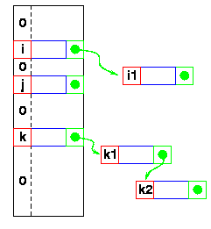
Hash Tables - Linked lists
Collisions - Resolution
Linked list attached to each primary table slot
h(i) == h(i1)
h(k) == h(k1) == h(k2)
Searching for i1
Calculate h(i1)
Item in table, i, doesn’t match
Follow linked list to i1
If NULL found, key isn’t in table

Slide 60
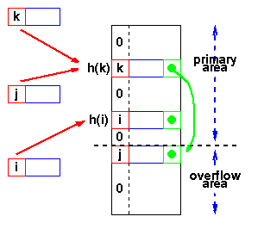
Hash Tables - Overflow area
Overflow area
Linked list constructed in special area of table called overflow area
h(k) == h(j)
k stored first
Adding j
Calculate h(j)
Find k
Get first slot in overflow area
Put j in it
k’s pointer points to this slot
Searching - same as linked list

Slide 61
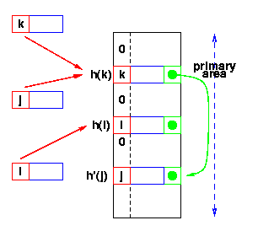
Hash Tables - Re-hashing
Use a second hash function
Many variations
General term: re-hashing
h(k) == h(j)
k stored first
Adding j
Calculate h(j)
Find k
Repeat until we find an empty slot
Calculate h’(j)
Put j in it
Searching - Use h(x), then h’(x)

Slide 62
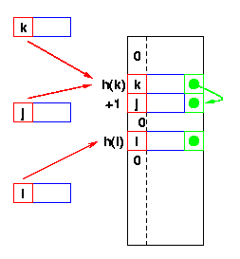
Hash Tables - Re-hash functions
The re-hash function
Many variations
Linear probing
h’(x) is +1
Go to the next slot until you find one empty
Can lead to bad clustering
Re-hash keys fill in gaps between other keys and exacerbate the collision problem

Slide 63
Hash Tables - Summary so far ...
Potential O(1) search time
If a suitable function h(key) ® integer can be found
Space for speed trade-off
“Full” hash tables don’t work (more later!)
Collisions
Inevitable
Hash function reduces amount of information in key
Various resolution strategies
Linked lists
Overflow areas
Re-hash functions
Linear probing h’ is +1
Quadratic probing h’ is +ci²
Any other hash function!
or even sequence of functions!

Slide 64
Hash Tables - Choosing the Hash Function
“Almost any function will do”
But some functions are definitely better than others!
Key criterion
Minimum number of collisions
Keeps chains short
Maintains O(1) average

Slide 65

Collision Frequency
Birthdays or the von Mises paradox
There are 365 days in a normal year
Birthdays on the same day unlikely?
How many people do I need before “it’s an even bet” (ie the probability is > 50%) that two have the same birthday?
View
the days of the year as the slots in a hash table
the “birthday function” as mapping people to slots
Answering von Mises’ question answers the question about the probability of collisions in a hash table

Slide 66
Binary Heap Priority Q Data Structure
Heap-order property
parent’s key is less than children’s keys
result: minimum is always at the top
Structure property
complete tree with fringe nodes packed to the left
result: depth is always O(log n); next open location always known
2
4
5
7
6
10
8
11
9
12
14
20
How do we find the minimum?
Notes:
Alright, there are two problems with binary search trees as pqs.
First, they’re overkill. Why keep everything ordered? We just need to know the least at any given time.
Second, they’re not guaranteed to be complete, so we have worst case O(n) times.

Slide 67
Heaps
A heap is a certain kind of complete binary tree.
Notes:
A heap is a data structure with several applications, including a way to implement Priority Queues, as shown in Chapter 11. The definition of a heap is a special kind of complete binary tree.
You probably recall that a complete binary tree requires that its nodes are added in a particular order...

Slide 68
Heaps
Root
A heap is a certain kind of complete binary tree.
When a complete
binary tree is built,
its first node must be
the root.
Notes:
The first node of a complete binary tree is always the root...

Slide 69
Heaps
Complete binary tree.
Left child
of the
root
The second node is
always the left child
of the root.
Notes:
...the second node is always the left child of the root...

Slide 70
Heaps
Complete binary tree.
Right child
of the
root
The third node is
always the right child
of the root.
Notes:
...then the right child of the root...

Slide 71
Heaps
Complete binary tree.
The next nodes
always fill the next
level from left-to-right.
Notes:
...and so on. The nodes always fill each level from left-to-right...

Slide 72
Heaps
Complete binary tree.
The next nodes
always fill the next
level from left-to-right.
Notes:
...from left-to-right...

Slide 73
Heaps
Complete binary tree.
The next nodes
always fill the next
level from left-to-right.
Notes:
...from left-to-right...

Slide 74
Heaps
Complete binary tree.
The next nodes
always fill the next
level from left-to-right.
Notes:
...from left-to-right...

Slide 75
Heaps
Complete binary tree.
Notes:
...and when a level is filled you start the next level at the left.

Slide 76
Heaps
45
A heap is a certain kind of complete binary tree.
35
23
27
21
22
4
19
Each node in a heap
contains a key that
can be compared to
other nodes' keys.
Notes:
So, a heap is a complete binary tree. Each node in a heap contains a key, and these keys must be organized in a particular manner. Notice that this is not a binary search tree, but the keys do follow some semblance of order.
Can you see what rule is being enforced here?

Slide 77
Heaps
45
A heap is a certain kind of complete binary tree.
35
23
27
21
22
4
19
The "heap property"
requires that each
node's key is >= the
keys of its children
Notes:
The heap property requires that each node's key is >= to the keys of its children.
This is a handy property because the biggest node is always at the top. Because of this, a heap can easily implement a priority queue (where we need quick access to the highest priority item).

Slide 78
Adding a Node to a Heap
45
Put the new node in the next available spot.
Push the new node upward, swapping with its parent until the new node reaches an acceptable location.
35
23
27
21
22
4
19
42
Notes:
We can add new elements to a heap whenever we like. Because the heap is a complete binary search tree, we must add the new element at the next available location, filling in the levels from left-to-right.
In this example, I have just added the new element with a key of 42.
Of course, we now have a problem: The heap property is no longer valid. The 42 is bigger than its parent 27.
To fix the problem, we will push the new node upwards until it reaches an acceptable location.

Slide 79
Adding a Node to a Heap
45
Put the new node in the next available spot.
Push the new node upward, swapping with its parent until the new node reaches an acceptable location.
35
23
42
21
22
4
19
27
Notes:
Here we have pushed the 42 upward one level, swapping it with its smaller parent 27.
We can't stop here though, because the parent 35 is still smaller than the new node 42.

Slide 80
Adding a Node to a Heap
45
Put the new node in the next available spot.
Push the new node upward, swapping with its parent until the new node reaches an acceptable location.
42
23
35
21
22
4
19
27
Notes:
Can we stop now? Yes, because the 42 is less than or equal to its parent.

Slide 81
Adding a Node to a Heap
45
The parent has a key that is >= new node, or
The node reaches the root.
The process of pushing the new node upward is called reheapification upward.
42
23
35
21
22
4
19
27
Notes:
In general, there are two conditions that can stop the pushing upward:
1. We reach a spot where the parent is >= the new node, or
2. We reach the root.
This process is called reheapification upward (I didn't just make up that name, really).

Slide 82
Removing the Top of a Heap
45
Move the last node onto the root.
42
23
35
21
22
4
19
27
Notes:
We can also remove the top node from a heap. The first step of the removal is to move the last node of the tree onto the root. In this example we move the 27 onto the root.

Slide 83
Removing the Top of a Heap
27
Move the last node onto the root.
42
23
35
21
22
4
19
Notes:
Now the 27 is on top of the heap, and the original root (45) is no longer around. But the heap property is once again violated.

Slide 84
Removing the Top of a Heap
27
Move the last node onto the root.
Push the out-of-place node downward, swapping with its larger child until the new node reaches an acceptable location.
42
23
35
21
22
4
19
Notes:
We'll fix the problem by pushing the out-of-place node downward. Perhaps you can guess what the downward pushing is called....reheapification downward.

Slide 85
Removing the Top of a Heap
42
Move the last node onto the root.
Push the out-of-place node downward, swapping with its larger child until the new node reaches an acceptable location.
27
23
35
21
22
4
19
Notes:
When we push a node downward it is important to swap it with its largest child. (Otherwise we are creating extra problems by placing the smaller child on top of the larger child.) This is what the tree looks like after one swap.
Should I continue with the reheapification downward?

Slide 86
Removing the Top of a Heap
42
Move the last node onto the root.
Push the out-of-place node downward, swapping with its larger child until the new node reaches an acceptable location.
35
23
27
21
22
4
19
Notes:
Yes, I swap again, and now the 27 is in an acceptable location.

Slide 87
Removing the Top of a Heap
42
The children all have keys <= the out-of-place node, or
The node reaches the leaf.
The process of pushing the new node downward is called reheapification downward.
35
23
27
21
22
4
19
Notes:
Reheapification downward can stop under two circumstances:
1. The children all have keys that are <= the out-of-place node.
2. The out-of-place node reaches a leaf.

Slide 88
Implementing a Heap
42
We will store the data from the nodes in a partially-filled array.
35
23
27
21
An array of data
Notes:
This slide shows the typical way that a heap is implemented. For the most part, there is nothing new here, because you already know how to implement a complete binary tree using a partially-filled array. That is what we are doing with the heap.

Slide 89
Implementing a Heap
42
Data from the root goes in the first location of the array.
35
23
27
21
42
An array of data
Notes:
Following the usual technique for implementing a complete binary tree, the data from the root is stored in the first entry of the array.

Slide 90
Implementing a Heap
42
Data from the next row goes in the next two array locations.
35
23
27
21
42
35
23
An array of data
Notes:
The next two nodes go in the next two locations of the array.

Slide 91
Implementing a Heap
42
Data from the next row goes in the next two array locations.
35
23
27
21
42
35
23
27
21
An array of data
Notes:
and so on.

Slide 92
Implementing a Heap
42
Data from the next row goes in the next two array locations.
35
23
27
21
42
35
23
27
21
An array of data
We don't care what's in
this part of the array.
Notes:
As with any partially-filled array, we are only concerned with the front part of the array. If the tree has five nodes, then we are only concerned with the entries in the first five components of the array.

Slide 93
Important Points about the Implementation
42
The links between the tree's nodes are not actually stored as pointers, or in any other way.
The only way we "know" that "the array is a tree" is from the way we manipulate the data.
35
23
27
21
42
35
23
27
21
An array of data
Notes:
With this implementation of a heap, there are no pointers. The only way that we know that the array is a heap is the manner in which we manipulate it.

Slide 94
Important Points about the Implementation
42
If you know the index of a node, then it is easy to figure out the indexes of that node's parent and children. Formulas are given in the book.
35
23
27
21
42
35
23
27
21
[1] [2] [3] [4] [5]
Notes:
The manipulations are the same manipulations that you've used for a complete binary tree, making it easy to compute the index where various nodes are stored.

Slide 95
Nifty Storage Trick
Calculations:
child:
parent:
root:
next free:
1
2
2
3
4
5
4
5
6
7
7
6
10
8
8
9
11
9
12
14
20
10
11
12
0
1
2
3
4
5
6
7
8
9
10
11
12
12
2
4
5
7
6
10
8
11
9
12
14
20
Notes:
It so happens that we can store a complete tree in an array and still be able to find children and parents easily. We’ll take advantage of this.
Child:
left = 2*node
right = 2*node + 1
parent = floor(node/2)
root = 1
nextfree = length + 1

Slide 96
Nifty Storage Trick
Calculations:
child: left = 2*node
right=2*node+1
parent: floor(node/2)
root: 1
next free: length+1
1
2
2
3
4
5
4
5
6
7
7
6
10
8
8
9
11
9
12
14
20
10
11
12
0
1
2
3
4
5
6
7
8
9
10
11
12
12
2
4
5
7
6
10
8
11
9
12
14
20
Notes:
It so happens that we can store a complete tree in an array and still be able to find children and parents easily. We’ll take advantage of this.
Child:
left = 2*node
right = 2*node + 1
parent = floor(node/2)
root = 1
nextfree = length + 1

Slide 97
DeleteMin
pqueue.deleteMin()
2
2
20
4
5
4
5
7
6
10
8
7
6
10
8
11
9
12
14
20
11
9
12
14
20
Notes:
OK, to delete, we start by plucking out that value in O(1) time.
Now, we have a hole at the top, and a node that isn’t proper for a complete tree at the bottom.
So, we fix it by putting the value in the hole, and moving the hole until we restore the heap-order property.

Slide 98
Percolate Down
20
4
4
5
20
5
7
6
10
8
7
6
10
8
11
9
12
14
11
9
12
14
4
4
6
5
6
5
7
20
10
8
7
12
10
8
11
9
12
14
11
9
20
14

Slide 99
DeleteMin Code
Comparable deleteMin(){
x = A[1];
A[1]=A[size--];
percolateDown(1);
return x;
}
percolateDown(int hole) {
tmp=A[hole];
while (2*hole <= size) {
left = 2*hole;
right = left + 1;
if (right <= size &&
A[right] < A[left])
target = right;
else
target = left;
if (A[target] < tmp) {
A[hole] = A[target];
hole = target;
}
else
break;
}
A[hole] = tmp;
}
Trick to avoid repeatedly copying the value at A[1]
Move down
runtime:
Notes:
Note that there are three things going on here: find the smaller child
if the smaller child is still smaller than the moving value, move the smaller child up
otherwise, we’ve found the right spot, and stop.

Slide 100
Insert
pqueue.insert(3)
2
2
4
5
4
5
7
6
10
8
7
6
10
8
11
9
12
14
20
11
9
12
14
20
3
Notes:
Inserting works similarly. We tack a hole on at the end of the tree, and move that hole _up_ until it’s in the right place for the new value.

Slide 101
Percolate Up
2
2
4
5
4
5
7
6
10
8
7
6
3
8
11
9
12
14
20
3
11
9
12
14
20
10
2
4
3
7
6
5
8
11
9
12
14
20
10

Slide 102
Insert Code
void insert(Comparable x) {
// Efficiency hack: we won’t actually put x
// into the heap until we’ve located the position
// it goes in. This avoids having to copy it
// repeatedly during the percolate up.
int hole = ++size;
// Percolate up
for( ; hole>1 && x < A[hole/2] ; hole = hole/2)
A[hole] = A[hole/2];
A[hole] = x;
}
runtime:
Notes:
Notice that this code is a _lot_ easier.

Slide 103
Performance of Binary Heap
 | Binary heap worst case | Binary heap avg case | AVL tree worst case | BST tree avg case
Insert | O(log n) | O(1) percolates 1.6 levels | O(log n) | O(log n)
Delete Min | O(log n) | O(log n) | O(log n) | O(log n)
In practice: binary heaps much simpler to code, lower constant factor overhead

