Slide 1
CSYE 7374 Autonomous Learning in Games
Nik Bear Brown
nikbearbrown@gmail.com
Graph Search

Slide 2
Topics
Uninformed Search
Breadth-First Search
Depth-First Search
Iterative Deepening
Heuristic Search
- Greedy Search
- A*-Search
- IDA*-Search

Slide 3
Artificial Intelligence: A Modern Approach
Stuart and Norvig
Some slides from Artificial Intelligence: A Modern Approach
Stuart Russell, Peter Norvig
https://www.amazon.com/dp/9332543518/ref=cm_sw_r_tw_dp_U_x_rZufEbGBSJ2J7

Slide 4
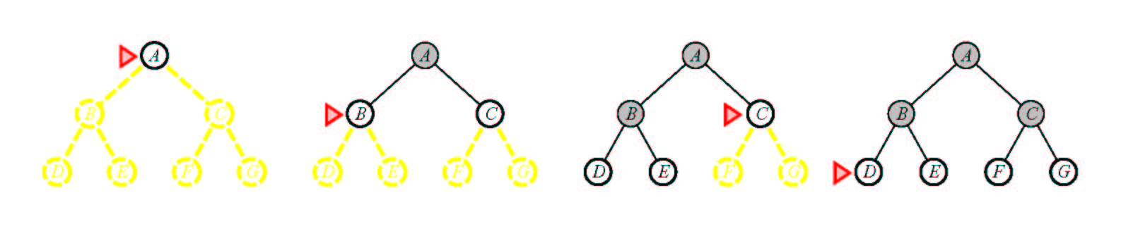
Breadth-First Search
Notes:
Suppose the solution is at depth 4 at the right. Then we must explore almost all paths of length 5 before we find it.
Suppose all paths of length 10 are solutions?
Note how much memory this approach takes.

Slide 5
Pseudocode for Breadth-First Search
Initialize: Let Q = {S}
While Q is not empty
pull Q1, the first element in Q
if Q1 is a goal
report(success) and quit
else
child_nodes = expand(Q1)
eliminate child_nodes which represent loops
put remaining child_nodes at the back of Q
end
Continue

Slide 6
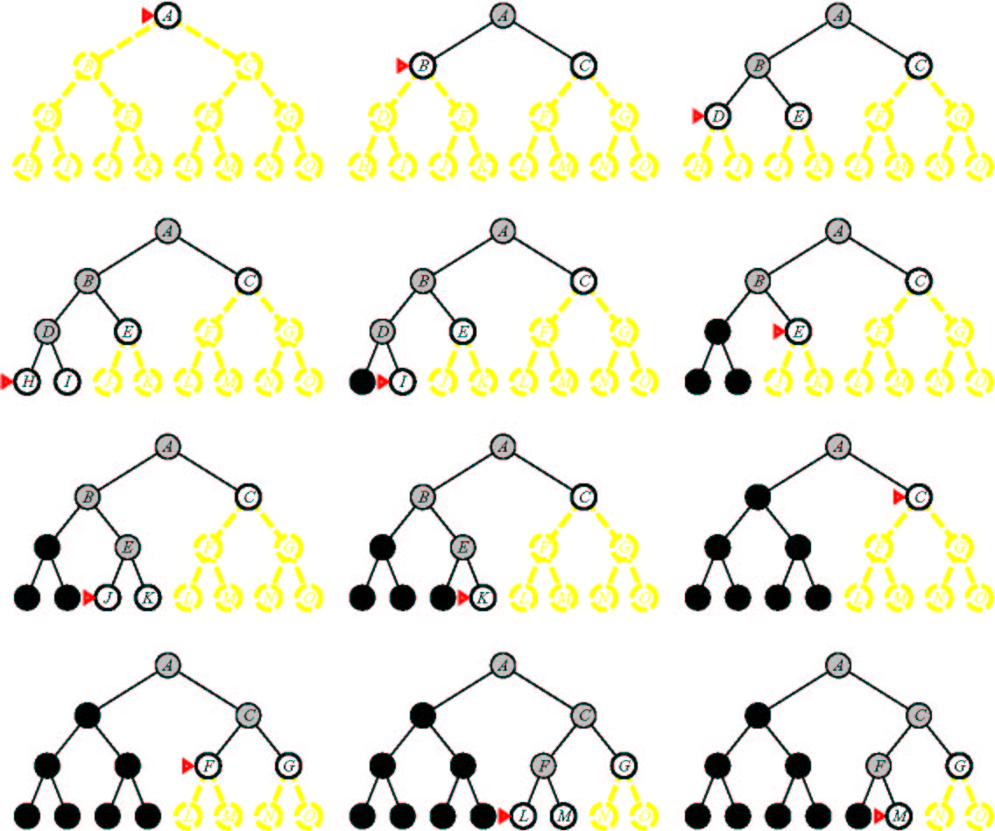
Depth-First Search
Notes:
Notice how much less memory this takes.
Note that we could have generated the answer but not noticed it.
Is depth-first search optimal? (I.e., if it finds the solution, it’s the best one) no. Can miss a better one somewhere else in the tree.
What’s the worst problem? Can go on forever. Can implement a cut off.

Slide 7
Depth First Search (DFS)
S
A
D
B
D
C
E
Here, to avoid repeated states assume we don’t expand any child node which appears already in the path from the root S to the parent. (Other strategies are also possible)
D
F
G

Slide 8
Pseudocode for Depth-First Search
Initialize: Let Q = {S}
While Q is not empty
pull Q1, the first element in Q
if Q1 is a goal
report(success) and quit
else
child_nodes = expand(Q1)
eliminate child_nodes which represent loops
put remaining child_nodes at the front of Q
end
Continue

Slide 9
Breadth First Search
S
A
D
B
A
D
E
C
E
E
S
B
S
B
F
(Use the simple heuristic of not generating a child node if that node is a parent to avoid “obvious” loops: this clearly does not avoid all loops and there are other ways to do this)

Slide 10
Comparing DFS and BFS
Same Time Complexity, unless...
say we have a search problem with
goals at some depth d
but paths without goals and which have infinite depth (i.e., loops in the search space)
in this case DFS never may never find a goal!
(it stays on an infinite (non-goal) path forever)
BFS does not have this problem
it will find the finite depth goals in time O(b^{d})
Practical considerations
if there are no infinite paths, and many possible goals in the search tree, DFS will work best
For large branching factors b, BFS may run out of memory
BFS is “safer” if we know there can be loops

Slide 11
Depth-Limited Search
This is Depth-first Search with a cutoff on the maximum depth of any path
i.e., implement the usual DFS algorithm
when any path gets to be of length m, then do not expand this path any further and backup
this will systematically explore a search tree of depth m
Properties of DLS
Time complexity = O(b^m), Space complexity = O(bm)
If goal state is within m steps from S:
DLS is complete
e.g., with N cities, we know that if there is a path to goal state G it can be of length N-1 at most
But usually we don’t know where the goal is!
if goal state is more than m steps from S, DLS is incomplete!
=> the big problem is how to choose the value of m

Slide 12
Iterative Deepening Search
Basic Idea:
we can run DFS with a maximum depth constraint, m
i.e., DFS algorithm but it backs-up at depth m
this avoids the problem of infinite paths
But how do we choose m in practice? say m < d (!!)
We can run DFS multiple times, gradually increasing m
this is known as Iterative Deepening Search
Procedure
for m = 1 to infinity
if (depth-first search with max-depth = m ) returns success
then report (success) and quit
else
continue
end

Slide 13
Iterative Deepening Search
Complexity
Space complexity = O(bd)
(since its like depth first search run different times)
Time Complexity
1 + (1+b) + (1 +b+b²) + .......(1 +b+....b^{d}) = O(b^{d}) (i.e., the same as BFS or DFS in the the worst case)
The overhead in repeated searching of the same subtrees is small relative to the overall time
e.g., for b=10, only takes about 11% more time than DFS
A useful practical method
combines
guarantee of finding a solution if one exists (as in BFS)
space efficiency, O(bd) of DFS

Slide 14
Bidirectional Search
Idea
simultaneously search forward from S and backwards from G
stop when both “meet in the middle”
need to keep track of the intersection of 2 open sets of nodes
What does searching backwards from G mean
need a way to specify the predecessors of G
this can be difficult,
e.g., predecessors of checkmate in chess?
what if there are multiple goal states?
what if there is only a goal test, no explicit list?
Complexity
time complexity is O(2 b^{(d/2)}) = O(b ^{(d/2)}) steps
memory complexity is the same

Slide 15
Repeated States
S
B
S
B
C
C
C
S
B
S
State Space
Example of a Search Tree
For many problems we can have repeated states in the search tree
i.e., the same state can be gotten to by different paths
=> same state appears in multiple places in the tree
this is inefficient, we want to avoid it
How inefficient can this be?
a problem with a finite number of states can have an infinite search tree!

Slide 16
Techniques for Avoiding Repeated States
Method 1
when expanding, do not allow return to parent state
(but this will not avoid “triangle loops” for example)
Method 2
do not create paths containing cycles (loops)
i.e., do not keep any child-node which is also an ancestor in the tree
Method 3
never generate a state generated before
only method which is guaranteed to always avoid repeated states
must keep track of all possible states (uses a lot of memory)
e.g., 8-puzzle problem, we have 9! = 362,880 states
Methods 1 and 2 are most practical, work well on most problems

Slide 17
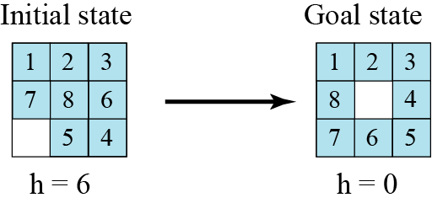
Heuristic search
Using heuristic search, we assign a quantitative value called a heuristic value (h value) to each node. This quantitative value shows the relative closeness of the node to the goal state. For example, consider solving the 8-puzzle.

Slide 18
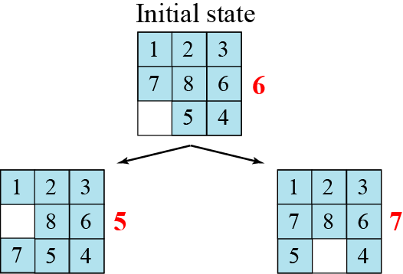

Slide 19
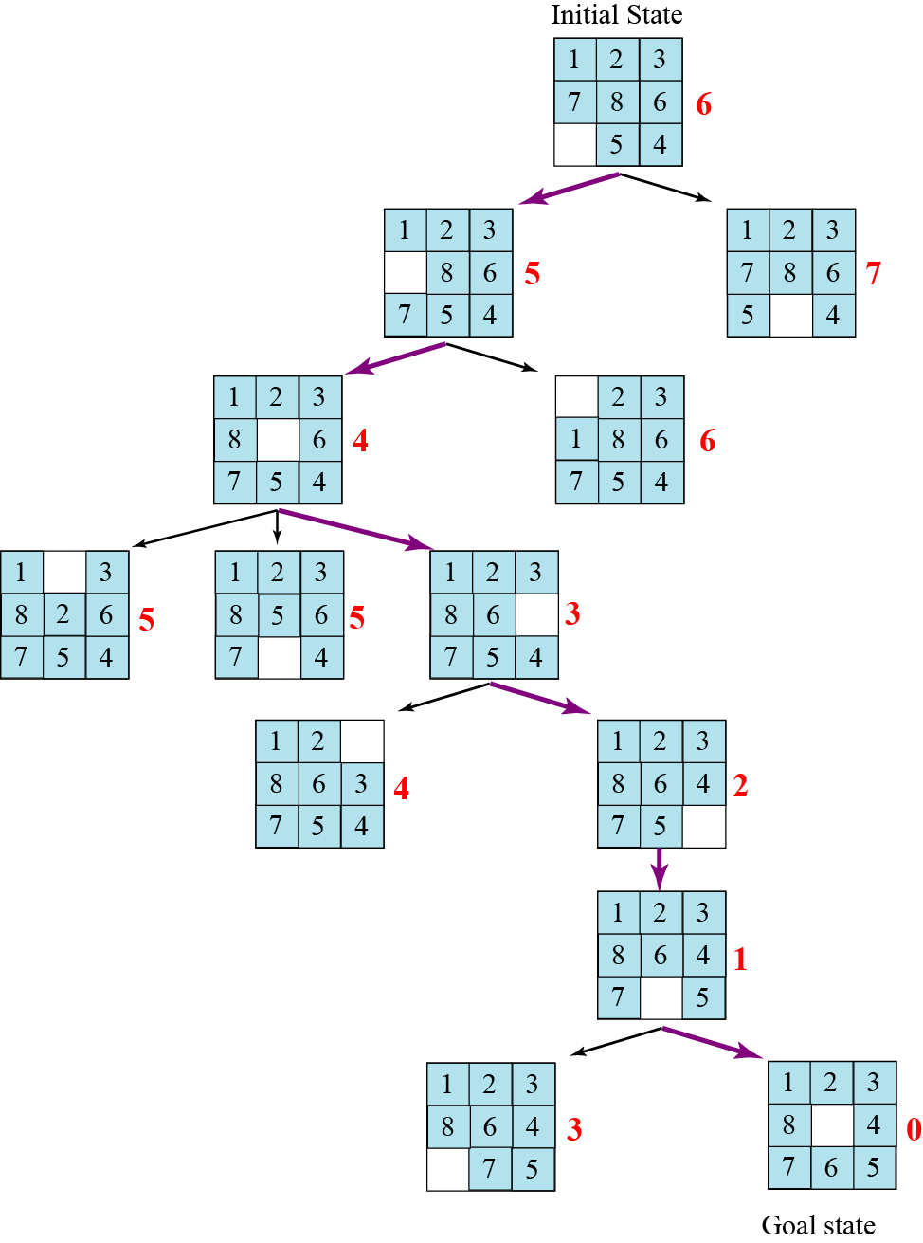

Slide 20
Uniform Cost Search
Uniform Cost Search
orders the nodes on the Q according to path cost from S
always expands the node with minimum path cost from S
Initialize: Let Q = {S}
While Q is not empty
pull Q1, the first element in Q
if Q1 is a goal report(success) and quit
else
child_nodes = expand(Q1)
<eliminate child_nodes which represent loops>
put remaining child_nodes in Q
sort Q according to path-cost to each node
end
Continue

Slide 21
Heuristics and Search
in general
a heuristic is a “rule-of-thumb” based on domain-dependent knowledge to help you solve a problem
in search
one uses a heuristic function of a state where h(node) = estimated cost of cheapest path from the state for that node to a goal state G
h(G) = 0
h(other nodes) ≥ 0
(note: we will assume all individual node-to-node costs are > 0)

Slide 22
A(*) Algorithm
Goal: Find shortest path
Prerequisites
Graph
Method to estimate distance between points (heuristic)
Basic Method
Try all paths?
Takes time
Orient search towards target
Minimizes areas of the map to be examined
Uses heuristics that indicate the estimated cost of getting to the destination
Main advantage

Slide 23
A(*) Algorithm
Algorithm
Open list
Nodes that need to be considered as possible starts for further extensions of the path
Closed list
Nodes that have had all their neighbors added to the open list
G score
Contains the length or weight of the path from the current node to the start node
Low lengths are better
Every node has a G score
H score
Heuristic
Resembles G score except it represents an estimate of the distance from the current node to the endpoint
To find shortest path, this score must underestimate the distance

Slide 24
The A* Algorithm
A heuristic h is admissible if
it for any node n it does NOT overestimate the true path cost from n to the nearest goal.
The A* search is a search algorithm orders the nodes on the Q according to f(n)=g(n)+h(n), where h(n) is an admissible heuristic
i.e., it sorts nodes on Q according to an admissible heuristic h*
It is like uniform-cost,
but uses fcost(node) = path-cost(S to node) + h(node)
rather than just path cost(S to node)
note that uniform cost search can be viewed as A* search where h(n) equals 0 for all n (the latter heuristic equal to 0 for every node is clearly admissible! Why?)

Slide 25
Pseudo-code for the A* Search Algorithm
Initialize: Let Q = {S}
While Q is not empty
pull Q1, the first element in Q
if Q1 is a goal report(success) and quit
else
child_nodes = expand(Q1)
<eliminate child_nodes which represent loops>
put remaining child_nodes in Q
sort Q according to ucost = pathcost(S to node) + h*(node)
end
Continue

Slide 26
Example of A* Algorithm in action
S
5 + 8.9 = 13.9
2 +10.4 = 12..4
A
D
3 + 6.7 = 9.7
B
D
4 + 8.9 = 12.9
7 + 4 = 11
8 + 6.9 = 14.9
C
E
E
6 + 6.9 = 12.9
Dead End
B
F
10 + 3.0 = 13
11 + 6.7 = 17.7
G
13 + 0 = 13

Slide 27
Comments on heuristic estimation
The estimate of the distance is called a heuristic
typically it comes from domain knowledge
e.g., the straight-line distance between 2 points
If the heuristic never overestimates, then the search procedure using this heuristic is “admissible”, i.e.,
h*(N) is less than or equal to realcost(N to G)
A* is a search with admissible heuristic is optimal
i.e., if one uses an admissible heuristic to order the search one is guaranteed to find the optimal solution
The closer the heuristic is to the real (unknown) path cost, the more effective it will be, ie if h1(n) and h2(n) are two admissible heuristics and h1(n)≤h2(n) for any node n then A* search with h2(n) will in general expand fewer nodes than A* search with h1(n)

Slide 28
Properties of A*
A* generates an optimal solution if h(n) is an admissible heuristic and the search space is a tree:
h(n) is admissible if it never overestimates the cost to reach the destination node
A* generates an optimal solution if h(n) is a consistent heuristic and the search space is a graph:
h(n) is consistent if for every node n and for every successor node n’ of n:
h(n) ≤ c(n,n’) + h(n’)
If h(n) is consistent then h(n) is admissible
Frequently when h(n) is admissible, it is also consistent

Slide 29
Admissible Heuristics
A heuristic is admissible if it is too optimistic, estimating the cost to be smaller than it actually is.
Example:
In the road map domain,
h(n) = “Euclidean distance to destination”
is admissible as normally cities are not connected by roads that make straight lines

Slide 30
Metric Space
A set of points X
Distance function d(x,y) d : X →[0… ∞)
d(x,y) = 0 iff x=y
d(x,y) = d(y,x) Symmetric
d(x,z) ≤ d(x,y) + d(y,z) Triangle inequality
Metric space M(X,d)
x
z
y

Slide 31
Dominance
If h2(n) ≥ h1(n) for all n (both admissible)
then h2 dominates h1
h2 is better for search: it is guaranteed to expand
less or equal nr of nodes.

Slide 32
Examples of Heuristic Functions for A*
the 8-puzzle problem
the number of tiles in the wrong position
is this admissible?
the sum of distances of the tiles from their goal positions, where distance is counted as the sum of vertical and horizontal tile displacements (“Manhattan distance”)
is this admissible?
How can we invent admissible heuristics in general?
look at “relaxed” problem where constraints are removed
e.g., we can move in straight lines between cities
e.g., we can move tiles independently of each other

Slide 33
IDA(*) Algorithm
A*, like depth-first search, except based on increasing values of total cost rather than increasing depths
IDA* sets bounds on the heuristic cost of a path, instead of depth
A* always finds a cheapest solution if the heuristic is admissible
IDA* is optimal in terms of solution cost, time, and space for admissible best-first searches on a tree

Slide 34
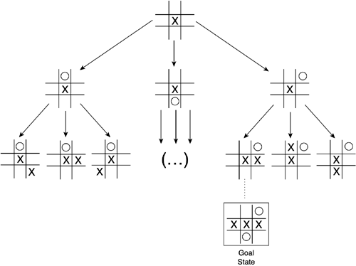
State Space
Model of a system as a set of input, output and state variables

Slide 35
Setting Up a State Space Model
State-space Model is a Model for The Search Problem
usually a set of discrete states X
e.g., in driving, the states in the model could be towns/cities
Start State - a state from X where the search starts
Goal State(s)
a goal is defined as a target state
For now: all goal states have utility 1, and all non-goals have utility 0
there may be many states which satisfy the goal
e.g., drive to a town with an airport
or just one state which satisfies the goal
e.g., drive to Las Vegas
Operators
operators are mappings from X to X
e.g. moves from one city to another that are legal (connected with a road)

Slide 36
A State Space and a Search Tree are different
S
B
D
S
B
C
C
B
State Space
Example of a Search Tree
A State Space represents all states and operators for the problem
A Search Tree is what an algorithm constructs as it solves a search problem:
so we can have different search trees for the same problem
search trees grow in a dynamic fashion until the goal is found

Slide 37
Puzzle-Solving as Search
You have a 3-gallon and a 4-gallon
You have a faucet with an unlimited amount of water
You need to get exactly 2 gallons in 4-gallon jug
State representation: (x, y)
x: Contents of four gallon
y: Contents of three gallon
Start state: (0, 0)
Goal state(s) G = {(2, 0), (2, 1), (2, 2)}
Operators
Fill 3-gallon (0,0)->(0,3), fill 4-gallon (0,0)->(0,4)
Fill 3-gallon from 4-gallon (4,0)->(1,3), fill 4-gallon from 3-gallon (0,3)->(3,0) or (1,3)->(4,0) or (2,3)->(4,0)….
Empty 3-gallon into 4-gallon, empty 4-gallon into 3-gallon
Dump 3-gallon down drain (0,3)->(0,0), dump 4-gallon down drain (4,0)->(0,0)

Slide 38
Adversarial Search
How should you play against an opponent?
Games as search problems
Game has
initial state — configuration + player to move
successor function
terminal test — game over or not

Slide 39
Adversarial Search to play a game
A way to play such a game is to:
Consider all the legal moves you can make
Compute new position resulting from each move
Evaluate each to determine which is best
Make that move
Wait for your opponent to move and repeat
Key problems are:
Representing the “board”
Generating all legal next boards
Evaluating a position

Slide 40
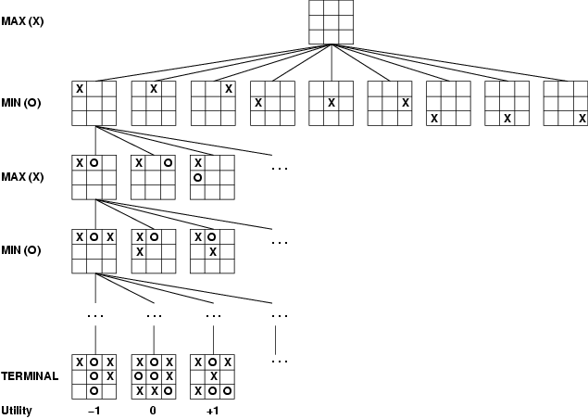
Game tree (2-player, deterministic, turns)

Slide 41
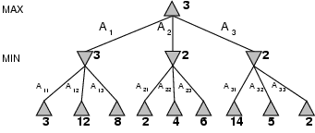
Minimax
Perfect play for deterministic games
Idea: choose move to position with highest minimax value = best achievable payoff against best play
E.g., 2-ply game:

Slide 42
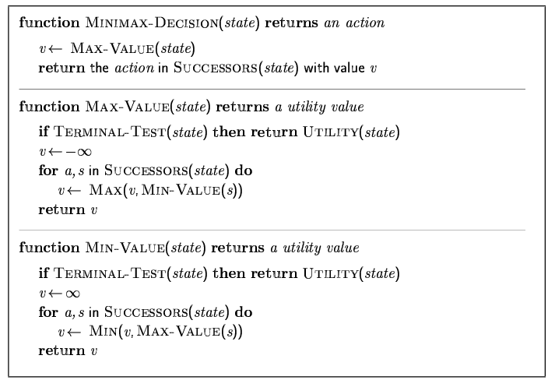
Minimax algorithm

Slide 43
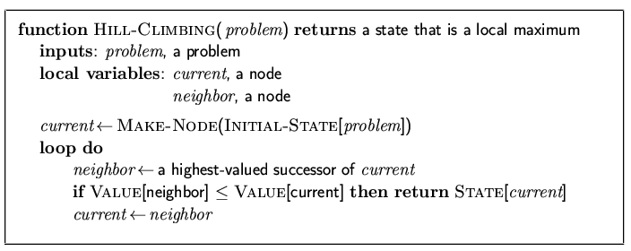
Hill-climbing search
"Like climbing Everest in thick fog with amnesia"

Slide 44
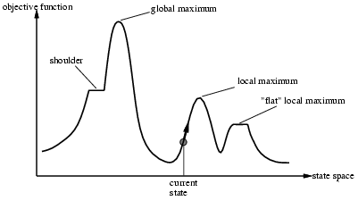
Hill-climbing search
Problem: depending on initial state, can get stuck in local maxima

Slide 45
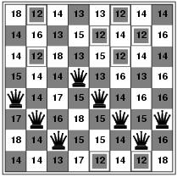
Hill-climbing search: 8-queens problem
h = number of pairs of queens that are attacking each other, either directly or indirectly
h = 17 for the above state

Slide 46
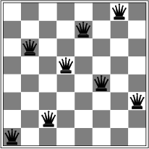
Hill-climbing search: 8-queens problem
A local minimum with h = 1

Slide 47
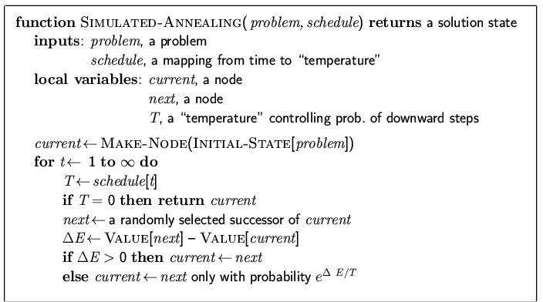
Simulated annealing search
Idea: escape local maxima by allowing some "bad" moves but gradually decrease their frequency

Slide 48
Properties of simulated annealing search
One can prove: If T decreases slowly enough, then simulated annealing search will find a global optimum with probability approaching 1
Widely used in VLSI layout, airline scheduling, etc

Slide 49
Genetic Algorithm (Holland)
heuristic method based on ‘ survival of the fittest ’
useful when search space very large or too complex
for analytic treatment
in each iteration (generation) possible solutions or
individuals represented as strings of numbers
3021 3058 3240
00010101 00111010 11110000
00010001 00111011 10100101
00100100 10111001 01111000
11000101 01011000 01101010

Slide 50
Basic algorithm
Create an initial population, either random or “blank”.
While the best candidate so far is not a solution:
Create new population using successor functions.
Evaluate the fitness of each candidate in the population.
Return the best candidate found.
---
Select the best-fit individuals for reproduction - parents
2) Breed new individuals through crossover and mutation operations to give birth to offspring
3) Evaluate the individual fitness of new individuals
4) Replace least-fit population with new individuals

Slide 51
Basic components
Candidate representation
Important to choose this well. More work here means less work on the successor functions.
Successor function(s)
Mutation, crossover
Fitness function
Solution test
Some parameters
Population size
Generation limit

Slide 52
Candidate representation
We want to encode candidates in a way that makes mutation and crossover easy.
The typical candidate representation is a binary string. This string can be thought of as the genetic code of a candidate – thus the term “genetic algorithm”!
Other representations are possible, but they make crossover and mutation harder.

Slide 53
Successor functions
Mutation – Given a candidate, return a slightly different candidate.
Crossover – Given two candidates, produce one that has elements of each.
We don’t always generate a successor for each candidate. Rather, we generate a successor population based on the candidates in the current population, weighted by fitness.

Slide 54
Successor functions
If your candidate representation is just a binary string, then these are easy:
Mutate(c): Copy c as c’. For each bit b in c’, flip b with probability p. Return c’.
Cross (c1, c2): Create a candidate c such that c[i] = c1[i] if i % 2 = 0, c[i] = c2[i] otherwise. Return c.
Alternatively, any other scheme such that c gets roughly equal information from c1 and c2.

Slide 55
Fitness function
The fitness function is analogous to a heuristic that estimates how close a candidate is to being a solution.
In general, the fitness function should be consistent for better performance. However, even if it is, there are no guarantees. This is a probabilistic algorithm!
In our classification rule example, one possible fitness function would be information gain over training data.

Slide 56
Solution test
Given a candidate, return whether the candidate is a solution.
Often just answers the question “does the candidate satisfy some set of constraints?”
Optional! Sometimes you just want to do the best you can in a given number of generations, e.g. the classification rule example.

Slide 57
Basic algorithm (recap)
Create an initial population, either random or “blank”.
While the best candidate so far is not a solution:
Create new population using successor functions.
Evaluate the fitness of each candidate in the population.
Return the best candidate found.

Slide 58
Pros and Cons
Pros
Faster (and lower memory requirements) than searching a very large search space.
Easy, in that if your candidate representation and fitness function are correct, a solution can be found without any explicit analytical work.
Cons
Randomized – not optimal or even complete.
Can get stuck on local maxima, though crossover can help mitigate this.
It can be hard to work out how best to represent a candidate as a bit string (or otherwise).

Slide 59
Genetic Algorithm Introduction 1
Inspired by natural evolution
Population of individuals
Individual is feasible solution to problem
Each individual is characterized by a Fitness function
Higher fitness is better solution
Based on their fitness, parents are selected to reproduce offspring for a new generation
Fitter individuals have more chance to reproduce
New generation has same size as old generation; old generation dies
Offspring has combination of properties of two parents
If well designed, population will converge to optimal solution

Slide 60
Algorithm
BEGIN
Generate initial population;
Compute fitness of each individual;
REPEAT /* New generation /*
FOR population_size / 2 DO
Select two parents from old generation;
/* biased to the fitter ones */
Recombine parents for two offspring;
Compute fitness of offspring;
Insert offspring in new generation
END FOR
UNTIL population has converged
END

Slide 61
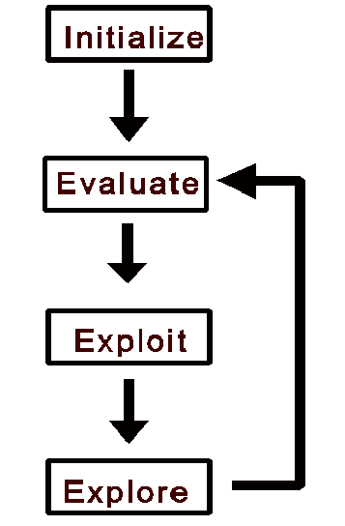
© http://www.spectroscopynow.com
all individuals in population
evaluated by fitness function
individuals allowed to
reproduce (selection),
crossover, mutate
Flowchart of GA
Notes:
Flowchart of GA iteration

Slide 62
Searching
search space defined by all possible encodings of
solutions
selection, crossover, and mutation perform
‘pseudo-random’ walk through search space
operations are non-deterministic yet directed
Notes:
Non-deterministic since random crossover point or mutation prob. Directed by fitness fn

Slide 63
Data Structures
Data matrix
(two modes)
Dissimilarity matrix
(one mode)

Slide 64
Crossover
combine two individuals to create new individuals
for possible inclusion in next generation
main operator for local search (looking close to
existing solutions)
perform each crossover with probability p_{c} {0.5,…,0.8}
crossover points selected at random
individuals not crossed carried over in population

Slide 65
Initial Strings
Offspring
Single-Point
11000101 01011000 01101010
11000101 01011001 01111000
00100100 10111001 01111000
00100100 10111000 01101010
Two-Point
11000101 01011000 01101010
11000101 01111001 01101010
00100100 10111001 01111000
00100100 10011000 01111000
Uniform
11000101 01011000 01101010
01000101 01111000 01111010
00100100 10111001 01111000
10100100 10011001 01101000

Slide 66
Mutation
each component of every individual is modified with
probability p_{m}
main operator for global search (looking at new
areas of the search space)
p_{m} usually small {0.001,…,0.01}
rule of thumb = 1/no. of bits in chromosome
individuals not mutated carried over in population

Slide 67
References
Holland, J. (1992), Adaptation in natural and artificial systems , 2nd Ed. Cambridge: MIT Press.
Davis, L. (Ed.) (1991), Handbook of genetic algorithms. New York: Van Nostrand Reinhold.
Goldberg, D. (1989), Genetic algorithms in search, optimization and machine learning. Addison-Wesley.
Fogel, D. (1995), Evolutionary computation: Towards a new philosophy of machine intelligence. Piscataway: IEEE Press.
Bäck, T., Hammel, U., and Schwefel, H. (1997), ‘Evolutionary computation: Comments on the history and the current state’, IEEE Trans. On Evol. Comp. 1, (1)

Slide 68
Online Resources
http://www.spectroscopynow.com
http://www.cs.bris.ac.uk/~colin/evollect1/evollect0/index.htm
IlliGAL (http://www-illigal.ge.uiuc.edu/index.php3)
GAlib (http://lancet.mit.edu/ga/)
Notes:
Colin Burgess/ Univ of Bristol Comp Sci

