Slide 1

What is the perfect size of a dataset?

Slide 2
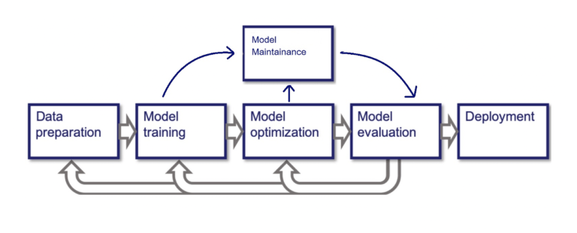
MACHINE LEARNING PIPELINE

Slide 3
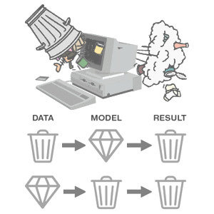
GARBAGE IN, GARBAGE OUT
Failed industrial projects because of the faulty dataset
Tay, Microsoft's Chatbot (2016)
Use – To learn from and engage with users’ conversations
Issue - Started posting offensive and inappropriate messages
Reason – bot learned from the biased and toxic interactions with users
Google Photos' Racist Labeling (2015)
Use – Label images
Issue – Labeled a photo of two black people as “gorillas”
Reason – Algorithm’s insensitivity and lack of diversity in training data
Amazon's AI Recruiting Tool (2018)
Use – to review resumes and identify the most qualified candidates
Issue – Biased against female applicants
Reason – predominantly male-oriented training data

Slide 4

What can be the right size of data for machine learning?

Slide 5

Then, what could be the possible ways to find the right sample data size?

Slide 6

Possible ways
Rule of thumb
Cross-validation method
Learning curve
Power analysis
Mead’s correction using Power analysis
Simulation using Power analysis
Consulting with the experts

Slide 7
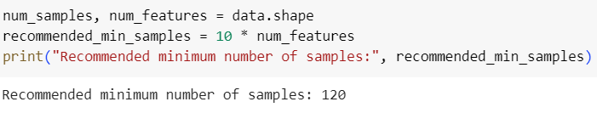
Rule of thumb
No. of features * 10

Slide 8
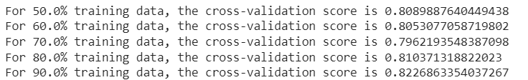
Cross-validation
How does this work?
The data set is split into multiple folds, and a model is trained and evaluated on different subsets of the data
What is it doing?
By comparing the mean cross-validation accuracies for different dataset sizes, it’s evaluating how model performance changes as the dataset size increases.

Slide 9
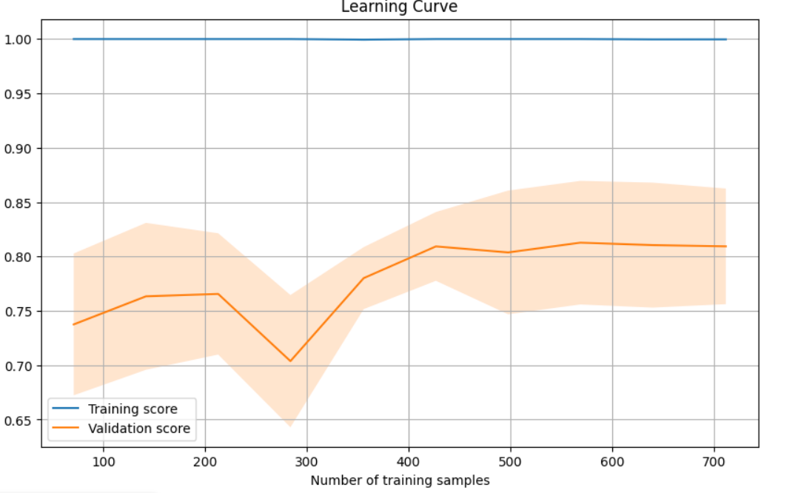
Learning Curve

Slide 10
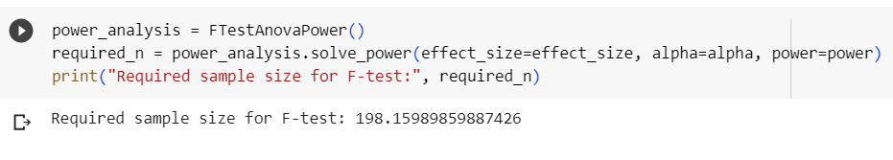
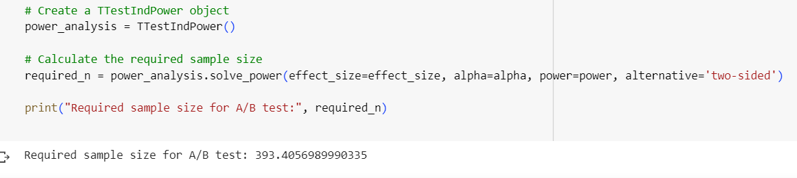
Power Analysis
What is power analysis?
How do we calculate it?
Our results:
For F-test
For A/B testing

Slide 11
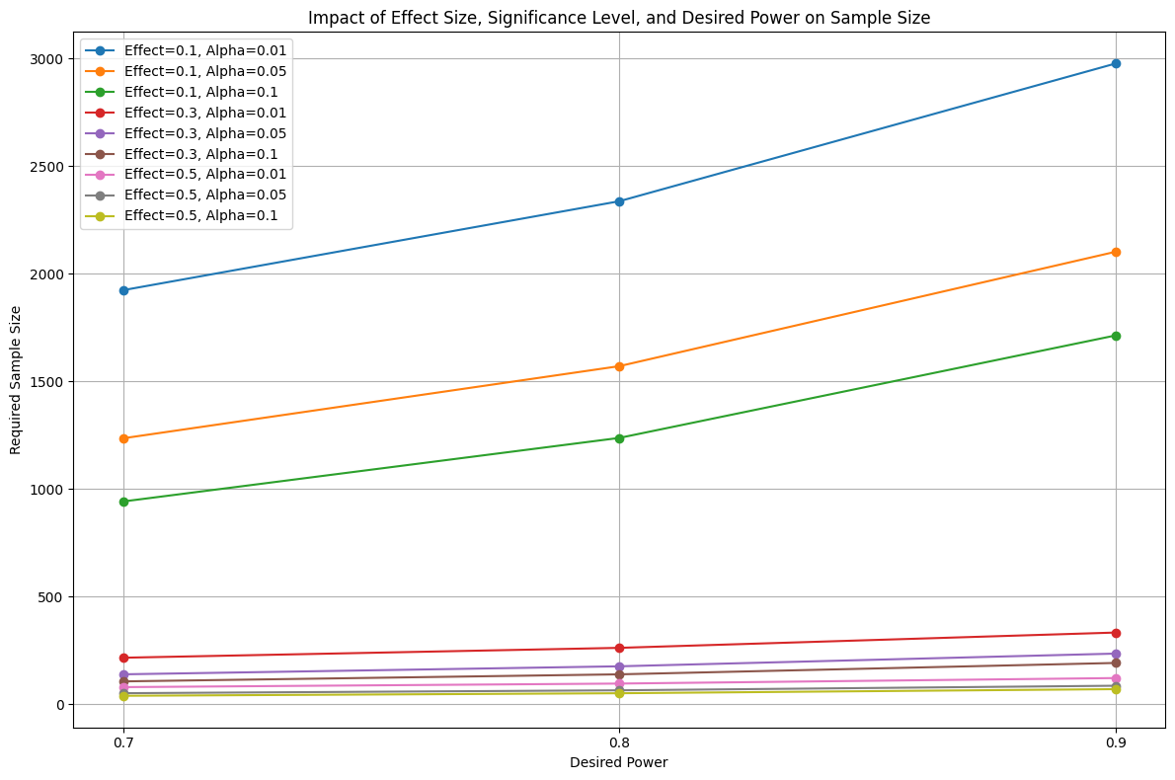
How do we decide on the values of parameters?

Slide 12
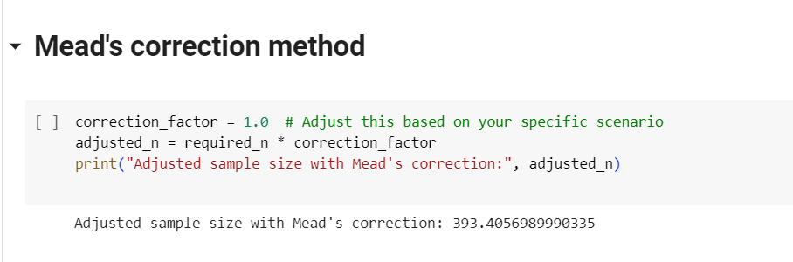
Mead’s correction

Slide 13
The correction factor in Mead's correction is given by:
Correction Factor = (n−1/6​) × Sample Kurtosis
Where:
n is the sample size.
Sample Kurtosis is the kurtosis calculated from the sample data.
The correction factor takes into account the kurtosis of the distribution and adjusts the sample variance accordingly. By considering the kurtosis, Mead's correction attempts to provide a more accurate estimate of the population variance, especially when the distribution deviates from normality.
The formula for calculating the corrected sample variance using Mead's correction is:
Corrected Sample Variance= ((n−1)(n−2)​/ n(n−3) ) × Sample Variance − Correction Factor
Where:
Sample Variance is the regular sample variance calculated from the data.

Slide 14
Simulation using Power Analysis
If analytical solutions are complex, simulations can help us estimate the required sample size by generating data and analyzing it repeatedly
Scenario: Suppose you want to conduct an experiment comparing two diets (Diet A and Diet B) to improve the overall weight loss journey of the people.

Slide 15
Conclusion
Practical Approach (through experimentation):
Advantages: This approach provides direct insights into how a model performs on a real-world dataset. It allows you to see the actual impact of dataset size on model performance.
Use Case: This approach is useful when you have access to a dataset and want to assess model performance realistically. It helps you understand the challenges and limitations of working with a small dataset.
Statistical Approach (Using Power Analysis or other methods):
Advantages: Power analysis helps you estimate the required sample size to achieve a certain level of statistical power for hypothesis testing. It helps in planning studies and experiments by ensuring you have enough data to detect meaningful effects.
Use Case: This approach is beneficial when you're planning a study or experiment and want to ensure that your sample size is sufficient to detect the effect size you're interested in.

