Slide 1
AP
ABHISHEK
PRAKASH
Engineer who ships — backend to AI
Full-Stack & Backend Engineer · AI/ML Builder · Northeastern MS '26 · Boston, MA
2.5+
1M+
10K+
85%
Years Experience
Monthly Txns
Enterprise Users
API Latency Cut
NFO 7375: Branding & AI · Northeastern University · 2026

Slide 2
BRAND STRATEGY
Brand Strategy
Unique Value Proposition · Brand Pillars · Competitive Positioning
UNIQUE VALUE PROPOSITION
I ship production-grade systems end-to-end — distributed backends, DevOps pipelines, and AI-powered layers — built to serve millions of users and keep working under pressure. Unlike engineers who specialize in one layer, I own the full stack with proven impact at Dassault SolidWorks, Deloitte, and Zomato.
5 BRAND PILLARS
01
End-to-End Ownership
04
Relentless Shipping
Schema design to CI/CD to production monitoring
Zomato intern → Deloitte → SolidWorks → Co-founder
02
Performance at Scale
05
Human Reliability
85% latency cut. 99.9% uptime. 1M+ monthly transactions
Mentors 200+ MS students. Leads cross-functional teams
03
AI-First Thinking
GenAI, RAG, LangChain baked in — not bolted on

Slide 3


TARGET AUDIENCE
Target Audience
Two personas — two different conversations
PERSONA 01
PERSONA 02
The Engineering Hiring Manager
The AI-Forward Tech Lead
Sr. EM / VP Engineering · Fintech or SaaS
Staff Engineer / CTO · AI-first startup
THEY WANT:
THEY WANT:
Engineers who own problems end-to-end
Engineers who understand both the AI layer and the infra beneath it
Proof of production impact, not side projects
Someone who can build a RAG pipeline AND deploy it to prod
Someone who can ship without hand-holding
"Abhishek has owned real production systems — 1M+ transactions, microservices migration, 85% latency improvement. That's a track record."
"He built an LLM Q&A system with RAG, LangChain, and FastAPI — and deployed it to Kubernetes. That's the profile we need."

Slide 4
VISUAL IDENTITY
Visual Identity System
Logo · Colors · Typography · Brand Voice
AP
ABHISHEK PRAKASH
Engineer · Builder · AI
Deep Navy
Electric Blue
Sky Blue
Surface
Silver
#0A1628
#1E6FFF
#4D91FF
#0F2040
#A0AEC0
LOGO CONCEPT
COLOR PALETTE
TYPOGRAPHY
BRAND VOICE
Trebuchet MS
Direct
— No fluff. Lead with impact.
Precise
— Numbers, not adjectives.
Primary — Headlines & Brand Name
Calibri — Body text, descriptions, and secondary content
Confident
— Builders don't apologize.
Curious
— Always learning. Always shipping.

Slide 5



DIGITAL PRESENCE
Website & Social Media
Live portfolio · LinkedIn · Substack · GitHub · Brand voice in action
Live Portfolio Website
LinkedIn — Optimized
portfolioabhi11111111111.lovable.app
Custom banner · Updated headline · Full About section · Featured: Website + Madison Tool + GitHub
Built on Lovable · Dark navy brand identity · Mobile responsive · Case studies + project portfolio · Madison AI Tool section
Substack
substack.com/profile/223994226-abhishek-prakash · Writing about backend engineering, AI systems, and building in public.
5 EXAMPLE LINKEDIN POSTS — BRAND VOICE IN ACTION
Production Lesson
Career Story
AI/Technical
We reduced API latency 85% at SolidWorks. The real win wasn't the tech — it was mapping every dependency before writing a single line.
I have a Mechanical Engineering degree. I'm a software engineer. Engineering is engineering — the materials just change.
Most people build AI features. I build AI systems. The API call takes a week. Making it production-ready takes three more.

Slide 6
BRAND STORY 1
Brand Story 1: The Journey
Narrative Framework: The Hero's Journey
01
The Ordinary World
Mechanical Engineering grad from VIT. Built things with hands. Started wondering if code could do the same — but faster, at any scale.
02
The Call
Joined Zomato as an intern — 50K daily users, real latency issues, real consequences. Software engineering is just engineering with different constraints.
03
The Trials
Deloitte: 1M+ transactions, PCI-DSS compliance, RabbitMQ across 8 microservices. Systems that couldn't fail. Built them anyway. They held.
04
The Transformation
SolidWorks Co-op: led a monolith-to-microservices migration. Cut API latency 85%. Built the observability pipeline. Began adding AI to the stack.
05
The Return
Northeastern, graduating May 2026. Full-stack, backend, AI/ML — with real production scars to prove it. Ready to build what's next.
Framework: The Hero's Journey — chosen because the arc from Mechanical Engineering to AI/ML is genuinely non-linear and transformative.

Slide 7
BRAND STORY 2
Brand Story 2: The Build
Narrative Framework: Before / During / After
BEFORE
The Problem
Four legacy Perl/C# apps were causing deployment outages for 10K+ enterprise users. Bi-weekly releases were a ritual of anxiety — every change was a gamble. Developers were afraid to ship.
DURING
The Work
Led migration of all four apps to TypeScript microservices on Kubernetes. Built a centralized REST layer, Fluent Bit observability pipelines, and an internal NPM package cutting integration time 40%.
AFTER
The Result
Outages: eliminated. Releases: bi-weekly to weekly. API latency: -85%. Debug time: hours to minutes. 10,000 enterprise users never noticed — because nothing broke.
Brand Value: I don't just write code. I own outcomes.
Framework: Before / During / After — best for demonstrating transformation with concrete, measurable results.

Slide 8




MADISON AI TOOL
Madison AI Tool — Live Demo
AI-Powered A/B Testing Optimization using Thompson Sampling
Madison MAB
AI-Powered A/B Testing Optimization · Thompson Sampling · Live on Hugging Face
Upload & Analyze
Thompson Sampling
Instant Winner
Upload CSV with customer_segment, time_period, conversion_rate_pct. 50 data points across 5 segments and 10 campaigns.
Multi-Armed Bandit algorithm learns in real time. Allocates budget toward winners — no waiting for fixed test windows.
100 iterations identifies the highest-performing segment. Senior Executives: 35%+ conversion rate — clear winner.
Methodology: Thompson Sampling uses Beta Distribution priors, updating beliefs after each iteration. It balances exploration (trying all segments) and exploitation (doubling down on winners) — far more efficient than traditional A/B testing which requires equal traffic distribution.
Try it Live
huggingface.co/spaces/
abhishek139sharma

Slide 9
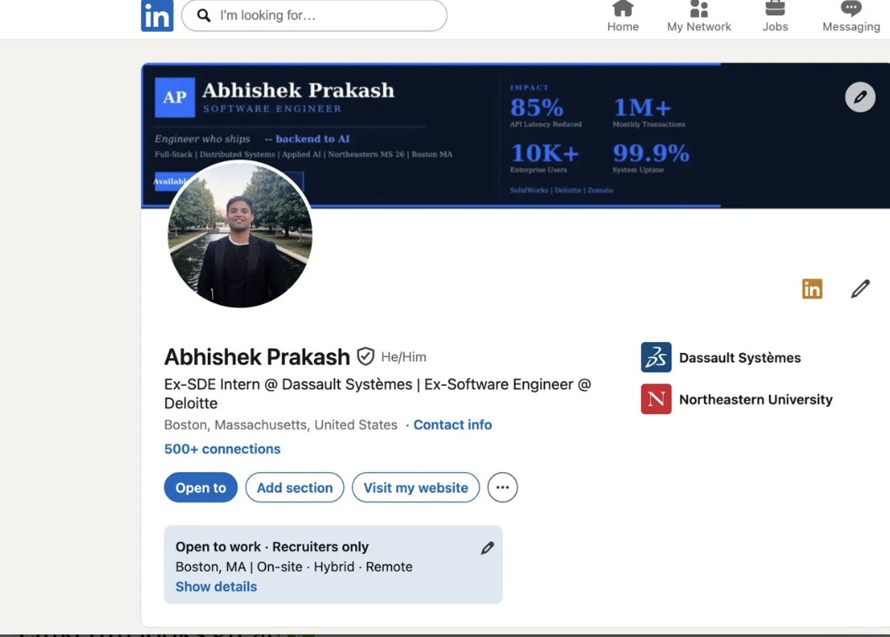
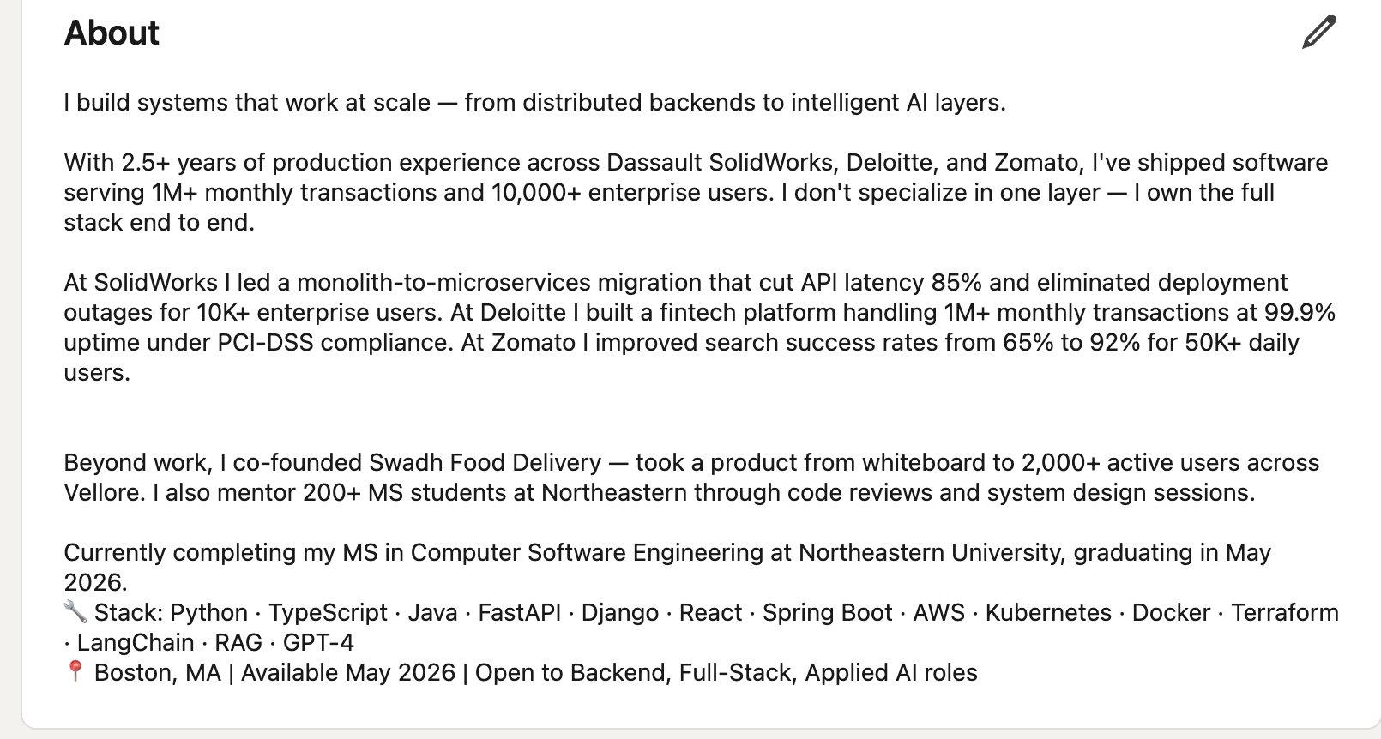
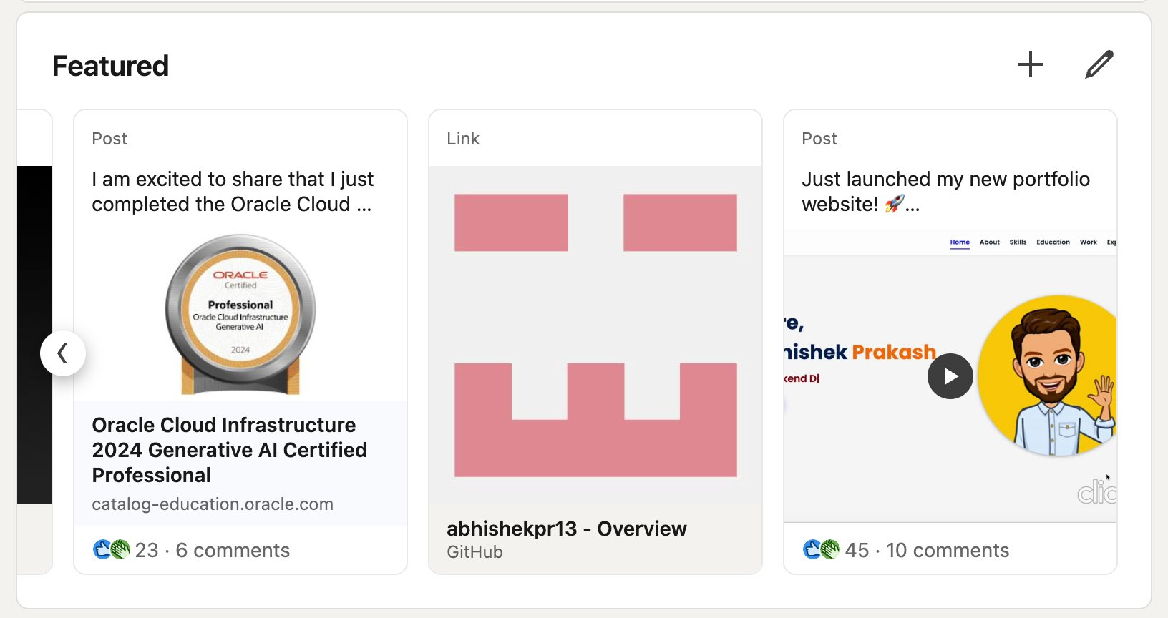
LINKEDIN OPTIMIZATION
LinkedIn — Fully Optimized
Custom banner · Updated headline · About section · Featured content
About Section
Profile + Brand Banner
Featured Section
Headline:
Software Engineer | Backend · Full-Stack · AI/ML | Northeastern MS '26 | Open to Full-Time Roles
Substack:
substack.com/profile/223994226-abhishek-prakash — Writing about backend engineering & AI
Featured:
Portfolio website · Madison MAB tool · GitHub · Oracle AI Certification

Slide 10
PATH A DELIVERABLES
Resumes & Portfolio
ATS-optimized · Visual design · 3 case studies · Consistent brand
ATS-OPTIMIZED RESUME
VISUAL RESUME
Abhishek Prakash
AP
Software Engineer · Distributed Systems · AI/ML
Tailored keywords for ATS parsing
Metrics on every bullet point
Dark navy brand colors · Impact stats sidebar · Two-column layout · Skills by category · Projects + Leadership
85% latency · 1M+ txns · 99.9% uptime
Clean single-column format
Action verbs: Led · Built · Reduced · Architected
Palette: #0A1628 · #1E6FFF · #4D91FF
Fonts: Space Grotesk (headers) · JetBrains Mono (code)
Portfolio:
3 case studies on website: SolidWorks migration · Deloitte fintech pipeline · LLM Document Intelligence System

Slide 11

CAREER STRATEGY
Career Positioning Strategy
Where I fit · Who I target · How I compete
TARGET ROLES
COMPETITIVE EDGE VS PEERS
-> Software Engineer II/III — Backend
Production experience — not just school projects
Full-stack + DevOps + AI — not siloed
-> Full-Stack Engineer (Fintech/SaaS)
Co-founded and shipped a real product (Swadh)
Mentors 200+ students — leadership signal
-> Applied AI / ML Engineer
TARGET COMPANIES
-> Forward Deployed Engineer
Stripe
Plaid
Coinbase
Wise
MongoDB
Anthropic
-> Platform / Infrastructure Engineer
Figma
Vercel
Bloomberg
Robinhood
Datadog
Snowflake

Slide 12
I build things
that hold up.
From a fintech pipeline handling a million transactions to a microservices migration
for ten thousand enterprise users — every system I've built has been built to last.
Email:
prakash.ab@northeastern.edu
LinkedIn:
linkedin.com/in/abhishek-prakash13
Website:
portfolioabhi11111111111.lovable.app
Madison:
huggingface.co/spaces/abhishek139sharma
Substack:
substack.com/profile/223994226-abhishek-prakash
GitHub:
github.com/abhishekpr13
Boston, MA · Available May 2026 · Open to Full-Time Roles
Ship it.

