Slide 1

Moodcore
By Arjun Kavungal

Slide 2
Brand
Brand Name: Moodcore
Positioning Statement:
Moodcore delivers real-time, predictive supplier risk intelligence by combining AI, data analysis, and sentiment data to anticipate disruptions before they occur.
One-Slide Brand Essence:
Moodcore exists to turn fragmented, delayed data into proactive, decision-ready intelligence. It removes the gap between data engineering and business strategy by providing clear, explainable insights into complex sentiment data.
Tool Name + Description:
Moodcore - An AI-powered platform that analyzes data and external sentiment signals to predict and visualize sentiment in real time.

Slide 3
Brand Strategy
Target Audience:
Small to medium sized businesses
Unique Value Proposition (UVP): Transforms complex supplier ecosystems into real-time, predictive risk insights using AI and network-based analysis.
Brand Pillars:
Predictive Intelligence
Data Integrity & Trust
Actionable Insights
Scalable Architecture
Competitive Positioning: Unlike traditional BI tools or generic AI platforms, Moodcore integrates real-time streaming and sentiment analysis to deliver network-aware, predictive risk intelligence rather than static dashboards.
Differentiation: Most AI tools analyze sentiment in isolation (social media, branding metrics). Moodcore connects sentiment directly to context—turning abstract signals into measurable business risk.

Slide 4
Competitive positioning
Qualtrics XM Powerful but hard to use. Starts at $1,500+/month, requires implementation consultants, and takes months to set up. Designed for Fortune 500 research teams — not founders or growth teams who need answers quickly.
Hootsuite Insights Sentiment as a checkbox feature. Surface-level scoring that flags "negative" without telling you the actual reason.
AWS Comprehend / Google Natural Language API Raw APIs that require engineering expertise to turn into something useful. No interface, no workflow, no alerts — just infrastructure. This requires additional software engineers.
SurveyMonkey (Genius) Surveys are only one channel. Sentiment analysis tools that only live inside your survey tool miss everything happening outside it — reviews, tickets, social, DMs.

Slide 5
Scenarios
Name: Matt
Role: Business owner
Pain points: reviews damage his brand before he can analyze them
Name: Sid
Role: Data analyst
Pain points: Too much feedback coming in from different channels — reviews, surveys, support tickets, social media, all at once

Slide 6
Story
The monster had a name nobody said out loud: brand analysis. Thousands of customer voices, piling up daily, shapeless and unread. It was eating our team alive - hours lost, decisions delayed, brand damage quietly spreading. We knew it was winning. Feedback was unread for weeks. A bad trend could brew for months before anyone noticed. The monster didn't roar - it just slowly swallowed everything. I decided to fight back. Not with more people or hours - but with automation. A sentiment analysis tool that could read the flood and make sense of it in seconds. It wasn't instant. The model had to learn nuance - sarcasm, context, industry language. There were false positives and missed signals. But we kept modifying it, kept pushing. The monster didn't vanish. But now it's caged. Every morning, the dashboard tells us exactly how customers feel - before it becomes a crisis. We stopped reacting and started modifying.

Slide 7
Story
Every day started the same way. Open the spreadsheet, pull the latest reviews, start reading. One by one. Copy, paste, categorize, repeat. I was doing this for hundreds of responses a week - support tickets, survey answers, app store reviews, social comments. It looked like a system. It wasn't. It was just controlled chaos with a color-coded veneer. The real problem wasn't the volume. It was what I was missing inside it. Patterns that only show up across many responses. Subtle shifts in tone that signal something bigger brewing. A product complaint that keeps appearing in slightly different words. I'd finish a three-hour analysis session and still feel like I hadn't seen the full picture. Decisions were getting made on incomplete signals, and I knew it. One missed trend cost us. A wave of frustration had been building quietly in our feedback for weeks - and we didn't catch it until customers started leaving. That was the moment I stopped looking for a better process and started building one. If I couldn't analyze fast enough, the tool would have to analyze for me. That's how Moodcore was created. A sentiment analysis tool that doesn't just sort feedback into positive and negative - it reads between the lines. It catches the exhausted customer, the quietly impressed one, the one about to churn. Automated, nuanced, and built for the kind of clarity that spreadsheets can't give you. The first time it flagged a silent crisis before anyone on my team noticed, I knew we'd built something real. You shouldn't need to read thousands of words to understand how your customers feel. Moodcore does that work so you can spend your time on what actually matters - acting on it.

Slide 8
Visual Identity Showcase
3. Visual Identity Showcase (2 minutes)
Logo Variations: Main logo, icon-only version (dashboard)), and dark/light mode variants.
Color Palette:
Blue #0000FF
orange #FFAA44
gray #AAAAAA
Typography:
sans-serif
Strong hierarchy for dashboards
Header is 36 pt
Subheader is 24 pt
Website Walkthrough:
Homepage: clear value proposition + live dashboard preview
Dashboard: brand scoring
Insights page: real-time alerts and sentiment signals
Social Media Examples:
Data-driven posts (sentiment trends, insights)
Short explainers on brand damage and analytics
Interface Extension: The brand identity carries into the tool with clean dashboards, high-contrast risk indicators, and network visualizations that reflect the similar colors and design logic as the brand system.

Slide 9
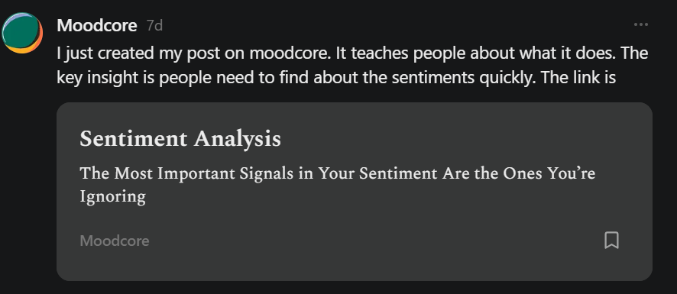
Social media

Slide 10
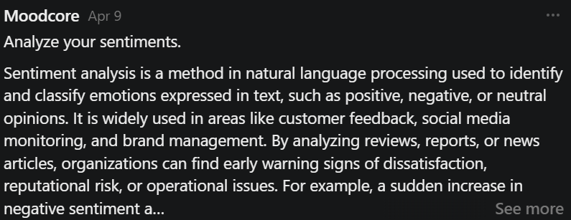

Slide 11
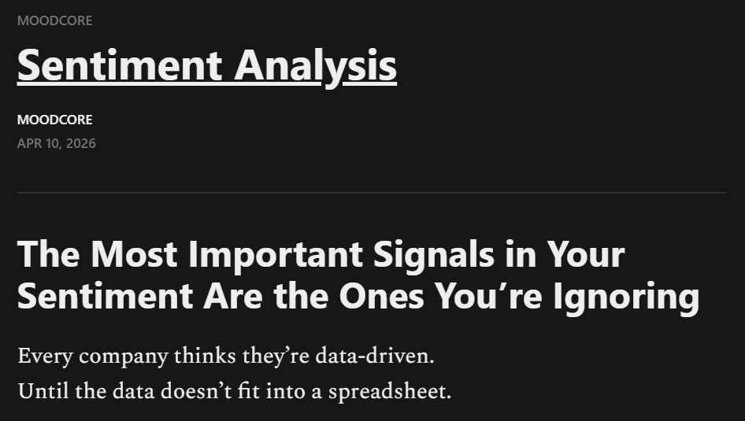

Slide 12
Brand Storytelling
A company relied on reviews for their reputation. Everything looked stable—on paper. But beneath the surface, a bad review destroyed their brand. No alerts were triggered because traditional systems only tracked keywords. Within weeks, brand damage cascaded upward, reducing customers and costing millions.
Moodcore changes this. By combining context with real-time sentiment analysis, it detects hidden vulnerabilities before they escalate—giving organizations the power to act early instead of react late.
Narrative Framework: Problem → Tension → Resolution Chosen because it clearly demonstrates the cost of inactivity and positions the tool as the solution to a real, high-stakes problem.
Connection to Brand Values:
Predictive Intelligence → detects issues early
Network Visibility → uncovers hidden dependencies
Actionable Insights → allows proactive decisions
Focus: The problem is invisible, cascading brand risk. The solution is real-time, connected intelligence for enterprise decision-makers.

