Slide 1
ANANYA
THATHIGOWDARA
DATA ENGINEER · BI SPECIALIST · AI BUILDER
"I turn messy, high-volume data into clean pipelines
and clear answers — from architecture to the boardroom."
🌐 LIVE: Portfolio Website · MEDA Clinical AI Tool · Substack: ananyant16 · LinkedIn: ananya-n-thathigowdara
01 / 13

Slide 2
// 02 BRAND STRATEGY
TARGET AUDIENCE
Brand
Strategy
PERSONA 1 — Data-Driven Hiring Manager
→ Pain: Candidates claim 'data skills' but can't build real pipelines
→ Needs: Full lifecycle ownership — ingestion to executive insight
→ Finds Ananya: LinkedIn, GitHub, Northeastern alumni network
Target · Position · Audience
PERSONA 2 — Startup CTO / Head of Data
→ Pain: Can't budget two hires — needs builder AND analyst
UNIQUE VALUE PROPOSITION
→ Needs: Set up Snowflake on Monday, present to board on Friday
Full-stack data professional who architects the pipeline AND owns the narrative it produces. Unlike pure analysts or engineers — Ananya delivers value at every layer.
→ Finds Ananya: GitHub, Wellfound, Twinly track record
COMPETITIVE POSITIONING
Unlike specialists who do pipelines OR dashboards — Ananya architects the infrastructure and owns the story it tells.
02 / 13

Slide 3





// 03 BRAND PILLARS
Five Pillars of the Brand
01
02
03
04
05
Engineering
Rigor
Insight Drives
Action
Full-Stack
Versatility
AI-Augmented
Solving
Cross-Functional
Comms
2M+ records/day. AWS, Airflow, Snowflake, dbt. Real production — not demos.
42% query gain. 18% faster decisions. Every metric tells a business story.
Pipelines → dashboards → ML → AI tools. Every layer covered.
Built MEDA: 90%+ accuracy on 5K+ clinical records. Builds & deploys AI.
3 product teams at Jio. KPIs for healthcare execs. Tech → strategy.
03 / 13

Slide 4
// 04 VISUAL IDENTITY SHOWCASE
Brand Identity System
COLOR PALETTE
Deep Navy
Brand Navy
Signal Red
Cloud Blue
#1A1A2E
#2C3E6B
#C0392B
#EAF0FB
Primary BG / Authority
Secondary / Sections
Accent / CTA / Emphasis
Data Cards / Light BG
TYPOGRAPHY SYSTEM
DISPLAY
BODY
MONO
Ananya Thathigowdara
Clean. Professional. Accessible.
42% → query.performance.gain()
Georgia
Calibri
Courier New
Headlines, Name, Titles
Body Copy, UI Text
Metrics, Tags, Code
04 / 13

Slide 5
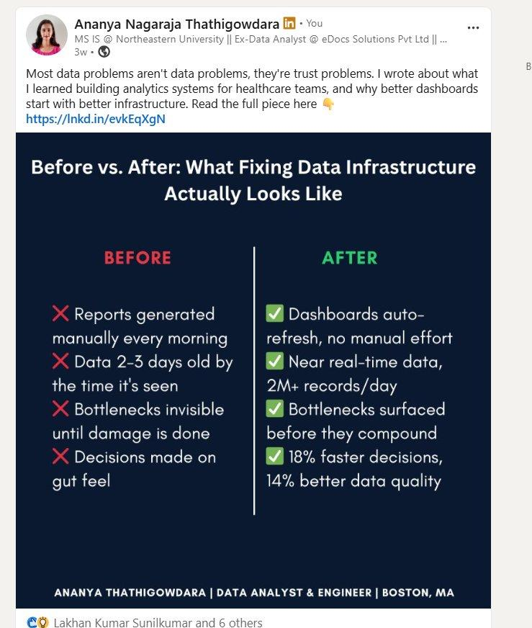
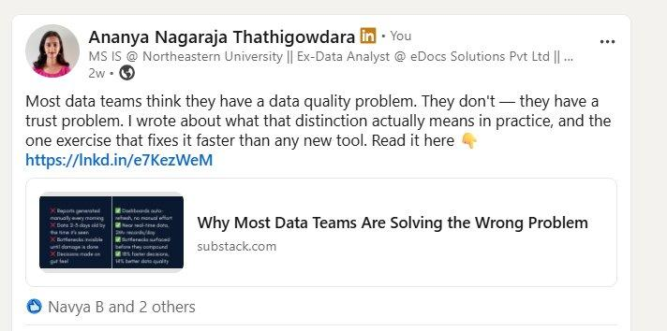
// 05 SOCIAL MEDIA PRESENCE — LIVE POSTS + SUBSTACK
Brand Voice Across Platforms
POST 1 — LINKEDIN INFOGRAPHIC
POST 2 + SUBSTACK ARTICLES
HOOK
"Most data problems aren't data problems, they're trust problems." — challenges audience assumptions.
VISUAL
Before/After in brand navy. Signal Red ❌ vs green ✅ — instant scannability.
SUBSTACK · ARTICLE 1
METRIC
Why Most Data Teams Are Solving the Wrong Problem
"2M+ records/day" + "18% faster decisions" — brand rule: every claim is a number.
ananyant16.substack.com
RESULT
SUBSTACK · ARTICLE 2
7 reactions · 3 weeks · Strong organic engagement on a new presence.
I Used to Make Charts. Then I Realized Nobody Was Using Them.
ananyant16.substack.com
LINKEDIN (primary) · 2 live posts + engagement · SUBSTACK · 2 published articles · GITHUB · portfolio + MEDA repo
05 / 13

Slide 6
// 06 EXPERIENCE
Where I've Built
Twinly
Data Engineer
Mar–Aug 2025 · Boston
→ 2M+ records/day · AWS S3 + Airflow event-driven ETL
→ 42% query performance gain · Snowflake + dbt warehouse design
→ 25% reduction in data issues · Power BI monitoring dashboards
eDocs Solutions
Data Analyst
Aug 2023–Jul 2024 · Mumbai
→ 21% rework reduction via SQL workflow analysis
→ 18% faster decision-making for healthcare teams via Power BI (DAX)
→ 14% data quality improvement via Excel, Power Query, t-tests
Jio Platforms
Data Analyst Intern
Mar–Jun 2023 · Remote
→ Analyzed 500K+ subscriber records (MongoDB, BigQuery) for churn + pricing
→ 62% of usage behavior variation explained via Python analysis
K-AKA Technology
Business Analyst Intern
Nov 2022–Feb 2023 · Bengaluru
→ 30% faster reporting turnaround · 25% onboarding success improvement
06 / 13

Slide 7

// 07 SELECTED PROJECTS
What I've Built
01 / AI · CLINICAL
02 / ML · ENVIRONMENT
03 / ANALYTICS · HEALTH
MEDA — Clinical Decision Support
Port Emissions Forecasting
Healthcare Cost Prediction
GPT-3.5 via OpenAI API for clinical medicine assistance. Validated on 5K+ anonymized records across 100+ benchmark scenarios.
ML-based hydrocarbon emission forecasting at ports — multiple linear regression + decision trees in R.
Predictive cost modeling using Random Forest, Logistic Regression, Gradient Boosting after EDA.
90%+ benchmark accuracy
15% prediction accuracy boost
ROC score: 0.95
60% faster drug lookup
Tableau + Power BI visualisation
Full EDA pipeline
30% fewer classification errors
Multiple ML models benchmarked
Data-driven cost estimation
Python · OpenAI API · Pandas · NumPy
R · Regression · Decision Trees · Tableau
Python · Random Forest · Gradient Boosting
07 / 13

Slide 8
// 08 BRAND STORYTELLING
CHALLENGE
Story 1
The first dashboard I built was never opened. Two weeks of SQL extracts, cleaned data, workflow diagrams. The team nodded, said 'great,' and went back to their spreadsheets.
From Mumbai
to Milliseconds
FRAMEWORK
TRANSFORMATION
The Hero's Journey
It took three more roles to understand — I had failed at the pipeline, not the visualization. Broken infrastructure means nobody trusts the data. I became the person who fixes the foundation first.
Challenge → Transformation → Return with Solution
📖 READ ON SUBSTACK
ananyant16.substack.com
100-WORD BRAND STORY · DEPLOYABLE AS-IS
RETURN WITH SOLUTION
At eDocs: 14% data quality improvement → 18% faster decisions. At Twinly: 2M+ records/day, 42% faster queries. Clean pipes. Clear answers. Confident decisions.
08 / 13

Slide 9
// 09 BRAND STORY 2
MEDA — CLINICAL AI TOOL
What Medicine
Taught Me
About Data
90%+
BENCHMARK ACCURACY
5K+
FRAMEWORK
Overcoming the Monster
CLINICAL RECORDS VALIDATED
Threat Identified → Confrontation → Victory → New Order
60%
THREAT IDENTIFIED
At every company — the same monster. Reports that contradicted each other. Dashboards built but never opened. Executives deciding on gut feel because the numbers couldn't be trusted.
FASTER DRUG LOOKUP
CONFRONTATION
30%
I came into clinical data as an engineer, not a doctor. That meant I asked questions insiders had stopped asking. In healthcare, data errors hurt people. No 'approximately correct.'
VICTORY → NEW ORDER
FEWER CLASSIFICATION ERRORS
MEDA: 90%+ benchmark accuracy on 5K+ clinical records. 100+ edge cases tested. Zero silent failures. The new order — systems that know their boundaries and never guess.
09 / 13

Slide 10
// 10 MADISON AI TOOL — LIVE DEMO
HOW THIS CONNECTS TO THE BRAND
MEDA
Clinical Decision
Support System
Pillar 4 — AI-Augmented Solving
Builds, validates, and deploys AI — doesn't just prompt-wrap it.
Pillar 1 — Engineering Rigor
Medicine & Data Assistant
Built with Python · GPT-3.5 · OpenAI API
Deployed on Streamlit Cloud
100+ edge cases. Statistical validation. No assumptions.
Drug interaction lookup with 90%+ benchmark accuracy
The Outsider Advantage
Clinical query processing on 5,000+ anonymized records
Engineer in a medical domain → more rigorous than insiders.
Edge case validation — 100+ benchmark test scenarios
60% reduction in drug lookup time vs manual process
Graceful degradation — zero silent failures
⚡ LIVE NOW — meda-clinical-tool.streamlit.app · Show it running in real time
10 / 13

Slide 11
// 11 CAREER POSITIONING STRATEGY
Where I'm Headed
TARGET ROLES
Data Engineer
Analytics Engineer
Senior Data Analyst
Applied Data Scientist
Leverages Twinly production experience directly
dbt + Snowflake skill set in high demand
Path to team leadership + BI ownership
AI project portfolio differentiates here
TARGET INDUSTRIES
KEY DIFFERENTIATORS
Healthcare Technology (MEDA + eDocs)
Speed + Scale: 2M+ records/day — production load, not a lab exercise
FinTech & Financial Services (quantitative rigor)
Measurable Outcomes: Every project includes a specific improvement metric
SaaS / B2B Tech (Jio + Twinly product experience)
Startups Series A–C (can build from scratch)
AI Literacy: Builds and validates AI — not just a user
International Experience: Mumbai → Boston shows global adaptability
GEOGRAPHY: Boston, MA · Remote-first companies · NYC / Seattle / SF open for senior roles
11 / 13

Slide 12
// 12 LIVE BRAND ECOSYSTEM
Everything Is Live
Every deliverable is live, functional, and accessible right now:
🌐 PORTFOLIO WEBSITE
⚕️ MEDA — AI TOOL
✍️ SUBSTACK ARTICLE 1
Deployed on Vercel / v0.dev
meda-clinical-tool.streamlit.app
ananyant16.substack.com
Full brand identity · Experience · Projects · Stories · Contact
Drug interactions · Symptom assessment · 90%+ accuracy · Live demo
Why Most Data Teams Are Solving the Wrong Problem
✍️ SUBSTACK ARTICLE 2
💼 LINKEDIN
💻 GITHUB
ananyant16.substack.com
linkedin.com/in/ananya-n-thathigowdara
github.com/Ananya1ani
I Used to Make Charts. Then I Realized Nobody Was Using Them.
2 live posts · Infographic + article share · 10 reactions total
MEDA repo · Portfolio code · Projects documented
12 / 13

Slide 13
Ready to Build
Something?
Graduating April 2026 · Data Engineering & Analytics · Boston, MA
EMAIL
LINKEDIN
GITHUB
SUBSTACK
ananyant166@gmail.com
linkedin.com/in/
ananya-n-thathigowdara
github.com/Ananya1ani
ananyant16
.substack.com
Ship it.

