Slide 1

Prismiq
Turn customer feedback into actionable intelligence.
Ishaan Samel
Northeastern University | MS Information Systems 2026
INFO 7375 Branding & AI

Slide 2

Brand Essence
Our Mission
Prismiq is the AI-powered bridge between raw customer feedback and meaningful business growth for SMBs.
To empower local businesses with enterprise-grade sentiment analysis and response automation.
What is Prismiq?
A streamlined tool built with n8n, Claude API, and Streamlit to refine data into clarity.

Slide 3

The Problem
SMBs are drowning in digital whispers, yet they lack the voice to answer back.
Passive Collection
Reviews are collected automatically but analyzed
manually—or not at all.
Resource Gap
Small teams don't have the 40+ hours a month
needed for professional engagement.
Trust Erosion
An unanswered review is a signal to customers that
their voice doesn't matter.
The Hidden Cost
Unread feedback leads to a massive loss in lifetime
customer value.

Slide 4

Target Audience
Tanvi
Garima
PROFILE
PROFILE
Owner of a Mental Health startup in Mumbai.
Product Manager at a Tegra Medical, Franklin, MA.
THE PAIN POINT
THE OBJECTIVE
Receives 50–200 reviews per month.
Evaluating AI automation tools for feedback loops.
No dedicated marketing or social media team.
Wants to reduce manual review processing time.
Overwhelmed by daily operations and logistics.
Needs high-accuracy sentiment analysis (Claude API).

Slide 5

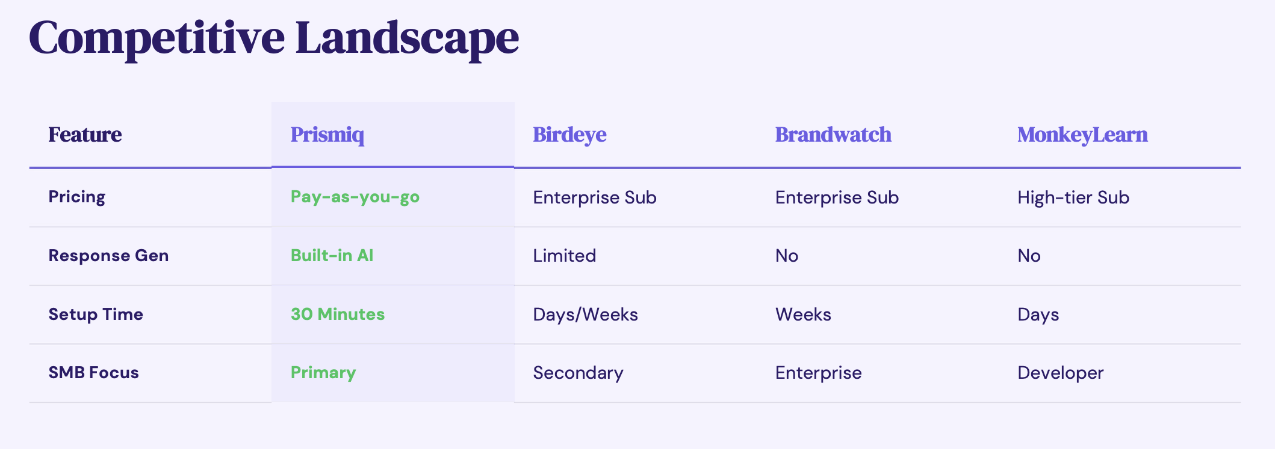
Unique Value Proposition
Pay-As-You-Go
Integrated Intelligence
Speed to Value
Eliminate enterprise subscription bloat. Prismiq offers a cost-effective model where you only pay for the reviews you analyze.
Go beyond raw data. Prismiq combines high-accuracy sentiment analysis with automated, personalized response generation.
Deployment in minutes, not weeks. A 30-minute setup allows SMBs to reclaim their customer dialogue immediately.

Slide 6

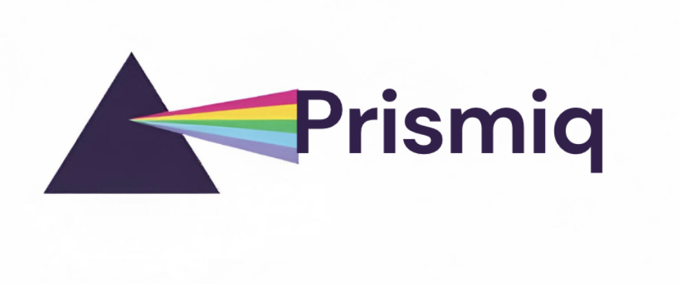



Brand Identity - Logo
Logo & Symbolism
The prism triangle represents the refinement of
raw data into actionable clarity.
Variations

Slide 7
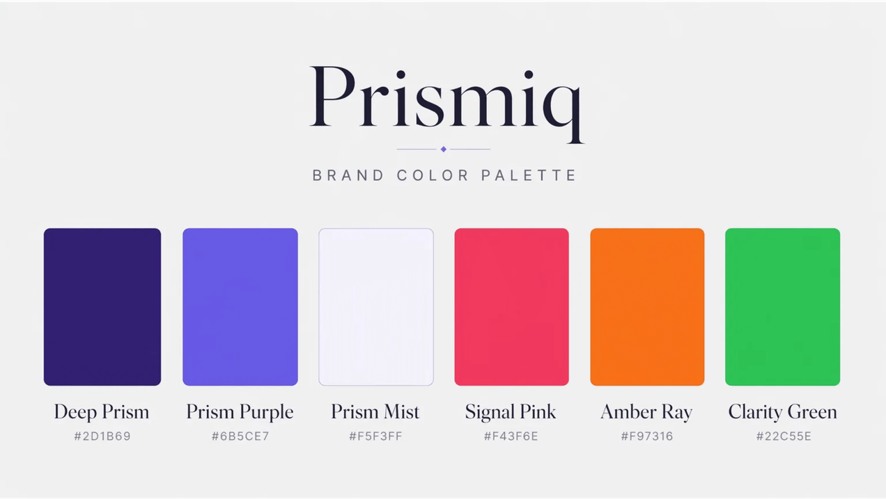
Brand Identity System
Logo & Symbolism
The prism triangle represents the refinement of
raw data into actionable clarity.
Typography
DM Serif Display
Used for headlines to convey authority and elegance.
DM Sans
Used for body text to ensure modern readability and accessibility.

Slide 8

Brand Pillars
Transparency
Accessibility
Open about how AI interprets and generates sentiment for every review.
Simple, non-technical tools designed for the local business community.
Precision
Human Voice
High-accuracy analysis powered by the advanced reasoning of Claude API.
AI-generated responses that sound like a neighbor, not a generic bot.

Slide 9

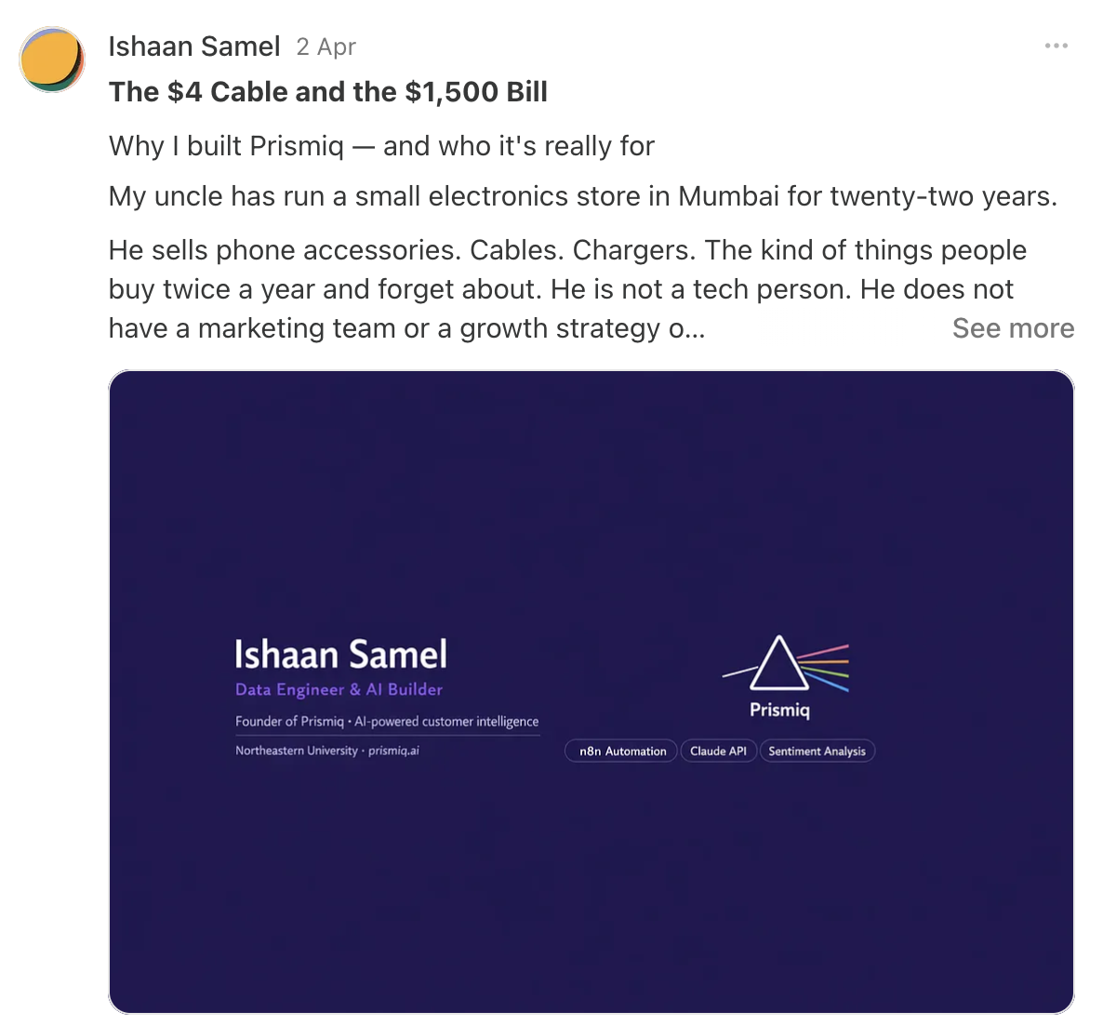
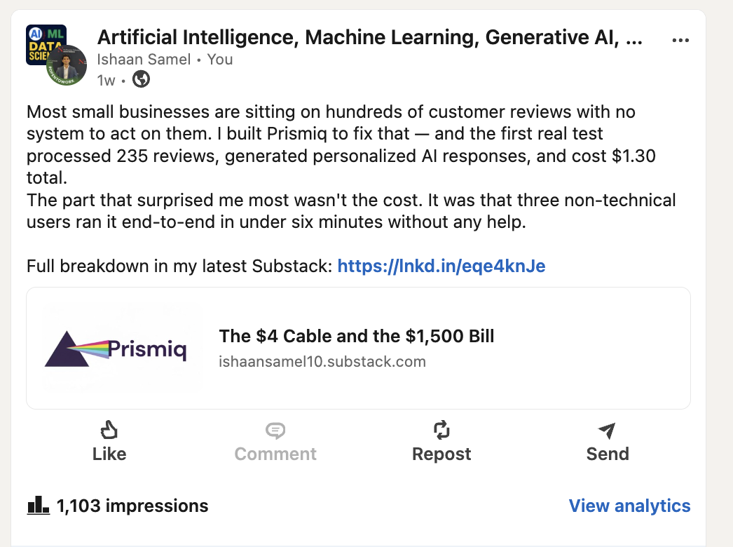
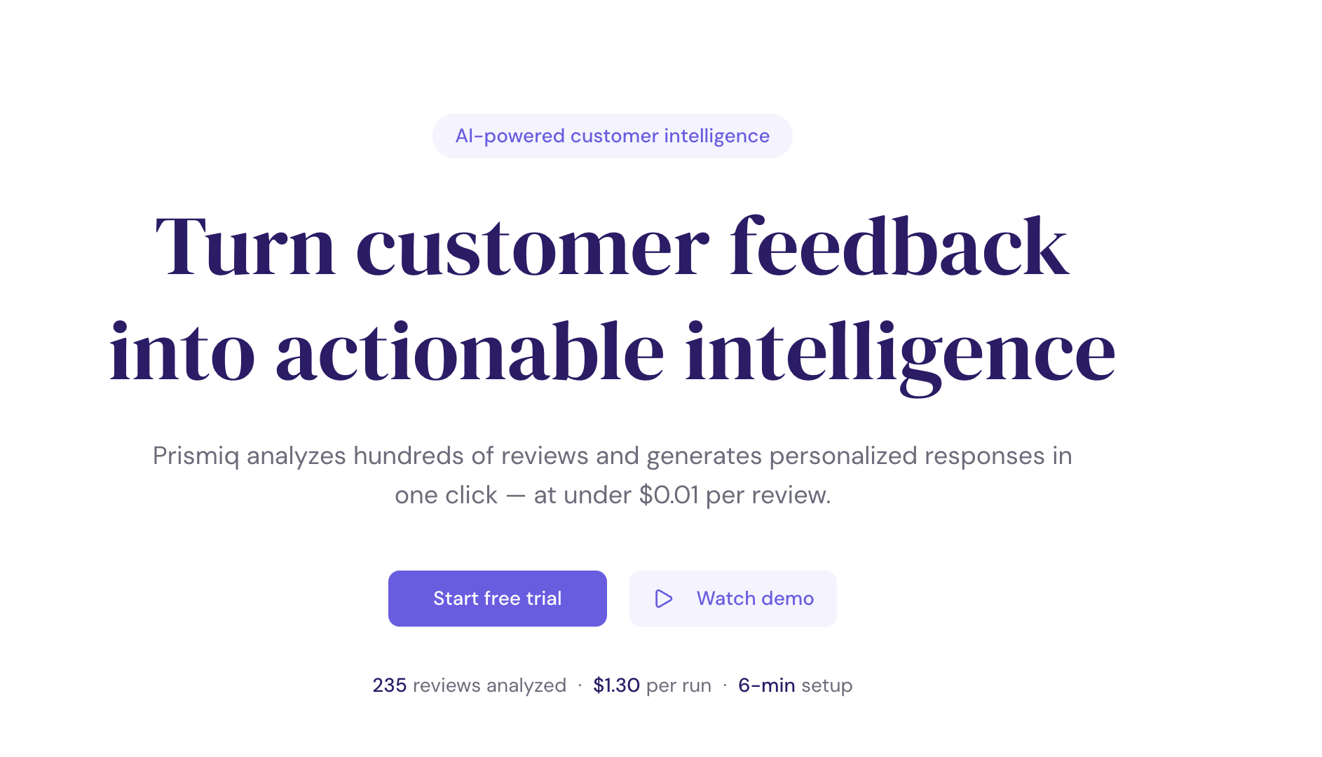
Digital Presence
Substack
LinkedIn
Vercel
THOUGHT LEADERSHIP
B2B ENGAGEMENT
PLATFORM HUB
Weekly insights on AI branding and SMB
Professional networking and industry case
High-performance hosting for the Streamlit
automation.
studies.
dashboard.
URL
FOCUS
EXPERIENCE
ishaansamel10.substack.com
Building a community of AI-forward SMB
Seamless transition from brand story to live
owners.
tool.
Unified brand consistency across every digital touchpoint.

Slide 10

The $4 Cable and the $1,500 Bill
The Origin
The Cost
My uncle ran a small Mumbai electronics shop for 22 years, built on trust and local service.
That unresponded review likely cost him $1,500 in lifetime customer value and reputational damage.
The Incident
The Why
A customer left a 1-star review over a $4 cable. My uncle, busy with daily operations, never saw it.
Prismiq exists so no legacy is tarnished by the silence of an overwhelmed owner.
"We refine the data, so you can reclaim the dialogue."

Slide 11
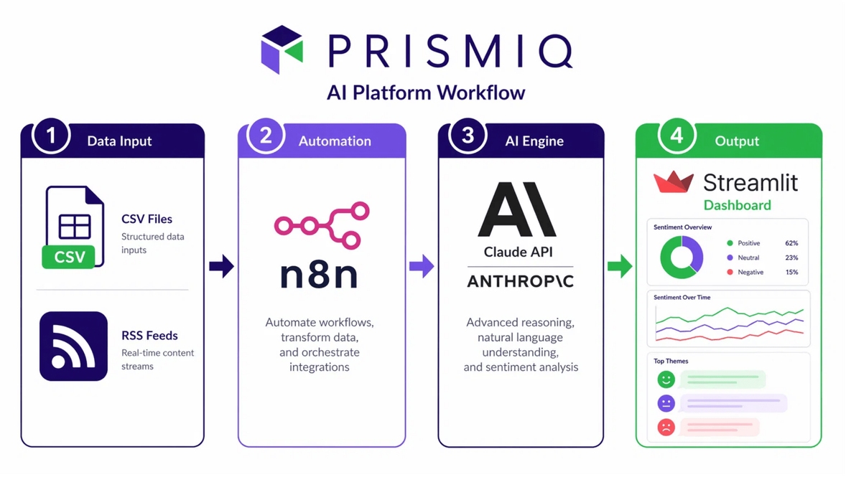
Live Demo: From Data to Action
Validated Performance
235
Reviews Analyzed in Pilot Run
$1.30
Total API & Infrastructure Cost
6 Min
Average End-to-End Completion
3 / 3
Non-Technical User Testers Succeeded

Slide 12

Join the Prismiq Revolution
Start your 30-minute setup today.
PLATFORM
CONTACT
Prismiq on Vercel
Ishaan Samel
"Built in one semester. Works in the real world."

