Slide 1
A Simulation of the Social impact on a society over time
A project by: Abi Pradhan
Kunal Sheth
Nikesh Ghimire

Slide 2
A Simulation of the Social impact on a society over time
A project by: Abi Pradhan
Kunal Sheth
Nikesh Ghimire

Slide 3
Our Inspiration
Represent reality
Our take on Societal changes
Interpret and understand these changes

Slide 4
The Backend
The inner workings of the code.

Slide 5


Altruists, Egoists and Hooligans
Altruists
The Good – Give others a point, take a cost c for themselves
Egoists
The Bad – Silent Members, does not affect others
Hooligans
The Ugly – Destructive members, incur a cost c for others
Ratio of Altruists, Egoists and Hooligans:
Random spread (Not Skewed)

Slide 6

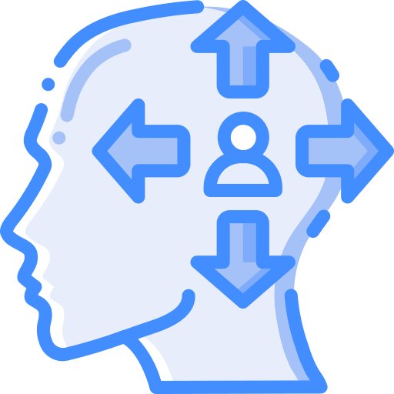
Introverts and Extroverts
Introverts
Exactly have 2 friends
Extroverts
Minimum of 2 Friends
Maximum of 7 friends
Ratio of Introverts and Extroverts:
Random spread (Not Skewed)

Slide 7



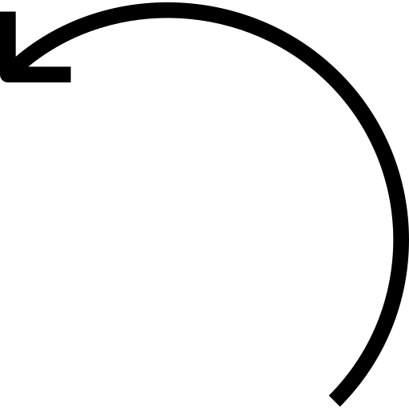




Structure of the Community
City
Block
Family
Neighborhood
Apartment
Person

Slide 8
Connections of the Community
People allowed 2 (Max) connections with any other person
Connections only exist on a personal level
People allowed 2 to 7 connections with any other person

Slide 9
Questioning the Design
Why did we do it the way we did?

Slide 10


Our take on a “realistic” model
The model used in class was very useful in terms of understanding how the model works
However, we believed this model was oversimplified
We wanted our model to keep some of these simplicities while trying to complicate others
Altruists, Egoists and Hooligans remain the same, connections and structure do not

Slide 11
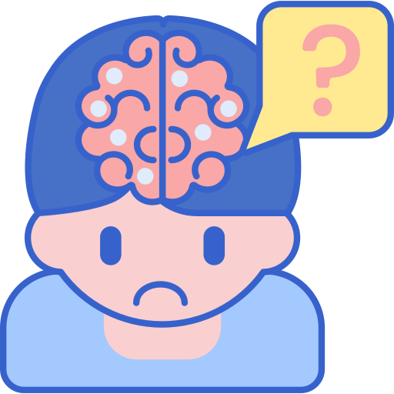
Real life is too dynamic…
We can not model the intricacies of life and our model still grossly over simplifies a lot of details.

Slide 12
Into the demo
This is the important part Hope you haven’t fell asleep yet

Slide 13
Into the code
This is also important Hope you that woke you up

Slide 14




Our Approach
Top-down approach
Building the community
Creating instances of classes
Bottom-up approach
Establishing each person’s friends (connections)
Analyzing payoffs and transitions

Slide 15



Representing each Level
Egoistic Family
Family

Slide 16
Another example
Altruistic Apartment
Apartment

Slide 17

Our Findings
This is what we found
“Actual mileage may vary”

Slide 18
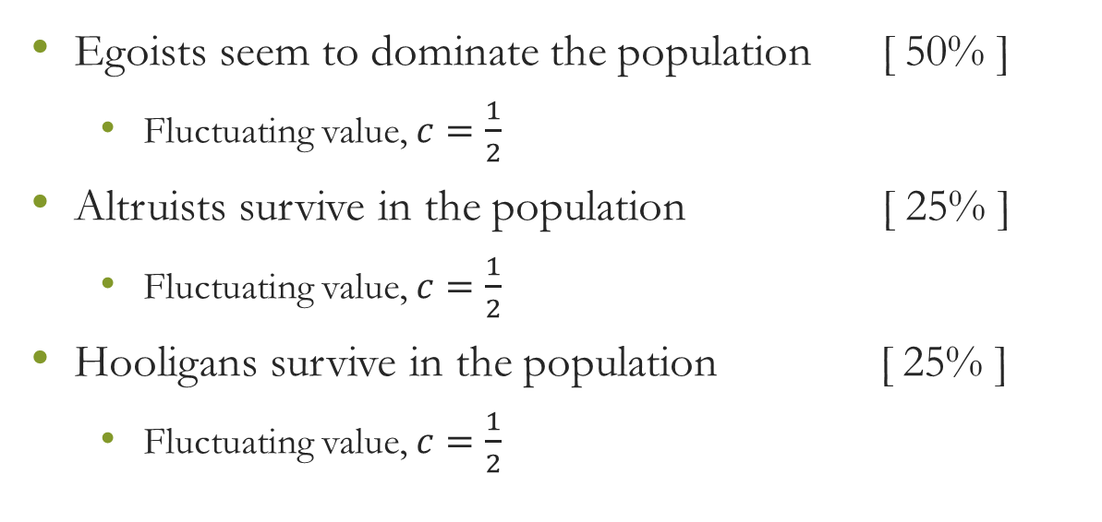
Egoists for the win!
Egoists seem to dominate the population [ 50% ]
Fluctuating value, $c=\frac{1}{2}$
Altruists survive in the population [ 25% ]
Fluctuating value, $c=\frac{1}{2}$
Hooligans survive in the population [ 25% ]
Fluctuating value, $c=\frac{1}{2}$

Slide 19


Reasoning?
Our model is very complex in nature
Attributes some aspects randomly
Number of friends
Tie-breaker implementation
Population size may affect the percentages
Introverts and Extroverts social types never change

Slide 20


Our Challenges
We faced these issues
Here's how we dealt with them… phew…

Slide 21
Thank you
Have a wonderful winter break

