Slide 1
Nuclear reactor model for axial offset control
UROP PROJECT
Nikolas Chung
Supervisors: Christos Evripidou, Dr Mehmet Mercangoz

Slide 2
Outline
01
What is this project, and why?
05
Live demo
02
From references to model structure
06
Model validation
03
Background: reactor physics
07
Model constraints
04
What exactly are we controlling?
08
Final notes

Slide 3
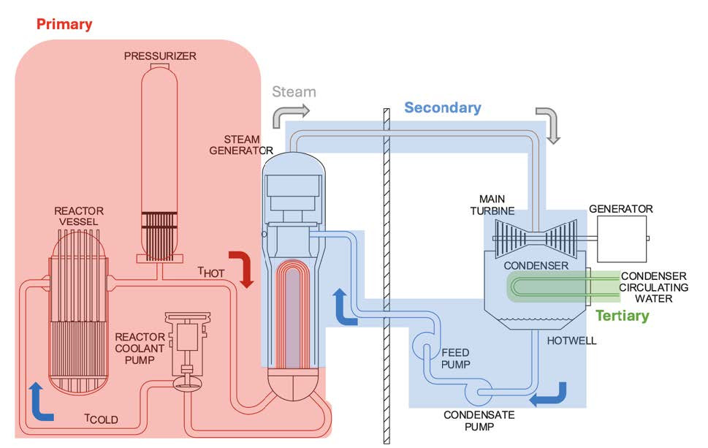
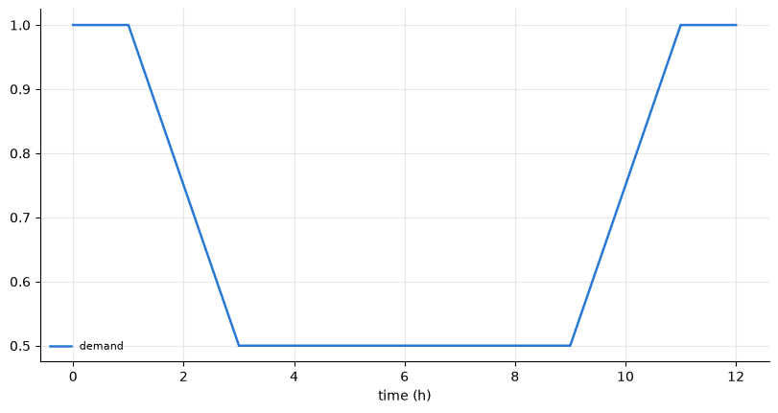
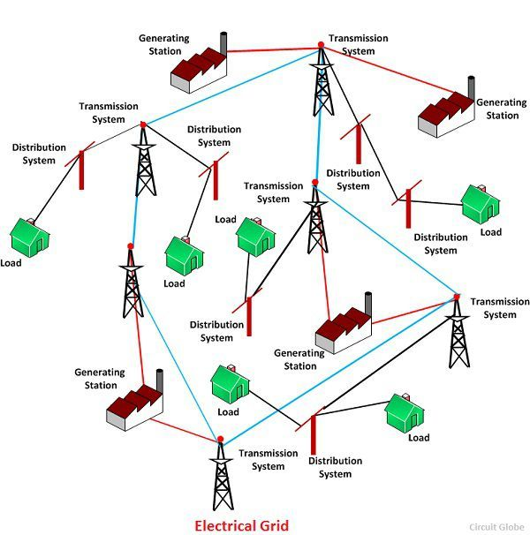
What is this project, and why?
01 · MOTIVATION
Intrinsic motivation: nuclear energy, PDC
Extrinsic motivation: the renaissance of nuclear energy
Goal: a Python platform for experimenting with control strategies for nuclear energy systems in load following.

Slide 4
Who is this project useful for?
01 · MOTIVATION
01
Audience
Control-oriented researchers. Core idea: build, plug, run.
02
Approach
A simple API and interactivity. Only limited background in nuclear reactor analysis is needed.
03
Status
Still a little rough around the edges: some parts still need validation, and the UX can be polished further.

Slide 5
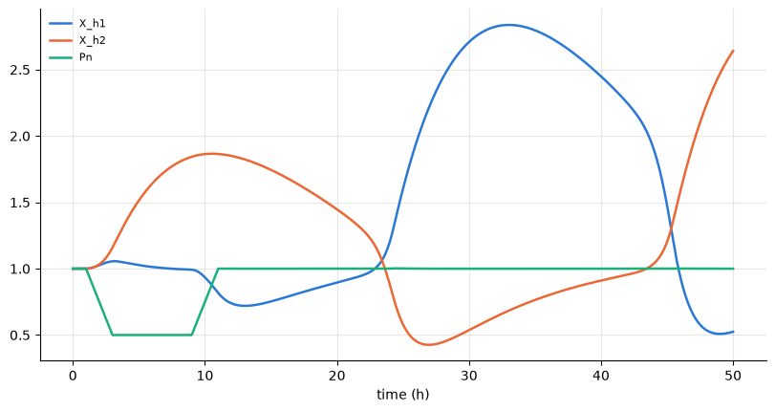
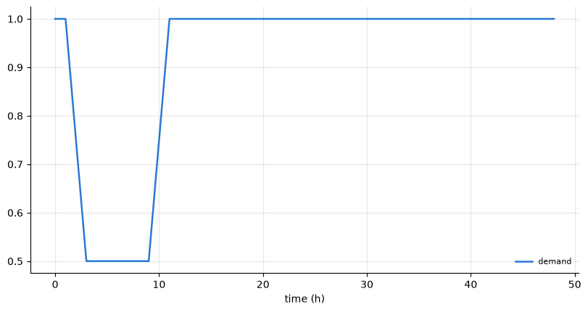
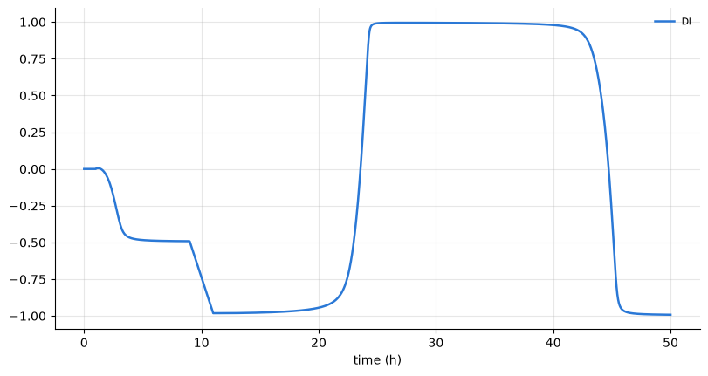
What makes this control problem interesting?
01 · MOTIVATION
Uranium → iodine → xenon (xenon is a very strong neutron absorber)
2
3.65m
1
3.02 m

Slide 6
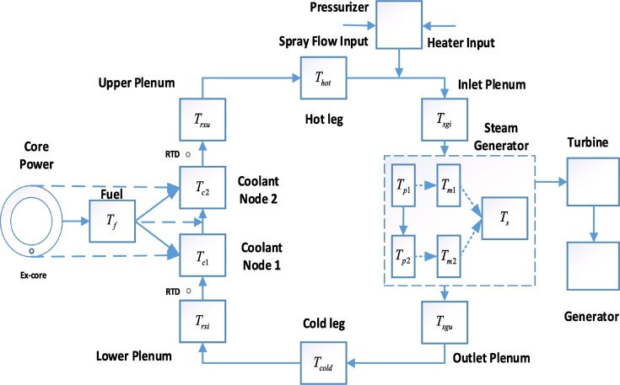
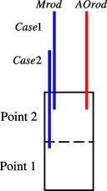
Model structure: what makes it different?
02 · MODEL STRUCTURE
Plant based on the H. B. Robinson PWR (Kerlin et al., 1976)
Why 2 coolant nodes? →
Two-point core: Li (2014)
Plant: Vajpayee et al. (2020)

Slide 7
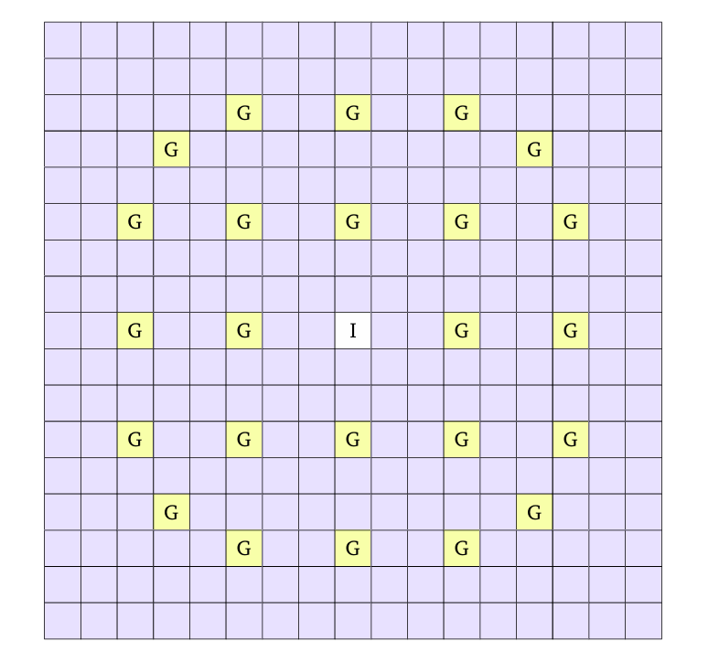
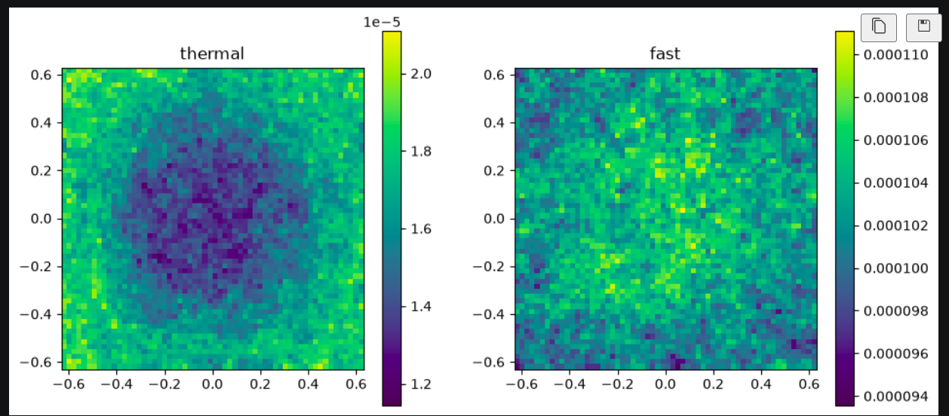
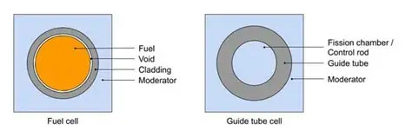
Background: the chain reaction
03 · BACKGROUND
Fission: neutrons are born fast (high energy) and are slowed down by the coolant until they are thermal (low energy).
Thermal neutrons are reabsorbed in the fuel, and the chain reaction continues.
It is all about controlling the chain reaction.

Slide 8
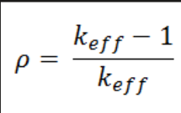
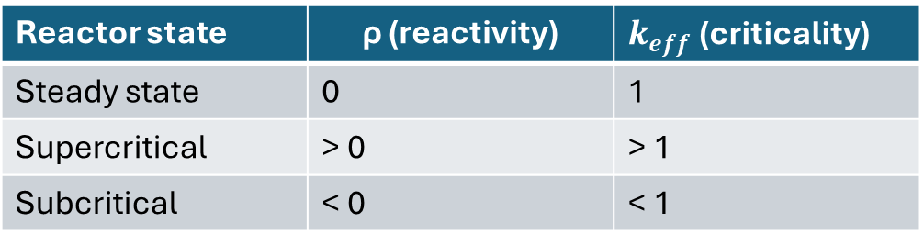
Reactivity and criticality
03 · BACKGROUND
Reactivity ρ measures how far the core is from criticality.
Reactor state | ρ (reactivity) | $k_{eff}$ (criticality)
Steady state | 0 | 1
Supercritical | > 0 | > 1
Subcritical | < 0 | < 1

Slide 9
What changes reactivity?
03 · BACKGROUND
Increases reactivity ↑ | Decreases reactivity ↓
Coolant temperature decreases | Coolant temperature increases
Fuel temperature decreases | Fuel temperature increases
Less boron | More boron
Control rods withdrawn | Control rods inserted
Less xenon | More xenon
Primary-side explanation →

Slide 10
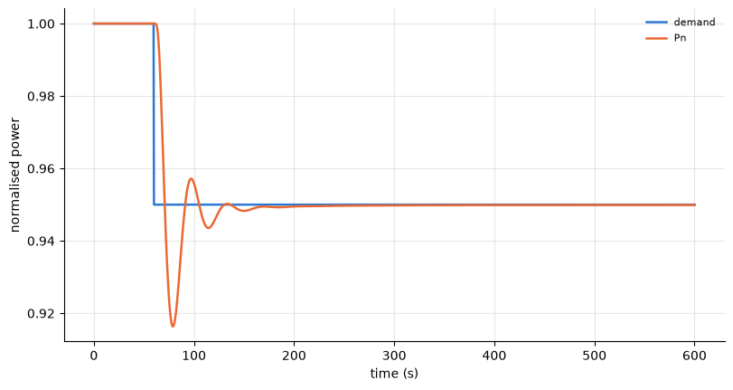
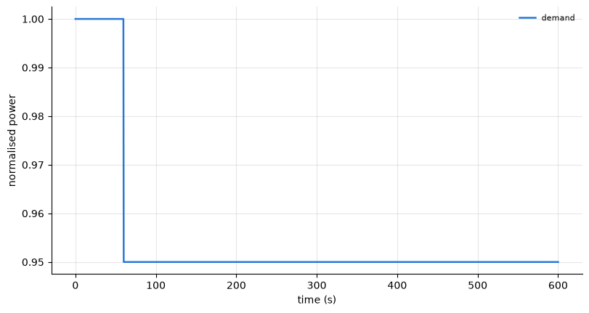
Control example: load disturbance
04 · CONTROL PROBLEM
First: what happens on the secondary side?
UTG
FC

Slide 11
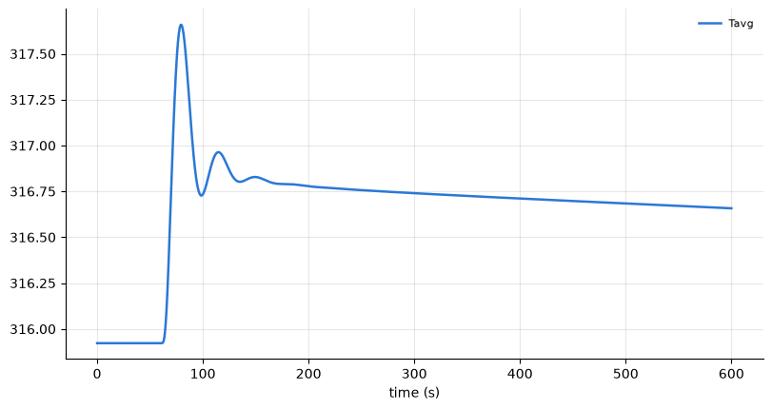
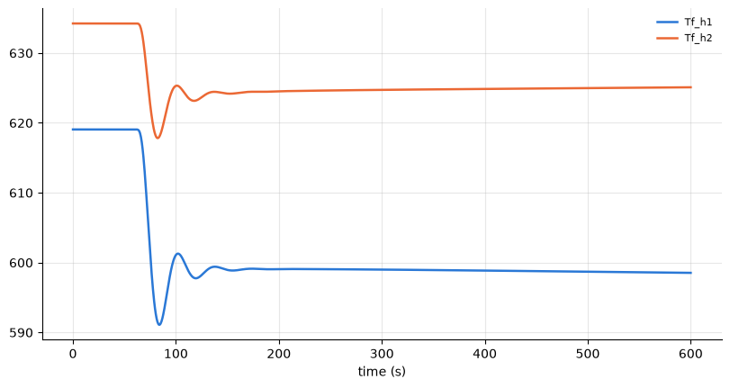
04 · CONTROL PROBLEM
On the primary side, it is more complicated
Coolant temperature rises and coolant becomes less dense
→ reactivity decreases
Fuel temperature decreases
→ reactivity increases
The reactivity effects cancel, so Tavg takes a long time to settle
Reactivity reference →

Slide 12
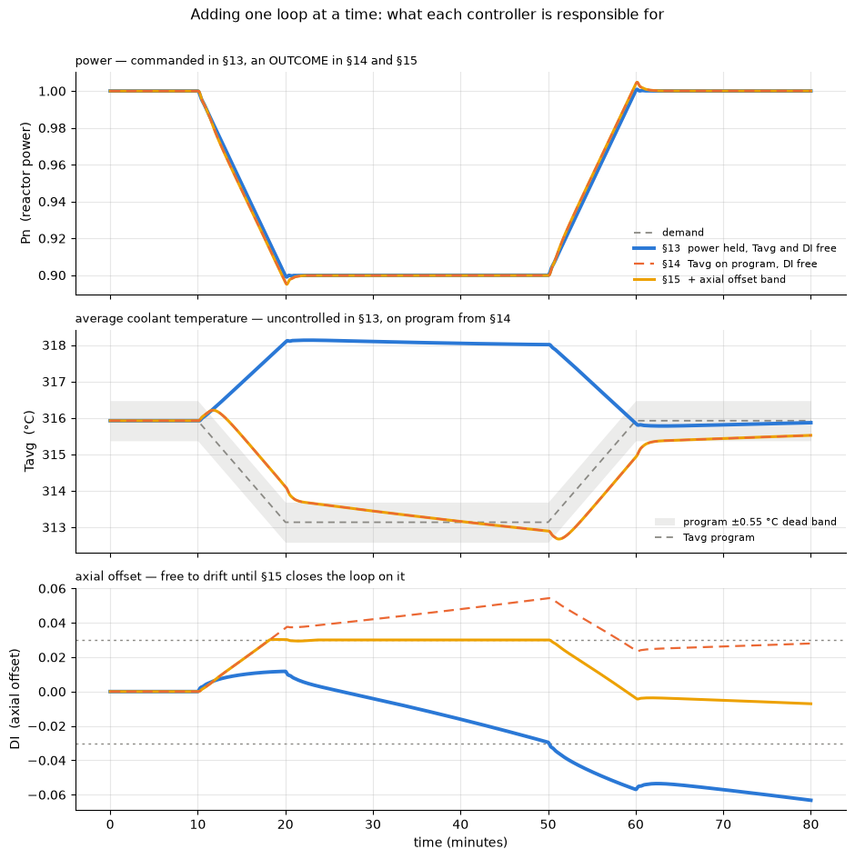
Therefore, control rods are needed
04 · CONTROL PROBLEM

Slide 13
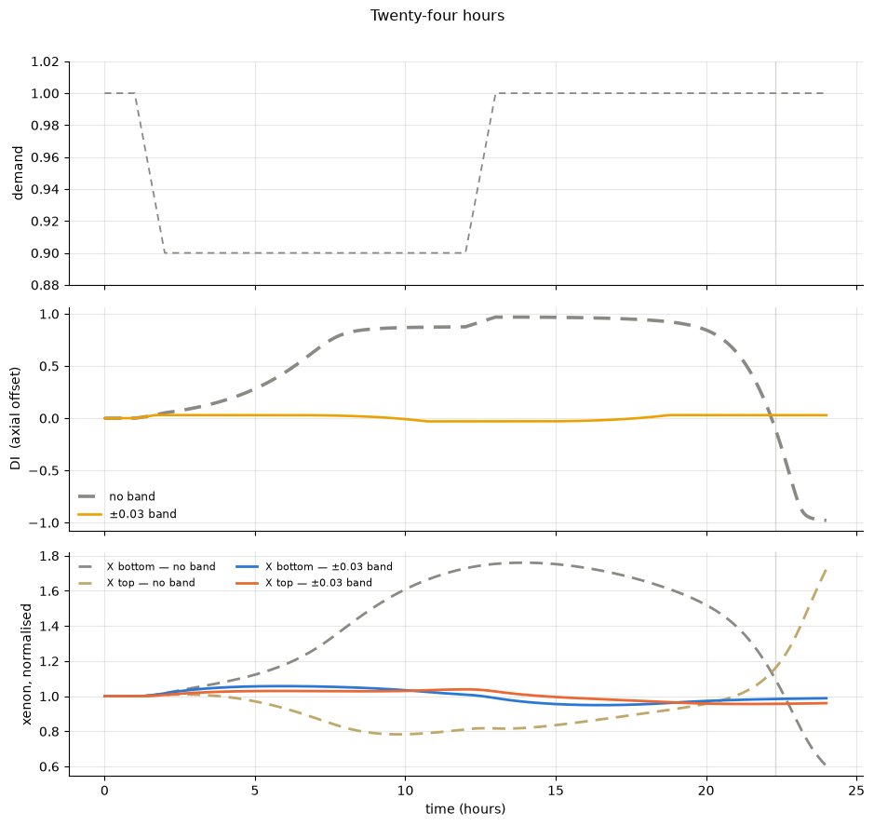
04 · CONTROL PROBLEM
Axial offset over a 24-hour load-follow cycle

Slide 14
Demo time
05 · LIVE DEMO
Search for the GitHub repo

Slide 15
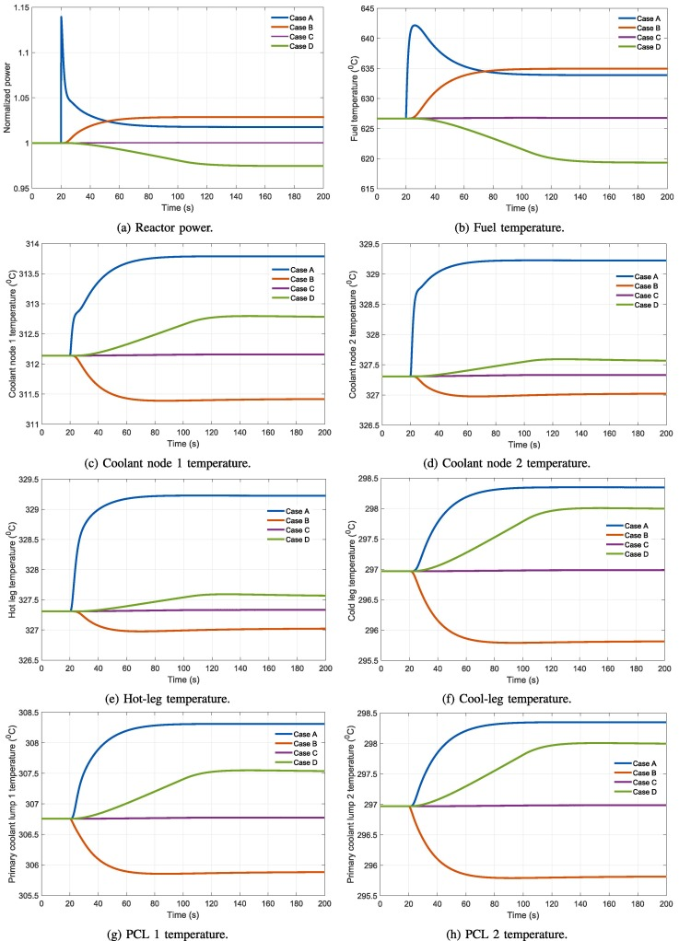
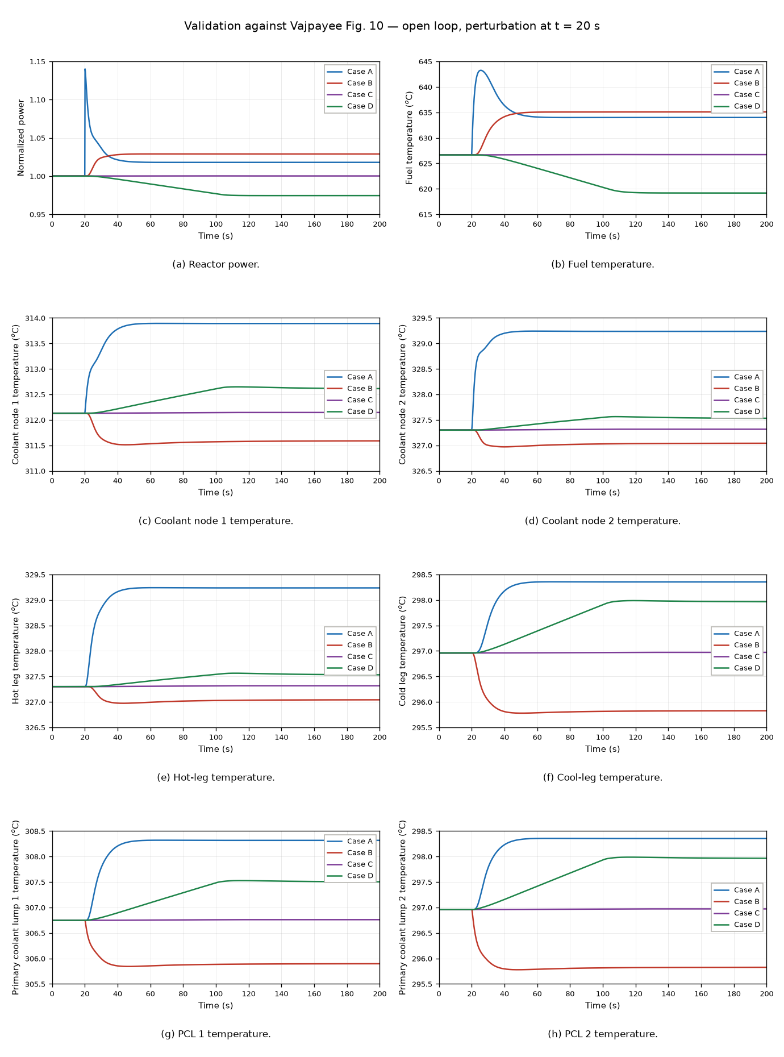
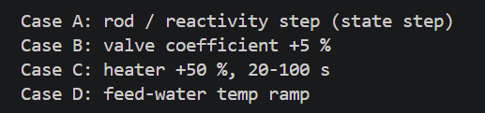
Validation against Vajpayee et al. (2020), Fig. 10
06 · VALIDATION
Published (Vajpayee et al., 2020)
This model
Open-loop test cases
Case A rod / reactivity step (state step)
Case B valve coefficient +5 %
Case C heater +50 %, 20–100 s
Case D feed-water temperature ramp
Perturbation applied at t = 20 s

Slide 16
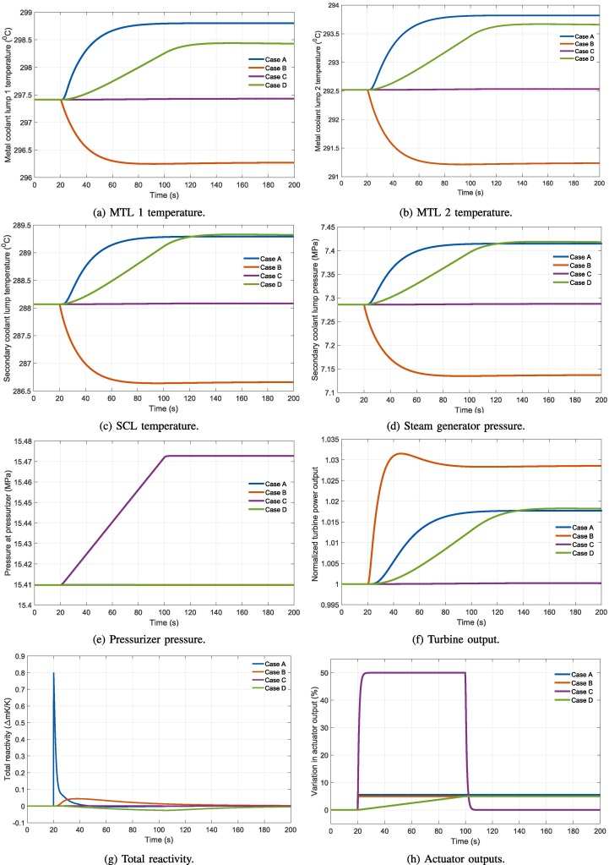
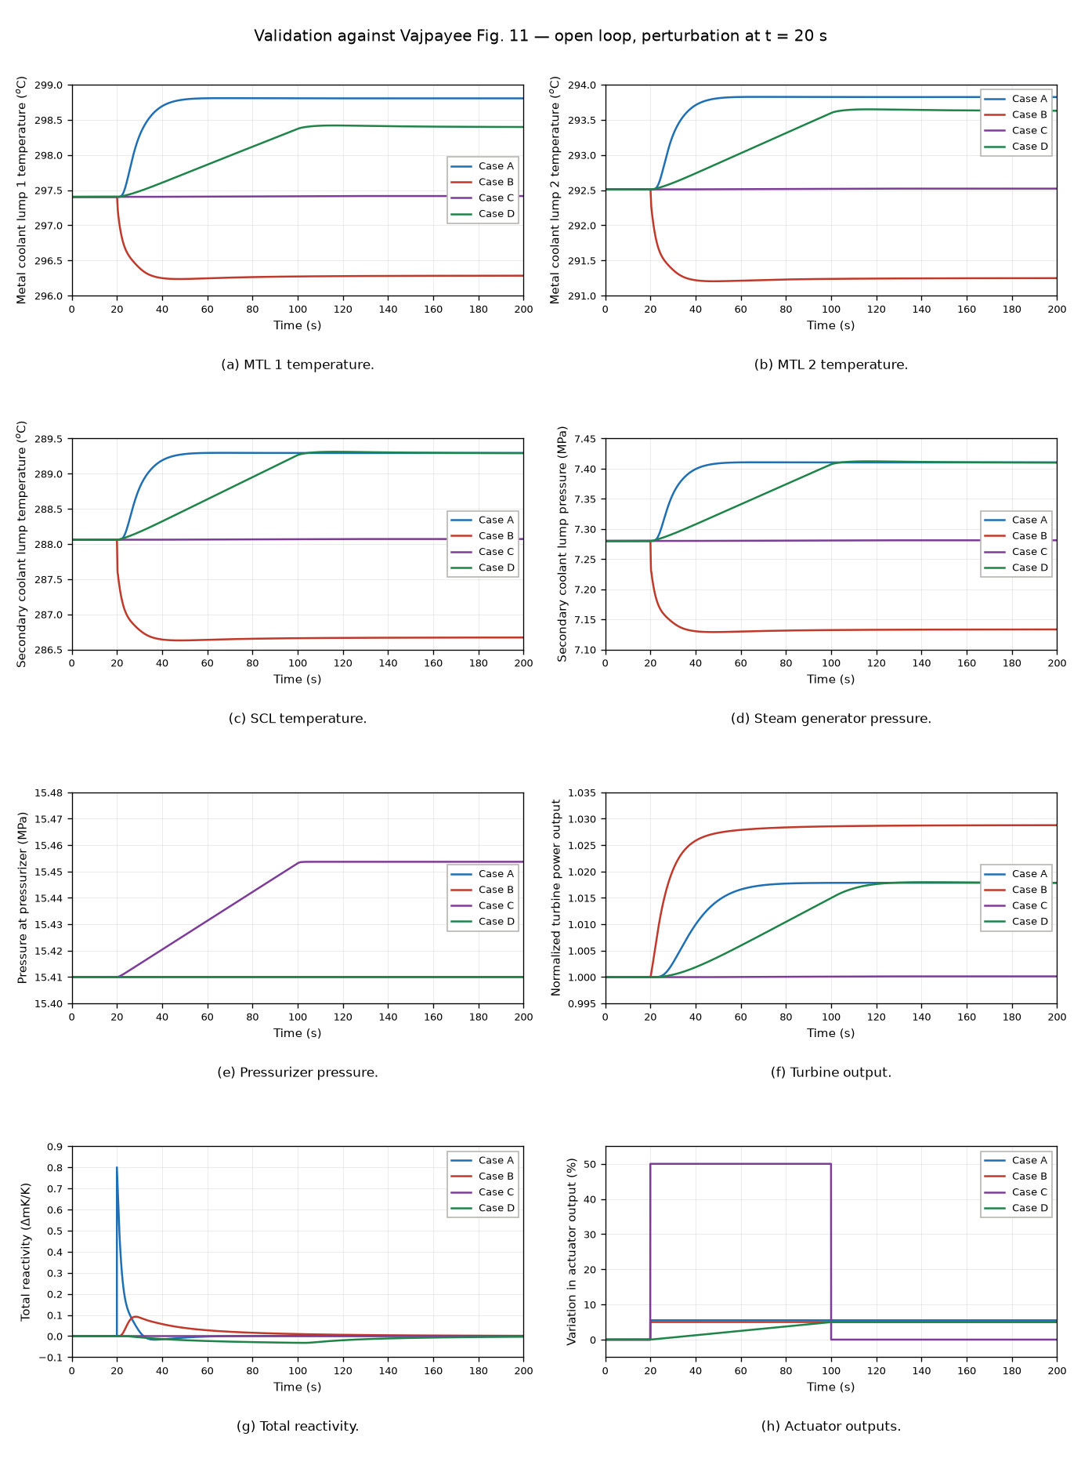
06 · VALIDATION
Validation against Vajpayee et al. (2020), Fig. 11
Published (Vajpayee et al., 2020)
This model
Open-loop test cases
Case A rod / reactivity step (state step)
Case B valve coefficient +5 %
Case C heater +50 %, 20–100 s
Case D feed-water temperature ramp
Perturbation applied at t = 20 s

Slide 17
What is missing, and what the model is not
07 · MODEL CONSTRAINTS
Still to validate
Against Li’s model (diffusion / coupling parameter)
Recreate the MATLAB/Simulink solvers to validate against Vajpayee et al.
Out of scope
Start-up and shut-down
Thermal limits (peaking factors)
Radial offset
…and more, documented in validation_notes.md

Slide 18
Special thanks
08 · FINAL NOTES
Dr Mehmet Mercangoz, Christos Evripidou, Li Qu, Javal, fellow UROPs Marco and Nas, and everyone for being so welcoming and supportive!

Slide 19
References
Kerlin, T.W., Katz, E.M., Thakkar, J.G. and Strange, J.E. (1976). Theoretical and experimental dynamic analysis of the H. B. Robinson nuclear plant. Nuclear Technology, 30(3), pp. 299–316. doi:10.13182/NT76-A31645.
Li, G. (2014). Modeling and LQG/LTR control for power and axial power difference of load-follow PWR core. Annals of Nuclear Energy, 68, pp. 193–203. doi:10.1016/j.anucene.2014.01.022.
Vajpayee, V., Becerra, V., Bausch, N., Deng, J., Shimjith, S.R. and Arul, A.J. (2020). Dynamic modelling, simulation, and control design of a pressurized water-type nuclear power plant. Nuclear Engineering and Design, 370, 110901. doi:10.1016/j.nucengdes.2020.110901.

Slide 20
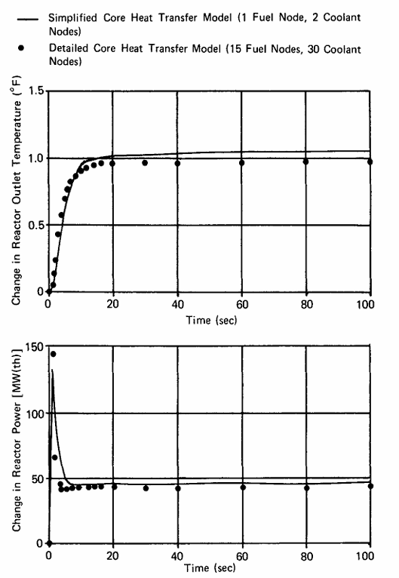
APPENDIX
Backup: why two coolant nodes?
A simplified core heat-transfer model (1 fuel node, 2 coolant nodes) closely tracks the detailed model (15 fuel nodes, 30 coolant nodes).
Shown: change in reactor outlet temperature and reactor power.
Source: Kerlin et al. (1976)
← Back

