Slide 1
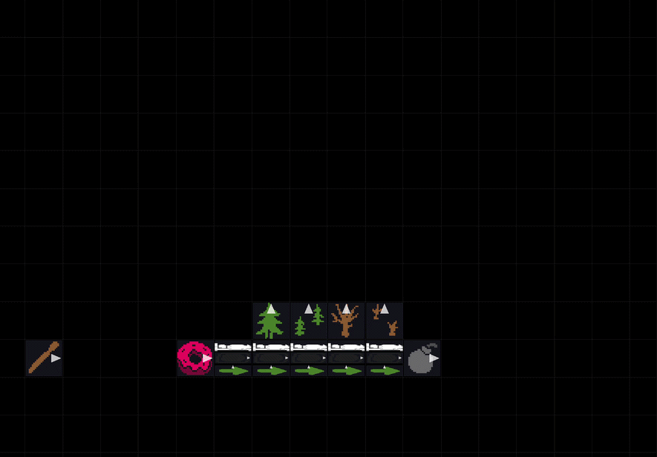
Decoder
Each unique object is hard coded to decode each hex value’s corresponding bit. The Tree handles the LSB, Trees handles the second bit, Husk handles the third bit, Husks handles the most significant bit.
The beds are used to keep the objects on track. We use FacedBy to detect when an object is next to the symbols, but that means we have to force the objects to move along a direction that they are not facing. The bed forces them to be Nudged right.
Decode the symbol into 4 bits
(cat = 1001 = baba keke keke baba)

Slide 2
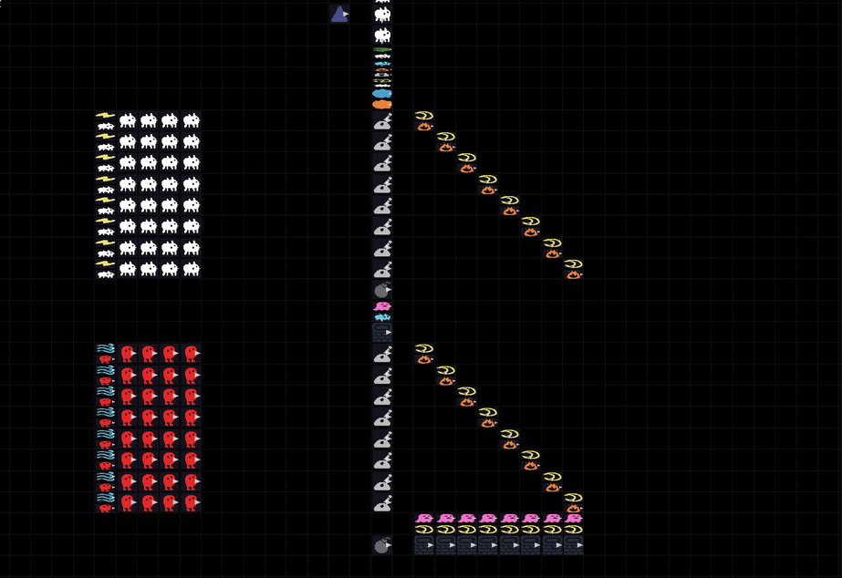
8-bit Mux
The control signal comes in from the top. If the control signal is a Baba, Lily creates an intermediate Badbad which immediately falls through to the bottom layer. If the control signal is a Keke it instead creates an intermediate Me which travels down the top Lever. Any Babas or Kekes which are on a Lever and Me or Badbad are destroyed.
Choose an 8-bit signal based off a control signal

Slide 3
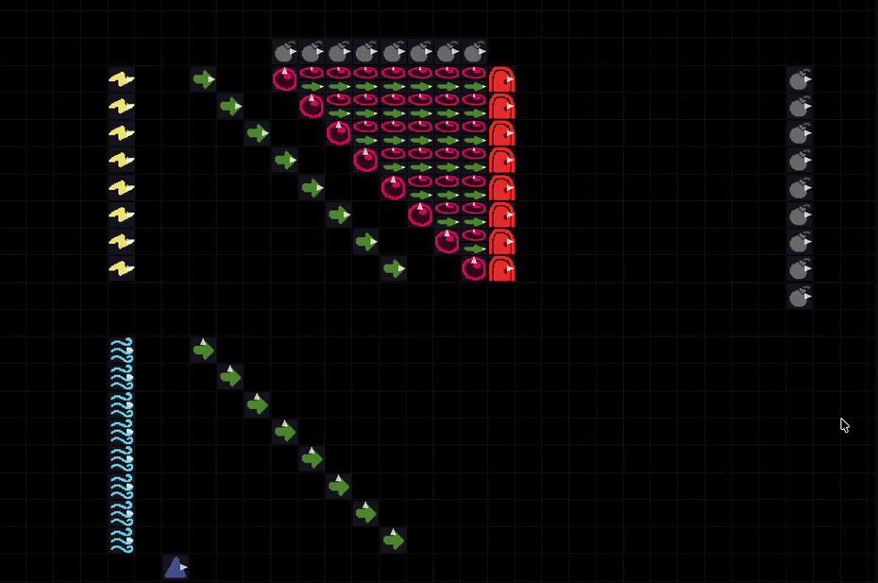
Adder
First, we combine the two signals. Then, on each Orb, we check if there are two Babas. If there are we send a Crab upward. Crab represents our carry, and each Orb outputs either Baba or Keke depending on the carry bit and the overlapped Babas and Kekes.
Adds two 8-bit numbers and throws away carry

Slide 4
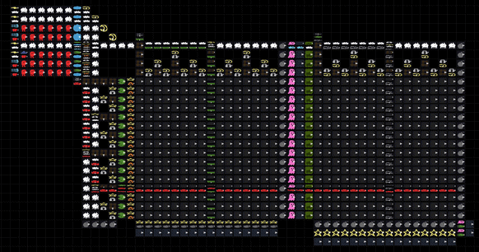
Memory
Our Memory module is interleaved. The left side represents the most significant nibble. The right side represents the least significant nibble. Our input is an 8-bit signal. We split into the higher and lower order 4-bits to row-select and then column-select.
In order to read memory, we turn the row-column selected value into a banana, which falls out of the memory module. We then use the revert keyword to turn the value back into the original value.
In order to write to memory, we bluetooth memory writing. We use the hex value we want to write to complete a new rule that makes that hex value at the row-column select place. This means that we cannot read and write at the same time but because we are a single-cycle CPU this doesn’t matter.
Either read or write a memory value.
This is used for both program instructions and data values

Slide 5
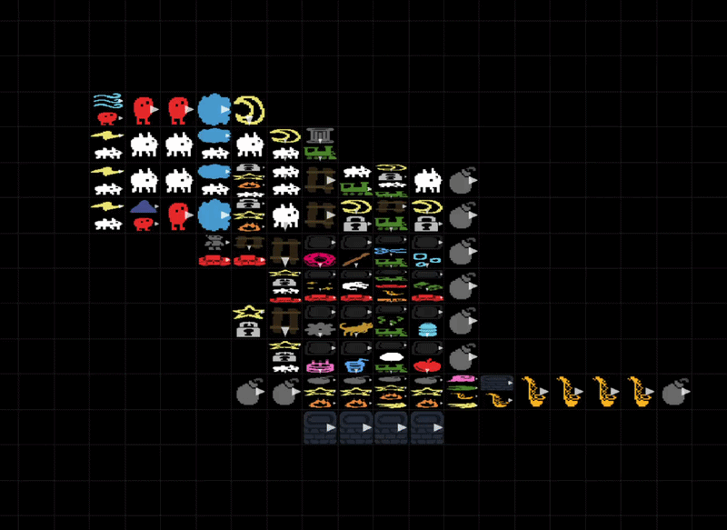
Encoder
For simplicity, we use a downscaled read-only memory module to encode signals from binary to hex objects. The binary input stream is treated as a 4-bit read address, and the corresponding hex objects are placed in sorted order from address 0 to 15
Encode a 4-bit stream to hex
(sax = 6, cash = 7)

Slide 6
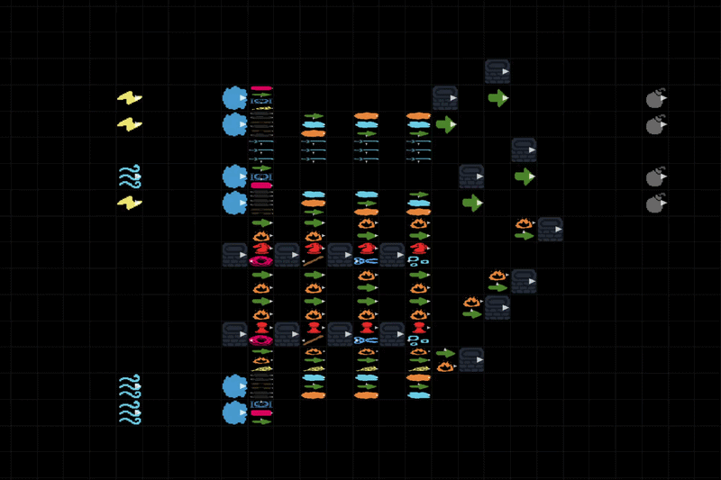
Registers
Our four 8-bit registers are stored as 8 hex tiles. The register module supports 1 write port (top) and 2 read ports (middle + bottom) simultaneously.
Eye and Ear are used to read the higher-order and lower-order hex values, respectively. Teeth is used to write to registers. These three objects are routed to their corresponding registers using the Shift property.
Writing to registers involves a bluetooth writing process, similar to writing memory.
Read or write a register value. Supports two read ports and one write port

Slide 7
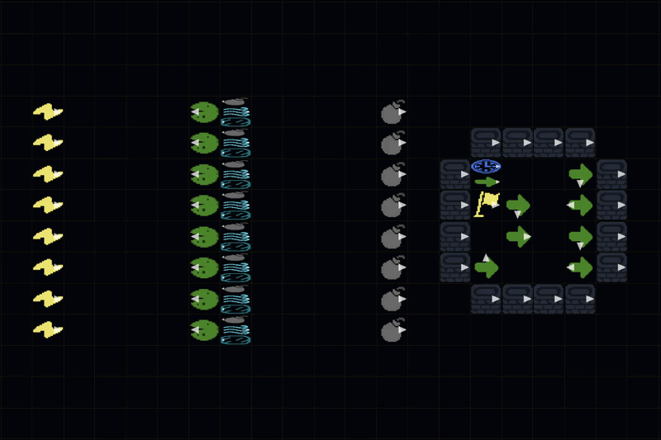
PC Flip Flop
Bolt outputs a constant Baba signal, while Wind outputs a constant Keke signal.
Lily is reused to convert Baba into Badbad and Keke into Me.
We utilize Bolt and Wind on top of Ice to create a simple clocked flip flop. Each clock tick, a Bolt on an incoming Me (from Keke) becomes Wind, while a Wind on an incoming BadBad (from Baba) becomes Bolt.
8-bit D flip-flop always written on every clock tick

