Slide 1
AI Market Growth Trends in Automotive
Forecast 2025–2035: Drivers, Segments & Regional Shifts

Slide 2
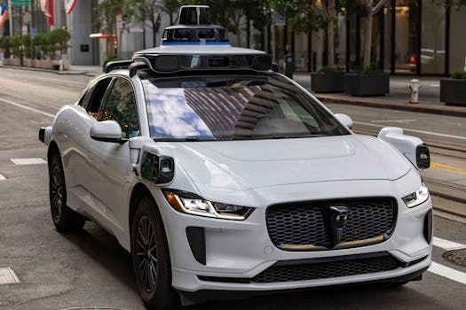
Key Growth Drivers
• Rise in demand for self-driving vehicles
• Government policies and regulatory support
• AI integration in traffic management and manufacturing
• Consumer interest in safety and efficiency
• Tech giants investing in AI (Tesla, Waymo, NVIDIA)

Slide 3

Market Segmentation
• Hardware dominates (75%+ share in 2024)
• Level 2 autonomy holds largest revenue share
• Passenger vehicles lead in adoption
• North America: largest market (35%+ in 2024)
• Asia-Pacific: fastest growing region

Slide 4
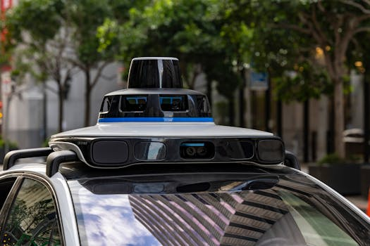
Technology Trends
• Deep learning leads in segment size
• Machine learning fastest growing segment
• AI edge deployment via Qualcomm platforms
• On-prem AI inference for cost efficiency
• AI enhances in-cabin systems & smart home integration

Slide 5
Future Outlook & Summary
2035 forecast: $59.33B market (27.2% CAGR)
AI will transform safety, comfort, and efficiency
Regional expansion: APAC accelerating growth
Edge AI and real-time data processing key enablers
Industry consolidation expected as tech matures

