Slide 1
Current Cybersecurity Threat Landscape
Protecting Enterprises in 2025

Slide 2

Top 5 Threat Categories
• Ransomware targeting SMBs
• AI-powered malware evolution
• IoT device vulnerabilities
• Phishing & credential theft
• Critical infrastructure attacks

Slide 3

Ransomware Trends & Attacks
• 3x increase since 2019
• Targeting unprepared SMBs
• Double extortion tactics
• Notable: Colonial Pipeline (2021)
• Crypto-locking + data leaks

Slide 4
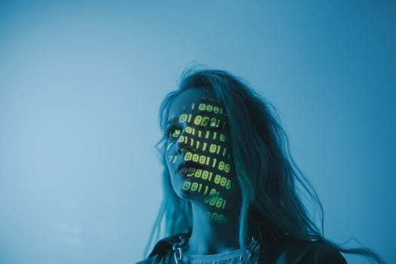
AI-Powered Threats & Defenses
• Malware using AI for evasion
• Automated phishing campaigns
• AI-driven threat detection rising
• Need for adaptive security tools
• Battle of AI vs AI

Slide 5
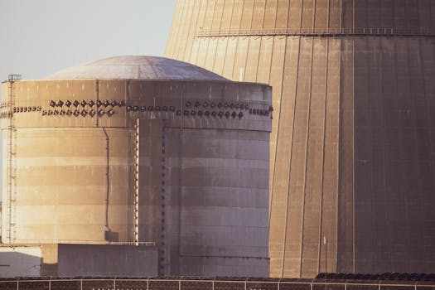
Critical Infrastructure Vulnerabilities
• 5G expanding attack surface
• Legacy systems with weak patches
• Power, water, and transport at risk
• Supply chain compromise threats
• State-sponsored targeting rising

Slide 6
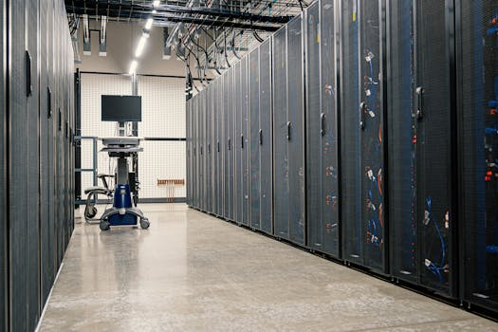
Defensive Strategies for Enterprises
• Zero Trust Architecture
• AI-enhanced threat detection
• Regular patching & audits
• Employee cybersecurity training
• Incident response playbooks

Slide 7
Summary & Key Takeaways
Threats are evolving fast
AI is both weapon and shield
SMBs most vulnerable
Defense requires proactive tech + people
Act now — don’t wait for breach

