Slide 1

PRADKSHAN

Slide 2
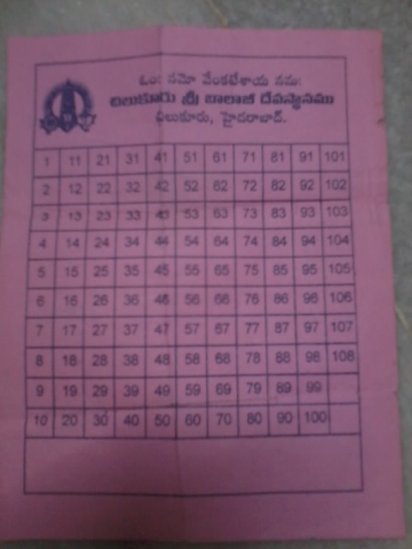
CURRENT SYSTEM

Slide 3
Ways of measuring pradakshan
Manual Counting
Use GPS system
Use Time constraint

Slide 4
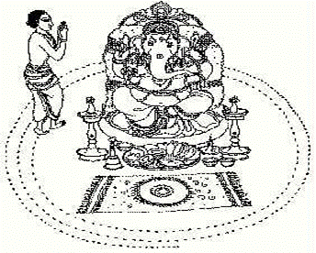
Proposed System

Slide 5
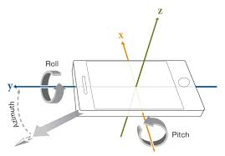
How it works
Based on Mobile Orientation

Slide 6
Need of Pradakshan app
Avoid Mind Distraction
To Automate System

