Slide 1
COLLECT GAME IN C
Dipika Joshi [THA081BCT09]
Shreya Maharjan [THA081BCT42]
Sristi Rani [THA081BCT44]
Department of Electronics and Computer Engineering
Thapathali Campus
3/21/2025

Slide 2
INTRODUCTION TO OUR PROJECT
Collect game
Objective
Language used
Core feature

Slide 3
GAME MECHANICS
Core Action
Movement
Object Behavior
Collision Detection
Scoring
Game Over

Slide 4
DEVELOPMENT PROCESS
Brainstorming
Right tools and libraries
Structuring the code
Final testing

Slide 5
CODE BREAKDOWN
Create game windows and renderer
Handle user input
Collision detection
Game loop
Cleanup

Slide 6
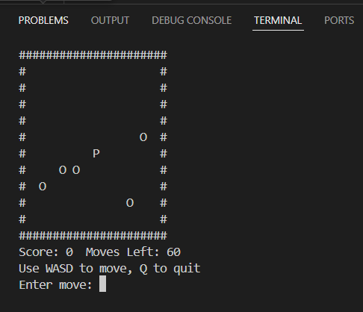
DEMO

Slide 7
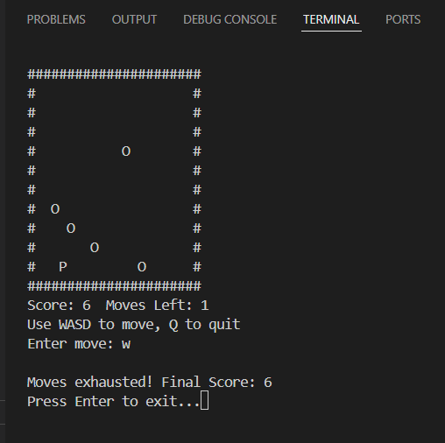

Slide 8
CONCLUSION
Summary
What we learned
Problem solving in game development
Project Impact
Future scope and Recommendations

Slide 9
THANK YOU

