Slide 1

FPGAs

Slide 2
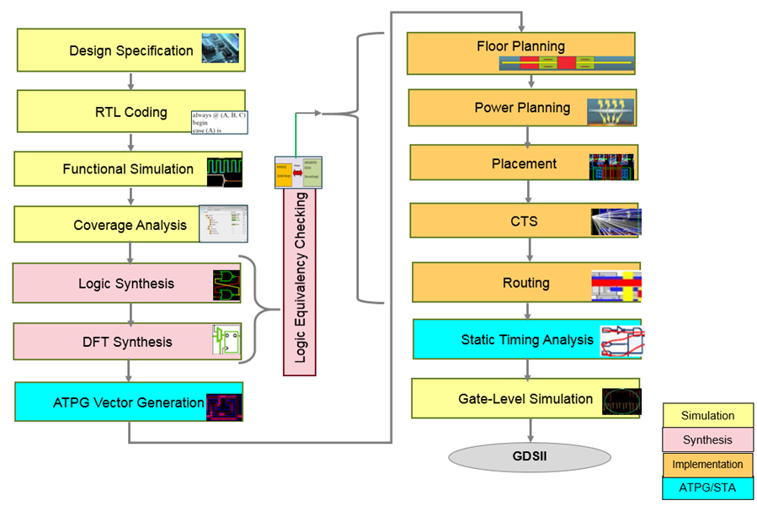
ASIC Design Flow

Slide 3
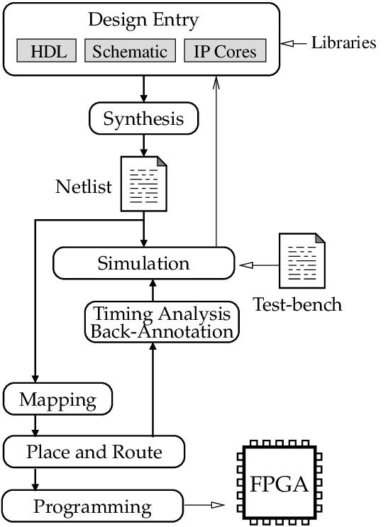
FPGA Design Flow

Slide 4
FPGA
A reconfigurable digital logic device programmed using HDL
Allows creation of custom hardware circuits in parallel
Can be reprogrammed unlimited times using configuration bitstreams
Contains logic blocks, memory blocks, DSP units, and I/O
Used in applications that demand high speed and deterministic performance

Slide 5
FPGA
FPGA CHIP
I/O Blocks
I/O blocks
Routing Fabric
(Programmable interconnect connecting all FPGA resources)
Logic slice
BRAM Block RAM
(Memory block)
DSP
DSP48/ALU
(Multiplexer,
Accumulator)
LUTs
Flip-Flops
clock /Reset Management

Slide 6
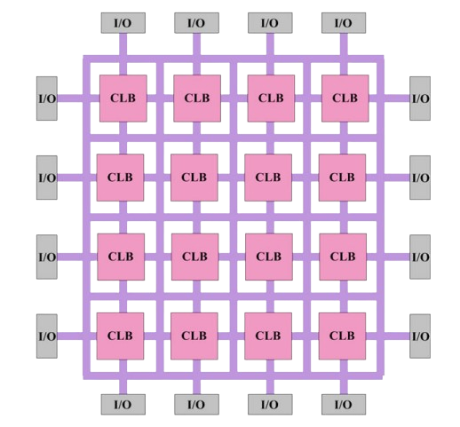
FPGA-Architecture

Slide 7
FPGA
Slices contain LUTs for combinational logic
Flip-Flops store sequential state between clock cycles
Carry chains allow fast arithmetic inside slices
Slices are repeated thousands of times across the FPGA
Form the main building blocks of FPGA logic

Slide 8
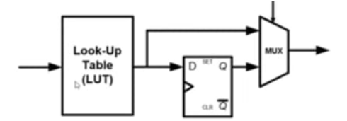
FPGA

Slide 9
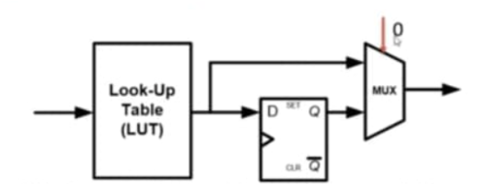
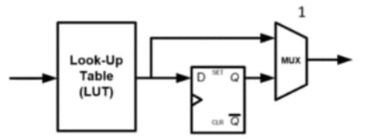
FPGA

Slide 10
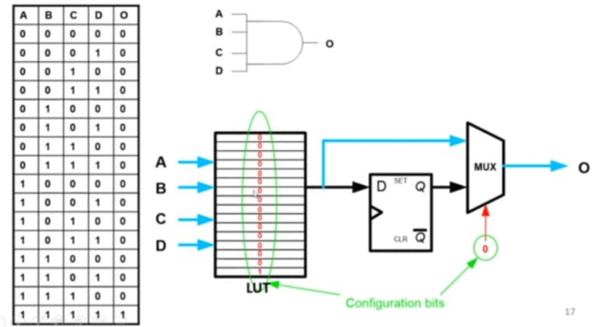
FPGA

Slide 11
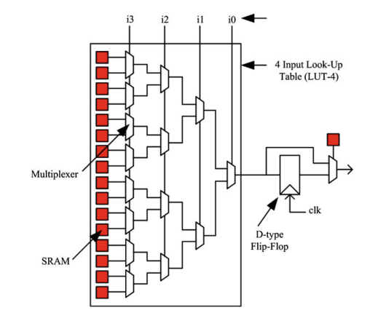
FPGA-Logic Elements

Slide 12
FPGA-Logic Elements

Slide 13
UART

Slide 14
UART Protocol
A Hardware Description Language (HDL) used for modeling digital systems.
Allows designers to describe the behavior and structure of electronic systems.
*Verilog AMS used for modeling Analog & Mixed Signal Language
Origin
Developed in 1984 by Gateway Design Automation.
Standardized as IEEE 1364 in 1995.
Versions
Verilog-1995: The first IEEE standard.
Verilog-2001: Improved features and usability.
Verilog-2005: Minor updates and clarifications.
SystemVerilog (2005): Extension to Verilog for design and verification.

Slide 15
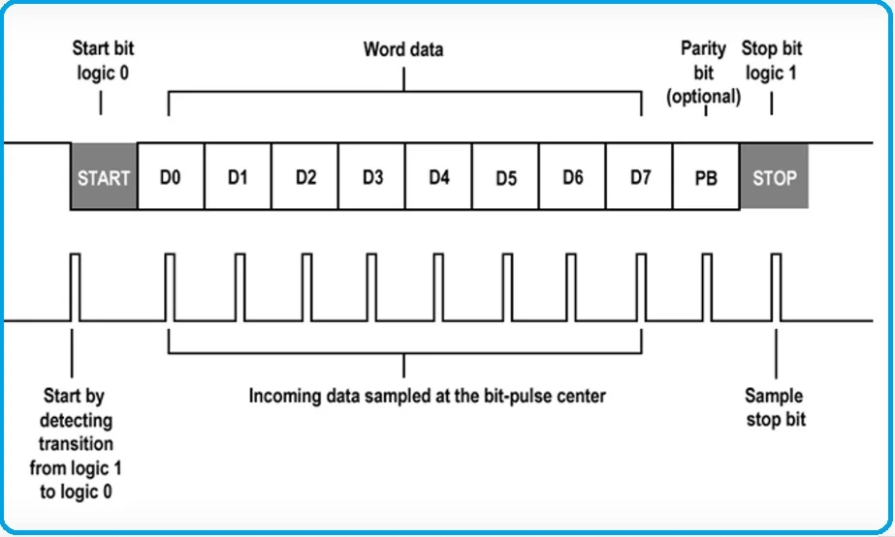
UART Protocol

Slide 16
Thank you !!!

