Slide 1
Predictive Policing
A study on Classification Algorithms to Predict Crime Status
Project : Semester VIII
Supervisor: Submitted By: Dr. Shirshu Varma Niketan Santosh Rane Professor, IIIT Allahabad. [IEC2013094]

Slide 2
PROBLEM DEFINITION
This project primarily aims to compare the different classification algorithms based on accuracy.
The objective of this project is twofold:
1. To analyze Voted-Perceptron and Sequential Minimal Optimization (SMO) in terms of accuracy when classifying the crime status of a specific neighborhood based on its geographical and socio-economic structure.
2. To show a comparative analysis of proposed algorithms against different classifiers: Naïve Bayes, Logistic Regression, SVM, and K-Means, in terms of AUC so we can reasonably choose more accurate algorithms to classify crime status.

Slide 3
DATASET DESCRIPTION
Extracted from UCI Machine Learning Repository and named “Communities and Crime Unnormalized Data Set”.
Emphasizes on communities of US and combines socio-economic data from 1990 US.
The dataset consists of 2215 number of instances and 147 attributes. Out of the 147 attributes, 125 attributes are predictive, 4 non-predictive and 18 potential goal attributes.
Each instance has a community name which is for information only and not been used for data exploration.
Other attributes include information across variety of crime-related features, ranging from percentage of households with minimum wage salary, to population density and percentage of people under poverty level to percentage of police officers per 100K population.
Also included are measured of crime considered violent, such as murder, rape, robbery and assault. The detailed information about the attributes of the dataset can be obtained from the UCI machine learning repository website.

Slide 4
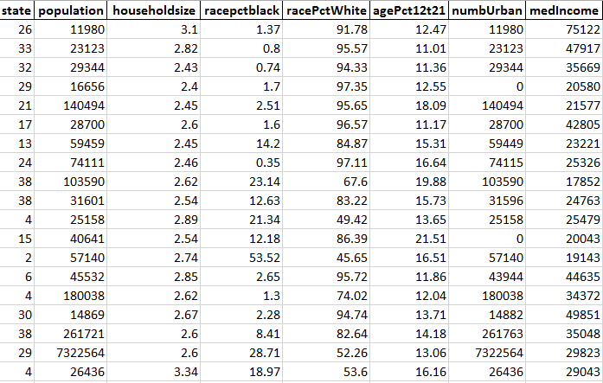
Figure 1: Training Dataset

Slide 5
PREPROCESSING
To reduce the noise and incomplete data.
Features are removed on the basis of missing values (attributes have more than 80% of missing values) such as pctPoliceWhite and pctPoliceBlack.
The attribute violentPerPop (total number of violent crimes per 100K population) has been chosen as a target attribute.
Due to this, all instances where violentPerPop was missing led to the removal of 221 instances and 1994 instances were remained.
Implementation of min-max normalization technique [0, 1] on all attributes except state.
Categorization of violentPerPop into a binomial class “CrimeStatus”. The threshold set for the categorization was 20%.
The CrimeStatus has two values, “Critical (1)” and “Non-Critical (0).” This is done because in order to predict, the target value should be discrete in nature.

Slide 6
Hardware and Software Requirements
Programming Language: Python
Pandas Library (Python): Python library for data manipulation
Scikit-learn (Python): Python library for machine learning

Slide 7
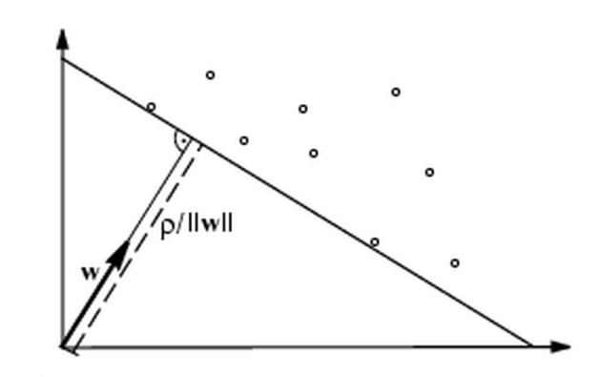
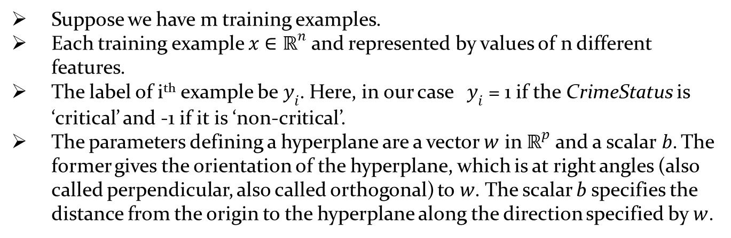
Voted Perceptron Algorithm
Suppose we have m training examples.
Each training example $x∈ℝ^{n}$ and represented by values of n different features.
The label of i^{th} example be$y_{i}$. Here, in our case ${ y}_{i}$ = 1 if the CrimeStatus is ‘critical’ and -1 if it is ‘non-critical’.
The parameters defining a hyperplane are a vector $w$ in $ℝ^{p}$ and a scalar$b$. The former gives the orientation of the hyperplane, which is at right angles (also called perpendicular, also called orthogonal) to$w$. The scalar b specifies the distance from the origin to the hyperplane along the direction specified by$w$.

Slide 8
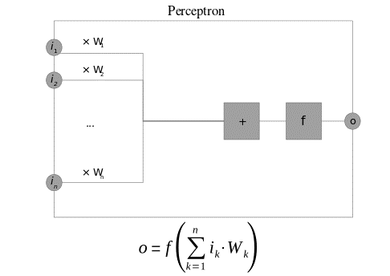
Figure 2. A Perceptron algorithm block illustration

Slide 9
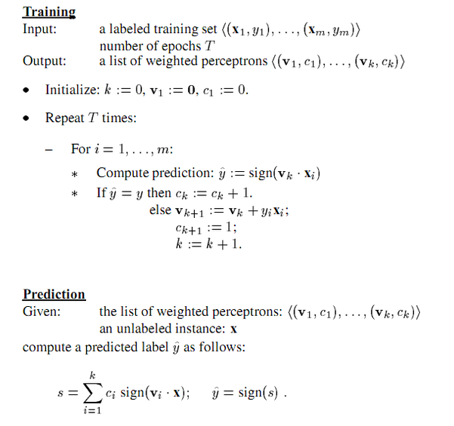

Slide 10
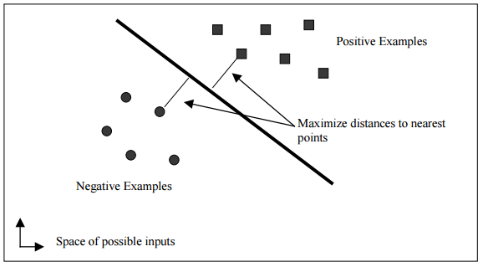
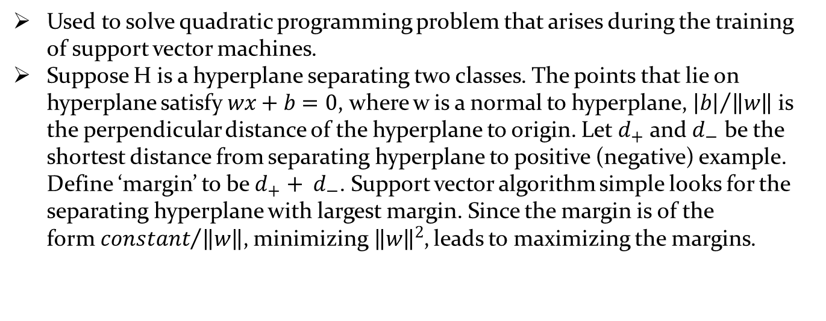
Sequential Minimal Optimization
Used to solve quadratic programming problem that arises during the training of support vector machines.
Suppose H is a hyperplane separating two classes. The points that lie on hyperplane satisfy$wx+b=0$, where w is a normal to hyperplane, ${\left|b\right|}/{\left\|w\right\|}$ is the perpendicular distance of the hyperplane to origin. Let $d_{+}$ and $d_{−}$ be the shortest distance from separating hyperplane to positive (negative) example. Define ‘margin’ to be$d_{+}+ d_{−}$. Support vector algorithm simple looks for the separating hyperplane with largest margin. Since the margin is of the form${constant}/{\left\|w\right\|}$, minimizing${ \left\|w\right\|}^{2}$, leads to maximizing the margins.
Figure 4. A linear support vector machine

Slide 11

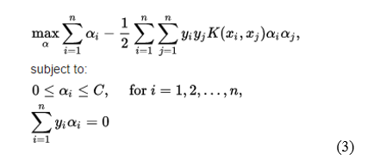
Using a Lagrangian, this optimization problem can be converted into dual form which gives:
Requiring that the gradient of LP with respect to w and b vanish and substituting the value of w in the above equation leads to the following optimization problem:
, where C is parameter assigning penalty to errors and K (x_{i}, x_{j}) is the kernel function, both supplied by the user; and the variables $α_{i}$ are Lagrange multipliers.

Slide 12
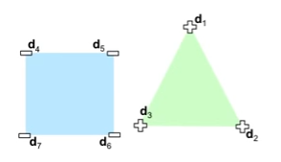
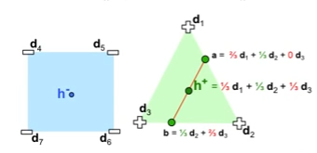
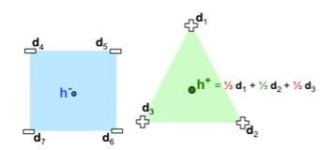
Figure 5. Intuition behind SMO Algorithm and SVM

Slide 13
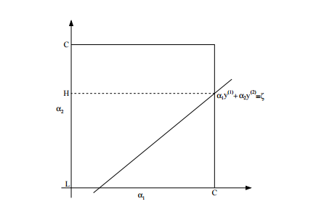

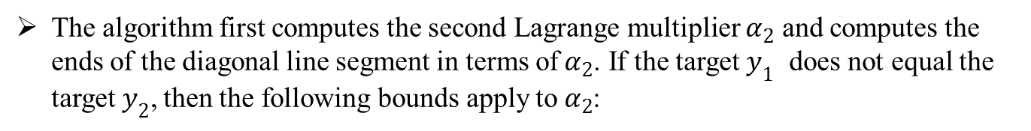
Figure 6. A plot illustrating bound on $α_{1}$ and $α_{2}$
The algorithm first computes the second Lagrange multiplier $α_{2}$ and computes the ends of the diagonal line segment in terms of$α_{2}$. If the target $y_{1}$ does not equal the target$y_{2}$, then the following bounds apply to$α_{2}$:

Slide 14


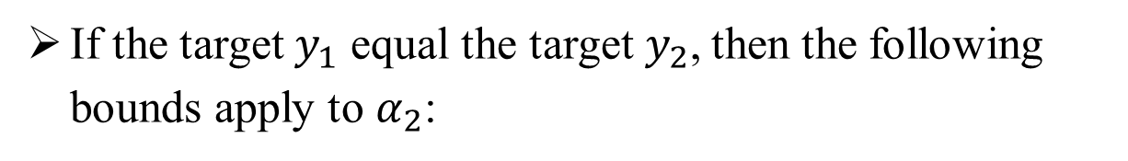
If the target $y_{1}$ equal the target$y_{2}$, then the following bounds apply to$α_{2}$:
The second derivative of the objective function along the diagonal line can be expressed as:

Slide 15

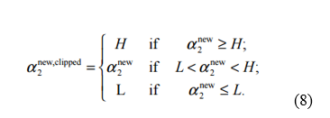


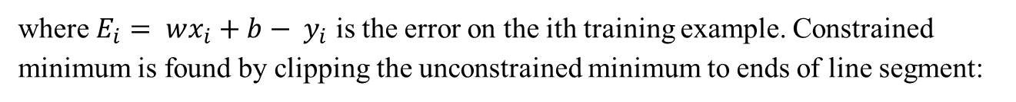
Minimum ${ α}_{2}$ calculated as:
where $E_{i}= wx_{i}+b− y_{i}$ is the error on the ith training example. Constrained minimum is found by clipping the unconstrained minimum to ends of line segment:
Now, let s $= y_{1}y_{2}$ . The value of $α_{1}$ is computed from the new, clipped${ α}_{2}$:
The weight vector update is:

Slide 16
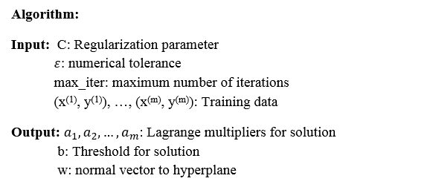
SMO decomposes the given problem into sub-problems.
Solve the smallest possible optimization problem at every step.
Smallest possible optimization problem involves two Lagrange multipliers.
At every step, SMO chooses two Lagrange multipliers to jointly optimize, finds the optimal values for these multipliers, and updates the SVM to reflect the new optimal values.

Slide 17
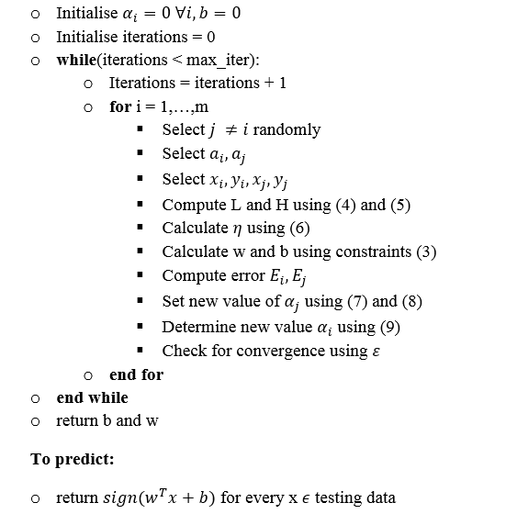

Slide 18
RESULTS
Implemented on both Normalized and unnormalized dataset.
The value of T is also varied from 1 to 100 in order to get improved result.
Iterations | Support Vectors | Mistakes | Precision | Recall | F1-Score | Accuracy | AUC
1 | 377 | 377 | 0.7474 | 0.7407 | 0.7312 | 0.7407 | 0.7147
2 | 705 | 705 | 0.7511 | 0.7497 | 0.7419 | 0.7497 | 0.7232
3 | 974 | 974 | 0.7778 | 0.7738 | 0.7687 | 0.7738 | 0.7539
4 | 1322 | 1322 | 0.7976 | 0.7918 | 0.7864 | 0.7918 | 0.7706
5 | 1589 | 1589 | 0.7800 | 0.7763 | 0.7711 | 0.7763 | 0.7578
10 | 2821 | 2821 | 0.8036 | 0.8094 | 0.8005 | 0.8034 | 0.7866
15 | 4203 | 4203 | 0.8124 | 0.8129 | 0.8115 | 0.8129 | 0.7994
20 | 5342 | 5342 | 0.8134 | 0.8139 | 0.8134 | 0.8139 | 0.8039
25 | 6133 | 6133 | 0.8286 | 0.8289 | 0.8288 | 0.8289 | 0.8212
50 | 12862 | 12862 | 0.8209 | 0.8209 | 0.8203 | 0.8209 | 0.8128
75 | 17842 | 17842 | 0.8428 | 0.8430 | 0.8418 | 0.8430 | 0.8316
100 | 24120 | 24120 | 0.8507 | 0.8510 | 0.2808 | 0.8510 | 0.8447
Results of Voted-Perceptron Algorithm on unnormalized training set

Slide 19
Iterations | Support Vectors | Mistakes | Precision | Recall | F1-Score | Accuracy | AUC
1 | 250 | 250 | 0.8606 | 0.8600 | 0.8599 | 0.8600 | 0.8545
2 | 436 | 436 | 0.8682 | 0.8681 | 0.8672 | 0.8681 | 0.8589
3 | 634 | 634 | 0.8646 | 0.8635 | 0.8635 | 0.8635 | 0.8583
4 | 792 | 792 | 0.8805 | 0.8806 | 0.8805 | 0.8806 | 0.8765
5 | 966 | 966 | 0.8989 | 0.8987 | 0.8985 | 0.8986 | 0.8941
10 | 1577 | 1577 | 0.9014 | 0.8996 | 0.9000 | 0.8997 | 0.9005
15 | 2151 | 2151 | 0.9052 | 0.9052 | 0.9051 | 0.9052 | 0.9021
20 | 2826 | 2826 | 0.9272 | 0.9267 | 0.9269 | 0.9767 | 0.9254
25 | 3220 | 3220 | 0.9348 | 0.9347 | 0.9347 | 0.9348 | 0.9323
50 | 5259 | 5259 | 0.9409 | 0.9407 | 0.9408 | 0.9408 | 0.9395
75 | 6611 | 6611 | 0.9405 | 0.9403 | 0.9404 | 0.9403 | 0.9390
100 | 7693 | 7693 | 0.9325 | 0.9320 | 0.9322 | 0.9323 | 0.9289
Results of Voted-Perceptron Algorithm on normalized training set
“Support Vectors” tell us the size of all instances on which the mistake has occurred during training.
The best accuracy is found to be 94.08% using 50 iterations.

Slide 20
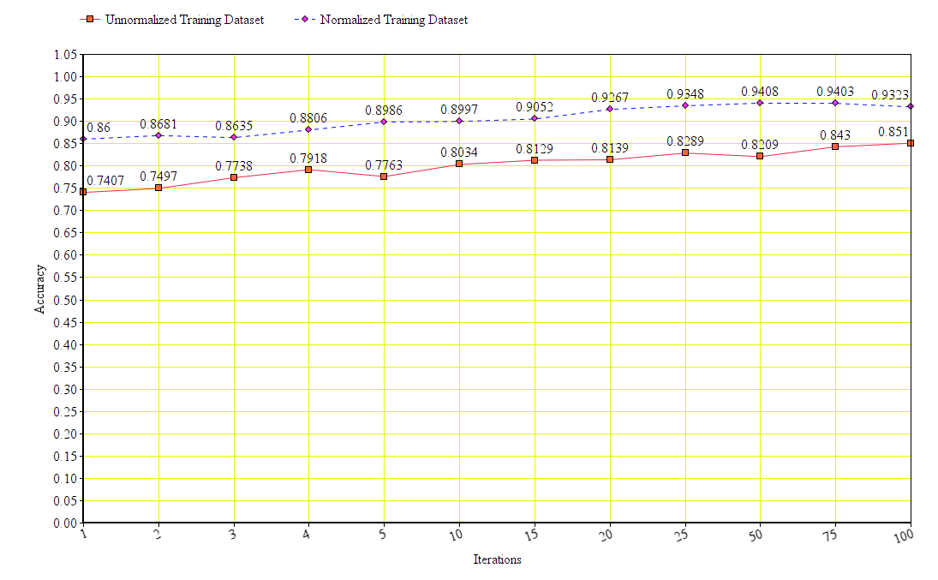
Figure 7. Plot illustrating result of voted-perceptron algorithm

Slide 21
Sequential Minimal Optimization:
The SVM has given an objective of predicting the CrimeStatus of a state.
Two different SVM’s are trained for this problem: a linear SVM and a quadratic SVM.
Sequential Minimization Algorithm is used to solve the SVM.
The results are obtained for different values of epsilon, C and iterations.

Slide 22
Kernel | Epsilon | C | Iterations | Precision | Recall | F1-Score | Accuracy | AUC
Linear | 0.01 | 0.1 | 1000 | 0.8530 | 0.8490 | 0.8498 | 0.8490 | 0.8513
Linear | 0.01 | 0.1 | 10000 | 0.8589 | 0.8570 | 0.8575 | 0.8570 | 0.8562
Linear | 0.01 | 1.0 | 1000 | 0.8642 | 0.8635 | 0.8637 | 0.8635 | 0.8623
Linear | 0.01 | 1.0 | 10000 | 0.8695 | 0.8660 | 0.8666 | 0.8660 | 0.8676
Linear | 0.001 | 0.1 | 1000 | 0.8565 | 0.8545 | 0.8550 | 0.8545 | 0.8543
Linear | 0.001 | 0.1 | 10000 | 0.8645 | 0.8640 | 0.8642 | 0.8640 | 0.8608
Linear | 0.001 | 1.0 | 1000 | 0.8572 | 0.8515 | 0.8524 | 0.8515 | 0.8554
Linear | 0.001 | 1.0 | 10000 | 0.8795 | 0.8786 | 0.8788 | 0.8786 | 0.8766
Quadratic | 0.01 | 0.1 | 1000 | 0.8729 | 0.8731 | 0.8724 | 0.8731 | 0.8641
Quadratic | 0.01 | 0.1 | 10000 | 0.8736 | 0.8736 | 0.8730 | 0.8736 | 0.8656
Quadratic | 0.01 | 1.0 | 1000 | 0.9168 | 0.9162 | 0.9157 | 0.9162 | 0.9088
Quadratic | 0.01 | 1.0 | 10000 | 0.9186 | 0.9167 | 0.9159 | 0.9167 | 0.9068
Quadratic | 0.001 | 0.1 | 1000 | 0.8755 | 0.8756 | 0.8753 | 0.8756 | 0.8702
Quadratic | 0.001 | 0.1 | 10000 | 0.8731 | 0.8731 | 0.8724 | 0.8731 | 0.8626
Quadratic | 0.001 | 1.0 | 1000 | 0.9248 | 0.9232 | 0.9226 | 0.9232 | 0.9149
Quadratic | 0.001 | 1.0 | 10000 | 0.9166 | 0.9152 | 0.9145 | 0.9152 | 0.9064
Results of SMO Algorithm on normalized training set

Slide 23
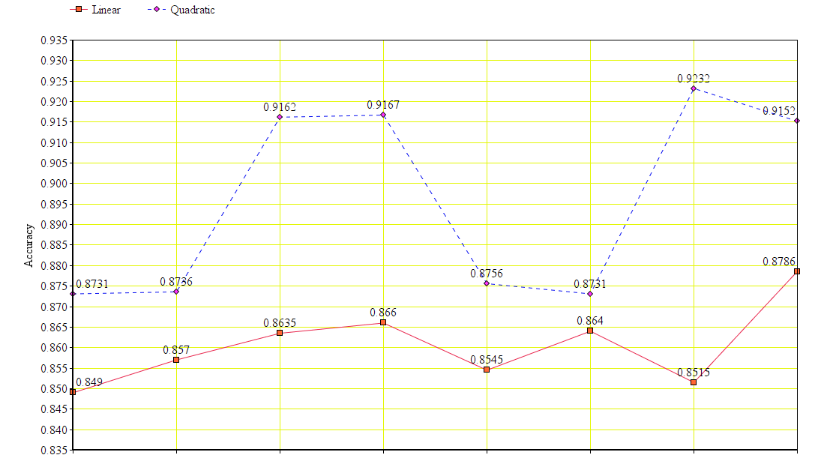
Figure 8.Results of SMO Algorithm on normalized training set

Slide 24
Comparison:
Evaluation of selected classification algorithms is conducted by comparing the precision, recall, accuracy and f1-score.
Algorithm | Precision | Recall | F1-Score | Accuracy | AUC
Naive Bayes | 0.8575 | 0.8539 | 0.8515 | 0.8539 | 0.8386
Logistic Regression | 0.8955 | 0.8954 | 0.8921 | 0.8954 | 0.8937
SVM using sklearn | 0.8030 | 0.8012 | 0.7959 | 0.7692 | 0.7955
K-means | 0.4567 | 0.4361 | 0.4384 | 0.4361 | 0.4415
K-means using sklearn | 0.4555 | 0.4377 | 0.4401 | 0.4377 | 0.4413
Voted-Perceptron | 0.9409 | 0.9407 | 0.9408 | 0.9408 | 0.9395
SMO Algorithm | 0.9248 | 0.9232 | 0.9226 | 0.9232 | 0.9149
Voted-perceptron algorithm gives the best classification results.

Slide 25
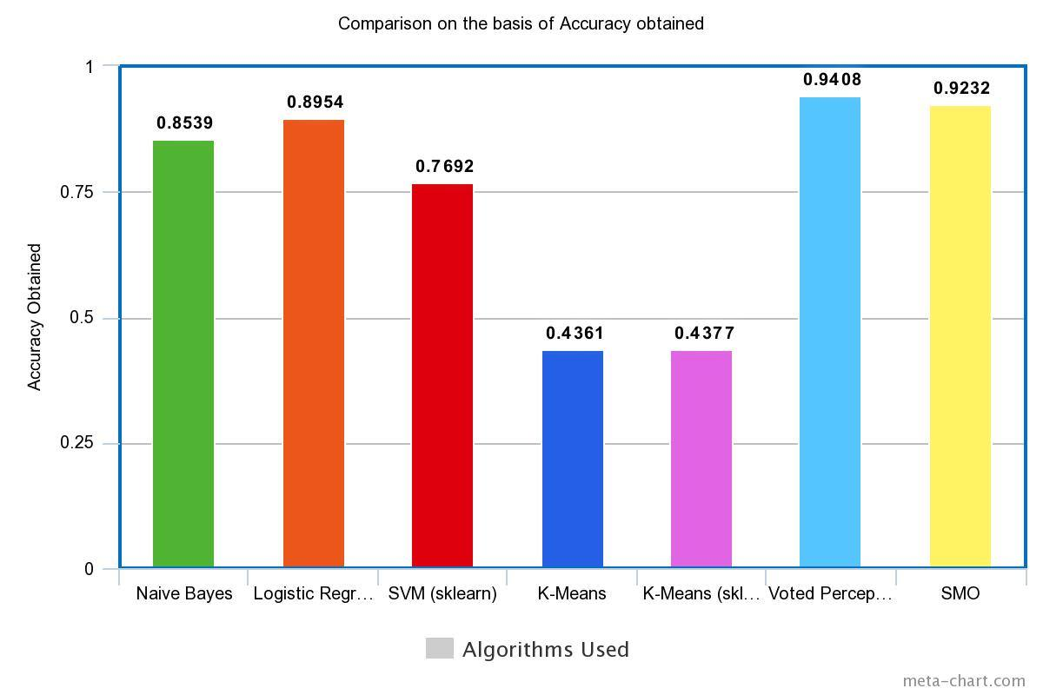
Figure 9. Plot illustrating comparison of classifiers on the basis of accuracy

Slide 26
CONCLUSION
The aim of this project was to perform classification of the given dataset into binary categories, “Critical” and “Non-Critical”.
In this project, Voted-Perceptron and Sequential Minimal Optimization algorithms are implemented.
The results are compared with different classifiers to determine more accurate classifier.
We have shown via results that Voter-perceptron Algorithm presents the best accuracy. From the experimental results, Voted-Perceptron with T = 100 gives the best performance followed closely by SMO Algorithm.
Based on the results, Voted-Perceptron and SMO are strong candidates for crime related classifications and better than K-means, Logistic Regression and Naïve Bayes.

Slide 27
FUTURE SCOPE
Due to the huge size of criminal activities data, the pattern detection and prediction of crime status is almost impossible for human investigators irrespective of their years of experience.
By using Classification Algorithms to increase the efficiency as well as precision, police department and investigators can allocate their time to other valuable tasks.
Predicting the crime-prone areas can also help in efficient distribution of police forces to reduce crime rate of a state.

Slide 28
REFERENCES
[1] Anna L. Buczak, Christopher M. Gifford, “Fuzzy Association Rule Mining for Community Crime Pattern Discovery”, In ACM SIGKDD Workshop on Intelligence and Security Informatics (ISIKDD '10), 2012.
[2] Chung-Hsien Yu, Max W. Ward, Melissa Morabito, Wei Ding, “Crime Forecasting Using Data Mining Techniques”, In Proceedings of the 2011 IEEE 11th International Conference on Data Mining Workshops (ICDMW '11), 2011
[3] Donald E. Brown, “The Regional Crime Analysis Program (RECAP): A Framework for Mining Data to Catch Criminals”, In Proceedings of the International Conference on Systems, Man, and Cybernetics, 1998.
[4] Shyam Varan Nath, “Crime Pattern Detection Using Data Mining”, In Proceedings of the International Conference on Web Intelligence and Intelligent Agent Technology, 2006.
[5] Hsinchun Chen, Wingyan Chung, Jennifer Jie Xu, Gang Wang, Yi Qin, Michael Chau, “Crime Data Mining: A General Framework and Some Examples”, Computer, IEEE Computer Society Press, 2004.
[6] John C. Platt, “A Fast Algorithm for Training Support Vector Machines”, Appeared in Kernel Methods of Support Vector Learning, MIT Press, 1998.
[7] Freund, Y. and Schapire R. E. “Large Margin Classification Using Perceptron Algorithm”, Machine Learning, 1998.
[8] Rosenblatt, “The Perceptron: A Probabilistic Model for information storage and organization on brain”, Psychological Review, MIT Press, 1998.
[9] Christopher J.C. Burges, "A Tutorial on Support Vector Machines for Pattern Recognition," Appeared in Data Mining and Knowledge Discovery 2, 121-167, 1998
[10] UCI Machine Learning Repository, http://archive.ics.uci.edu/ml/datasets/Communities+and+Crime+Unnormalized#

Slide 29


