Slide 1
Java Collection Framework

Slide 2
Framework
Interfaces (ADT, Abstract Data Types)
Implementations (of ADT)
Algorithms (sort)
Java.util.*
Java 5 released!
Lots of changes about collections

Slide 3
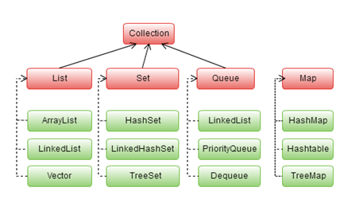
Interfaces Design

Slide 4
Collection interface
int size()
boolean isEmpty()
boolean contains(Object element)
boolean containsAll(Collection c)
boolean add(Object element)
boolean addAll(Collection c)
boolean remove(Object element)
boolean removeAll(Collection c)
void clear()
Object[] toArray()
Iterator iterator()

Slide 5
Java ArrayList class
Java ArrayList class uses a dynamic array for storing the elements. It inherits AbstractList class and implements List interface.
The important points about Java ArrayList class are:
Java ArrayList class can contain duplicate elements.
Java ArrayList class maintains insertion order.
Java ArrayList class is non synchronized.
Java ArrayList allows random access because array works at the index basis.
In Java ArrayList class, manipulation is slow because a lot of shifting needs to occur if any element is removed from the array list.

Slide 6
Why ArrayList is better than Array?
The limitation with array is that it has a fixed length so if it is full you cannot add any more elements to it, likewise if there are number of elements gets removed from it the memory consumption would be the same as it doesn’t shrink.
On the other ArrayList can dynamically grow and shrink after addition and removal of elements (See the images below). Apart from these benefits ArrayList class enables us to use predefined methods of it which makes our task easy. Let’s see the diagrams to understand the addition and removal of elements from ArrayList and then we will see the programs.

Slide 7
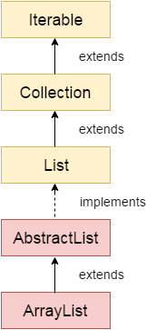
ArrayList Hierarchy

Slide 8
Constructors of Java ArrayList
Constructor | Description
ArrayList() | It is used to build an empty array list.
ArrayList(Collection<? extends E> c) | It is used to build an array list that is initialized with the elements of the collection c.
ArrayList(int capacity) | It is used to build an array list that has the specified initial capacity.

Slide 9
Java ArrayList Example
import java.util.*;
class ArrayList1{
public static void main(String args[]){
ArrayList<String> list=new ArrayList<String>();//Creating arraylist
list.add("Ravi");//Adding object in arraylist
list.add("Vijay");
list.add("Ravi");
list.add("Ajay");
//Invoking arraylist object
System.out.println(list);
}
}
}
O/p: [Ravi, Vijay, Ravi, Ajay]

Slide 10
Ways to iterate the elements of the collection in java
There are various ways to traverse the collection elements:
By Iterator interface.
By for-each loop.
By ListIterator interface.
By for loop.
By forEach() method.
By forEachRemaining() method.

Slide 11
Sorting
Sort ArrayList
Sort ArrayList in Descending order
Sort ArrayList of Objects using Comparable and Comparator

Slide 12
Add/Remove
Add element to ArrayList
Add element at particular index of ArrayList
Append Collection elements to ArrayList
Copy All List elements to ArrayList
Insert all the collection elements to the specified position in ArrayList
Remove element from the specified index in ArrayList
Remove specified element from ArrayList

Slide 13
Get/Search
Get Sub List of ArrayList
Get the index of last occurrence of the element in the ArrayList
Get element from ArrayList
Get the index of first occurrence of the element in the ArrayList
Check whether element exists in ArrayList

Slide 14
Other Tutorials on ArrayList
Compare two ArrayList
Synchronize ArrayList
Swap two elements in ArrayList
Override toString() method – ArrayList
Serialize ArrayList
Join two ArrayList
Clone ArrayList to another ArrayList
Make ArrayList Empty
Check whether ArrayList is empty or not
Trim the Size of ArrayList
Replace the value of existing element in ArrayList
Increase the capacity(size) of ArrayList

Slide 15
Conversions:
Convert LinkedList to ArrayList
Convert Vector to ArrayList
Convert ArrayList to String Array
Convert Array to ArrayList
Convert HashSet to ArrayList

Slide 16
Differences:
ArrayList vs Vector
ArrayList vs HashMap
ArrayList vs LinkedList

Slide 17
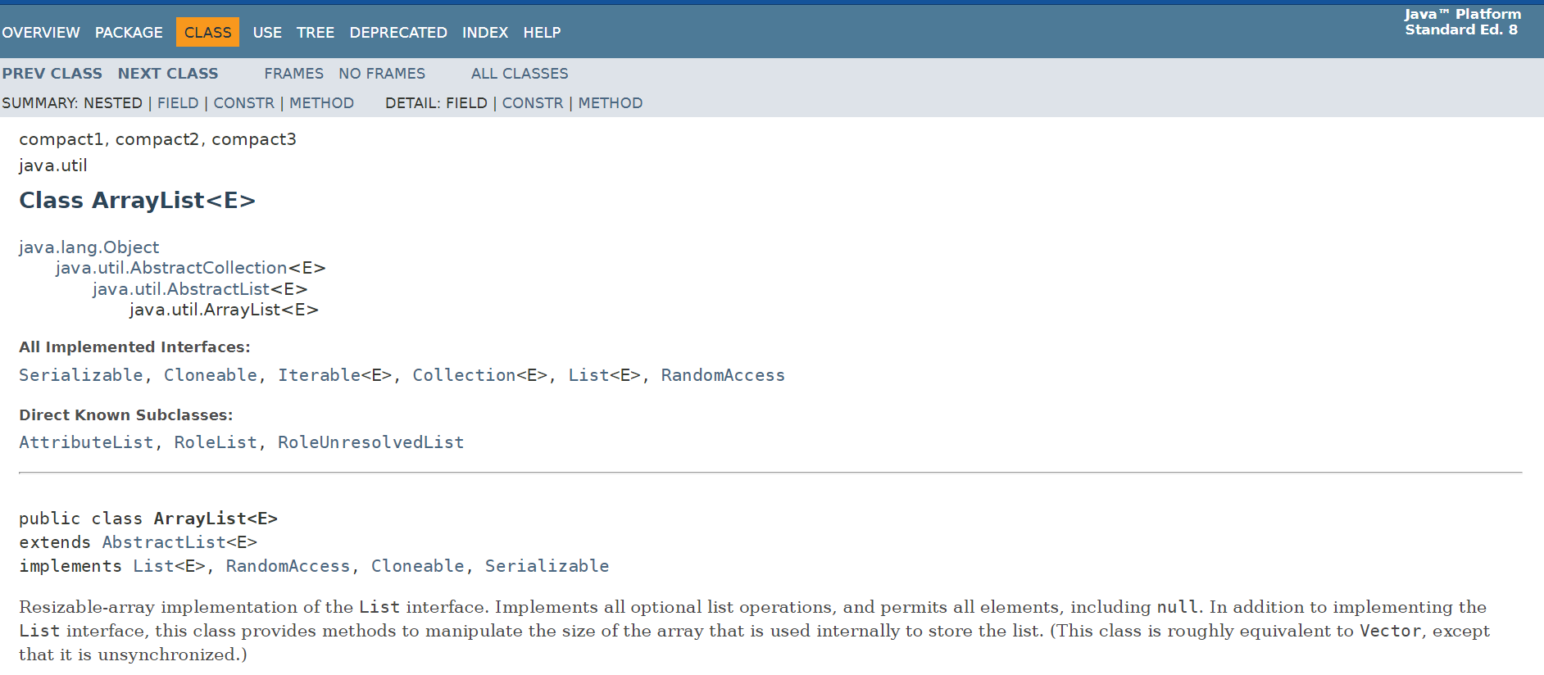
Reference
ArrayList Java 8 Documentation

Slide 18
Other topics with example
Java Non-generic Vs. Generic Collection
Methods of Java ArrayList
How ArrayList increase capacity increase?
User-defined class objects in Java ArrayList
Java ArrayList Serialization and Deserialization Example
How to Use an Iterator ?
One mini Core-Java project using ArrayList

Slide 19
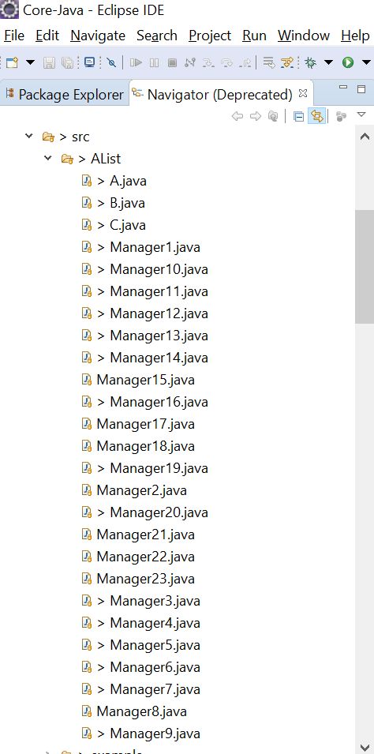
There will be lab for all the above concepts

Slide 20
To be continued with all classes in collections..

