Slide 1

Accelerating Data Science with
Apache SystemML
Presented by:
Niketan Pansare
IBM Research - Almaden
npansar@us.ibm.com
http://systemml.apache.org/
November 2016
Notes:
IBM Insight 2014

Slide 2

What is SystemML (in a nutshell)
Provides a R-like language (DML) for data scientists to implement machine learning algorithms

Slide 3
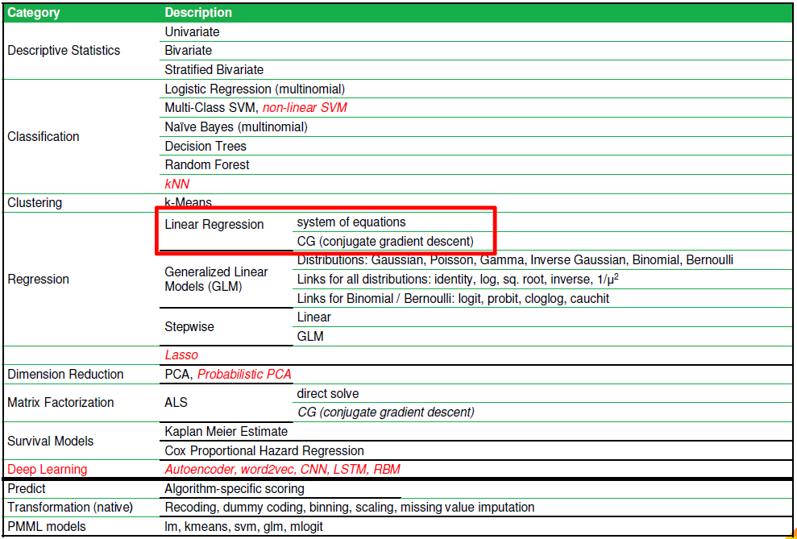
What is SystemML (in a nutshell)
Provides a R-like language (DML) for data scientists to implement machine learning algorithms
  Also comes with approx. 20+ algorithms pre-implemented

Slide 4





What is SystemML (in a nutshell)
Provides a R-like language (DML) for data scientists to implement machine learning algorithms
Compiles execution plans ranging from single node (scale up) to clusters (scale out on data parallel platforms MapReduce, Spark)
DML Scripts
Language
Compiler
Runtime
In-Memory Single Node
(scale-up)
Hadoop or Spark Cluster
(scale-out)

Slide 5
What is SystemML (in a nutshell)
Provides a R-like language (DML) for data scientists to implement machine learning algorithms
Compiles execution plans ranging from single node (scale up) to clusters (scale out on data parallel platforms MapReduce, Spark)
Runs in embeddable, standalone, and cluster (hybrid)
Supports various APIs (Scala/Python/Java)

Slide 6
Invoking SystemML
Data on disk/HDFS
  In-memory single node
Java Command Line:
java -cp SystemML.jar org.apache.sysml.api.DMLScript \
–f LinearRegCG.dml –exec singlenode –nvargs X=X.mtx Y=Y.mtx B=B.mtx
java -cp systemml-0.10.0-incubating-standalone.jar org.apache.sysml.api.DMLScript \
–f LinearRegCG.dml –nvargs X=X.mtx Y=Y.mtx B=B.mtx
(Latter command preserves rewrites, but may spawn local MR jobs)

Slide 7
Invoking SystemML
Data on disk
  In-memory single node
  Hadoop
Hadoop Command Line:
hadoop jar SystemML.jar \
–f LinearRegCG.dml –exec hybrid –nvargs X=X.mtx Y=Y.mtx B=B.mtx

Slide 8
Invoking SystemML
Data on disk
  In-memory single node
  Hadoop
  Spark
Spark Command Line:
./spark-submit --master yarn-client SystemML.jar \
–f LinearRegCG.dml –nvargs X=X.mtx Y=Y.mtx B=B.mtx

Slide 9
Invoking SystemML
Data on disk
  In-memory single node
  Hadoop
  Spark
RDD/Dataframe
  Also, Python MLContext API
Spark MLContext Scala API:
./spark-shell --jars SystemML.jar
import org.apache.sysml.api.mlcontext._
import org.apache.sysml.api.mlcontext.ScriptFactory._
val ml = new MLContext(sc)
val X = // ... RDD, DataFrame, etc.
val script = dmlFromFile("LinearRegCG.dml").in("X", X)
.in(...).out("B")
val b = ml.execute(script).getDataFrame("B")

Slide 10
Invoking SystemML
Data on disk
  In-memory single node
  Hadoop
  Spark
RDD/Dataframe
  Also, Python MLContext API
double [] []
  JMLC API
  https://apache.github.io/incubator-systemml/jmlc
  Especially useful for scoring and embeddable application

Slide 11
DEMO
Link: https://github.com/niketanpansare/future_of_data

Slide 12
Ongoing/Future Work
Usability / Applications:
  Add Deep Learning primitives (SYSTEMML-540)
  Embedded Scala/Python/R DSL with sufficient optimization scope (SYSTEMML-451)
Optimizer:
  Cost-model enhancement (SYSTEMML-416)
  Global program optimization (SYSTEMML-421)
  Source code generation for automatic operator fusion (SYSTEMML-448)
Runtime:
  Add GPU backend (SYSTEMML-445) => CUDA / OpenCL
  Frame support / Sparse block representation
  Integrate Apache Flink as additional backend for SystemML (SYSTEMML-636 / PR-119)
  NUMA-aware single node backend (SYSTEMML-406)

Slide 13
Thank You

