Slide 1
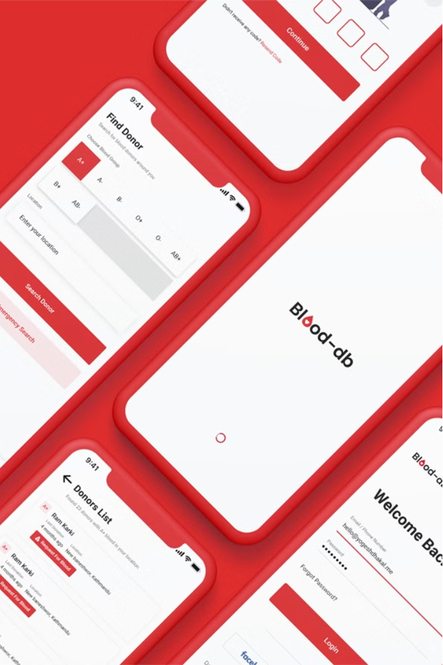


Plasma Pulse Blood Bank Platform
Revolutionizing Blood Availability through Innovation and Technology
vd
by varun teja dharmavarapu

Slide 2
Empowering Blood Availability
Mission
Team
To make blood available to everyone from anywhere through an online platform.
Varun (Project Lead), Satya, Thoshik, Niketh, Geethika.
Objective
Impact
Provide an overview of the Plasma Pulse Blood Bank platform.
Save lives by facilitating blood donation and improving access to blood.

Slide 3
AI-Driven Decision Support
Data Collection
Decision Support
Gather data from various sources to power the platform.
Provide actionable insights to optimize blood bank operations.
1
2
3
Data Processing
Analyze the collected data using advanced algorithms.

Slide 4
Advantages of Plasma Pulse
Accessibility
Efficiency
Transparency
Access blood donation services from anywhere.
Automate processes like appointment scheduling and inventory management.
Real-time inventory updates for donors and hospitals.

Slide 5

Enhancing User Experience
1
Intuitive Interface
2
Easy Navigation
Ensure a seamless and user-friendly experience.
Provide clear and intuitive pathways for users.
3
Clear Communication
Deliver concise and informative messaging.

Slide 6
Key Features
Online Donor Registration
Appointment Scheduling
Allow users to easily sign up as blood donors.
Streamline the donation process with online booking.
Donor Eligibility Criteria
Donor Rewards Program
Ensure donors meet the necessary requirements.
Incentivize and recognize regular blood donors.

Slide 7




Dashboards for All
Donor
Admin
Hospital
Staff
Manage personal donation history and schedule.
Monitor inventory, reporting, and analytics.
Request blood and view real-time inventory.
Coordinate donation events and manage volunteers.

Slide 8
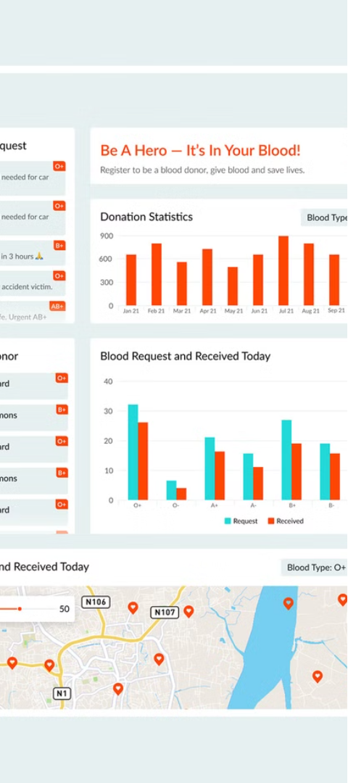
Empowering Blood Inventory Management
1
Blood Inventory Overview
Monitor the status of available blood units.
2
Inflow and Outflow Tracking
Visualize the movement of blood units in and out.
3
Reporting and Analytics
Generate insightful reports to drive informed decisions.

Slide 9



Streamlining Hospital Workflows
Blood Request Form
Real-Time Inventory Updates
Expedited Fulfillment
Hospitals can easily submit blood requests online.
Hospitals can view available blood units in real-time.
Blood requests are processed and fulfilled efficiently.

Slide 10
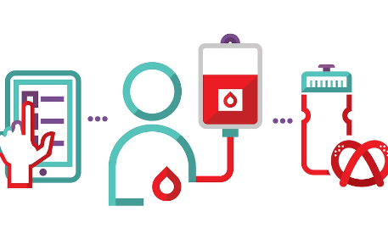


The Future of Blood Availability
Ongoing Development
Commitment to Impact
Building a Movement
The Plasma Pulse platform is currently in the testing phase, with plans for full deployment.
The team is dedicated to leveraging technology and AI to save lives and improve access to blood.
By empowering donors and hospitals, the platform aims to create a sustainable blood donation ecosystem.

