Slide 1

Niket Jethva – 19IT5015 Nimitt Patel – 19IT5014 Chirag Mali – 19IT5016
The
Jumping Man

Slide 2
Introduction
Jumping Man is a desktop game using pygame which is a set of Python modules designed for writing video games.
This allows you to create fully featured games and multimedia programs in the python language.
Jump Man is an GUI implemented game.
the player has to jump over the objects to finish the game.

Slide 3
Features
Easily implemented using Pythons extensive library.
Pygame Implementation .
Less Disk space Required.

Slide 4

Integrated Development Environment
PYCHARM
Pycharm provides code analysis, a graphical debugger, an integrated unit tester, integration with version control systems , and supports web development with Django as well as Data Science with Anaconda.
PyCharm is cross-platform, with Windows, macOS and Linux versions. The Community Edition is released under the Apache License, and there is also Professional Edition with extra features – released under a proprietary license.

Slide 5
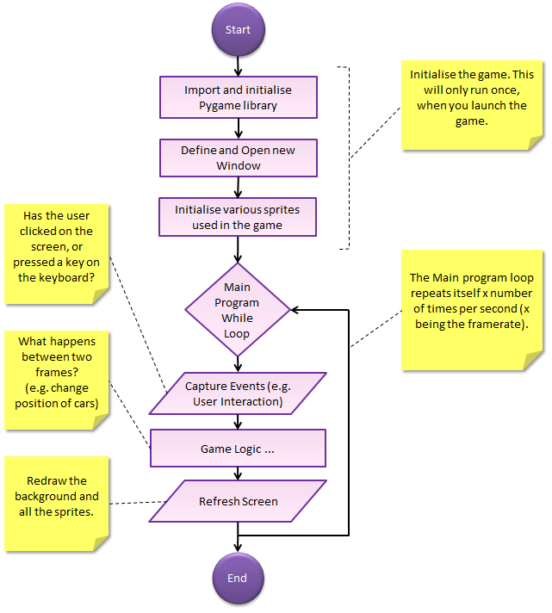

Slide 6
Pygame Functions
pygame.init()
pygame.display.set_mode()
pygame.display.set_caption()
pygame.display.update()
Time.sleep()
pygame.key
pygame.transform()
pygame.image()

Slide 7
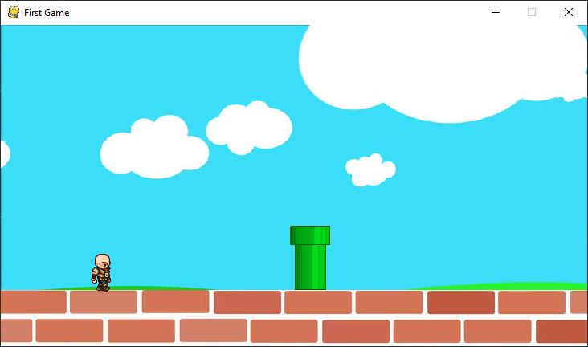
Project Status

Slide 8
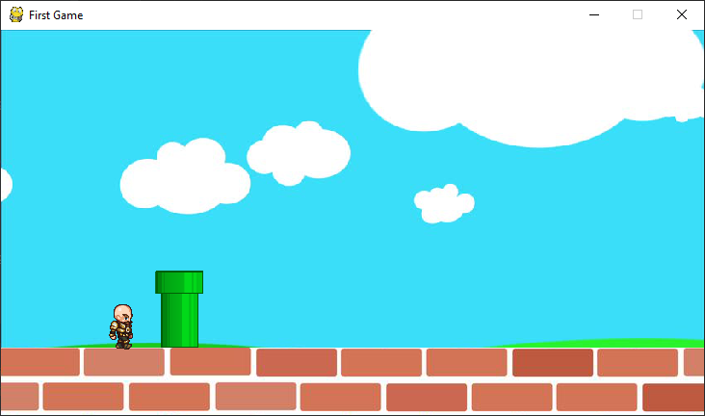

Slide 9
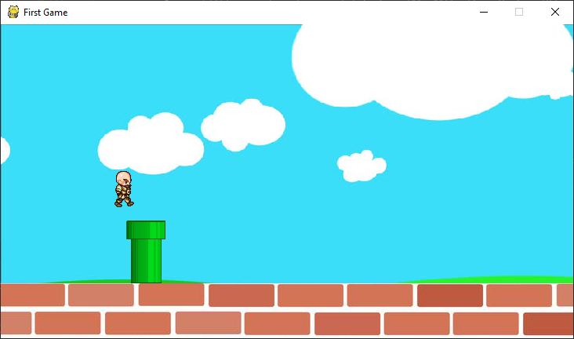

Slide 10
Challenges Faced
Finding different Image of same character.
Image Transformation .
Jump the Character .
Checking the Collisions .

Slide 11
Thank You..

