Slide 1
CS542: Link State Routing Protocol Simulation
Team Members:
1) Patel Niket Bhogilal (A20384264)
2) Patel Purvank Dhimantkumar (A20380792)

Slide 2
Introduction:
Finding the shortest between two routers in a computer network is a common problem. There are mainly two techniques to find a shortest path between two routers in a network: 1) Link State Routing 2) Distance Vector Routing.
Link State Routing:
Link State Routing Protocol is one of the main protocols in routing protocols. It is used in packet switching techniques for data communications.
In Link State Routing, each node in the network has the entire topology of the domain, it includes list of nodes and links, and how they are connected, including costs and condition of links.
The node in a domain can use Dijkstra’s Algorithm to find a shortest path to all other nodes in a topology.

Slide 3
Dijkstra’s Algorithm:
A Dijkstra’s Algorithm is used to create a shortest path tree using the knowledge of whole topology.
The algorithm divided nodes into two groups: 1) Tentative nodes 2) Permanent Nodes
It finds the neighbour of the current node, makes them tentative. After that it examines them, if they pass certain criteria, it makes them permanent.
The nodes create a routing table based on the shortest path tree generated by the Dijkstra’s Algorithm.

Slide 4
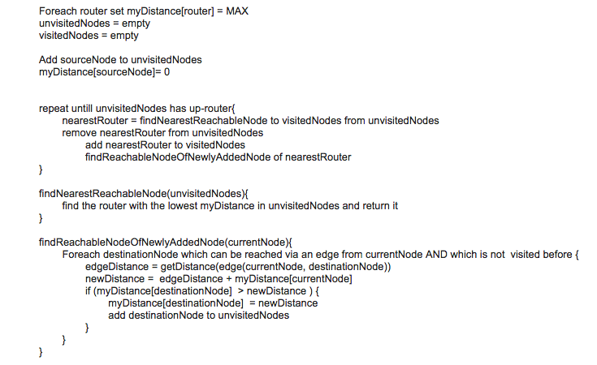
Pseudo Code of Dijkstra’s Algorithm:

Slide 5
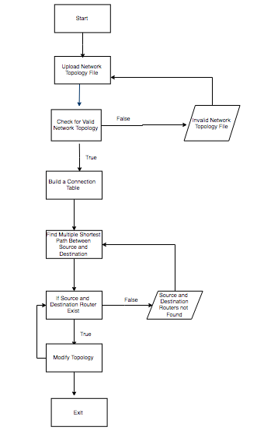
Flow Diagram

Slide 6
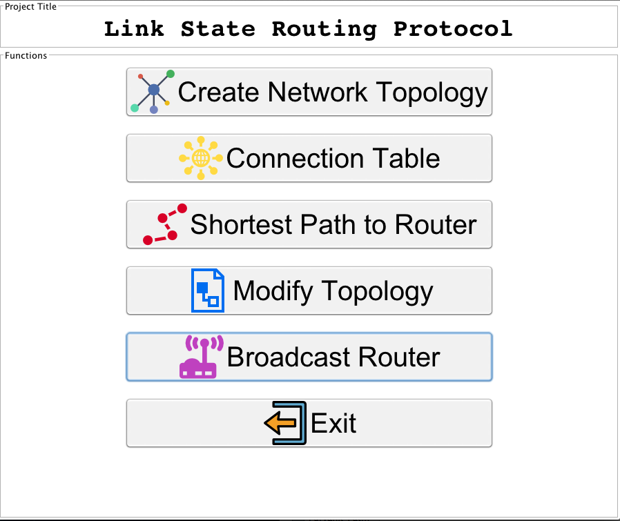
Welcome screen

Slide 7
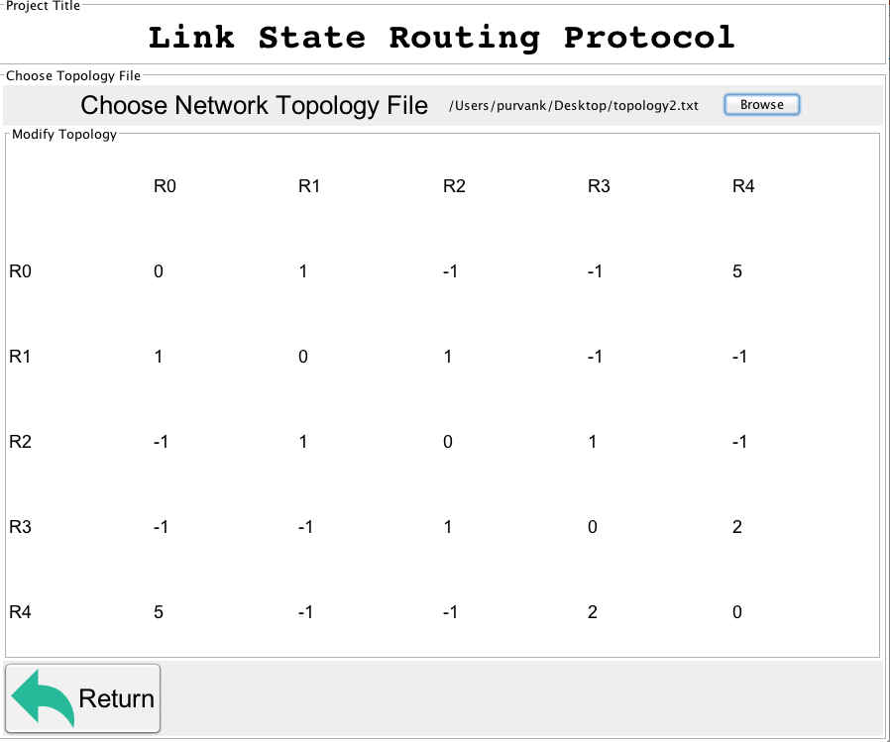
Create Network Topology

Slide 8
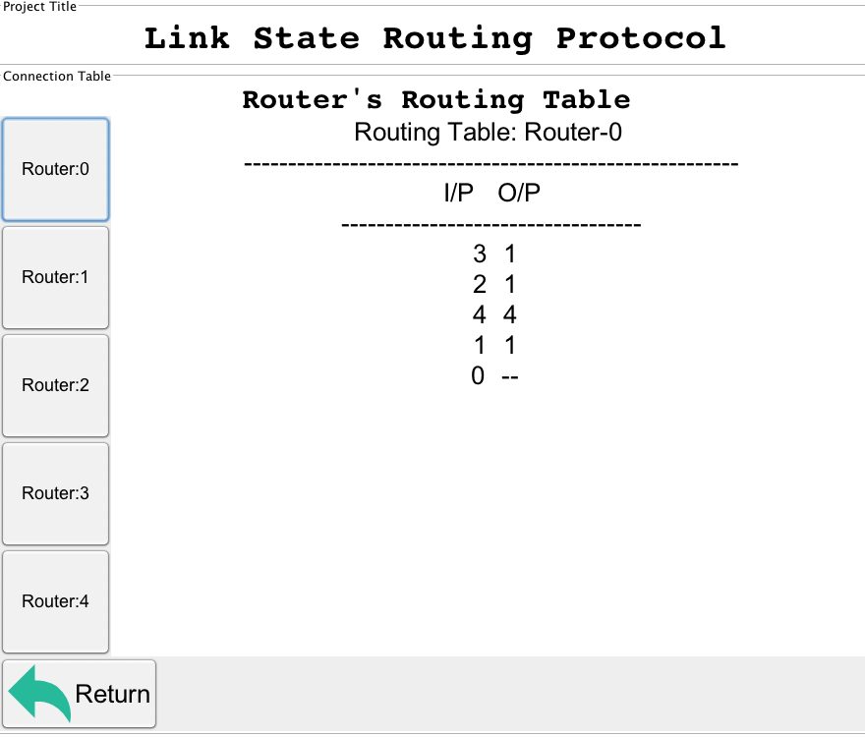
Connection Table

Slide 9
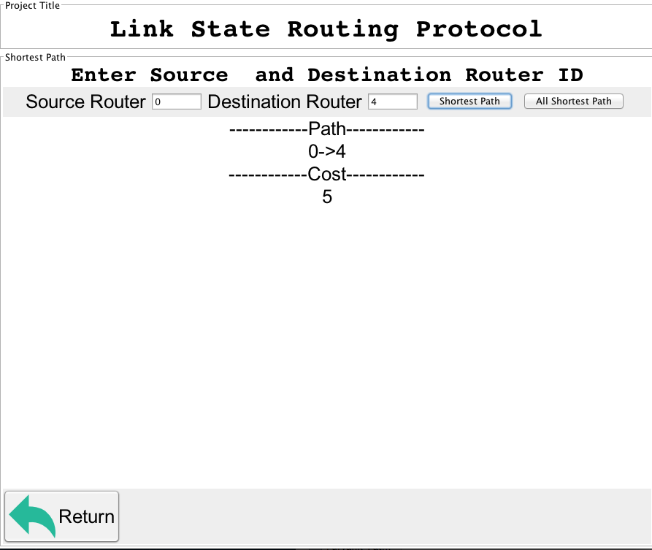
Shortest Path Between Source and Destination

Slide 10
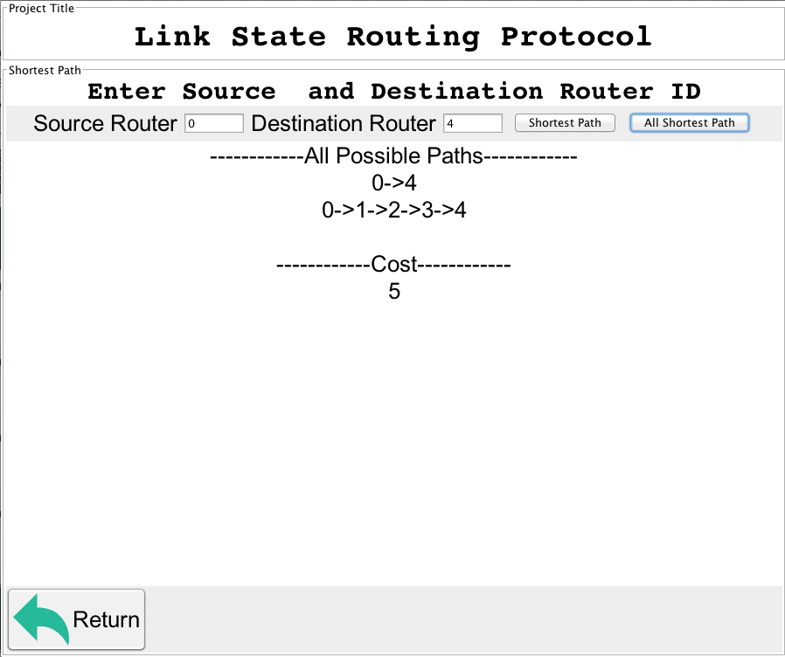
All Shortest Paths from Source to Destination

Slide 11
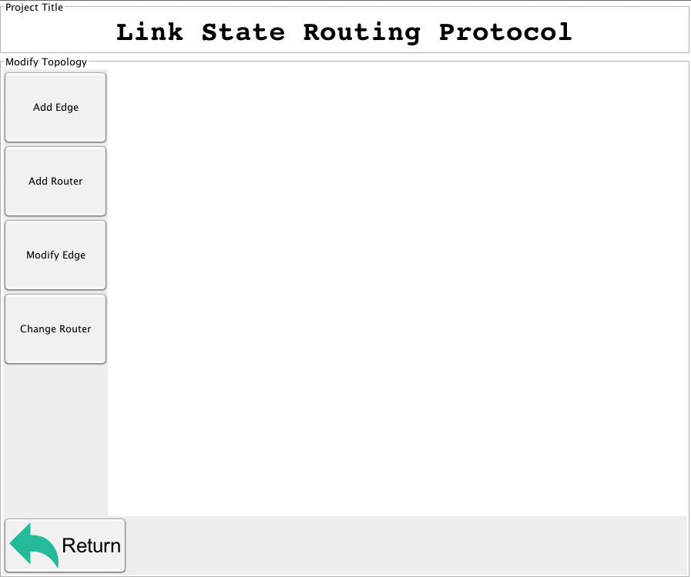
Modify Topology

Slide 12
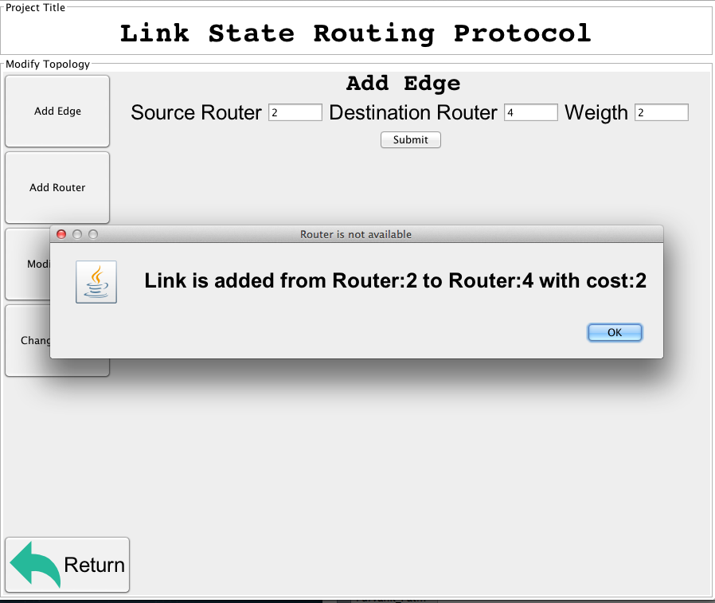
Modify Topology (Add Edge)

Slide 13
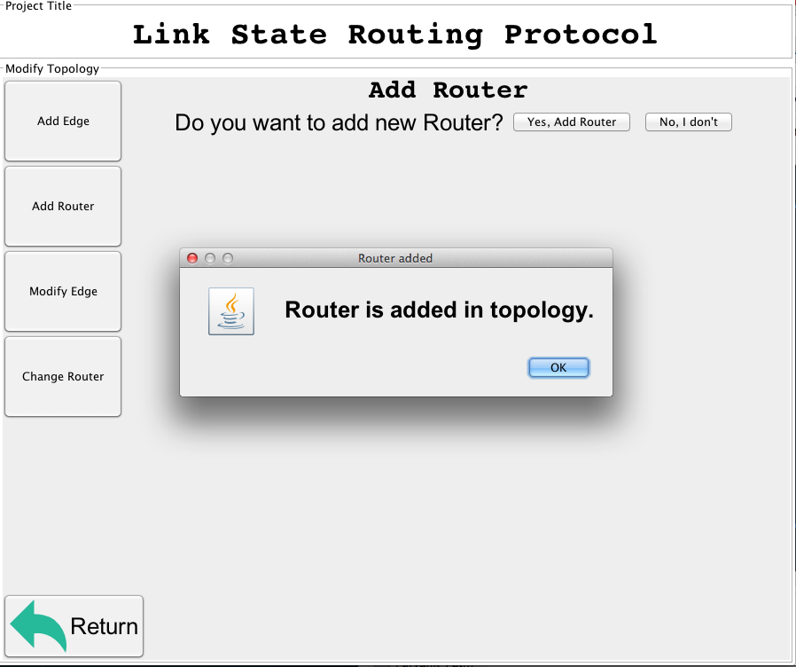
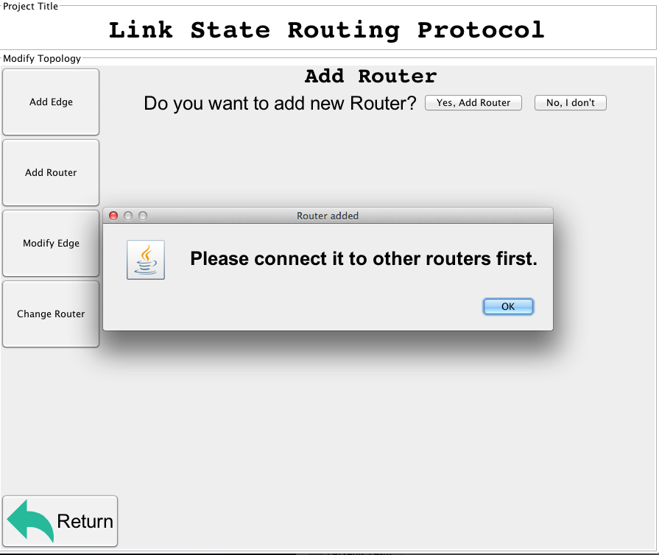
Modify Topology (Add Router)

Slide 14
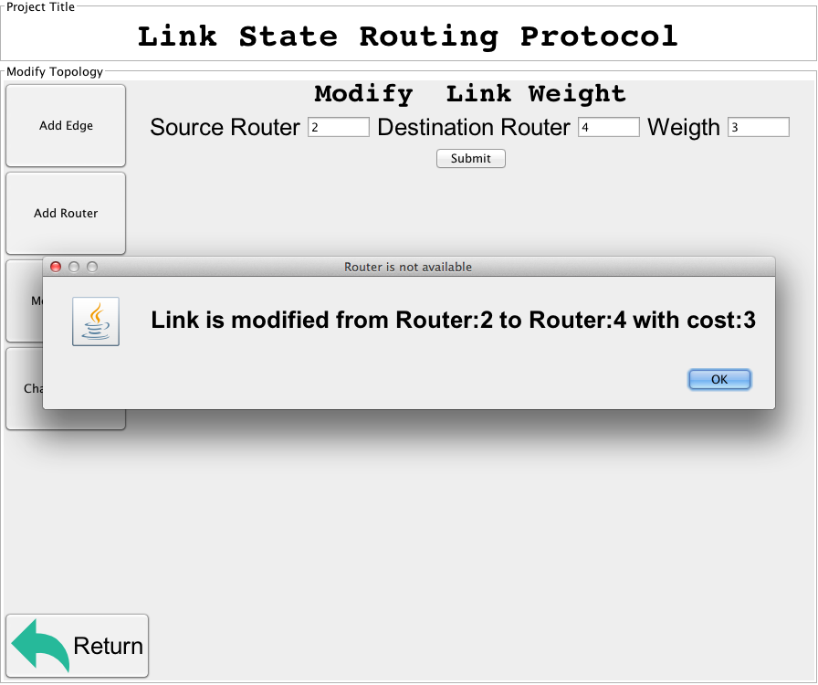
Modify Topology (modify link weight)

Slide 15
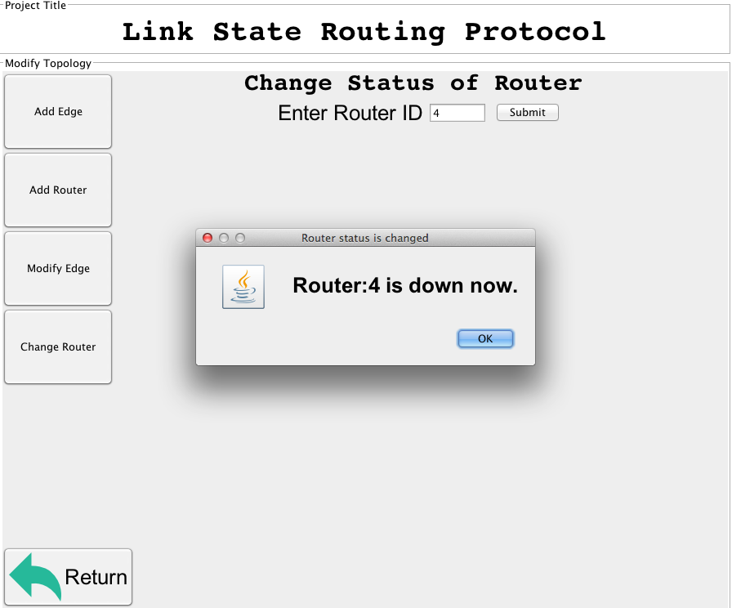
Modify Topology (Change Router Status up/down)

Slide 16
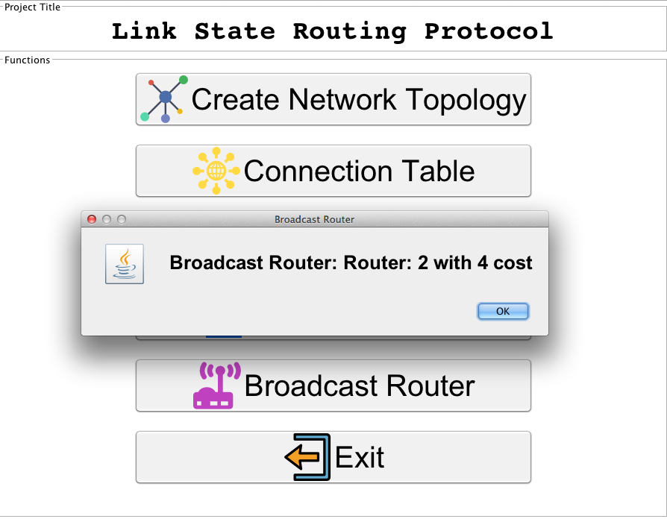
Broadcast Router

Slide 17
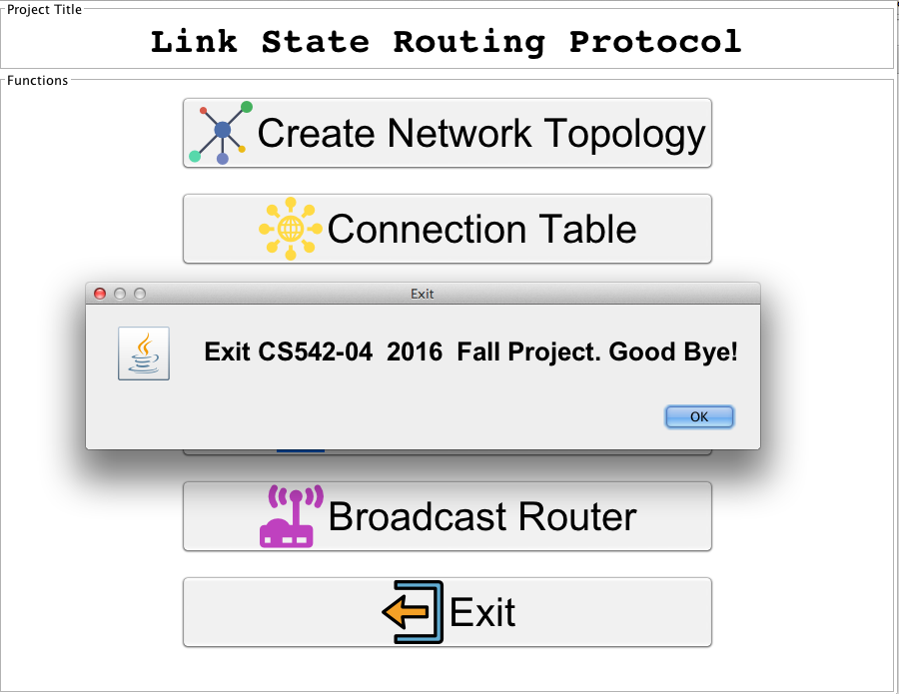
Exit

Slide 18
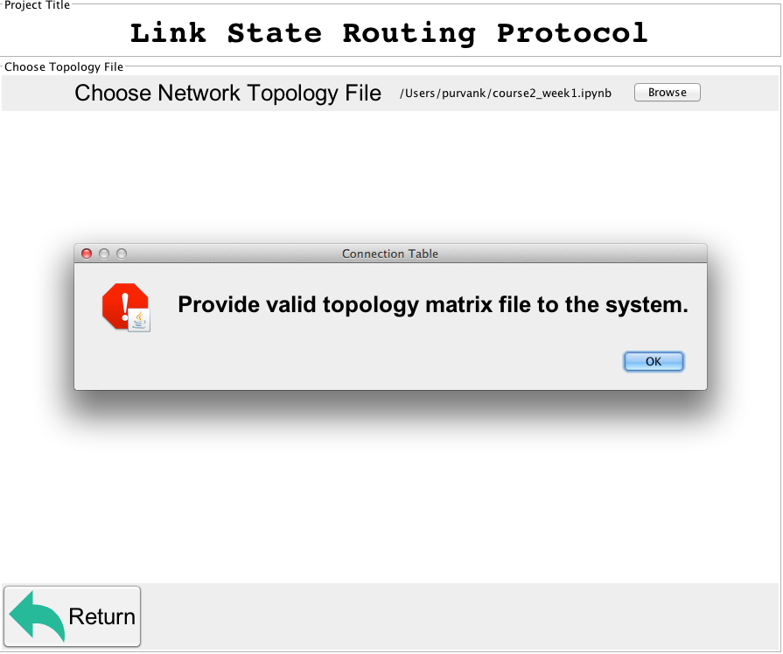
Validation (Invalid file)

Slide 19
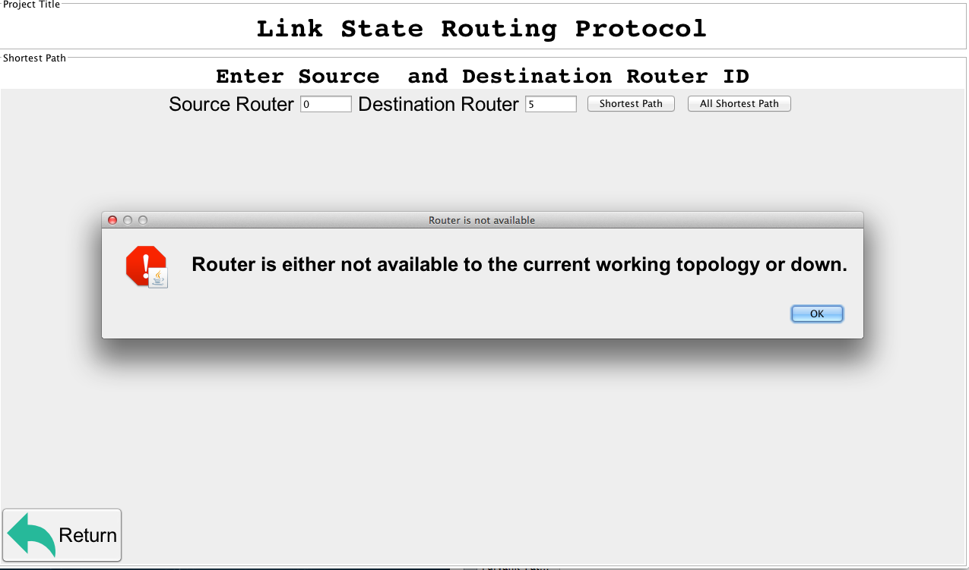
Validation

Slide 20
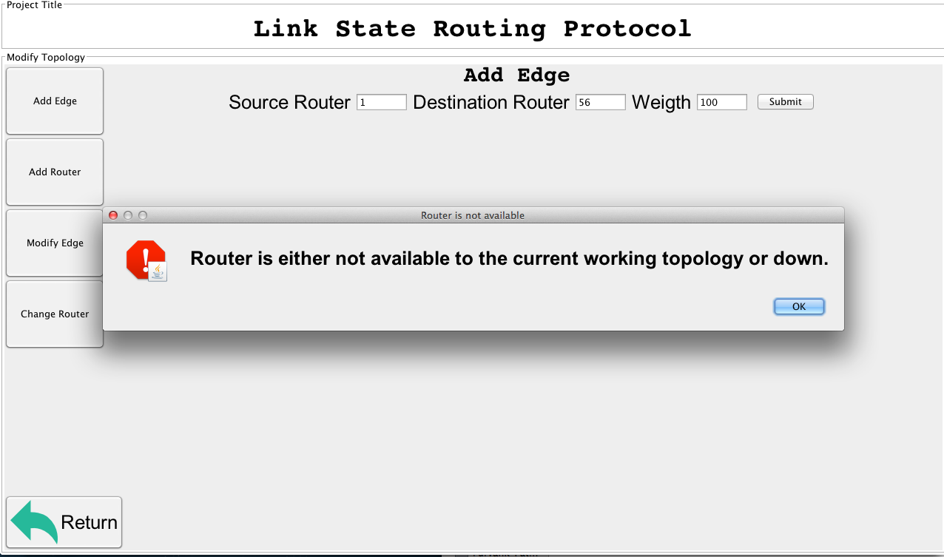
Validation

Slide 21
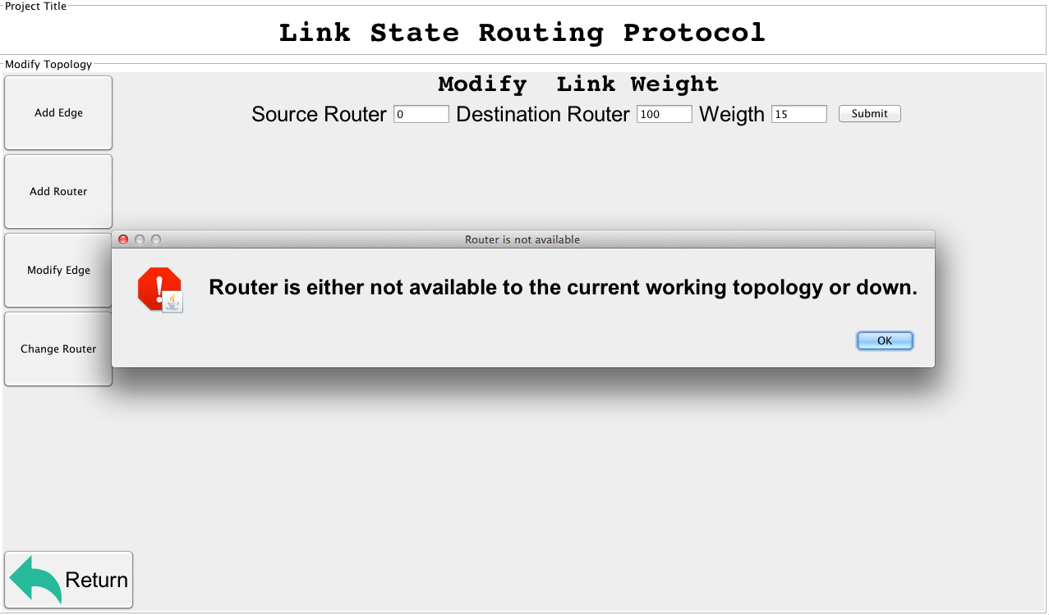
Validation

Slide 22
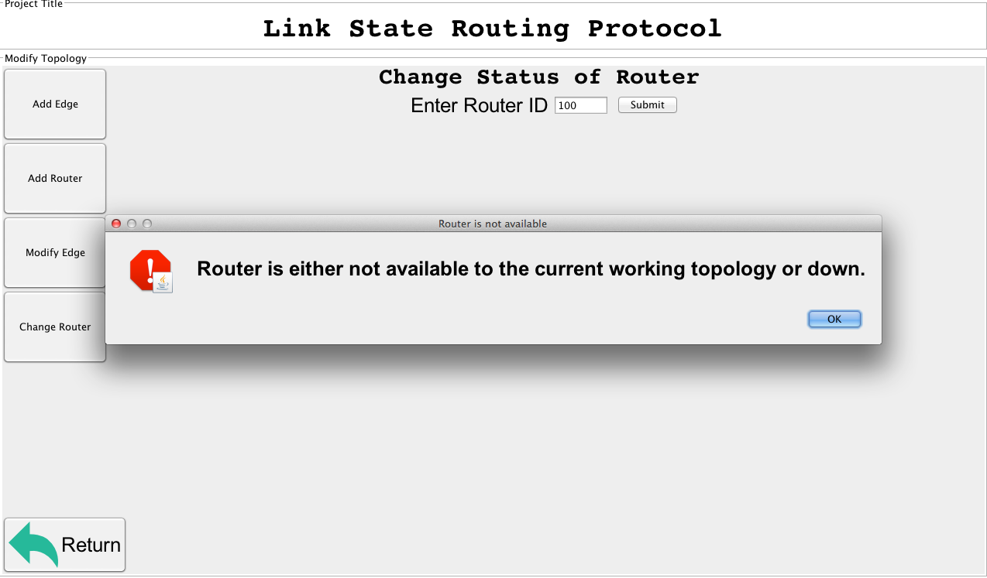
Validation:

Slide 23
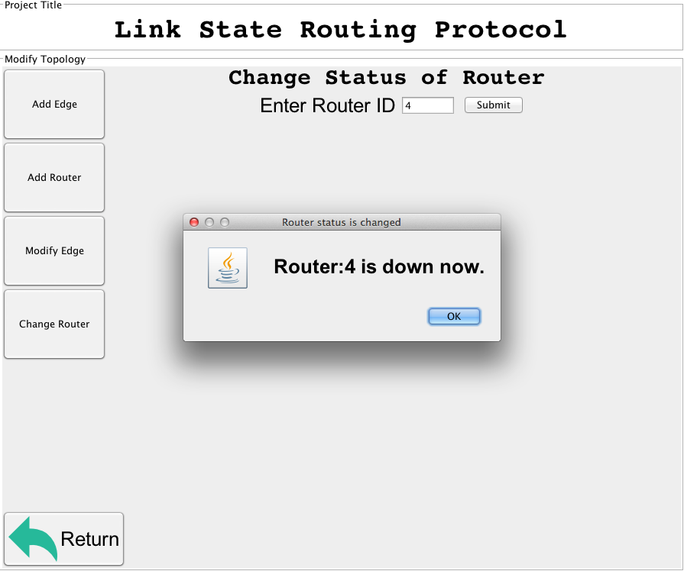
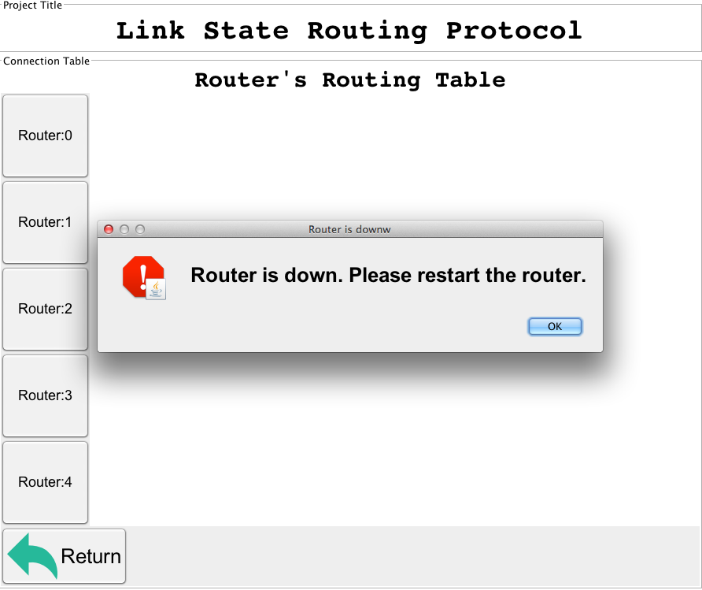
Validation

Slide 24
Additional Features:
If there are multiple shortest path available between source and router with same cost, the algorithm will find all of them.
User can add a new router in a network topology.
User can add an edge between two routers in a network topology.
User can change the status of the router in a network topology, that is user can remove/down the router or user can up the already down router.
Full GUI is implemented to help the user to simulate the link state routing algorithm.

Slide 25
References:
Data Communication and Networking 4th Edition by Behrouz A. Forouzan.
Wikipedia: Link State Routing.

Slide 26
Thank You.

