Slide 1
Lexical Analyzer For HTML
Team Members :-
Niket Raj 1PI13CS100
Mukesh G 1PI13CS093
Aizaz 1PI13CS089
Sharath S 1PI13CS140

Slide 2
INTRODUCTION
Lexical analysis is the process of converting a sequence of characters (such as in a computer program or web page) into a sequence of tokens (strings with an identified "meaning").
A program that performs lexical analysis may be called a Lexical Analyzer.

Slide 3
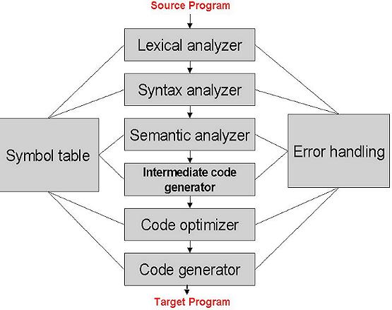
Lexical Analyzer within a Compiler

Slide 4
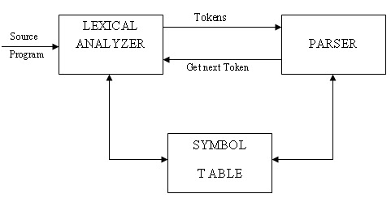
Lexer Parser Interaction

Slide 5
Lexical Analyzer for html
Input : A HTML code or file
Output : sequence of tokens
Read input file
Identify HTML tags and attributes
Count line numbers
Remove whitespaces

Slide 6
What is a token?
Defined by the programming language
Can be separated by spaces
All the basic elements in a language must be tokens so that they can be recognized
A lexeme is a particular instant of a token.

Slide 7
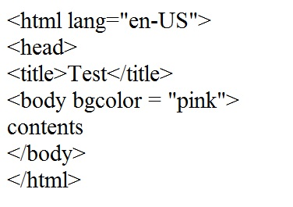
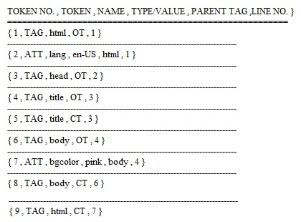
HTML code =====➔ Tokens

Slide 8
Panic Mode Recovery
When lexer detects an error when it discovers that an input's prefix does not fit the specification of any token class known as Panic Mode.
The simplest possible panic mode recovery is to skip the erroneous characters until the lexical analyzer finds another token. But this is likely to cause the parser to read a deletion error, which can cause severe difficulties in the syntax analysis and remaining phases. One way the parser can help the lexical analyzer can improve its ability to recover from errors is to make its list of legitimate tokens (in the current context) available to the error recovery routine. The error-recovery routine can then decide whether a remaining input's prefix matches one of these tokens closely enough to be treated as that token.

Slide 9
THANK YOU…

