Slide 1
Дигитална собственост и онлайн икономика в Web3
Реферат по дисциплина „Web Технологии“

Slide 2
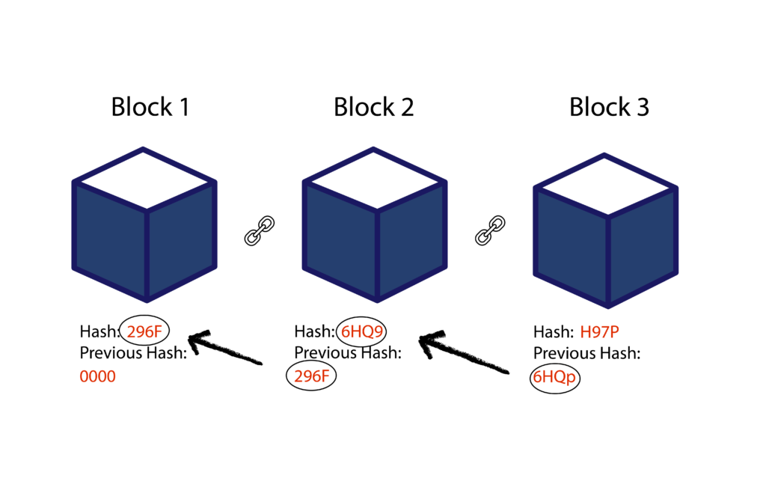
Web3: Блокчейн

Slide 3
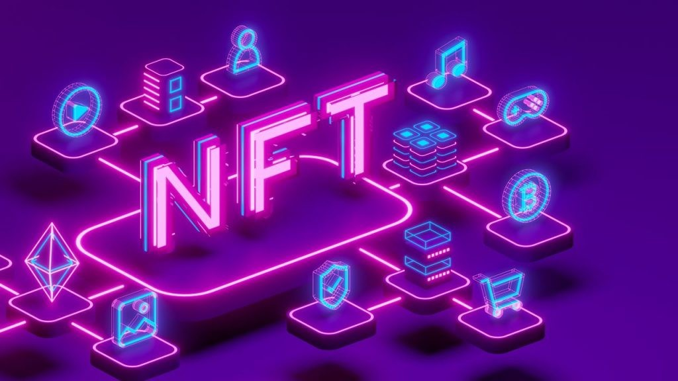
Web3: Механизми

Slide 4
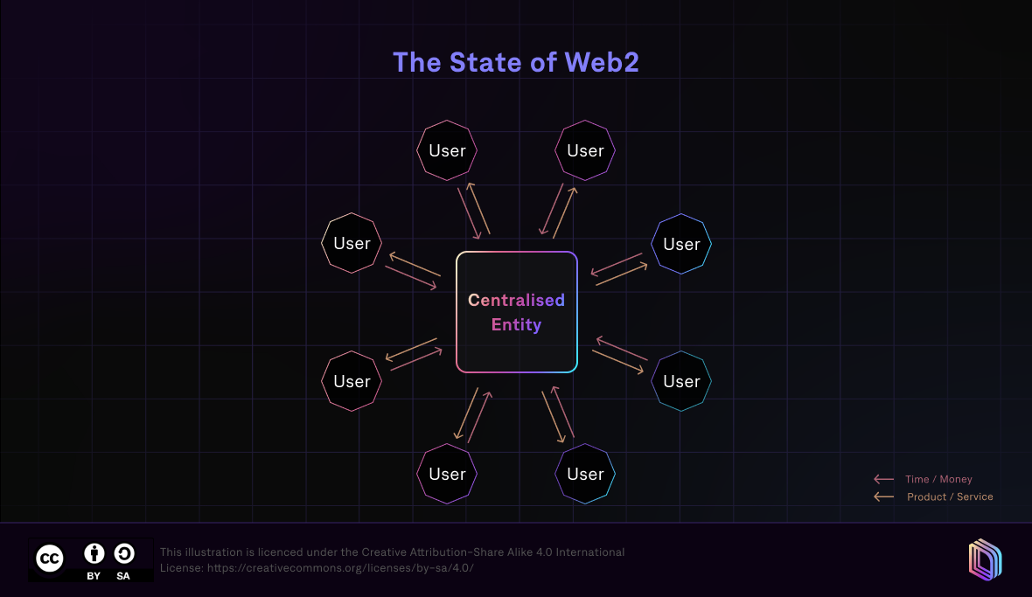
Web3: Проблемът, който решава

Slide 5
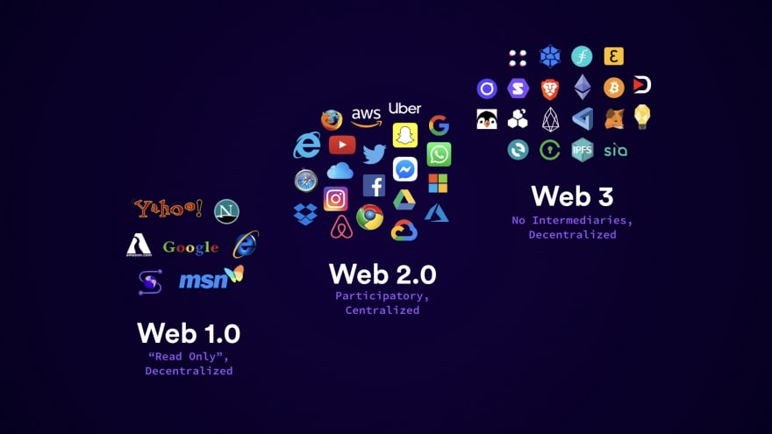
Web2 vs Web3

Slide 6
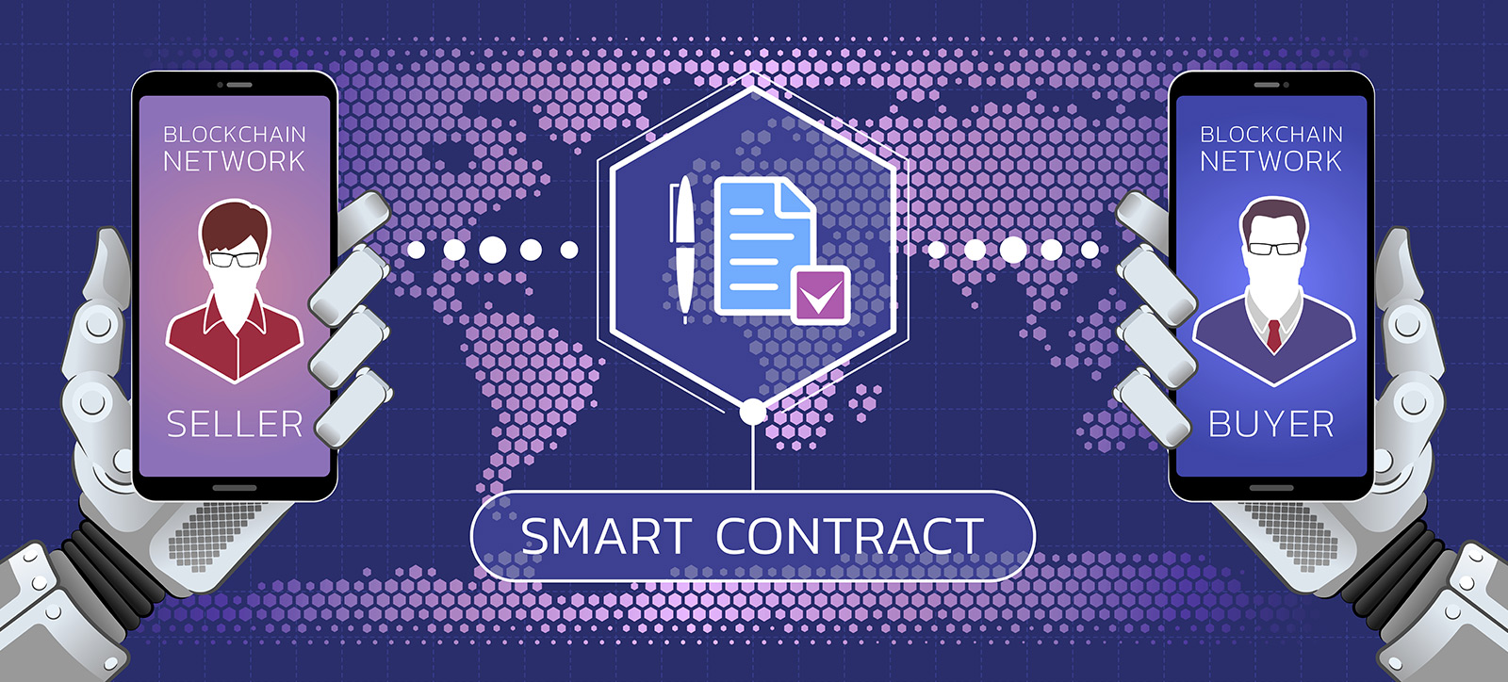
Web3: Как работят системите

Slide 7
Refs
Blockchain Technology & Fundamentals
  Investopedia: Blockchain
  Webopedia: Blockchain - How It Works and Use Cases
  Blockchain Council: The Ultimate Guide to Web3
Smart Contracts
  Britannica: How Smart Contracts Work
  Investopedia: Smart Contracts
  Webopedia: What's a Smart Contract?
NFTs & Token Ownership
  Investopedia: Non-Fungible Tokens (NFT)
Web3 Fundamentals Overview
  Nexus Docs: Web3 Fundamentals Overview
Digital Ownership
  arXiv: Digital Ownership

Slide 8
Въпроси?

Slide 9
Благодаря за вниманието!

