Slide 1
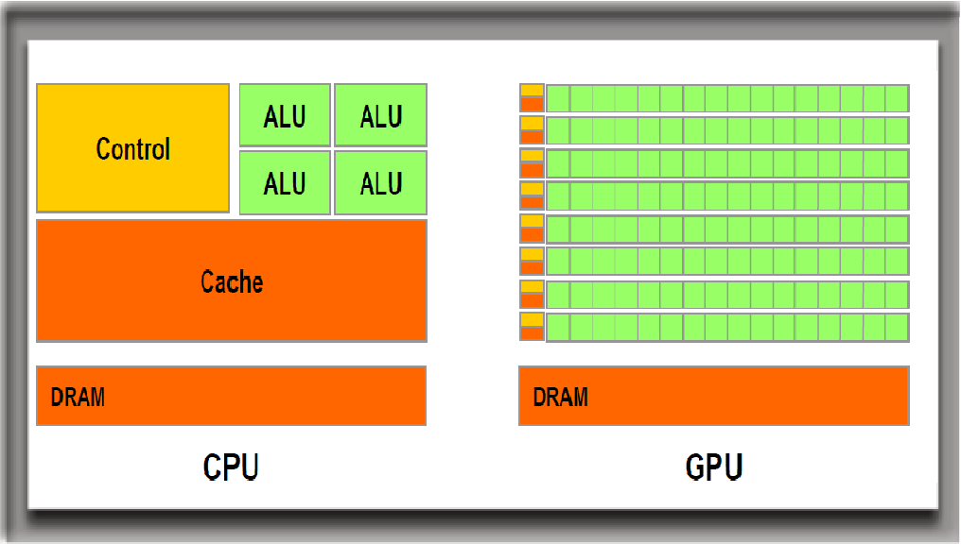

Slide 2

References
OpenGL ES 2 for Android
앨리삵 :: OpenGL 강좌
http://alleysark.tistory.com/257

Slide 3
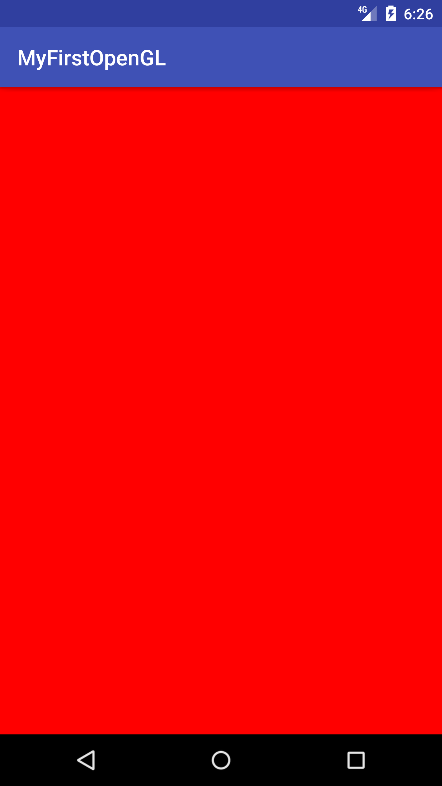
First Open GL
public class MainActivity extends AppCompatActivity {
private GLSurfaceView glSurfaceView;
private boolean rendererSet = false;
@Override
protected void onCreate(Bundle savedInstanceState) {
super.onCreate(savedInstanceState);
glSurfaceView = new GLSurfaceView(this);
// Request an OpenGL ES 2.0 compatible context.
glSurfaceView.setEGLContextClientVersion(2);
// Assign our renderer.
glSurfaceView.setRenderer(new MyRenderer());
}
}
public class MyRenderer implements GLSurfaceView.Renderer {
@Override
public void onSurfaceCreated(GL10 gl, EGLConfig config) {
// Set the background clear color to red. The first component is
// red, the second is green, the third is blue, and the last
// component is alpha, which we don't use in this lesson.
glClearColor(1.0f, 0.0f, 0.0f, 0.0f);
}
@Override
public void onSurfaceChanged(GL10 gl, int width, int height) {
// Set the OpenGL viewport to fill the entire surface.
glViewport(0, 0, width, height);
}
@Override
public void onDrawFrame(GL10 gl) {
// Clear the rendering surface.
glClear(GL_COLOR_BUFFER_BIT);
}
}

Slide 4
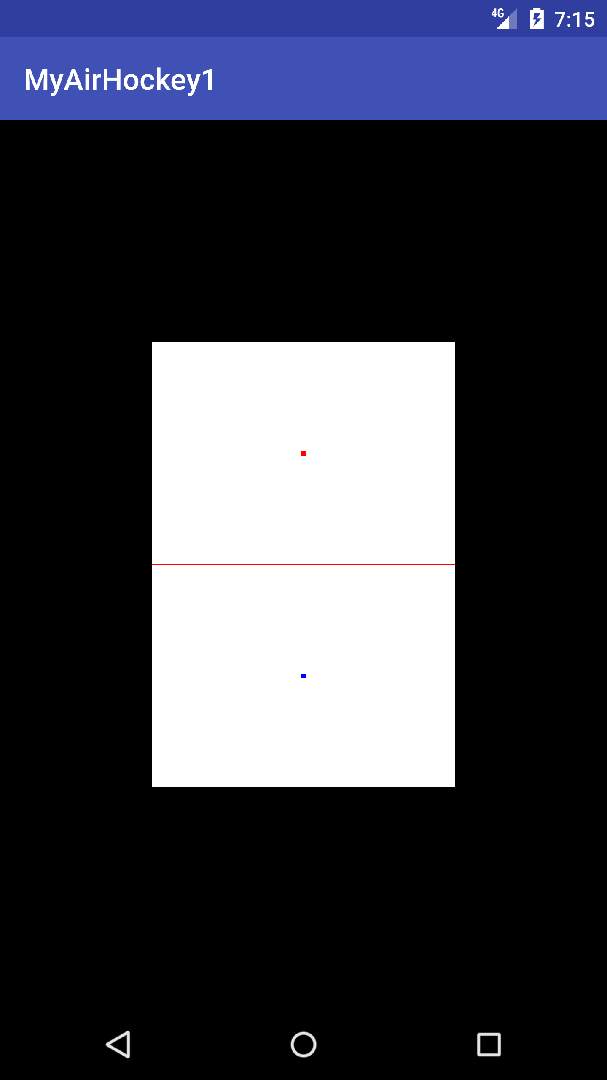
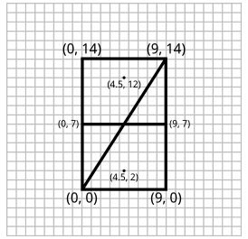
MyAirHockey1
두 개의 삼각형
하나의 선
두개의 점
➀
➁

Slide 6
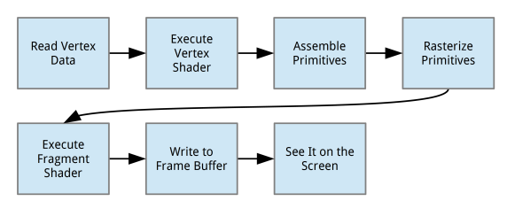
Open GL pipeline
A vertex shader generates the final position of each vertex and is run once per vertex. Once the final positions are known, OpenGL will take the visible set of vertices and assemble them into points, lines, and triangles.
A fragment shader generates the final color of each fragment of a point,line, or triangle and is run once per fragment. A fragment is a small, rectangular area of a single color, analogous to a pixel on a computer screen
※ shader는 GPU에게 전달한 data를 가지고 어떻게 그림을 그려야 할지 알려주는 프로그램 혹은 함수의 기능

Slide 7
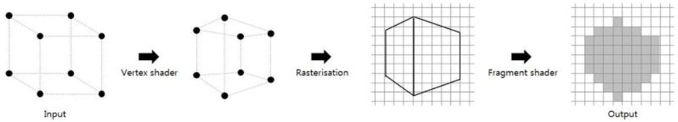
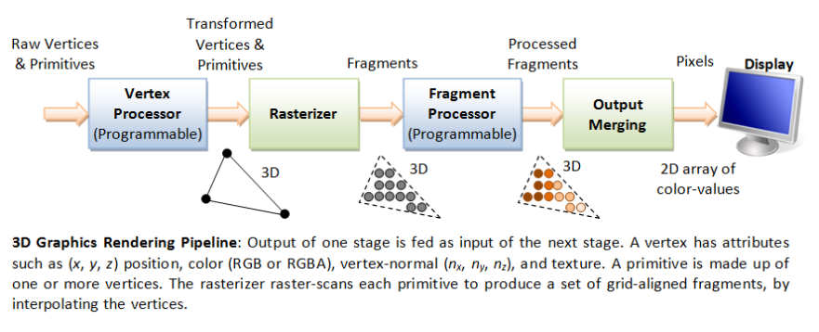
Open GL pipeline(2)
Vertex shader가 정점 집합을 3D 공간에 배치
Rasterizers가 Fragment shader가 해석 가능하도록 Rasterization 함
Fragment shader가 각 pixel 최종 color 정의

Slide 8
Vertex Shader
< res/raw/simple_vertex_shader.glsl >
attribute vec4 a_Position;
void main()
{
gl_Position = a_Position;
gl_PointSize = 10.0;
}
Vertex 정보를 2D or 3D 공간에 배치하는 기능
GLSL(open GL Shader Language) 사용
C 언어와 문법과 구조가 비슷함.
정의한 모든 vertex에 대해서, 각각 한번씩 호출된다.

Slide 9
Vertex Shader
< res/raw/simple_vertex_shader.glsl >
attribute vec4 a_Position;
void main()
{
gl_Position = a_Position;
gl_PointSize = 10.0;
}
shader가 호출될 때 마다 vertex position 정보는 a_Position attribute에 전달됨
vec4는 전달인자가 4개임을 의미
x, y, z, w를 의미하고, 기본값은 (0, 0, 0, 1)을 가진다.
attribute keyword는 속성들을 shader에게 전달하는 방법
gl_Position: built-in variable, vertex shader의 output variable 중 다음 단계에 위치 정보를 전달

Slide 10
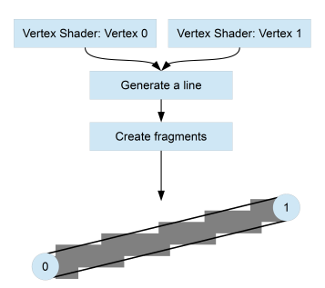
Rasterization
Generating fragments

Slide 11
Fragment Shader
Vertex shader의 output data가 Rasterization된 후, 각 픽셀이 어떻게 처리 될지를 정의
프래그먼트 셰이더는 프리미티브의 모든 프래그먼트에 대해 한 번 호출된다.
삼각형이 10,000 프래그먼트로 매핑되면 프래그먼트 셰이더는 10,000 번 호출됨.
< res/raw/simple_fragment_shader.glsl >
precision mediump float;
uniform vec4 u_Color;
void main()
{
gl_FragColor = u_Color;
}
uniform: attribute와 달리, 모든 verte에 대해서 동일 값을 유지, 재정의 될 때까지.
gl_FragColor : built-in variable, 현재 fragment의 최종 color로 정의됨.

Slide 12

Open GL Color Model
RGB(Red, Green, Blue) model
Red + Green = Yellow
Red + Blue = Magenta
Blue + Green = Cyan
Red + Green + Blue = White
Color들은 선형 관계를 가짐
범위는 [0, 1] : 0은 색이 없음을, 1은 최대 밝기 임
1은 0.5의 2배 만큼 밝음을 의미
※ 우리가 학교에서 배운 color 모델과 다르다. 파랑 + 노랑 = 녹색 이라고 배움.
이런 차이는 paint가 빛을 발산하지 않고, 흡수하기 때문.
RGB Model은 스스로 빛을 발산하기 때문에, 색을 섞으면 어두워 지지 않고 밝아 진다.

Slide 13
Vertex Buffer 정의
private static final int BYTES_PER_FLOAT = 4;
private final FloatBuffer vertexData;
float[] tableVerticesWithTriangles = {
// Triangle 1
-0.5f, -0.5f,
0.5f, 0.5f,
-0.5f, 0.5f,
// Triangle 2
-0.5f, -0.5f,
0.5f, -0.5f,
0.5f, 0.5f,
// Line 1
-0.5f, 0f,
0.5f, 0f,
// Mallets
0f, -0.25f,
0f, 0.25f
};
vertexData = ByteBuffer
.allocateDirect(tableVerticesWithTriangles.length * BYTES_PER_FLOAT)
.order(ByteOrder.nativeOrder())
.asFloatBuffer();
vertexData.put(tableVerticesWithTriangles);
-0.5, 0.5
0.5, 0.5
0, 0.25
➀
-0.5, 0
0.5, 0
➁
0, -0.25
-0.5, -0.5
0.5, -0.5

Slide 14
Init
private static final int POSITION_COMPONENT_COUNT = 2;
private int program;
private int uColorLocation;
private int aPositionLocation;
@Override
public void onSurfaceCreated(GL10 glUnused, EGLConfig config) {
glClearColor(0.0f, 0.0f, 0.0f, 0.0f);
// shader codes
String vertexShaderSource = TextResourceReader.readTextFileFromResource(context, R.raw.simple_vertex_shader);
String fragmentShaderSource = TextResourceReader.readTextFileFromResource(context, R.raw.simple_fragment_shader);
// get shader object id
int vertexShader = ShaderHelper.compileVertexShader(vertexShaderSource);
int fragmentShader = ShaderHelper.compileFragmentShader(fragmentShaderSource);
// get program id
program = ShaderHelper.linkProgram(vertexShader, fragmentShader);
glUseProgram(program);
// shader 내부 변수에 대한 index값
uColorLocation = glGetUniformLocation(program, U_COLOR);
aPositionLocation = glGetAttribLocation(program, A_POSITION);
// Bind our data, specified by the variable vertexData, to the vertex
// attribute at location A_POSITION_LOCATION.
vertexData.position(0);
// attribute vertex buffer mapping
glVertexAttribPointer(aPositionLocation, POSITION_COMPONENT_COUNT, GL_FLOAT, false, 0, vertexData);
glEnableVertexAttribArray(aPositionLocation);
}
< res/raw/simple_vertex_shader.glsl >
attribute vec4 a_Position;
void main()
{
gl_Position = a_Position;
gl_PointSize = 10.0;
}

Slide 15
Init– Shader Compile
public static int compileVertexShader(String shaderCode) {
return compileShader(GL_VERTEX_SHADER, shaderCode);
}
public static int compileFragmentShader(String shaderCode) {
return compileShader(GL_FRAGMENT_SHADER, shaderCode);
}
private static int compileShader(int type, String shaderCode) {
// Create a new shader object.
final int shaderObjectId = glCreateShader(type);
// Pass in the shader source.
glShaderSource(shaderObjectId, shaderCode);
// Compile the shader.
glCompileShader(shaderObjectId);
// Get the compilation status.
final int[] compileStatus = new int[1];
glGetShaderiv(shaderObjectId, GL_COMPILE_STATUS, compileStatus, 0);
// Verify the compile status.
if (compileStatus[0] == 0) {
// If it failed, delete the shader object.
glDeleteShader(shaderObjectId);
return 0;
}
// Return the shader object ID.
return shaderObjectId;
}
Create
Shader
precision mediump float;
uniform vec4 u_Color;
void main()
{
gl_FragColor = u_Color;
}
Pass Text
Compile

Slide 16
Init– Shader Linking
public static int linkProgram(int vertexShaderId, int fragmentShaderId) {
// Create a new program object.
final int programObjectId = glCreateProgram();
if (programObjectId == 0) return 0;
// Attach the vertex shader to the program.
glAttachShader(programObjectId, vertexShaderId);
// Attach the fragment shader to the program.
glAttachShader(programObjectId, fragmentShaderId);
// Link the two shaders together into a program.
glLinkProgram(programObjectId);
// Get the link status.
final int[] linkStatus = new int[1];
glGetProgramiv(programObjectId, GL_LINK_STATUS, linkStatus, 0);
// Verify the link status.
if (linkStatus[0] == 0) {
// If it failed, delete the program object.
glDeleteProgram(programObjectId);
return 0;
}
// Return the program object ID.
return programObjectId;
}
Create
Program
Attach(v-shader)
Attach(f-shader)
LinkProgram

Slide 17
Viewport 설정
@Override
public void onSurfaceChanged(GL10 glUnused, int width, int height) {
// Set the OpenGL viewport to fill the entire surface.
glViewport(0, 0, width, height);
}

Slide 18
Draw
@Override
public void onDrawFrame(GL10 glUnused) {
// Clear the rendering surface.
glClear(GL_COLOR_BUFFER_BIT);
// Draw the table.
glUniform4f(uColorLocation, 1.0f, 1.0f, 1.0f, 1.0f);
glDrawArrays(GL_TRIANGLES, 0, 6);
// Draw the center dividing line.
glUniform4f(uColorLocation, 1.0f, 0.0f, 0.0f, 1.0f);
glDrawArrays(GL_LINES, 6, 2);
// Draw the first mallet blue.
glUniform4f(uColorLocation, 0.0f, 0.0f, 1.0f, 1.0f);
glDrawArrays(GL_POINTS, 8, 1);
// Draw the second mallet red.
glUniform4f(uColorLocation, 1.0f, 0.0f, 0.0f, 1.0f);
glDrawArrays(GL_POINTS, 9, 1);
}
< res/raw/simple_fragment_shader.glsl >
precision mediump float;
uniform vec4 u_Color;
void main()
{
gl_FragColor = u_Color;
}

Slide 19
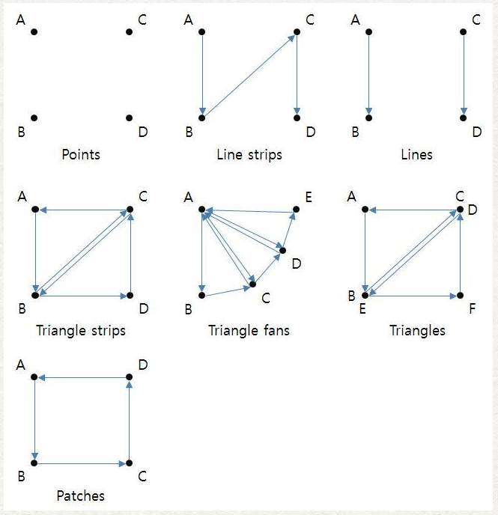
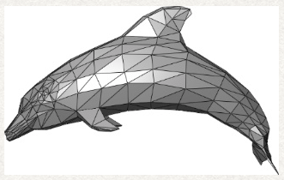
Primitive type
Vertex는 도형을 이루는 기본 요소
point는 하나의 vertex
line은 두개의 vertex
triangl은 세 개의 vertex
quas는 네 개의 vertex
정점 집합만으로 도형의 형태를 정의하지 못함
해석 방식을 지정해 주어야 한다
mode: 어떻게 해석하는가?
해석한 결과를 primitive type이라 함.
mesh

Slide 21
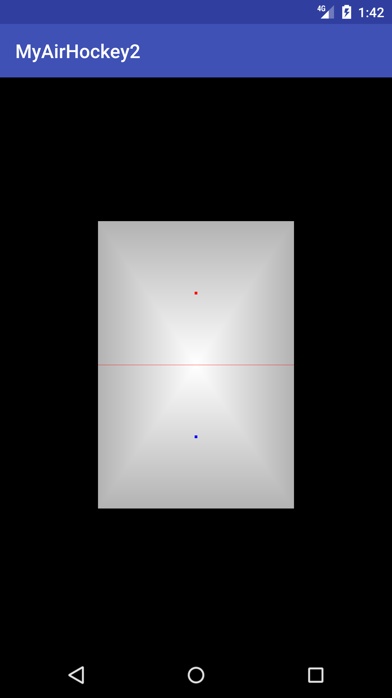
MyAirHockey2
primitive type 중 triangle pan 이용
Vertex buffer에 color 지정
Adding a new color attribute

Slide 22
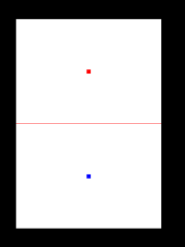
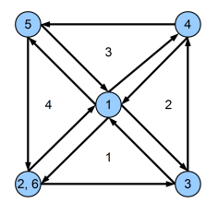
Triangle pan
float[] tableVerticesWithTriangles = {
// Triangle Fan
0, 0,
-0.5f, -0.5f,
0.5f, -0.5f,
0.5f, 0.5f,
-0.5f, 0.5f,
-0.5f, -0.5f,
// Line 1
-0.5f, 0f,
0.5f, 0f,
// Mallets
0f, -0.25f,
0f, 0.25f
};
@Override
public void onDrawFrame(GL10 glUnused) {
// Clear the rendering surface.
glClear(GL_COLOR_BUFFER_BIT);
// Draw the table.
glUniform4f(uColorLocation, 1.0f, 1.0f, 1.0f, 1.0f);
glDrawArrays(GL_TRIANGLES, 0, 6);
// Draw the center dividing line.
glUniform4f(uColorLocation, 1.0f, 0.0f, 0.0f, 1.0f);
glDrawArrays(GL_LINES, 6, 2);
// Draw the first mallet blue.
glUniform4f(uColorLocation, 0.0f, 0.0f, 1.0f, 1.0f);
glDrawArrays(GL_POINTS, 8, 1);
// Draw the second mallet red.
glUniform4f(uColorLocation, 1.0f, 0.0f, 0.0f, 1.0f);
glDrawArrays(GL_POINTS, 9, 1);
}
@Override
public void onDrawFrame(GL10 glUnused) {
// Draw the table.
glDrawArrays(GL_TRIANGLE_FAN, 0, 6);
…
}

Slide 23
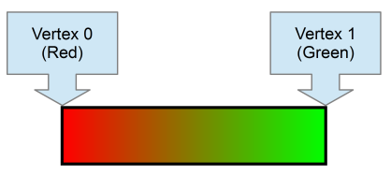
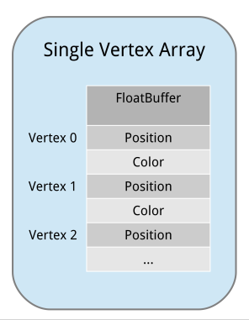
Adding a new color attribute
< res/raw/simple_vertex_shader.glsl >
attribute vec4 a_Position;
attribute vec4 a_Color;
varying vec4 v_Color;
void main()
{
v_Color = a_Color;
gl_Position = a_Position;
gl_PointSize = 10.0;
}
float[] tableVerticesWithTriangles = {
// Order of coordinates: X, Y, R, G, B
// Triangle Fan
0f, 0f, 1f, 1f, 1f,
-0.5f, -0.5f, 0.7f, 0.7f, 0.7f,
0.5f, -0.5f, 0.7f, 0.7f, 0.7f,
0.5f, 0.5f, 0.7f, 0.7f, 0.7f,
-0.5f, 0.5f, 0.7f, 0.7f, 0.7f,
-0.5f, -0.5f, 0.7f, 0.7f, 0.7f,
// Line 1
-0.5f, 0f, 1f, 0f, 0f,
0.5f, 0f, 1f, 0f, 0f,
// Mallets
0f, -0.25f, 0f, 0f, 1f,
0f, 0.25f, 1f, 0f, 0f
};
private static final String A_COLOR = "a_Color";
private static final int COLOR_COMPONENT_COUNT = 3;
private static final int STRIDE =
(POSITION_COMPONENT_COUNT + COLOR_COMPONENT_COUNT) * BYTES_PER_FLOAT;
private int aColorLocation;
aColorLocation = glGetAttribLocation(program, A_COLOR);
// update position vertex
glVertexAttribPointer(aPositionLocation, POSITION_COMPONENT_COUNT, GL_FLOAT, false, STRIDE, vertexData);
vertexData.position(POSITION_COMPONENT_COUNT);
glVertexAttribPointer(aColorLocation, COLOR_COMPONENT_COUNT, GL_FLOAT,
false, STRIDE, vertexData);
glEnableVertexAttribArray(aColorLocation);

Slide 25
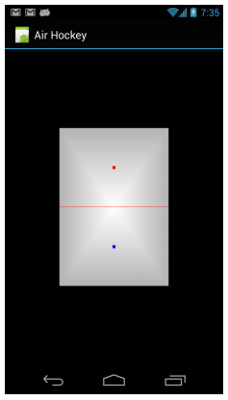
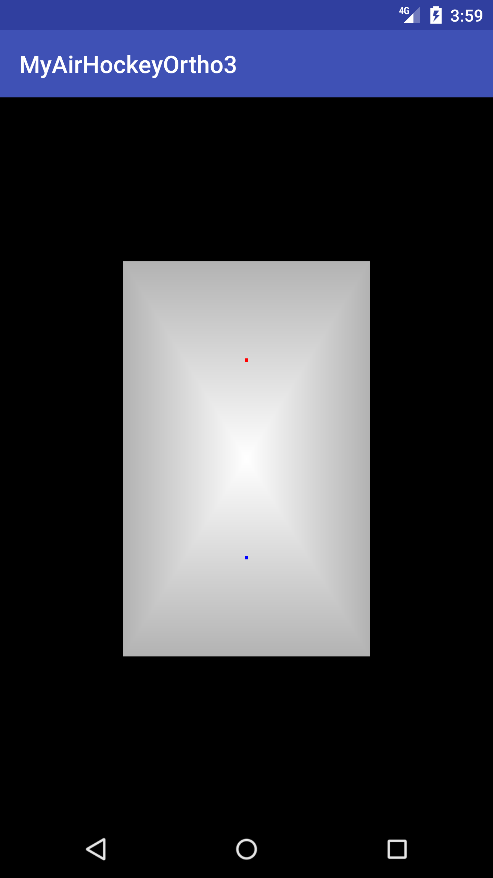
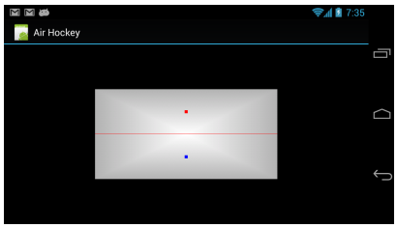
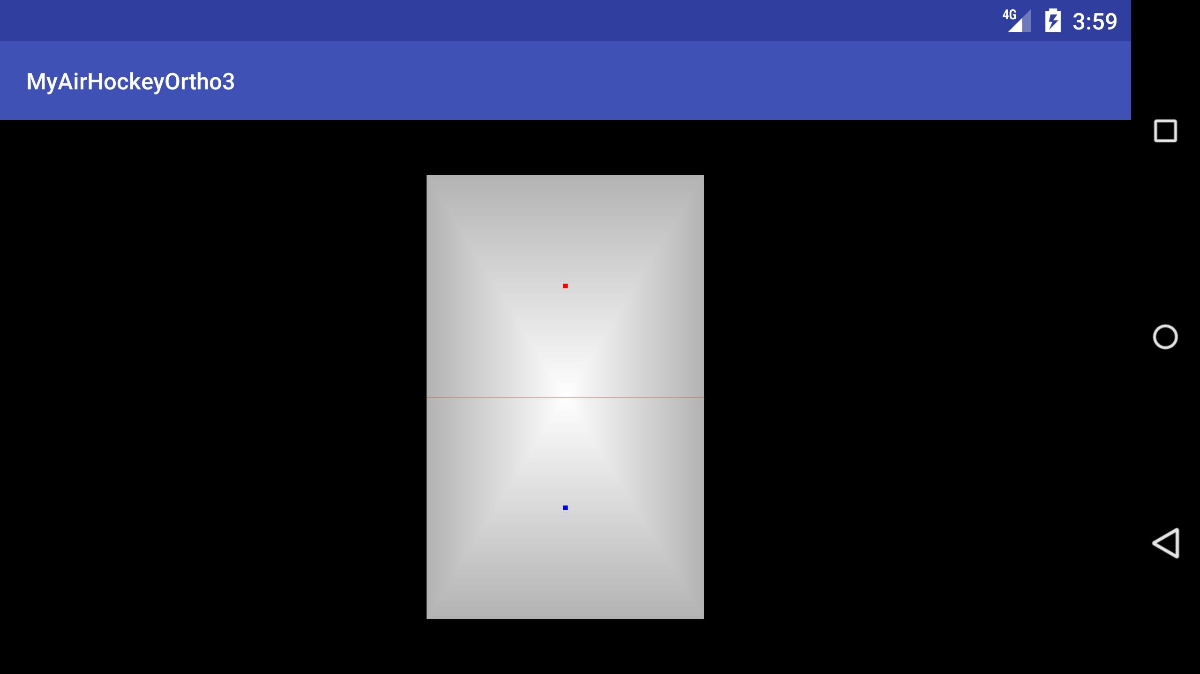
화면 비율 적용

Slide 26
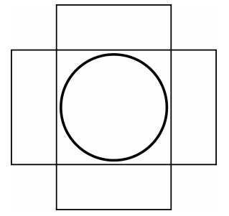
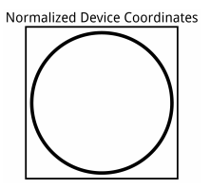
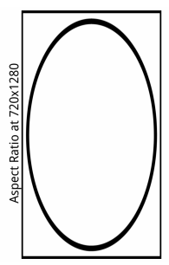
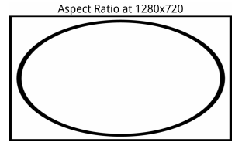
정규화된 좌표가 실제 단말의 viewport에 의해서, 화면 비율에 맞춰서 늘어 날 수 있다.
[-1280/720, 1280/720] = [-1.78, 1.78], portrait에서 높이를 [-1.78, 1.78], landscape인 경우 width를 [-1.78, 1.78]로 설정

Slide 27

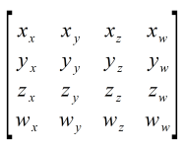
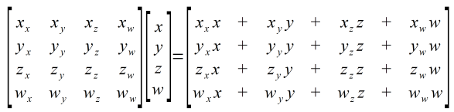
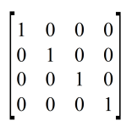
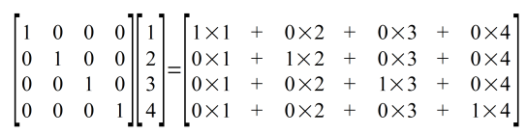

행렬
Vector
Matrix
Matrix-Vector Multiplication
The Identity Matrix (단위 행렬)
=

Slide 28
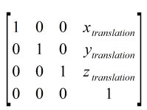
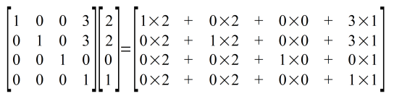
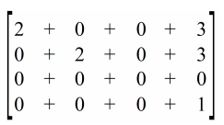

행렬
(2,2) 을 (3,3)만큼 이동했을 때, (5,5)가 되는 과정
=
=

Slide 29
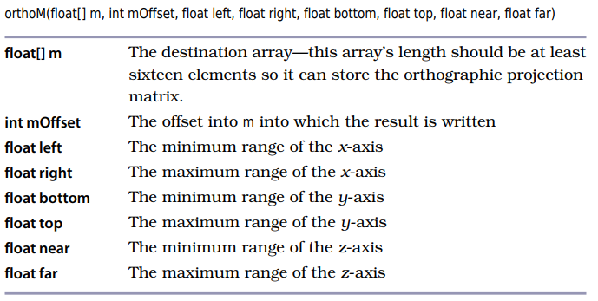
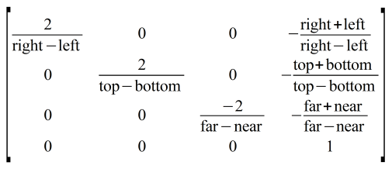
Defining an Orthographic Projection
orthographic projection matrix 함수

Slide 30
Adding an Orthographic Projection
private static final String U_MATRIX = "u_Matrix";
private final float[] projectionMatrix = new float[16];
private int uMatrixLocation;
uMatrixLocation = glGetUniformLocation(program, U_MATRIX);
@Override
public void onSurfaceChanged(GL10 glUnused, int width, int height) {
// Set the OpenGL viewport to fill the entire surface.
glViewport(0, 0, width, height);
final float aspectRatio = width > height ?
(float) width / (float) height :
(float) height / (float) width;
// Create the Orthographic Projection Matrix
if (width > height) {
// Landscape
orthoM(projectionMatrix, 0, -aspectRatio, aspectRatio, -1f, 1f, -1f, 1f);
} else {
// Portrait or square
orthoM(projectionMatrix, 0, -1f, 1f, -aspectRatio, aspectRatio, -1f, 1f);
}
}
@Override
public void onDrawFrame(GL10 glUnused) {
// Sending the Matrix to the Shader
glUniformMatrix4fv(uMatrixLocation, 1, false, projectionMatrix, 0);
}
Update Shader
uniform mat4 u_Matrix;
attribute vec4 a_Position;
attribute vec4 a_Color;
varying vec4 v_Color;
void main()
{
v_Color = a_Color;
gl_Position = u_Matrix * a_Position;
gl_PointSize = 10.0;
}

Slide 32
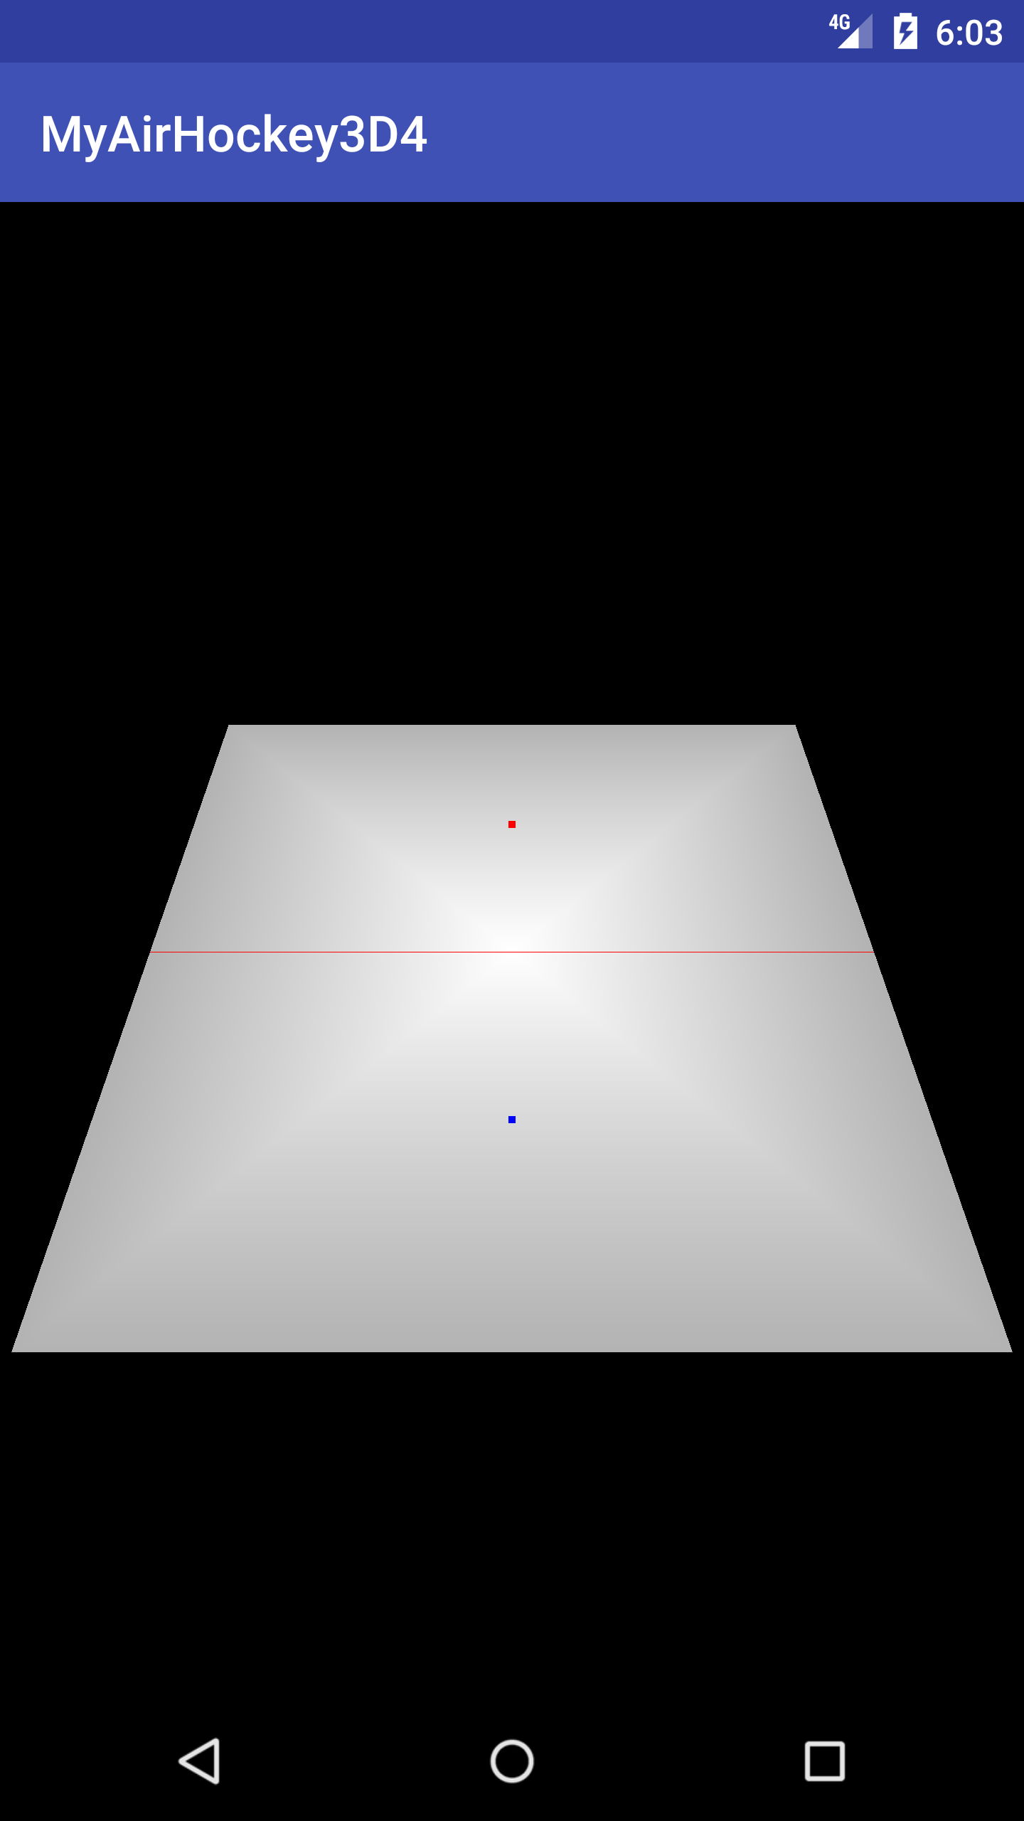
3D
(x,y,z,w)에서 w의 활용

Slide 33
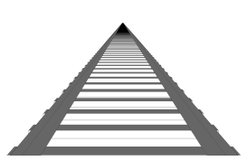
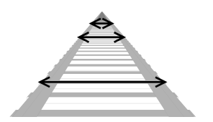
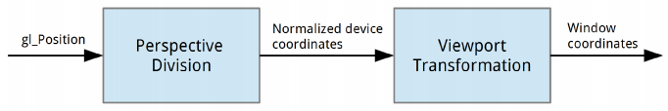
원금감의 표현
멀어질 수록 소실점(vanish point)에 가까워 짐.

Slide 34
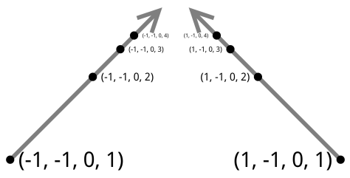
Transforming a Coordinate from the Shader to the Screen
gl_Position(x, y, z, w)을, x,y,z에 대해서 w로 나눈다.
(1, 1, 1, 1) => (1, 1, 1)
(1, 1, 1, 2) => (0.5, 0.5, 0.5)
w 값이 크면 클수록 중앙의 소실점에 가까워 진다.(0, 0, 0)
Homogenous Coordinates
아래는 모두 동일한 점이다.
(1, 1, 1, 1), (2, 2, 2, 2), (3, 3, 3, 3) => (1, 1, 1)
w로 나누었을 때 장점은?
원근 효과에서 z 좌표로 부터 분리
orthographic 과 perspective projection으로 변경 가능

Slide 35
private static final int POSITION_COMPONENT_COUNT = 4;
float[] tableVerticesWithTriangles = {
// Order of coordinates: X, Y, Z, W, R, G, B
// Triangle Fan
0f, 0f, 0f, 1.5f, 1f, 1f, 1f,
-0.5f, -0.8f, 0f, 1f, 0.7f, 0.7f, 0.7f,
0.5f, -0.8f, 0f, 1f, 0.7f, 0.7f, 0.7f,
0.5f, 0.8f, 0f, 2f, 0.7f, 0.7f, 0.7f,
-0.5f, 0.8f, 0f, 2f, 0.7f, 0.7f, 0.7f,
-0.5f, -0.8f, 0f, 1f, 0.7f, 0.7f, 0.7f,
// Line 1
-0.5f, 0f, 0f, 1.5f, 1f, 0f, 0f,
0.5f, 0f, 0f, 1.5f, 1f, 0f, 0f,
// Mallets
0f, -0.4f, 0f, 1.25f, 0f, 0f, 1f,
0f, 0.4f, 0f, 1.75f, 1f, 0f, 0f
};
그러나, W값을 일일이 지정해야하는 단점 존재
동적으로 할당하는 방법을 찾아야 함.

Slide 36
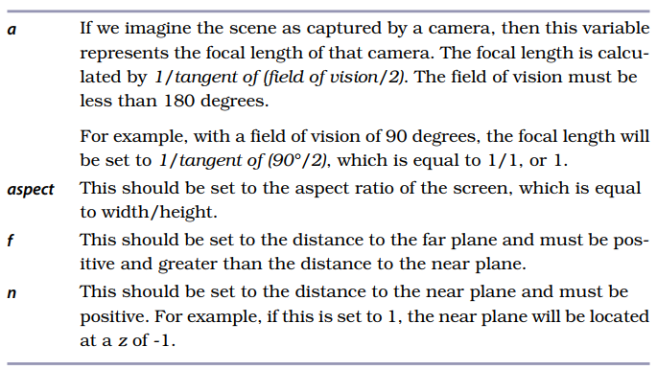
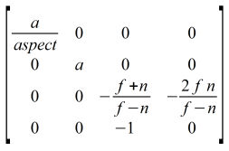
Defining a Perspective Projection

Slide 37
perspectiveM
public static void perspectiveM(float[] m, float yFovInDegrees, float aspect, float n, float f) {
final float angleInRadians = (float) (yFovInDegrees * Math.PI / 180.0);
final float a = (float) (1.0 / Math.tan(angleInRadians / 2.0));
m[0] = a / aspect;
m[1] = 0f;
m[2] = 0f;
m[3] = 0f;
m[4] = 0f;
m[5] = a;
m[6] = 0f;
m[7] = 0f;
m[8] = 0f;
m[9] = 0f;
m[10] = -((f + n) / (f - n));
m[11] = -1f;
m[12] = 0f;
m[13] = 0f;
m[14] = -((2f * f * n) / (f - n));
m[15] = 0f;
}
private final float[] projectionMatrix = new float[16];
@Override
public void onSurfaceChanged(GL10 glUnused, int width, int height) {
// 45도, z값은 -1 ~ -10
MatrixHelper.perspectiveM(projectionMatrix, 45, (float) width / (float) height, 1f, 10f);
}

Slide 38
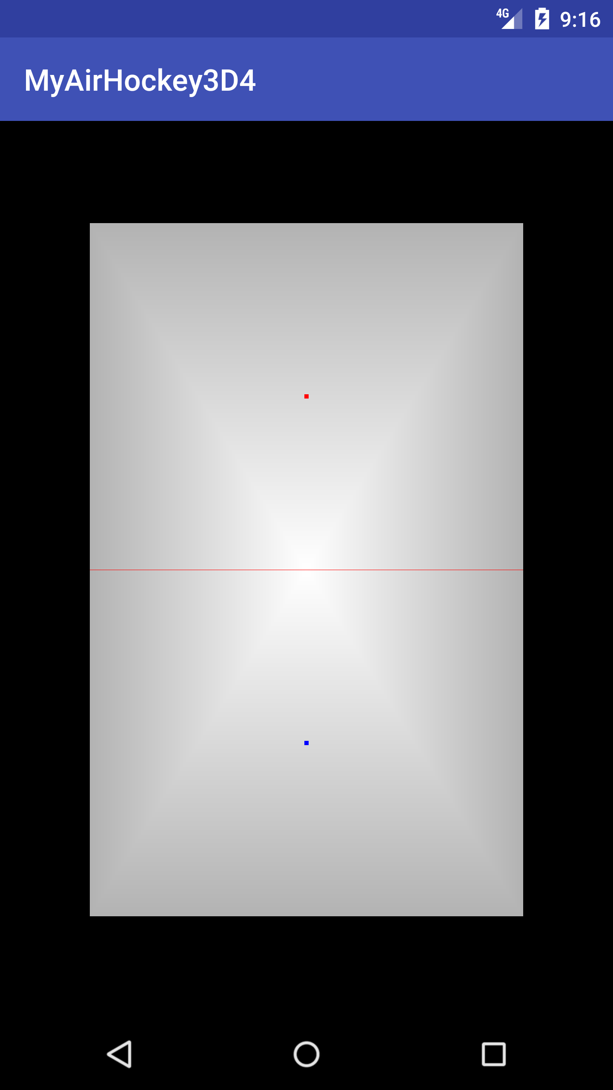
Model Matrix
z 값에 대해서, 하드 코딩하는 대신, 변환 행렬 작성
private final float[] modelMatrix = new float[16];
setIdentityM(modelMatrix, 0);
translateM(modelMatrix, 0, 0f, 0f, -2f);
final float[] temp = new float[16];
multiplyMM(temp, 0, projectionMatrix, 0, modelMatrix, 0);
System.arraycopy(temp, 0, projectionMatrix, 0, temp.length);

Slide 39
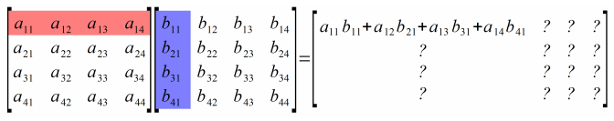


Matrix Multiplication
Order of Multiplication

